Slide 1

SmartRide
523K0010 – Phạm Lê Anh Khôi
523K0013 – Dương Thành Long

Slide 2
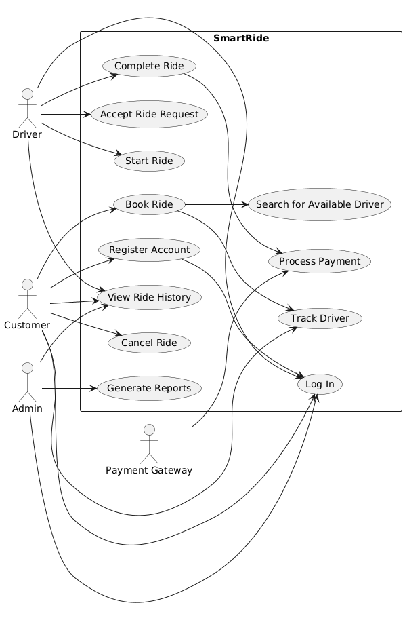
Use case diagram

Slide 3
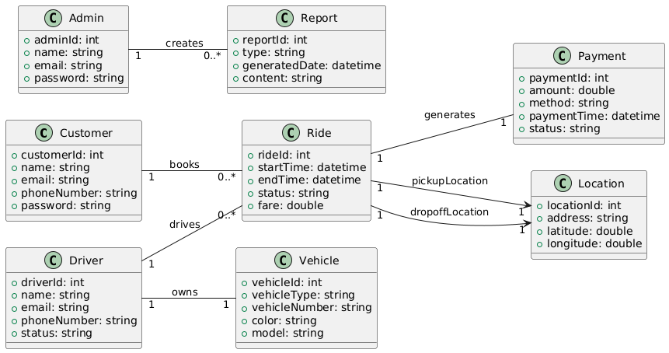
Domain class diagram

Slide 4
Use cases
Book Ride
Process Payment

Slide 5
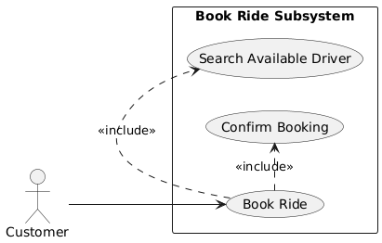
Subsystem use case diagram: Book Ride

Slide 6
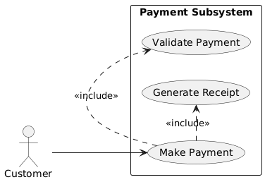
Subsystem use case diagram: Process Payment

Slide 7
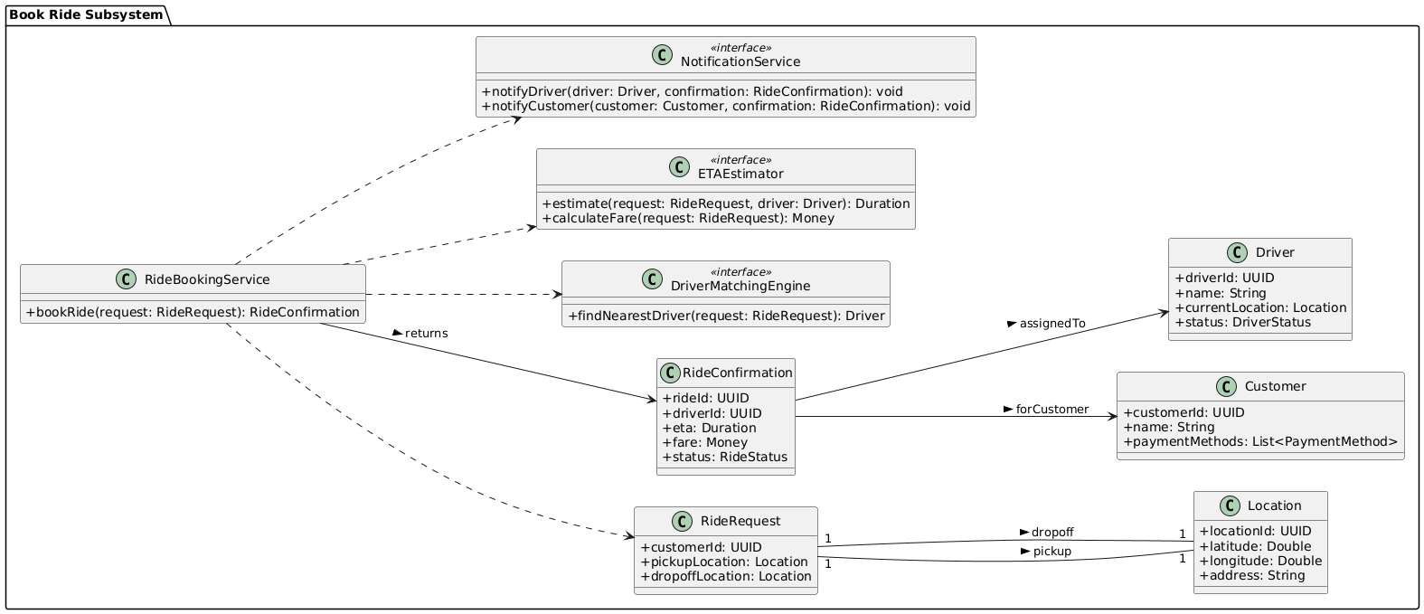
Subsystem domain class model: Book Ride

Slide 8
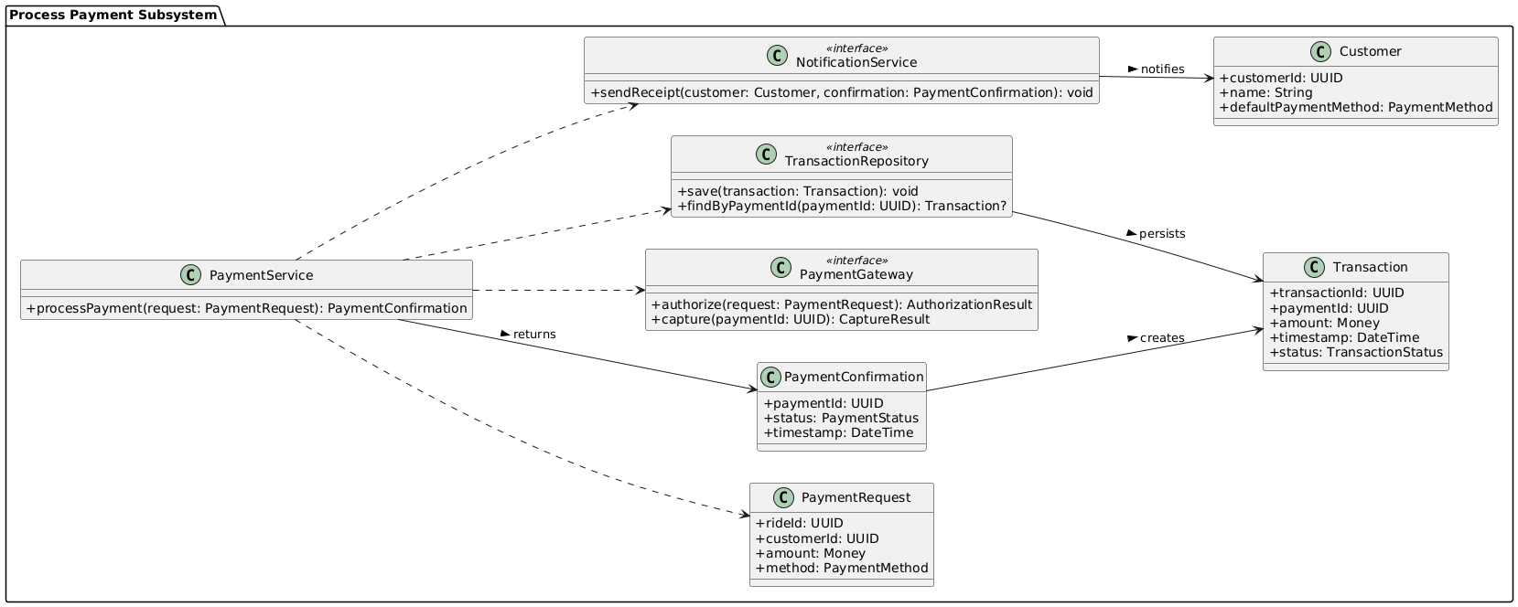
Subsystem domain class model: Process Payment

Slide 9
Analysis Model

Slide 10
Use case: Book ride
Use case name: | Book ride
Scenario: | Customer books a ride via the mobile app or website.
Triggering event: | Customer opens the booking screen and enters trip details.
Brief description: | The system processes the ride request and assigns an available driver.
Actors: | Customer, System, Driver
Related use cases: | Track Ride, Make Payment
Stakeholders: | Customers, Operations Team
Preconditions: | User must be logged in. Location services must be available.
Postconditions: | Ride is booked and driver is notified.
Flow of activities:
Actor | System
1. Customer enters pickup and dropoff location. | 1.1 System verifies location validity.
2. Customer confirms ride. | 1.2 System matches with available driver. 1.3 System notifies driver and confirms booking to customer.
Exception conditions: | 1.1 No drivers available. 1.2 Invalid location.

Slide 11
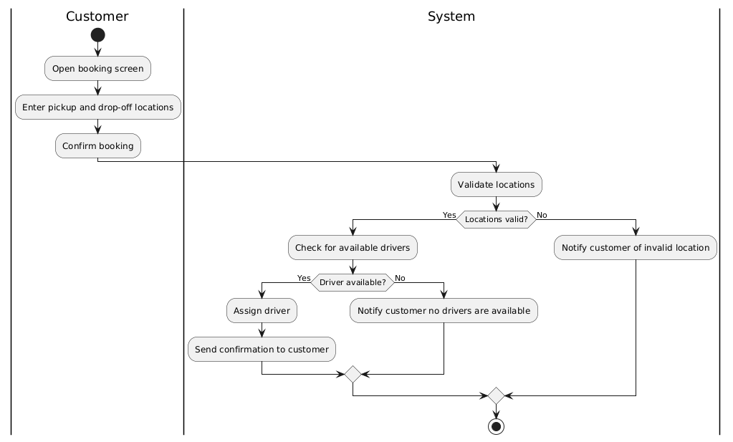
Use case: Book ride

Slide 12
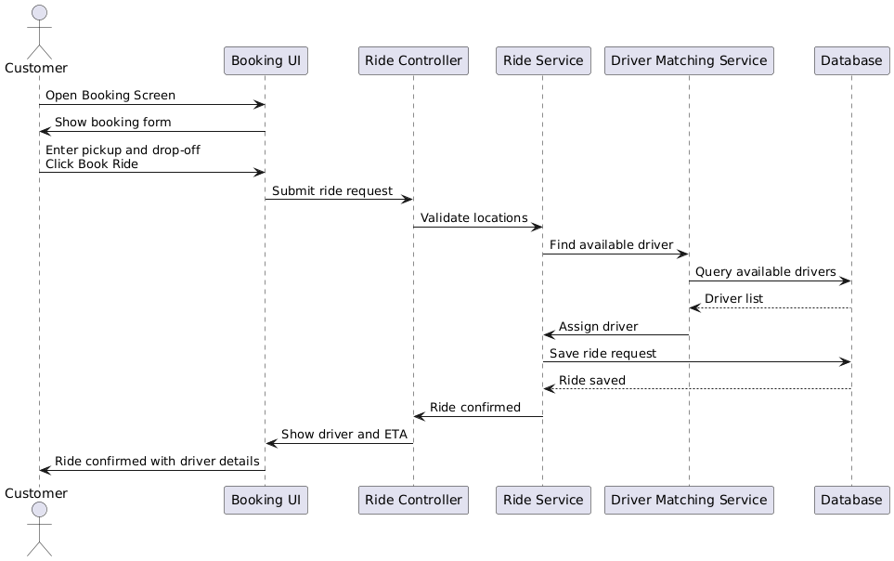
Use case: Book ride

Slide 13
Use case: process payment
Use case name: | Process payment
Scenario: | Customer pays for a completed ride.
Triggering event: | Ride is completed and fare is calculated.
Brief description: | Customer chooses a payment method and the system processes the transaction.
Actors: | Customer, Payment Gateway
Related use cases: | Book Ride
Stakeholders: | Customers, Finance Department
Preconditions: | Ride must be completed. Payment gateway must be operational.
Postconditions: | Payment is successful and receipt is issued.
Flow of activities:
Actor | System
1. Customer chooses to pay. | 1.1 System displays fare and payment options.
2. Customer selects payment method and confirms. | 1.2 System connects to payment gateway. 1.3 System processes payment. 1.4 System issues receipt.
Exception conditions: | 1.2 Invalid card or insufficient funds. 1.3 Payment gateway fails.

Slide 14
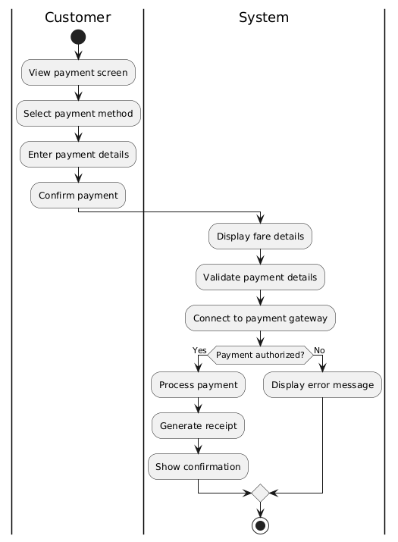
Use case: Process Payment

Slide 15
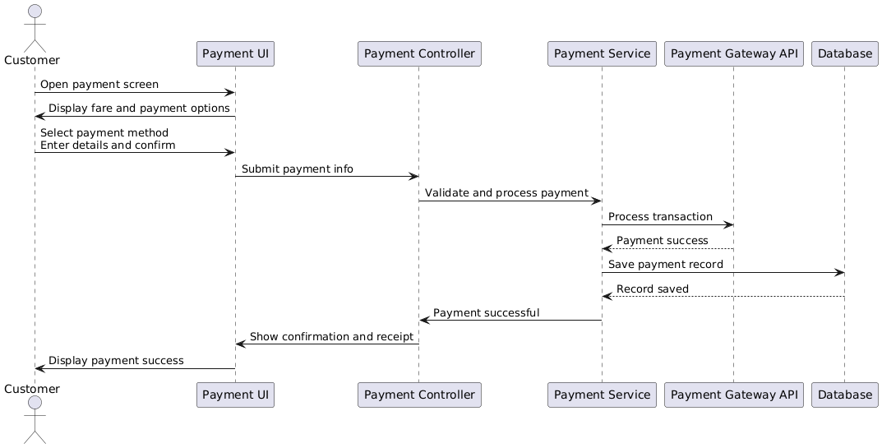
Use case: Process Payment

Slide 16
Design Model

Slide 17
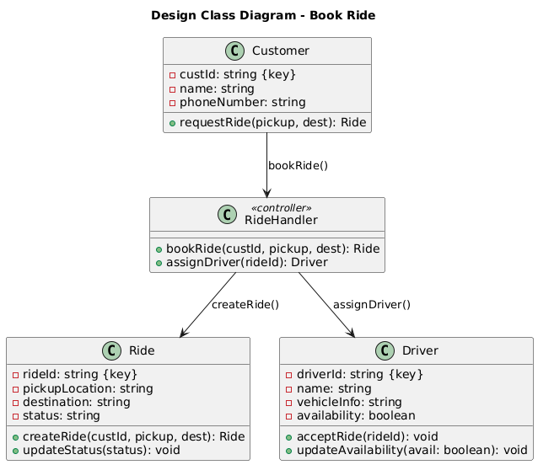
Design class: Book ride

Slide 18
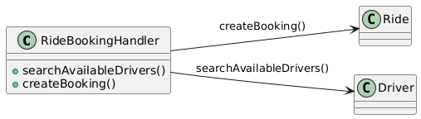
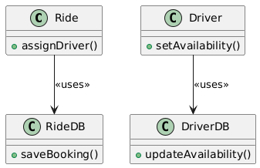
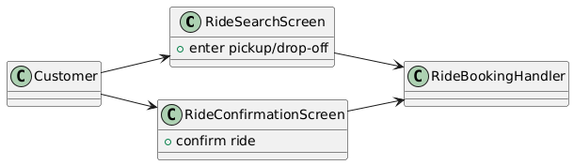
Domain Design class: Book Ride
Controller
UI
Data Access

Slide 19
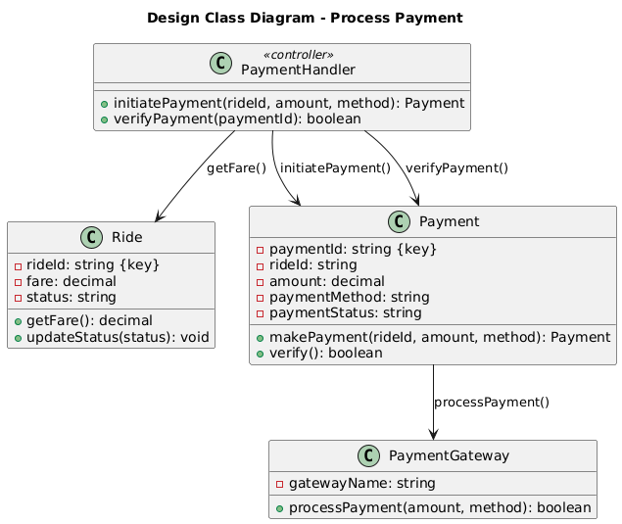
Design class: Process Payment

Slide 20
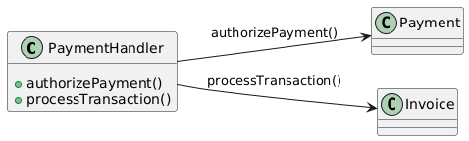
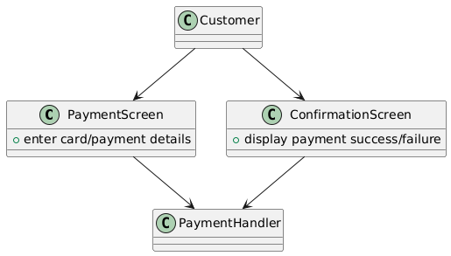
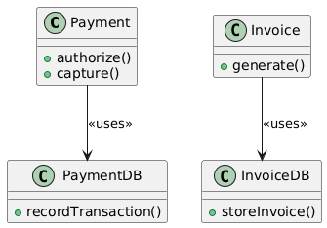
Domain Design class: Process Payment
Controller
UI
Data Access

Slide 21
UI Designs

Slide 22
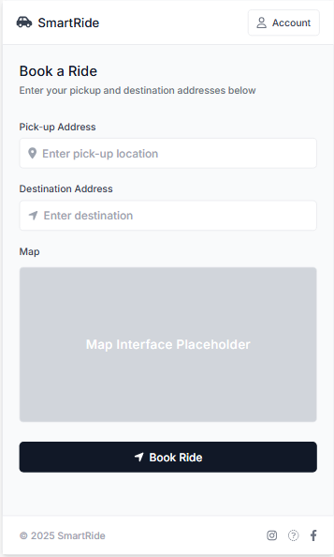
Book Ride

Slide 23
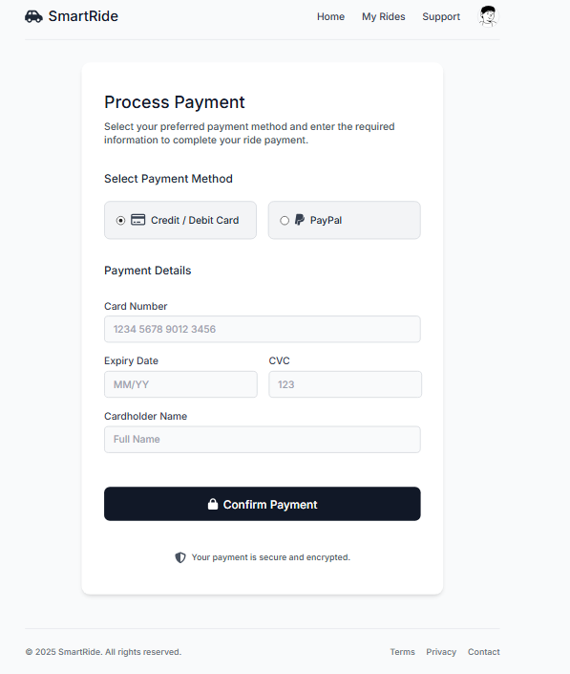
Process payment

Slide 24
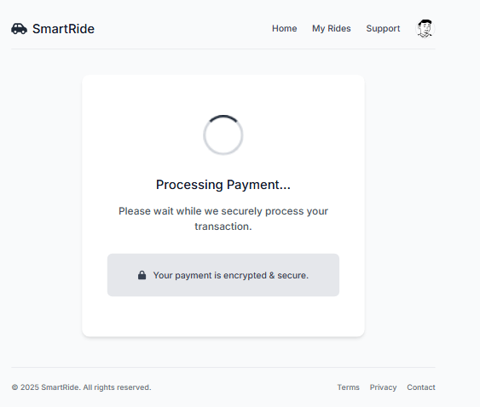
Process payment

Slide 25
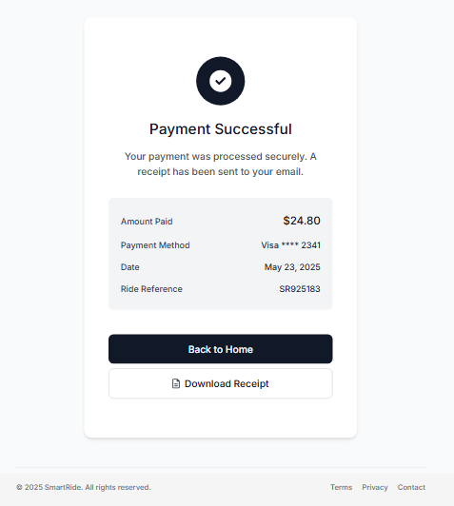
Process payment

Slide 26
Test case

Slide 27
Book ride
Field | Value
Test Case ID | TC02
Use Case | Book Ride
Description | Verify ride booking flow and driver assignment
Preconditions | Customer is logged in and has valid location details
Test Steps | 1. Enter pickup/dropoff location 2. Request ride 3. System assigns a driver
Expected Result | Ride is recorded with Requested or Confirmed status, driver is notified
Postconditions | New Ride record is created with reference to Customer and Driver (if assigned)

Slide 28
Process payment
Field | Value
Test Case ID | TC03
Use Case | Process Payment
Description | Verify that payment is processed after ride completion
Preconditions | Ride has Completed status, and valid payment method is configured
Test Steps | 1. View completed ride 2. Choose payment method 3. Submit payment
Expected Result | Payment is recorded, transaction ID is generated, and status is Paid
Postconditions | New Payment record linked to Ride and Account is created

Slide 29
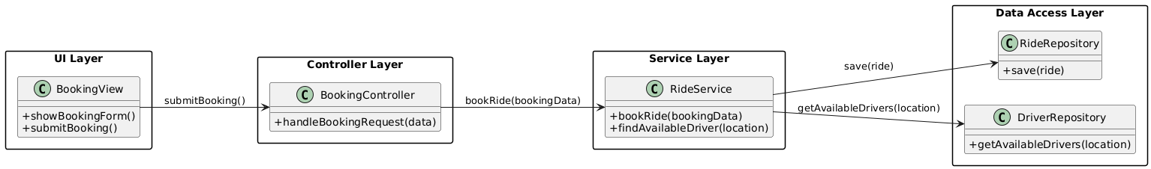
Book ride

Slide 30
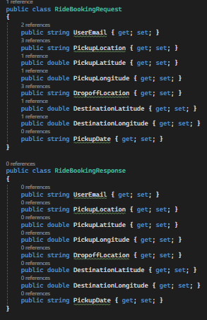
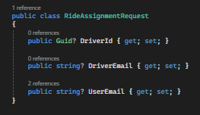
Book ride: Models

Slide 31
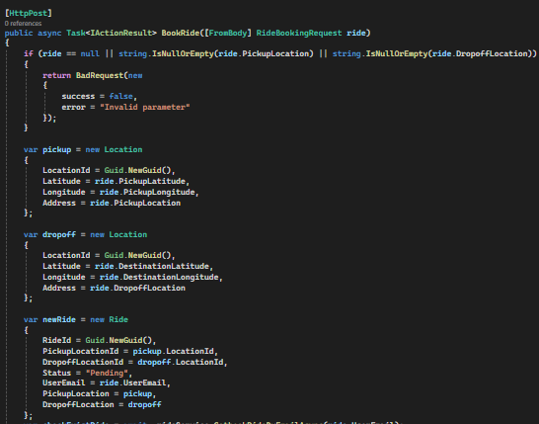
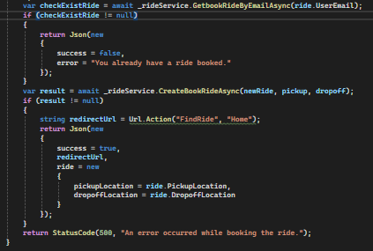
Book ride: Back-end logic
Controllers

Slide 32
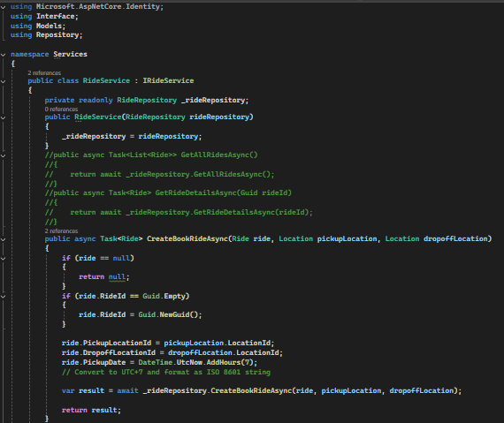
Book ride: Back-end logic
Services

Slide 33
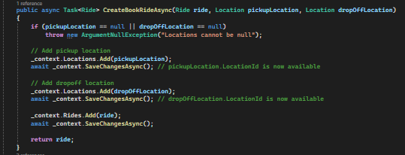
Book ride: Back-end logic
Repositories

Slide 34
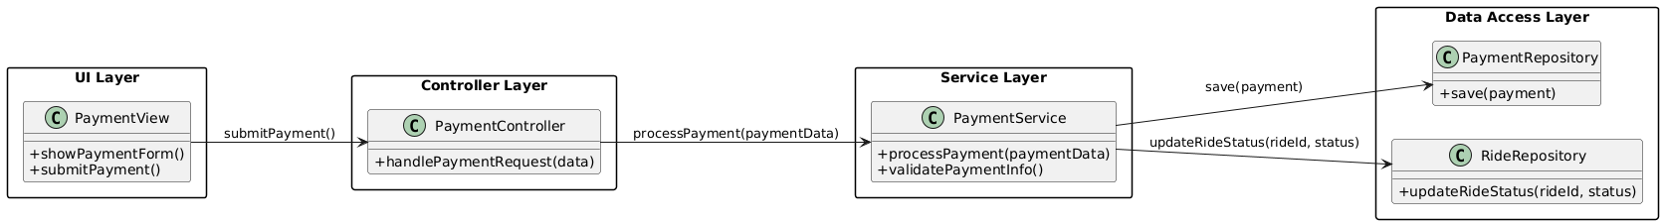
Process payment

