Slide 1

SmartRide
523K0010 – Phạm Lê Anh Khôi
523K0013 – Dương Thành Long

Slide 2
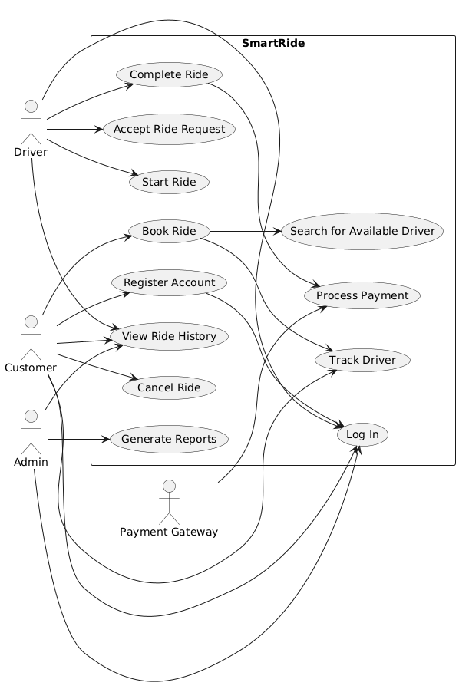
Use case diagram

Slide 3
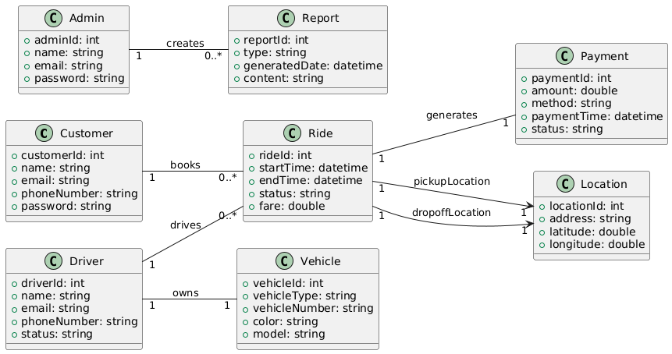
Domain class diagram

Slide 4
Use cases
Register Customer
Track Driver

Slide 5
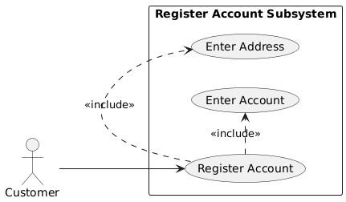
Subsystem use case diagram: Register account

Slide 6
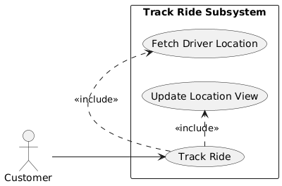
Subsystem use case diagram: Track Driver

Slide 7
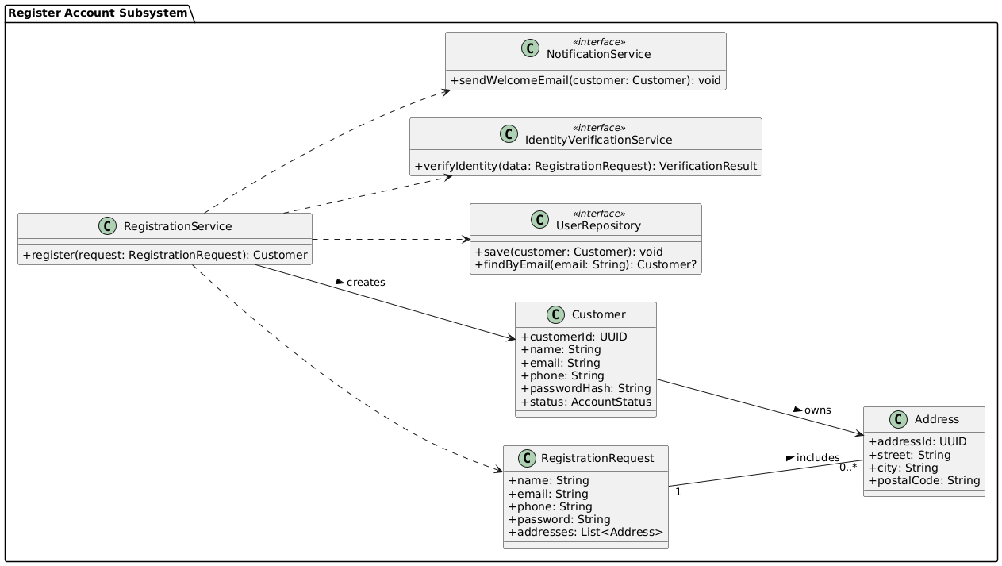
Subsystem domain class model: register account

Slide 8
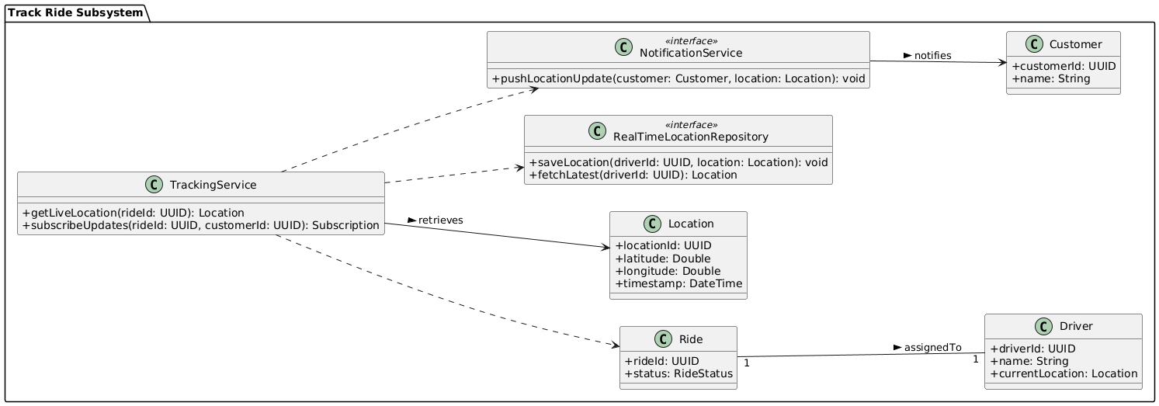
Subsystem domain class model: Track Driver

Slide 9
Analysis Model

Slide 10
Use case: Register Account
Use case name: | Register Account
Scenario: | Customer registers for a SmartRide account.
Triggering event: | A new customer wants to use the ride booking service.
Brief description: | Customer provides personal information and login details to create an account.
Actors: | Customer
Related use cases: | Login, Book Ride
Stakeholders: | Customer Support, Marketing
Preconditions: | Registration service must be available.
Postconditions: | Account is created and stored in the system.
Flow of activities:
Actor | System
1. Customer chooses to register. | 1.1 System displays registration form.
2. Customer fills in name, phone, email, and password. | 2.1 System validates input fields.
3. Customer submits registration. | 2.2 System creates new accounts and confirms registration.
Exception conditions: | 2.1 Missing or invalid data. Email already exists.

Slide 11
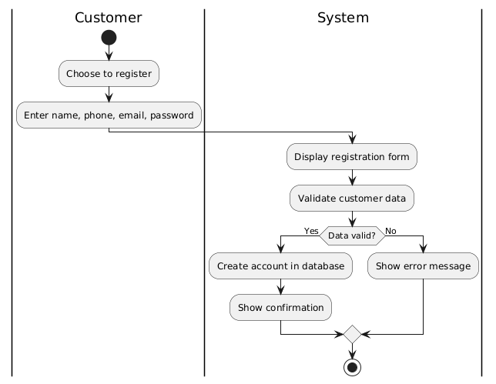
Use case: Register Account

Slide 12
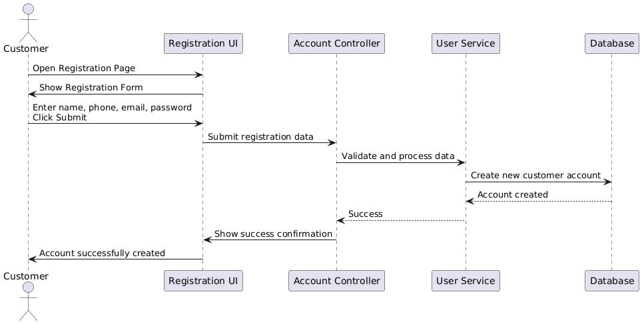
Use case: Register Account

Slide 13
Use case: Track Ride
Use case name: | Track driver
Scenario: | Customer wants to monitor their ride’s progress.
Triggering event: | A ride has been accepted by a driver.
Brief description: | The system provides real-time GPS tracking of the driver’s location.
Actors: | Customer, Driver
Related use cases: | Book Ride
Stakeholders: | Customers, Operations Team
Preconditions: | A driver has accepted the ride. GPS service is available.
Postconditions: | Customer can view updated driver location until arrival.
Flow of activities:
Actor | System
1. Customer opens track screen. | 1.1 System retrieves and displays current driver location.
2. Customer refreshes or waits. | 1.2 System updates location in real-time using GPS.
Exception conditions: | 1.1 GPS service fails or is unavailable.

Slide 14
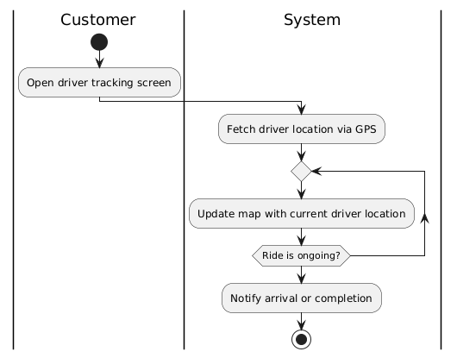
Use case: Track Ride

Slide 15
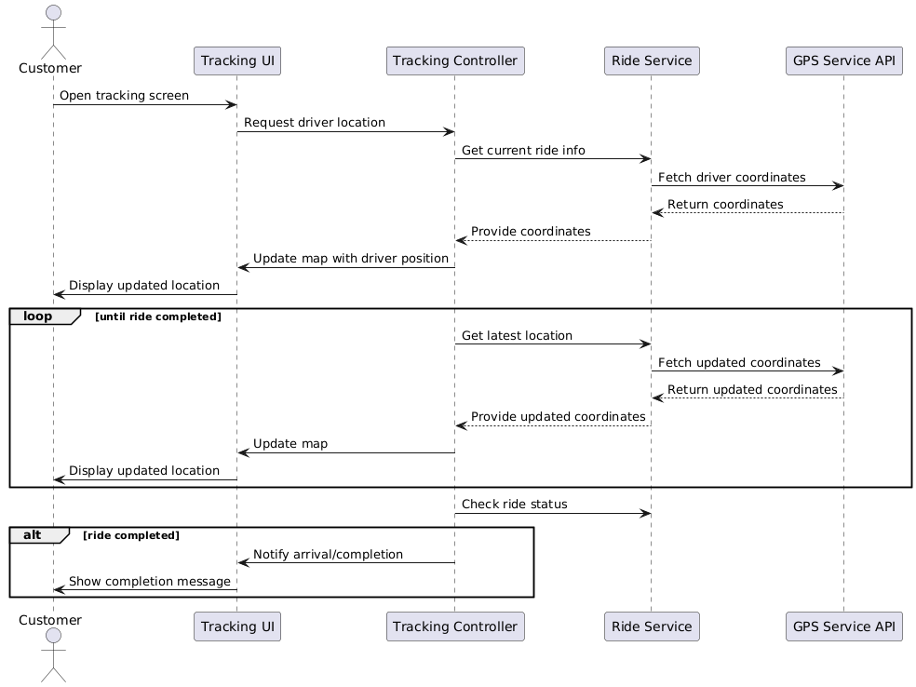
Use case: Track Ride

Slide 16
Design Model

Slide 17
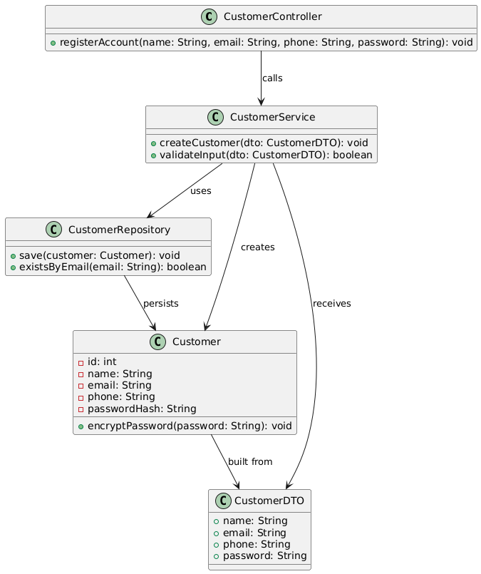
Design class: register account

Slide 18
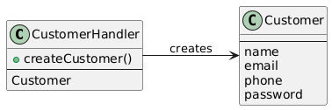

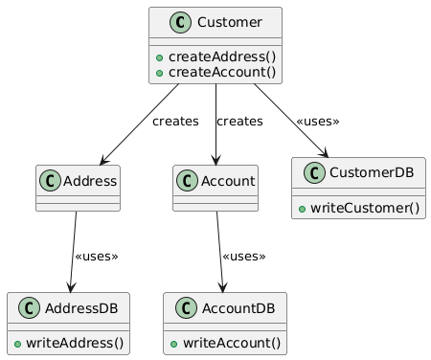
Domain Design class: register account
Controller
UI
Data Access

Slide 19
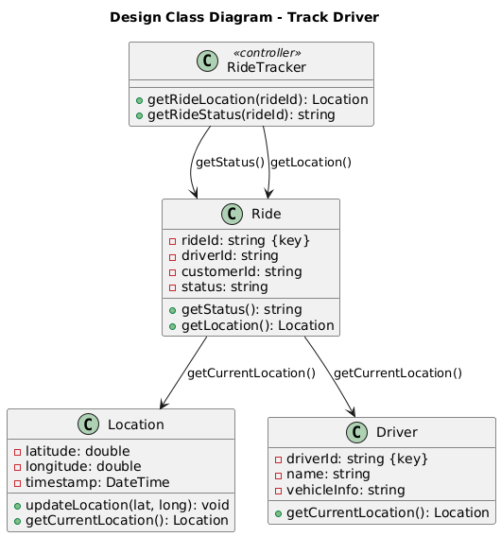
Design class: Track Driver

Slide 20
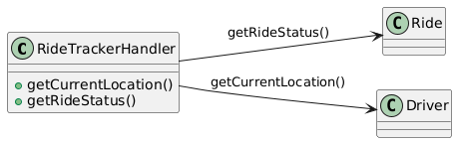
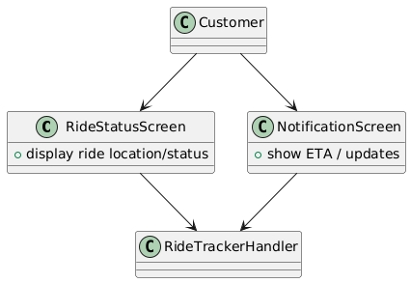
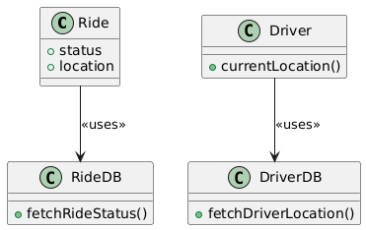
Domain Design class: Track Ride
Controller
UI
Data Access

Slide 21
UI Designs

Slide 22
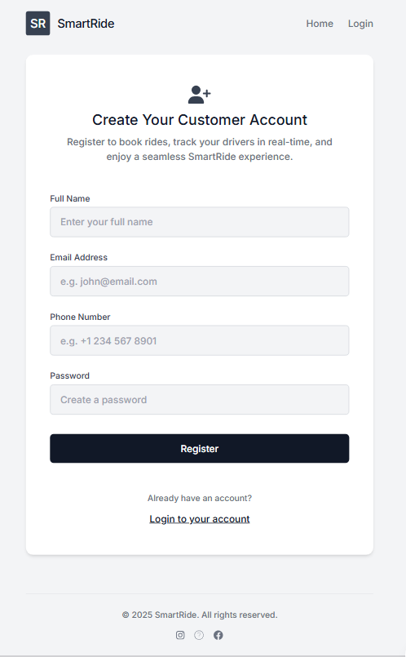
Register account

Slide 23
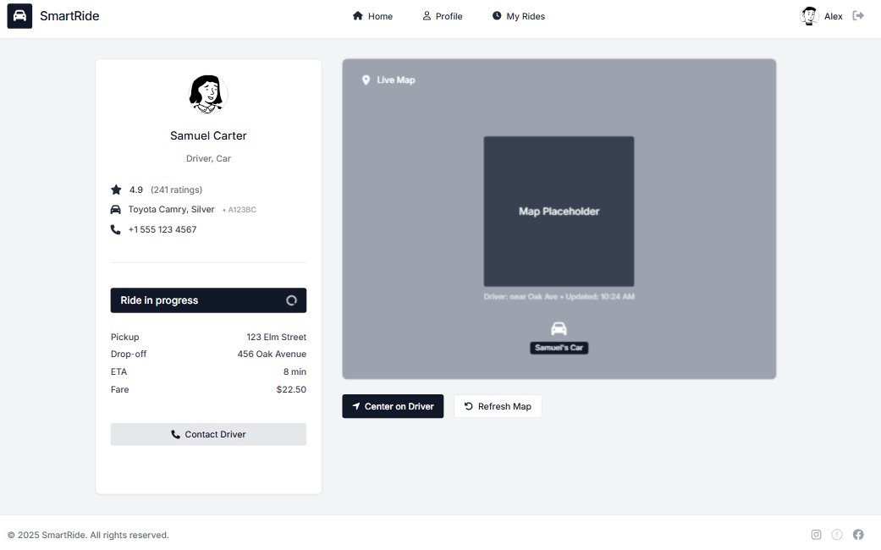
Track ride

Slide 24
Register account
Field | Value
Test Case ID | TC01
Use Case | Register Account
Description | Verify customer can register with valid details
Preconditions | Customer is not already registered
Test Steps | 1. Navigate to registration page 2. Fill all required fields 3. Submit form
Expected Result | Customer account is created, data is saved to database, confirmation is shown
Postconditions | New Customer, Account, and optionally Address records created in the system

Slide 25
Track driver
Field | Value
Test Case ID | TC04
Use Case | Track Driver
Description | Ensure customer can track driver’s current location
Preconditions | Ride has been accepted and driver is en route
Test Steps | 1. Open app during active ride 2. View driver's live location on map
Expected Result | System shows updated driver location in real-time
Postconditions | Location data is polled from DriverLocation and presented to the customer

Slide 26
Programing model

Slide 27
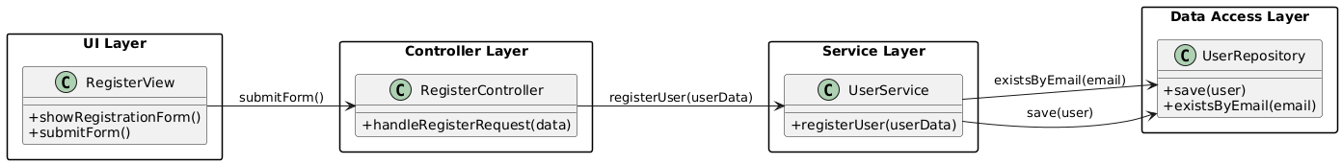
Register account

Slide 28
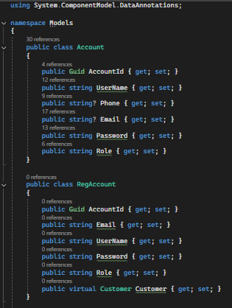
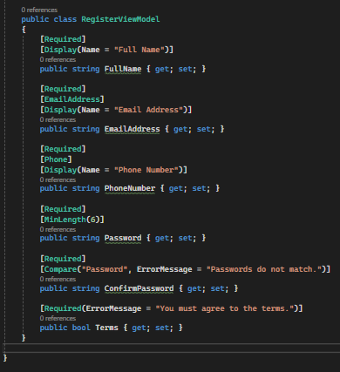
Register account: Account Models

Slide 29
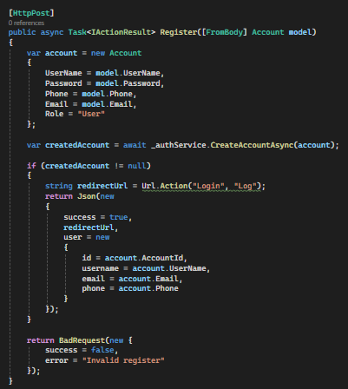
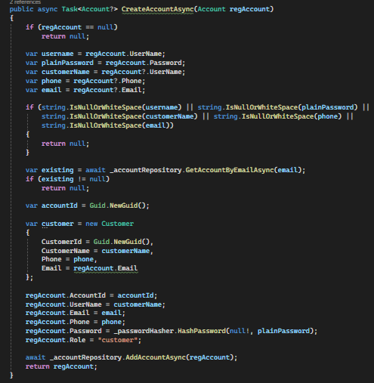
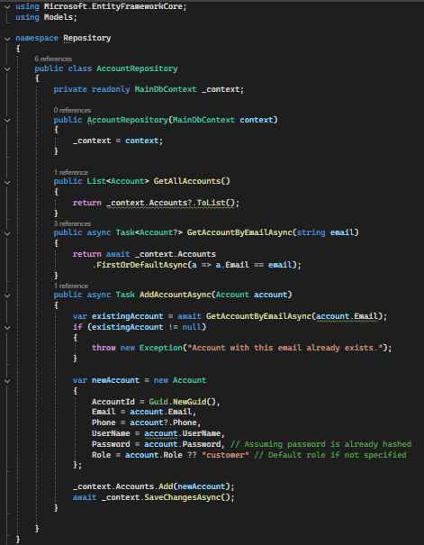
Register account: Back-end logic
Controllers
Services
Repositories

Slide 30
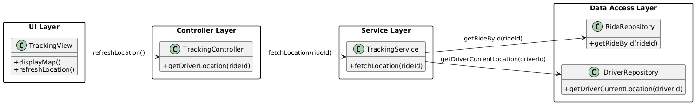
Track driver

Slide 31
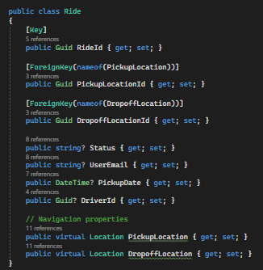
Track driver: Models

Slide 32
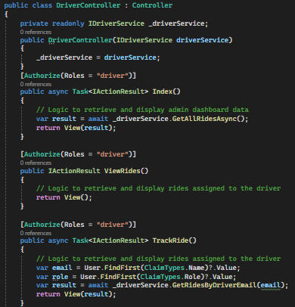
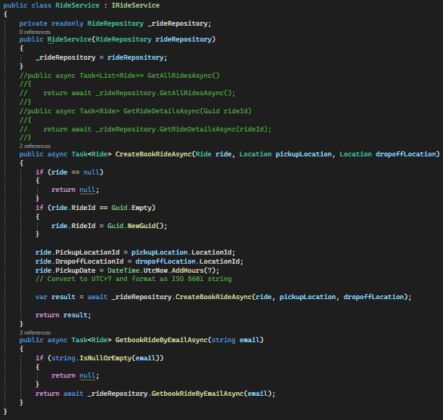
Track driver: Back-end logic
Controllers
Services

Slide 33
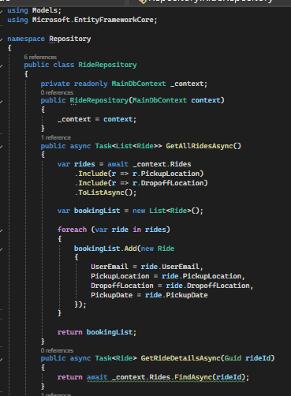
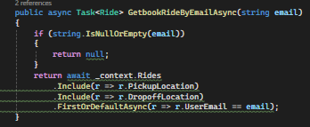
Track driver: Back-end logic
Repositories

Slide 34
Thank you for listening

