Slide 1



SmartRide
523K0010 – Phạm Lê Anh Khôi
523K0013 – Dương Thành Long

Slide 2
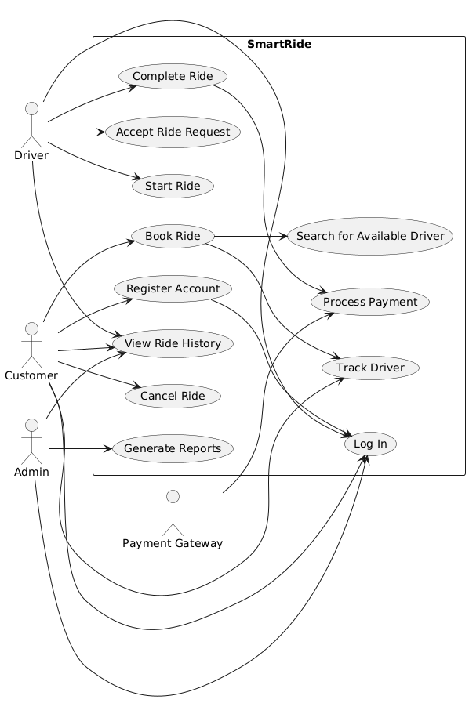
Use case diagram

Slide 3
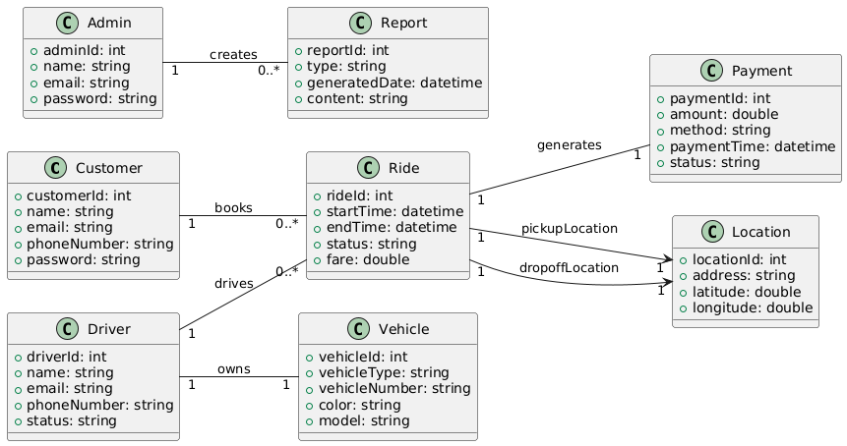
Domain class diagram

Slide 4
Analysis Model

Slide 5
Use case 1: Register Account
Use case name: | Register Account
Scenario: | Customer registers for a SmartRide account.
Triggering event: | A new customer wants to use the ride booking service.
Brief description: | Customer provides personal information and login details to create an account.
Actors: | Customer
Related use cases: | Login, Book Ride
Stakeholders: | Customer Support, Marketing
Preconditions: | Registration service must be available.
Postconditions: | Account is created and stored in the system.
Flow of activities:
Actor | System
1. Customer chooses to register. | 1.1 System displays registration form.
2. Customer fills in name, phone, email, and password. | 2.1 System validates input fields.
3. Customer submits registration. | 2.2 System creates new accounts and confirms registration.
Exception conditions: | 2.1 Missing or invalid data. Email already exists.

Slide 6
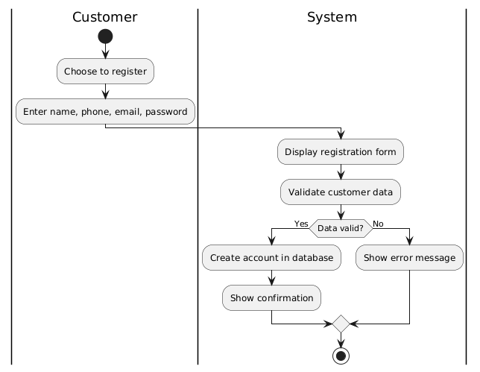
Use case 1: Register Account

Slide 7
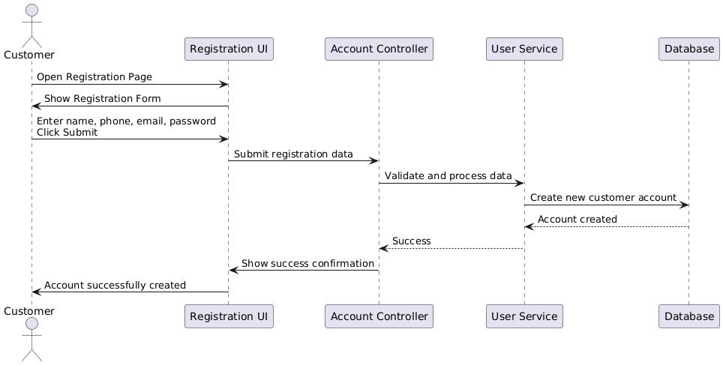
Use case 1: Register Account

Slide 8
Use case 2: Book ride
Use case name: | Book ride
Scenario: | Customer books a ride via the mobile app or website.
Triggering event: | Customer opens the booking screen and enters trip details.
Brief description: | The system processes the ride request and assigns an available driver.
Actors: | Customer, System, Driver
Related use cases: | Track Ride, Make Payment
Stakeholders: | Customers, Operations Team
Preconditions: | User must be logged in. Location services must be available.
Postconditions: | Ride is booked and driver is notified.
Flow of activities:
Actor | System
1. Customer enters pickup and dropoff location. | 1.1 System verifies location validity.
2. Customer confirms ride. | 1.2 System matches with available driver. 1.3 System notifies driver and confirms booking to customer.
Exception conditions: | 1.1 No drivers available. 1.2 Invalid location.

Slide 9
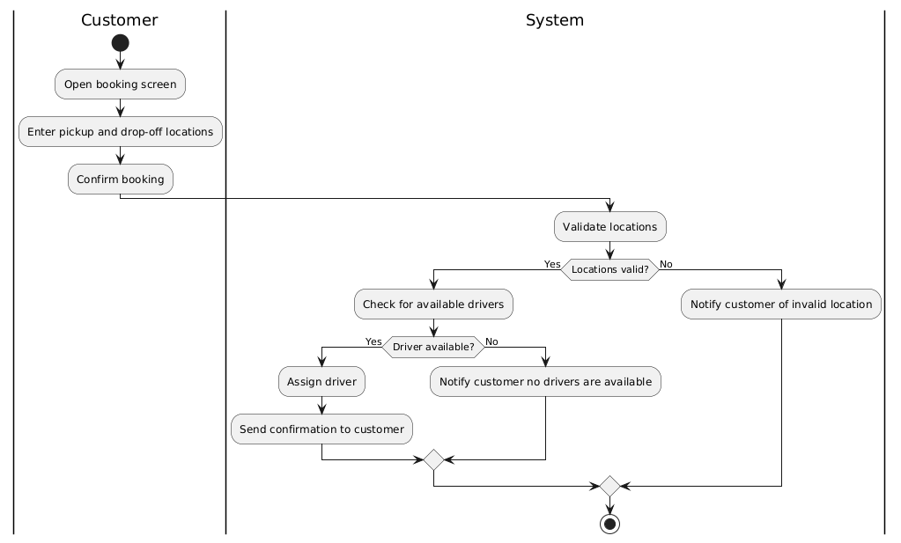
Use case 2: Book ride

Slide 10
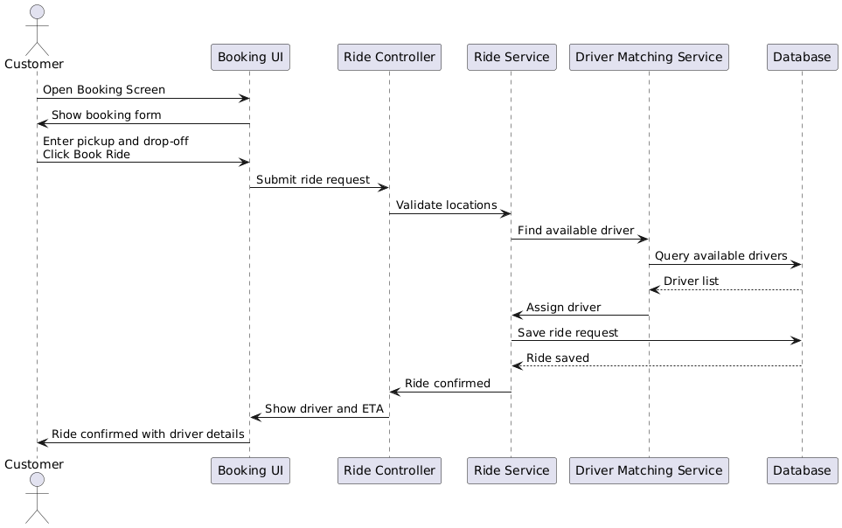
Use case 2: Book ride

Slide 11
Use case 3: process payment
Use case name: | Process payment
Scenario: | Customer pays for a completed ride.
Triggering event: | Ride is completed and fare is calculated.
Brief description: | Customer chooses a payment method and the system processes the transaction.
Actors: | Customer, Payment Gateway
Related use cases: | Book Ride
Stakeholders: | Customers, Finance Department
Preconditions: | Ride must be completed. Payment gateway must be operational.
Postconditions: | Payment is successful and receipt is issued.
Flow of activities:
Actor | System
1. Customer chooses to pay. | 1.1 System displays fare and payment options.
2. Customer selects payment method and confirms. | 1.2 System connects to payment gateway. 1.3 System processes payment. 1.4 System issues receipt.
Exception conditions: | 1.2 Invalid card or insufficient funds. 1.3 Payment gateway fails.

Slide 12
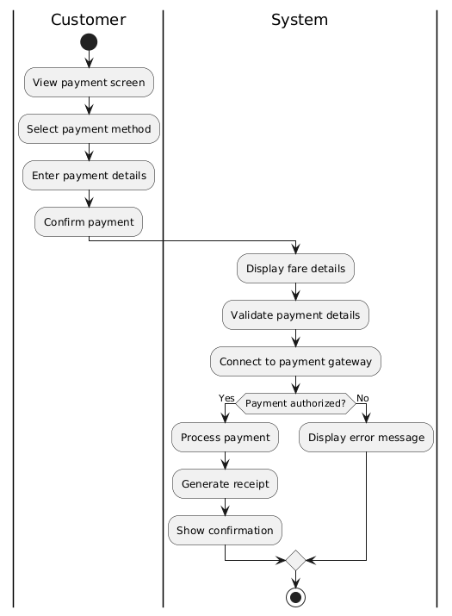
Use case 3: Process Payment

Slide 13
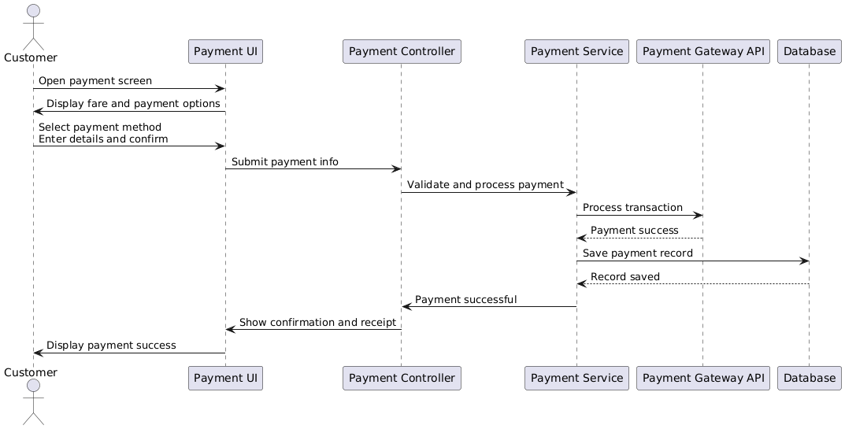
Use case 3: Process Payment

Slide 14
Use case 4: Track Ride
Use case name: | Track driver
Scenario: | Customer wants to monitor their ride’s progress.
Triggering event: | A ride has been accepted by a driver.
Brief description: | The system provides real-time GPS tracking of the driver’s location.
Actors: | Customer, Driver
Related use cases: | Book Ride
Stakeholders: | Customers, Operations Team
Preconditions: | A driver has accepted the ride. GPS service is available.
Postconditions: | Customer can view updated driver location until arrival.
Flow of activities:
Actor | System
1. Customer opens track screen. | 1.1 System retrieves and displays current driver location.
2. Customer refreshes or waits. | 1.2 System updates location in real-time using GPS.
Exception conditions: | 1.1 GPS service fails or is unavailable.

Slide 15
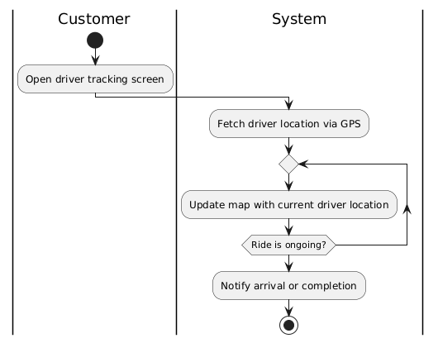
Use case 4: Track Ride

Slide 16
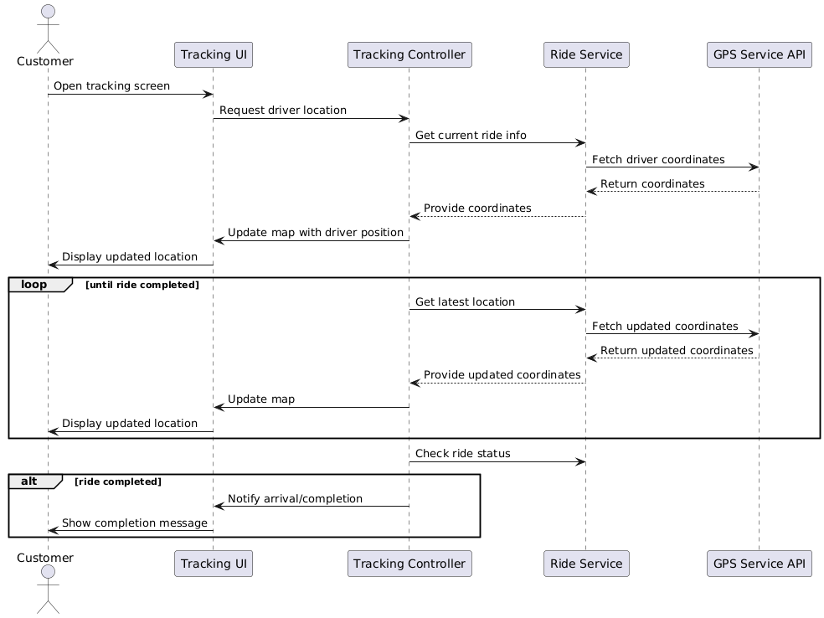
Use case 4: Track Ride

Slide 17
Design Model

Slide 18
Use case 4: Track Ride

