Slide 1
SmartRide
523K0013 - Dương Thành Long
523K0010 - Phạm Lê Anh Khôi

Slide 2
Introduction
SmartRide is a transportation service company operating in a busy metropolitan city. The company connects customers with available drivers for a fee, using cars and motorbikes. Currently, SmartRide’s operations are managed manually, leading to inefficiencies such as long wait times, lost ride opportunities, and slow payment handling. To address these challenges and to prepare for future growth, SmartRide has commissioned the development of a new Online Ride-Sharing Platform (ORSP).
SESoft Consulting has been tasked with designing and developing the ORSP to automate and enhance SmartRide’s operations, focusing on improving ride booking, driver assignment, real-time tracking, and online payments. This system is expected to deliver a faster, more reliable, and user-friendly experience for both customers and drivers, while also providing managerial insights to support business decision-making.

Slide 3
Project Objectives
The primary objectives of the ORSP project are:
Automate ride-booking by allowing customers to easily request rides through a digital platform.
Reduce customer wait times by efficiently matching available drivers to ride requests in real time.
Introduce secure online payment processing to replace manual cash handling.
Provide real-time tracking for customers to monitor driver location and estimated arrival times.
Enable account management for customers and drivers through user profiles.
Generate operational reports to help SmartRide’s management monitor service performance and demand trends.
Initially, the system will focus on the core functionality, with the flexibility to add new features such as ride-sharing options, loyalty programs, and promotional offers in the future.

Slide 4
Project Type
The SmartRide ORSP engagement is a custom software development project with the following characteristics:
Domain: Transportation / Ride-Sharing Platform
Application Type:
Web Application: Responsive portal for managers and administrative users
Mobile Applications: Native or cross-platform apps for iOS and Android, used by customers and drivers
Architecture Style: Client-server, cloud-hosted microservices
Technology Stack (Indicative):
Backend: ASP.NET Core with Entity Framework Core
Frontend: React (web) and React Native (mobile)
Database: Microsoft SQL Server
Hosting: Azure or AWS

Slide 5
Goals
Enable customers to create accounts, book rides, and pay online.
Enable drivers to create profiles, accept ride requests, and navigate to customers.
Provide real-time GPS tracking and ETA updates to customers.
Automate payment handling, receipts, and confirmations.
Allow managers to access reports on rides, revenue, and demand trends.
Ensure system security, reliability, and scalability for future growth.

Slide 6
Project Incentives
Reduce Customer Churn: By cutting down wait times and offering real-time tracking, SmartRide aims to prevent lost bookings and improve overall customer loyalty.
Increase Ride Completion Rate: Automated driver matching and dynamic dispatch will help fulfill more ride requests, directly boosting revenue.
Streamline Operations: Eliminating manual processes for dispatch and payments will lower administrative overhead and reduce error rates.
Enhance Driver Utilization: Faster, fairer assignment of rides will keep drivers active and reduce idle time, improving their earnings and retention.
Enable Data-Driven Growth: Built-in reporting and analytics will empower management to spot demand trends, optimize pricing, and plan for peak periods.
Future-Proof the Platform: A modular, scalable system foundation will allow SmartRide to roll out new features (shared rides, loyalty programs, new vehicle types) with minimal rework.

Slide 7
Assumptions
City Coverage: SmartRide initially operates within a single metropolitan area; no immediate multi-city expansion is planned.
User Technology Proficiency: All customers and drivers possess basic smartphone literacy and can install and use mobile apps for booking rides, navigation, and payments.
Hardware Availability: Drivers use their own GPS-enabled smartphones. Server infrastructure (cloud or on-premises) will be provisioned separately and is outside the scope of this project.
Ride Type Stability: Only cars and motorbikes are supported at launch. Any new vehicle types (e.g., vans, e-bikes) will be added via future system updates.
Customer Interactions: The system handles ride requests, real-time tracking, and payments. Customer support inquiries (e.g., refunds, complaints) are managed through external channels.
Third-Party Payment Gateway: SmartRide integrates with an existing PCI-compliant payment provider; the platform does not process or store raw payment card data.
External Navigation Service: A reliable GPS/navigation API is available for real-time location tracking and ETA calculations.
User Roles: The system supports three primary user roles—Customer, Driver, and Manager, and each must register an Account before using the platform.

Slide 8
Scope: Included
User Account Management:
Registration, login, and profile management for Customers, Drivers, and Managers.
Ride Lifecycle:
Ride request submission with pickup and drop-off locations.
Automatic driver matching and assignment.
Real-time GPS-based tracking and ETA updates.
Ride status updates (requested, accepted, in-progress, completed).
Vehicle Management:
Registration and maintenance of Driver’s Vehicle details (type, license plate, status).

Slide 9
Scope: Included
Payment Processing:
Integration with a third-party, PCI-compliant payment gateway.
Fare calculation, transaction execution, and digital receipt generation.
Reporting & Analytics:
Generation of operational reports (ride volumes, revenue, driver activity) for Managers.
Notifications:
Real-time alerts to Customers and Drivers for ride status changes and payment confirmations.

Slide 10
Scope: Excluded
Hardware Procurement: Server infrastructure, driver devices, or in-vehicle hardware.
Customer Support Workflows: Ticketing system, dispute resolution, or refund management.
Dynamic Pricing & Promotions: Surge pricing algorithms, loyalty rewards, or discount campaigns.
Shared Rides & Pooling: Carpooling or multi-passenger matching.

Slide 11
Functional Requirements
The Online Ride-Sharing Platform (ORSP) for SmartRide must support the following core goals:
Enable Customer Account Management: Customers must be able to create, update, and manage their user accounts, including personal details, payment information, and ride history.
Enable Driver Account Management: Drivers must be able to register, update, and manage their profiles, vehicle information, and availability status.
Support Ride Booking: Customers must be able to input pickup and drop-off locations and submit ride requests through the platform.
Automate Driver Assignment: The system must automatically locate available drivers based on proximity, availability, and estimated arrival times, and assign them to incoming ride requests.
Provide Real-time Tracking: Both customers and drivers must have access to live GPS tracking to monitor driver location, route progress, and estimated arrival times.
Enable Secure Online Payments: Customers must be able to securely complete ride payments through an integrated online payment gateway, with digital receipts generated upon successful transactions.
Generate Operational Reports: Managers must be able to access system-generated reports summarizing ride volumes, driver activity, peak usage periods, and other relevant operational metrics.
Support Notifications and Updates: The system must send real-time updates to customers and drivers about ride status changes, estimated arrival times, and payment confirmations.
Ensure Ride History Management: Customers and drivers must be able to view their respective ride histories, including trip details, payment records, and ratings.
Facilitate System Scalability and Maintenance: The system must be designed to easily accommodate future expansions, such as adding new cities, new vehicle types, or new customer loyalty programs.

Slide 12
Non-Functional Requirements
The Online Ride-Sharing Platform (ORSP) must meet the following key quality attributes to ensure a reliable, scalable, and user-friendly system:
Performance and Scalability The system must handle high volumes of concurrent users, especially during peak hours, without significant performance degradation. It must be scalable to support future expansion to additional cities and increased numbers of customers and drivers.
Reliability and Availability The platform must maintain a minimum uptime of 99.9% to ensure customers and drivers can access the service at all times. System recovery mechanisms must be in place to handle unexpected failures with minimal service interruption.
Security The system must protect user data through encryption and secure authentication methods. Integration with third-party payment gateways must comply with industry standards for financial data protection (e.g., PCI DSS compliance).
Usability The platform must provide a clean, intuitive user interface that is easy to navigate for customers, drivers, and managers. Key tasks (such as booking a ride, accepting a ride, or making a payment) must be easily completed with minimal steps and training.
Maintainability The system must be designed with a modular architecture to allow easy updates, bug fixes, and the addition of new features without significant system downtime.
Interoperability The ORSP must integrate seamlessly with external systems such as GPS navigation services and third-party payment gateways without requiring manual intervention.
Responsiveness Real-time features such as ride tracking, driver assignment, and notification delivery must occur with minimal latency to enhance the user experience.

Slide 13
Pain Points
SmartRide’s current manual operations present several critical challenges that negatively impact customer satisfaction, driver efficiency, and overall business growth:
Long Wait Times: Customers often experience significant delays in securing a ride, especially during peak hours, due to the lack of an automated driver assignment process.
Missed Ride Opportunities: Without an efficient system to match customers with available drivers, many potential rides are lost, leading to lost revenue and frustrated customers.
Manual Payment Processing: Payments are currently handled manually between drivers and customers, which is time-consuming, error-prone, and inconvenient for both parties.
Driver Assignment Inefficiencies: During periods of high demand, there is no organized method for quickly identifying and assigning nearby available drivers to customers.
Limited Visibility for Customers: Customers have no way to track where their driver is or receive accurate arrival time estimates, leading to uncertainty and dissatisfaction.
High Administrative Overhead: Manual ride tracking, payment recording, and business reporting require significant administrative effort, slowing down operations and decision-making.
Scalability Limitations: The current manual approach is not scalable. As customer demand grows, the company struggles to handle increased ride requests without compromising service quality.

Slide 14
Actors
Customer: An individual who uses the platform to book rides, track driver locations, make payments, and manage their ride history and personal profile.
Driver: A registered individual who uses the platform to receive ride requests, accept bookings, navigate to pickup and drop-off locations, and manage their availability and profile.
Manager: A SmartRide administrative user who oversees system operations, reviews reporting and analytics, manages customer or driver accounts when necessary, and monitors service performance trends.
Payment Gateway (External Actor): A third-party service responsible for securely processing customer payments. SmartRide will integrate with an external gateway to manage financial transactions without directly handling sensitive payment data.
GPS Navigation Service (External Actor): A third-party service used to provide real-time location tracking, route optimization, and estimated arrival times for both customers and drivers.

Slide 15
Domain Entities
Entity | Description
Customer | A user who requests and pays for rides via the platform.
Driver | A service provider who accepts ride requests and transports customers.
Ride | A record of a single trip, including pickup/drop-off locations, status, and associated users.
Vehicle | Details about a driver’s transport (car or motorbike), including type and registration data.
Location | Geographic information (latitude, longitude, address) for ride pickup and drop-off points.
Payment | Transaction details for a ride, including fare, method, status, and receipt information.
Account | Authentication and profile information for all users (customers, drivers, managers).
Manager | An administrative user who oversees operations and accesses reports and analytics.
Report | Aggregated summaries of rides, payments, and performance metrics for managerial review.

Slide 16
List of Tasks
User Account Management
Ride Booking
Driver Assignment
Real-Time Tracking
Ride Status Management
Navigation Support
Payment Processing
Notifications & Alerts
Reporting & Analytics
Error Handling & Validation

Slide 17
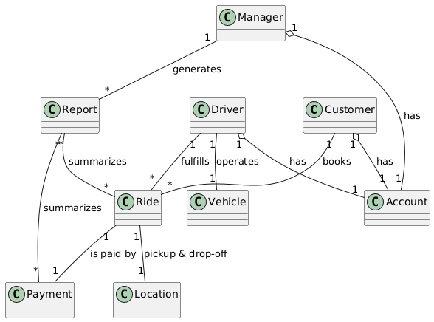
Data Model

Slide 18
Tasks & Support

Slide 19
User Registration and Authentication
Aspect | Description
Purpose | Allow new users (Customers, Drivers, Managers) to create an account and log in securely.
Precondition | User has downloaded the SmartRide app or accessed the web portal.
Frequency | Once per user (registration), then at each subsequent app launch or session (login).
Critical | Insecure or failed authentication exposes privacy/data or prevents use of the system.
Work area | Registration & Login screens (mobile/web).
Subtask | Example Solution
1. Collect user details | Present form for name, email/phone, password, (driver: license)
2. Validate input | Check mandatory fields, email format, password strength
3. Create account record | Invoke Account.create() → store credentials in user database
4. Send confirmation (optional) | Email/SMS with verification link or code
5. Authenticate on login | Account.login() → check credentials → issue session token
Variants
1a. Social Login | User chooses Google/Facebook SSO → OAuth flow → create or link local account.
1b. Password Reset | User forgot password → requests reset link → completes password change.

Slide 20
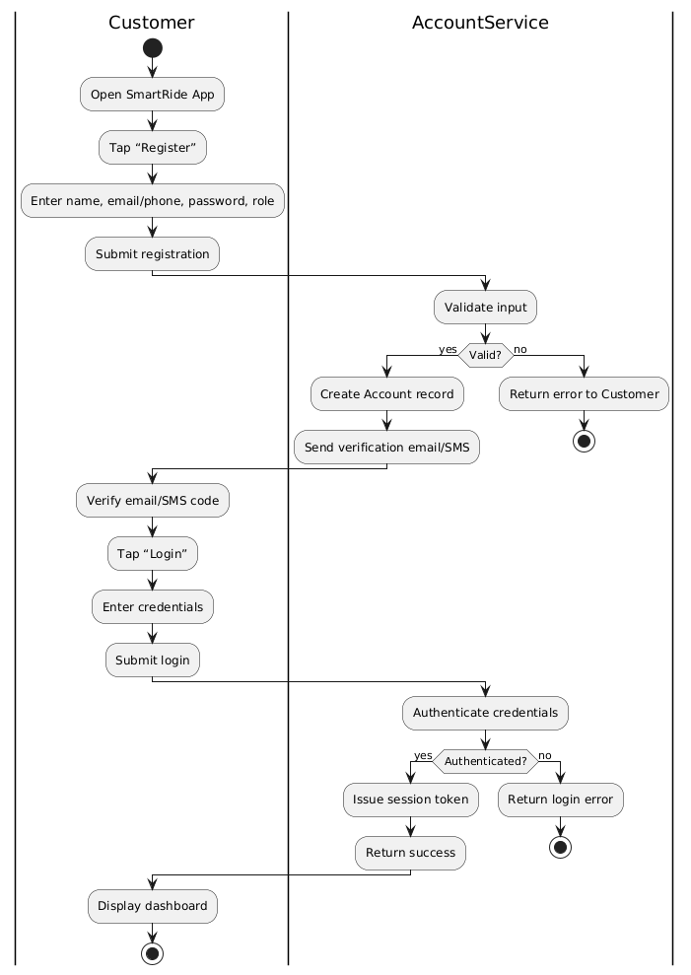
User Registration and Authentication

Slide 21
Ride Booking
Aspect | Description
Purpose | Enable a Customer to request a new ride by specifying pickup and drop-off locations.
Precondition | User is authenticated and has a valid payment method on file.
Frequency | Every time a Customer needs a trip.
Critical | Invalid locations or missing payment info block ride creation and frustrate users.
Work area | “Book a Ride” screen with map and form.
Subtask | Example Solution
1. Enter pickup location | Map-based search / GPS “use my current location”
2. Enter drop-off location | Address autocomplete + map pin drop
3. Validate service area | Check coordinates against supported city polygon
4. Show vehicle types & ETAs | Query ETA service for cars/motorbikes
5. Confirm ride request | Ride.create() + persist pickup/drop-off and customer ID
Variants
2a. Schedule for later | Customer selects future date/time → system enqueues ride request.
2b. Fare estimate only | Customer previews fare and ETA without booking.

Slide 22
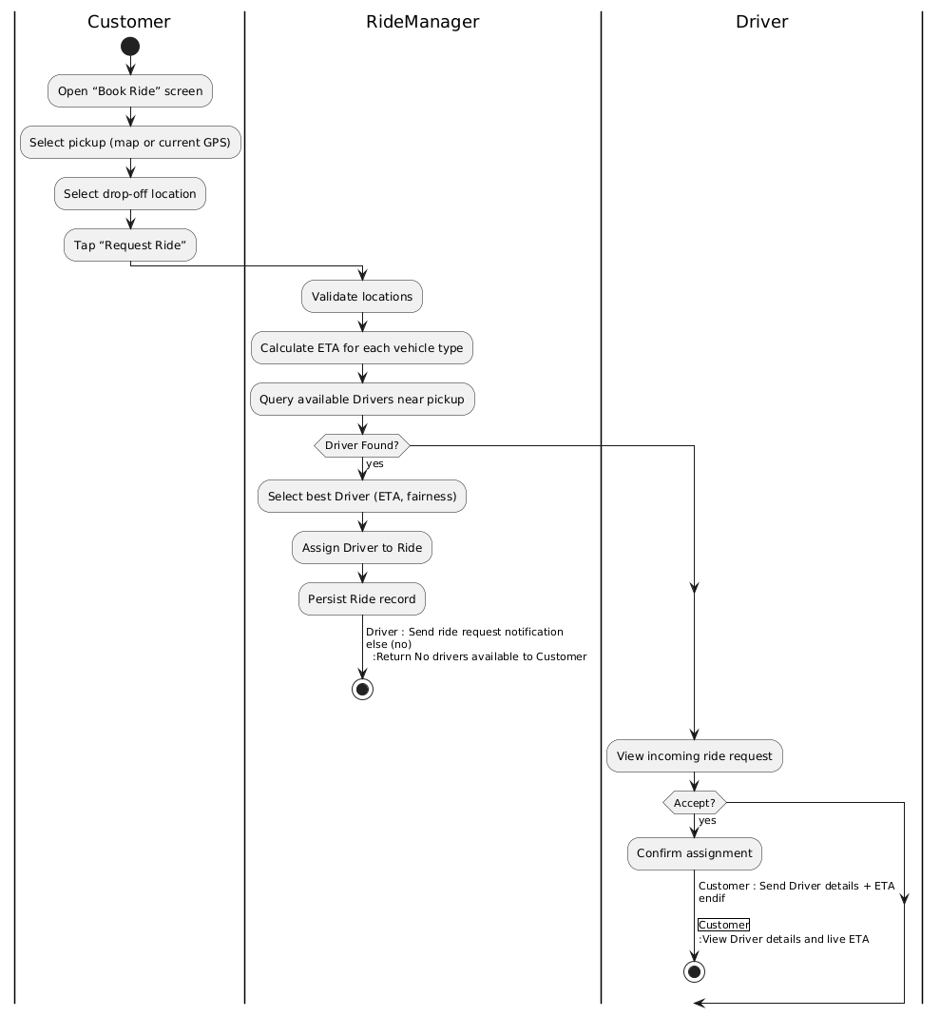
Ride Booking

Slide 23
Driver Assignment
Aspect | Description
Purpose | Automatically match a new Ride request to the most suitable available Driver.
Precondition | A Ride has been created and at least one Driver is marked available nearby.
Frequency | Once per new Ride request.
Critical | Poor matching leads to long waits or ride cancellations.
Work area | Backend dispatch service (RideManager).
Subtask | Example Solution
1. Locate nearby drivers | Spatial query: Driver.location within radius of pickup point
2. Filter by availability | Exclude drivers marked “busy” or “offline”
3. Rank by ETA & fairness | Sort by estimated arrival time and recent assignment count
4. Dispatch assignment | Ride.assignDriver(driverId) → notify driver via push/SMS
5. Await driver response | Timeout after N seconds → retry or escalate to next candidate
Variants
3a. Manual override | Manager forces assignment to a specific driver in special cases.
3b. Shared ride matching | (Future) match multiple customers to one driver.

Slide 24
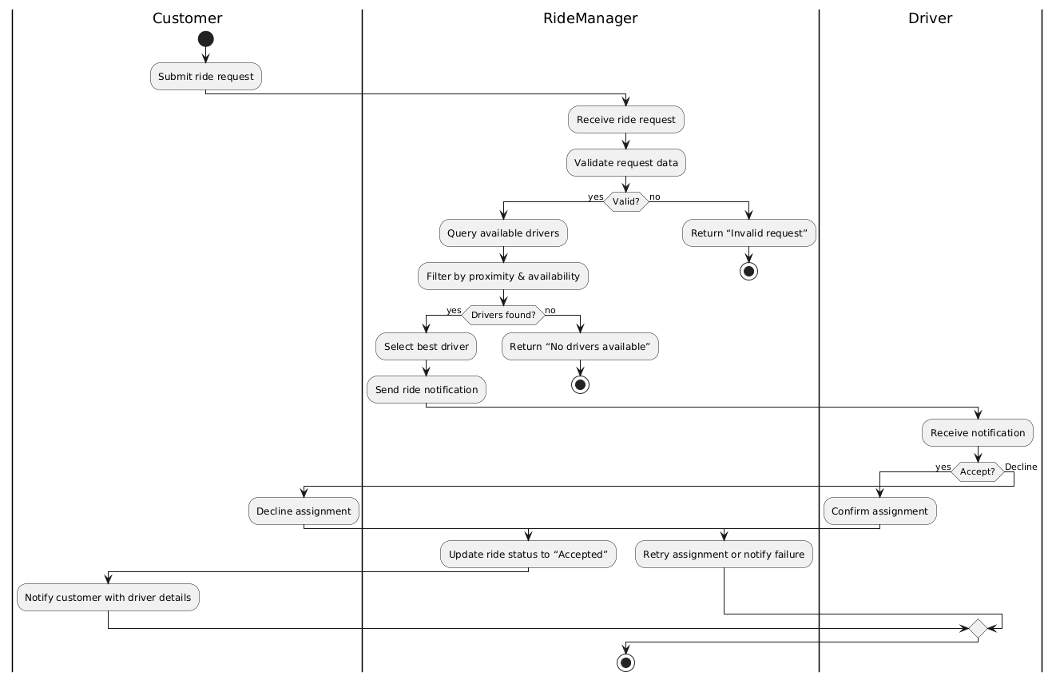
Driver Assignment

Slide 25
Ride Status Tracking
Aspect | Description
Purpose | Provide both Customer and Driver with real-time updates on ride progress and ETA.
Precondition | Driver has accepted the Ride and GPS updates are being sent.
Frequency | Continuous, throughout the lifecycle of each Ride.
Critical | Delays or inaccuracies in tracking decrease user trust and can cause missed pickups.
Work area | Mobile apps (Customer & Driver), backend location service.
Subtask | Example Solution
1. Driver sends GPS heartbeat | App → Location.update(latitude, longitude)
2. Update Ride record | Ride.updatePosition() & recalculate ETA
3. Push notification to Customer | Real-time socket message or push notification
4. Display map & ETA | Mobile UI map redraw with driver marker and time label
Variants
4a. Intermittent connectivity | Buffer location updates locally → sync when online.
4b. Alternative routing | Driver manually updates route → recalculate ETA.

Slide 26
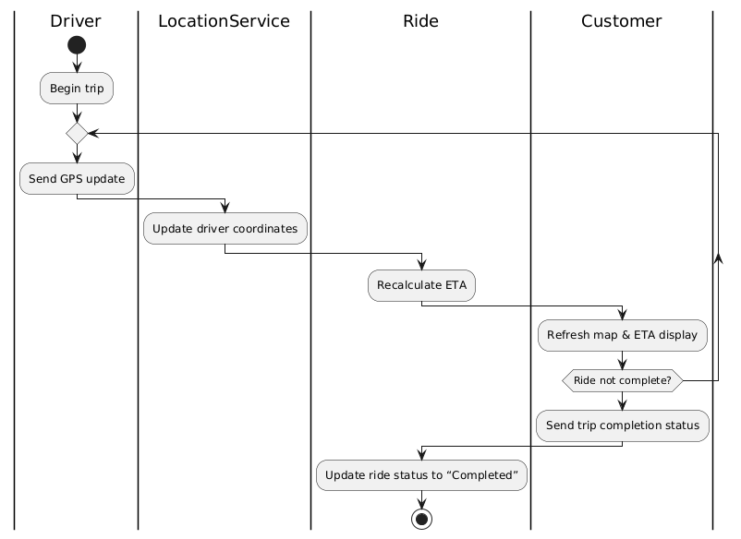
Ride Status Tracking

Slide 27
Payment Processing & Receipt Generation
Aspect | Description
Purpose | Charge the Customer for a completed Ride and generate a digital receipt.
Precondition | Ride status = “Completed” and Customer has a valid payment method.
Frequency | Once per Ride completion.
Critical | Failed transactions lead to revenue loss and require manual follow-up.
Work area | Backend payment service (PaymentProcessor) and Customer app.
Subtask | Example Solution
1. Calculate fare | Formula: base fare + distance × rate + time × rate
2. Initiate transaction | Payment.process(paymentInfo) → call third-party gateway API
3. Handle gateway response | On success → Payment.markPaid(); on failure → retry/alert
4. Generate digital receipt | Payment.generateReceipt() → PDF or in-app view
5. Notify Customer | Push notification + email with receipt link
Variants
5a. Wallet top-up | Deduct from in-app wallet balance before fallback to card.
5b. Split fare | Customer splits payment among multiple riders.

Slide 28
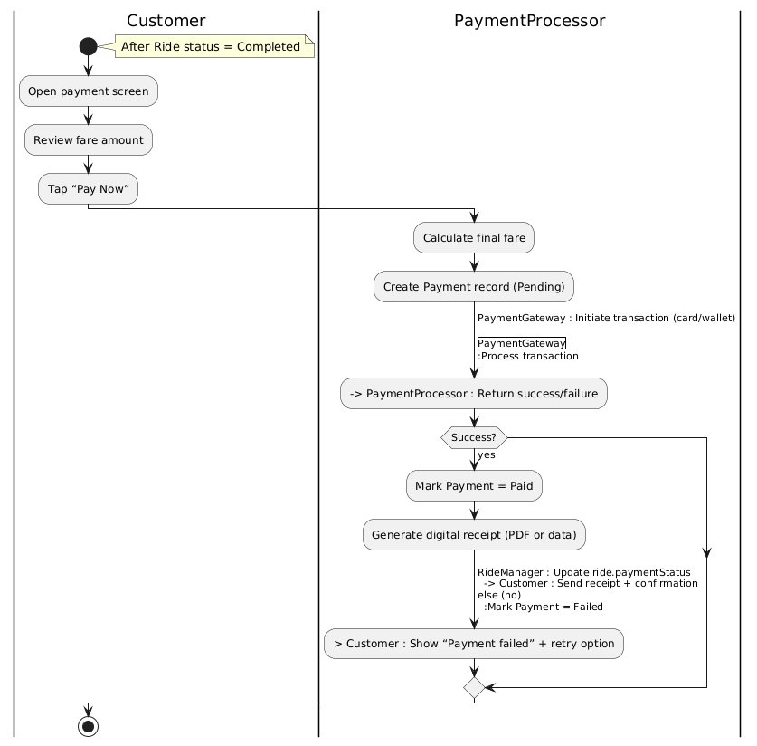
Payment Processing & Receipt Generation

Slide 29
Operational Reporting
Aspect | Description
Purpose | Provide Managers with insights on ride volumes, revenue, and driver performance over time.
Precondition | System has processed multiple Rides and Payments to aggregate data.
Frequency | On-demand or scheduled (e.g., daily at midnight).
Critical | Inaccurate or delayed reports hinder strategic decision-making.
Work area | Manager portal / reporting dashboard.
Subtask | Example Solution
1. Query ride/payment data | ReportGenerator.fetchRides(startDate, endDate)
2. Aggregate metrics | Calculate totals, averages, peak-hour counts
3. Format report | Render as table/chart in dashboard
4. Export or schedule delivery | CSV/PDF export or automated email dispatch
Variants
6a. Custom date range | Manager selects arbitrary start/end dates.
6b. Performance alerts | System automatically flags underperforming metrics via email.

Slide 30
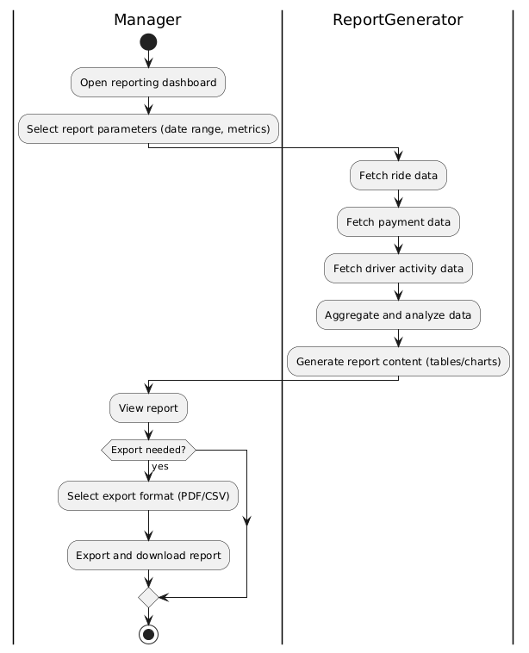
Operational Reporting

Slide 31
List of identified classes
Domain Entities:
Customer
Driver
Manager
Ride
Payment
Account
Data-Holder
Vehicle
Location
Report
Coordinator Classes
RideManager
PaymentProcessor
UserAccountManager
ReportGenerator
External Classes
NotificationService
NavigationService
PaymentGateway)
GPSService

Slide 32
CRC Cards
Customer
Driver
Description | A user who books rides, tracks status, and makes payments via the platform.
Responsibility | Collaborator
Book a new ride | Ride
View ride status | Ride
Make payment | Payment
View payment receipt | Payment
Update personal profile | Account
View ride history | Ride
Description | A service provider who accepts ride requests, updates trip statuses, and navigates to pickup/drop-off.
Responsibility | Collaborator
Accept a ride assignment | Ride
Update ride status | Ride
Send GPS location updates | Location
View payment history | Payment
Update availability status | Account
Manage vehicle details | Vehicle

Slide 33
CRC Cards
Ride
Payment
Description | Represents a single trip from pickup to drop-off, managing state transitions and linking customer, driver, locations, and payment.
Responsibility | Collaborator
Create ride request | Customer
Assign driver to ride | Driver, RideManager
Track ride progress (status & ETA) | Location
Update ride status (accepted, completed) | Driver
Link to payment for fare collection | Payment
Description | Handles fare calculation, transaction processing, and receipt generation through a third-party gateway.
Responsibility | Collaborator
Calculate ride fare | Ride
Process payment transaction | PaymentGateway
Generate digital receipt | Customer, Ride
Update payment status on ride | Ride

Slide 34
CRC Cards
Manager
Account
Description | Administrative user who accesses reports, monitors operations, and manages accounts.
Responsibility | Collaborator
Generate operational reports | ReportGenerator, Report
View ride and payment analytics | Ride, Payment
Manage user accounts | Account
Monitor system performance metrics | Report
Description | Manages authentication credentials and profile data for all user types (Customer, Driver, Manager).
Responsibility | Collaborator
Register new user account | Customer, Driver, Manager
Authenticate user login | Customer, Driver, Manager
Update credentials and profile data | Customer, Driver
Enforce role-based access control | Manager

Slide 35
CRC Cards
Vehicle
Location
Description | Data-holder for a driver’s transport details.
Responsibility | Collaborator
Store vehicle information | —
Provide vehicle type | Driver
Validate registration status | —
Description | Data-holder for geographic coordinates and address details used in ride booking and tracking.
Responsibility | Collaborator
Hold pickup/drop-off coordinates | Ride
Provide address lookup | None or external GIS service
Supply data for ETA calculations | RideManager

Slide 36
CRC Cards
Report
Description | Data-holder for aggregated analytics and summaries used by managers.
Responsibility | Collaborator
Store ride volume and revenue data | ReportGenerator
Hold driver performance metrics | ReportGenerator
Format summary for display/export | Manager

Slide 37
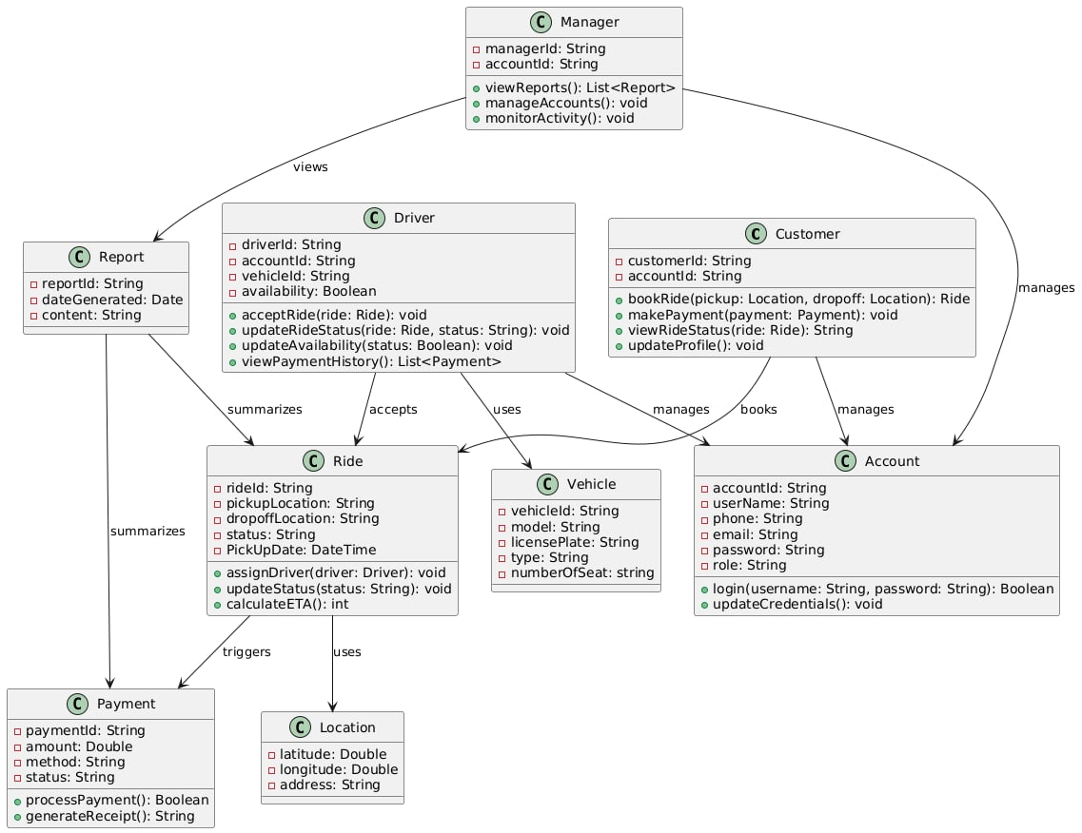
UML Class Diagram

Slide 38
Design Patterns: Singleton Pattern
Used in: Manager, Report
We apply the Singleton pattern to the Manager and Report classes (or their controller/service counterparts) to ensure there is only one instance managing administrative operations and generating system-wide reports at any given time. This guarantees consistency across reports and prevents conflicts when multiple managers are accessing administrative data.
Justification:
Ensures centralized control over system-wide data
Prevents duplicate report generation
Simplifies coordination of admin tasks

Slide 39
Design Patterns: Factory Pattern
Used in: Ride, Payment creation
The Factory pattern is used to encapsulate the creation of Ride and Payment objects. For example, a RideFactory an handle the creation of ride instances depending on the vehicle type (car, motorbike), and a PaymentFactory can handle the creation of payments depending on the payment method (credit card, wallet, etc.).
Justification:
Encapsulates object creation logic
Supports future extension (e.g., adding new vehicle types or payment methods)
Simplifies client-side code

Slide 40
Design Patterns: Observer Pattern
Used in: Ride, Customer, Driver updates
The Observer pattern is applied to Ride so that Customer and Driver can subscribe to ride status updates (e.g., when the driver is nearby, when the ride starts, when it finishes). This ensures that both users get real-time notifications without tight coupling between objects.
Justification:
Enables real-time status updates
Reduces coupling between Ride and its observers
Improves user experience with live notifications

Slide 41
Design Patterns: Strategy Pattern
Used in: Payment processing
The Payment class uses the Strategy pattern to switch between different payment methods (e.g., credit card, PayPal, wallet) at runtime. Each payment method implements a common interface, making it easy to add or change payment options without touching the core payment processing logic.
Justification:
Supports multiple, interchangeable payment strategies
Improves flexibility and testability of payment workflows
Makes the system easily extendable for future payment methods

Slide 42
Design Heuristics Applied
Separation of Concerns: Each class has a clear and focused responsibility (e.g., Ride handles trip management, Payment handles financial transactions).
Low Coupling, High Cohesion: Interactions between classes are minimal and well-defined; each class’s internal logic is cohesive.
Don’t Repeat Yourself (DRY): Shared logic like authentication is placed in the Account class or related services to avoid duplication.
Encapsulation: Attributes are kept private, and access is provided through public methods to protect the system’s internal state.

Slide 43
Bootstrapping Process (Initialization)
Introduction
The bootstrapping process initializes key components in a specific order to ensure proper system functionality.
Key Components:
Main: The entry point of the SmartRide ORSP responsible for initializing core services and starting the application.
Customer: Represents end users who register, book rides, and make payments.
Driver: Represents service providers who register, accept rides, and update trip status.
Account: Manages authentication and profile information for Customers, Drivers, and Managers.
Ride: Encapsulates a single trip’s details, state transitions, and links to Customer, Driver, and Location.
Location: Holds geographic data (pickup and drop-off coordinates and addresses) used for booking and tracking.
Vehicle: Data-holder for Driver’s transport details (type, license plate).
RideManager: Coordinates ride request processing, driver assignment, and status updates.
PaymentProcessor: Orchestrates fare calculation, transaction submission to a PaymentGateway, and receipt generation.
Payment: Represents a fare transaction, its status, and associated receipt details.
ReportGenerator: Aggregates ride and payment data to produce management reports.
Report: Data-holder for summarized metrics (ride volumes, revenue, driver performance).
NotificationService: Sends real-time alerts to Customers and Drivers (e.g., status changes, payment confirmations).
NavigationService: Interfaces with external GPS/navigation APIs to compute routes and ETAs.
PaymentGateway: Adapter for a third-party payment service used by the PaymentProcessor.

Slide 44
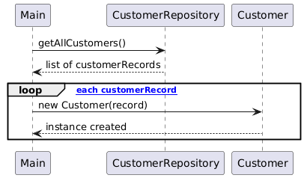
Bootstrapping Process (Initialization)
Customer Initialization

Slide 45
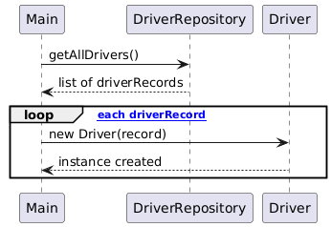
Bootstrapping Process (Initialization)
Driver Initialization

Slide 46
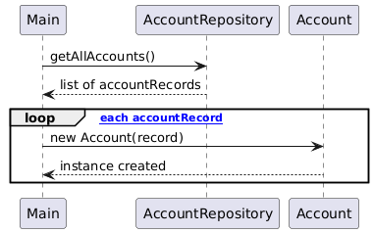
Bootstrapping Process (Initialization)
Account Initialization

Slide 47
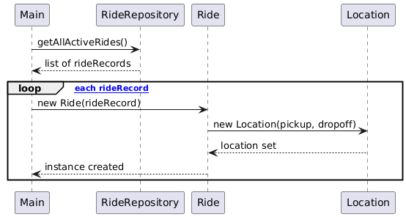
Bootstrapping Process (Initialization)
Ride Initialization

Slide 48
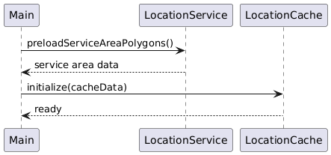
Bootstrapping Process (Initialization)
Location Initialization

Slide 49
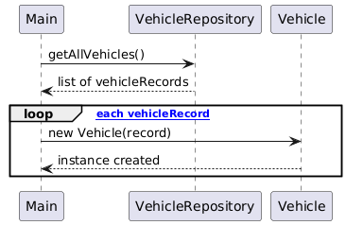
Bootstrapping Process (Initialization)
Vehicle Initialization

Slide 50
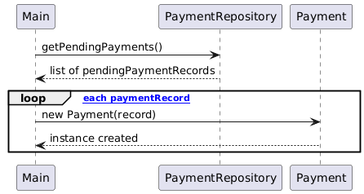
Bootstrapping Process (Initialization)
Payment Initialization

Slide 51
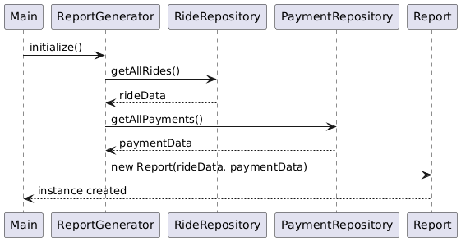
Bootstrapping Process (Initialization)
Report Initialization

Slide 52
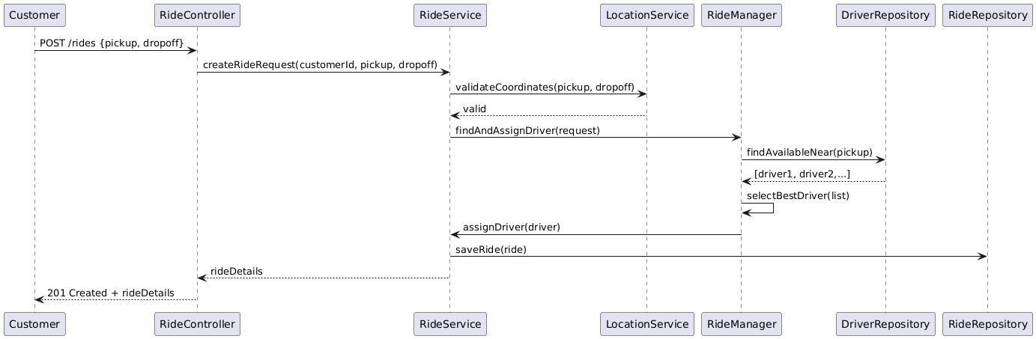
Four typical, non-trivial interaction patterns/scenarios
Ride Booking and Driver Assignment
Ensures customer input (location) is valid, driver availability is checked, and assignment happens automatically and reliably.

Slide 53
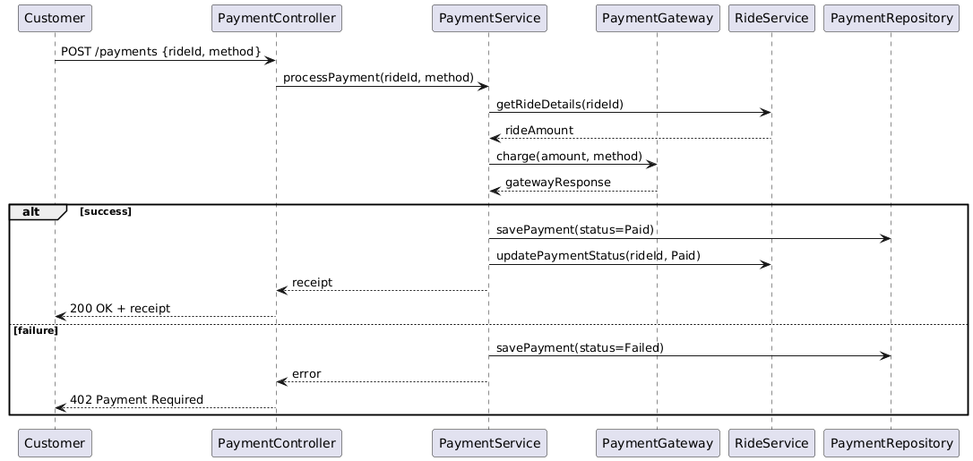
Four typical, non-trivial interaction patterns/scenarios
Payment Processing After Ride Completion
Validates payment details, ensures secure processing, and updates ride status based on payment outcome.

Slide 54
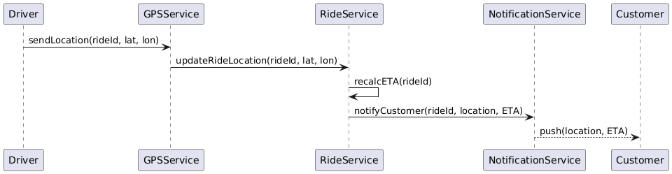
Four typical, non-trivial interaction patterns/scenarios
Driver Location Update and Real-time Tracking
Enables live driver tracking, keeps ETA accurate, and improves customer confidence during the waiting period.

Slide 55
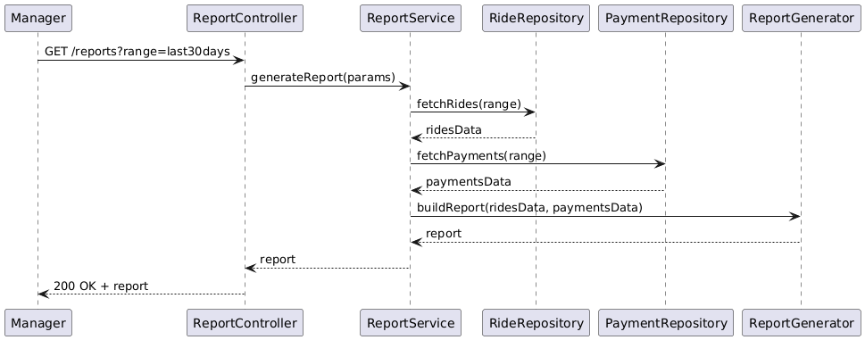
Four typical, non-trivial interaction patterns/scenarios
Manager Generating Operational Reports
Ensures data integrity across modules, supports operational decision-making, and validates report generation processes.

Slide 56
Thank You For Listening

