Slide 1
SmartRide
523K0013 - Dương Thành Long
523K0010 - Phạm Lê Anh Khôi

Slide 2
Introduction
- SmartRide is a transportation service company operating in a busy metropolitan city. The company connects customers with available drivers for a fee, using cars and motorbikes. Currently, SmartRide’s operations are managed manually, leading to inefficiencies such as long wait times, lost ride opportunities, and slow payment handling. To address these challenges and to prepare for future growth, SmartRide has commissioned the development of a new Online Ride-Sharing Platform (ORSP).
- SESoft Consulting has been tasked with designing and developing the ORSP to automate and enhance SmartRide’s operations, focusing on improving ride booking, driver assignment, real-time tracking, and online payments. This system is expected to deliver a faster, more reliable, and user-friendly experience for both customers and drivers, while also providing managerial insights to support business decision-making.
.

Slide 3
Goals
Enable customers to create accounts, book rides, and pay online.
Enable drivers to create profiles, accept ride requests, and navigate to customers.
Provide real-time GPS tracking and ETA updates to customers.
Automate payment handling, receipts, and confirmations.
Allow managers to access reports on rides, revenue, and demand trends.
Ensure system security, reliability, and scalability for future growth.

Slide 4
Project Objectives
The primary objectives of the ORSP project are:
Automate ride-booking by allowing customers to easily request rides through a digital platform.
Reduce customer wait times by efficiently matching available drivers to ride requests in real time.
Introduce secure online payment processing to replace manual cash handling.
Provide real-time tracking for customers to monitor driver location and estimated arrival times.
Enable account management for customers and drivers through user profiles.
Generate operational reports to help SmartRide’s management monitor service performance and demand trends.
Initially, the system will focus on the core functionality, with the flexibility to add new features such as ride-sharing options, loyalty programs, and promotional offers in the future.

Slide 5
Pain Points
SmartRide’s current manual operations present several critical challenges that negatively impact customer satisfaction, driver efficiency, and overall business growth:
Long Wait Times: Customers often experience significant delays in securing a ride, especially during peak hours, due to the lack of an automated driver assignment process.
Missed Ride Opportunities: Without an efficient system to match customers with available drivers, many potential rides are lost, leading to lost revenue and frustrated customers.
Manual Payment Processing: Payments are currently handled manually between drivers and customers, which is time-consuming, error-prone, and inconvenient for both parties.
Driver Assignment Inefficiencies: During periods of high demand, there is no organized method for quickly identifying and assigning nearby available drivers to customers.
Limited Visibility for Customers: Customers have no way to track where their driver is or receive accurate arrival time estimates, leading to uncertainty and dissatisfaction.
High Administrative Overhead: Manual ride tracking, payment recording, and business reporting require significant administrative effort, slowing down operations and decision-making.
Scalability Limitations: The current manual approach is not scalable. As customer demand grows, the company struggles to handle increased ride requests without compromising service quality.

Slide 6
Functional Requirements at Goal Level
The Online Ride-Sharing Platform (ORSP) for SmartRide must support the following core goals:
Enable Customer Account Management: Customers must be able to create, update, and manage their user accounts, including personal details, payment information, and ride history.
Enable Driver Account Management: Drivers must be able to register, update, and manage their profiles, vehicle information, and availability status.
Support Ride Booking: Customers must be able to input pickup and drop-off locations and submit ride requests through the platform.
Automate Driver Assignment: The system must automatically locate available drivers based on proximity, availability, and estimated arrival times, and assign them to incoming ride requests.
Provide Real-time Tracking: Both customers and drivers must have access to live GPS tracking to monitor driver location, route progress, and estimated arrival times.
Enable Secure Online Payments: Customers must be able to securely complete ride payments through an integrated online payment gateway, with digital receipts generated upon successful transactions.
Generate Operational Reports: Managers must be able to access system-generated reports summarizing ride volumes, driver activity, peak usage periods, and other relevant operational metrics.
Support Notifications and Updates: The system must send real-time updates to customers and drivers about ride status changes, estimated arrival times, and payment confirmations.
Ensure Ride History Management: Customers and drivers must be able to view their respective ride histories, including trip details, payment records, and ratings.
Facilitate System Scalability and Maintenance: The system must be designed to easily accommodate future expansions, such as adding new cities, new vehicle types, or new customer loyalty programs.

Slide 7
Non-Functional Requirements
The Online Ride-Sharing Platform (ORSP) must meet the following key quality attributes to ensure a reliable, scalable, and user-friendly system:
Performance and Scalability The system must handle high volumes of concurrent users, especially during peak hours, without significant performance degradation. It must be scalable to support future expansion to additional cities and increased numbers of customers and drivers.
Reliability and Availability The platform must maintain a minimum uptime of 99.9% to ensure customers and drivers can access the service at all times. System recovery mechanisms must be in place to handle unexpected failures with minimal service interruption.
Security The system must protect user data through encryption and secure authentication methods. Integration with third-party payment gateways must comply with industry standards for financial data protection (e.g., PCI DSS compliance).
Usability The platform must provide a clean, intuitive user interface that is easy to navigate for customers, drivers, and managers. Key tasks (such as booking a ride, accepting a ride, or making a payment) must be easily completed with minimal steps and training.
Maintainability The system must be designed with a modular architecture to allow easy updates, bug fixes, and the addition of new features without significant system downtime.
Interoperability The ORSP must integrate seamlessly with external systems such as GPS navigation services and third-party payment gateways without requiring manual intervention.
Responsiveness Real-time features such as ride tracking, driver assignment, and notification delivery must occur with minimal latency to enhance the user experience.

Slide 8
Actors of the Project
Customer: An individual who uses the platform to book rides, track driver locations, make payments, and manage their ride history and personal profile.
Driver: A registered individual who uses the platform to receive ride requests, accept bookings, navigate to pickup and drop-off locations, and manage their availability and profile.
Manager: A SmartRide administrative user who oversees system operations, reviews reporting and analytics, manages customer or driver accounts when necessary, and monitors service performance trends.
Payment Gateway Provider (External Actor): A third-party service responsible for securely processing customer payments. SmartRide will integrate with an external gateway to manage financial transactions without directly handling sensitive payment data.
GPS Navigation Service (External Actor): A third-party service used to provide real-time location tracking, route optimization, and estimated arrival times for both customers and drivers.

Slide 9
Identified Classes
Customer
Diver
Ride
Vehicle
Payment
Manager
Location
Account

Slide 10
Class Responsibility Collaborator
Customer
Description: A platform user who books rides, tracks their status, and makes payments.
Responsibilities:
Book ride → Collaborator: Ride
Make payment → Collaborator: Payment
View ride status → Collaborator: Ride
Manage profile → Collaborator: Account
Driver
Description: A registered service provider who accepts ride requests and transports customers.
Responsibilities:
Accept ride requests → Collaborator: Ride
Update ride status → Collaborator: Ride
Manage availability → Collaborator: Account
View payment history → Collaborator: Payment
Manage vehicle information → Collaborator: Vehicle

Slide 11
Class Responsibility Collaborator
Ride
Description: Represents a single transportation service from pickup to drop-off.
Responsibilities:
Link customer with driver → Collaborators: Customer, Driver
Track ride progress → Collaborator: Location
Update ride status (requested, accepted, ongoing, completed) → Collaborator: Driver
Generate ride history → Collaborators: Customer, Driver
Payment
Description: Handles processing and recording of customer payments for rides.
Responsibilities:
Process ride payment → Collaborators: Customer, Ride
Generate digital receipt → Collaborator: Customer
Store payment history → Collaborator: Account

Slide 12
Class Responsibility Collaborator
Manager
Description: An administrative user who monitors system operations and accesses business analytics.
Responsibilities:
Access ride and payment reports → Collaborator: Report
Manage user accounts → Collaborator: Account
Monitor driver and customer activity → Collaborators: Driver, Customer
Account
Description: Stores login credentials and user profile data for all users.
Responsibilities:
Store user credentials → Collaborators: Customer, Driver, Manager
Allow profile updates → Collaborators: Customer, Driver
Manage security (authentication/authorization) → Internal logic or Auth module

Slide 13
Class Responsibility Collaborator
Vehicle (Data Holder)
Description: Stores static information about a driver’s registered vehicle.
Responsibilities:
Hold vehicle details (model, license plate, type) → Collaborator: Driver
Location (Data Holder)
Description: Stores geolocation data used for pickup, drop-off, and real-time tracking.
Responsibilities:
Record pickup/drop-off locations → Collaborators: Customer, Ride
Update real-time position during trip → Collaborator: Ride

Slide 14
Class Responsibility Collaborator
Report (Data Holder)
Description: Contains summarized data for administrative review and analytics.
Responsibilities:
Store ride and payment summaries → Collaborators: Ride, Payment
Present operational metrics to managers → Collaborator: Manager

Slide 15
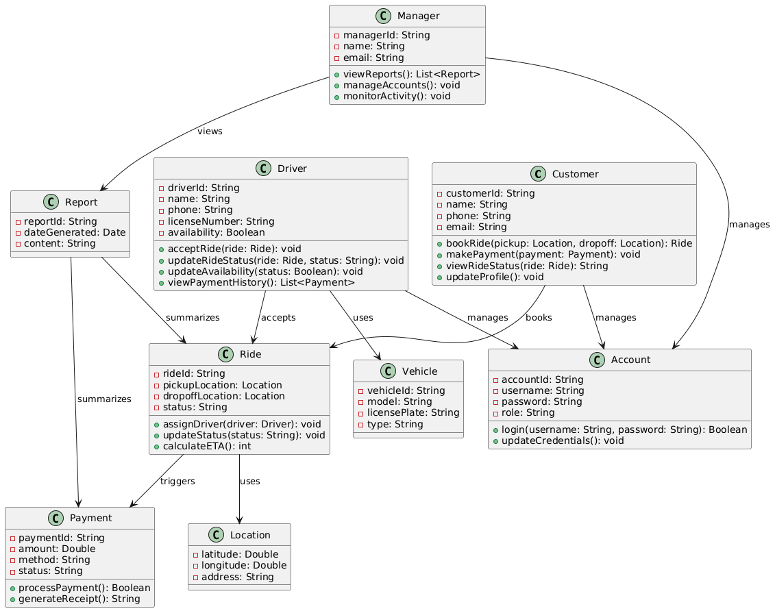
UML Class Diagram

Slide 16
Design Patterns: Singleton Pattern
Used in: Manager, Report
We apply the Singleton pattern to the Manager and Report classes (or their controller/service counterparts) to ensure there is only one instance managing administrative operations and generating system-wide reports at any given time. This guarantees consistency across reports and prevents conflicts when multiple managers are accessing administrative data.
Justification:
Ensures centralized control over system-wide data
Prevents duplicate report generation
Simplifies coordination of admin tasks

Slide 17
Design Patterns: Factory Pattern
Used in: Ride, Payment creation
The Factory pattern is used to encapsulate the creation of Ride and Payment objects. For example, a RideFactory an handle the creation of ride instances depending on the vehicle type (car, motorbike), and a PaymentFactory can handle the creation of payments depending on the payment method (credit card, wallet, etc.).
Justification:
Encapsulates object creation logic
Supports future extension (e.g., adding new vehicle types or payment methods)
Simplifies client-side code

Slide 18
Design Patterns: Observer Pattern
Used in: Ride, Customer, Driver updates
The Observer pattern is applied to Ride so that Customer and Driver can subscribe to ride status updates (e.g., when the driver is nearby, when the ride starts, when it finishes). This ensures that both users get real-time notifications without tight coupling between objects.
Justification:
Enables real-time status updates
Reduces coupling between Ride and its observers
Improves user experience with live notifications

Slide 19
Design Patterns: Strategy Pattern
Used in: Payment processing
The Payment class uses the Strategy pattern to switch between different payment methods (e.g., credit card, PayPal, wallet) at runtime. Each payment method implements a common interface, making it easy to add or change payment options without touching the core payment processing logic.
Justification:
Supports multiple, interchangeable payment strategies
Improves flexibility and testability of payment workflows
Makes the system easily extendable for future payment methods

Slide 20
Design Heuristics Applied
Separation of Concerns: Each class has a clear and focused responsibility (e.g., Ride handles trip management, Payment handles financial transactions).
Low Coupling, High Cohesion: Interactions between classes are minimal and well-defined; each class’s internal logic is cohesive.
Don’t Repeat Yourself (DRY): Shared logic like authentication is placed in the Account class or related services to avoid duplication.
Encapsulation: Attributes are kept private, and access is provided through public methods to protect the system’s internal state.

Slide 21
Bootstrapping Process (Initialization)
Introduction
The bootstrapping process initializes key components in a specific order to ensure proper system functionality.
Key Components:
Customer: Initiates ride bookings and interacts with the system
Driver: Accepts ride requests and updates ride status
Ride: Manages ride details, assignments, and status tracking
Vehicle: Represents driver vehicles and their availability
Location: Stores pickup and drop-off information
Payment: Handles online transactions and receipts
Account: Manages authentication and profile information
Manager: Oversees system operations and accesses reports
Report: Generates summaries of rides, payments, and trends

Slide 22
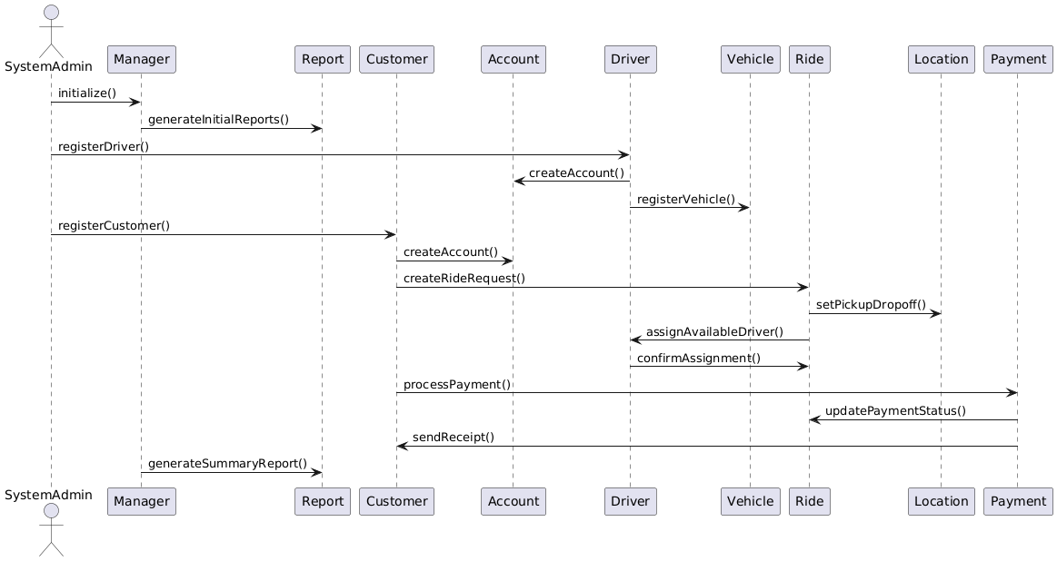
Bootstrapping Process (Initialization)

Slide 23
Bootstrapping Process (Initialization)
Component Initialization:
Customer Initialization:
System starts by creating the Customer instance
Customer can initiate ride booking and manage their profile
Driver Initialization:
System creates Driver instance after registration
Driver registers vehicle and becomes available for ride assignments
Ride Initialization:
Customer creates Ride instance
Ride sets Location with pickup and drop-off points
Ride checks for available Driver and assigns one
Vehicle Initialization:
System registers Vehicle during driver onboarding
Vehicle is linked to Driver and marked available or unavailable

Slide 24
Bootstrapping Process (Initialization)
Component Initialization:
Location Initialization:
System captures Location data during ride request
Location provides routing and estimated time of arrival (ETA)
Payment Initialization:
System creates Payment instance after ride completion
Payment processes online transaction and updates ride payment status
Account Initialization:
System creates Account for Customer and Driver during registration
Account manages login credentials and user roles
Report Initialization:
System creates Report instance on manager request
Report aggregates ride, payment, and performance data

Slide 25
Bootstrapping Process (Initialization)
Explanation
The Customer and Driver components initialize first to enable ride requests and driver availability. The Ride system activates next to handle booking management, including driver assignment and location tracking. The Vehicle component links to drivers to manage vehicle details and status. The Location system manages pickup and drop-off points and calculates estimated arrival times. The Payment system prepares for secure online transactions after the ride is completed. The Account system ensures proper user authentication and role management for both customers and drivers. The Report system activates on demand to provide managers with business insights and performance data. Each component maintains independence while ensuring necessary collaboration to deliver a seamless ride-sharing experience.

Slide 26
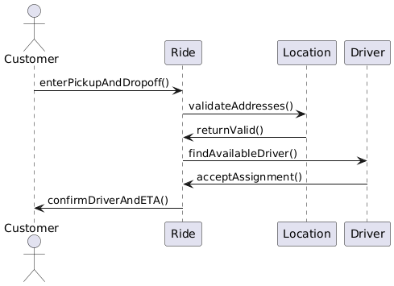
Four typical, non-trivial interaction patterns/scenarios
Ride Booking and Driver Assignment
Ensures customer input (location) is valid, driver availability is checked, and assignment happens automatically and reliably.

Slide 27
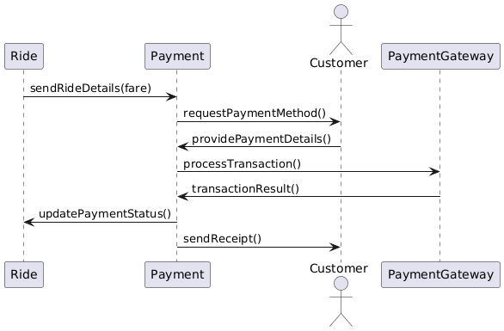
Four typical, non-trivial interaction patterns/scenarios
Payment Processing After Ride Completion
Validates payment details, ensures secure processing, and updates ride status based on payment outcome.

Slide 28
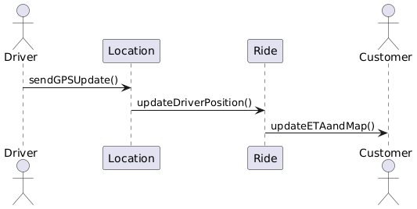
Four typical, non-trivial interaction patterns/scenarios
Driver Location Update and Real-time Tracking
Enables live driver tracking, keeps ETA accurate, and improves customer confidence during the waiting period.

Slide 29
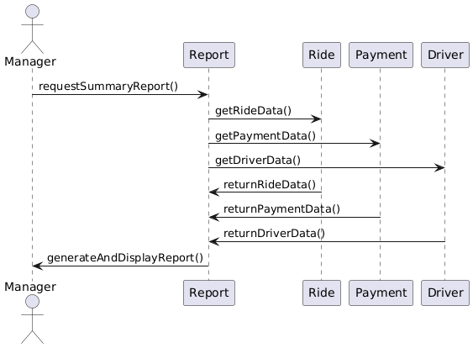
Four typical, non-trivial interaction patterns/scenarios
Manager Generating Operational Reports
Ensures data integrity across modules, supports operational decision-making, and validates report generation processes.

Slide 30

Thank You For Watching

