Slide 1
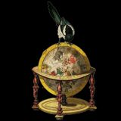
Pasteurization
A tipsy tour through history & Saving Humanity
Eric White

Slide 2
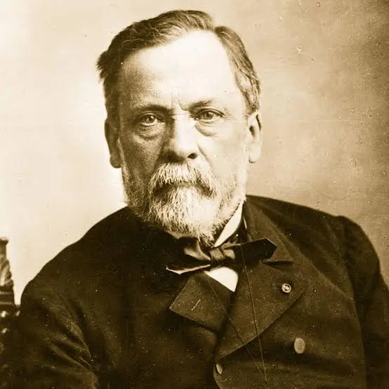
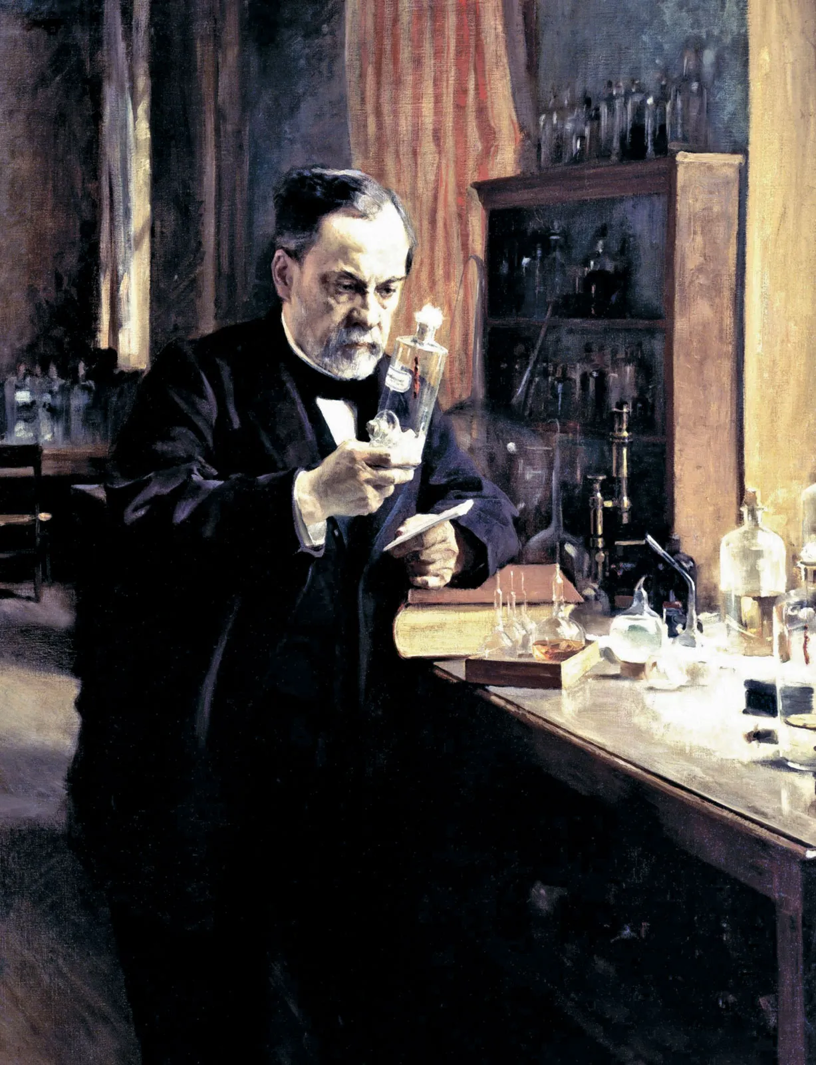
Louis Pasteur
“I just wanted to save the wine industry” —Pasteur (probably)
Notes:
Here's to the unsung hero who made it possible to enjoy a glass of wine without playing bacterial roulette with your intestines. Ladies and gentlemen, grab your glasses and raise them high to Louis Pasteur—the man who looked at France's spoiling wine problem and said, "Hold my petri dish."
“Wine is the most healthful and most hygienic of beverages.”
― Louis Pasteur 1876
Before him? Every sip was basically a dare. After him? You could actually trust that bottle you bought wouldn't turn into vinegar before Tuesday.

Slide 3

France's Boozy Crisis: The 1800s Edition
Back in the 1800s, France has a real problem: wine and beer are spoiling, exports are getting wrecked, reputations are getting wrecked, and everybody’s losing money
Notes:
Back in the 1800s, France has a real problem: wine and beer are spoiling, exports are getting wrecked, reputations are getting wrecked, and everybody’s losing money. This story starts with wine and beer—milk becomes the superstar later when people realize, ‘Oh wait… this same trick could make everything safer
🍷 Wine Woes
Wine spoiled faster than a frat party keg left in the sun. French winemakers were losing their minds—and their money.

Slide 4
“dans les champs de l'observation, le hasard ne favorise que les esprits préparés”
(“In the field of observation, chance favors only the prepared mind”)
Louis Pasteur, 1854
Notes:
Pasteur uttered his oft-quoted remark: "dans les champs de l'observation, le hasard ne favorise que les esprits préparés" ("In the field of observation, chance favors only the prepared mind").

Slide 5
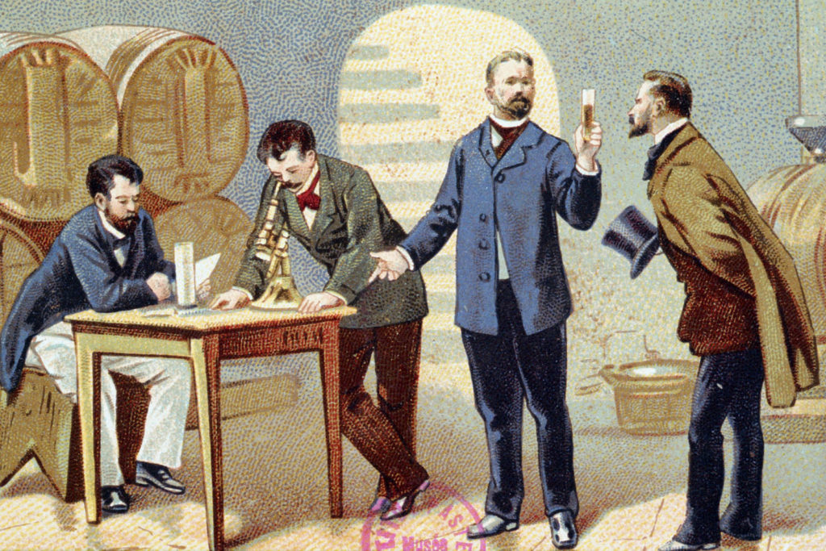
Louis Pasteur: Science Nerd
Notes:
Previously … Jöns Jacob Berzelius and Justus von Liebig had proposed the theory that fermentation was caused by decomposition.
Pasteur demonstrated that this theory was incorrect, and that yeast was responsible for fermentation to produce alcohol from sugar. He also demonstrated that, when a different microorganism contaminated the wine, lactic acid was produced, making the wine sour.
===
Pasteur was initially motivated to investigate fermentation a decade earlier while working at Lille. In 1856 a local wine manufacturer, M. Bigot, whose son was one of Pasteur's students, sought for his advice on the problems of making beetroot alcohol and souring.
===
Pasteur began his research in the topic by repeating and confirming works of Theodor Schwann, who demonstrated a decade earlier that yeast were alive.
According to his son-in-law, René Vallery-Radot, in August 1857 Pasteur sent a paper about lactic acid fermentation to the Société des Sciences de Lille..
A memoire was subsequently published on 30 November 1857, he developed his ideas stating that: "I intend to establish that, just as there is an alcoholic ferment, the yeast of beer, which is found everywhere that sugar is fermented into alcohol and carbonic acid, so also there is a particular ferment, a lactic yeast, always present when sugar becomes lactic acid."
This memoir on alcoholic fermentation was published in full form in 1858.
Additionally,
In 1861, Pasteur observed that less sugar fermented per part of yeast when the yeast was exposed to air.
The lower rate of fermentation aerobically became known as the Pasteur effect. (aerobic vs anaerobic)
In 1866, Pasteur published Études sur le Vin, about the diseases of wine, and he published Études sur la Bière in 1876, concerning the diseases of beer

Slide 6
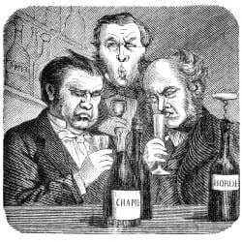
France's Boozy Crisis: The 1800s Edition
Emperor Napoleon III called upon Louis Pasteur in 1863 to investigate why French wines were spoiling and turning to vinegar.
Notes:
Louis Pasteur was commissioned to study wine by Emperor Napoleon III in 1863.
===
The emperor's commission was prompted by a crisis in the French wine industry, where "diseases" (unwanted bacterial fermentations) were causing wine to sour or turn to vinegar, this threatenied France's flagship export and trade agreements with England. An 1860 trade deal with Britain increased export volume, but much of the wine arrived spoiled, endangering the treaty and France's commercial standing.
===
The commission was suggested to the Emperor by his aide-de-camp, Ildephonse Favé, later known for his book Nos Revers about why France lost the Franco-Prussian War in 1870-71.
===

Slide 7
Germ Theory: The Plot Twist That Changed Everything
Old Theory
Bad smells cause disease. Miasma theory. Cute, wrong, but cute.
Pasteur's Bombshell
"Nah fam, it's invisible microbes causing all your problems."
Mind = Blown
Revolutionary. Disgusting. Effective. Welcome to modern microbiology.
Notes:
Imagine telling people in the 1860s that tiny invisible creatures they couldn't see were making them sick. They thought he was nuts. Turns out, he was just several decades ahead of everyone else—and also maybe a little nuts, but in a productive way.
=== What is going on ===
Acetic Acid Bacteria (AAB), especially genera like Acetobacter, which convert ethanol into acetic acid (vinegar), and Lactic Acid Bacteria (LAB), leading to sour, vinegary flavors and aromas. Pasteur identified these unwanted bacteria, differentiating them from beneficial yeast, by showing they caused the "disease" of souring and that gentle heating (pasteurization) could kill them, preserving the wine's flavor

Slide 8
The "Bright" Idea: Just Add Heat
Heat it up
Kill the microbes
Cool it down
Profit (literally)
The process was elegantly simple: controlled heat for controlled death. It was basically a spa day for beverages—if spa days involved targeted microbial genocide.
Notes:
Why Pasteurize?
Stabilizes wine: Stops unwanted microbial activity, making it shelf-stable.
Prevents spoilage: Eliminates bacteria and yeasts that cause sourness or unwanted bubbles.
Protects against oxidation: Reduces risks of microbial spoilage and oxidation
People heated stuff before. Pasteur’s real win was explaining what was happening: spoilage wasn’t mysterious bad vibes—it was microorganisms causing specific changes. Once you have that cause-and-effect, industry can standardize it: time + temperature = consistent results

Slide 9
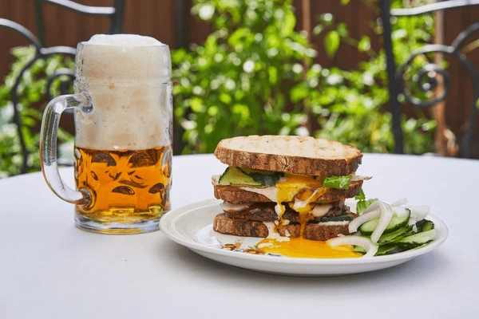

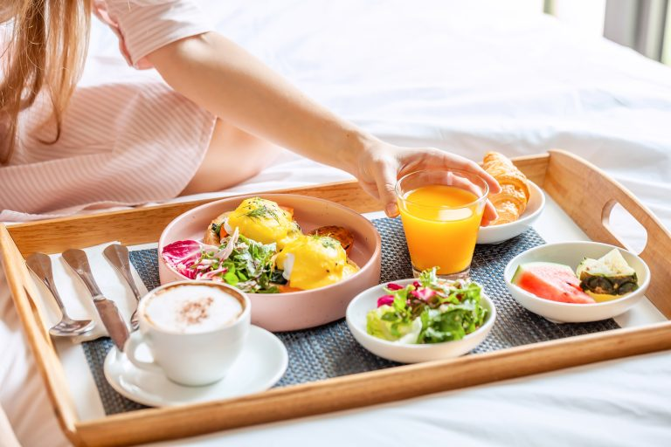
Microbes Defeated, Brunch Officially Safe
Notes:
Anywhere from secs to minutes
Pasteurizing wine uses heat to kill spoilage microbes (yeasts, bacteria) and stabilize the drink, preventing re-fermentation and off-flavors, typically by heating the liquid or bottled wine in a hot water bath (like 140-165°F/60-74°C) for short periods (seconds to minutes) before rapidly cooling to preserve flavor, though it can slightly soften the profile compared to unheated wine. Common methods involve sous-vide for bottles or immersion circulators in a water bath, ensuring the wine reaches the target temperature for the correct duration.
Beer pasteurization temperatures vary by method, with flash pasteurization hitting around 160-162°F (71-72°C) for just 15-30 seconds
Milk pasteurization uses different temperatures and times, most commonly High-Temperature Short-Time (HTST) at 161°F (72°C) for 15 seconds, or the Low-Temperature Long-Time (LTLT) method at 145°F (63°C) for 30 minutes, both effectively killing harmful bacteria while preserving flavor and nutrients for safe

Slide 10
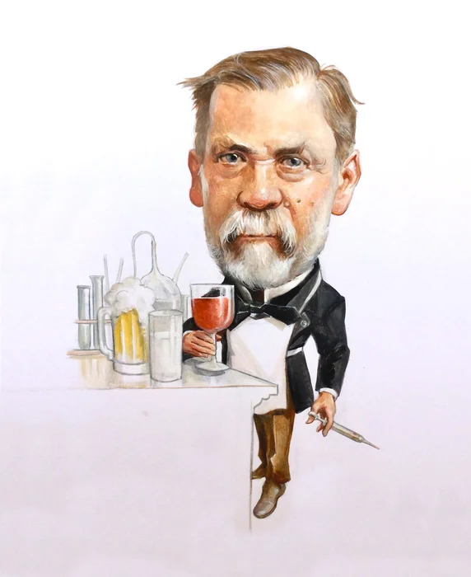
More on Pasteurization
Wine: 1863 / 140-165°F/60-74°C
Beer: 1870s / 160-162°F/71-72°C
Milk: 1880s / 161°F/72°C
…
Heated to these temps for just a short time
Notes:
Anywhere from secs to minutes
In 1866, Pasteur published Études sur le Vin, about the diseases of wine, and he published Études sur la Bière in 1876, concerning the diseases of beer
Pasteurizing wine uses heat to kill spoilage microbes (yeasts, bacteria) and stabilize the drink, preventing re-fermentation and off-flavors, typically by heating the liquid or bottled wine in a hot water bath (like 140-165°F/60-74°C) for short periods (seconds to minutes) before rapidly cooling to preserve flavor, though it can slightly soften the profile compared to unheated wine. Common methods involve sous-vide for bottles or immersion circulators in a water bath, ensuring the wine reaches the target temperature for the correct duration.
Beer pasteurization temperatures vary by method, with flash pasteurization hitting around 160-162°F (71-72°C) for just 15-30 seconds
Milk pasteurization uses different temperatures and times, most commonly High-Temperature Short-Time (HTST) at 161°F (72°C) for 15 seconds, or the Low-Temperature Long-Time (LTLT) method at 145°F (63°C) for 30 minutes, both effectively killing harmful bacteria while preserving flavor and nutrients for safe

Slide 11
Microbes Defeated, Brunch Officially Safe
What Happened Next …
90%
10X
100%
Drop in Foodborne Illness
Trade Explosion
Brunch Success Rate
Notes:
Instead of throwing you ‘bar-certified statistics,’ here’s the real takeaway: public health agencies treat pasteurization as one of the biggest safety moves in food history—especially for milk. Raw milk still shows up in outbreaks because pasteurization is doing the unglamorous work of keeping you from meeting the porcelain gods.
90% - Drop in Foodborne Illness - Deaths from contaminated milk and beverages plummeted after widespread pasteurization adoption.
10X - Trade Explosion - Global food trade increased dramatically when products could survive long journeys without spoiling.
100% - Brunch Success Rate - Cereal + milk became a viable breakfast option. The morning routine was forever changed.

Slide 12
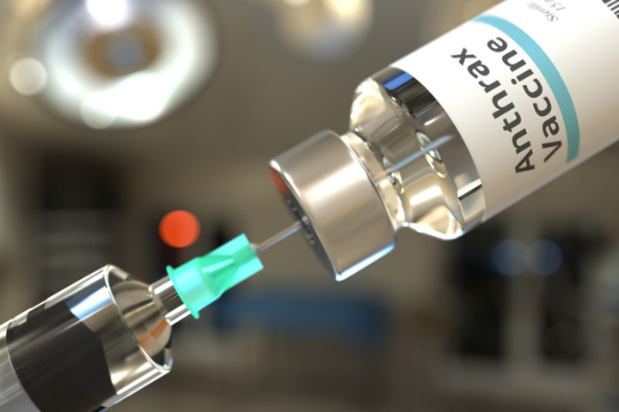
More Pasteur: He who invented vaccines
1879 - Chicken Cholera Vaccine (accidental)
1881 - Successful Demonstration of Anthrax vaccine
1885 - Successful Demonstration of Rabies vaccine
Notes:
Okay, the classic tale: he goes on vacation, comes back, uses an old weakened culture, chickens don’t die, boom—immunity. It’s the ‘science by procrastination’ fairy tale.”
Then the patched truth beat:
But historians argue that the ‘vacation miracle’ story got polished over time—Pasteur’s vaccine work was real, but some of the storytelling is… let’s say ‘optimized for marketing’
As documented later by Pasteur in his notebook in March 1880, in October 1879, being delayed in returning to the laboratory due to his daughter’s wedding and ill health, he instructed Roux to start a new chicken cholera culture using bacteria from a culture that had sat since July.
The two chickens inoculated with this new culture showed some symptoms of infection, but instead of the infections being fatal, as they usually were, the chickens recovered completely.
Louis Pasteur developed the first successful anthrax vaccine in 1881, using an attenuated (weakened) form of the bacteria, famously demonstrated in a public experiment where vaccinated sheep survived a lethal anthrax challenge while unvaccinated ones died, proving the concept of vaccination and leading to its widespread use in livestock, though later research suggests competitor Toussaint may have first created a similar vaccine. Pasteur's method involved cultivating Bacillus anthracis at a higher temperature (43°C) or with oxygen, reducing its virulence, a significant step in immunology
Louis Pasteur developed the first rabies vaccine, a groundbreaking achievement in 1885 when he successfully treated young Joseph Meister, bitten by a rabid dog, using a weakened form of the virus derived from dried, infected rabbit spinal cords. This marked the beginning of modern immunization, as Pasteur's method involved attenuating the virus by passing it through rabbits and drying their nervous tissue, creating a less potent but still protective vaccine. The treatment, though risky, proved life-saving and established a new approach to preventing infectious diseases
First Human Trial: In July 1885, he administered the vaccine to 9-year-old Joseph Meister, who was severely bitten, saving the boy's life and proving the vaccine's efficacy.

Slide 13

Louis Pasteur: Hero or PR King?
😇 The Angel of Science
Saved countless lives through pasteurization
Revolutionized medicine with germ theory
Advanced vaccination research
Protected global food supplies
Made brunch mathematically safer
Notes:
Here’s where it gets fun: Pasteur the scientist… and Pasteur the legend. He was brilliant, but also very aware of reputation, credit, and legacy. The historical record paints a guy who could be intense with rivals and very eager to control the story.
He’s also described as ruthless with rivals

Slide 14

Louis Pasteur: Hero or PR King?
😈 The Fame-Chasing Diva
Ruthlessly competitive with scientific rivals
Fought competitors like science was WWE
Obsessed with his own legacy
Not exactly humble about his achievements
Notes:
Here’s where it gets fun: Pasteur the scientist… and Pasteur the legend. He was brilliant, but also very aware of reputation, credit, and legacy. The historical record paints a guy who could be intense with rivals and very eager to control the story.
He’s also described as ruthless with rivals
Key examples include:
Searching
Louis Pasteur was a fiercely competitive and often authoritarian figure whose desire for scientific dominance led to public feuds, the suppression of colleagues' work, and occasional deception.
Examples of his ruthless behavior include:
The Anthrax Vaccine Deception: In 1881, Pasteur publicly triumphed in a trial at Pouilly-le-Fort by vaccinating sheep against anthrax. He claimed the vaccine was made using his "oxygen attenuation" method. However, his private notebooks later revealed he secretly used a chemical inactivation method developed by his rival, Jean-Joseph Henri Toussaint, whom he had previously publicly attacked. Toussaint later suffered a nervous breakdown and died.
Bitter Rivalry with Robert Koch: Pasteur engaged in a lifelong, hostile competition with German scientist Robert Koch. This was fueled by both scientific disagreement and intense nationalism following the Franco-Prussian War. Pasteur frequently dismissed Koch's work in public, sometimes relegating major German discoveries to mere footnotes while calling them "remarkable" only when it served his own narrative.
Treatment of Assistants: Pasteur was known as an authoritarian leader who treated even his most talented assistants as mere "toilers in the Pastorian vineyard". He had a series of bitter conflicts with his close collaborator, Emile Roux, specifically over the ethics of testing the rabies vaccine on humans before it was fully proven in animals.
Hostility Toward Dissenters: When Dr. Victor Feltz observed bacteria in patients with puerperal fever, Pasteur denied the observation. To "prove" Feltz wrong, Pasteur injected guinea pigs with the patient's blood and others with anthrax, then sent the dying animals to Feltz to force him to concede his diagnosis was incorrect.
Authoritarian Rule at École Normale: As director of scientific studies, Pasteur was so rigid that he provoked two serious student revolts. During the "bean revolt," he forced students to eat a mutton stew they had rejected, and on another occasion, he threatened to expel anyone caught smoking, leading to the resignation of 73 out of 80 students.

Slide 15
Louis Pasteur
He accidentally saved the world while trying to fix France's wine problem.
Wine, Beer, Milk, Germs, Microbes, Vaccines
Notes:
Raise Your Glass to Louis Pasteur
Heating Things Up Since 1865
To the man who made drinking safer, brunch possible, and vaccines by accident. To the scientist who was brilliant, petty, revolutionary, and insufferable—sometimes all at once.
He wasn't trying to save humanity. He was trying to save wine. But in the process, he revolutionized medicine, transformed food safety, and enabled global commerce.
Not bad for a French chemist with a microscope and an attitude problem.

Slide 16

More Pasteur: That Time Vacation Created Vaccines
The Setup
Pasteur was studying chicken cholera. Important work. Serious science stuff.
The Vacation
He went on holiday. Left his cultures sitting on the bench. Oops. procrastination achieved.
Notes:
Okay, the classic tale: he goes on vacation, comes back, uses an old weakened culture, chickens don’t die, boom—immunity. It’s the ‘science by procrastination’ fairy tale.”
Then the patched truth beat:
But historians argue that the ‘vacation miracle’ story got polished over time—Pasteur’s vaccine work was real, but some of the storytelling is… let’s say ‘optimized for marketing’
As documented later by Pasteur in his notebook in March 1880, in October 1879, being delayed in returning to the laboratory due to his daughter’s wedding and ill health, he instructed Roux to start a new chicken cholera culture using bacteria from a culture that had sat since July.
The two chickens inoculated with this new culture showed some symptoms of infection, but instead of the infections being fatal, as they usually were, the chickens recovered completely.
After further incubation of the culture for an additional 8 days, Roux again inoculated the same two chickens.
As was also noted by Pasteur in his notebook in March 1880, and contrary to some accounts, this time the chickens died. Thus, although the attenuated bacteria did not provide immunity, these experiments provided important clues as to how bacteria could be artificially attenuated in the laboratory. As a result, upon Pasteur’s return to the laboratory, the focus of the research was directed at creating a vaccine through attenuation.

Slide 17
More Pasteur: Anthrax Vaccine
1881 - Successful Demonstration of Anthrax vaccine
Notes:
Louis Pasteur developed the first successful anthrax vaccine in 1881, using an attenuated (weakened) form of the bacteria, famously demonstrated in a public experiment where vaccinated sheep survived a lethal anthrax challenge while unvaccinated ones died, proving the concept of vaccination and leading to its widespread use in livestock, though later research suggests competitor Toussaint may have first created a similar vaccine. Pasteur's method involved cultivating Bacillus anthracis at a higher temperature (43°C) or with oxygen, reducing its virulence, a significant step in immunology
Background …Pasteur's laboratory found that anthrax bacillus was not easily weakened by culturing in air as it formed spores – unlike chicken cholera bacillus. In early 1881, his laboratory discovered that growing anthrax bacilli at about 42 °C made them unable to produce spores,and he described this method in a speech to the French Academy of Sciences on 28 February.
On 21 March, despite inconsistent results, he announced successful vaccination of sheep. To this news, veterinarian Hippolyte Rossignol proposed that the Société d'agriculture de Melun organize an experiment to test Pasteur's vaccine. Pasteur signed an agreement accepting the challenge on 28 April. Pasteur's assistants, Roux and Chamberland, who were assigned the task of conducting the trial, were concerned about the unreliability of the attenuated vaccine, and therefore Chamberland secretly prepared an alternative vaccine using chemical inactivation.
Without divulging their method of preparing the vaccine to anyone but Pasteur, Roux and Chamberland performed the public experiment on May at Pouilly-le-Fort.^{[12]} 58 sheep, 2 goats and 10 cattle were used, half of which were given the vaccine on 5 and 17 May; while the other half was untreated.
On 31 May, Roux and Chamberland next injected the animals with the fresh virulent culture of anthrax bacillus. The official result was observed and analyzed on 2 June in the presence of over 200 spectators, with Pasteur himself in attendance. The results were as Pasteur had bravely predicted: "I hypothesized that the six vaccinated cows would not become very ill, while the four unvaccinated cows would perish or at least become very ill."
However, all vaccinated sheep and goats survived, while unvaccinated ones had died or were dying before the viewers.

Slide 18
More Pasteur: Rabies Vaccine
1885 - Successful Demonstration of Rabies vaccine
"The child's death appeared inevitable. I decided not without acute and harrowing anxiety, as may be imagined, to apply to Joseph Meister the method which I had found consistently successful with dogs" - Louis Pasteur 1885
Notes:
Louis Pasteur developed the first rabies vaccine, a groundbreaking achievement in 1885 when he successfully treated young Joseph Meister, bitten by a rabid dog, using a weakened form of the virus derived from dried, infected rabbit spinal cords. This marked the beginning of modern immunization, as Pasteur's method involved attenuating the virus by passing it through rabbits and drying their nervous tissue, creating a less potent but still protective vaccine. The treatment, though risky, proved life-saving and established a new approach to preventing infectious diseases
First Human Trial: In July 1885, he administered the vaccine to 9-year-old Joseph Meister, who was severely bitten, saving the boy's life and proving the vaccine's efficacy.

Slide 19
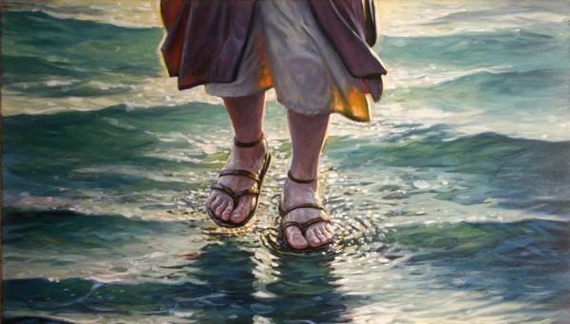
More Pasteur: That Time Vacation Created Vaccines
The Return
Came back to weakened bacteria. Injected chickens anyway because why waste good cultures?
The Miracle
The chickens didn't die. They became IMMUNE. First vaccine by procrastination achieved.
Notes:
Okay, the classic tale: he goes on vacation, comes back, uses an old weakened culture, chickens don’t die, boom—immunity. It’s the ‘science by procrastination’ fairy tale.”
Then the patched truth beat:
But historians argue that the ‘vacation miracle’ story got polished over time—Pasteur’s vaccine work was real, but some of the storytelling is… let’s say ‘optimized for marketing’
Pasteur's first work on vaccine development was on chicken cholera. He received the bacteria samples (later called Pasteurella multocida after him) from Henry Toussaint.[101] Being unable to conduct the experiments himself due to a stroke in 1868,[102] Pasteur relied heavily on his assistants Emile Roux and Charles Chamberland. The work with chicken cholera was initiated in 1877, and by the next year, Roux was able to maintain a stable culture using broths
As documented later by Pasteur in his notebook in March 1880,[104][105] in October 1879, being delayed in returning to the laboratory due to his daughter’s wedding and ill health, he instructed Roux to start a new chicken cholera culture using bacteria from a culture that had sat since July. The two chickens inoculated with this new culture showed some symptoms of infection, but instead of the infections being fatal, as they usually were, the chickens recovered completely. After further incubation of the culture for an additional 8 days, Roux again inoculated the same two chickens. As was also noted by Pasteur in his notebook in March 1880, and contrary to some accounts, this time the chickens died. Thus, although the attenuated bacteria did not provide immunity, these experiments provided important clues as to how bacteria could be artificially attenuated in the laboratory. As a result, upon Pasteur’s return to the laboratory, the focus of the research was directed at creating a vaccine through attenuation.

