Slide 1
02.526
Interactive Data Visualization
Assignment 2
Presented by: Chein Wong

Slide 2
Visualization 1

Slide 3
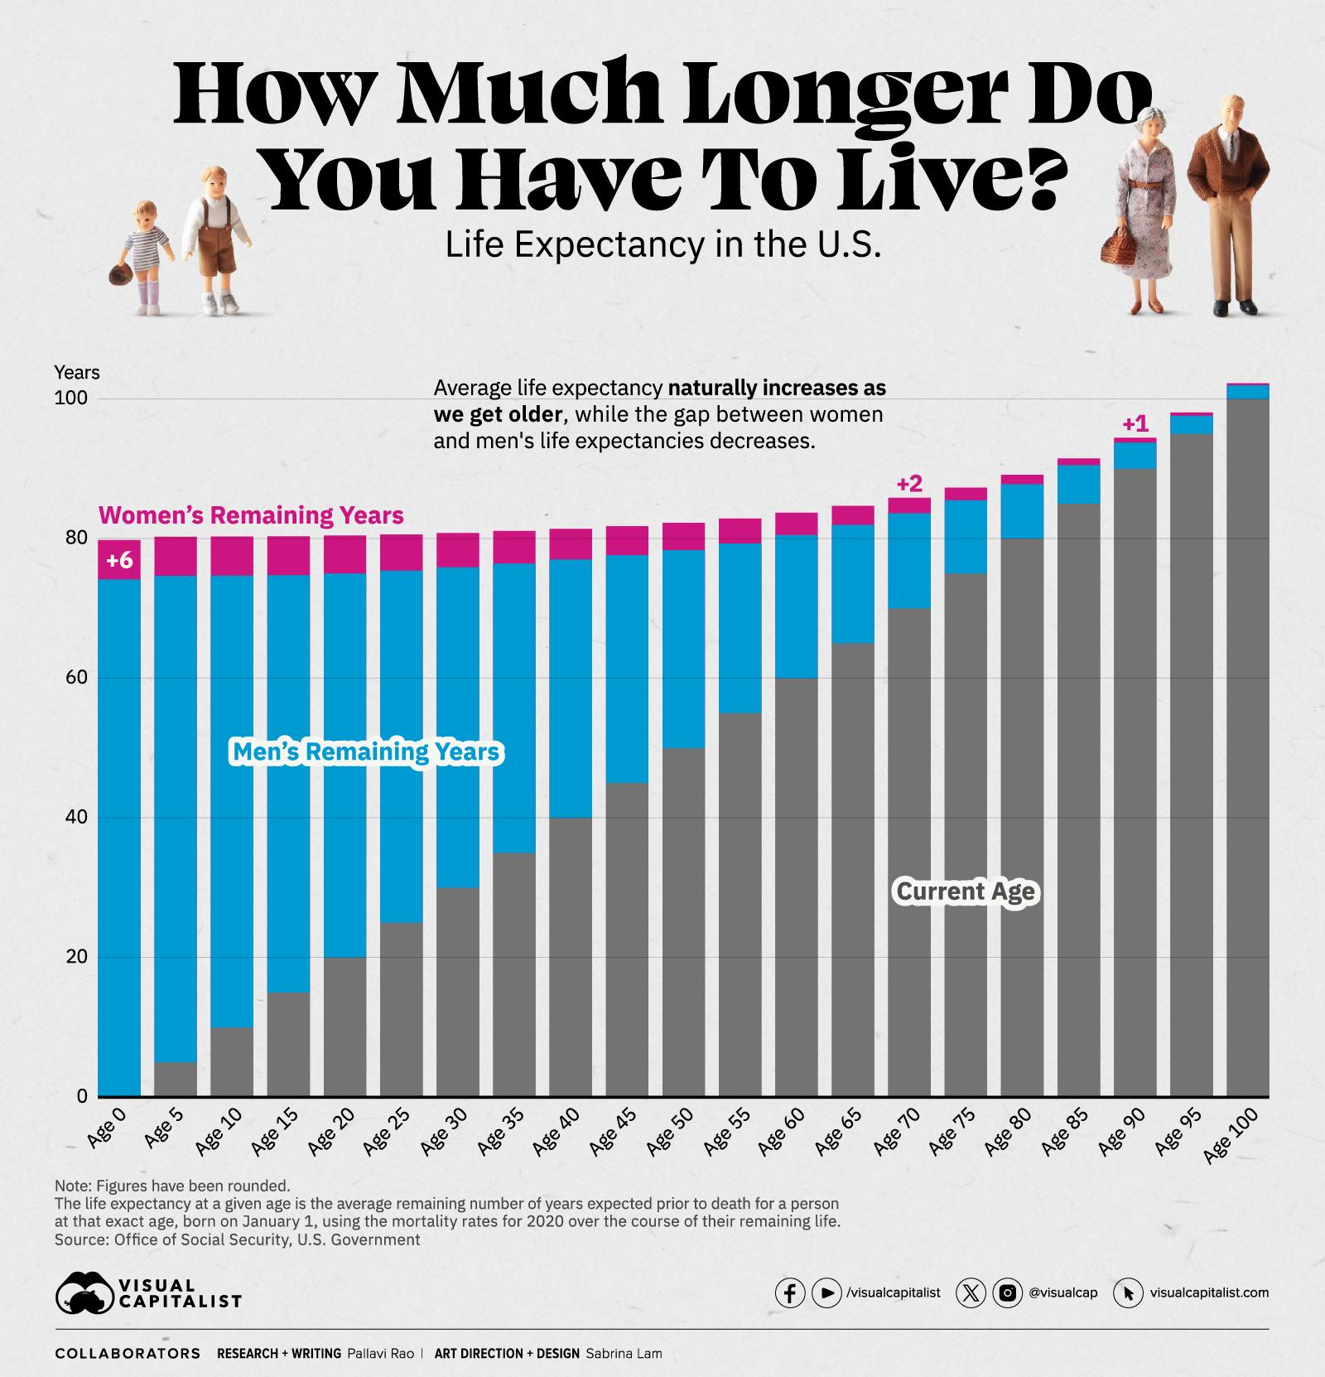
Can I have 2 volunteers to tell me how much longer do you have to live from this visualization (viz)?
Notes:
https://www.visualcapitalist.com/charted-american-life-expectancy-trends-2023/

Slide 4
Viz Interpretation and Analysis
It attempts to share the following information:
The remaining years to live according to different gender.
The average life expectancy in the US over age.
It uses 4 different channels as follow:
Magnitude Channel:
“Years” as vertical position channel.
“Age” as horizontal position channel.
“Current Age” as area channel.
Identity Channel:
”Gender’s Remaining Years” as color identity channel.
Notes:
https://www.visualcapitalist.com/charted-american-life-expectancy-trends-2023/

Slide 5
Possible Viz’s Issues
Data
Unable to highlight the core information.
Idiom
Expressiveness:
Using 2 channels to represent the same data attribute “age”.
Effectiveness:
Accuracy: Women’s remaining years is not accurately represented.
Separability: Integrating both women’s and men’s remaining years in a single bar might create some form of confusion.
Notes:
https://www.visualcapitalist.com/charted-american-life-expectancy-trends-2023/

Slide 6
Possible Improvement
Remove the information of the life expectancy in the U.S if the intent is for the users to know how much longer they can live based on their current age.
Split the chart for different gender to avoid misinterpretation on the women’s remaining years.
Remove the additional channel that represent the “current Age”.
Notes:
https://www.visualcapitalist.com/charted-american-life-expectancy-trends-2023/

Slide 7
Visualization 2

Slide 8
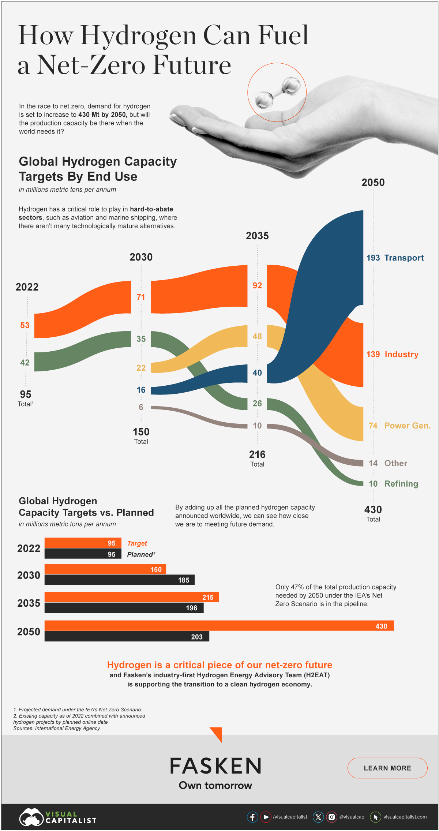
Viz Interpretation and Analysis
It attempts to share the following information:
The demand of hydrogen over years from different industries.
The planned supply vs the expected demand.
First viz uses 3 different channels as follow:
Magnitude Channel:
“Years” as horizontal position channel.
“Hydrogen Demand” as area channel.
Identity Channel:
”Industry” as color identity channel.
Second viz uses 3 different channels as follow:
Magnitude Channel:
“Years” as vertical position channel.
“Hydrogen level” as horizontal position channel.
Identity Channel:
”Target vs plan” as color identity channel.
Notes:
https://www.visualcapitalist.com/sp/how-hydrogen-could-fuel-a-net-zero-fu/

Slide 9
Possible Viz’s Issues
Data
Unable to highlight the core information.
Idiom
Effectiveness:
Accuracy: The interval in the ‘year’ channel is not equal.
Consistency:
The ‘year’ channels used in both vizs are not consistent.
Notes:
https://www.visualcapitalist.com/sp/how-hydrogen-could-fuel-a-net-zero-fu/

Slide 10
Possible Improvement
Change the title to “Can the supply of Hydrogen meet the demand by 2050?”.
Combine the 2 vizs since the additional information from the second viz is about the planned supply of the hydrogen.
Avoid using the same color to represent 2 different information in the 2 vizs.
Notes:
https://www.visualcapitalist.com/sp/how-hydrogen-could-fuel-a-net-zero-fu/

Slide 11
02.526
Interactive Data Visualization
Thank You!
Presented by: Chein Wong

