Slide 1

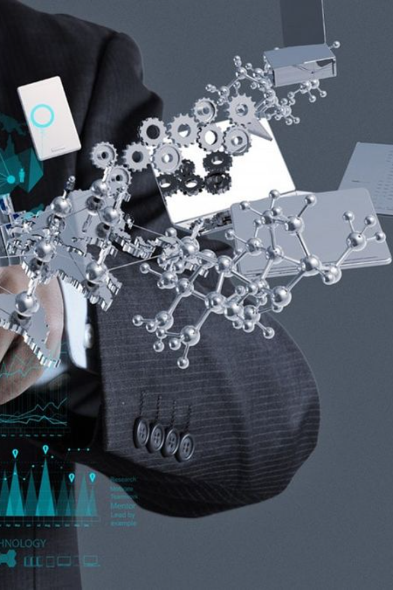
TIC: Unleashing the Power of Information and Communication Technologies
Welcome to our presentation on TIC (Information and Communication Technologies) and the incredible advancements that have shaped our digital world.

Slide 2
Introduction to TIC
Explore the origins of TIC, its definition, and the integral role it plays in modern society. Discover how information and communication technologies have revolutionized the way we live, work, and connect.

Slide 3
Importance and Impact of TIC in Society
1
Connectivity fo All 🌐
2
Transforming Industries 🚀
Discover how TIC has bridged the digital divide, providing equal access to information, education, and opportunities.
Unleash the impact of TIC across diverse sectors, including healthcare, finance, transportation, and more.
3
Fostering Innovation 🌟
4
Empowering Individuals 💪
Witness the disruptive nature of TIC, catalyzing breakthrough technologies and enabling groundbreaking ideas.
Explore how TIC empowers individuals to communicate, collaborate, and achieve their goals.

Slide 4

Evolution of TIC Technologies
1
The Birth of Computing 🖥️
Step back in time and witness the evolution of early computers and their monumental impact on TIC.
Internet & World Wide Web 🌐
2
Reveal the rise of the internet and explore how the World Wide Web transformed the way we communicate and access information.
3
Mobile Revolution 📱
Delve into the mobile era and the proliferation of smartphones, revolutionizing TIC and making the world more connected than ever.

Slide 5
Key Technologies Related to TIC
Artificial Intelligence
Internet of Things (IoT)
Blockchain Technology
Unlock the potential of AI and its applications in TIC, from chatbots to automation and data analysis.
Step into the interconnected world of IoT and explore its impact on smart homes, healthcare, and more.
Unravel the mysteries of blockchain and its transformative potential in industries like finance, supply chain, and beyond.

Slide 6
Applications and Benefits of TIC Technologies
Enhanced Communication 📞
Innovative Healthcare Solutions 🏥
Discover how TIC technologies have revolutionized communication, enabling real-time global connectivity.
Explore the intersection of TIC and healthcare, from telemedicine to wearable devices and personalized treatments.
Efficient Workflows ✨
Sustainable Development ♻️
Unleash the power of TIC in optimizing business processes, reducing costs, and increasing productivity.
See how TIC technologies contribute to environmental sustainability through smart energy grids, waste management, and more.

Slide 7

Challenges and Concerns in the Adoption of TIC
1
Cybersecurity Risks 🔒
2
Digital Divide 🌍
Address the growing concern of cybersecurity threats and the measures taken to safeguard TIC systems and data.
Discuss the persistent challenge of the digital divide and the importance of promoting digital inclusion for all.
3
Privacy and Ethics 🕵️
Delve into the ethical considerations surrounding TIC technologies, data privacy, and consent.

Slide 8
Conclusion and Future Prospects
Constant Advancements 🔍
Ethical Frameworks 💡
Reflect on the rapid pace of TIC advancements and the exciting possibilities they hold for the future.
Discuss the urgent need for ethical frameworks to shape the development and deployment of TIC technologies.

