Slide 1
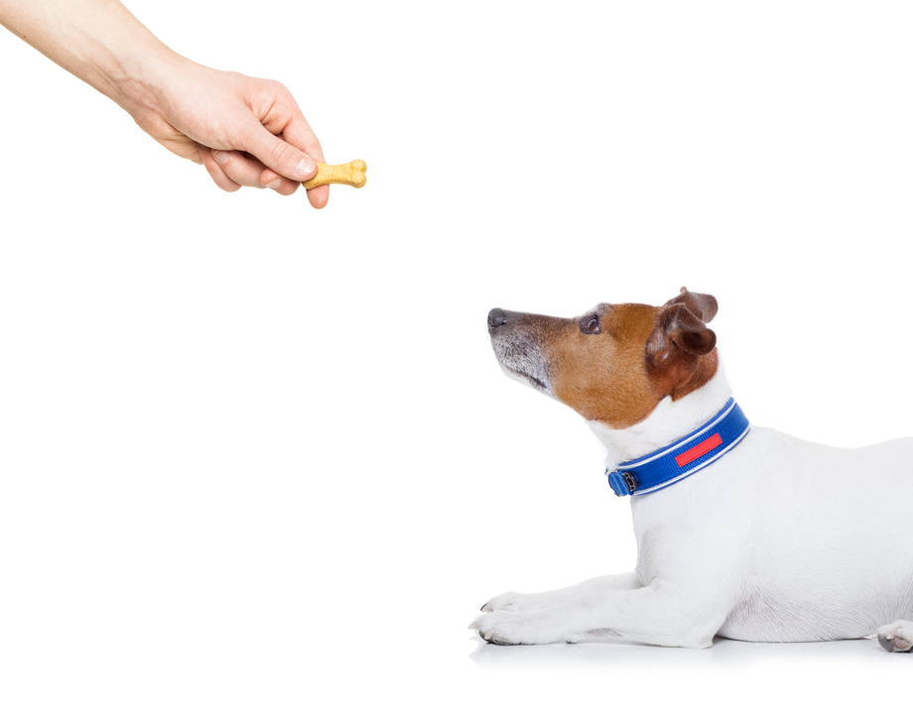
CS 5/7320 Artificial Intelligence Reinforcement Learning AIMA Chapter 17+22
Slides by Michael Hahsler with figures from the AIMA textbook.
This work is licensed under a Creative Commons Attribution-ShareAlike 4.0 International License.

Slide 2
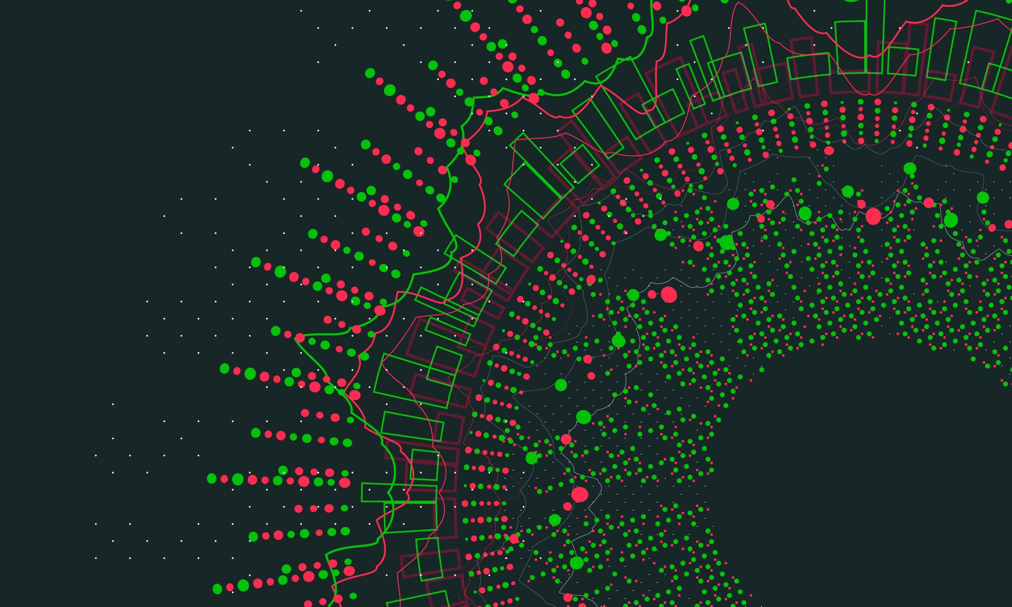
Sequential Decision Problems
AIMA Chapter 17: Making Complex Decisions

Slide 3
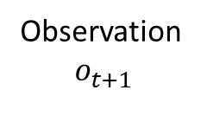
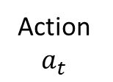
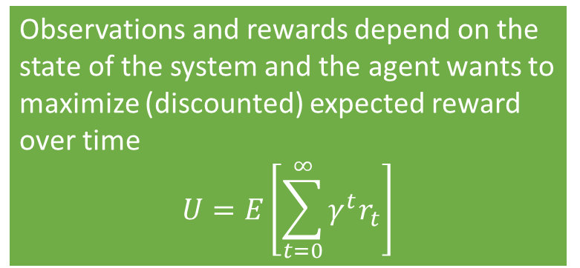

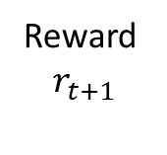
Sequential Decision Problems
Utility-based agent: The agent’s utility depends on a sequence of decisions spread out over time.
Sequential decision problems incorporate utilities, uncertainty, and sensing.
Action
$a_{t}$
Agent
Sequence: $r_{0}, o_{0}, a_{0}, r_{1}, o_{1}, a_{1}, r_{2}, o_{2}, a_{2},, …$
Observations and rewards depend on the state of the system and the agent wants to maximize (discounted) expected reward over time
$$U=E\left[\sum_{t=0}^{∞}{γ^{t}r_{t}}\right]$$
Reward $$r_{t+1}$$
Environment
Observation $$o_{t+1}$$

Slide 4
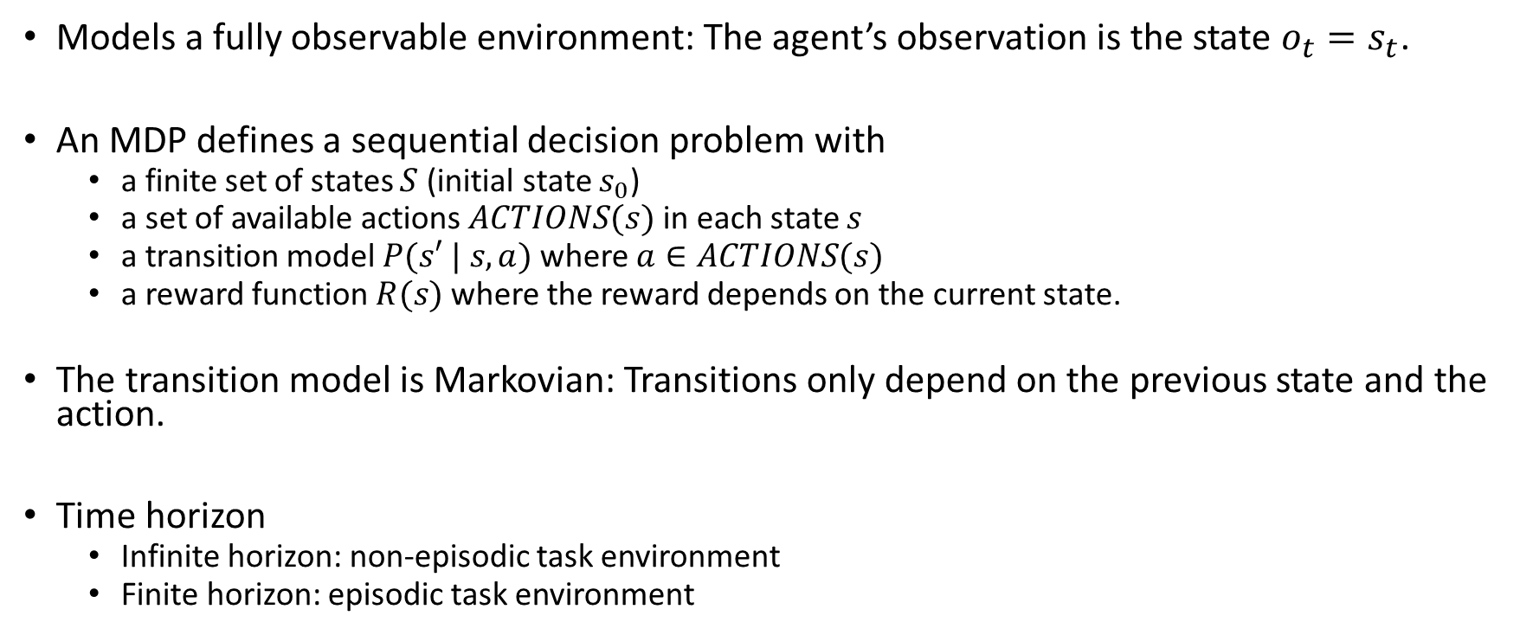
Definition: Markov Decision Process (MDP)
Models a fully observable environment: The agent’s observation is the state $o_{t}=s_{t}$.
An MDP defines a sequential decision problem with
a finite set of states $S$ (initial state $s_{0}$)
a set of available actions $ACTIONS(s)$ in each state $s$
a transition model $P(s′ | s, a)$ where $a∈ACTIONS(s)$
a reward function $R(s)$ where the reward depends on the current state.
The transition model is Markovian: Transitions only depend on the previous state and the action.
Time horizon
Infinite horizon: non-episodic task environment
Finite horizon: episodic task environment

Slide 5
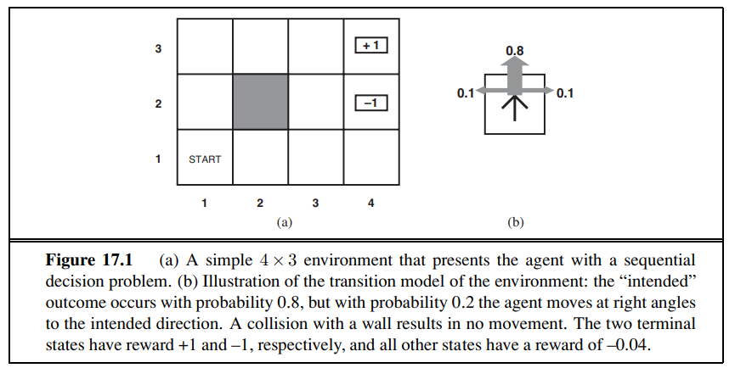
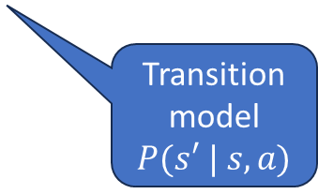
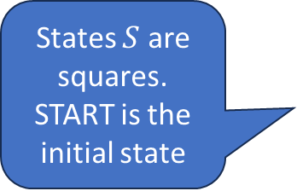
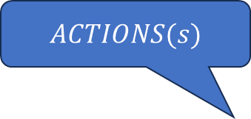
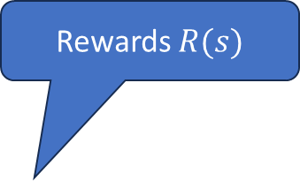
Example: 4x3 Grid World
Rewards $R(s)$
$ACTIONS(s)$
Goal: What direction should we go in each square?
-0.04
-0.04
-0.04
States $S$ are squares. START is the initial state
-0.04
-0.04
-0.04
-0.04
-0.04
Transition model
$P(s′ | s, a)$
-0.04

Slide 6
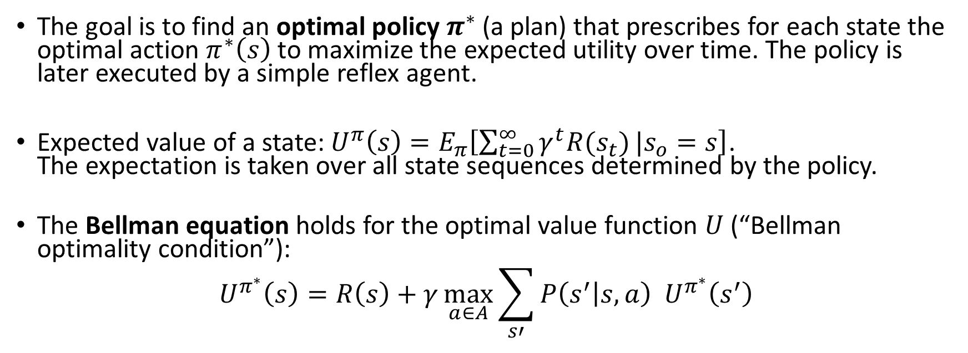
Optimal Policy
The goal is to find an optimal policy $π^{∗}$ (a plan) that prescribes for each state the optimal action $π^{∗}\left(s\right)$ to maximize the expected utility over time. The policy is later executed by a simple reflex agent.
Expected value of a state: $U^{π}\left(s\right)=E_{π}\left[\sum_{t=0}^{∞}{γ^{t}R(s_{t})}|s_{o}=s\right]$. The expectation is taken over all state sequences determined by the policy.
The Bellman equation holds for the optimal value function $U$ (“Bellman optimality condition”):
$$U^{π^{∗}}\left(s\right)=R\left(s\right)+γ\max_{a∈A}{\sum_{s′}{P\left(s^{′} | s,a\right){ U}^{π^{∗}}\left(s^{′}\right)}}$$
Immediate Reward
Use the best action as the policy
Expectation
Utility of the next state

Slide 7
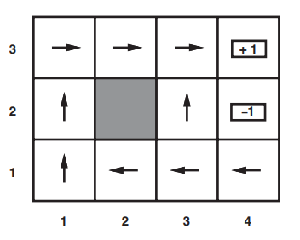
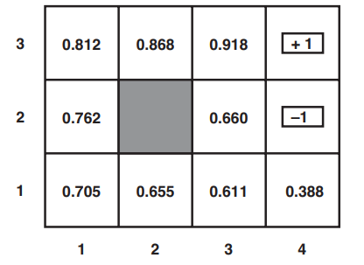

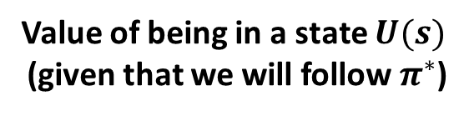
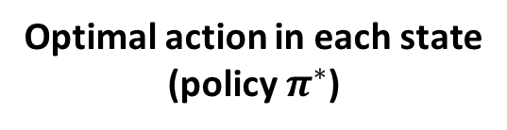
Solution: 4x3 Grid World
Optimal action in each state
(policy $π^{∗}$)
Value of being in a state $U(s)$ (given that we will follow $π^{∗}$)
Always move to
higher utility states
Why is it optimal to walk away from the +1 square?
$$γ=1$$
Question: How to we find the optimal value function/optimal policy?

Slide 8
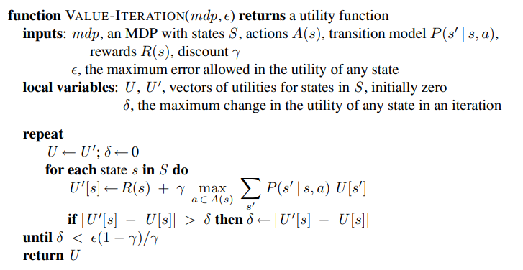
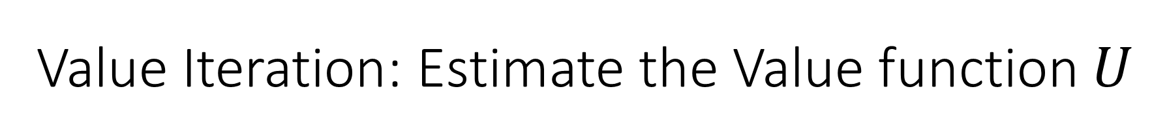
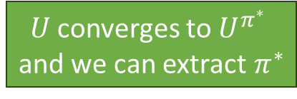
Value Iteration: Estimate the Value function $U$
Bellman update: Update a state with the reward + the expected utility of the state reached with the best action
$U$ converges to $U^{π^{∗}}$ and we can extract $π^{∗}$

Slide 9
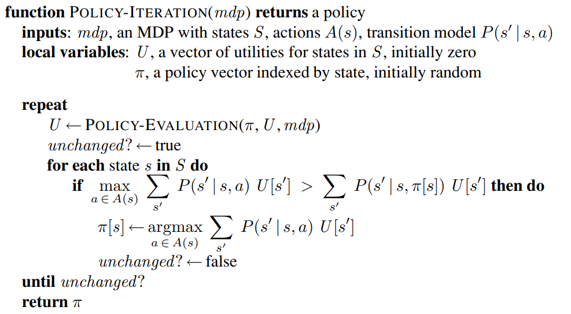
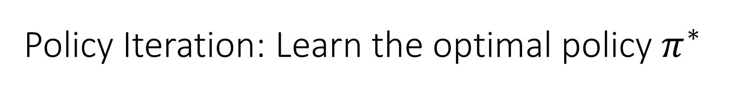
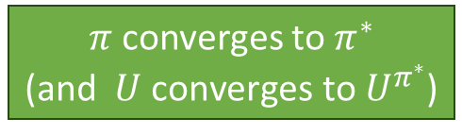
Policy Iteration: Learn the optimal policy $π^{∗}$
Calculate U given current policy (eighter solve an LP or iterative solution)
Policy
Improvement
$π$ converges to $π^{∗}$ (and $U \text{converges} \text{to} U^{π^{∗}}$)

Slide 10
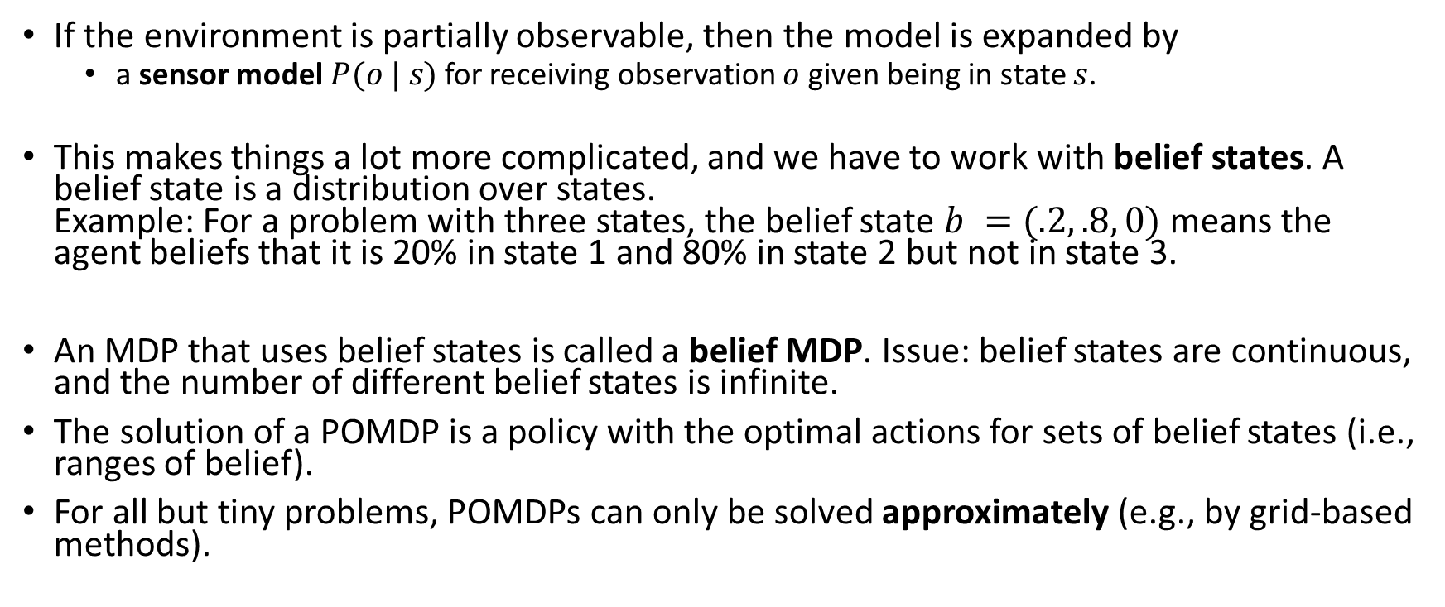
Partially Observable Markov Decision Model (POMDP)
If the environment is partially observable, then the model is expanded by
a sensor model $P(o | s)$ for receiving observation $o$ given being in state $s$.
This makes things a lot more complicated, and we have to work with belief states. A belief state is a distribution over states. Example: For a problem with three states, the belief state $b =(.2, .8, 0)$ means the agent beliefs that it is 20% in state 1 and 80% in state 2 but not in state 3.
An MDP that uses belief states is called a belief MDP. Issue: belief states are continuous, and the number of different belief states is infinite.
The solution of a POMDP is a policy with the optimal actions for sets of belief states (i.e., ranges of belief).
For all but tiny problems, POMDPs can only be solved approximately (e.g., by grid-based methods).

Slide 11
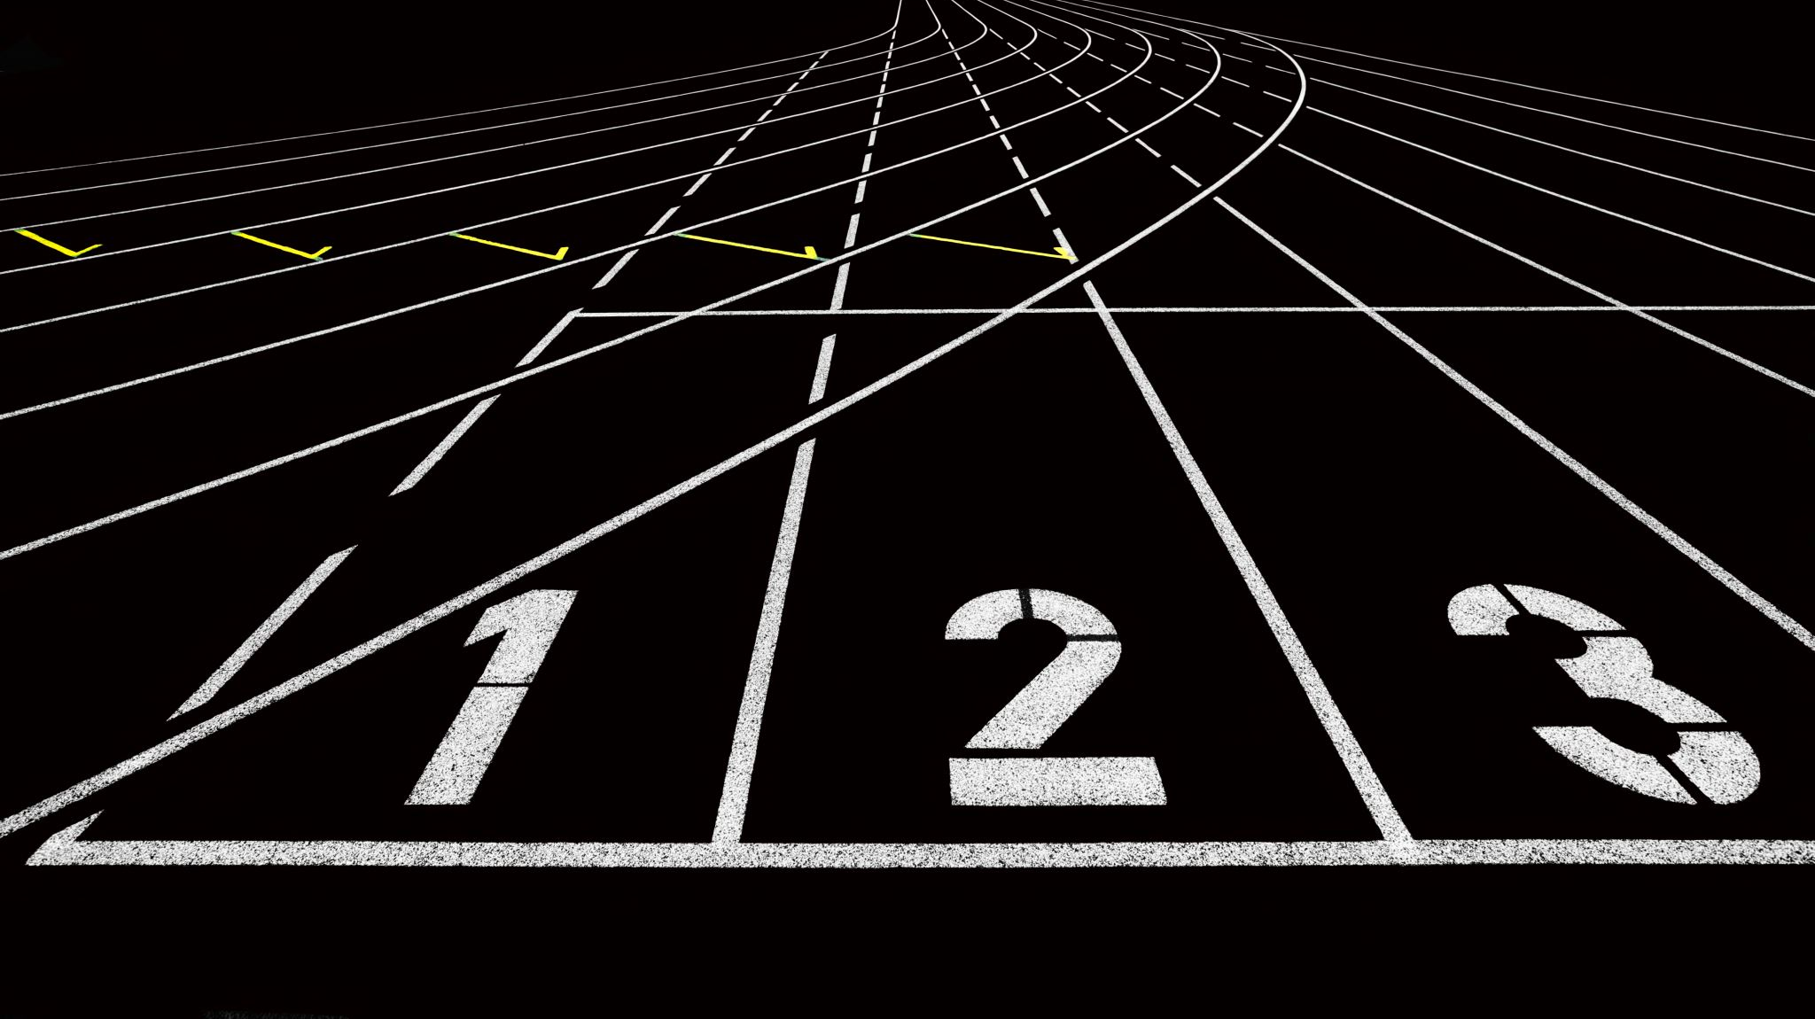
Reinforcement Learning
AIMA Chapter 22

Slide 12
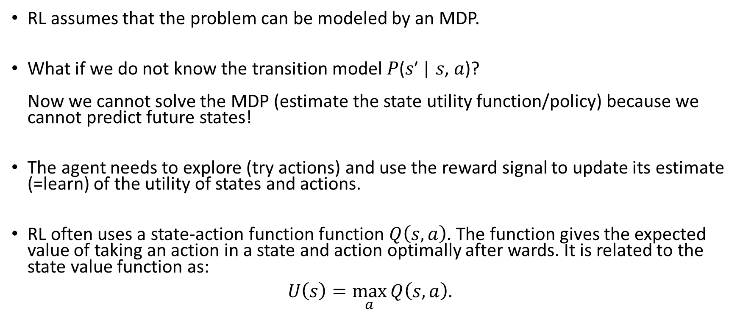
Reinforcement Learning (RL)
RL assumes that the problem can be modeled by an MDP.
What if we do not know the transition model 𝑃(𝑠′ | 𝑠, 𝑎)? Now we cannot solve the MDP (estimate the state utility function/policy) because we cannot predict future states!
The agent needs to explore (try actions) and use the reward signal to update its estimate (=learn) of the utility of states and actions.
RL often uses a state-action function function $Q\left(s, a\right)$. The function gives the expected value of taking an action in a state and action optimally after wards. It is related to the state value function as:
$U\left(s\right)=\max_{a}{Q\left(s, a\right)}$.
Notes:
Reward may be sparse. Need for credit assignment.
Reward shaping creates pseudo rewards that advance learning (e.g., ball possession or distance to the goal in soccer).
Hierarchical RL: Break the task into smaller sub-tasks so we can learn the succession of sub-task efficiently.

Slide 13
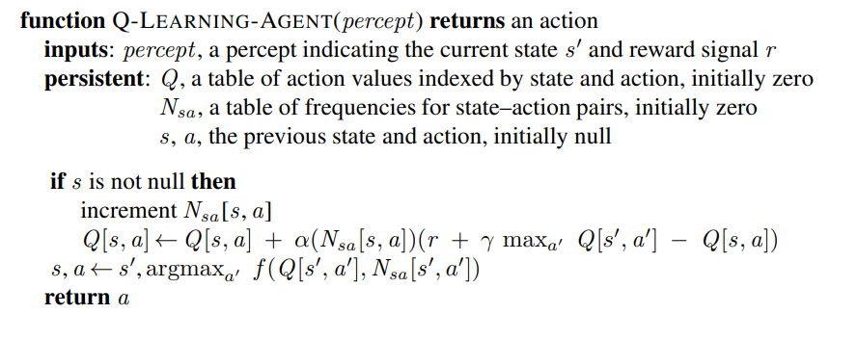
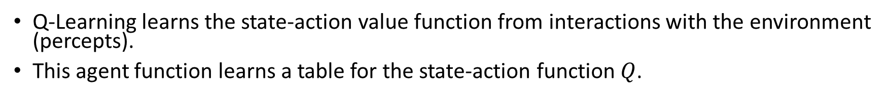
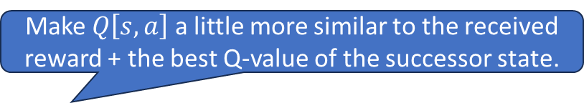
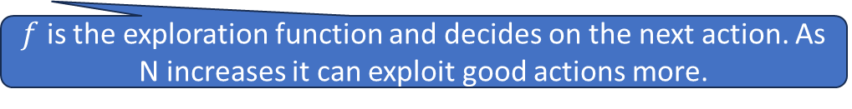
Q-Learning
Q-Learning learns the state-action value function from interactions with the environment (percepts).
This agent function learns a table for the state-action function $Q$.
New episode has no s.
Learning rate
Make $Q\left[s,a\right]$ a little more similar to the received reward + the best Q-value of the successor state.
$f$ is the exploration function and decides on the next action. As N increases it can exploit good actions more.

Slide 14
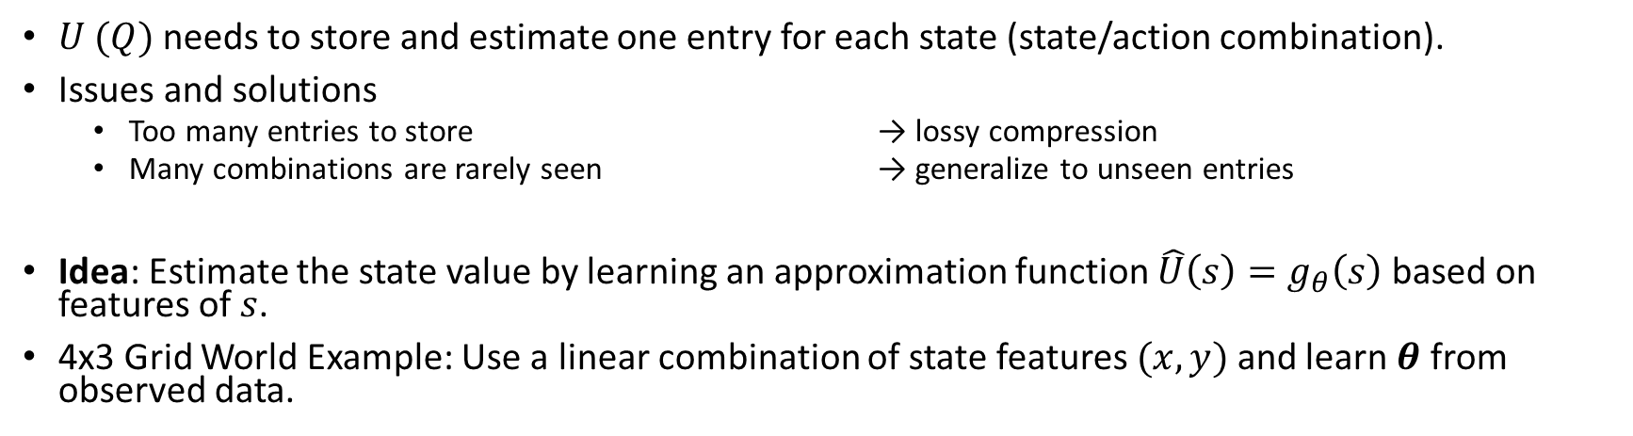

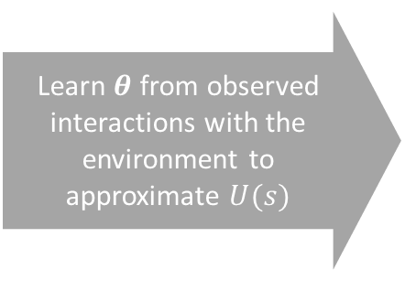

Function Approximation
$U (Q)$needs to store and estimate one entry for each state (state/action combination).
Issues and solutions
Too many entries to store → lossy compression
Many combinations are rarely seen → generalize to unseen entries
Idea: Estimate the state value by learning an approximation function $\hat{U}\left(s\right)=g_{θ}\left(s\right)$ based on features of $s$.
4x3 Grid World Example: Use a linear combination of state features $(x, y)$ and learn $θ$ from observed data.
Learn $θ$ from observed interactions with the environment to approximate $U(s)$
$$U(s)$$
$${\hat{U}}_{θ}\left(x,y\right)=θ_{0}+θ_{1}x+θ_{2}y$$
Notes:
$θ$ can be updated iteratively after each new observed utility.
We typically need non-linear approximators that can be incrementally updated (online learning). → Deep ANNs
Notes:
Deep RL is still somewhat unpredictable since the deep ANN has many parameters…

Slide 15

Summary
Agents can learn the value of being in a state from reward signals.
Rewards can be delayed (e.g., at the end of a game).
Not being able to fully observe the state makes the problem more difficult (POMDP).
Unknown transition models lead to the need of exploration by trying actions (model free methods like Q-Learning).
All these problems are computationally very expensive and often can only be solved by approximation. State of the art is to use deep artificial neural networks for function approximation.

