Slide 1
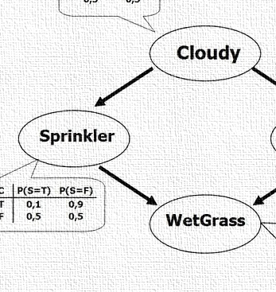
CS 5/7320 Artificial Intelligence Probabilistic Reasoning AIMA Chapter 13
Slides by Michael Hahsler based on slides by Svetlana Lazepnik with figures from the AIMA textbook
This work is licensed under a Creative Commons Attribution-ShareAlike 4.0 International License.

Slide 2
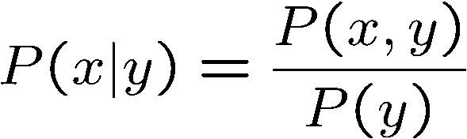

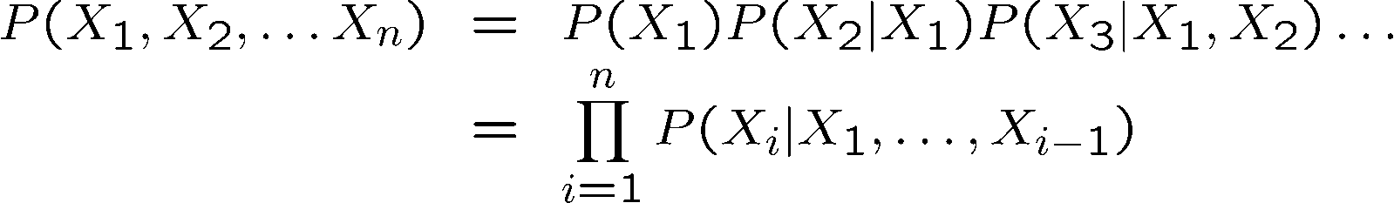

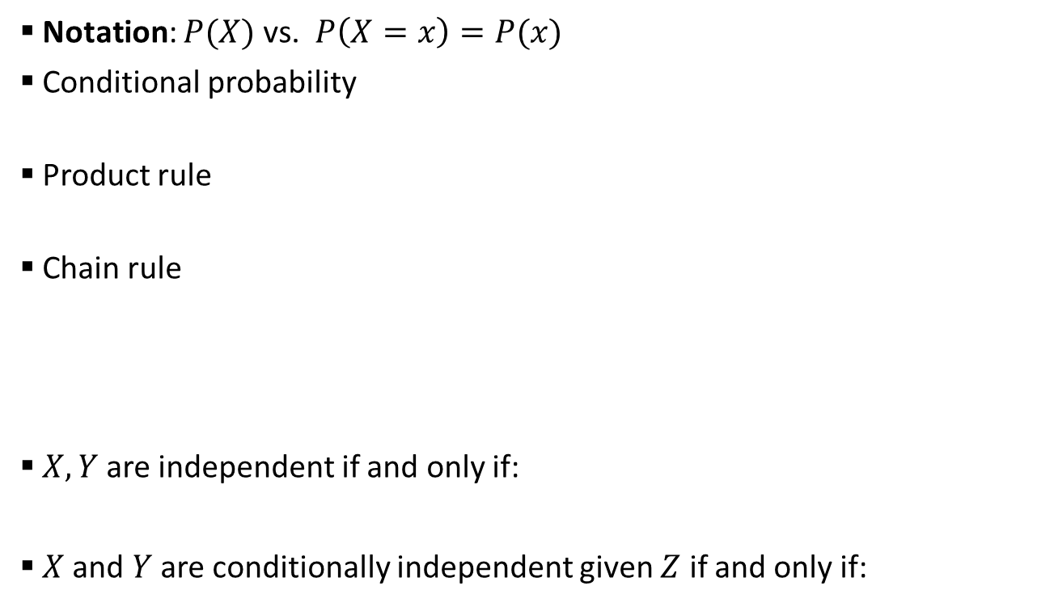


Probability Recap
Notation: $P(X)$ vs. $P\left(X=x\right)=P(x)$
Conditional probability
Product rule
Chain rule
$X, Y$are independent if and only if:
$X$ and $Y$ are conditionally independent given $Z$ if and only if:
$$=αP(x,y)$$
Written as $X⫫Y$
Written as $X⫫Y|Z$

Slide 3
Contents
Bayesian Networks
Exact Inference
Approximate Inference

Slide 4

Bayesian Networks
Modeling a Joint Distribution

Slide 5
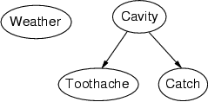
Bayesian Networks (aka Belief Networks)
A type of graphical model.
A way to specify dependence between random variables.
A compact specification of a full joint distributions.
A general and important model to reason with uncertainty in AI.

Slide 6
Structure of Bayesian Networks
Nodes: Random variables
Can be assigned (observed) or unassigned (unobserved)
Arcs: Dependencies
An arrow from one variable to another indicates direct influence.
Show independence
Weather is independent of the other variables (no connection).
Toothache and Catch are conditionally independent given Cavity (directed arc).
Must form a directed acyclic graph (DAG)
A network with all random variables assigned represents a state of the system.

Slide 7

Example: N independent coin flips
Complete independence: no interactions between coin flips
$$P\left(X_{1},X_{2},…,X_{n}\right)=P\left(X_{1}\right)P\left(X_{2}\right)…P(X_{n})$$
…
X₁
X₂
X_{n}
Joint probability distribution
Marginal probability distributions

Slide 8
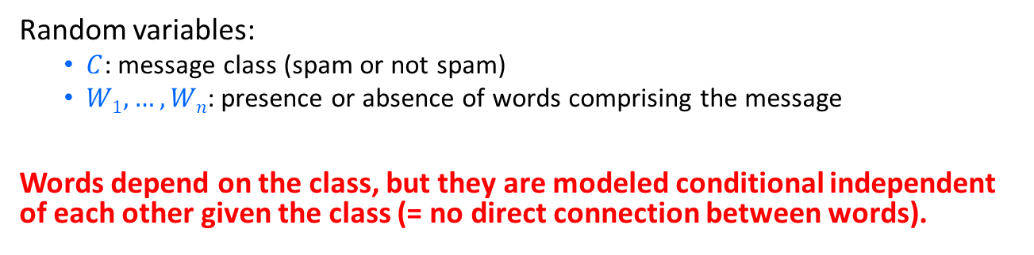
Example: Naïve Bayes spam filter
Random variables:
$C$: message class (spam or not spam)
$W1, …, Wn$: presence or absence of words comprising the message
Words depend on the class, but they are modeled conditional independent of each other given the class (= no direct connection between words).
C
…
W₁
W₂
W_{n}
$$P\left(W_{1},W_{2},…,W_{n}|C\right)=P\left(W_{1}|C\right)P\left(W_{2}|C\right)…P(W_{n}|C)$$

Slide 9
Example: Burglar Alarm
Description: I have a burglar alarm that is sometimes set off by minor earthquakes. My two neighbors, John and Mary, promised to call me at work if they hear the alarm
Example inference task: suppose Mary calls and John doesn’t call. What is the probability of a burglary?
What are the random variables?
Burglary, Earthquake, Alarm, JohnCalls, MaryCalls
What are the direct influence relationships?
A burglar can set off the alarm
An earthquake can set off the alarm
The alarm can cause Mary to call
The alarm can cause John to call

Slide 10
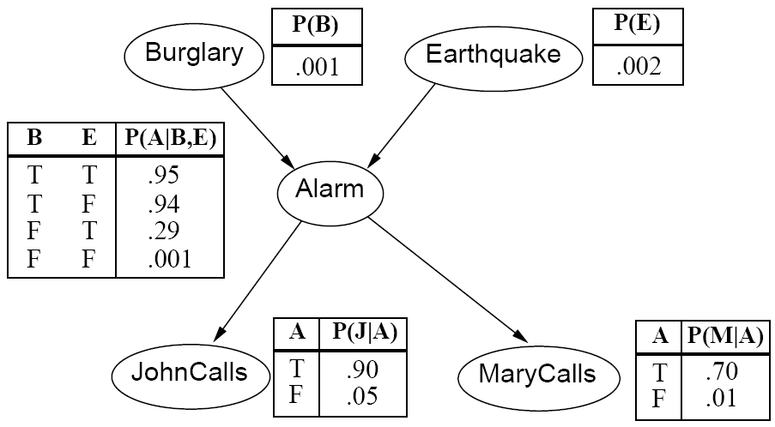
Example: Burglar Alarm
What are the model parameters?

Slide 11


Parameters: Conditional probability tables
To specify the full joint distribution, we need to specify a conditional distribution for each node given its parents as a conditional probability table (CPT): $P (X | Parents(X))$
…
Z₁
Z₂
Z_{n}
X
$$P (X | Z1, …, Zn)$$

Slide 12
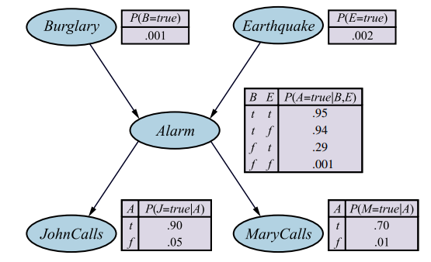
Example: Burglar Alarm with CPTs
No parents
2 parents
1 parent

Slide 13
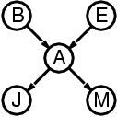
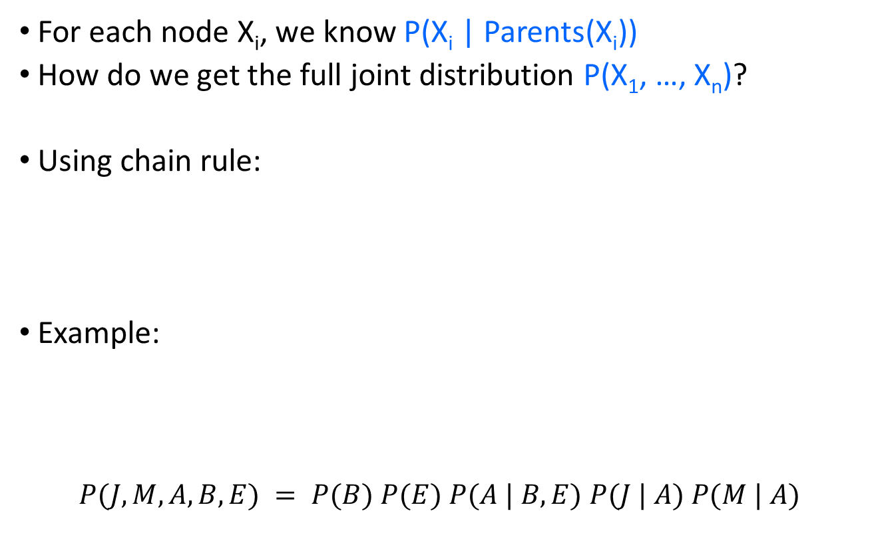
The joint probability distribution
For each node X_{i}, we know P(X_{i} | Parents(X_{i}))
How do we get the full joint distribution P(X₁, …, X_{n})?
Using chain rule:
Example:
$$P(J, M, A, B, E) = P(B) P(E) P(A | B, E) P(J | A) P(M | A)$$
Construct following arrows

Slide 14
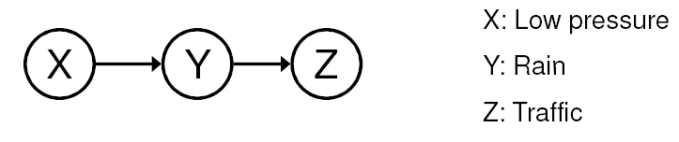


Dependence
Example: causal chain
Are X and Z independent?
$$P\left(X,Y,Z\right)=P\left(X\right)P\left(Y | X\right)P\left(Z | Y\right)$$
$$P\left(X,Z\right)=\sum_{y}{P\left(X\right)P\left(y | X\right)P\left(Z | y\right)} \\ =P\left(X\right)\sum_{y}{P\left(Z | y\right)P(y|X)}$$
Conditioning
Marginalize over Y
X and Z are not independent!
$$≠P(X)P(Z)$$

Slide 15
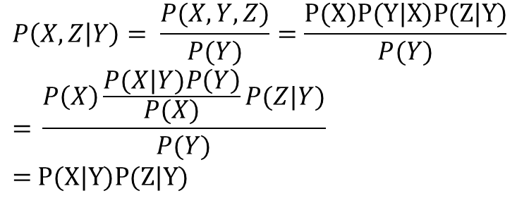
Conditional independence
Example: causal chain
Is Z independent of X given Y?
$$P\left(X,Z | Y\right)= \frac{P(X,Y,Z)}{P(Y)}=\frac{\text{P}\text{(}\text{X}\text{)}\text{P}\text{(}\text{Y}\text{|}\text{X}\text{)}\text{P}\text{(}\text{Z}\text{|}\text{Y}\text{)}}{P(Y)} \\ \text{= }\frac{P\left(X\right)\frac{P(X|Y)P\left(Y\right)}{P(X)}P(Z|Y)}{P(Y)} \\ \text{= }\text{P}\text{(}\text{X}\text{|}\text{Y}\text{)}\text{P}\text{(}\text{Z}\text{|}\text{Y}\text{)}$$
Conditioning
Bayes’ rule
X and Z are conditionally independent given Y
= Definition of conditional indepedence

Slide 16
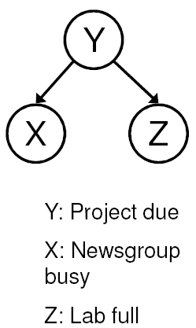
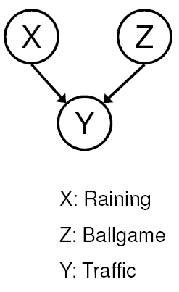
Conditional independence
Common cause
Are X and Z independent?
No
Are they conditionally independent given Y?
Yes
Common effect
Are X and Z independent?
Yes
Are they conditionally independent given Y?
No

Slide 17
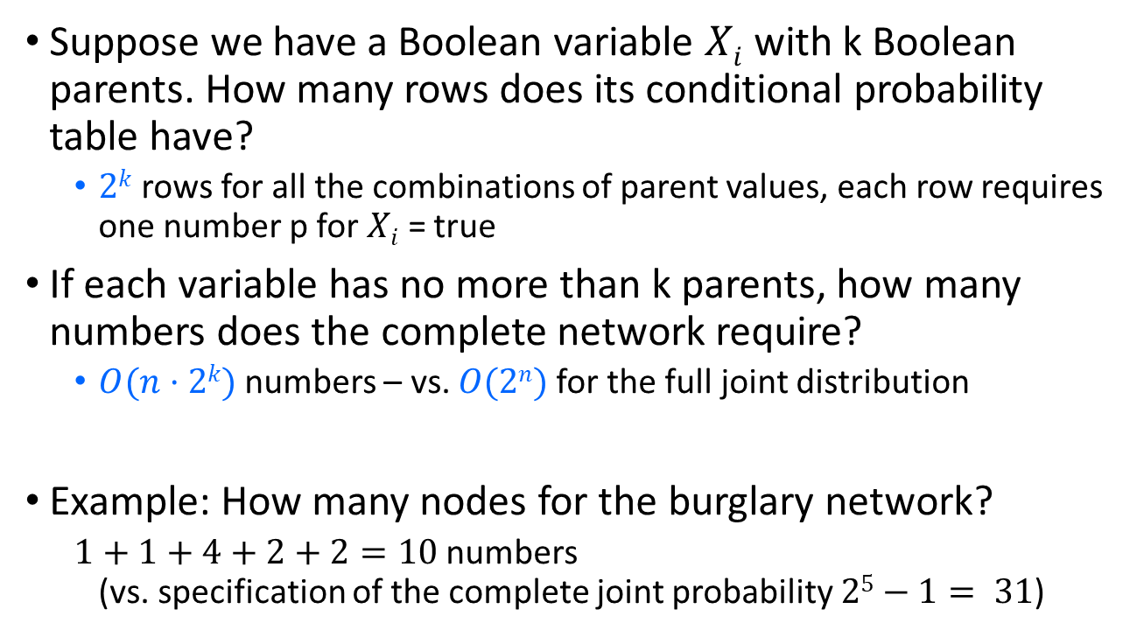
Compactness
Suppose we have a Boolean variable $Xi$ with k Boolean parents. How many rows does its conditional probability table have?
$2k$ rows for all the combinations of parent values, each row requires one number p for $Xi$ = true
If each variable has no more than k parents, how many numbers does the complete network require?
$O(n·2k)$numbers – vs. $O(2n)$for the full joint distribution
Example: How many nodes for the burglary network?
$1+1+4+2+2=10$numbers (vs. specification of the complete joint probability $25−1= 31$)

Slide 18
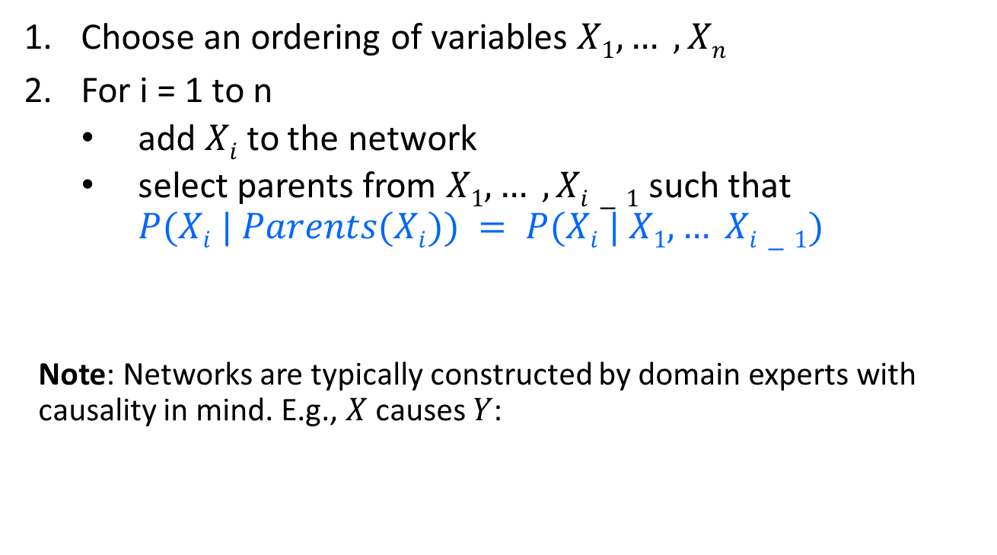
Constructing Bayesian networks
Choose an ordering of variables $X1, … , Xn$
For i = 1 to n
add $Xi$to the network
select parents from $X1, … ,Xi−1$ such that $P(Xi | Parents(Xi)) = P(Xi | X1, … Xi−1)$
Note: Networks are typically constructed by domain experts with causality in mind. E.g., $X$ causes $Y$:
X
Y

Slide 19
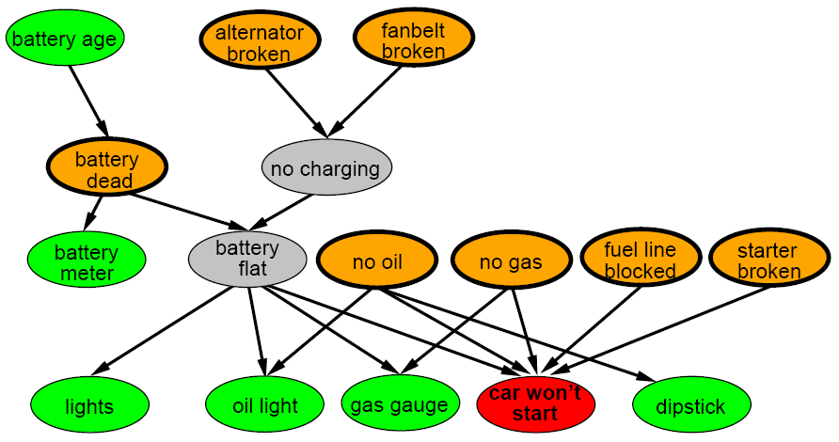
A more realistic Bayes Network: Car diagnosis
Initial observation: car won’t start
Green: testable evidence
Orange: “broken, so fix it” nodes
Gray: “hidden variables” to ensure sparse structure, reduce parameters

Slide 20
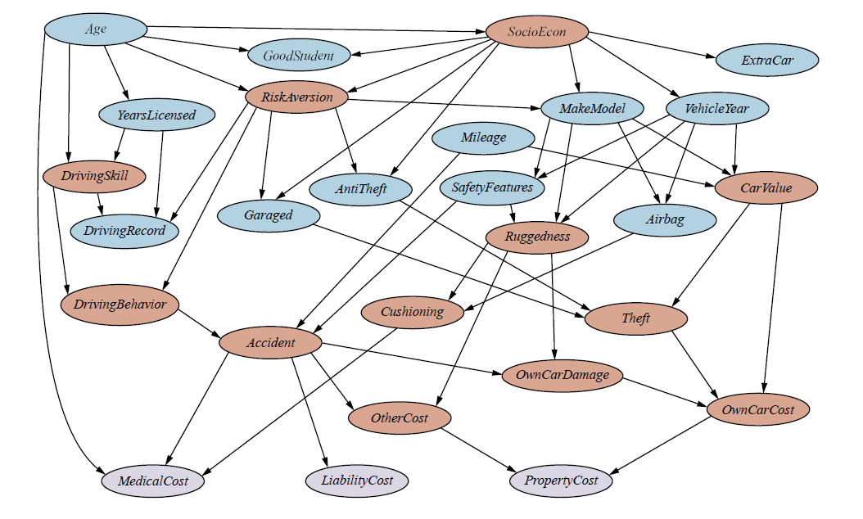
Car insurance: Cost is affected by many factors

Slide 21

Summary
Bayesian networks provide a natural representation for joint probabilities used to calculated conditional probabilities used in inference.
Conditional independence (induced by causality) reduces the number of needed parameters.
Representation
Topology
Conditional probability tables
Generally easy for domain experts to construct
$P(B, E, A, J, M)$ is defined by

Slide 22
Exact Inference in BN
Calculate the posterior probability given evidence

Slide 23
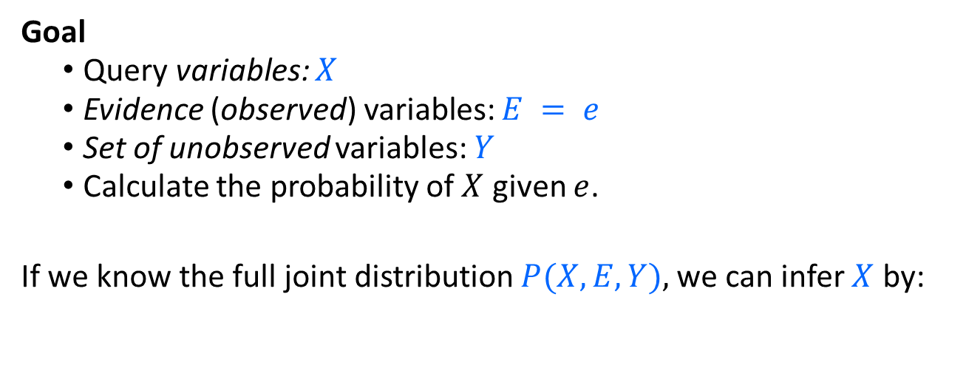
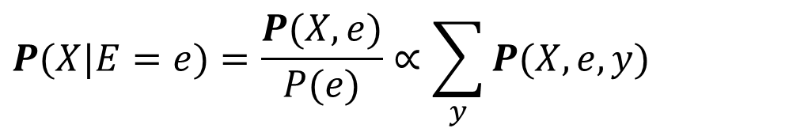
Exact Inference
Goal
Query variables: $X$
Evidence (observed) variables: $E = e$
Set of unobserved variables: $Y$
Calculate the probability of $X$ given $e$.
If we know the full joint distribution $P(X, E, Y),$we can infer $X$ by:
$$P(X|E=e)=\frac{P(X,e)}{P(e)}∝\sum_{y}{P(X,e,y)}$$
Sum over values of unobservable variables = marginalizing them out.

Slide 24


Exact inference: Example
Assume we can observe being called and the two variables have the values$j$and $m$. We want to know the probability of a burglary. Query: $P(B | j, m)$ with unobservable variables: Earthquake, Alarm
$$P(b|j,m)=\frac{P(b,j,m)}{P(j,m)}∝\sum_{E=e}{\sum_{A=a}{P(b,e,a,j,m)}} \\ =\sum_{E=e}{\sum_{A=a}{P(b)P(e)P(a|b,e)P(j|a)P(m|a)}} \\ =P(b)\sum_{E=e}{P(e)\sum_{A=a}{P(a|b,e)}P(j|a)P(m|a)}$$
Full joint probability and marginalize over E and A

Slide 25
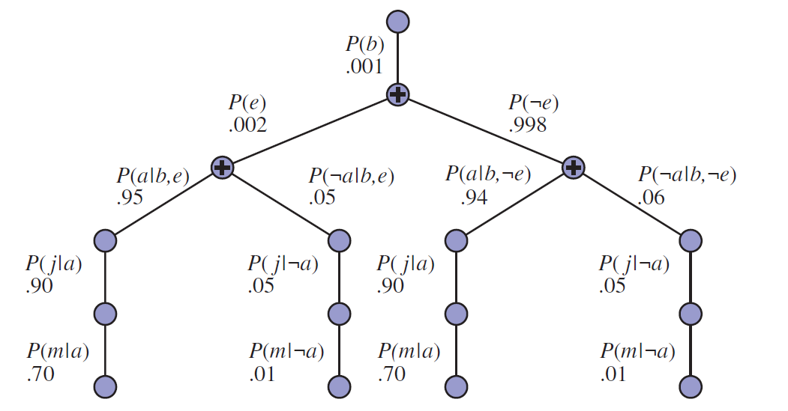

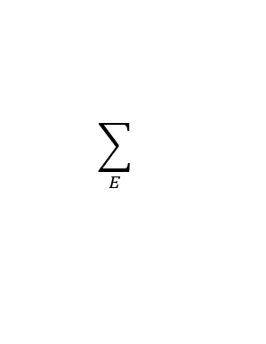
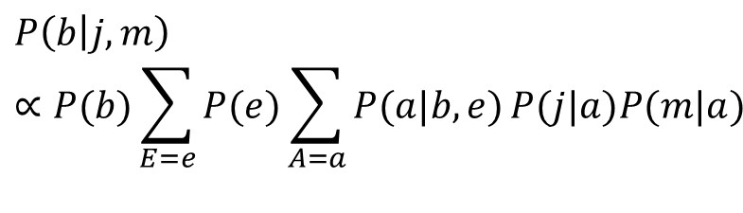
Exact inference: Example
$$P\left(b | j,m\right)∝P(b)\sum_{E=e}{P(e)\sum_{A=a}{P(a|b,e)}P(j|a)P(m|a)}$$
Evaluation tree (lines represent multiplications)
$$\sum_{E}{}$$
$$\sum_{A}{}$$

Slide 26
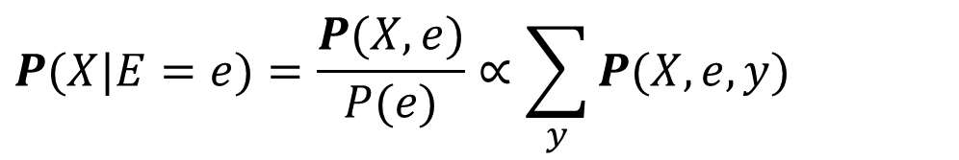
Issues with Exact Inference in AI
$$P(X|E=e)=\frac{P(X,e)}{P(e)}∝\sum_{y}{P(X,e,y)}$$
Problems
Full joint distributions are too large to store. Bayes nets provide significant savings for representing the conditional probability structure.
Marginalizing out many unobservable variables Y may involve too many summation terms. This summation is called exact inference by enumeration. Unfortunately, it does not scale well (#p-hard).
In praxis, approximate inference by sampling is used.

Slide 27
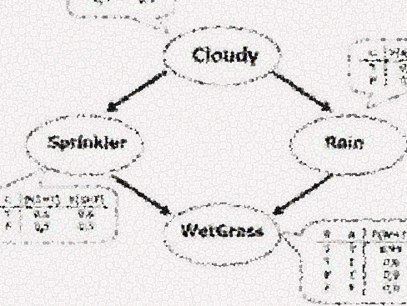
Approximate Inference in BN
Estimate the posterior probability given evidence

Slide 28
BN as a Generative Model
Bayesian networks can be used as generative models.
Allows us to efficiently generate samples from the joint distribution.
Idea: Generate samples from the network to estimate joint and conditional probability distributions.

Slide 29
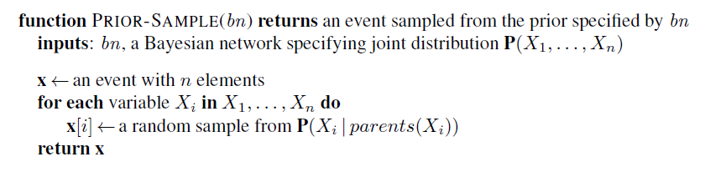
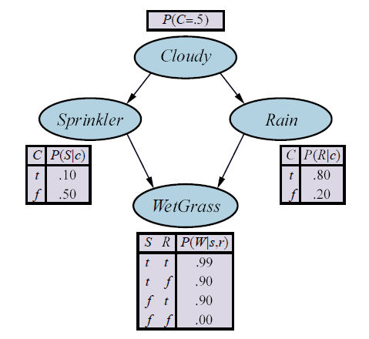
Prior-Sample Algorithm to Create a Sample (Event)
We need to start with the random variables that have no parents.

Slide 30
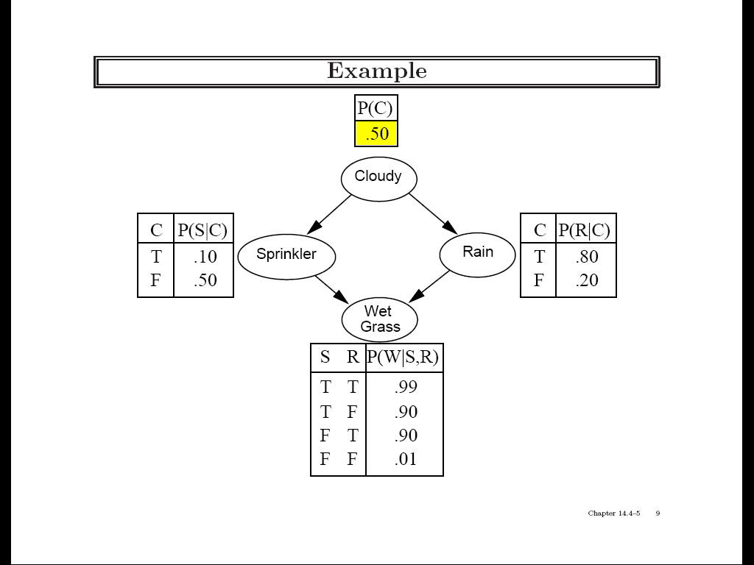
Example: Sampling from a Bayesian Network

Slide 31
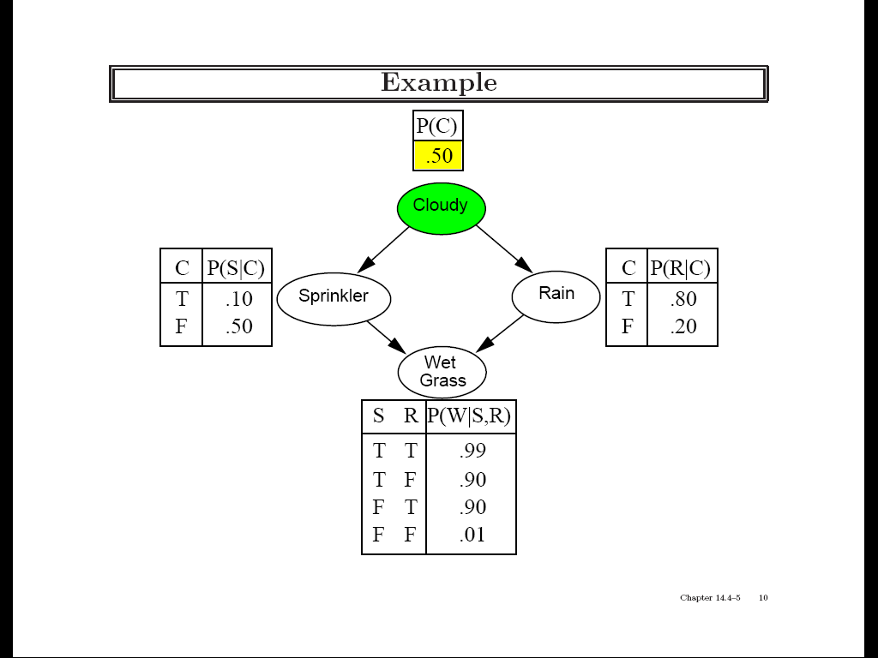
Example: Sampling from a Bayesian Network
Draw a random value using the probability.

Slide 32
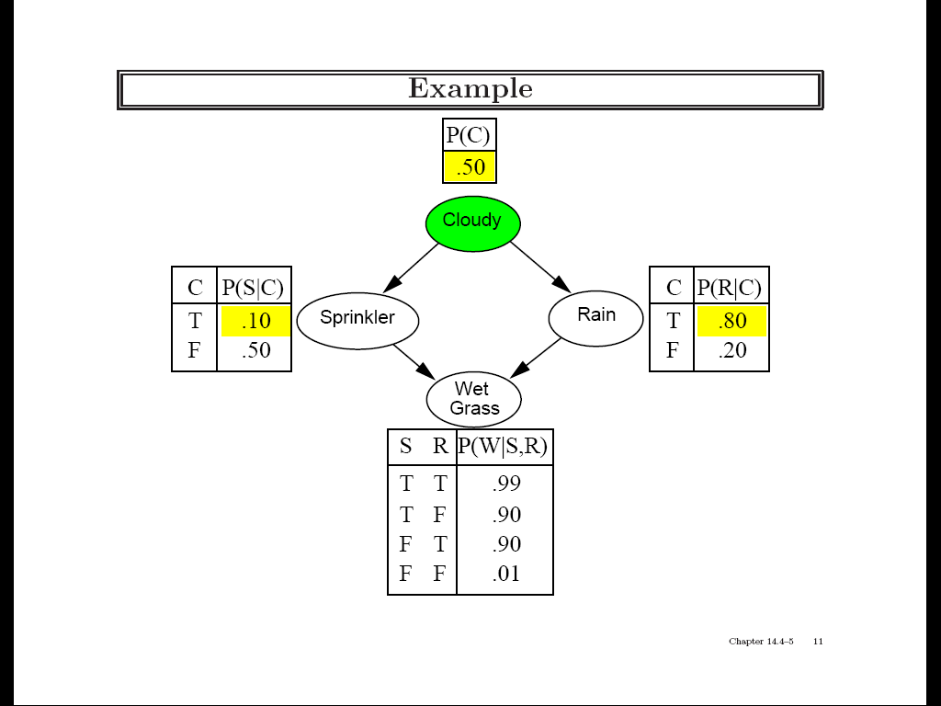
Example: Sampling from a Bayesian Network

Slide 33
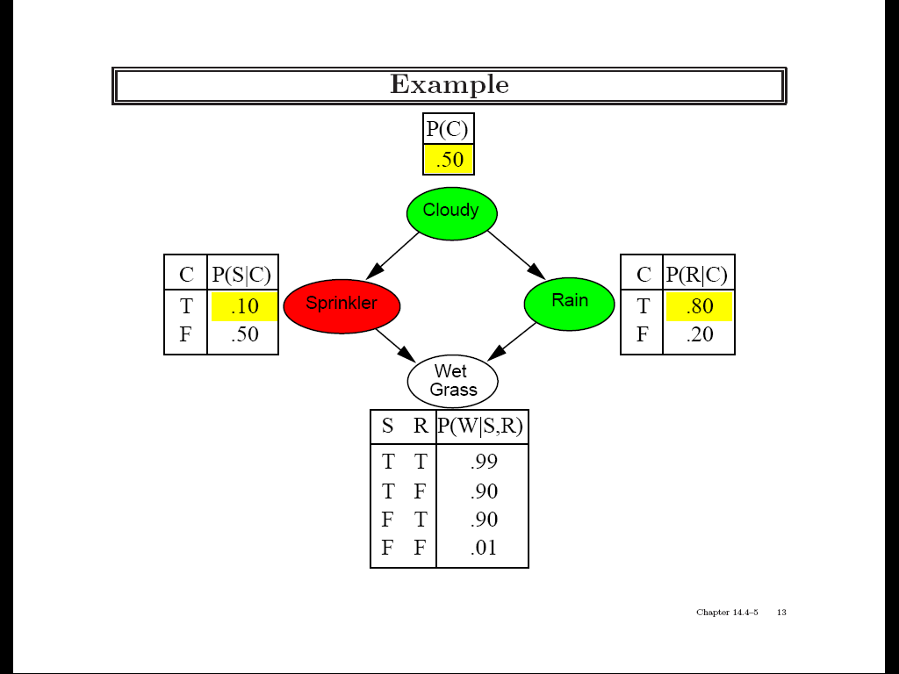
Example: Sampling from a Bayesian Network

Slide 34
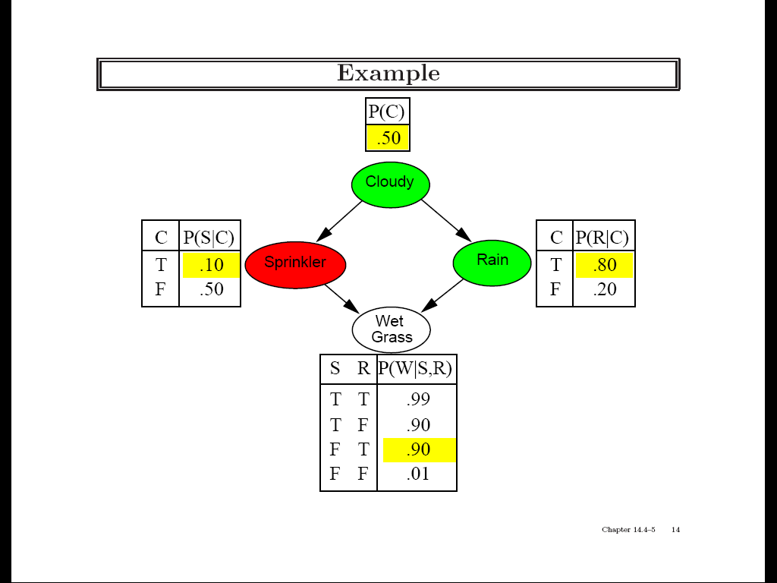
Example: Sampling from a Bayesian Network

Slide 35
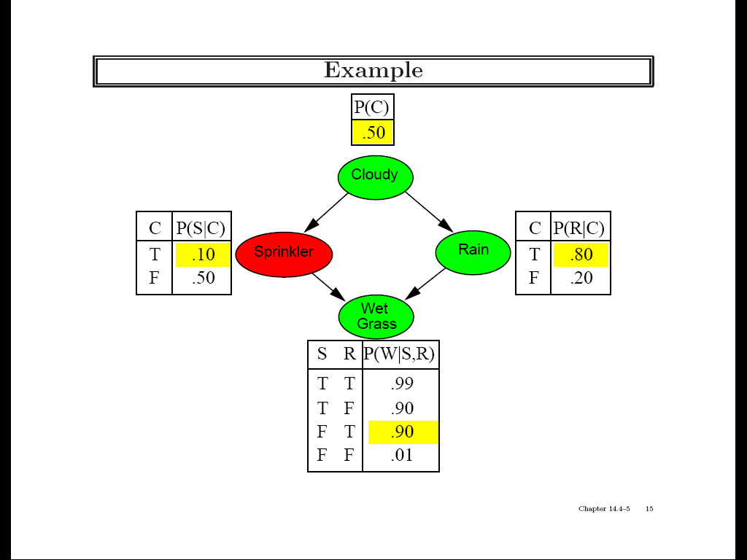
Example: Sampling from a Bayesian Network
Prior Sample returns the event:
[C = True, S = False, R = True, W = True]

Slide 36
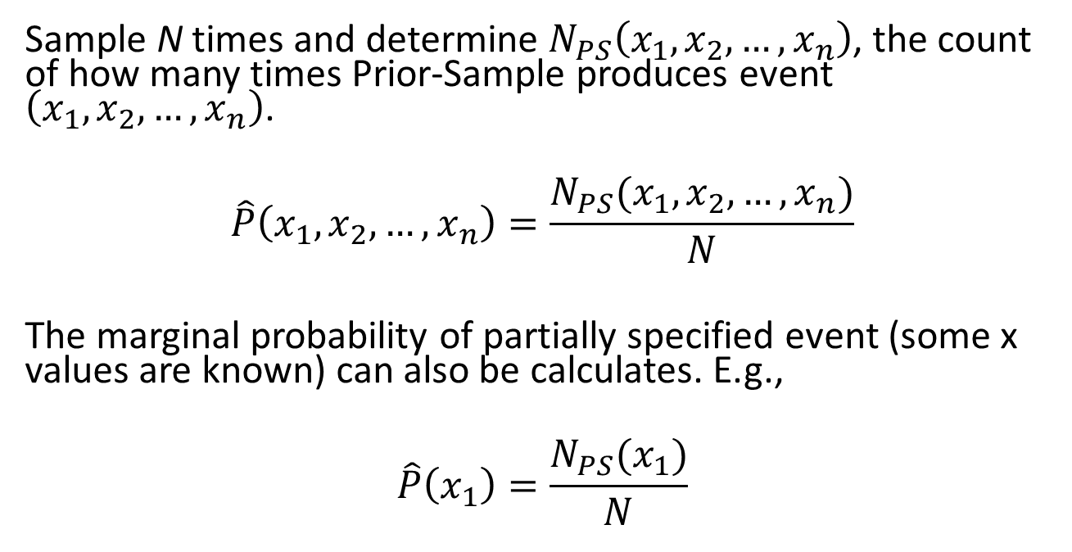
Estimating the Joint Probability Distribution
Sample N times and determine $N_{PS}\left(x_{1},x_{2},…,x_{n}\right)$, the count of how many times Prior-Sample produces event $\left(x_{1},x_{2},…,x_{n}\right)$.
$$\hat{P}\left(x_{1},x_{2},…,x_{n}\right)=\frac{N_{PS}(x_{1},x_{2},…,x_{n})}{N}$$
The marginal probability of partially specified event (some x values are known) can also be calculates. E.g.,
$$\hat{P}\left(x_{1}\right)=\frac{N_{PS}(x_{1})}{N}$$

Slide 37
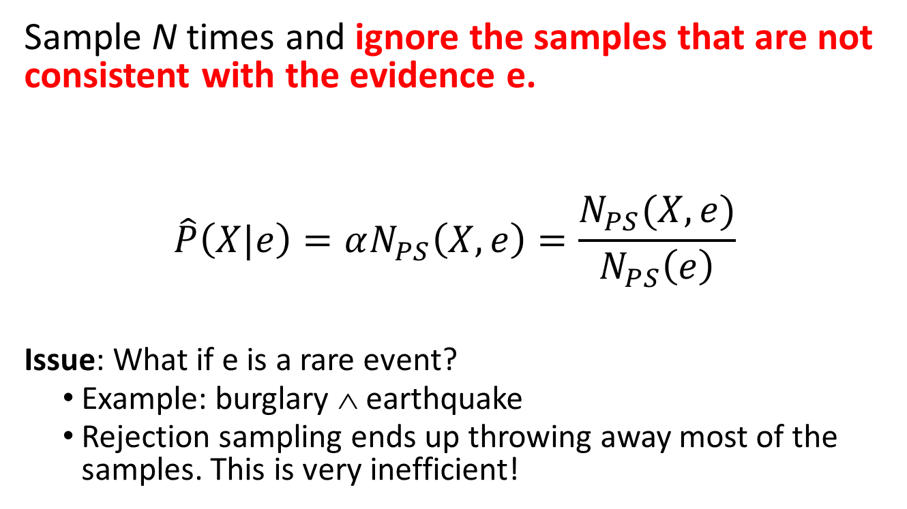
Estimating Conditional Probabilities: Rejection sampling
Sample N times and ignore the samples that are not consistent with the evidence e.
$$\hat{P}\left(X|e\right)=αN_{PS}\left(X,e\right)=\frac{N_{PS}(X,e)}{N_{PS}\left(e\right)}$$
Issue: What if e is a rare event?
Example: burglary ∧ earthquake
Rejection sampling ends up throwing away most of the samples. This is very inefficient!

Slide 38
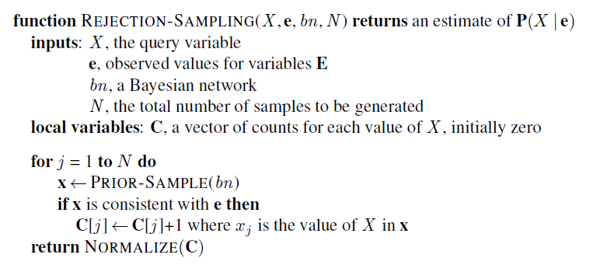
Estimating Conditional Probabilities: Rejection sampling
We throw away many samples if e is rare!

Slide 39
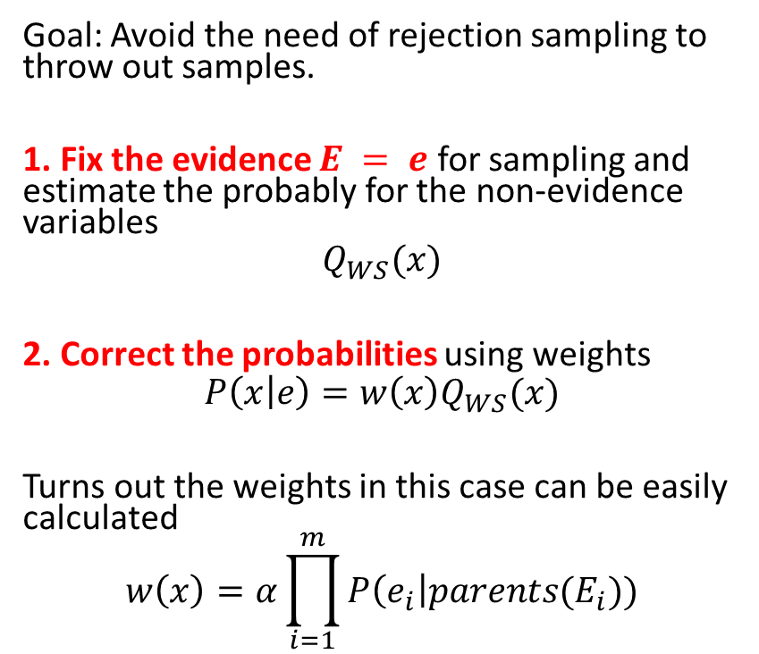
Estimating Conditional Probabilities: Importance sampling (likelihood weighting)
Goal: Avoid the need of rejection sampling to throw out samples.
1. Fix the evidence $E = e$ for sampling and estimate the probably for the non-evidence variables
$$Q_{WS}(x)$$
2. Correct the probabilities using weights
$$P\left(x | e\right)=w\left(x\right)Q_{WS}(x)$$
Turns out the weights in this case can be easily calculated
$$w\left(x\right)=α\prod_{i=1}^{m}{P\left(e_{i}\right|parents(E_{i}))}$$
Example: Evidence = it rains
1. Fix as true
2. Correct sampled probabilities

Slide 40
Estimating Conditional Probabilities: Markov Chain Monte Carlo Sampling (MCMC)
Generates a sequence of samples instead of creating each sample individually from scratch.
Create a state by making random changes to the current state. The sequence of states forms a random process called a Markov Chain (MC).
The MCs stationary distribution turns out to be the posterior distribution of the non-evidence variables.
Estimate the stationary distribution using Monte Carlo simulation by counting how often each state is reached and normalize to obtain probability estimates.
Algorithms:
Gibbs sampling (works well for BNs)
Metropolis-Hastings sampling
Note: Simulated annealing belongs to the family of MCMC algorithms.

Slide 41
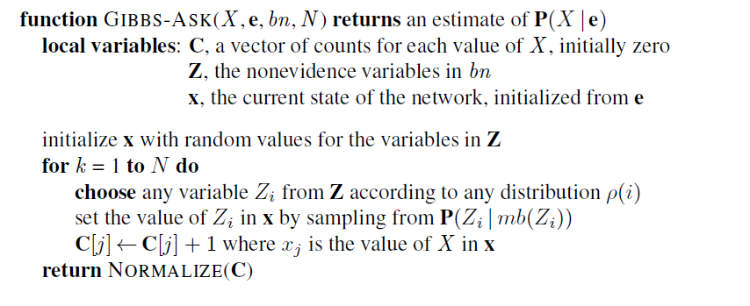
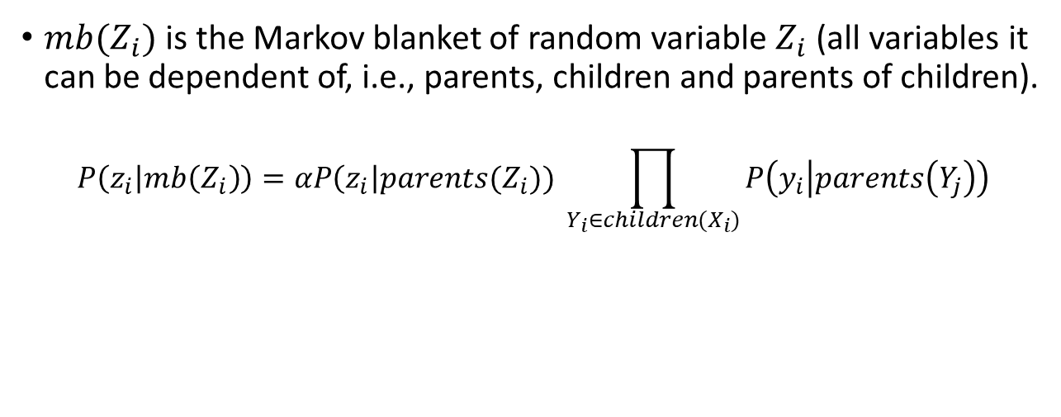
Gibbs sampling in Bayes Networks
Random State
Change one variable
Count
$mb(Z_{i})$ is the Markov blanket of random variable $Z_{i}$ (all variables it can be dependent of, i.e., parents, children and parents of children).
$$P\left(z_{i} | mb\left(Z_{i}\right)\right)=αP\left(z_{i}\right|parents(Z_{i})) \prod_{Y_{i}∈children(X_{i})}{P\left(y_{i} | parents\left(Y_{j}\right)\right)}$$

Slide 42
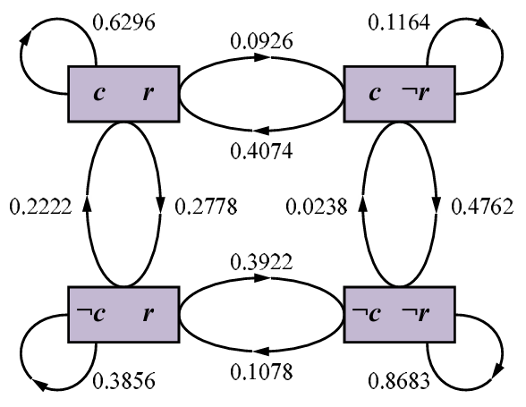
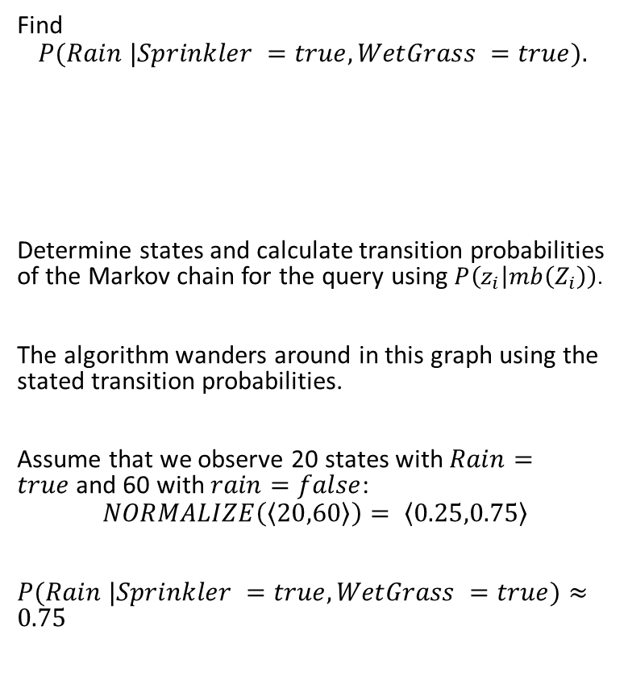
Gibbs Sampling: Example
unknown
Find
$$P(Rain |Sprinkler =true,WetGrass =true).$$
Determine states and calculate transition probabilities of the Markov chain for the query using $P\left(z_{i} | mb\left(Z_{i}\right)\right)$.
The algorithm wanders around in this graph using the stated transition probabilities.
Assume that we observe 20 states with $Rain=true$and 60 with $rain=false$:
$$NORMALIZE\left(\left\langle 20,60\right\rangle \right)= \left\langle 0.25,0.75\right\rangle$$
$P(Rain |Sprinkler =true,WetGrass =true)≈0.75$
?
true
true
Note the self-loops: the state stays the same when either variable is chosen and then resamples the same value it already has.

Slide 43

Conclusion
Bayesian networks provide an efficient way to store a probabilistic model by exploiting (conditional) independence between variables.
Exact Inference (estimating conditional probabilities) is difficult, for all but tiny models.
State of the art is to use approximate inference by sampling from the model.
Software libraries provide general inference engines.

