Slide 1
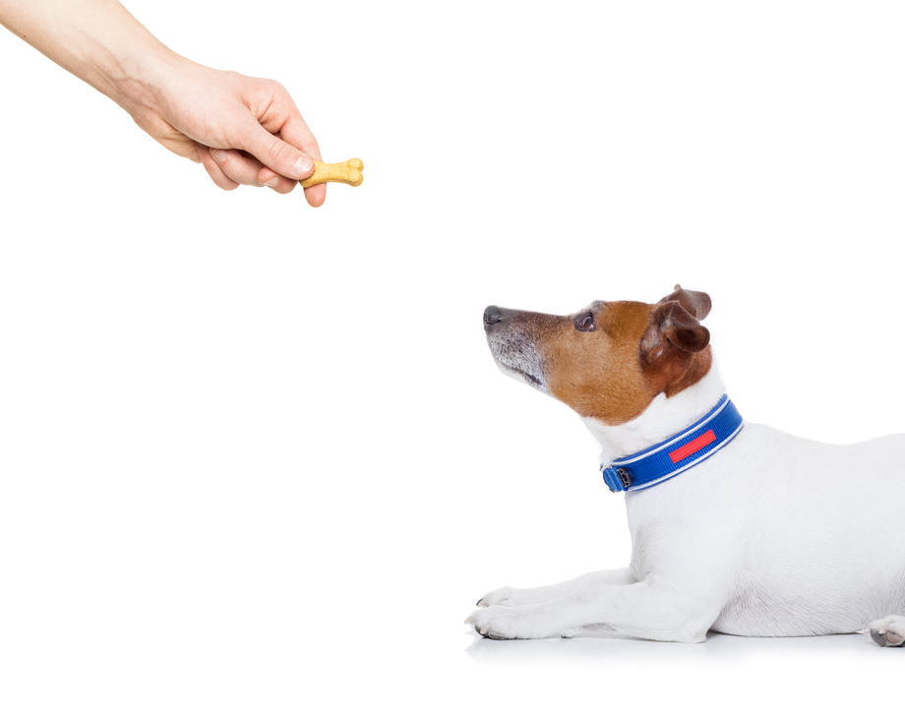
CS 5/7320 Artificial Intelligence Reinforcement Learning AIMA Chapter 17+22
Slides by Michael Hahsler with figures from the AIMA textbook.
This work is licensed under a Creative Commons Attribution-ShareAlike 4.0 International License.

Slide 2
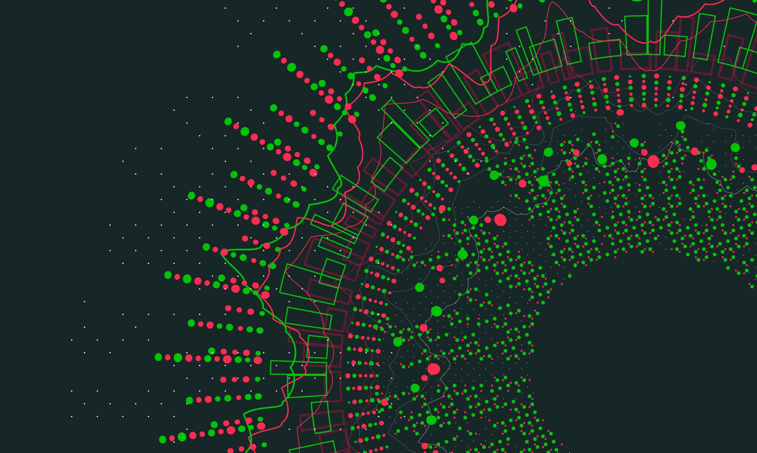
Sequential Decision Problems
AIMA Chapter 17: Making Complex Decisions

Slide 3
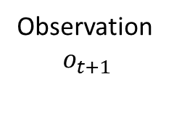
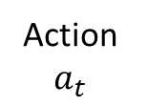
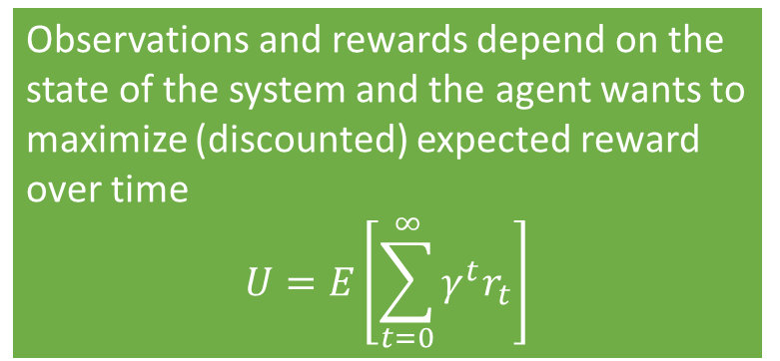

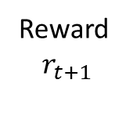
Sequential Decision Problems
Utility-based agent: The agent’s utility depends on a sequence of decisions spread out over time.
Sequential decision problems incorporate utilities, uncertainty, and sensing.
Action
$a_{t}$
Agent
Sequence: $r_{0}, o_{0}, a_{0}, r_{1}, o_{1}, a_{1}, r_{2}, o_{2}, a_{2},, …$
Observations and rewards depend on the state of the system and the agent wants to maximize (discounted) expected reward over time
$$U=E\left[\sum_{t=0}^{∞}{γ^{t}r_{t}}\right]$$
Reward $$r_{t+1}$$
Environment
Observation $$o_{t+1}$$

Slide 4
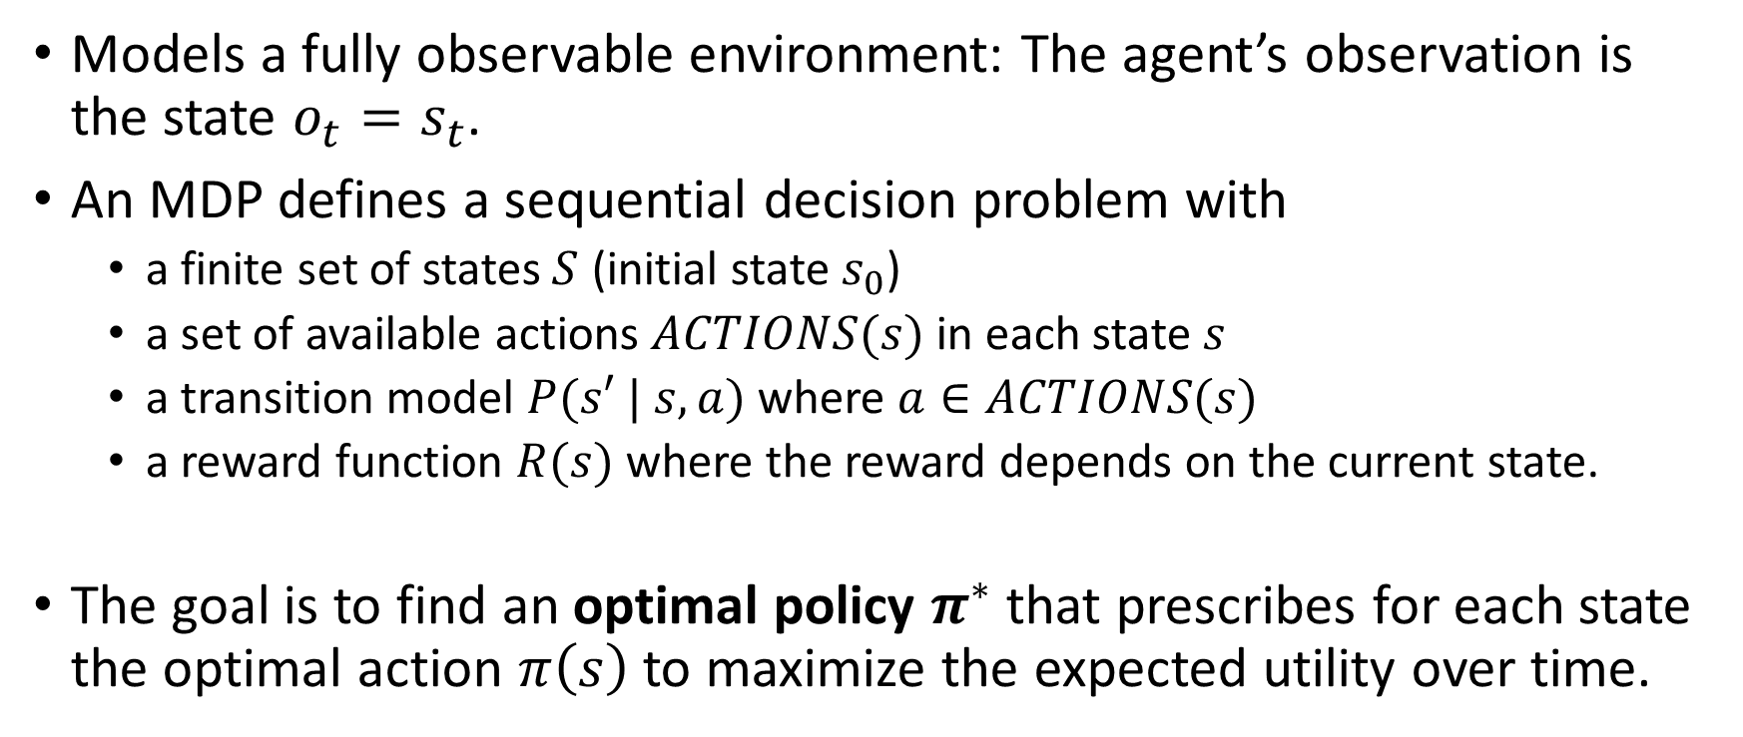
Markov Decision Process (MDP)
Models a fully observable environment: The agent’s observation is the state $o_{t}=s_{t}$.
An MDP defines a sequential decision problem with
a finite set of states $S$ (initial state $s_{0}$)
a set of available actions $ACTIONS(s)$ in each state $s$
a transition model $P(s′ | s, a)$ where $a∈ACTIONS(s)$
a reward function $R(s)$ where the reward depends on the current state.
The goal is to find an optimal policy $π^{∗}$ that prescribes for each state the optimal action $π\left(s\right)$ to maximize the expected utility over time.

Slide 5
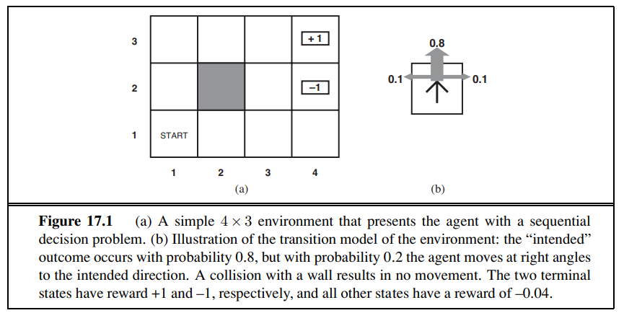
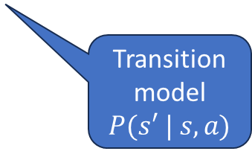
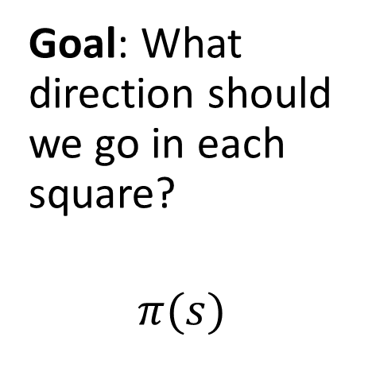
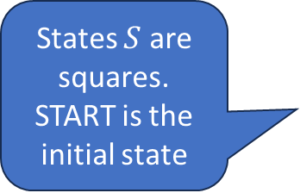
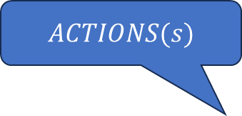
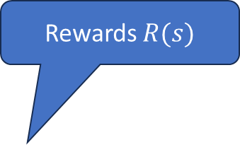
Example: 4x3 Grid World
Rewards $R(s)$
$ACTIONS(s)$
Goal: What direction should we go in each square?
$$π(s)$$
-0.04
-0.04
-0.04
States $S$ are squares. START is the initial state
-0.04
-0.04
-0.04
-0.04
-0.04
Transition model
$P(s′ | s, a)$
-0.04

Slide 6
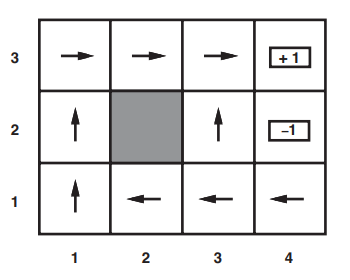
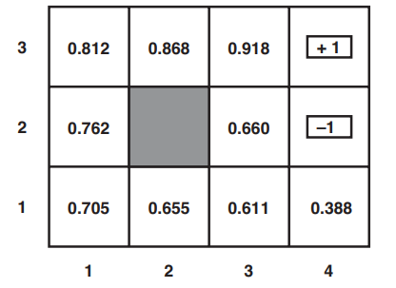

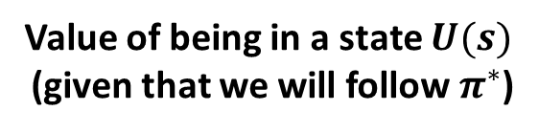
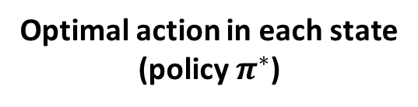
Solution: 4x3 Grid World
Optimal action in each state
(policy $π^{∗}$)
Value of being in a state $U(s)$ (given that we will follow $π^{∗}$)
Always move to
higher utility states
Why is it optimal to walk away from the +1 square?
$$γ=1$$
Question: How to we find the optimal value function/optimal policy?

Slide 7
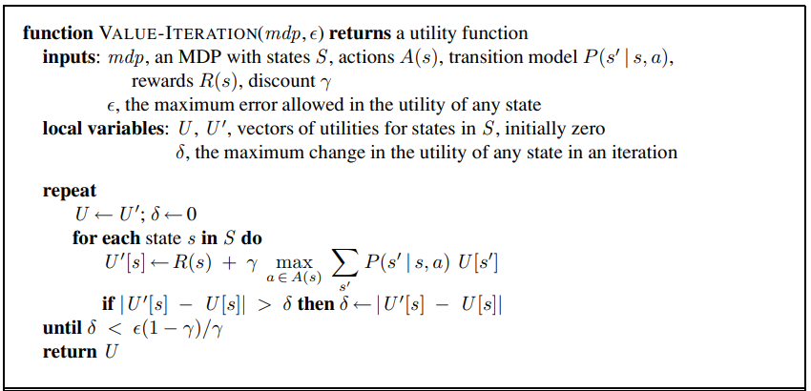
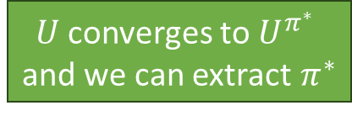
Value Iteration: Estimate the Value function
Bellman update: Update a state with the reward + the expected utility of the state reached with the best action
$U$ converges to $U^{π^{∗}}$ and we can extract $π^{∗}$

Slide 8
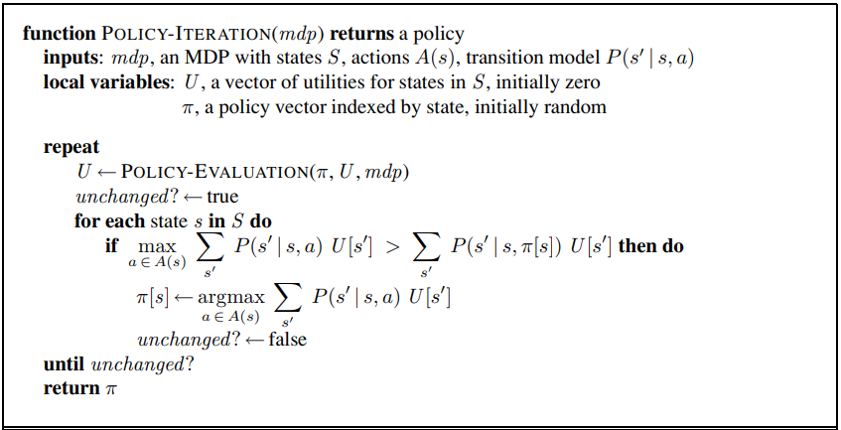
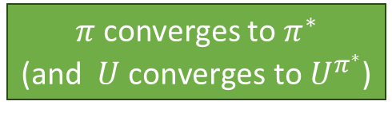
Policy Iteration: Learn the optimal policy
Calculate U given current policy (eighter solve an LP or iterative solution)
Policy
Improvement
$π$ converges to $π^{∗}$ (and $U \text{converges} \text{to} U^{π^{∗}}$)

Slide 9
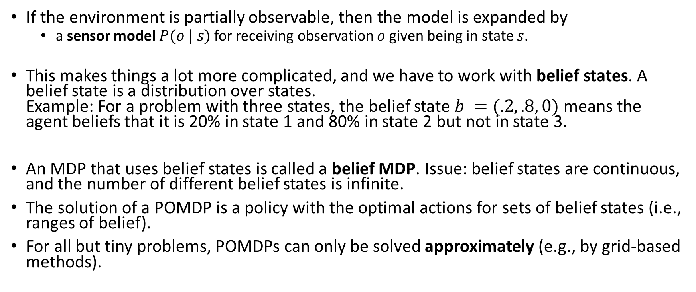
Partially Observable Markov Decision Model (POMDP)
If the environment is partially observable, then the model is expanded by
a sensor model $P(o | s)$ for receiving observation $o$ given being in state $s$.
This makes things a lot more complicated, and we have to work with belief states. A belief state is a distribution over states. Example: For a problem with three states, the belief state $b =(.2, .8, 0)$ means the agent beliefs that it is 20% in state 1 and 80% in state 2 but not in state 3.
An MDP that uses belief states is called a belief MDP. Issue: belief states are continuous, and the number of different belief states is infinite.
The solution of a POMDP is a policy with the optimal actions for sets of belief states (i.e., ranges of belief).
For all but tiny problems, POMDPs can only be solved approximately (e.g., by grid-based methods).

Slide 10
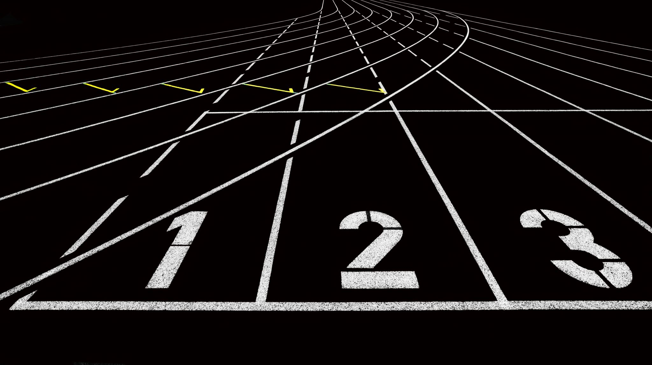
Reinforcement Learning
AIMA Chapter 22

Slide 11
Reinforcement Learning
Reinforcement learning assumes that the problem can be modeled by an MDP.
What if we do not know the transition model 𝑃(𝑠′ | 𝑠, 𝑎)? Now we cannot solve the MDP (estimate the state utility function/policy) because we cannot predict future states!
The agent needs to explore (try actions) and use the reward signal to update its estimate (=learn) of the utility of states and actions.
Notes:
Reward may be sparse. Need for credit assignment.
Reward shaping creates pseudo rewards that advance learning (e.g., ball possession or distance to the goal in soccer).
Hierarchical RL: Break the task into smaller sub-tasks so we can learn the succession of sub-task efficiently.

Slide 12
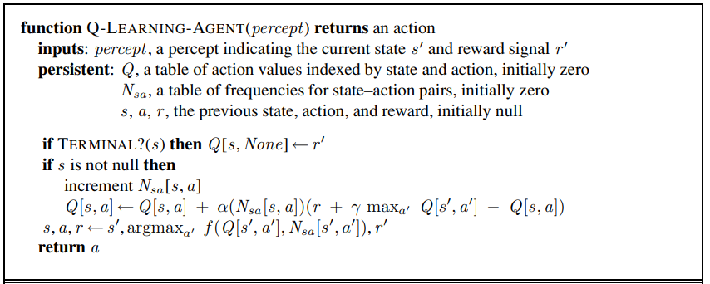
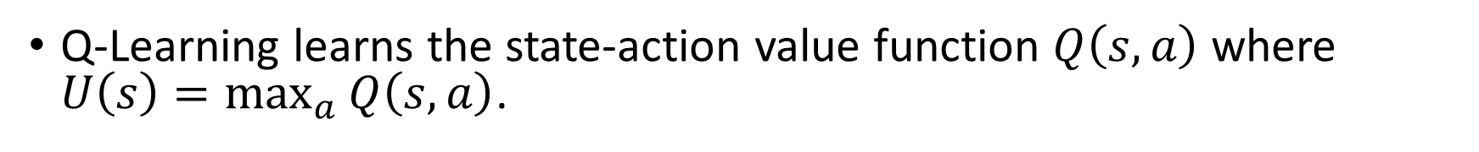
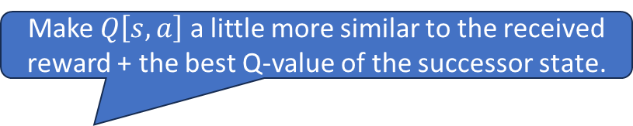
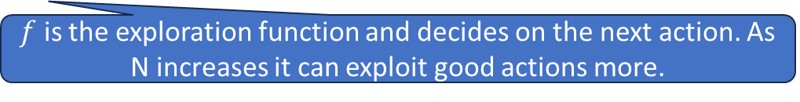
Q-Learning
Q-Learning learns the state-action value function $Q\left(s, a\right)$ where $U\left(s\right)=\max_{a}{Q\left(s, a\right)}$.
Make $Q\left[s,a\right]$ a little more similar to the received reward + the best Q-value of the successor state.
$f$ is the exploration function and decides on the next action. As N increases it can exploit good actions more.

Slide 13
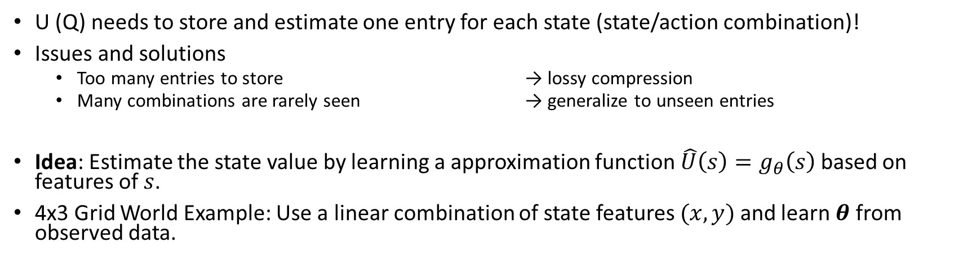

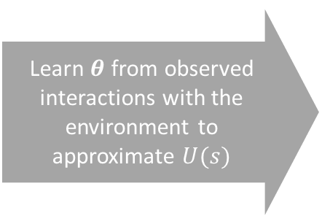

Function Approximation
U (Q) needs to store and estimate one entry for each state (state/action combination)!
Issues and solutions
Too many entries to store → lossy compression
Many combinations are rarely seen → generalize to unseen entries
Idea: Estimate the state value by learning a approximation function $\hat{U}\left(s\right)=g_{θ}\left(s\right)$ based on features of $s$.
4x3 Grid World Example: Use a linear combination of state features $(x, y)$ and learn $θ$ from observed data.
Learn $θ$ from observed interactions with the environment to approximate $U(s)$
$$U(s)$$
$${\hat{U}}_{theta}\left(x,y\right)=θ_{0}+θ_{1}x+θ_{2}y$$
Notes:
We can also approximate the state-value function Q for Q-learning.
We typically need non-linear approximators that can be incrementally updated (online learning). → Deep ANNs
Notes:
Deep RL is still somewhat unpredictable since the deep ANN has many parameters…

Slide 14

Summary
Agents can learn the value of being in a state from reward signals.
Rewards can be delayed (e.g., at the end of a game).
Not being able to fully observe the state makes the problem more difficult (POMDP).
Unknown transition models lead to the need of exploration by trying actions (model free methods like Q-Learning).
All these problems are computationally very expensive and often can only be solved by approximation. State of the art is to use deep artificial neural networks for function approximation.

