Slide 1
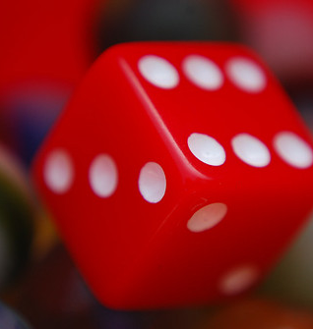
CS 5/7320 Artificial Intelligence Uncertainty and Probabilities AIMA Chapter 12
Slides by Michael Hahsler based on slides by Svetlana Lazepnik with figures from the AIMA textbook
This work is licensed under a Creative Commons Attribution-ShareAlike 4.0 International License.
"Dice" by Steve A Johnson

Slide 2

Uncertainty is Bad for Agents Based on Logic
Example: Catching a Flight
Let action A_{t} = leave for airport t minutes before flight
Question: Will A_{t} get me there on time?
Problems:
Partial observability (road state, other drivers' plans, etc.)
Noisy sensors (traffic reports)
Uncertainty in action outcomes (flat tire, etc.)
Complexity of modeling and predicting traffic
A purely logical approach leads to conclusions that are too weak for effective decision making:
A₂₅ will get me there on time if there is no accident on the bridge and it doesn't rain and my tires remain intact, etc., etc.
A_{Inf} guarantees to get there in time, but who lives forever?

Slide 3
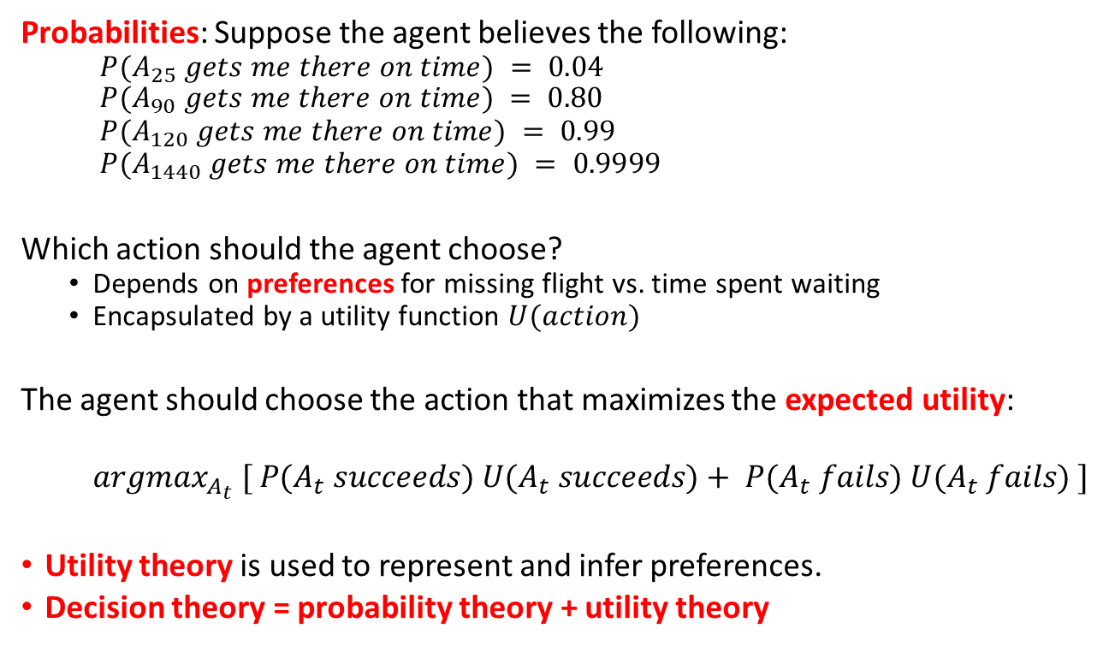
Making Decisions Under Uncertainty
Probabilities: Suppose the agent believes the following:
$P(A_{25} gets me there on time) = 0.04$
$$P(A_{90} gets me there on time) = 0.80$$
$$P(A_{120} gets me there on time) = 0.99$$
$$P(A_{1440} gets me there on time) = 0.9999$$
Which action should the agent choose?
Depends on preferences for missing flight vs. time spent waiting
Encapsulated by a utility function $U(action)$
The agent should choose the action that maximizes the expected utility:
$$argmax_{A_{t}} [ P(A_{t} succeeds) U(A_{t} succeeds)+ P(A_{t} fails) U(A_{t} fails) ]$$
Utility theory is used to represent and infer preferences.
Decision theory = probability theory + utility theory

Slide 4
Sources of Uncertainty
Probabilistic assertions summarize effects of:
Ignorance
Lack of explicit theories, relevant facts, observability, etc.
Randomness
Intrinsically random behavior
Laziness
Failure to enumerate exceptions, qualifications, etc.
Example: What is the source of uncertainty for a coin toss?

Slide 5
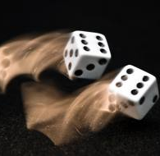
A Quick Review of Probability Theory
What are Probabilities?
Random variables
Events
Joint probabilities
Marginal probabilities
Conditional probabilities
Bayes’ Rule
Conditional independence

Slide 6
What are Probabilities?
Frequentism (Objective; Positivist)
Probabilities are long-run relative frequencies determined by observation.
For example, if we toss a coin many times$, P(heads)$is estimated as the proportion of the time the coin will come up heads
For example, if we toss a coin many times, 𝑃(ℎ𝑒𝑎𝑑𝑠) is estimated as the proportion of the time the coin will come up heads
But what if we are dealing with events that only happen once? E.g., what is the probability that a Republican will win the presidency in 2024? How do we define comparable elections? Reference class problem.
Bayesian Statistics (Subjective)
Probabilities are degrees of belief based on prior knowledge and updated by evidence.
How do we assign belief values to statements without evidence?
How do we update our degrees of belief given observations?
Provides tools to:

Slide 7
Random variables
Random Variable
Random variables are denoted by capital letters.
R: Is it raining?
W: What’s the weather?
Die: What is the outcome of rolling two dice?
V: What is the speed of my car (in MPH)?
Domain
Domain values must be mutually exclusive and exhaustive.
R $∈${True, False}
R ∈ {True, False}
W $∈$ {Sunny, Cloudy, Rainy, Snow}
W ∈ {Sunny, Cloudy, Rainy, Snow}
Die $∈$ {(1,1), (1,2), … (6,6)}
Die ∈ {(1,1), (1,2), … (6,6)}
V $∈$ [0, 200]
V ∈ [0, 200]
We describe the (uncertain) state of the world using random variables.
Random variables take on values in a domain D.

Slide 8
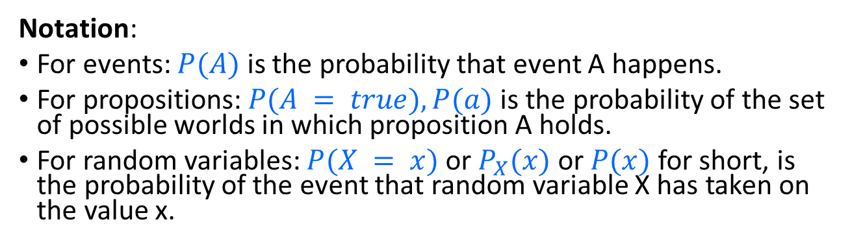
Events and Propositions
Probabilistic statements are defined over events, world states or sets of states
“It is raining”
“The weather is either cloudy or snowy”
“The sum of the two dice rolls is 11”
“My car is going between 30 and 50 miles per hour”
Events are described using propositions:
R = True
W = “Cloudy” ∨ W = “Snowy”
D ∈ {(5,6), (6,5)}
30 ≤ S ≤ 50
Notation:
For events: $P(A)$ is the probability that event A happens.
For propositions: $P(A = true), P(a)$is the probability of the set of possible worlds in which proposition A holds.
For random variables: $P(X = x)$or $P_{X}(x)$ or $P(x)$ for short, is the probability of the event that random variable X has taken on the value x.

Slide 9
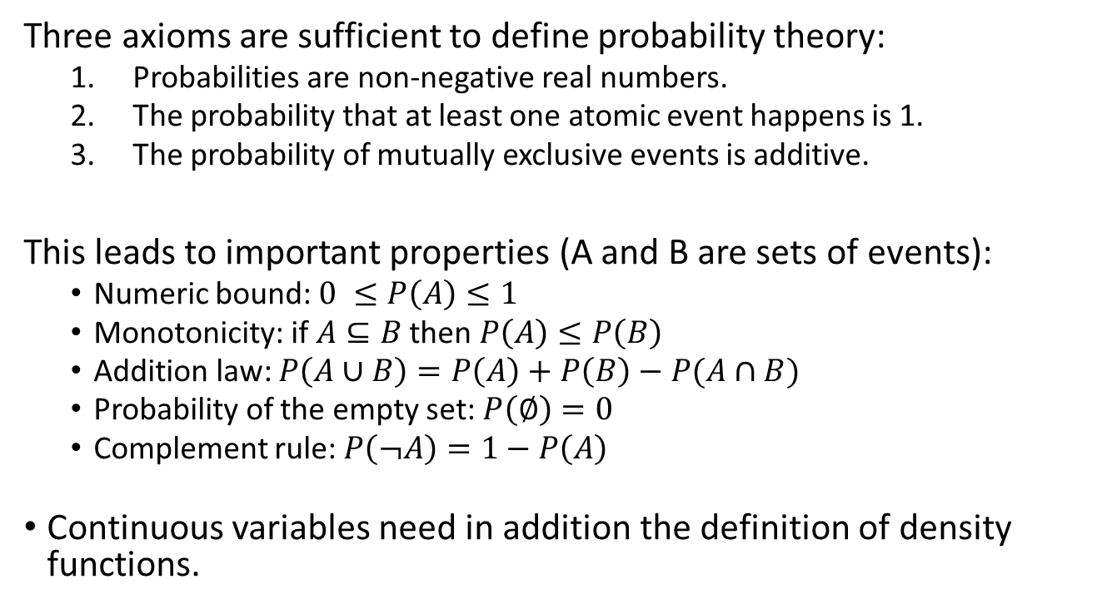
Kolmogorov’s 3 Axioms of Probability
Three axioms are sufficient to define probability theory:
Probabilities are non-negative real numbers.
The probability that at least one atomic event happens is 1.
The probability of mutually exclusive events is additive.
This leads to important properties (A and B are sets of events):
Numeric bound: $0 ≤P\left(A\right)≤1$
Monotonicity: if $A⊆B$ then $P\left(A\right)≤P\left(B\right)$
Addition law: $P\left(A∪B\right)=P\left(A\right)+P\left(B\right)−P(A∩B)$
Probability of the empty set: $P\left(∅\right)=0$
Complement rule: $P\left(¬A\right)=1−P\left(A\right)$
Continuous variables need in addition the definition of density functions.

Slide 10
Atomic events
Atomic event: a complete specification of the state of the world, or a complete assignment of domain values to all random variables.
Atomic events are mutually exclusive and exhaustive.
E.g., if the world consists of only two Boolean variables Cavity and Toothache, then there are 4 distinct atomic events: Cavity = false ∧Toothache = false Cavity = false ∧ Toothache = true Cavity = true ∧ Toothache = false Cavity = true ∧ Toothache = true

Slide 11

Joint probability distributions
A joint distribution is an assignment of probabilities to every possible atomic event
Notation:
$P(x), P(X=x)$is the probability that random variable X takes on value x
$P(X)$is the distribution of probabilities for all possible values of X. Often we are lazy or forget to make P bold.
Atomic event | P
Cavity = false ∧Toothache = false | 0.8
Cavity = false ∧ Toothache = true | 0.1
Cavity = true ∧ Toothache = false | 0.05
Cavity = true ∧ Toothache = true | 0.05
Sum: 1.00

Slide 12

Marginal probability distributions
Sometimes we are only interested in one variable. This is called the marginal distribution $P(Y)$
P(Cavity, Toothache)
Cavity = false ∧Toothache = false | 0.8
Cavity = false ∧ Toothache = true | 0.1
Cavity = true ∧ Toothache = false | 0.05
Cavity = true ∧ Toothache = true | 0.05
P(Cavity)
Cavity = false | ?
Cavity = true | ?
P(Toothache)
Toothache = false | ?
Toothache = true | ?
Marginal Prob. Distr.

Slide 13

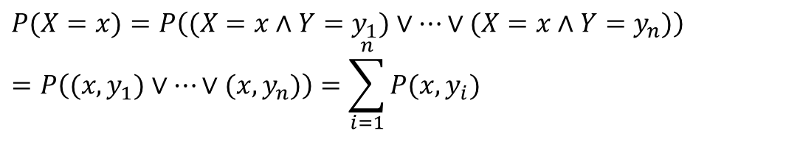
Marginal probability distributions
Suppose we have the joint distribution $P(X,Y)$ and we want to find the marginal distribution $P(Y)$
General rule: to find $P(X = x),$sum the probabilities of all atomic events where $X = x$. This is called “summing out” or marginalization.
$$P(X=x)=P\left((X=x∧Y=y_{1})∨…∨(X=x∧Y=y_{n})\right) \\ =P\left((x,y_{1})∨…∨(x,y_{n})\right)=\sum_{i=1}^{n}{P(x,y_{i})}$$

Slide 14

Marginal probability distributions
Suppose we have the joint distribution $P(X,Y)$ and we want to find the marginal distribution $P(Y)$
P(Cavity, Toothache)
Cavity = false ∧Toothache = false | 0.8
Cavity = false ∧ Toothache = true | 0.1
Cavity = true ∧ Toothache = false | 0.05
Cavity = true ∧ Toothache = true | 0.05
P(Cavity)
Cavity = false | 0.8+0.1 = 0.9
Cavity = true | 0.05+0.05=0.1
P(Toothache)
Toothache = false | 0.8+0.0.5= 0.85
Toothache = true | 0.1+0.05= 0.15
Marginal Prob. Distr.

Slide 15
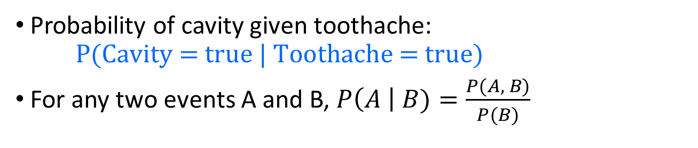



Conditional probability
Probability of cavity given toothache: $\text{P}\text{(}\text{Cavity}\text{ = }\text{true}\text{ | }\text{Toothache}\text{ = }\text{true}\text{)}$
For any two events A and B, $P\left(A \right| B)=\frac{P(A, B)}{P(B)}$
$$P(A,B)$$
$$P(A)$$
$$P(B)$$

Slide 16

Conditional probability
$$P\left(A \right| B)=\frac{P(A,B)}{P(B)}$$
P(Cavity, Toothache)
Cavity = false ∧Toothache = false | 0.8
Cavity = false ∧ Toothache = true | 0.1
Cavity = true ∧ Toothache = false | 0.05
Cavity = true ∧ Toothache = true | 0.05
Joint Prob. Distr.
P(Cavity)
Cavity = false | 0.9
Cavity = true | 0.1
P(Toothache)
Toothache = false | 0.85
Toothache = true | 0.15
Marginal Prob. Distr.
What is P(Cavity = true | Toothache = false)?
0.05 / 0.85 = 0.059
What is P(Cavity = false | Toothache = true)?
0.1 / 0.15 = 0.667

Slide 17
Conditional distributions
$$P\left(A \right| B)=\frac{P(A,B)}{P(B)}$$
P(Cavity, Toothache)
Cavity = false ∧Toothache = false | 0.8
Cavity = false ∧ Toothache = true | 0.1
Cavity = true ∧ Toothache = false | 0.05
Cavity = true ∧ Toothache = true | 0.05
A conditional distribution is a distribution over the values of one variable given fixed values of other variables
P(Cavity | Toothache = true)
Cavity = false | 0.667
Cavity = true | 0.333
P(Cavity | Toothache = false)
Cavity = false | 0.941
Cavity = true | 0.059
P(Toothache | Cavity = true)
Toothache= false | 0.5
Toothache = true | 0.5
P(Toothache | Cavity = false)
Toothache= false | 0.889
Toothache = true | 0.111

Slide 18


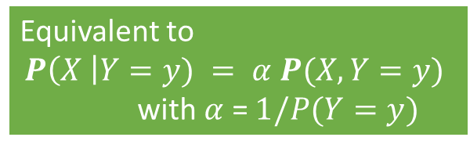

Normalization trick
To get the whole conditional distribution $P(X | Y = y)$at once, select all entries in the joint distribution matching $Y = y$and renormalize them to sum to one.
P(Cavity, Toothache)
Cavity = false ∧Toothache = false | 0.8
Cavity = false ∧ Toothache = true | 0.1
Cavity = true ∧ Toothache = false | 0.05
Cavity = true ∧ Toothache = true | 0.05
Select P(X, Y = y)
Toothache, Cavity = false
Toothache= false | 0.8
Toothache = true | 0.1
Sum is $P\left(Y=y\right)=0.9$
Renormalize sum to 1 (= divide by $P(Y=y)$)
P(Toothache | Cavity = false)
Toothache= false | 0.889
Toothache = true | 0.111
Equivalent to
$$P\left(X \right|Y=y) = α P(X, Y=y)$$
with $α$ = $1/P(Y=y)$

Slide 19
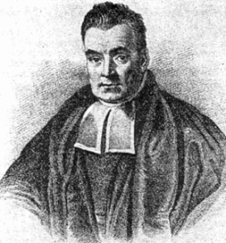
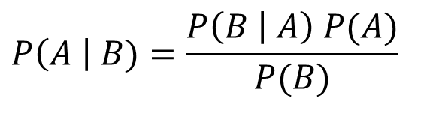
Bayes’ Rule
The product rule (definition of conditional distribution) gives us two ways to factor a joint distribution for events A and B:
Therefore,
Why is this useful?
Can get diagnostic probability P(Cavity | Toothache) from causal probability P(Toothache | Cavity)
We can update our beliefs based on evidence.
Important tool for probabilistic inference .
$$P\left(A,B\right)=P\left(A | B\right)P\left(B\right)=P\left(B | A\right)P(A)$$
Posterior Prob.
Prior Prob.
$$P\left(A \right| B)=\frac{P\left(B | A\right) P(A)}{P(B)}$$
Rev. Thomas Bayes (1702-1761)

Slide 20
Example: Getting Married in the Desert
Marie is getting married tomorrow, at an outdoor ceremony in the desert. In recent years, it has rained only 5 days each year (5/365 = 0.014). Unfortunately, the weatherman has predicted rain for tomorrow. When it actually rains, the weatherman correctly forecasts rain 90% of the time. When it doesn't rain, he incorrectly forecasts rain 10% of the time. What is Marie’s belief for the probability that it will rain on her wedding day?

Slide 21
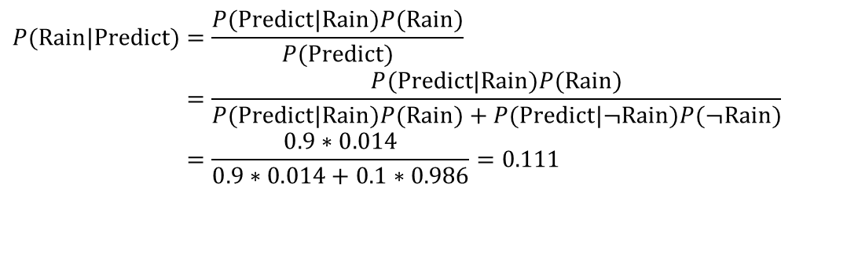
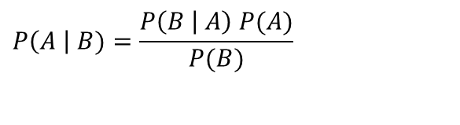
Example: Getting Married in the Desert
New Evidence
Prior Probability
Marie is getting married tomorrow, at an outdoor ceremony in the desert. In recent years, it has rained only 5 days each year (5/365 = 0.014). Unfortunately, the weatherman has predicted rain for tomorrow. When it actually rains, the weatherman correctly forecasts rain 90% of the time. When it doesn't rain, he incorrectly forecasts rain 10% of the time. What is Marie’s belief for the probability that it will rain on her wedding day?
$$P\left(A \right| B)=\frac{P\left(B | A\right) P(A)}{P(B)}$$
Posteriori
Probability
$$P(\text{Rain}|\text{Predict})=\frac{P(\text{Predict}|\text{Rain})P(\text{Rain})}{P(\text{Predict})} \\ =\frac{P(\text{Predict}|\text{Rain})P(\text{Rain})}{P(\text{Predict}|\text{Rain})P(\text{Rain})+P(\text{Predict}|¬\text{Rain})P(¬\text{Rain})} \\ =\frac{0.9∗0.014}{0.9∗0.014+0.1∗0.986}=0.111$$
The weather forecast updates her belief from 0.014 to 0.111

Slide 22
Example: Breast Cancer Screening
1% of women at age forty who participate in routine screening have breast cancer. 80% of women with breast cancer will get positive mammographies. 9.6% of women without breast cancer will also get positive mammographies. A woman in this age group had a positive mammography in a routine screening. What is the probability that she actually has breast cancer?

Slide 23
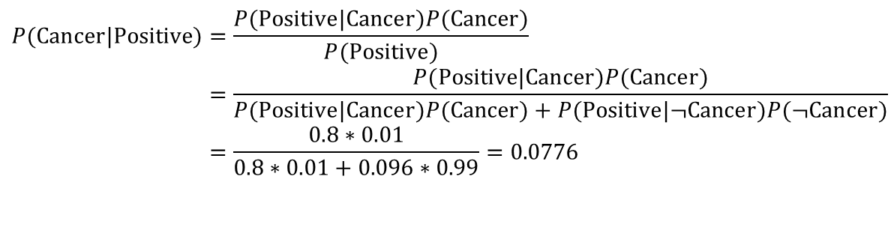
Example: Breast Cancer Screening
1% of women at age forty who participate in routine screening have breast cancer. 80% of women with breast cancer will get positive mammographies. 9.6% of women without breast cancer will also get positive mammographies. A woman in this age group had a positive mammography in a routine screening. What is the probability that she actually has breast cancer?
$$P(\text{Cancer}|\text{Positive})=\frac{P(\text{Positive}|\text{Cancer})P(\text{Cancer})}{P(\text{Positive})} \\ =\frac{P(\text{Positive}|\text{Cancer})P(\text{Cancer})}{P(\text{Positive}|\text{Cancer})P(\text{Cancer})+P(\text{Positive}|¬\text{Cancer})P(¬\text{Cancer})} \\ =\frac{0.8∗0.01}{0.8∗0.01+0.096∗0.99}=0.0776$$
The positive test updates our belief from 0.01 to 0.0776

Slide 24
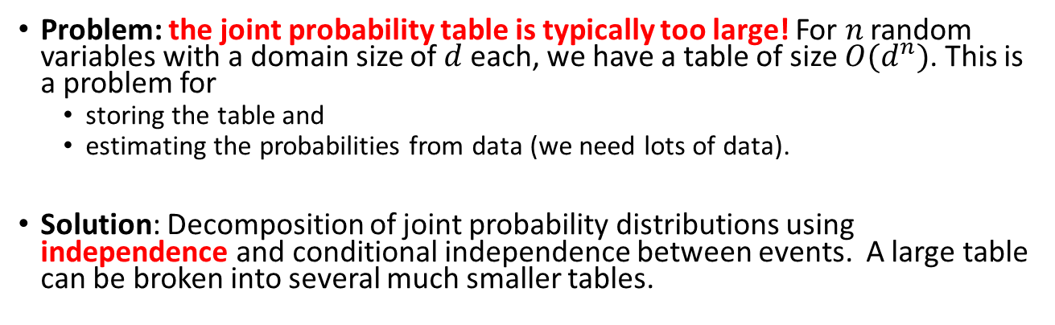
Approach to Choose Actions
Define Joint Probability
Conditional Probability
Bayes’ Rule to update beliefs about the state
Decide on Action
Normalization Trick
Probability theory
Utility theory
Problem: the joint probability table is typically too large! For $n$ random variables with a domain size of $d$ each, we have a table of size $O(d^{n})$. This is a problem for
storing the table and
estimating the probabilities from data (we need lots of data).
Solution: Decomposition of joint probability distributions using independence and conditional independence between events. A large table can be broken into several much smaller tables.

Slide 25
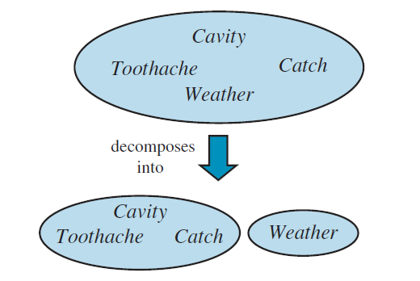
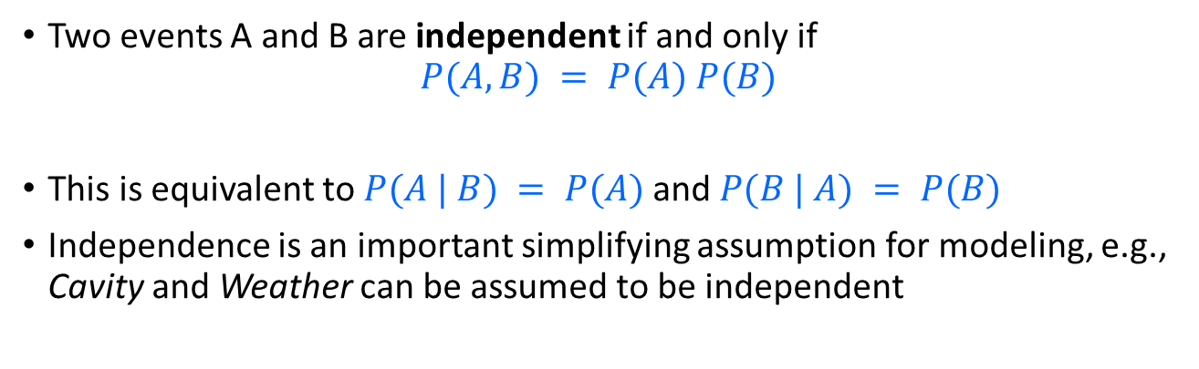
Independence Between Events
Two events A and B are independent if and only if
$$P(A, B) = P(A) P(B)$$
This is equivalent to $P(A | B) = P(A)$and $P(B | A) = P(B)$
Independence is an important simplifying assumption for modeling, e.g., Cavity and Weather can be assumed to be independent
Independence
P(Cavity, Weather) = P(Cavity)P(Weather)
P(Cavity | Weather) = P(Cavity)

Slide 26
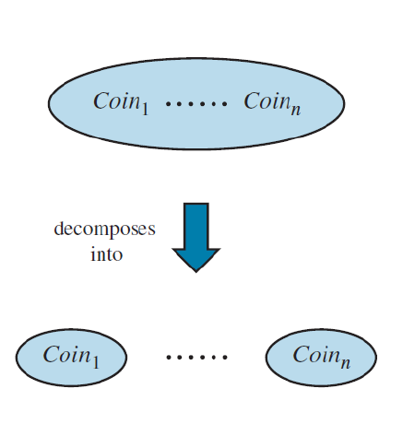
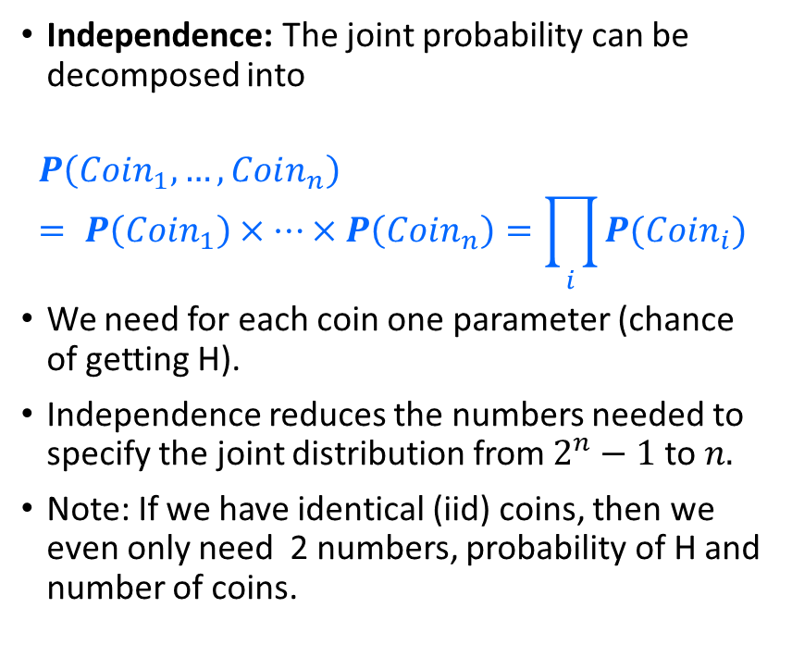
Decomposition of the Joint Probability Distribution
Independence: The joint probability can be decomposed into
$$P\left(Coin_{1},…,Coin_{n}\right)= P\left(Coin_{1}\right)×…×P\left(Coin_{n}\right)=\prod_{i}{P(Coin_{i})}$$
We need for each coin one parameter (chance of getting H).
Independence reduces the numbers needed to specify the joint distribution from $2^{n}−1$ to $n.$
Note: If we have identical (iid) coins, then we even only need 2 numbers, probability of H and number of coins.

Slide 27
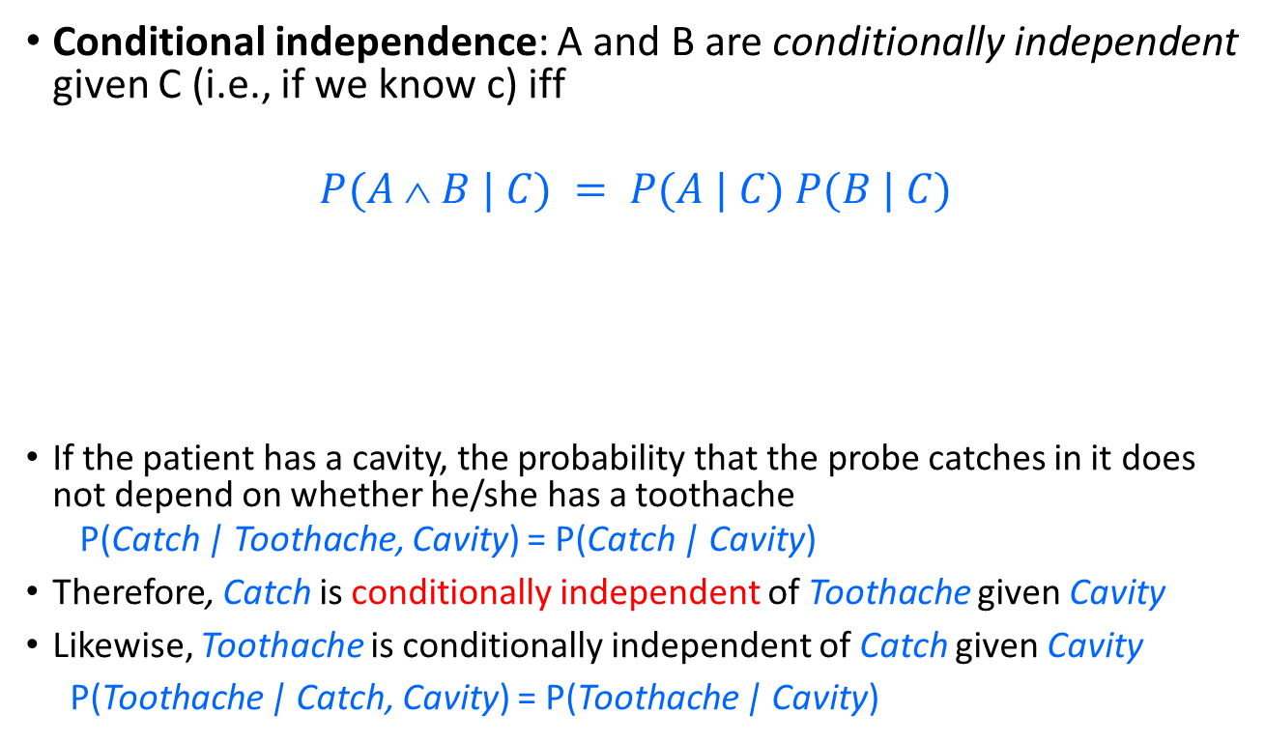
Conditional Independence
Conditional independence: A and B are conditionally independent given C (i.e., if we know c) iff
$$P(A  B | C) = P(A | C) P(B | C)$$
If the patient has a cavity, the probability that the probe catches in it does not depend on whether he/she has a toothache
P(Catch | Toothache, Cavity) = P(Catch | Cavity)
Therefore, Catch is conditionally independent of Toothache given Cavity
Likewise, Toothache is conditionally independent of Catch given Cavity
P(Toothache | Catch, Cavity) = P(Toothache | Cavity)
Toothache
Cavity
Catch

Slide 28
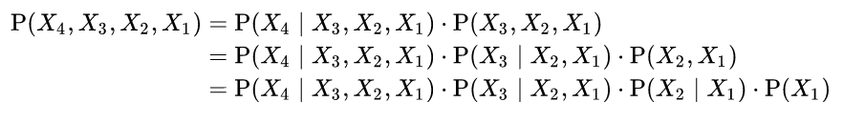
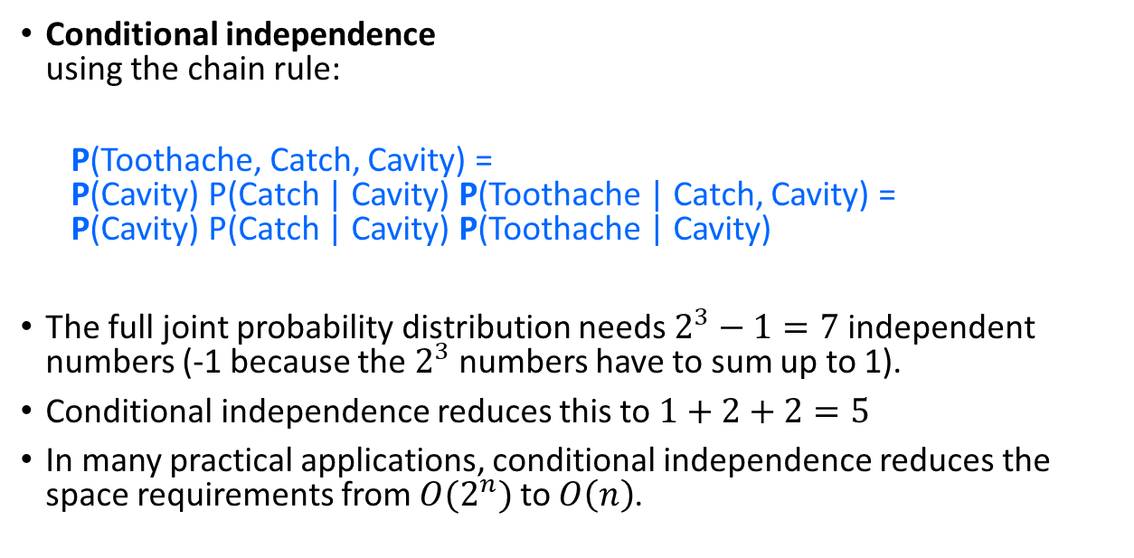
Decomposition of the Joint Probability Distribution
Toothache
Cavity
Conditional independence using the chain rule:
P(Toothache, Catch, Cavity) = P(Cavity) P(Catch | Cavity) P(Toothache | Catch, Cavity) = P(Cavity) P(Catch | Cavity) P(Toothache | Cavity)
The full joint probability distribution needs $2^{3}−1=7$ independent numbers (-1 because the $2^{3}$ numbers have to sum up to 1).
Conditional independence reduces this to $1+2+2=5$
In many practical applications, conditional independence reduces the space requirements from $O(2^{n})$ to $O\left(n\right)$.
Catch
Chain rule: Example for 4 variables.

Slide 29
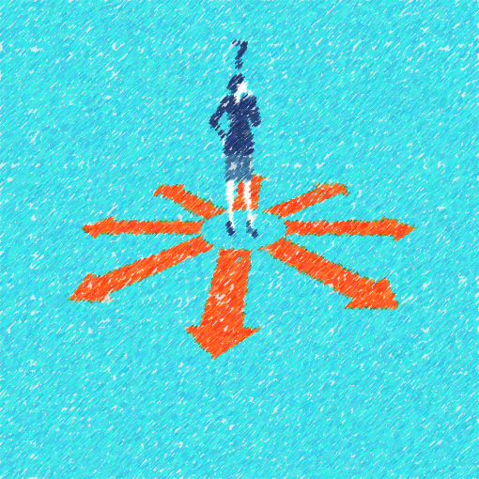
Bayesian Decision Making Making Decisions under Uncertainty based on Evidence

Slide 30
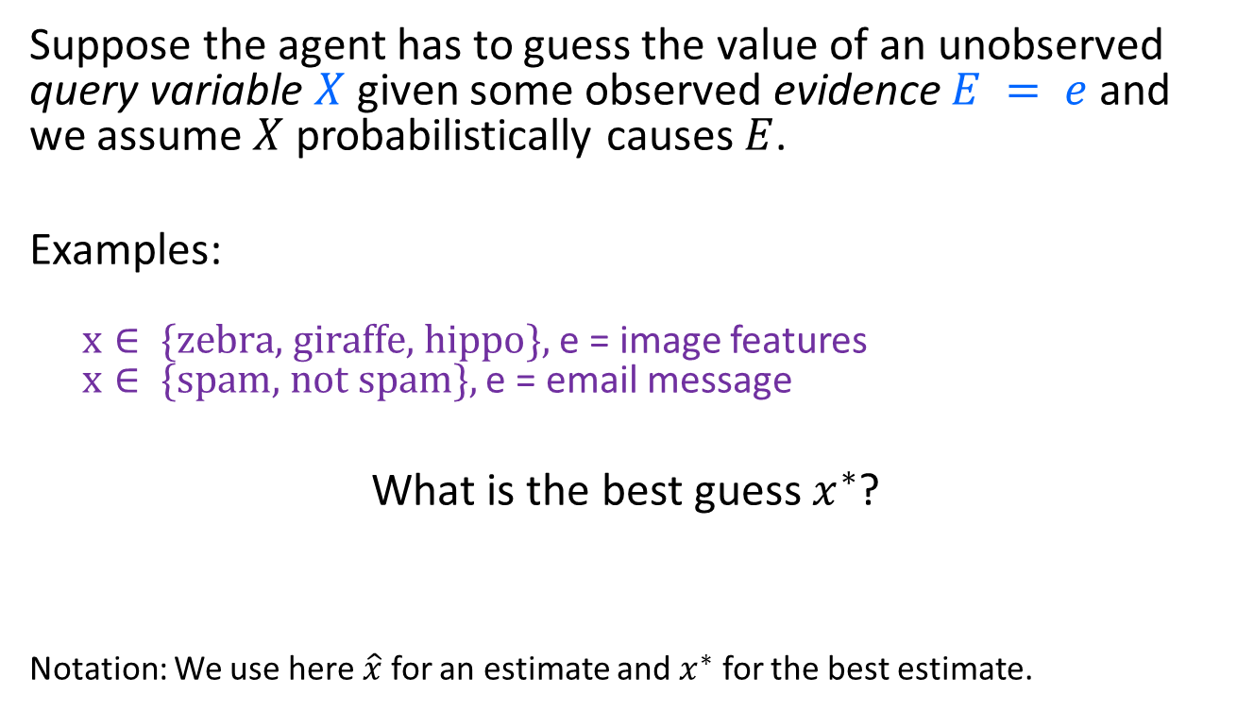
Probabilistic Inference
Suppose the agent has to guess the value of an unobserved query variable $X$ given some observed evidence $E = e$and we assume $X$ probabilistically causes $E$.
Examples:
$x∈ \{\text{zebra}\text{, }\text{giraffe}\text{, }\text{hippo}\},$e = image features $x∈ \{\text{spam}\text{, }\text{not} \text{spam}\},$e = email message
What is the best guess $x^{∗}$?
Notation: We use here $\hat{x}$ for an estimate and $x^{∗}$ for the best estimate.
Notes:
Expected loss of a decision: P(decision is correct) * 0 + P(decision is wrong) * 1

Slide 31
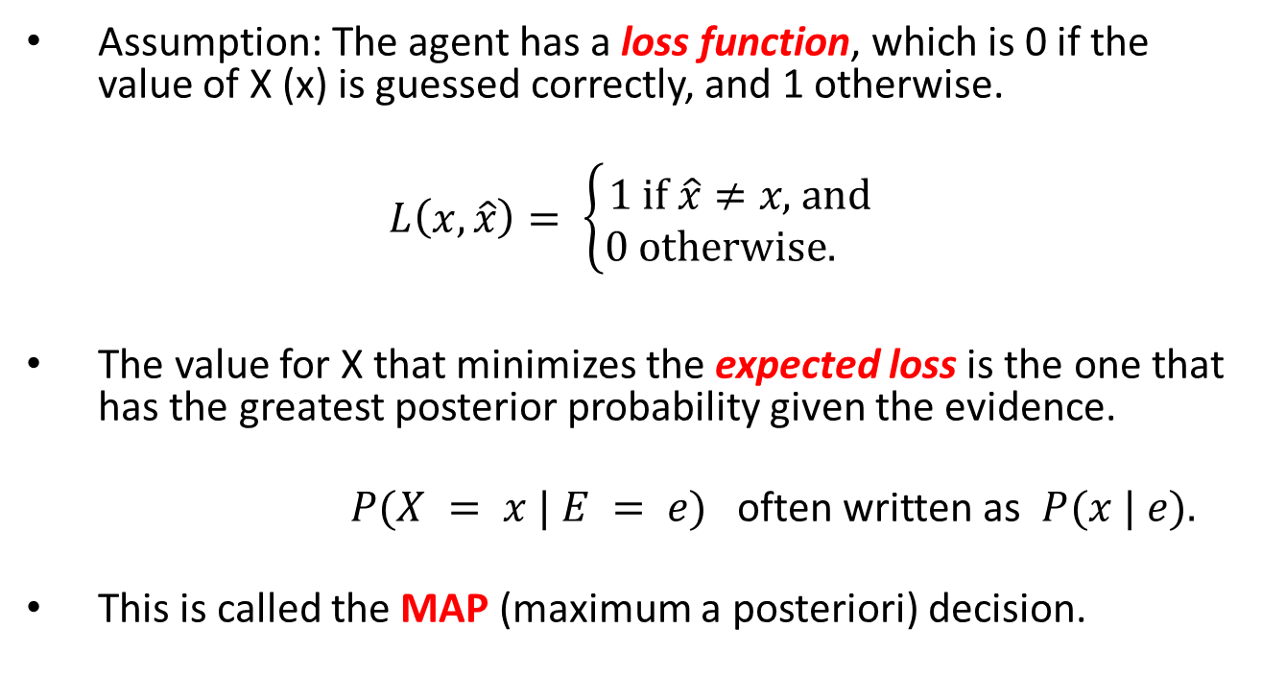
Bayes’ Decision Theory
Assumption: The agent has a loss function, which is 0 if the value of X (x) is guessed correctly, and 1 otherwise.
$$L\left(x, \hat{x}\right)= \left\{\begin{aligned}1 \text{if} \hat{x}≠x\text{, }\text{and} \\ 0 \text{otherwise}\text{. }\end{aligned}\right.$$
The value for X that minimizes the expected loss is the one that has the greatest posterior probability given the evidence.
$P(X = x | E = e)$often written as $P(x | e).$
This is called the MAP (maximum a posteriori) decision.
Notes:
Expected loss of a decision: P(decision is correct) * 0 + P(decision is wrong) * 1

Slide 32

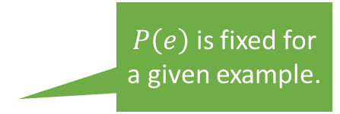
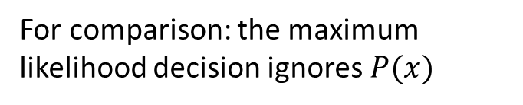
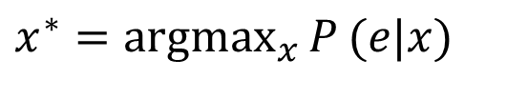
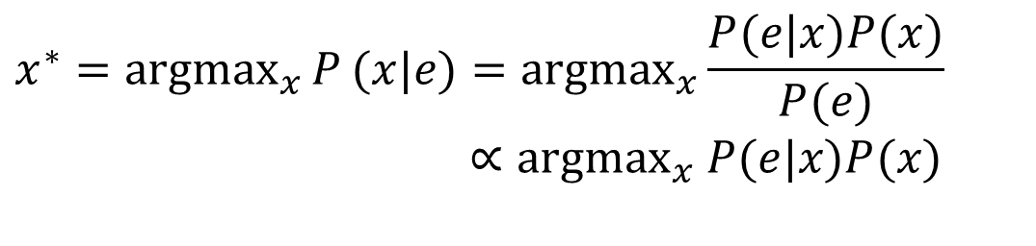
MAP: Maximum A Posteriori Decision
Use the value $x$ that has the highest (maximum) posterior probability given the evidence $e$
Posterior Prob.
Prior Prob.
$P\left(e\right)$ is fixed for a given example.
$$x^{∗}={argmax}_{x}{P}(x|e)={argmax}_{x}\frac{P(e|x)P(x)}{P(e)}$$ $∝{argmax}_{x} P(e|x)P(x)$
For comparison: the maximum likelihood decision ignores $P(x)$
$$x^{∗}={argmax}_{x}{P}(e|x)$$
likelihood

Slide 33

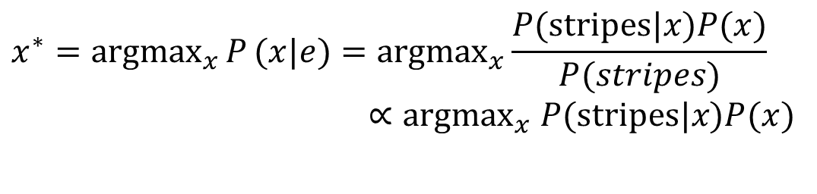
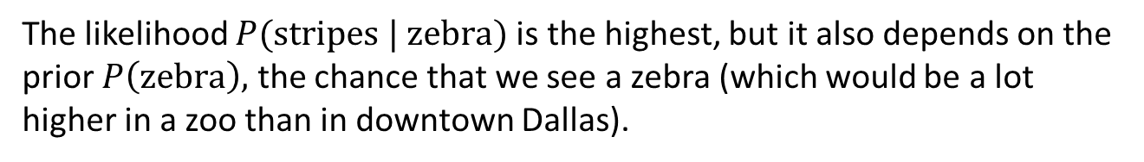
MAP: Example
Value of $x$ that has the highest (maximum) posterior probability given the evidence $e$.
$x∈ \{\text{zebra}\text{, }\text{dog}\text{, }\text{cat}\},$e = stripes
Posterior Prob.
$$x^{∗}={argmax}_{x}{P}(x|e)={argmax}_{x}\frac{P(\text{stripes}|x)P(x)}{P(stripes)}$$ $∝{argmax}_{x} P(\text{stripes}|x)P(x)$
likelihood
Prior Prob.
The likelihood $P(\text{stripes} \text{|} \text{zebra})$is the highest, but it also depends on the prior $P\left(\text{zebra}\right),$ the chance that we see a zebra (which would be a lot higher in a zoo than in downtown Dallas).

Slide 34
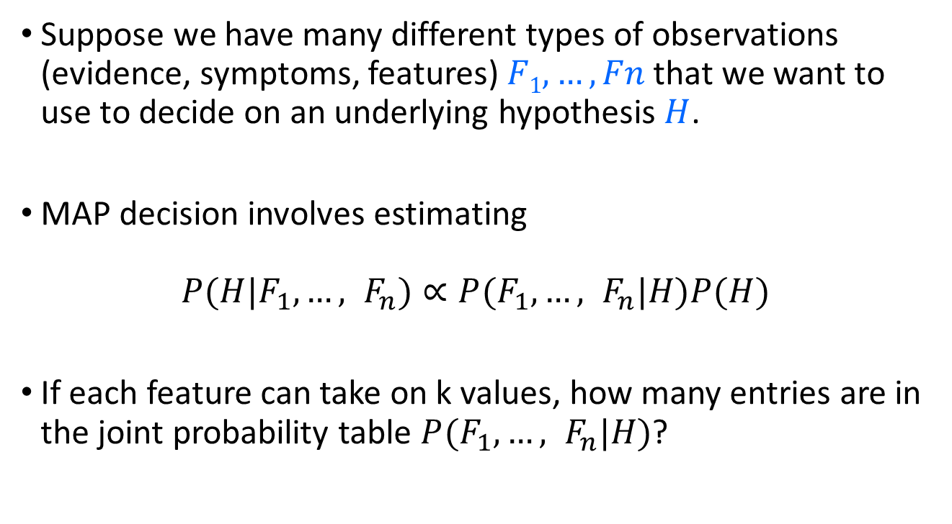
Bayes Classifier
Suppose we have many different types of observations (evidence, symptoms, features) $F1, …, Fn$that we want to use to decide on an underlying hypothesis $H$.
MAP decision involves estimating
$$P(H|F_{1},…, F_{n})∝P(F_{1},…, F_{n}|H)P(H)$$
If each feature can take on k values, how many entries are in the joint probability table $P(F_{1},…, F_{n}|H)$?

Slide 35
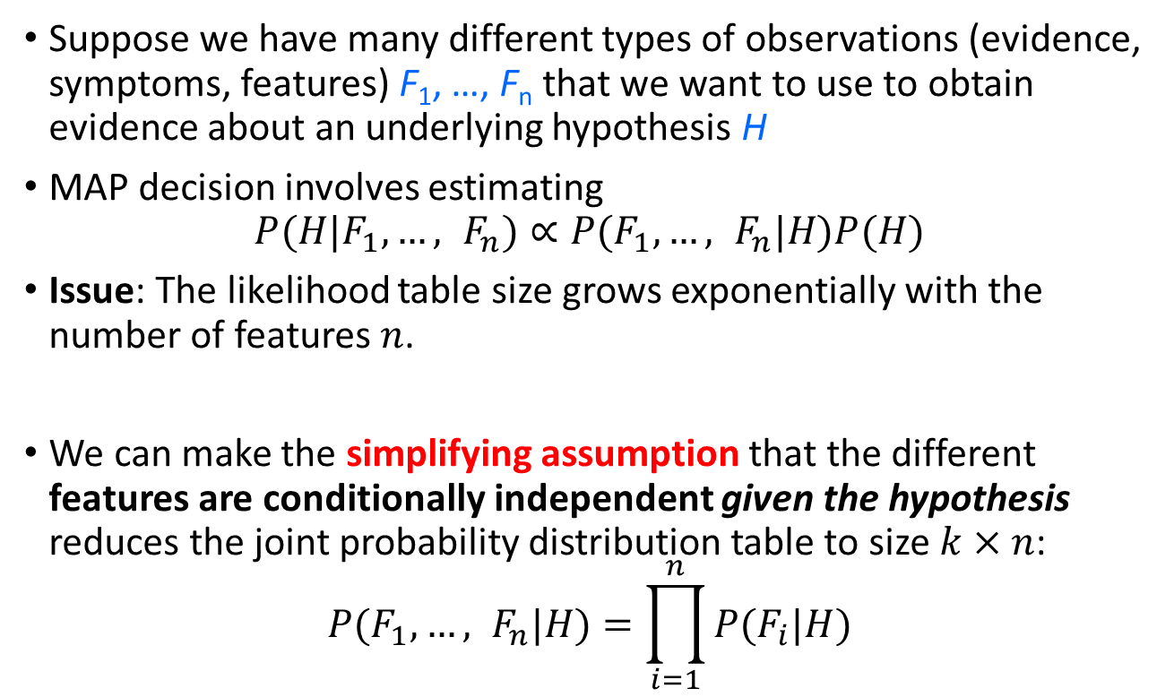
Naïve Bayes model
Suppose we have many different types of observations (evidence, symptoms, features) F₁, …, F_{n} that we want to use to obtain evidence about an underlying hypothesis H
MAP decision involves estimating $P(H|F_{1},…, F_{n})∝P(F_{1},…, F_{n}|H)P(H)$
Issue: The likelihood table size grows exponentially with the number of features $n$.
We can make the simplifying assumption that the different features are conditionally independent given the hypothesis reduces the joint probability distribution table to size $k×n$:
$$P(F_{1},…, F_{n}|H)=\prod_{i=1}^{n}{P(F_{i}|H)}$$

Slide 36

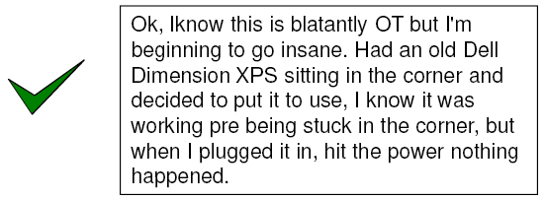
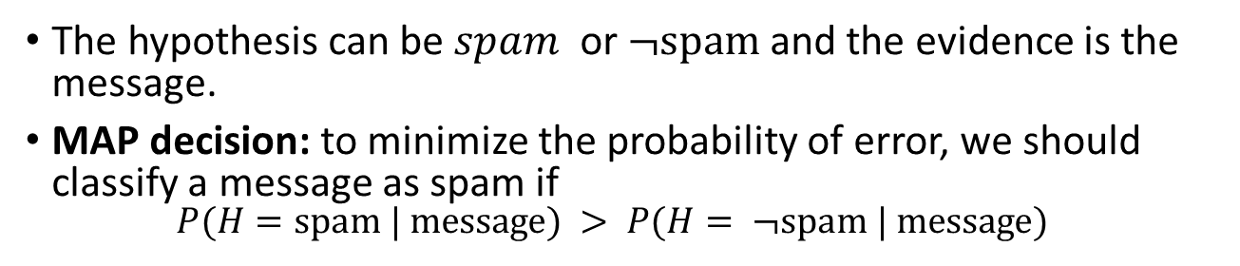
Example: Naïve Bayes Spam Filter
The hypothesis can be $spam$ or $¬\text{spam}$and the evidence is the message.
MAP decision: to minimize the probability of error, we should classify a message as spam if $P(H=\text{spam}\text{ | }\text{message}) > P(H= ¬\text{spam}\text{ | }\text{message})$
How do we represent the messages?

Slide 37
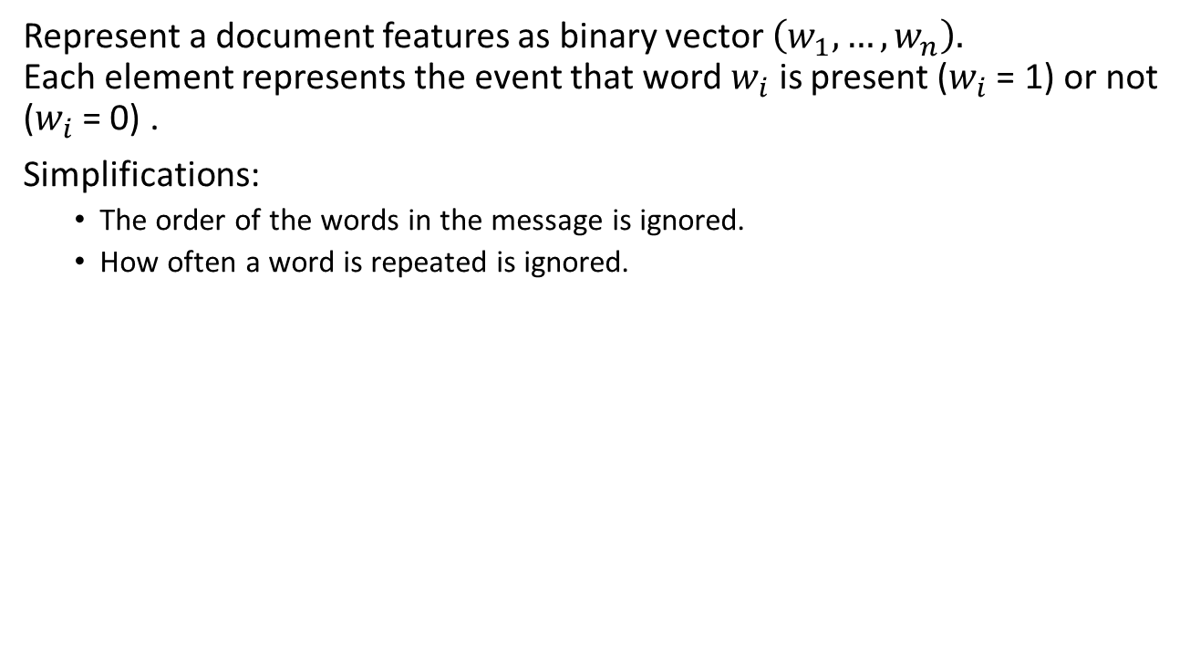
Natural Language Processing: Bag of Words
Represent a document features as binary vector $\left(w_{1}, …, w_{n}\right).$ Each element represents the event that word $w_{i}$ is present ($w_{i}$ = 1) or not ($w_{i}$ = 0) .
Simplifications:
The order of the words in the message is ignored.
How often a word is repeated is ignored.

Slide 38
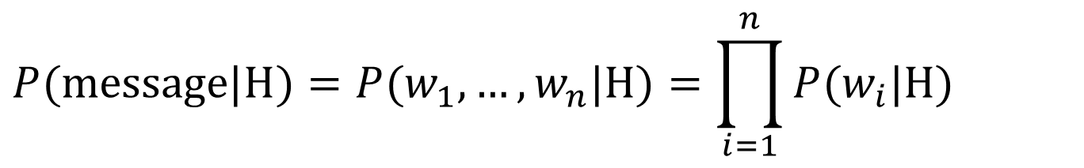
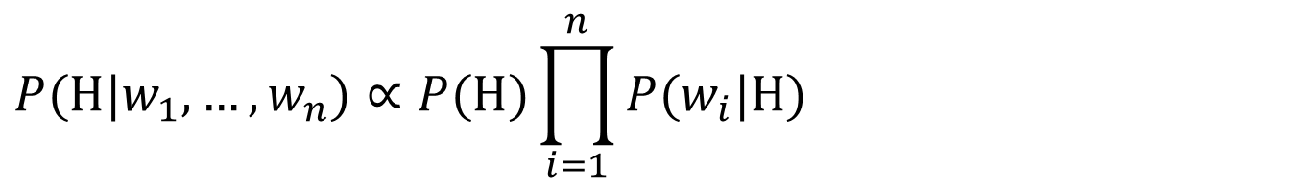
Naïve Bayes Spam Filter
If we assume that each word is conditionally independent of the others given message class (spam or not spam), then we can use a naïve Bayes classifier.
$$P(\text{message}\text{|}\text{H})=P(w_{1},…,w_{n}|\text{H})=\prod_{i=1}^{n}{P(w_{i}|\text{H})}$$
$$P(\text{H}|w_{1},…,w_{n})∝P(\text{H})\prod_{i=1}^{n}{P(w_{i}|\text{H})}$$
posterior
prior
Evidence (presents and absence of words)

Slide 39
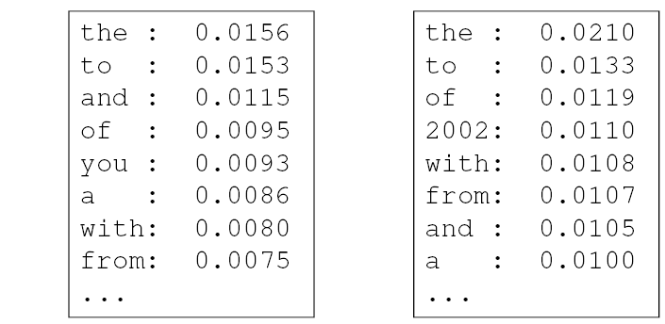
Parameter estimation
In order to classify a message, we need to know
the prior P(H) and
the likelihoods P(word = 1 | H), P(word = 0 | spam)
These are the parameters of the probabilistic model:
prior
P(word = 1| H= spam)
P(word = 1 | H = ¬spam)
spam: 0.33
¬spam: 0.67
+ likelihoods for the absence of words:
P(word = 0| H = spam) = 1 - P(word = 1| H = spam)
P(word = 0| H = ¬spam) = 1 - P(word = 1| H = ¬spam)

Slide 40
Parameter estimation: Prior
How do we obtain the prior P(H)?
Empirically: use training data
P(H = ¬spam) = 1 - P(H = spam)
# of spam messages
P(H = spam) =
total # of messages

Slide 41
Parameter estimation: Likelihoods
How do we obtain the likelihoods P(word = 1 | H = spam) and P(word = 1 | H = ¬spam)?
Empirically: use training data
# of spam messages that contain the word
P(word = 1| H = spam) =
total # of spam messages

Slide 42
Parameter estimation: Smoothing
Problem: What happens with words that we have never seen or seen only a few times?
Laplacian smoothing: add one to each count
Note: This is actually a Bayesian estimate with +1 and # of classes (2 for spam/not spam) representing an uniformed prior probability.
# of spam messages that contain the word + 1
P(word = 1 | H = spam) =
total # of spam messages + # of classes

Slide 43
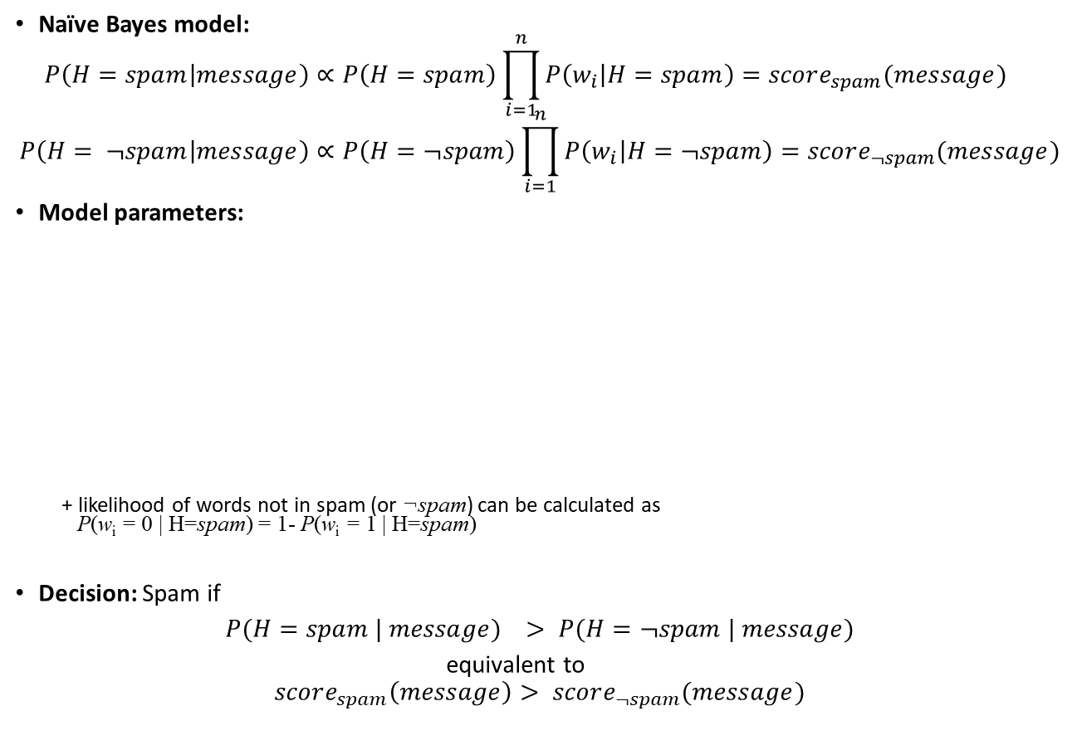
Summary of model and parameters
Naïve Bayes model:
$$P\left(H=spam | message\right)∝P\left(H=spam\right)\prod_{i=1}^{n}{P\left(w_{i} | H=spam\right)}=score_{spam}(message) \\ P\left(H= ¬spam | message\right)∝P\left(H=¬spam\right)\prod_{i=1}^{n}{P\left(w_{i} | H=¬spam\right)}=score_{¬spam}(message)$$
Model parameters:
+ likelihood of words not in spam (or ¬spam) can be calculated as P(w_{i} = 0 | H=spam) = 1- P(w_{i} = 1 | H=spam)
Decision: Spam if
$P(H=spam | message) > P(H=¬spam | message)$
equivalent to
$$score_{spam}\left(message\right)> score_{¬spam}(message)$$
Likelihood of words in spam
Likelihood of words in ¬spam
prior
P(w₁ = 1 | H=spam)
P(w₂ = 1 | H=spam)
…
P(w_{n} = 1 | H=spam)
P(w₁ = 1 | H=¬spam)
P(w₂ = 1 | H=¬spam)
…
P(w_{n} = 1 | H=¬spam)
P(H = spam)
P(H = ¬spam)
+ Laplacian Smoothing

Slide 44
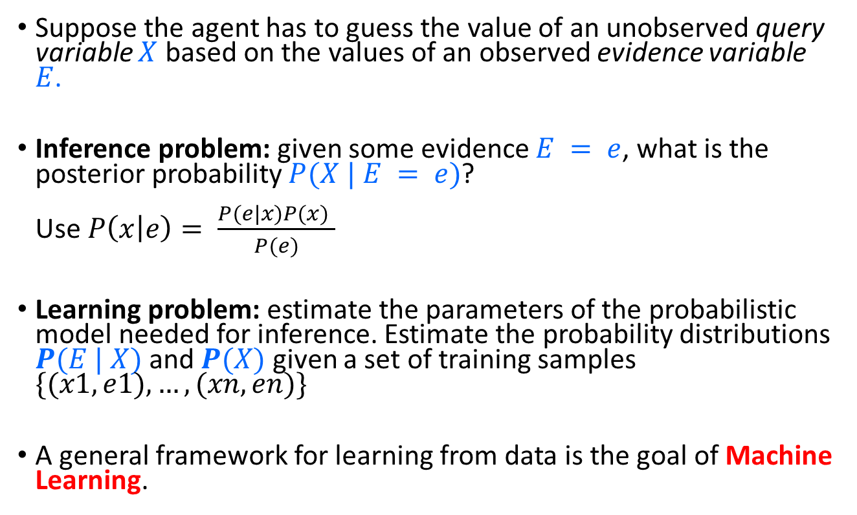
Bayesian decision making: Summary
Suppose the agent has to guess the value of an unobserved query variable $X$ based on the values of an observed evidence variable $E$.
Inference problem: given some evidence $E = e$, what is the posterior probability $P(X | E = e)$? Use $P\left(x | e\right)= \frac{P(e|x)P(x) }{P(e)}$
Learning problem: estimate the parameters of the probabilistic model needed for inference. Estimate the probability distributions $P(E | X)$and $P(X)$ given a set of training samples $\{(x1,e1), …, (xn,en)\}$
A general framework for learning from data is the goal of Machine Learning.

