Slide 1

CS 5/7320 Artificial Intelligence Automated Planning AIMA Chapter 11
Slides by Michael Hahsler with figures from the AIMA textbook
This work is licensed under a Creative Commons Attribution-ShareAlike 4.0 International License.

Slide 2
Contents
Classical Planning
Hierarchical Planning
Monitoring and Replaning

Slide 3

Classical Planning
Using Planning Domain Definition Languages

Slide 4
Classical Planning
Find a sequence of actions to accomplish a goal in a discrete, deterministic, static, fully observable environment.
Options:
Search with a custom heuristic evaluation function (Chapter 3)
Propositional logic with custom code (Chapter 7)
Issue: state space is exponentially large state
Solution: factored state representation using a Planning Domain Definition Language (PDDL)

Slide 5
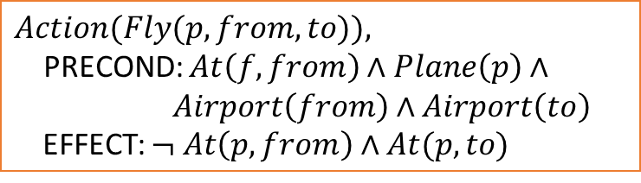



Planning Domain Definition Language (PDDL)
State: a conjunction of ground atomic fluents (in Conjunctive Normal Form; CNF).
Fluent: an aspect of the world that changes over time.
Action Schema (=precondition-effect description)
Action $a$ is applicable to state $s$ if $s$ entails the precondition of $a$.
The result of $a$ on $s$ is $s′$ which removes the negated fluents and adds the positive fluents.
$$RESULT\left(s,a\right)=\left(s−DEL\left(a\right)\right)∪ADD(a))$$
Goal is just like a precondition.
$$Action(Fly(p, from, to)),$$ PRECOND: $At\left(f, from\right)∧Plane\left(p\right)∧$ $Airport\left(from\right)∧Airport\left(to\right)$ EFFECT: $¬ At\left(p, from\right)∧At(p, to)$
$$DEL(a)$$
$$ADD(a)$$

Slide 6
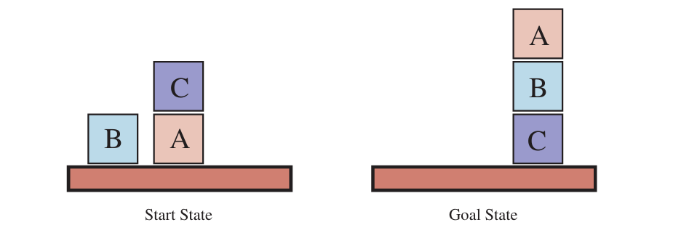
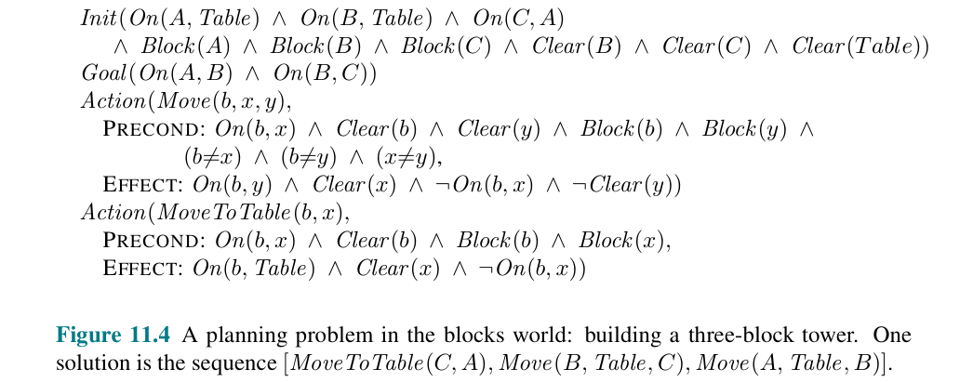
Example

Slide 7
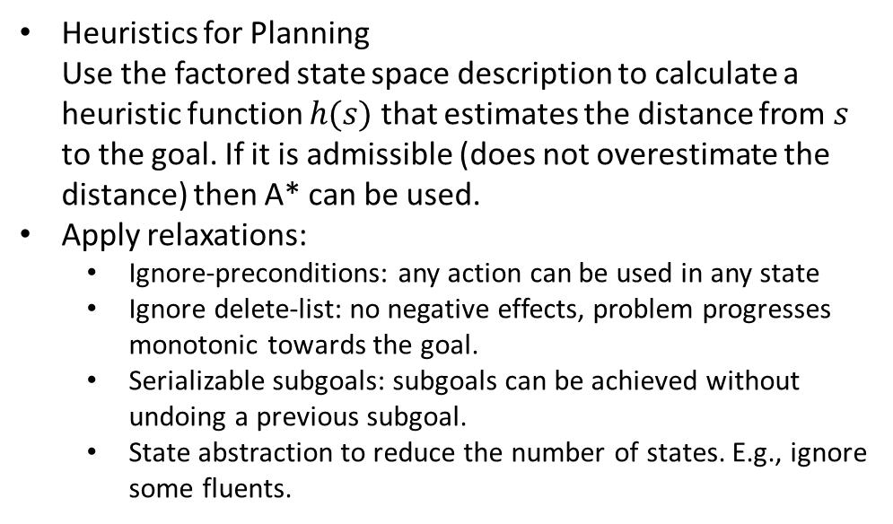
Algorithms
Forward state-space search: Needs heuristics to deal with the state space.
Backward search (= regression search): keeps the branching factor low. But how do we define heuristics?
Convert the PDDL description into propositional form and use one of th4 efficient solvers for the Boolean satisfiability problem (SAT).
Heuristics for Planning Use the factored state space description to calculate a heuristic function $h(s)$ that estimates the distance from $s$ to the goal. If it is admissible (does not overestimate the distance) then A* can be used.
Apply relaxations:
Ignore-preconditions: any action can be used in any state
Ignore delete-list: no negative effects, problem progresses monotonic towards the goal.
Serializable subgoals: subgoals can be achieved without undoing a previous subgoal.
State abstraction to reduce the number of states. E.g., ignore some fluents.
Remember the maze: We used x and y coordinates to calculate the distance to the goal.

Slide 8

Hierarchical Planning
Manage complexity using high-level actions.

Slide 9





High-level Actions
A high-level action (HLA) have one or several refinements into a sequence of HLAs or primitive actions.
An HLA achieves the goal if at least one implementation achieves the goal.
The agent can reason with HLAs.
HLA
Refinement
…
HLA
HLA
HLA
HLA
HLA
…
$$a$$
$$a$$
$$a$$
$$a$$
$$a$$
“Implementation” with only primitive actions

Slide 10
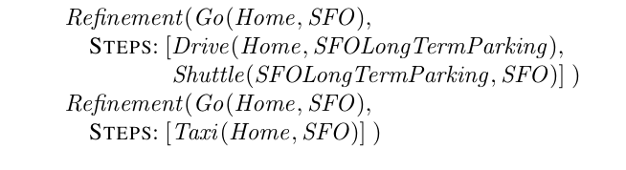
Example
Two refinements for the HLA to go to the SFO airport:
The agent can choose which implementation of an HLA to use.

Slide 11
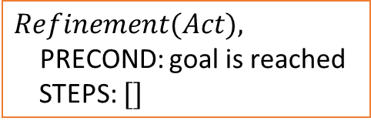
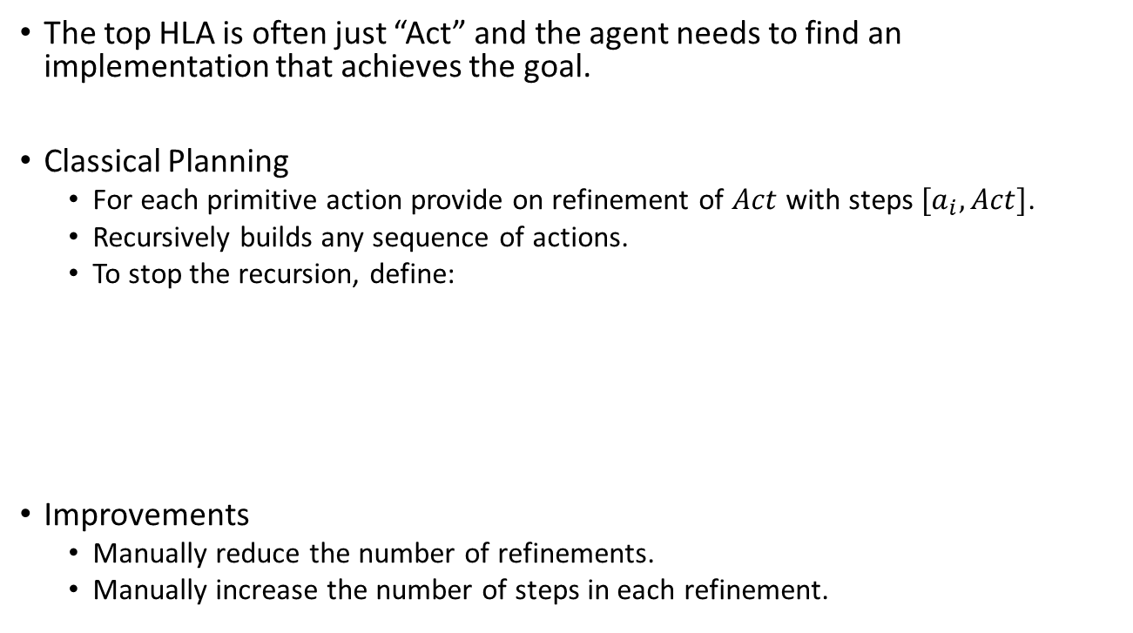
Search for Primitive Solutions
The top HLA is often just “Act” and the agent needs to find an implementation that achieves the goal.
Classical Planning
For each primitive action provide on refinement of $Act$ with steps $[a_{i},Act]$.
Recursively builds any sequence of actions.
To stop the recursion, define:
Improvements
Manually reduce the number of refinements.
Manually increase the number of steps in each refinement.
$$Refinement(Act),$$ PRECOND: goal is reached STEPS: $[]$

Slide 12
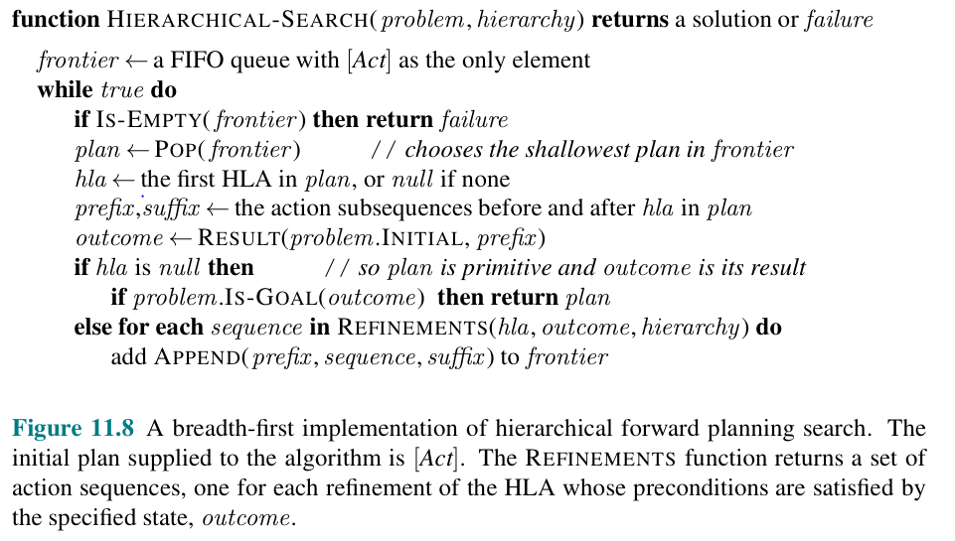
Implementation: Search for Primitive Solutions

Slide 13
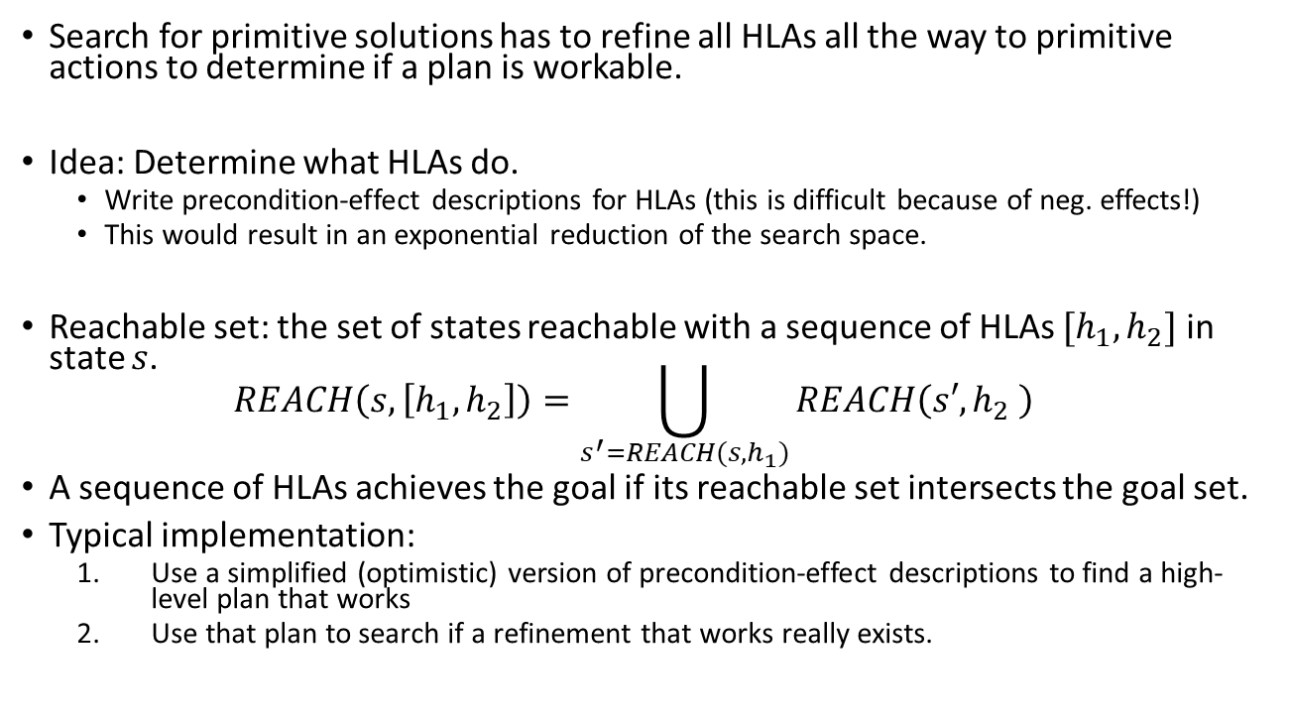
Searching for Abstract Solutions
Search for primitive solutions has to refine all HLAs all the way to primitive actions to determine if a plan is workable.
Idea: Determine what HLAs do.
Write precondition-effect descriptions for HLAs (this is difficult because of neg. effects!)
This would result in an exponential reduction of the search space.
Reachable set: the set of states reachable with a sequence of HLAs $[h_{1},h_{2}]$ in state $s$. $REACH\left(s,\left[h_{1},h_{2}\right]\right)=\bigcup_{s^{′}=REACH(s, h_{1})}{REACH\left(s′,h_{2} \right)}$
A sequence of HLAs achieves the goal if its reachable set intersects the goal set.
Typical implementation:
Use a simplified (optimistic) version of precondition-effect descriptions to find a high-level plan that works
Use that plan to search if a refinement that works really exists.

Slide 14

Monitoring and Replanning
Planning and Acting in Partially Observable, Nondeterministic, and Unknown Environments

Slide 15
Belief States
A belief state is a set of possible physical states the agent might be in.
Belief states need to be extended for factored state representation.
The belief state becomes a set of logical formula of fluents.
Fluents that do not appear in the formula are unknow.

Slide 16
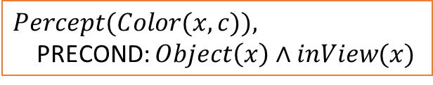
Percept Schema
The agent uses a percept schema to reason about percepts that it can obtains during executing a plan.
Example: Whenever the agent sees an object, then it will perceive its color. The agent can now reason that it needs to get the object inView to see the color.
Percept schemata and observability
Fully observable: Percept schemas have no preconditions.
Partially observable: Some percepts have preconditions.
Sensorless agent: has no percept schemas.
$$Percept(Color(x, c)),$$ PRECOND: $Object\left(x\right)∧inView(x)$

Slide 17
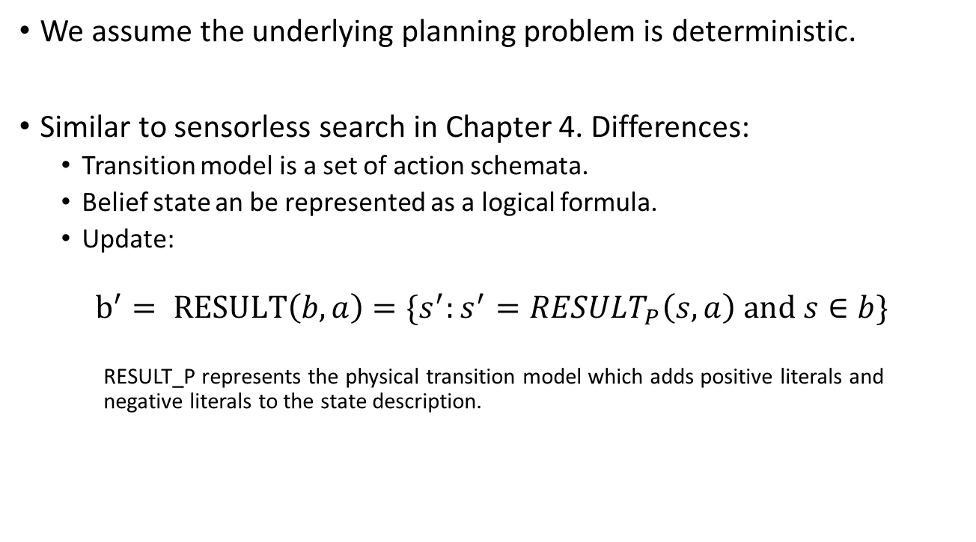
Sensorless Planning (Conformant planning)
We assume the underlying planning problem is deterministic.
Similar to sensorless search in Chapter 4. Differences:
Transition model is a set of action schemata.
Belief state an be represented as a logical formula.
Update:
$$b^{′}= RESULT\left(b,a\right)=\{s^{′}:s^{′}=RESULT_{P}\left(s,a\right) \text{and} s∈b\}$$
RESULT_P represents the physical transition model which adds positive literals and negative literals to the state description.

Slide 18
Contingency Planning
For partially observable planning problems.
We already have introduced conditional plans in Chapter 4 and just need to augment it by:
Action schemata instead of a transition function.
Percept schemata to reason about how to get needed percepts.
The state has a factored representation as facts in CNF.
Use AND-OR search over belief states.
Issue: Contingency plans become very complicated
Non-deterministic effects like failures in actions or percepts. E.g., moving north fails 1 out of 100 times.
Incorrect model of the world. E.g., actions with missing preconditions or missing effects, missing fluents, exogenous effects.
→ Online Planning

Slide 19
Online Planning
Online planning replans when necessary.
Requires execution monitoring to determine the need for replanning. The agent can perform
Action monitoring (verify that the preconditions are met)
Plan monitoring (verify that the remaining plan will still succeed)
Goal monitoring (check if a better set of goals becomes available)
Often contingency plans are made simpler by having some branches that just say “REPLAN”
Process:
Plan
Execute
Check
Replan
Execute
…

Slide 20
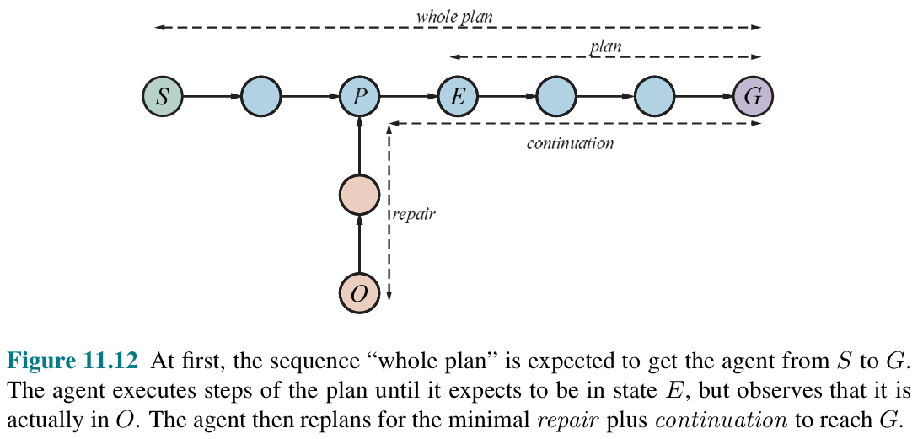
Plan Monitoring Example with Repair
1. Initial plan
2. Remaining plan
2. Failure detected: Should be in E. Remaining plan will not work.

Slide 21

Summary
Action schemata make specifying the transition function easier.
Hierarchical planning lets us deal with the exponential size of the state space. The agent can reason at a more abstract level of high-level actions and the states are typically discrete.
Online planning with monitoring and replanning is very flexible and can deal with many types of issues (sensor/actuator failure, imperfect models of the environment)

