Slide 1
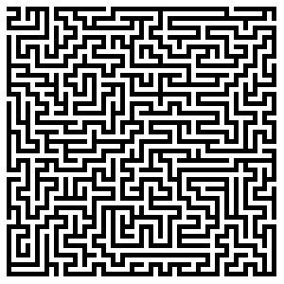
CS 5/7320 Artificial Intelligence Solving problems by searching AIMA Chapter 3
Discussion
Slides by Michael Hahsler based on slides by Svetlana Lazepnik with figures from the AIMA textbook.
This work is licensed under a Creative Commons Attribution-ShareAlike 4.0 International License.

Slide 2
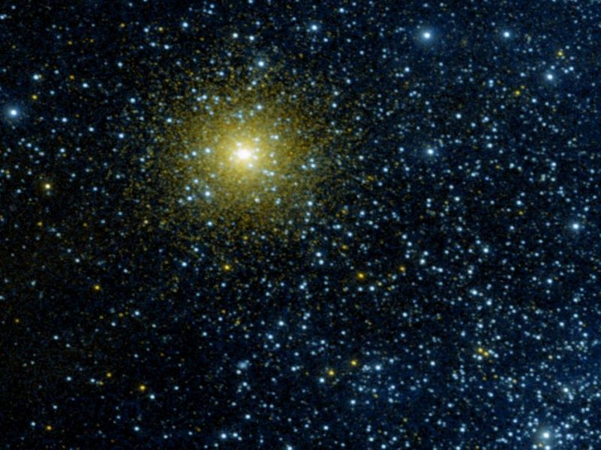
State Space for Search

Slide 3
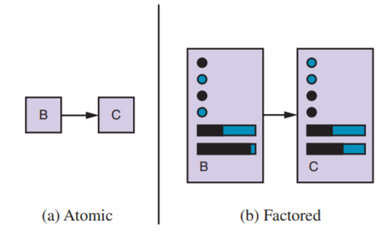
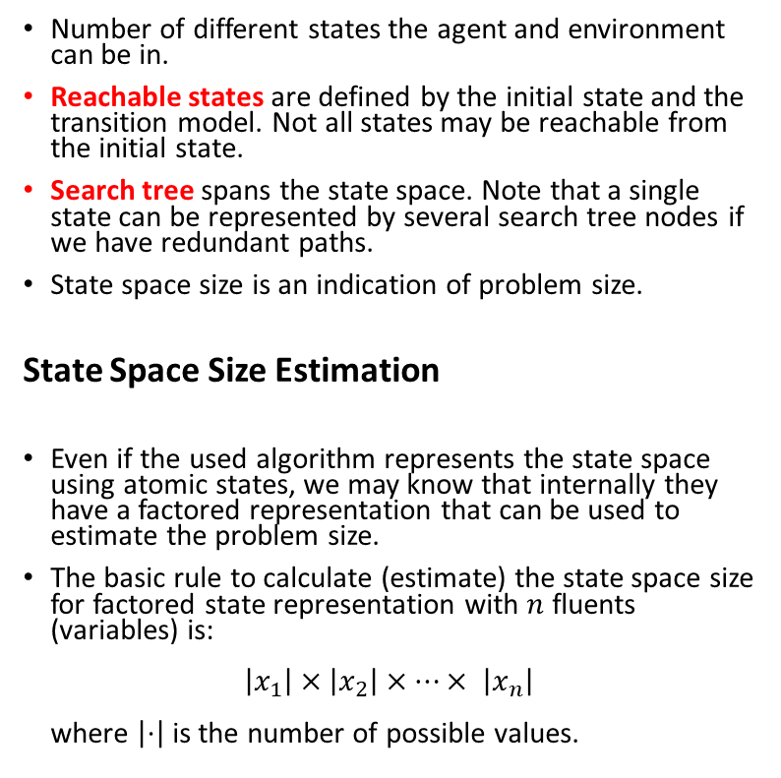


State Space
Number of different states the agent and environment can be in.
Reachable states are defined by the initial state and the transition model. Not all states may be reachable from the initial state.
Search tree spans the state space. Note that a single state can be represented by several search tree nodes if we have redundant paths.
State space size is an indication of problem size.
State Space Size Estimation
Even if the used algorithm represents the state space using atomic states, we may know that internally they have a factored representation that can be used to estimate the problem size.
The basic rule to calculate (estimate) the state space size for factored state representation with $n$ fluents (variables) is: $\left|x_{1}\right|×\left|x_{2}\right|×⋯× \left|x_{n}\right|$ where $\left|⋅\right|$ is the number of possible values.
State representation
$$x_{1}$$
$$x_{2}$$
…
The state consists of variables called fluents that represent conditions that can change over time.

Slide 4
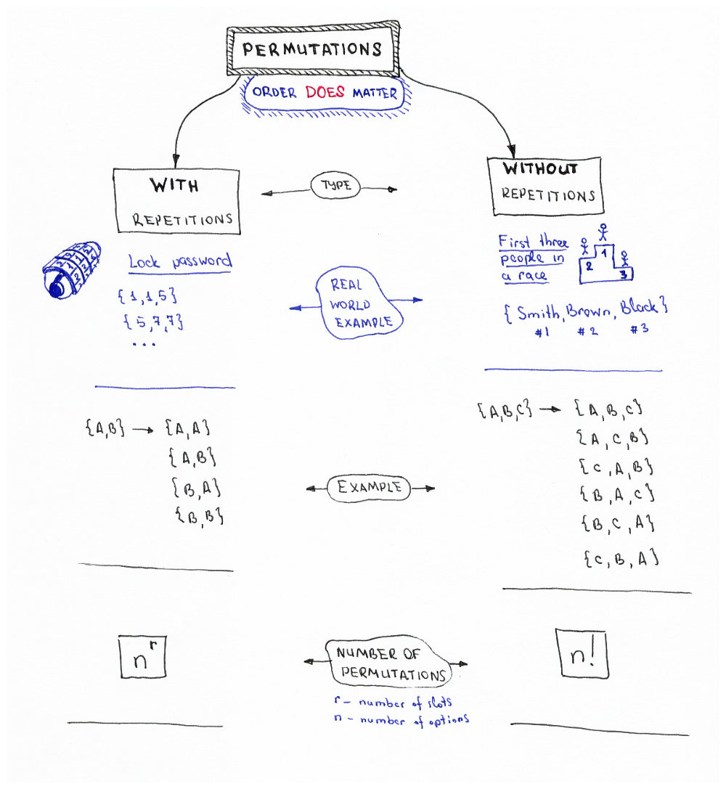



In how many ways can we order/arrange n objects?
$$2×2=2^{2}=4$$
$$3×2×1=6$$
Factorial: $n!=n×\left(n−1\right)×…×2×1$
#Python
import math
print (math.factorial(23))
Source: Permutations/Combinations Cheat Sheets by Oleksii Trekhleb https://itnext.io/permutations-combinations-algorithms-cheat-sheet-68c14879aba5

Slide 5
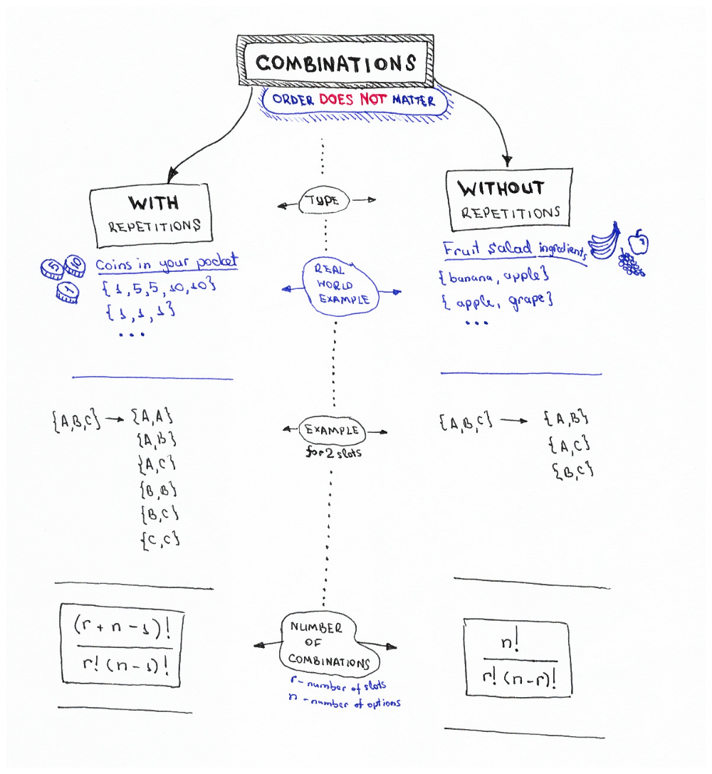
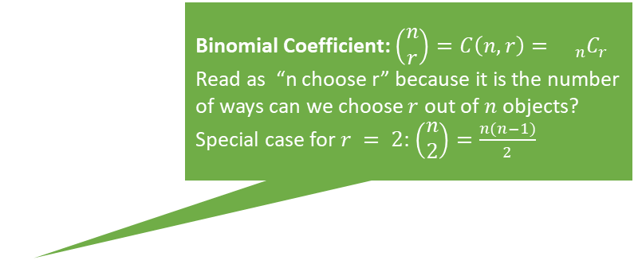

Binomial Coefficient: $\left(\begin{matrix}n \\ r\end{matrix}\right)=C\left(n,r\right)={{}_{n}C}_{r}$
Read as “n choose r” because it is the number of ways can we choose $r$ out of $n$ objects?
Special case for $r = 2$: $\left(\begin{matrix}n \\ 2\end{matrix}\right)=\frac{n(n−1)}{2}$
$$\left(\begin{matrix}3 \\ 2\end{matrix}\right)=3$$
#Python
import scipy.special
# the two give the same results
scipy.special.binom(10, 5)
scipy.special.comb(10, 5)
Source: Permutations/Combinations Cheat Sheets by Oleksii Trekhleb https://itnext.io/permutations-combinations-algorithms-cheat-sheet-68c14879aba5

Slide 6
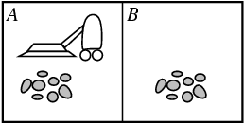
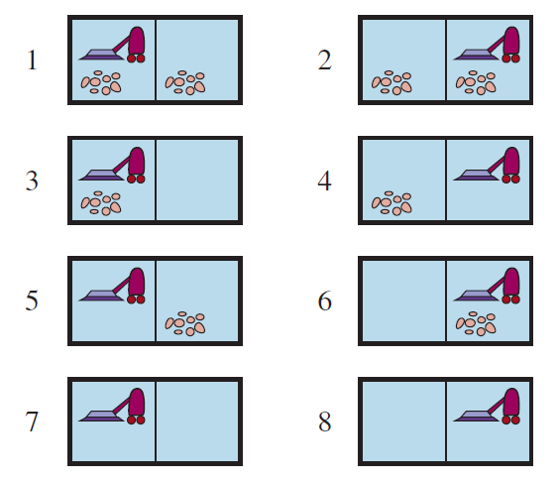
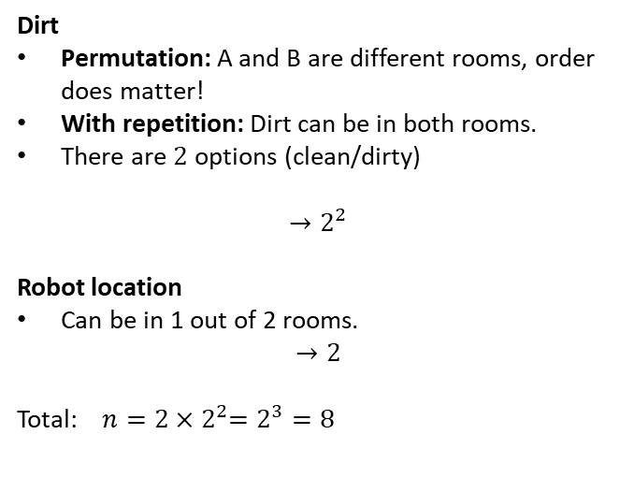
Example: What is the State Space Size?
Dirt
Permutation: A and B are different rooms, order does matter!
With repetition: Dirt can be in both rooms.
There are $2$ options (clean/dirty)
$${→2}^{2}$$
Robot location
Can be in 1 out of 2 rooms.
$$→2$$
Total: $n=2{×2}^{2}=2^{3}=8$
r … # of rooms n … options

Slide 7
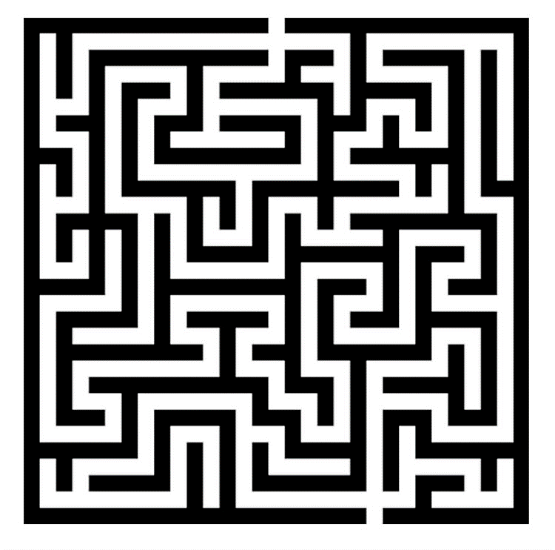
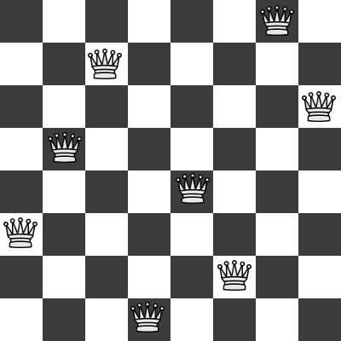
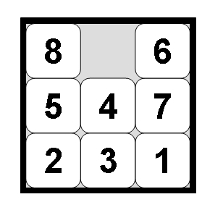
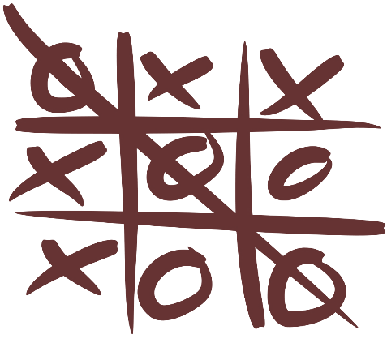
Examples: What is the State Space Size?
Often a rough upper limit is sufficient to determine how hard the search problem is.
Maze
8-queens problem
8-puzzle problem
Tic-tac-toe

Slide 8
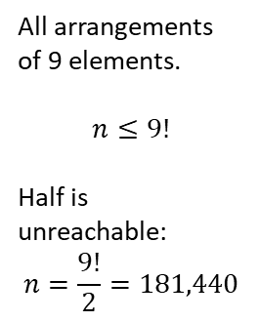
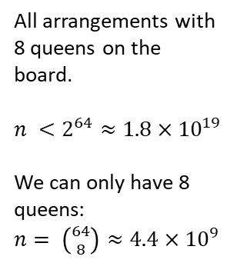
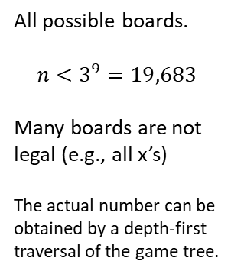
Examples: What is the State Space Size?
Often a rough upper limit is sufficient to determine how hard the search problem is.
Maze
8-queens problem
8-puzzle problem
Tic-tac-toe
Positions the agent can be in.
n = Number of white squares.
All arrangements with 8 queens on the board.
$n <2^{64}≈1.8×{10}^{19}$
We can only have 8 queens: $n= \left({64 \atop 8}\right)≈4.4×{10}^{9}$
All arrangements of 9 elements.
$$n≤9!$$
Half is unreachable: $$n=\frac{9!}{2}=181,440$$
All possible boards.
$$n<3^{9}=19,683$$
Many boards are not legal (e.g., all x’s)
The actual number can be obtained by a depth-first traversal of the game tree.

Slide 9
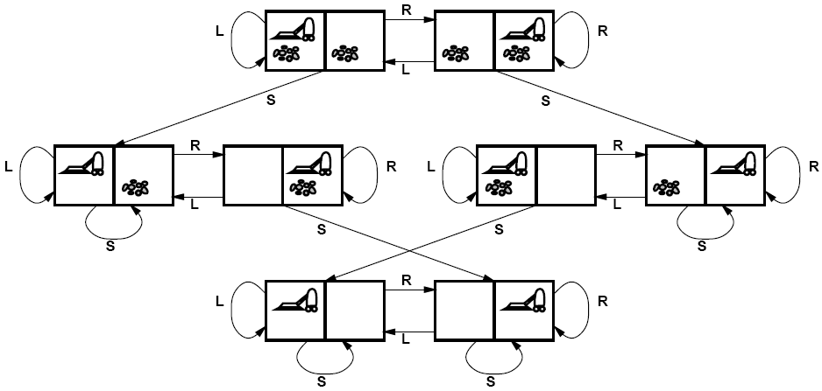
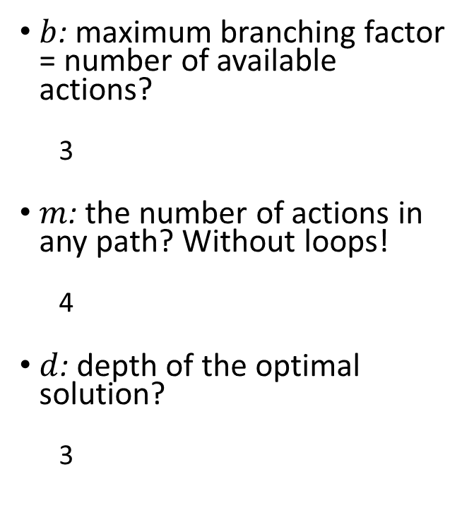
Example: What is the Search Complexity?
$b$: maximum branching factor = number of available actions?
3
$m$: the number of actions in any path? Without loops!
4
$d$: depth of the optimal solution?
3
State Space with Transition Model
Initial state
Goal states

Slide 10
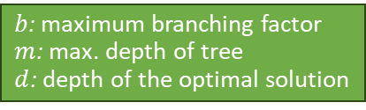
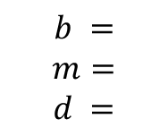
Examples: What is the Search Complexity?
$b$: maximum branching factor
$m$: max. depth of tree
$d$: depth of the optimal solution
Often a rough upper limit is sufficient to determine how hard the search problem is.
Maze
8-queens problem
8-puzzle problem
Tic-tac-toe
$$b =$$
$$m=$$
$$d =$$

Slide 11
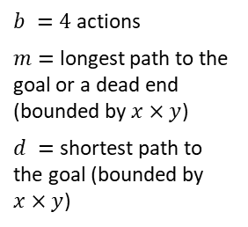
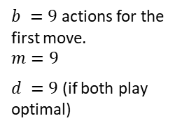
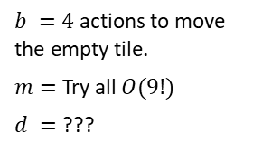
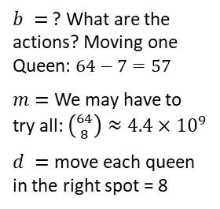
Examples: What is the Search Complexity?
$b$: maximum branching factor
$m$: max. depth of tree
$d$: depth of the optimal solution
Often a rough upper limit is sufficient to determine how hard the search problem is.
Maze
8-queens problem
8-puzzle problem
Tic-tac-toe
$b =4$ actions
$m=$ longest path to the goal or a dead end (bounded by $x×y$)
$d =$ shortest path to the goal (bounded by $x×y$)
$b =$ ? What are the actions? Moving one Queen: $64−7=57$
$m=$ We may have to try all: $\left({64 \atop 8}\right)≈4.4×{10}^{9}$
$d =$ move each queen in the right spot = 8
$b =4$ actions to move the empty tile.
$m=$ Try all $O(9!)$
$d =$ ???
$b =9$ actions for the first move.
$$m=9$$
$d =9$ (if both play optimal)

Slide 12
Assignment
Q&A

