Slide 1
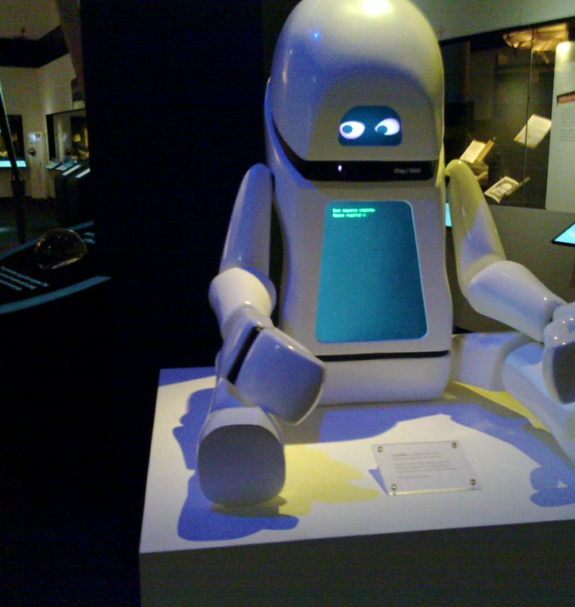
CS 5/7320 Artificial Intelligence Intelligent Agents AIMA Chapter 2
Discussion
Slides by Michael Hahsler with figures from the AIMA textbook.
This work is licensed under a Creative Commons Attribution-ShareAlike 4.0 International License.
Image: "Robot at the British Library Science Fiction Exhibition" by BadgerGravling

Slide 2
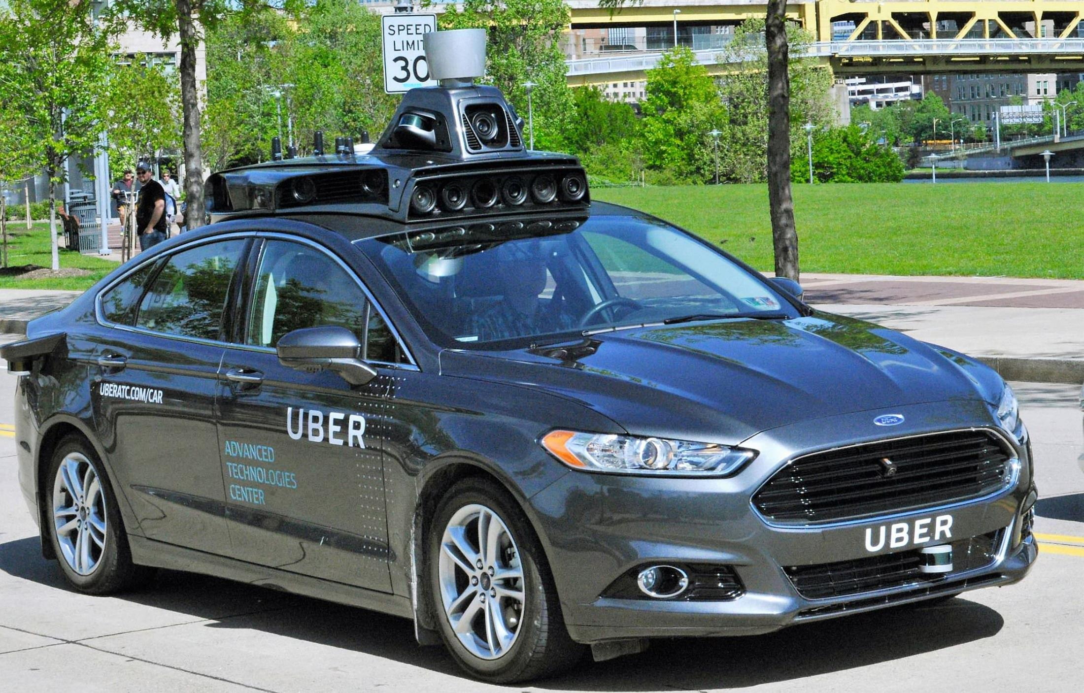
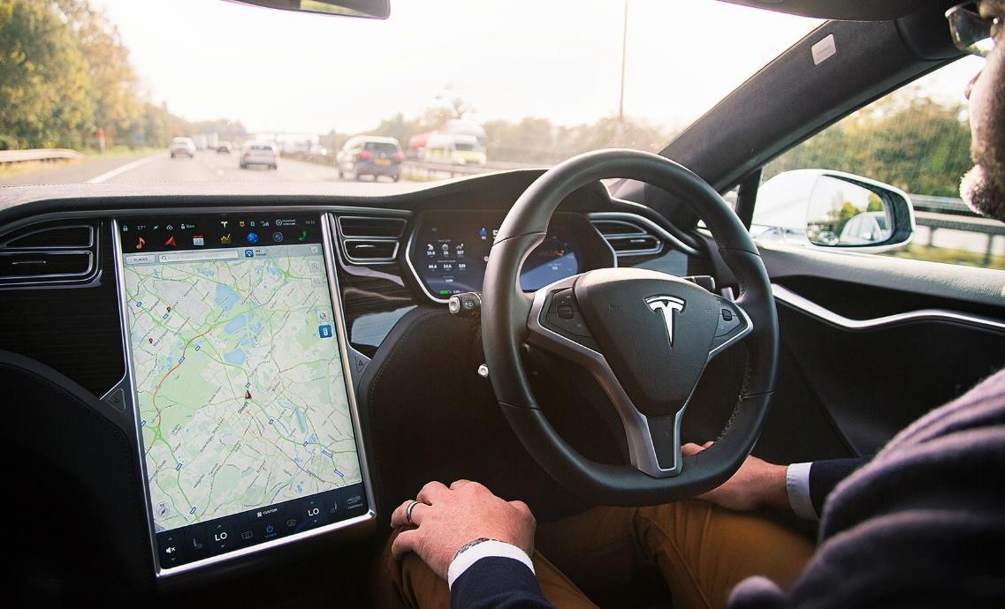
Self-driving Cars
SAE Automation Levels
Level 1 - Driver Assistance (“hands on”)
Level 2 - Partial Automation (“hands off”)
Level 3 - Conditional Automation
Level 4 - High Automation
Level 5 - Full Automation (“steering wheel optional”)
Components
Sensing
Maps
Path planning
Controlling the vehicle
Why is this so hard?

Slide 3
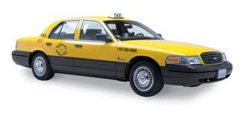
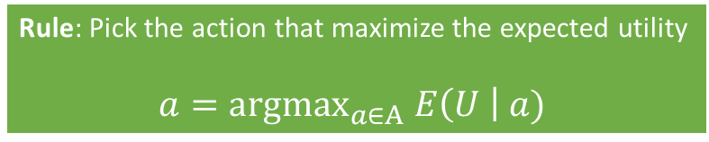
A Self-Driving Car as a Rational Agents
Rule: Pick the action that maximize the expected utility
$$a={\text{argmax}}_{a∈A} E\left(U \right| a)$$
Answer the following questions:
If we have two cars and one provides more (expected) utility. Which car is rational?
Can a rational self-driving car be involved in an accident?
How would a self-driving car explore and learn?
What does bounded rationality mean for a self-driving car?
Notes:
ExpectedUtility(action) = sum_outcomes Utility(outcome) * P(outcome)

Slide 4
PEAS Description of the Environment of a Self-Driving Car
Complete the PEAS description.
Performance measure
Environment
Actuators
Sensors

Slide 5
Percepts and States: Self-Driving Car
Describe percepts and states.
Percepts
States

Slide 6
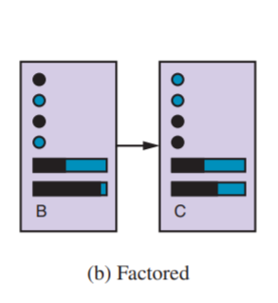
State Representation: Self-Driving Car
States help to keep track of the environment and the agent in the environment.
Design a structured representation for the state of a self-driving car.
What fluents should it contain?
What actions can cause transitions?
Draw a small transition diagram.
Action causes transition
Variables describing the system state are called “fluents”

Slide 7

Environment for a Self-Driving Car
Fully observable: The agent’s sensors always show the whole state.
vs.
Partially observable: The agent only perceives part of the state and needs to remember or infer the test.
Deterministic:
Percepts are 100% reliable
Changes in the environment are completely determined by the current state of the environment and the agent’s action.
Stochastic:
Percepts are unreliable (noise distribution, sensor failure probability, etc.). This is called a stochastic sensor model.
The transition function is stochastic leading to transition probabilities and a Markov process.
vs.
Known: The agent knows the transition function.
vs.
Unknown: The needs to learn the transition function by trying actions.
Check what applies and explain what it means for a self-driving car.

Slide 8
What Type of Intelligent Agent is a Self-Driving Car?
Utility-based agents
Simple reflex agents
Goal-based agents
Model-based reflex agents
Does it collect utility over time? How would the utility for each state be defined?
Does it have a goal state?
Is it learning?
Does it store state information. How would they be defined (atomic/factored)?
Does it use simple rules based on the current percepts?
Check what applies

Slide 9
Self-driving Cars
Why is this so hard?
Self-driving cars operate in a very complicated partially observable, stochastic, and dynamic environment.
Can only use bounded rationality because of limits with sensors and computational power.
Require a set of different agents that cooperate.

