Slide 1

CS 5/7320 Artificial Intelligence Making Simple Decisions AIMA Chapter 16
Introduction slides by Michael Hahsler
Decision network slides by Dan Klein and Pieter Abbeel
This work is licensed under a Creative Commons Attribution-ShareAlike 4.0 International License.

Slide 2
What is a simple decision?
The environment most likely is stochastic with non-deterministic actions. It may also only be partially observable. Otherwise, making a decision would be trivial.
We make the same decision frequently + making it once does not affect future decisions. This means we have an episodic environment.
Decision theory formalizes making optimal simple decisions under uncertainty.
Decision theory = Probability theory (evidence & belief) + Utility theory (want)

Slide 3
Decision-theoretic Agents (=Utility-based Agent)
Logical agents
Uncertainty
Conflicting goals
Goal-based agents
Can only assign goal/not goal to states and find goal states.
Utility-based agents
Assign a utility value to each state.
Cannot deal with:
A rational agent optimizes the expected utility (i.e., is utility-based).
Utility is related to the external performance measure (see PEAS).

Slide 4


Utility
A utility function $U\left(s\right)$ expresses the desirability of being in state $s$.
Utility functions are derived from preferences:
$U\left(A\right)>U\left(B\right)\overset{⇔}{}A≻B$ and $$U\left(A\right)=U\left(B\right)\overset{⇔}{}A \sim B$$
It is often enough to know a ordinal utility function representing a ranking of states to make decisions.

Slide 5


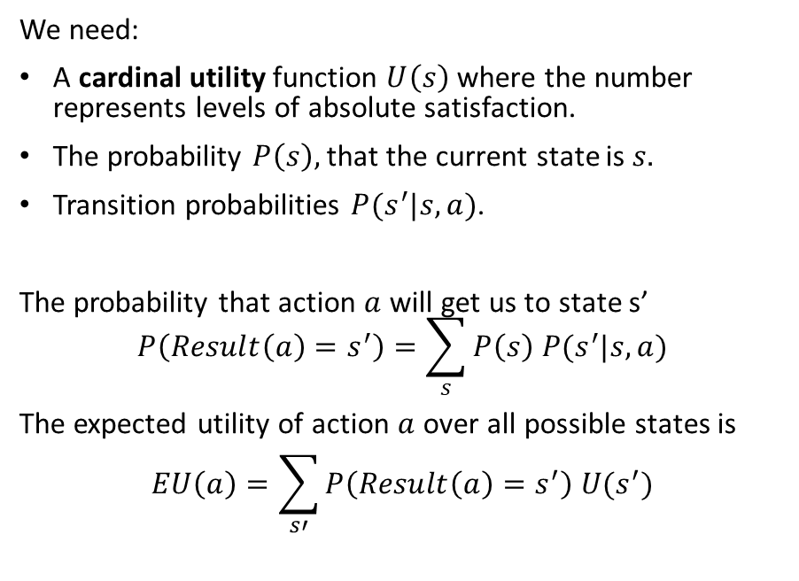
Expected Utility of an Action Under Uncertainty
We need:
A cardinal utility function $U\left(s\right)$ where the number represents levels of absolute satisfaction.
The probability $P\left(s\right),$that the current state is $s.$
Transition probabilities $P(s^{′}|s,a)$.
The probability that action $a$ will get us to state s’ $$P\left(Result\left(a\right)=s^{′}\right)=\sum_{s}{P\left(s\right) P(s^{′}|s,a)}$$
The expected utility of action $a$ over all possible states is $$EU\left(a\right)=\sum_{s′}{P\left(Result\left(a\right)=s^{′}\right) U(s^{′})}$$

Slide 6

Principle of Maximum Expected Utility (MEU)
Action
Given the expected utility of an action $$EU\left(a\right)=\sum_{s′}{P\left(Result\left(a\right)=s^{′}\right) U(s^{′})}$$
choose action that maximizes the expected utility: $$a^{∗}={argmax}_{a} EU(a)$$
Issues:
$P\left(Result\left(a\right)=s^{′}\right)= \sum_{s}{P\left(s\right) P(s^{′}|s,a)}$ may be a very large table.
$U\left(s\right)$ may be hard to estimate. It may depend on what states we can get to from s.

Slide 7
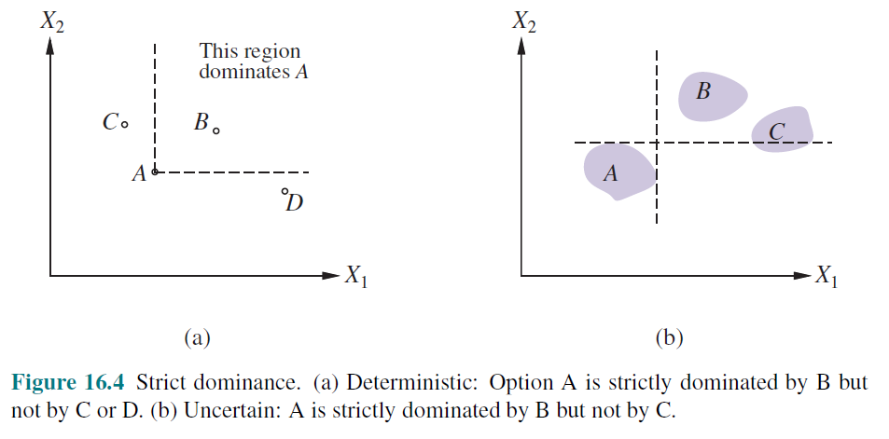
Multi-attribute Utility Theory

Slide 8
Decision Networks Using Bayes Nets to calculate the Expected Utility of Actions.
These slides were created by Dan Klein, Pieter Abbeel, Sergey Levine, with some materials from A. Farhadi. All CS188 materials are at http://ai.berkeley.edu

Slide 9


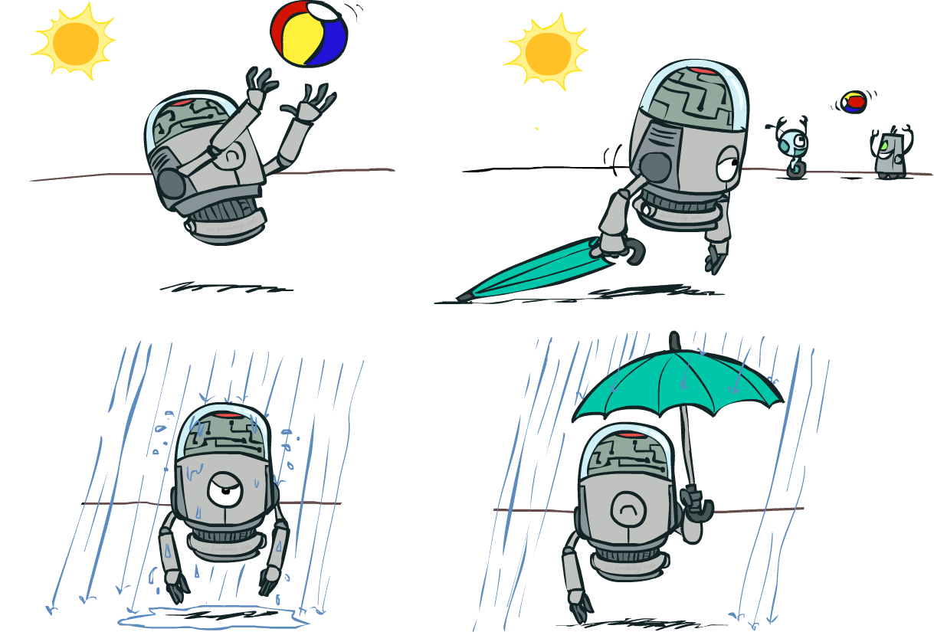

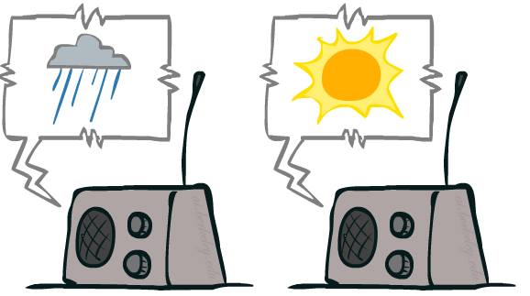
Decision Networks
Utility
Action
Umbrella
U
Weather
Random Events
Forecast
Notes:
There exists a ghostbusters demo

Slide 10
Decision Networks
Decision networks
Bayes nets with additional nodes for utility and actions.
Allows to specify the joint probability in a compact way using independence.
Calculate the expected utility for each possible action and choose the best.
Node types
Chance nodes: Random variables in BNs
Action nodes: Cannot have parents, act as observed evidence
Utility node: Depends on action and chance nodes
Umbrella
U
Weather
Forecast
Notes:
There exists a ghostbusters demo

Slide 11
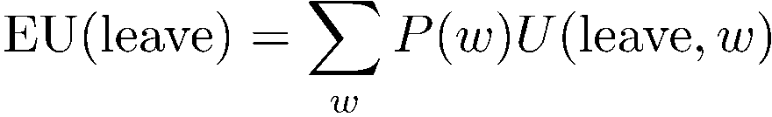
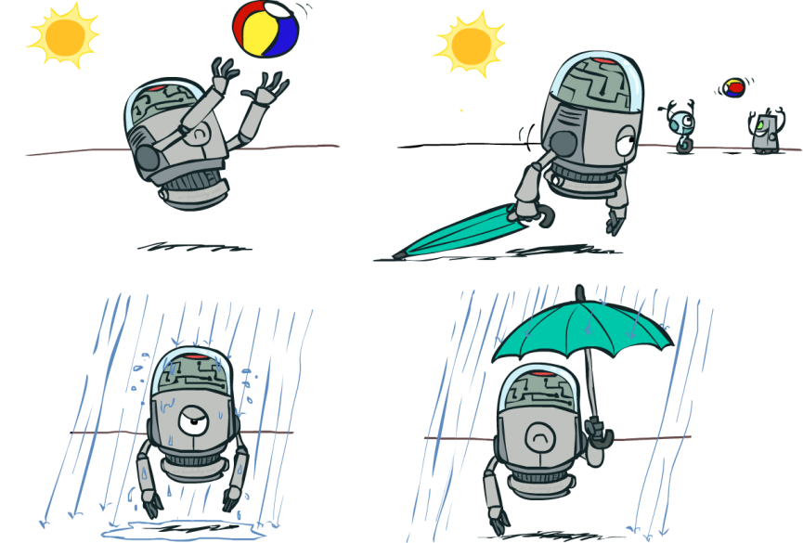
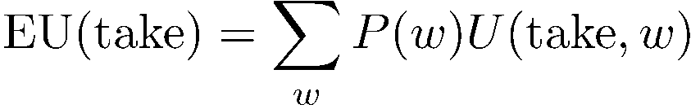

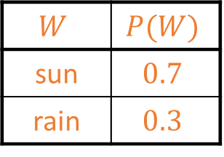

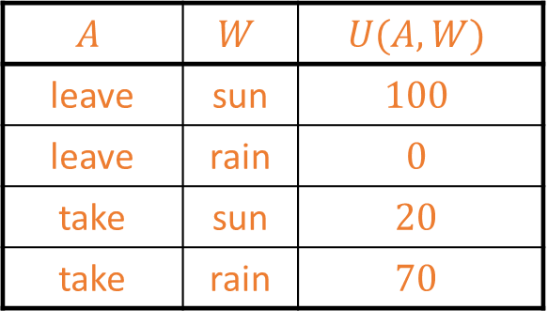
Decision Network without Forecast
Action: Umbrella = leave
Umbrella (A)
U
Action: Umbrella = take
Weather
$$W$$ | $$P(W)$$
sun | $$0.7$$
rain | $$0.3$$
$$A$$ | $$W$$ | $$U(A,W)$$
leave | sun | $$100$$
leave | rain | $$0$$
take | sun | $$20$$
take | rain | $$70$$
Optimal decision $a^{∗}$ = leave
Notes:
There exists a ghostbusters demo

Slide 12
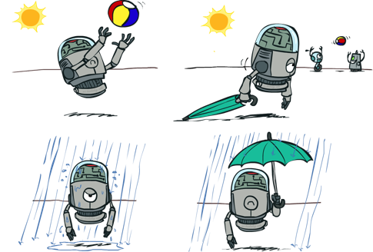
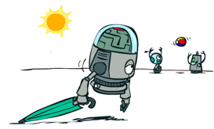


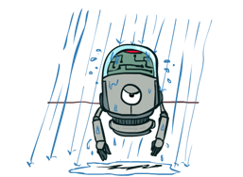
Decisions as Outcome Trees
{} … no evidence available
{}
Action
take
leave
Umbrella
Weather | {}
Weather | {}
U
Random Event
Weather
sun
sun
rain
rain
U(t,s)
U(t,r)
U(l,s)
U(l,r)

Slide 13

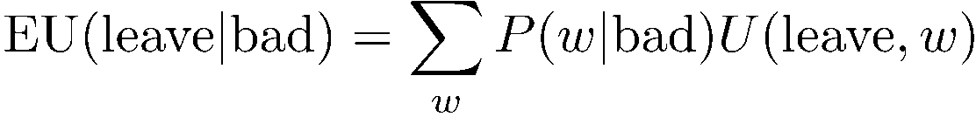

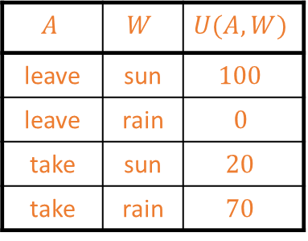

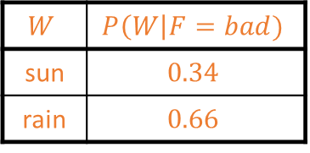
Decision Network with Bad Forecast
Action: Umbrella = leave
Umbrella (A)
$$A$$ | $$W$$ | $$U(A,W)$$
leave | sun | $$100$$
leave | rain | $$0$$
take | sun | $$20$$
take | rain | $$70$$
U
Action: Umbrella = take
Weather
$$W$$ | $$P(W)$$
sun | $$0.7$$
rain | $$0.3$$
$$W$$ | $$P\left(W\right|F=bad)$$
sun | $$0.34$$
rain | $$0.66$$
Optimal decision = take
Forecast
=bad
A bad forecast increases the probability of rain!

Slide 14

Decisions as Outcome Trees
{b} … evidence is bad weather forecast increases the probability of rain
Umbrella
{b}
take
leave
U
W | {b}
W | {b}
Weather
sun
sun
rain
rain
U(t,s)
U(t,r)
U(l,s)
U(l,r)
Forecast
=bad

Slide 15
Conclusion
Decision networks are an extension of Bayes nets that add actions and utility to compactly specify the joint probability. The network is used to calculate the expected utility of actions.
Decision networks can be used to make simple repeated decisions in a stochastic, partially observable, and episodic environment.
Sequential decision-making deals with decisions that influence each other and are made over time. This is a more complex decision problem and needs different methods like Markov Decision Processes.

