Slide 1
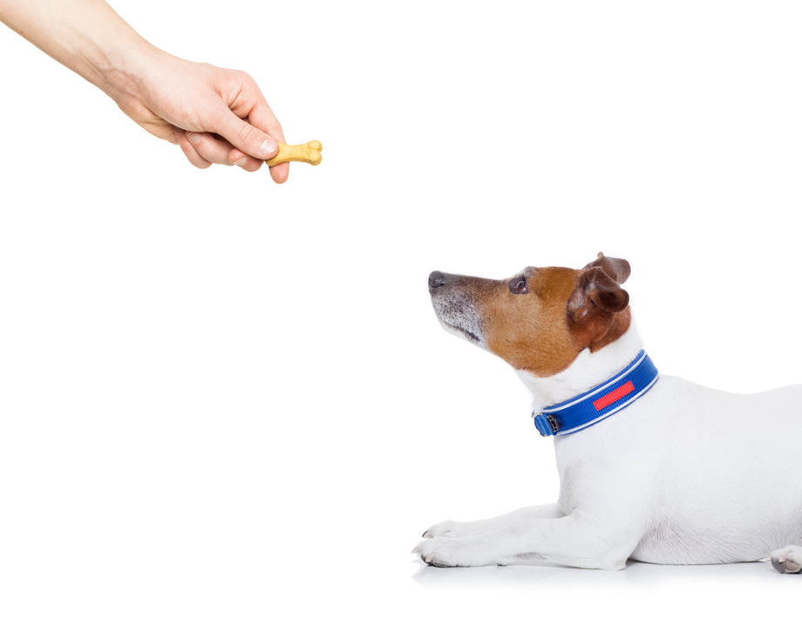
CS 5/7320 Artificial Intelligence Reinforcement Learning AIMA Chapter 17+22
Slides by Michael Hahsler with figures from the AIMA textbook.
This work is licensed under a Creative Commons Attribution-ShareAlike 4.0 International License.

Slide 2
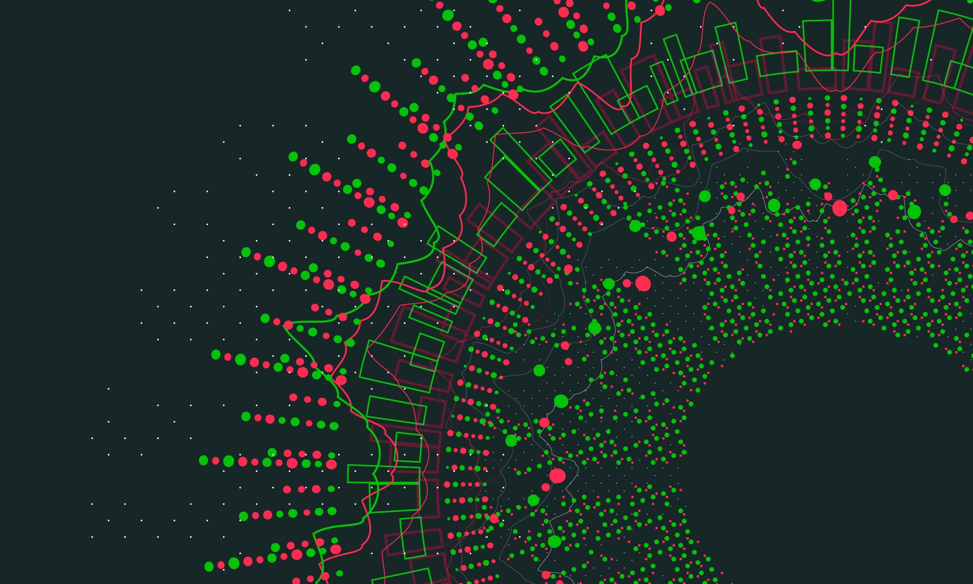
Sequential Decision Problems
AIMA Chapter 17: Making Complex Decisions

Slide 3
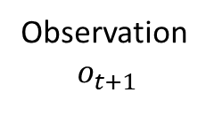
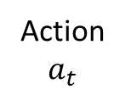
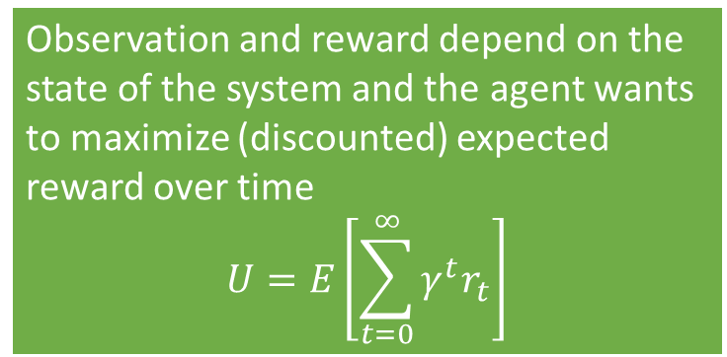

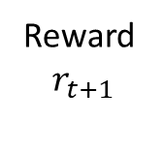
Sequential Decision Problems
Utility-based agent: The agent’s utility depends on a sequence of decisions.
Sequential decision problems incorporate utilities, uncertainty, and sensing.
Action
$a_{t}$
Agent
Sequence: $r_{0}, o_{0}, a_{0}, r_{1}, o_{1}, a_{1}, r_{2}, o_{2}, a_{2},, …$
Observation and reward depend on the state of the system and the agent wants to maximize (discounted) expected reward over time
$$U=E\left[\sum_{t=0}^{∞}{γ^{t}r_{t}}\right]$$
Reward $$r_{t+1}$$
Environment
Observation $$o_{t+1}$$

Slide 4
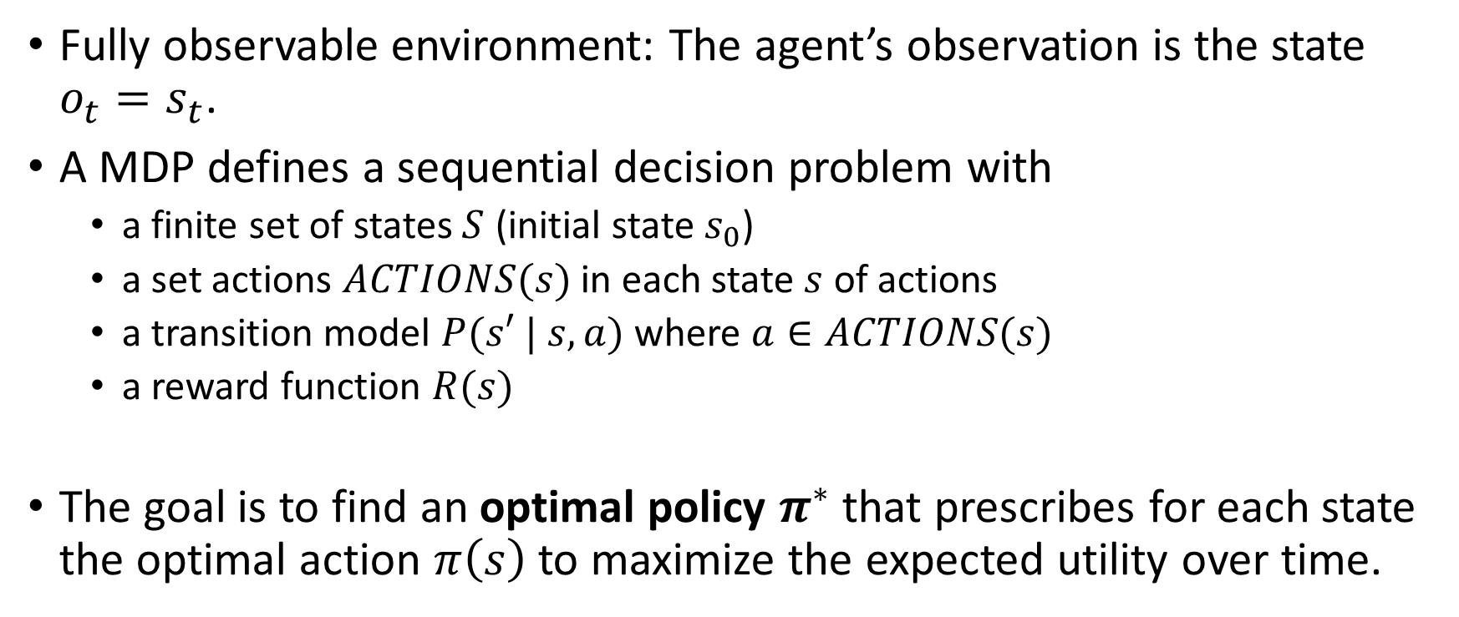
Markov Decision Process (MDP)
Fully observable environment: The agent’s observation is the state $o_{t}=s_{t}$.
A MDP defines a sequential decision problem with
a finite set of states $S$ (initial state $s_{0}$)
a set actions $ACTIONS(s)$ in each state $s$ of actions
a transition model $P(s′ | s, a)$ where $a∈ACTIONS(s)$
a reward function $R(s)$
The goal is to find an optimal policy $π^{∗}$ that prescribes for each state the optimal action $π\left(s\right)$ to maximize the expected utility over time.

Slide 5
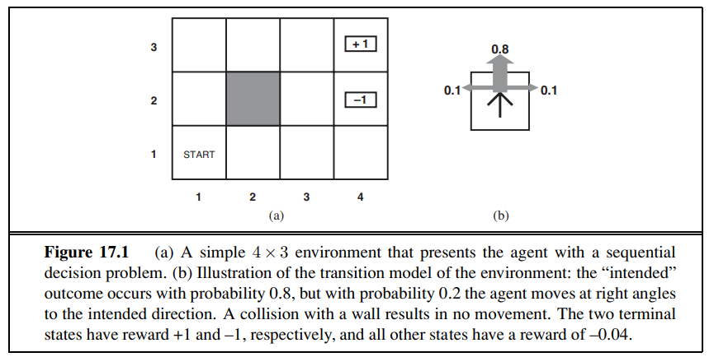
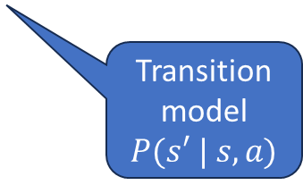
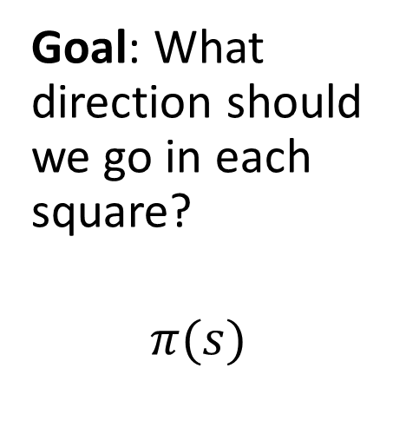
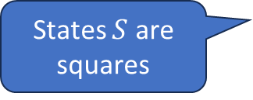
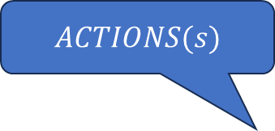
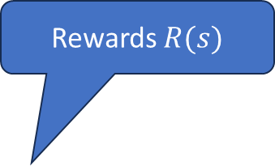
Example: 4x3 Grid World
Rewards $R(s)$
$ACTIONS(s)$
Goal: What direction should we go in each square?
$$π(s)$$
-0.04
-0.04
-0.04
-0.04
-0.04
States $S$ are squares
-0.04
-0.04
-0.04
Transition model
$P(s′ | s, a)$
-0.04

Slide 6
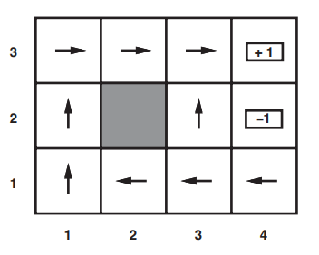
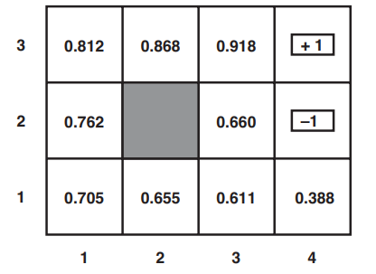

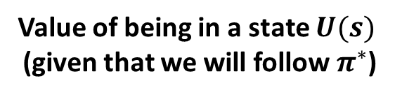
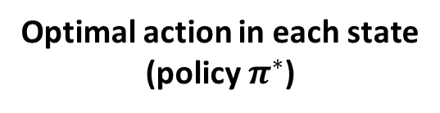
Solution: 4x3 Grid World
Optimal action in each state
(policy $π^{∗}$)
Value of being in a state $U(s)$ (given that we will follow $π^{∗}$)
Always move to
higher utility states
$$γ=1$$
Question: How to we find the optimal value function/optimal policy?

Slide 7
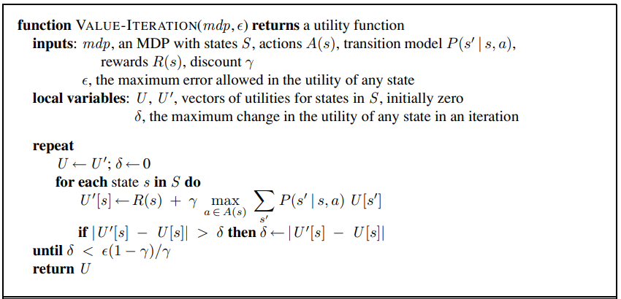

Value Iteration
Bellman update
$U$ converges to $U^{π^{∗}}$

Slide 8
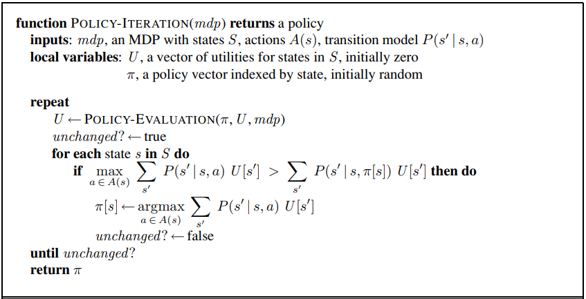
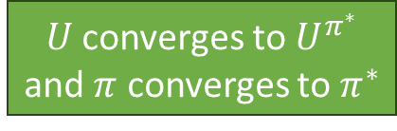
Policy Iteration
Calculate U given current policy (eighter solve an LP or iterative solution)
Policy
Improvement
$U$ converges to $U^{π^{∗}}$
and $π$ converges to $π^{∗}$

Slide 9
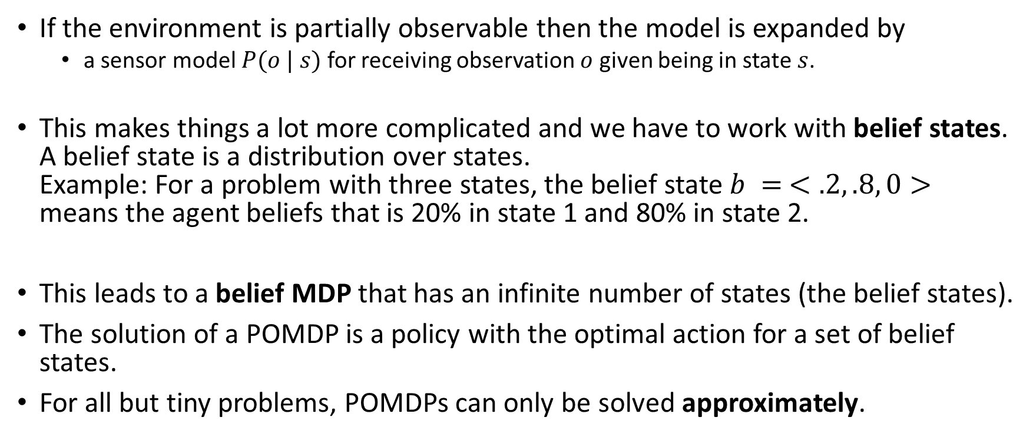
Partially Observable Markov Decision Model (POMDP)
If the environment is partially observable then the model is expanded by
a sensor model $P(o | s)$ for receiving observation $o$ given being in state $s$.
This makes things a lot more complicated and we have to work with belief states. A belief state is a distribution over states. Example: For a problem with three states, the belief state $b = <.2, .8, 0>$ means the agent beliefs that is 20% in state 1 and 80% in state 2.
This leads to a belief MDP that has an infinite number of states (the belief states).
The solution of a POMDP is a policy with the optimal action for a set of belief states.
For all but tiny problems, POMDPs can only be solved approximately.

Slide 10
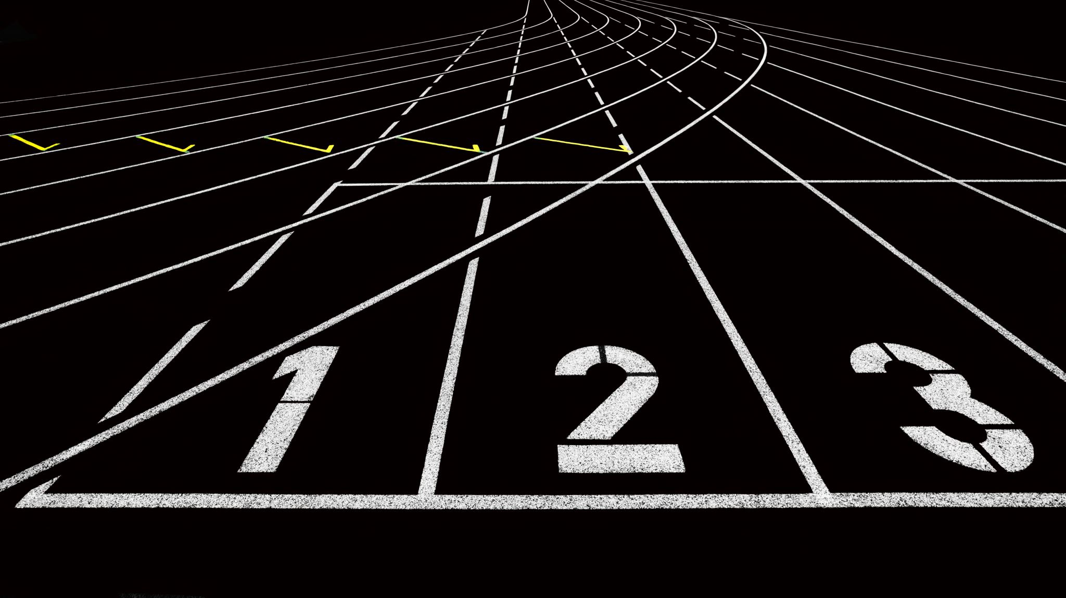
Reinforcement Learning
AIMA Chapter 22

Slide 11
Reinforcement Learning
The basis of reinforcement learning are MDPs.
What if we do not have a transition model 𝑃(𝑠′ | 𝑠, 𝑎)?
Now we cannot solve the MDP (estimate the state utility function/policy) because we cannot predict future states!
The agent needs to explore (try actions) and use the reward signal to update its belief about the utility of states and actions (i.e., this is also called learning or estimation)
Notes:
Reward may be sparse. Need for credit assignment.
Reward shaping creates pseudo rewards that advance learning (e.g., ball possession or distance to the goal in soccer).
Hierarchical RL: Break the task into smaller sub-tasks so we can learn the succession of sub-task efficiently.

Slide 12

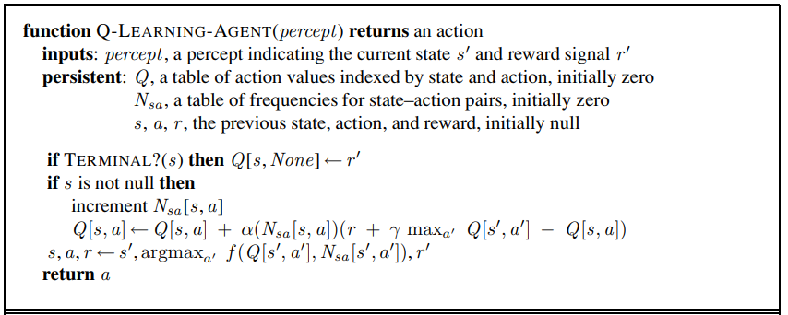
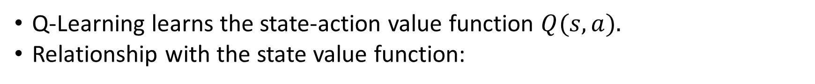
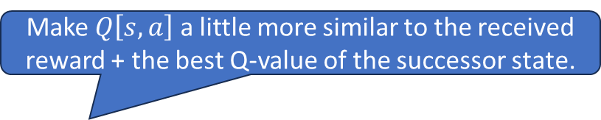
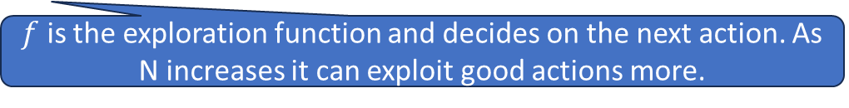
Q-Learning
Q-Learning learns the state-action value function $Q(s, a).$
Relationship with the state value function:
Make $Q\left[s,a\right]$ a little more similar to the received reward + the best Q-value of the successor state.
$f$ is the exploration function and decides on the next action. As N increases it can exploit good actions more.

Slide 13
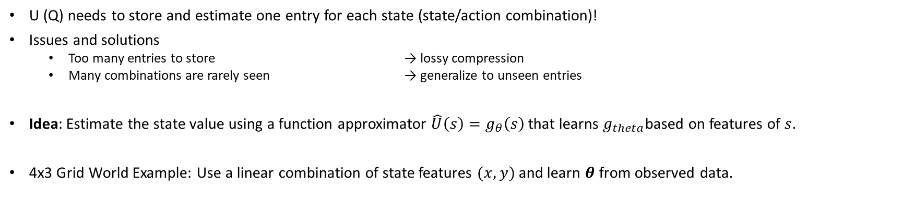

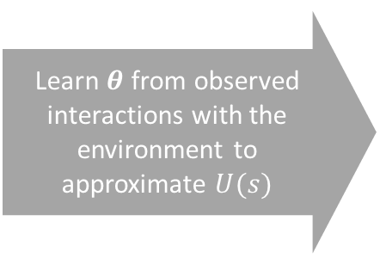

Function Approximation
U (Q) needs to store and estimate one entry for each state (state/action combination)!
Issues and solutions
Too many entries to store → lossy compression
Many combinations are rarely seen → generalize to unseen entries
Idea: Estimate the state value using a function approximator $\hat{U}\left(s\right)=g_{θ}\left(s\right)$ that learns $g_{theta}$based on features of $s$.
4x3 Grid World Example: Use a linear combination of state features $(x, y)$ and learn $θ$ from observed data.
Learn $θ$ from observed interactions with the environment to approximate $U(s)$
$$U(s)$$
$${\hat{U}}_{theta}\left(x,y\right)=θ_{0}+θ_{1}x+θ_{2}y$$
Notes:
We can also approximate the state-value function Q.
We typically need non-linear approximators that can be incrementally updated (online learning). → Deep ANNs
Notes:
Deep RL is still somewhat unpredictable since the deep ANN has many parameters…

Slide 14

Summary
Agents can learn the value of being in a state from reward signals.
Rewards can be delayed (e.g., at the end of a game).
Not being able to fully observe the state makes the problem more difficult (POMDP).
Unknown transition models lead to the need of exploration by trying actions (model free methods like Q-Learning).
All these problems are computationally very expensive and often can only be solved by approximation.
All functions (U, Q, etc.) can be approximated. State of the art is to use deep artificial neural networks.

