Slide 1

Enhancing Medical Image Quality Using Deep Learning Techniques and Advanced Evaluation Metrics
By: Christian De La Torre, Araceli Castelan, Jonathan Suconota, Kevin Sookram

Slide 2
Introduction
Medical imaging is essential for diagnosis and treatment.
Problem: Many X-ray and fundus images are low-resolution due to aging equipment or poor imaging conditions.
Risks: Low-quality images increase the chance of misdiagnosis and impact patient care.
Our focus: Using deep learning to enhance medical images and evaluating with advanced metrics.
Notes:
Recent advances in deep learning enable restoration of diagnostic detail in low-quality medical images, addressing a common challenge in healthcare settings with aging X-ray and fundus cameras. We implement and benchmark SRCNN, VDSR, and ClearSight-based networks, and compare traditional (PSNR, SSIM) and novel (ICI) evaluation metrics

Slide 3
Project Goals
Implement and compare deep learning models for super-resolution and image enhancement:
SRCNN (Super-Resolution Convolutional Neural Network)
VDSR (Very Deep Super-Resolution Network)
ClearSight-inspired dehazing (for restoration in challenging conditions)
Evaluate model performance using PSNR (Peak Signal-to-Noise Ratio) and SSIM (Structural Similarity Index).

Slide 4
Literature Review:
Patil et al. (2024) - Enhancing Medical Image Quality Using Deep Learning Techniques
Compared SRCNN and VDSR for X-ray super-resolution.
SRCNN: Fast, resource-efficient; less detail.
VDSR: Superior detail and clarity; higher computational cost.
Khan et al. (2022) - Integrated Deep Learning Methodology for Early Glaucoma Detection and Diagnosis using Retinal Fundus Images
Developed an integrated deep learning pipeline for early glaucoma detection from retinal fundus images.
Used a custom CNN to automate feature extraction and classification of healthy vs. glaucomatous eyes.
Achieved high accuracy and AUC, highlighting the model’s potential for large-scale, non-invasive glaucoma screening.
Wang et al. (2023) - ClearSight: Deep Learning-Based Image Dehazing
for Enhanced UAV Road Patrol
Applied deep CNNs for dehazing UAV images.
Demonstrated that restoration strategies can transfer to medical imaging.
Improved clarity in challenging environments.
Kaderuppan et al. (2024) - Image Comparative Index (ICI): A Pixel-Wise Image Similarity Metric for Computational Super-Resolution (SR) Microscopy
Proposed the Image Comparative Index (ICI) metric.
ICI provides better alignment with human perception compared to PSNR and SSIM.
Especially valuable for assessing super-resolved images.

Slide 5
Literature Review:
Bellal et al. (2022) - A Comprehensive Survey on Deep Learning in Abdominal Imaging: Datasets, Techniques, and Performance Metrics
Surveyed deep learning in abdominal imaging.
Reviewed enhancement models and a wide range of evaluation metrics.
Emphasized importance of both technical and clinical validation.
Yuan et al. (2021) - Manifold and patch-based unsupervised deep metric learning for fine-grained image retrieval
Developed unsupervised, patch-based metric learning for fine-grained image retrieval.
Patch-level approaches help distinguish subtle features.
Inspired our data augmentation and sampling strategies.

Slide 6
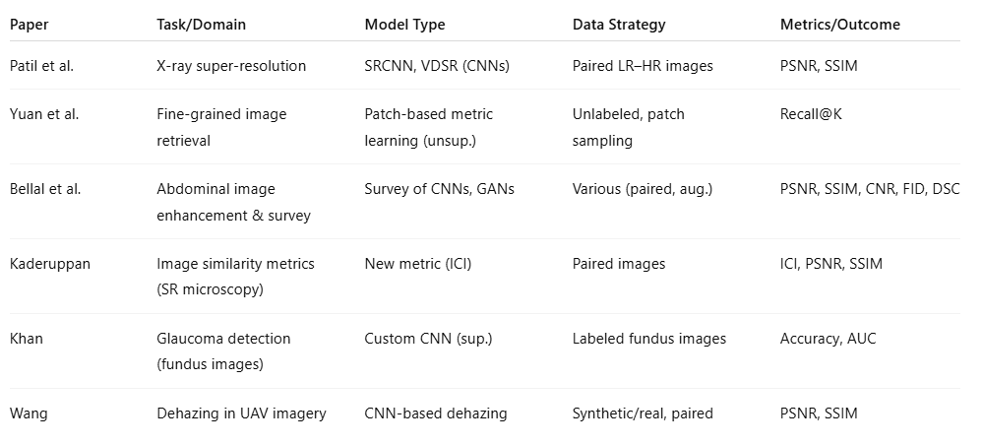
Comparison of Approaches:

Slide 7
Gaps and Open Questions
Do advanced metrics like ICI improve clinical decision-making?
Can these models generalize across different hospitals and imaging modalities?
How can we address data scarcity and reduce bias?
What’s the best way to combine technical and clinical evaluation?

Slide 8
Our Methodology
Models: SRCNN, VDSR, GAN-based models
Metrics: PSNR, SSIM, ICI
Data preparation: Data augmentation, patch-based sampling, balancing classes

Slide 9
Datasets
NIH Chest X-ray Dataset: Over 100,000 frontal-view X-rays.
https://www.kaggle.com/datasets/nih-chest-xrays/sample
This NIH Chest X-ray Dataset is comprised of 112,120 X-ray images with disease labels from 30,805 unique patients.
Chest X-Ray Images (Pneumonia)
https://www.kaggle.com/datasets/paultimothymooney/chest-xray-pneumonia
The dataset is organized into 3 folders (train, test, val) and contains subfolders for each image category (Pneumonia/Normal). There are 5,863 X-Ray images (JPEG) and 2 categories (Pneumonia/Normal).
CoronaHack -Chest X-Ray-Dataset
https://www.kaggle.com/datasets/praveengovi/coronahack-chest-xraydataset
Collection Chest X Ray of Healthy vs Pneumonia (Corona) affected patients infected patients along with few other categories such as SARS (Severe Acute Respiratory Syndrome ) ,Streptococcus & ARDS (Acute Respiratory Distress Syndrome)

Slide 10
Preliminary Results
Before:
After:

Slide 11
Conclusion and Next Steps
Deep learning significantly enhances medical image quality.
New metrics like ICI may better reflect clinical value.
Next: Expand evaluation, test on more datasets, collaborate with clinicians for feedback.

Slide 12

Thank You

