Slide 1

Chelmsford Makerspace
Introduction to Game Programming
and Development with C# and XNA
Workshop run by Sam and Will
Notes:
[Wait for everyone to arrive and be seated]
Welcome to the Game Development Workshop.
We aim to teach you how to work on some basic skills tonight which you can use to develop games with.
Although we are covering as many bases as we can by introducing programming, the main focus this evening will be on the C# language and its game programming framework, XNA.

Slide 2



Introductions
Sam –
Will –
  YouTube...............................................................Figglewatts
  Twitter................................................................@Figglewatts
  Site..............................................www.uncodedstudios.co.uk
  YouTube............................................................TheHalfShot
  Twitter.......................................................@MolramsGaming
  Site...........................................................www.molrams.com
Notes:
I’m Sam and I mainly utilise the Unity3D engine with C# to make games, and I started learning to make games with XNA.
I'm Will and I work closely with XNA to create games within my development site, Sharpened Studios.

Slide 3
By Sam and Will
PROJECTS MADE WITH C# AND XNA
Notes:
Now we’ll show you the kind of things you can do with C# and XNA.

Slide 4
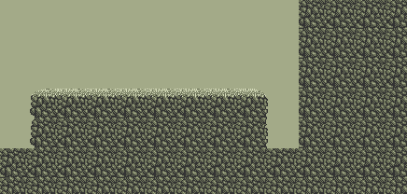
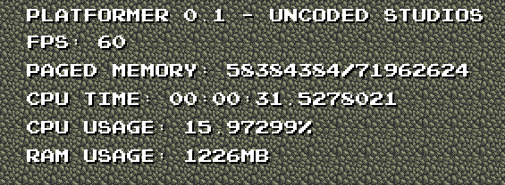
Tile Engine – By Sam
Draws images to the screen from a set of ‘tiles’
Ability to read level data from text files on a computer
Separate Level Editor which outputs text files which can be loaded into the game
Notes:
This is a ‘tile engine’ that I have made
Basically, it can pick sections of an image (or a tilesheet) and draw them onto the screen based upon a grid of numbers. The number tells the game which part of the image to draw.
I also made a level editor which allows you to create this grid of numbers and save it so it can be loaded into the game.

Slide 5
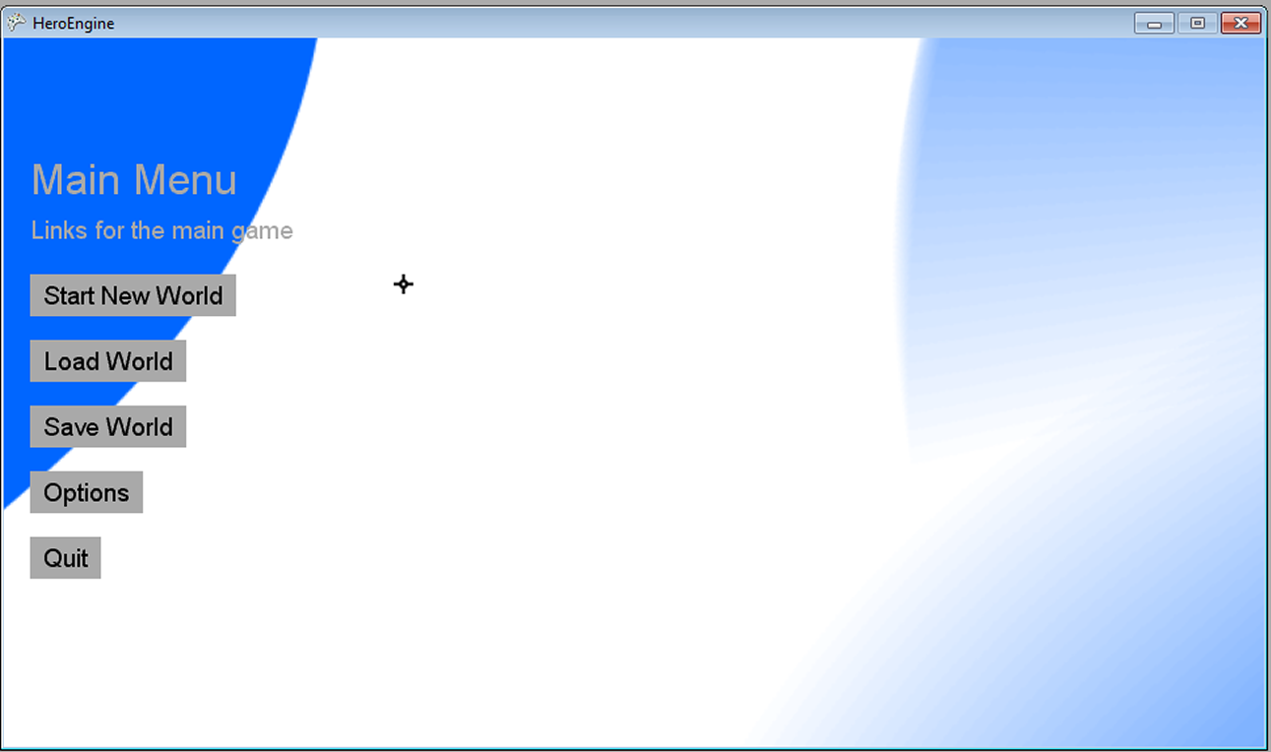
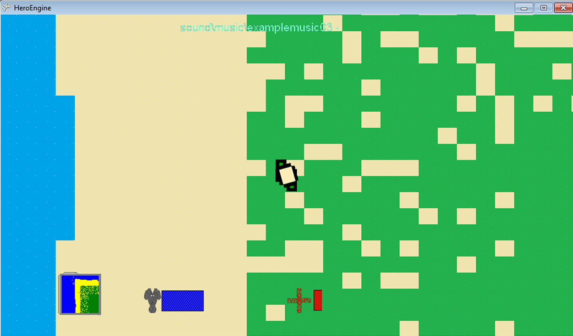
Hero Engine – By Will
Cross Platform, thanks to MonoGame.
Renders with tiles and a lot of hacks to look tile based.
Runs fast enough to even work on a Raspberry pi.
Still in pre-alpha. No betas yet :)
Notes:
The 'Hero Engine' was a summer project I worked on to build a simple top down game engine for adventure games which ended up being my main project and now hopefully going to be used in future games.
At present it draws and blends tiles together and has basic support for weapons, inventory and non playable characters. Hopefully going to be one of the first truly platform independent games, working on pcs, mobiles and raspberry pi.

Slide 6
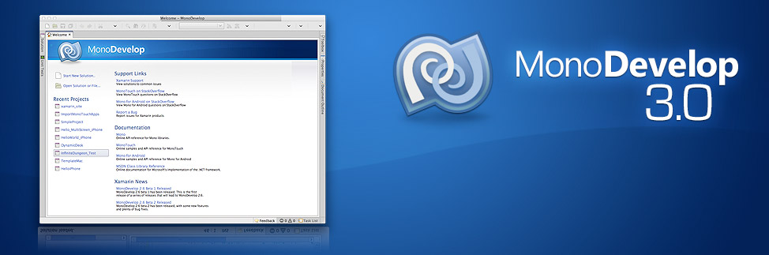
Programming
Notes:
Programming Games can use different languages such as python or c but for the purpose of the workshop we will be using C#. The language is platform independent and so runs on your phone just as well as it would work on a Mac. An IDE, or Intergrated Development Environment is what you use to program and test your games in. Its just like using notepad but it underlines and compiles your code for you so you don't have to mess about in command prompts.
For this workshop we will be using MonoDevelop which is a popular choice for its lightness and built on another form of C#, Mono.

Slide 7
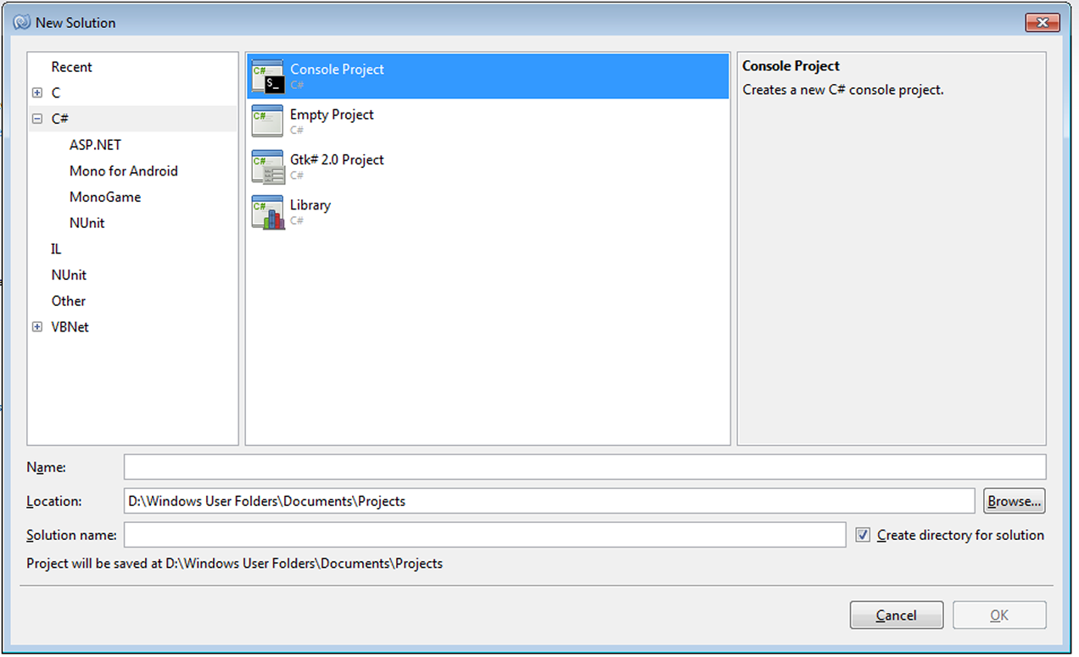
Intro to MonoDevelop
To create a new 'solution':
  >Start new Solution.
  >Click C#
  >Console Project
  >Give your solution a name
  >Change the location of your project if necessary
  >Click Ok.
Notes:
Creating a new solution is just clicking on the Start new Solution link on the start page. The click on the type of project you want to build. For us this is either Console Application or further down MonoGame and then click on Windows. Afterwards type the name of your program and click OK.

Slide 8
Running & Saving your Program
Running:
  >Click Run
  >Start Debugging
  The program will run but will not pause at the end.
  >To do that click Start without Debugging.
Saving:
  >To save the whole program click the multiple-floppydisk icon.
  >To save the file your working on, click the floppydisk icon.
  >You can use the shortcuts of Ctrl-S to quickly save it, very useful :)
Notes:
Running is pretty simple. Just click run and choose Start Debugging or Start without Debugging. For today we will mostly be using the former.
Saving is as simple as any other program, save all files with the multiple floppy disk icon on the menu bar or a single floppy disk to save the current file. Control S is a good shortcut to use as soon as your code works.

Slide 9
Introduction
USING C#

Slide 10
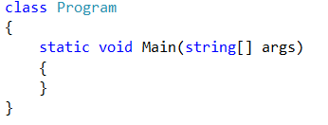
First steps
Notes:
When you first start a new project you’ll be greeted by something that looks like this inside something called a “namespace”. Don’t worry about the namespace at the moment. If you don’t see this piece of code anywhere on your screen then please raise your hand.
Do not worry if the colours are the same, what’s important is what is written.
[Help anyone who raises their hand]
You may also see a bunch of things that say “using” and then Microsoft dot something, and remember these because we’ll be explaining them later.
Now, as much as we encourage fiddling around with things here at the Makerspace, don’t modify this code, as it needs this to run.

Slide 11
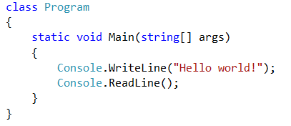
First steps
Notes:
Now you’re going to want to add these two lines of code inside the curly brackets of “Main”.
Make sure that it looks exactly the same as this (except the colours of the words, they do not have to be the same).
[Wait for everyone to type it in]
Now what this will do is write “Hello world exclamation mark” to something called the console. The console is a window with a black background which can display white writing. In this code we are telling the console to output the words Hello world, with an exclamation mark.
If we ran this code without Console.ReadLine();, then it would close instantly, because the console closes itself when it gets to the end of the code. Console readline is there to make the program wait for user input before it closes. We will be using these two methods along with the console a lot in this first part of the evening.

Slide 12
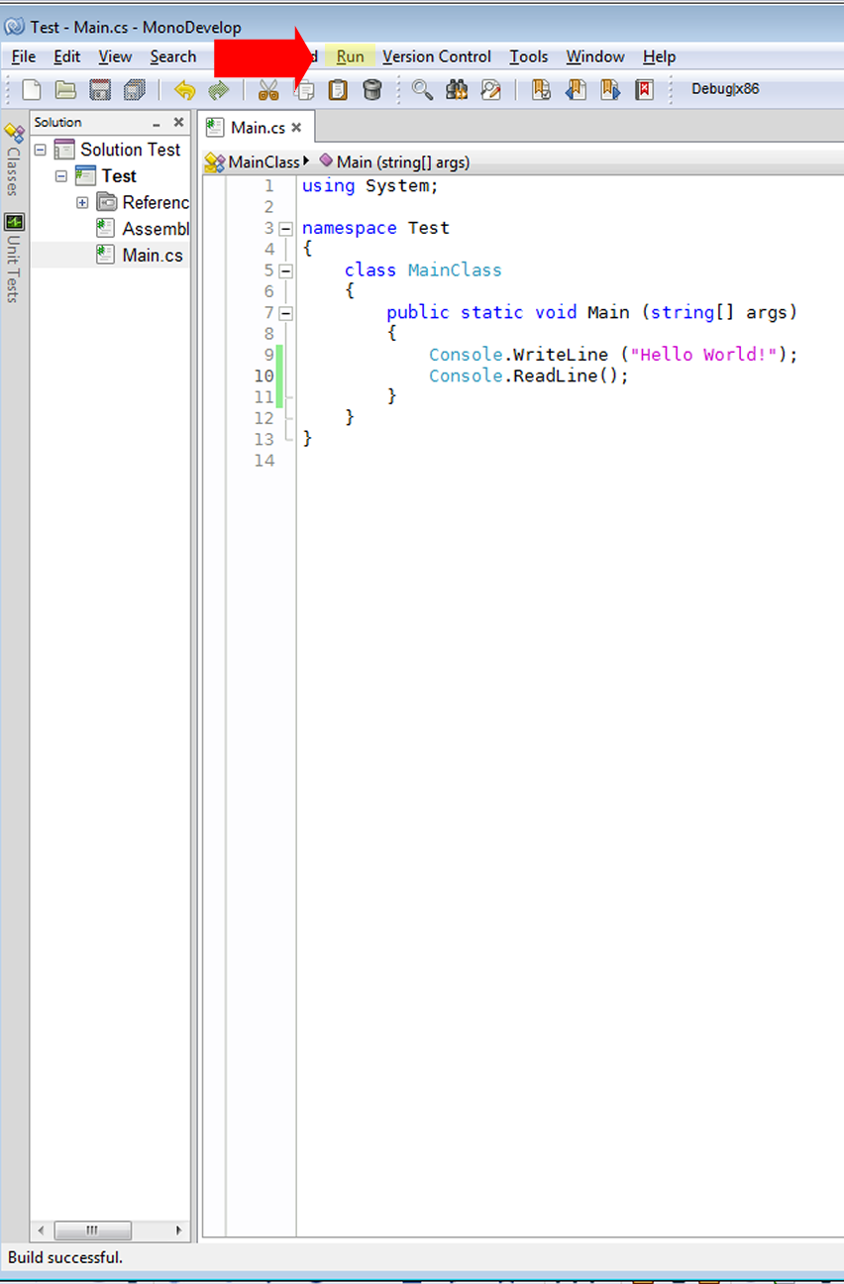
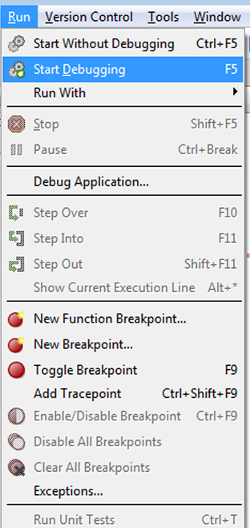
First steps
Notes:
Now that you have some good code, its time to run it. To do that, click Run and Start debugging.

Slide 13
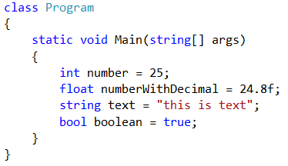
Variables
Notes:
What you can see here are called variables.
A variable is a part of the computer’s memory that you can store things in.
There are many different types of variables that C# uses and there is an infinite amount of variables you can make yourself.
To use a variable you must first tell the computer what type of variable it is, then you must give it a name.
You don’t have to give the variable a value yet, but in this case we are.
To give a variable a value you just put an equals sign, and then the value you want it to be, followed by a semicolon.
You will see a lot of semicolons in most programming languages. They just tell the computer that it’s the end of that particular line of code.
Here are 4 of the most commonly used variables.
The first of these is called an “int” – short for integer. This is a number with no decimal places. It’s useful for things like a player’s score in a game.
The second is a “float” – short for floating point number. This is just a number with decimal places. It’s useful for things like amounts of damage to inflict on things, as well as the speed of objects.
The third is a string. It’s just text. To use this, you must put quotation marks around the text, or it won’t work. Strings are used for everything involving text in games.
Finally, we have a bool – short for boolean. This is a variable that can either be true or false. It can be used in lots of places in a game. An example of this would be in a settings menu, you would have a boolean called isFullscreen or something which, when true would make the game run in fullscreen. You would then make the boolean change from true to false when the player pressed a button.

Slide 14
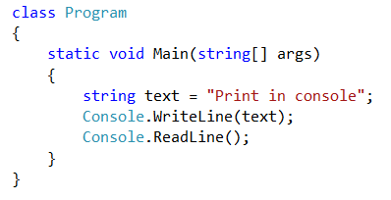
Variables
Notes:
You can combine variables with methods, as in the example shown. This writes “Print in console” to the console.

Slide 15
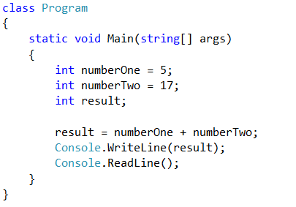
Arithmetic with variables
Notes:
You can perform mathematical operations on variables.
Here we are adding the variable numberTwo (with a value of 17) to numberOne (with a value of 5).
We are then making a variable to store the result in, then printing the result.
Try it out!

Slide 16
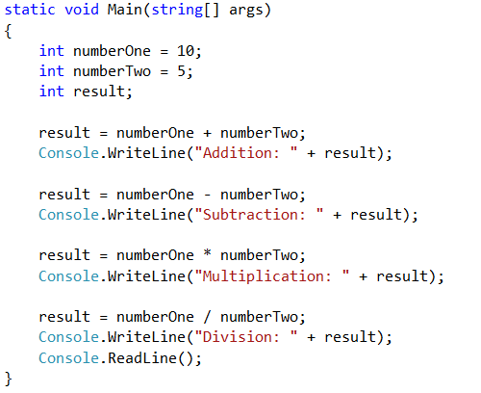
Arithmetic with variables
Notes:
This is the longest piece of code yet! Don’t be intimidated by it, I’ll break it down into easy steps for you.
First we’re making variables with a value of 10, 5 and an empty one for the result.
Then we are adding numberOne and numberTwo and printing the result, but with a twist!
You can see that I’ve put some text and a plus sign next to it, along with the name of a variable (result).
This is addition on a variable which isn’t a number. If you do addition on a string then it will add other text, or numbers onto the text.
Next we make the result equal numberOne minus numberTwo, then printing it again.
Then we multiply numberOne by numberTwo and print it.
Then we divide numberOne by numberTwo and print it.
Finally we wait for user input before ending the program.
This is all the mathematical operators you need to use at this point. There is one more, and it’s called Modulo, but that’s beyond the scope of this workshop. If you’re interested and want to know then feel free to ask one of us when there’s a spare moment.

Slide 17
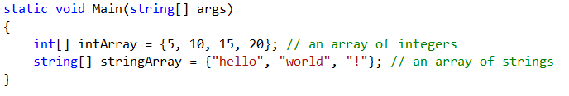
Multiple values in one variable?
Notes:
You can also store multiple values in one variable. This is called an array.
Above you can see the declaration of an array. It’s much the same as a normal variable, except you need to put the square brackets after it, and to define values for it you put an equals sign with curly braces and each value separated by a comma.
Don’t forget to end the line with a semicolon.
Here you can also see something called a comment, in green.
A comment is something that the computer ignores when it runs the program, so they are mainly used by us humans to decipher our code. You mainly want to use comments to describe what your code is doing, but some of the time you can use them to make silly little remarks about your code, or moan about glitches in your code which you have no idea how to fix.
To start a comment you write two forward slashes then the message you want to write.
You don’t need to put a space after the forward slashes, but I do it because it looks cleaner.

Slide 18
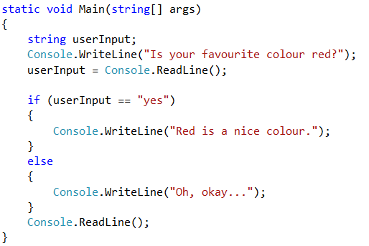
Loops
Notes:
Now we come onto loops, a crucial part of programming.
A loop is basically asking the computer if something is equal to something else, and if it is, running the code “inside” the loop.
In this case we are setting up a string called user input to store... Well... The user input.
We then print “Is your favourite colour red?” to the console, and make the user input a response to it.
If you make a string equal Console.ReadLine(), then the string will equal whatever the user types in and presses enter.
So then we check to see if userInput is equal to “yes”. When checking if something is equal to something else, you MUST use a double equals sign. If you use a single equals sign then it will cause an error. This is so the computer can distinguish between you setting a value and checking a value.
The basic structure of a loop is the type of loop, followed by brackets containing what you’re checking, then followed by curly braces to contain the code to be executed.
Inside the if loop we make the console output “red is a nice colour”.
After that we can start an else loop. This code is run if userInput is equal to anything but “yes”. Inside this we make the console write “Oh, okay”.
After all this we then wait for user input to shut down the program.
Try it yourself!

Slide 19
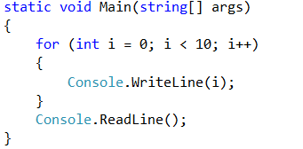
For loop
Notes:
Welcome to what is in my opinion, the most initially confusing loop.
As you can see it’s got the basic structure of a loop, declaring the type followed by the brackets, but what is this?
There’s some strange jargon where the comparison should be!
The for loop basically executes the code in the loop a set amount of times.
It creates a variable called i (it doesn’t have to be i, but it is in most generic for loops) then makes it be equal to zero.
After that there is a semicolon (it’s not the end of the line, but you must put one here because it separates the stages of the for loop), and a comparison.
The number here is the number of times you want the code in your loop to be executed. This can be a number like I’ve done here, or it could be another variable.
After that, another semicolon, then you have “i++”.
This just adds one to i, as simple as that.
Inside the loop we make the console draw the value of i.
So the loop goes:
I is 0
Is i less than 10? Yes.
Write i
Is i less than 10? Yes.
Add one to i
Write i
And so on until i is no longer less than 10, then it will wait for user input and close the program.
You should get a list of numbers from 0 to 9, and you may be wondering “where’s 10?”, well, there are 10 numbers there. In programming, 0 is counted as a number. If you have something where zero is counted as a number, it is called “zero-indexed”.
Try it out!

Slide 20
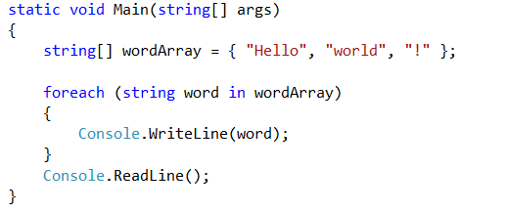
Foreach loop
Notes:
A Foreach loop is used to go through an array one value at a time.
It has the same structure as any other loop, with the type of loop stated first, but instead of a comparison, it makes a string and then says in and then the name of an array.
Basically it means “for each value of the array, make this variable equal to the value and then execute this code”.
So, we are going through each word in the wordArray, and printing it to the console, then we are waiting for user input before we close.
Simple!
Try it out!

Slide 21
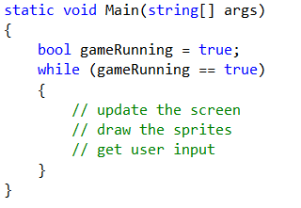
While loop
Notes:
Here we have a while loop.
As you can see the structure is the same as the other loops, and it even has a comparison!
A while loop checks to see if a condition is met, and if it is met, it will run the code inside the loop over and over again until the condition is no longer met.
While loops are dangerous though, as you can get stuck in an infinite loop, which will eventually cause your program to crash. Most IDEs and compilers stop you from doing this though.
You don’t need to try this one out as the loop is not used as much as the others, and it will eat up processing power if used with the console.

Slide 22
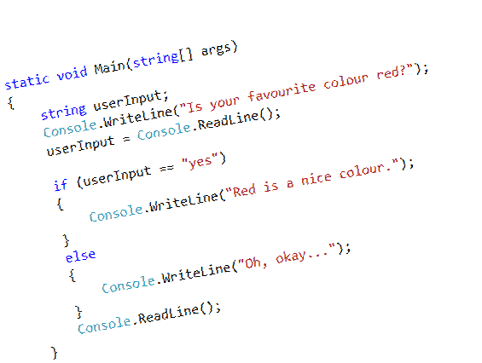
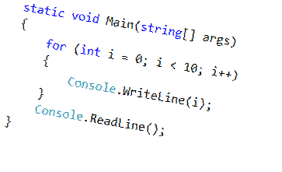
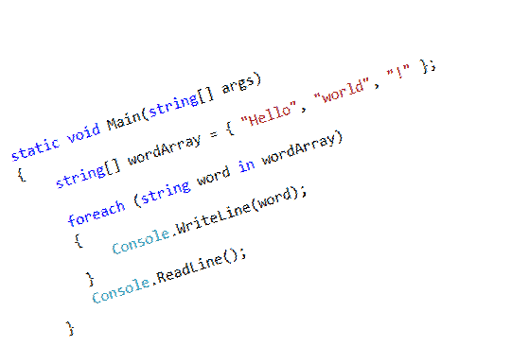
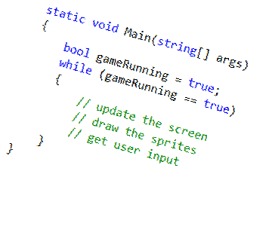
Importance of loops in Game Development
Notes:
Loops have many uses in Game Development.
An if loop will be used to check if a condition is met, for example, if the players amount of lives is less than zero, end the game.
A for loop will be used to go through lists of things, such as a list of items to check for collisions with other items.
A foreach loop will be used to go through lists of things as well. An example would be to go through each monster on the screen and set it’s target to the player.
A while loop is nearly always used as what is called an “update” loop. Basically, a while loop is made, and the code inside is only run when the game is running.
The code which is executed will be physics calculations, moving sprites around on screen, etc.

Slide 23
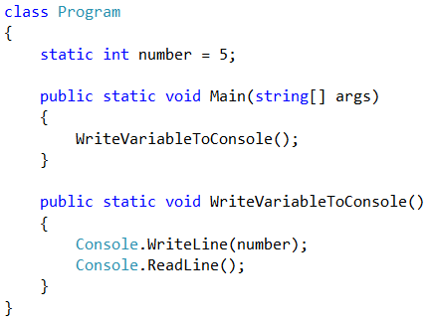
Functions
Notes:
Now, onto functions.
It’s time to step outside of the Main function which we have been using since the start of the workshop.
A function is basically code that is elsewhere in the program which can be executed at any point without typing up all the lines of code multiple times.
I’m not going to explain publics and statics now, as that’s Will’s job later on in the presentation, but type what you see into the class Program section.
Basically this makes a variable called number and makes it equal to 5.
I’m going to skip over the main function now, and direct your attention to what’s written underneath.
As I said, ignore the publics and statics and you have “void”. This is what you want to use for a function.
WriteVariableToConsole is the name of the function, and the brackets will be explained when we move on to arguments.
Inside the function is the code that will be executed whenever the function is ‘called’.
You can see the function being called in this code in the main function, where it just says “WriteVariableToConsole()”.
I don’t think I need to explain what the code inside the function we made does.

Slide 24
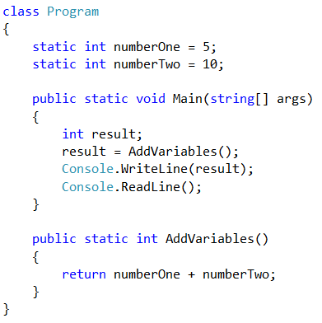
Functions which return values
Notes:
Now we are going to make a function which returns a value.
As you can see the code has the same structure as before, except with 2 variables declared at the start, different code in the Main method, and the function is completely different.
Let’s look at the function first. As you can see, instead of void I have put int, this is because we want to get an int from the function. Inside the function we have put return, and then numberOne plus numberTwo. What this will do, is if you make a variable equal to the function AddVariables, it will be equal to numberOne plus numberTwo, because the function returns that number.
We can see this in the main method. There is a variable called result, and below that result is equal to AddVariables();
Then the console prints the result, which should be 15.
Try it out!

Slide 25
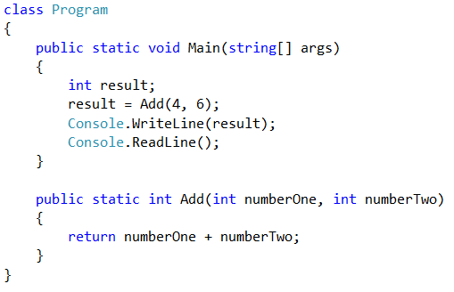
Functions with arguments
Notes:
Here you can see a function called “Add” with arguments.
The arguments are the variables inside the curly brackets.
Basically, an argument is a variable that you can “give” to the function when you call it, and the function will use these variables given to it in the various operations you make it do.
Here the add function has 2 arguments, numberOne and numberTwo.
When called, it adds numberOne and numberTwo and returns the result.
In the main function we make a result variable, then we add 4 and 6 together to make 10, and print the result. Simple!
Try it!
You could make a calculator with different functions for Add, Subtract, Multiply and Divide.

Slide 26
WILL
ADD THE XNA/MONOGAME STUFF HERE

