Slide 1
Multi-scale boundary detection using CNN convolution-deconvolution network
Xu Xu, Ga Wu

Slide 2
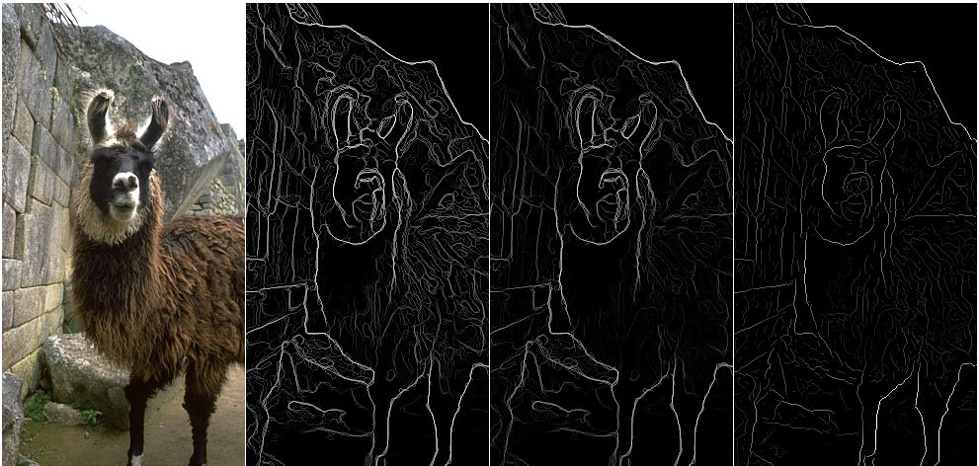
Boundary detection in computer vision
We address the problem of detecting edges and object boundaries in natural images.
The prediction goal is and image of the same size but delineates all the boundaries in the image.
In the ideal case, the result of applying an edge detector to an image may lead to a set of connected curves that indicate the boundaries of objects

Slide 3
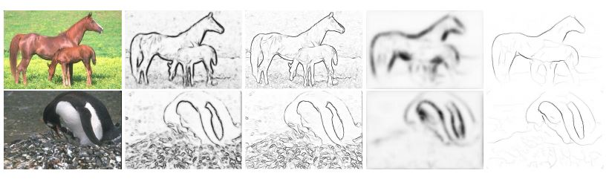
Multi-scale improves boundary detection
Common edge detectors(Canny) are mostly based on image gradients and Gaussian derivative filters, and not scale invariant.
Multi-Scale Improves Boundary Detection in Natural Images by Ren, ECCV 08
Combines strengths from both large-scale detection (robust but poor localization) and small-scale detection (detail-preserving but sensitive to clutter).
Notes:
Fig. 1. We run the Probability-of-Boundary operator [9] to generate boundary contrast signals at
multiple scales. Here we show both the (soft) contrast map and the boundary map (after nonmaximum
suppression), at a small scale and a large scale. Large-scale signals are reliable but
poor in localization, and details are smoothed out. On the other hand, small-scale signals capture
detailed structures but suffer from false positives in textured regions and clutter. The challenge is
how to combine the strengths of them.

Slide 4
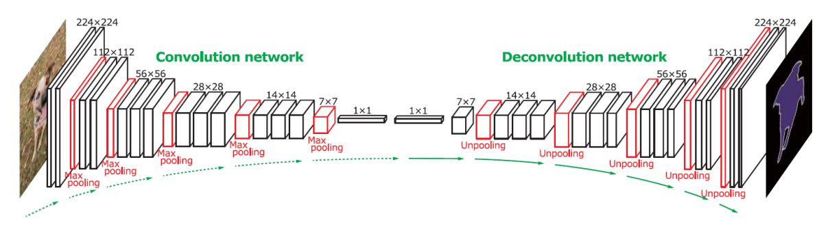
Deconvolution provides multi-scale boundary information
Convolutional networks of various depths can capture boundary cues including contrast, localization and relative contrast, at different scales. It learns the representations of input in a hierarchical way.
Deconvolution networks, mapping features back to image pixels, can generate an image of equal size to the input image. So ground-truth annotations of boundaries can be used to compute loss.
But this is not enough, we still have more challenges on this project.
Notes:
A deconvnet can be thought of as a convnet model that uses the same components (filtering, pooling) but in reverse, so instead of mapping pixels to features does the opposite.

Slide 5
Convolution-deconvolution network
Is single convolution-deconvolution network enough?

Slide 6
What is the challenge?
We have convolution and also same structured deconvolution layers
Parameter is doubled!
Is the training data enough for training?
Better way to create new variation data
Number of convolution layers directly impact final decision boundary detected.
Too deep, the boundary is more robust, but loss lots of details
Too shallow, the output is sensitive to clutter
We need to find a way to combine models!

Slide 7
Metric for boundary detection
Precision or Recall.
We want both of them
F measure
Anything more?
ROC curve
Notes:
We are not only care about how many of the edges is detected, and also how many of the detected is edge!

Slide 8
BSDS-500: Berkeley Segmentation Data Set and Benchmark 500
For research on boundary detection and image segmentation.
The dataset consists of 500 natural images, 200 for training,200 for testing, 100 for validation.
By average, each image is annotated by 5 persons.
The dataset consists of benchmarking code.

