Slide 1
Optical Number Recognition
Generate the training set
Three features – Original image, Canny image, Gradient image
Train the classifier – KNN, SVM, Random Forest
Pick the result
Pick the 5 numbers out

Slide 2


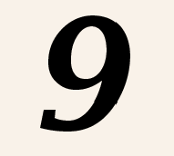
Training data
There are around 1000 samples for each number
Each number was reshaped to 16*16
Doing Canny and HOG(for the gradient) for each reshaped image
Turn the outputs to a 1*256 array.
Then we got the Training set, around 3000 samples for each number.

Slide 3
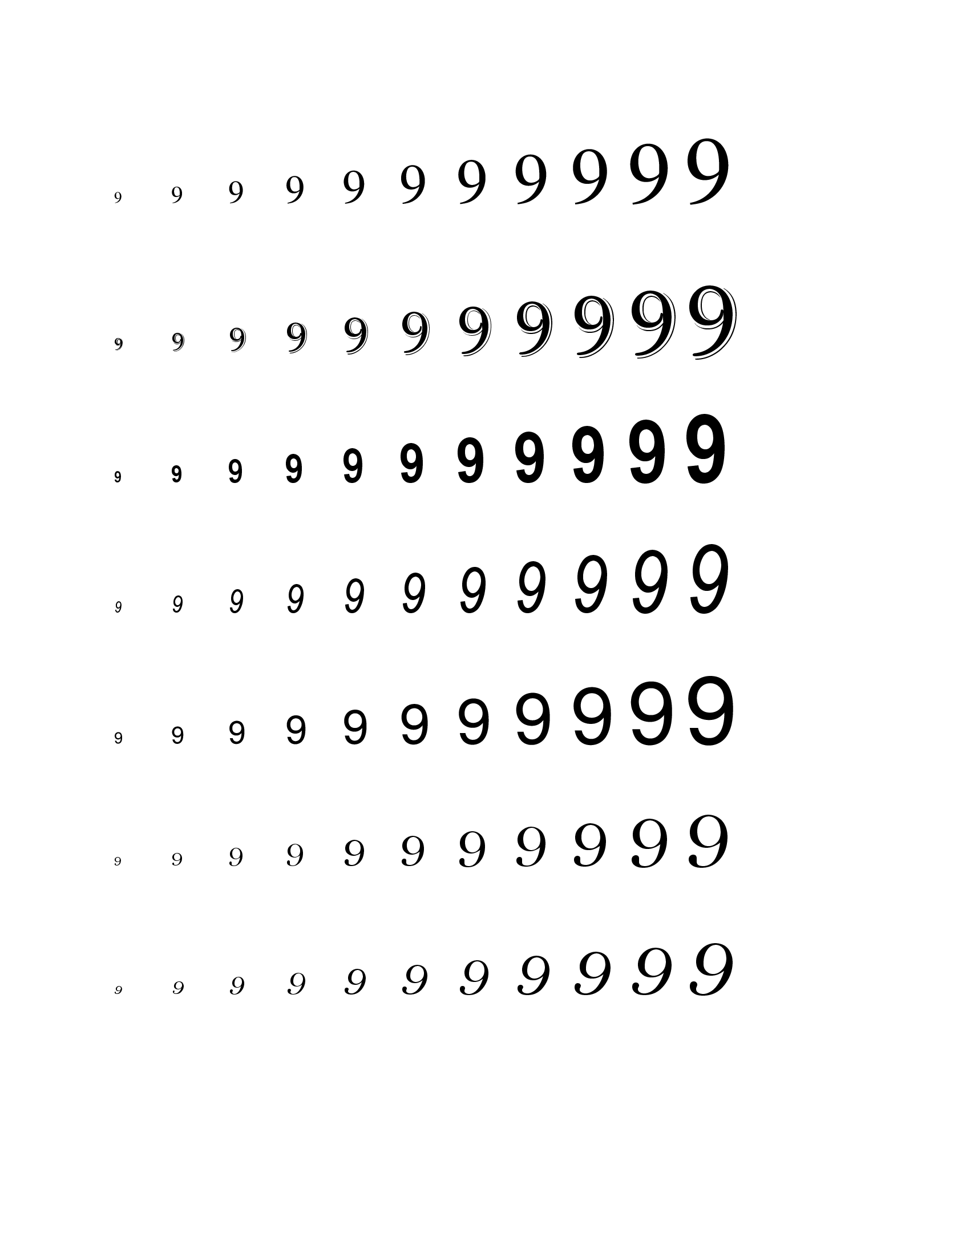
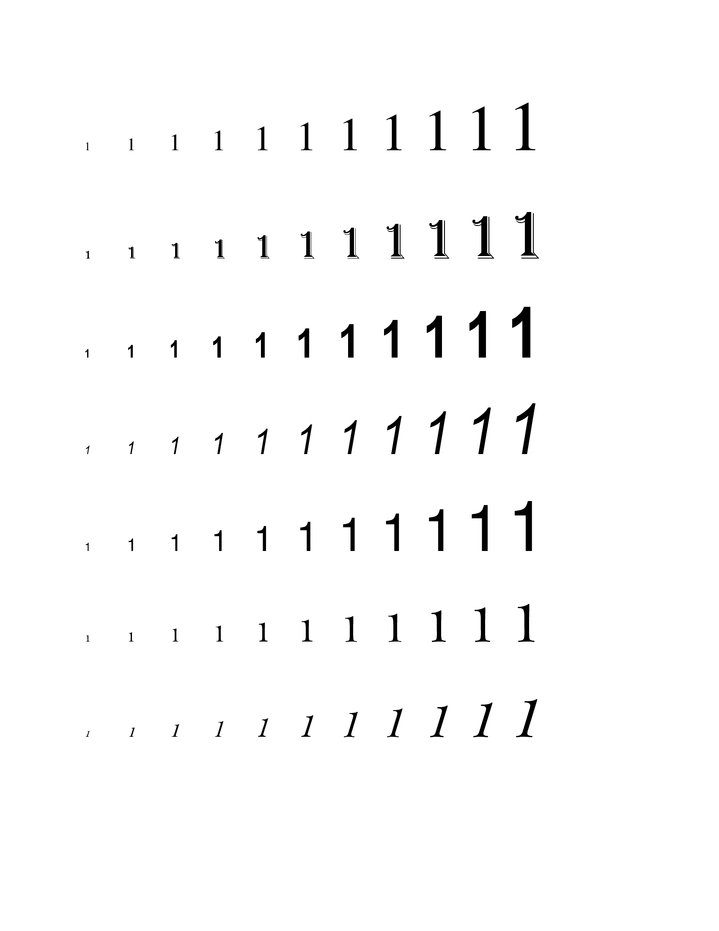
Training set example

Slide 4
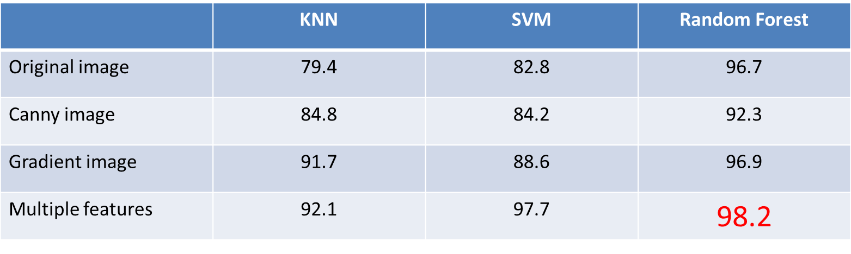
Classifier
KNN
SVM
Random Forest

Slide 5
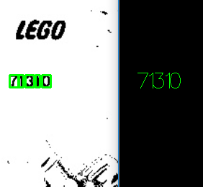
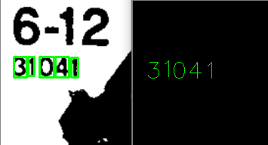
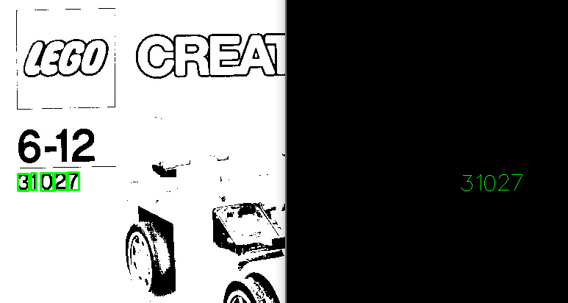
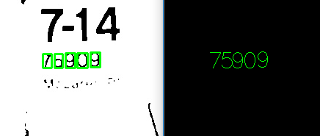
Some Results

Slide 6
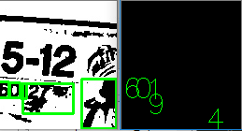
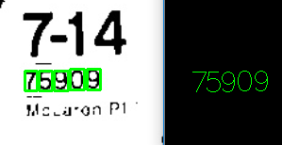
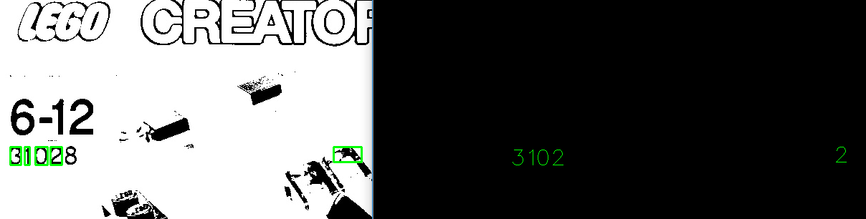
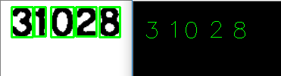
Some Results

