Slide 1
Automated Prediction of Interstitial Lung Desease (a machine learning application) May 2016 Peter Hirt Sylvain Kritter

Slide 2
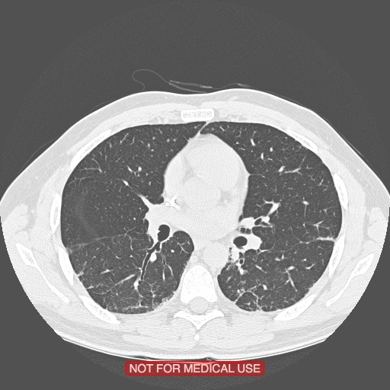
Data Set
DICOM is an acronym for Digital Imaging and Communications in Medicine.
ILD_DB_lungMasks
ILD_DB_txtROIs
ILD_DB_volumeROIs
Source of data:
University Hospital Geneva
under signed EULA
102 cases represented
"Building a reference multimedia database for interstitial lung diseases". Depeursinge A, Vargas A, Platon A, Geissbuhler A, Poletti PA, Müller H. In: Computerized Medical Imaging and Graphics, 36:3(227-238)

Slide 3
Input data
patches: 32x32x1
min 80% inside ROI
no overlap between patches
greyscale coded on 8 bits (256 values)
6 classes:
healthy 1622
GGO 336
reticulation 306
consolidation 59
micronodules 2297
fibrose 1129
ground truth polygon
area indicated and labeled by radiologist where ILD is present

Slide 4
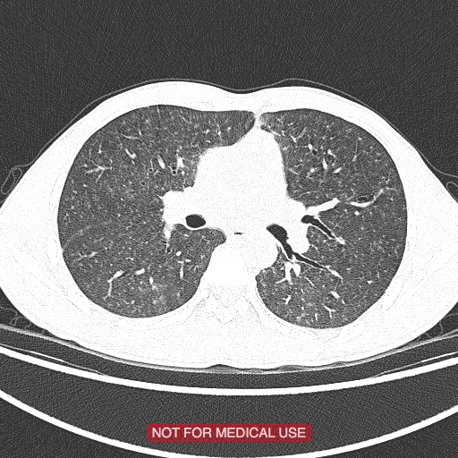



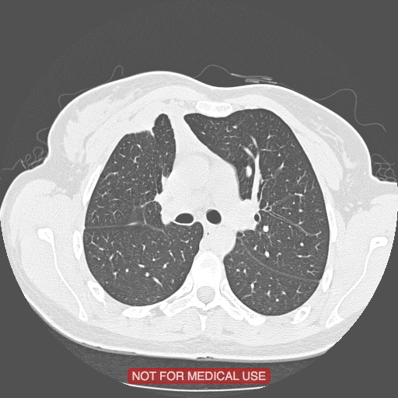
Summary of Data Processing Flow
thousands of pictures
Convolutional
Neural
Network
X_train
y_train
model &
weights
ETL
training
Extract
Transform
Label
Powerfull processor (GPU based ideally)
Honeycombing
86%
predict
ETL
predict
visualise
Standard CPU

Slide 5

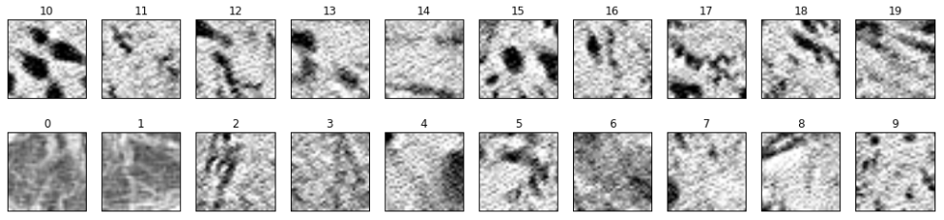
Details (1 of 6) DICOM file processing to patches
other categories discarded
patches
fillshape.py
healthy
generatetabc.py
fibrosis
ROI
ground glass
final.py
consolidation
lung mask
micronodules
samples of patches (with fibrosis)
reticulation

Slide 6
Details (2 of 6) Creation of dataset for CNN
patches
healthy
X_train.pkl
y_train.pkl
12500
fibrosis
data split
random method
ground glass
Dataset Creation.ipynb
X_test.pkl
y_test.pkl
6250
consolidation
micronodules
# patches: 6267
after data augmentation: 25068
modulo 1000: 25000
X_val.pkl
y_val.pkl
6250
reticulation
data augmentation:
3 x rotation by 90 degrees

Slide 7
Details (3 of 6) Training
X_train.pkl
y_train.pkl
ild_helpers.py
cnn_model4.py
X_val.pkl
ILD_CNN_model.pkl
y_val.pkl
ILD_CNN_model_weights
main4.py
...object.csv
...object-Best.csv

Slide 8
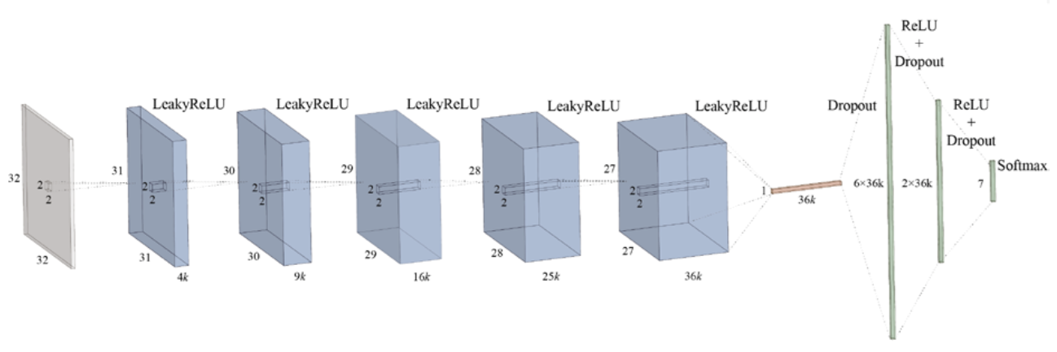
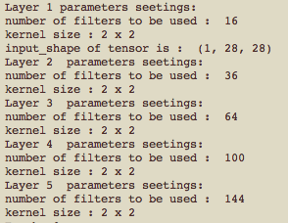
Details (4 of 6) Model
Pooling
Avg
2x2x16
2x2x36
2x2x64
2x2x100
2x2x1
Need review
1x144
16
36
64
100
144
28x28x1
27x27x16
26x26x36
25x25x64
24x24x100
23x23x144
23x23
sub_sample=(1,1) : stride
border_mode=‘valid’
16
36 64 100 144
total receptive field is 6x6 (2x2 on 5 layers of convolution and activation)

Slide 9
Details (5 of 6) Creation of dataset for CNN
predict
107
Prediction Data Preprocessing.ipynb
X_predict.pkl
X_file_reference.pkl
338
121
138glass
patient ID : 121
diagnostic: fibrose
# patches: 338
after data augmentation: 25068
modulo 1000: 25000
The file reference allows to rebuild the x/y position of the patch

Slide 10
Details (6 of 6) Predict new patient
ild_helpers.py
ILD_CNN_model.pkl
cnn_model4.py
ILD_CNN_model_weights
predicted_classes.pkl
ILD-CNN Prediction part .ipynb
X_predict.pkl
predicted_probabilities.pkl
patient ID : 121
diagnostic: fibrose

Slide 11
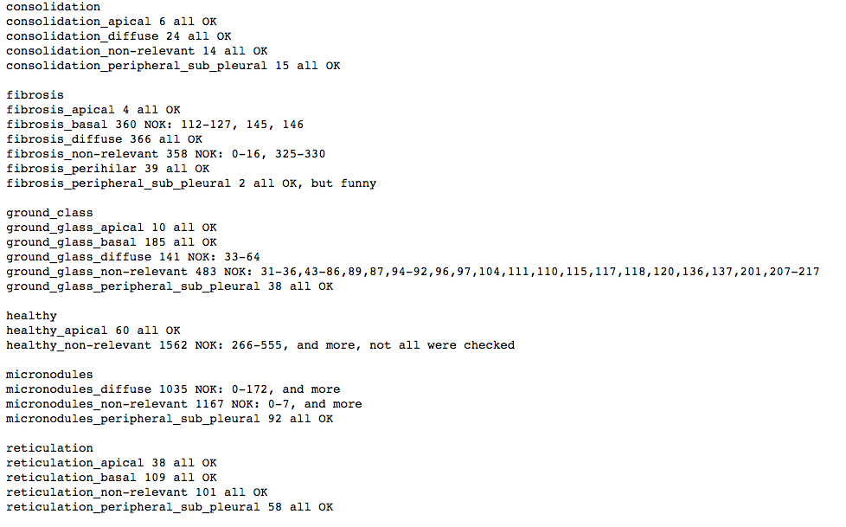
Details Patches

