Slide 1
International Housing Market
By Chelsea Mason

Slide 2
Introduction
This Dataset focuses on the Global Housing Market
This dataset focuses on the housing market for different countries in different years. It gives insight into what factors someone purchasing a home in different countries would face. There are 200 rows and 11 columns.
The Dataset has columns covering topics such as House Price Index, Rent Index, Affordability Ratio, Mortgage Rate %, Inflation Rate %, GDP Growth %, Population Growth %, Urbanization Rate %, and Construction Index.
There is a Country column. There are 20 countries and they include USA, Canada, UK, Germany, France, Italy, Spain, Australia, India, China, Japan, Brazil, South Korea, Mexico, South Africa, Russia, Netherlands, Sweden, Switzerland, and UAE.
The Year Column showcases the years. It has a range of 2015-2024.
This dataset does not have any outliers and the progression from the min to the max all are reasonable.
There are negatives in the GDP Growth % and Population Growth % but those are fine because negatives in those areas reflect a shrinking Population and GDP. Those are natural occurrences.

Slide 3
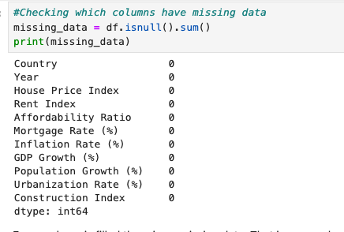
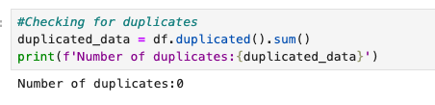
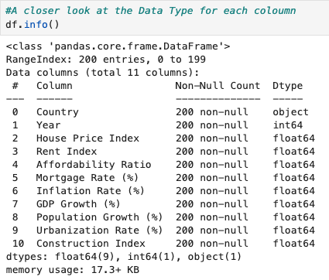
Data Cleaning
For Data Cleaning there were not any missing data nor duplicates. Due to this not much editing of the dataset was done. However, the editing that was done was to make the Year column a category. Before it was a integer and having it as a integer can skew the data when making graphs, that is why it was turned into a category. It also allowed for comparing the data of different years. I saved the year being recognized as a category to a new csv file, to reflect the cleaned data. This new csv is pretty much like the original except year is recognized as a category. No further edits needed to be made because there was not any outliers.

Slide 4
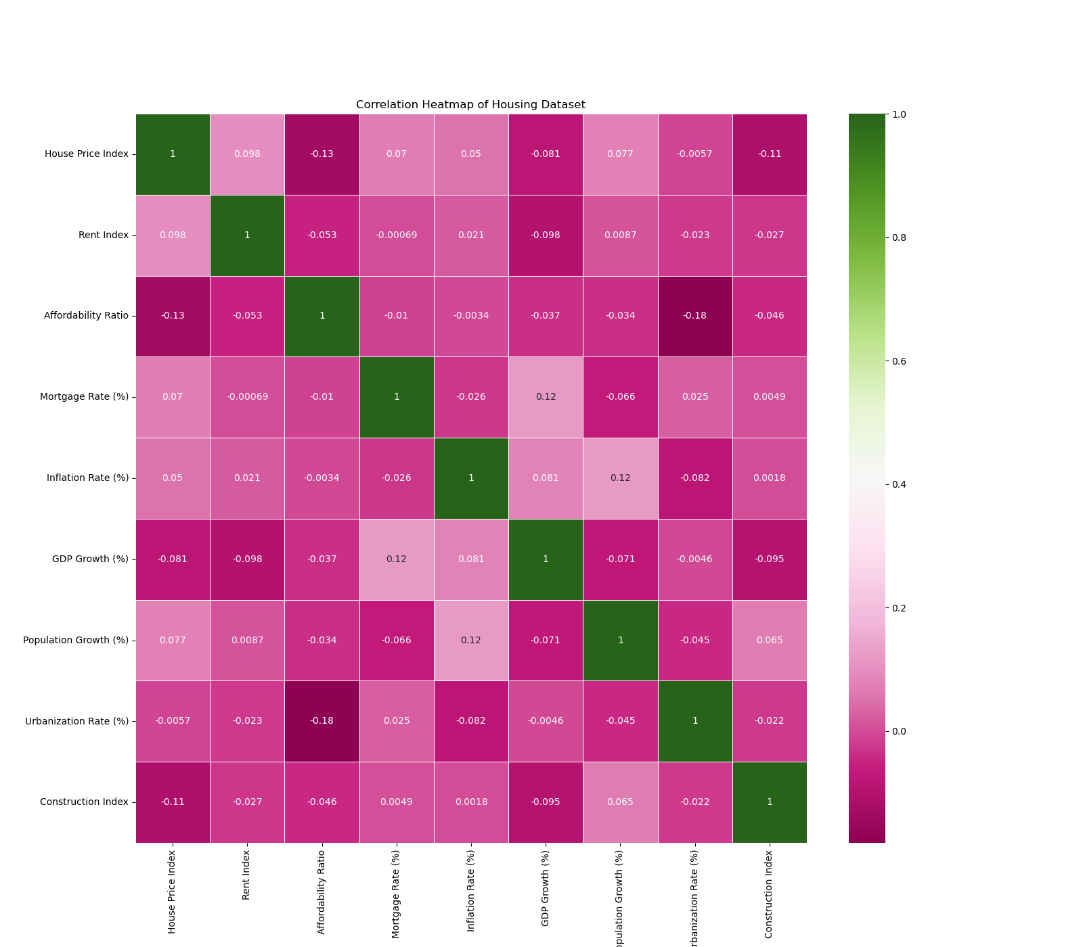
Heat Map
The point of the creation of this Heat Map is to view correlations. There aren't really any strong correlations. The strongest for a positive correlation are GDP Growth % and Mortgage Rate % at 0.12, and Population Growth % and Inflation Rate % at 0.12, Rent Index and Price Index at 0.098. The strongest for negative correlation are House Price Index and Affordability Ratio at -0.13, Urbanization Rate and Affordability Ratio -0.18, and Construction Index and House Price Index -0.11.

Slide 5
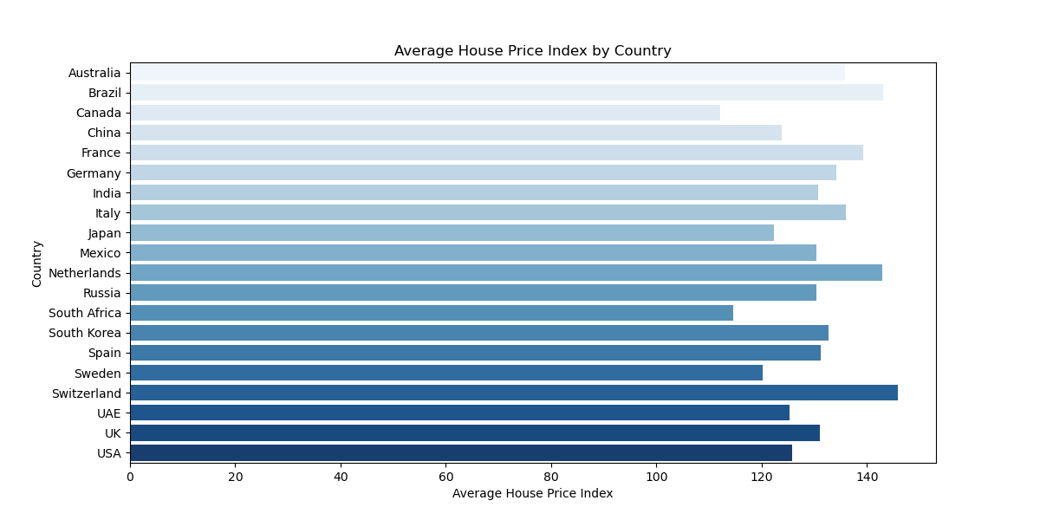
Average House Price Index by Country
ABOT US
MARKET ANALYSIS
House Price Index tracks the changes in house prices over time. It shows changes in home values. The bar plot shows the average House Price Index per country. Looking at the plot most countries Indexes are over 120, the two countries that fall below it are Canada and South Africa. A low House Price Index indicates homes are more inexpensive compared to the median income of that country. This implies that houses are more affordable in Canada and South Africa. Some of the highest House Price Indexes are above 140. Those countries are Brazil, Netherlands, and Switzerland. A high House Price Index indicates homes are more expensive compared to the median income of that country. Housing in these three countries are probably pretty pricey. Most of the countries fall in between 120 to 140 because of this it makes most of the countries look like they are closer to being on the expensive end when it comes to home prices.
Notes:
House Price Index tracks the changes in house prices over time. It shows changes in home values. The bar plot shows the average House Price Index per country. Looking at the plot most countries Indexes are over 120, the two countries that fall below it are Canada and South Africa. A low House Price Index indicates homes are more inexpensive compared to the median income of that country. This implies that houses are more affordable in Canada and South Africa. Some of the highest House Price Indexes are above 140. Those countries are Brazil, Netherlands, and Switzerland. A high House Price Index indicates homes are more expensive compared to the median income of that country. Housing in these three countries are probably pretty pricey. Most of the countries fall in between 120 to 140 because of this it makes most of the countries look like they are closer to being on the expensive end when it comes to home prices.

Slide 6
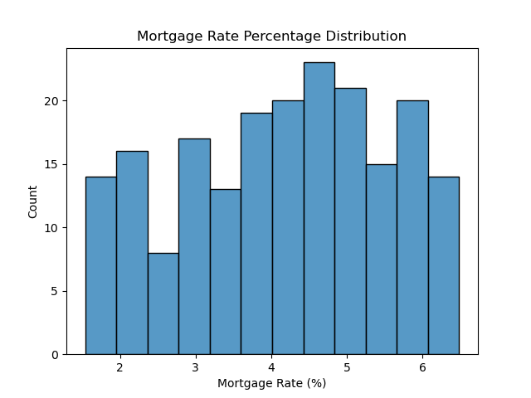
Mortgage Rate % Distribution
What is it?
The Mortgage rate is a percentage of a loan someone pays to own their home.
4 to 5
The count is the highest in between the 4 to 5 section. Meaning many countries Rates fall in between them.
Lowest
The Lowest count is right before 3 for Mortgage Rate. 3 is kind of like a buffer between lower and higher Mortgage Rates.

Slide 7
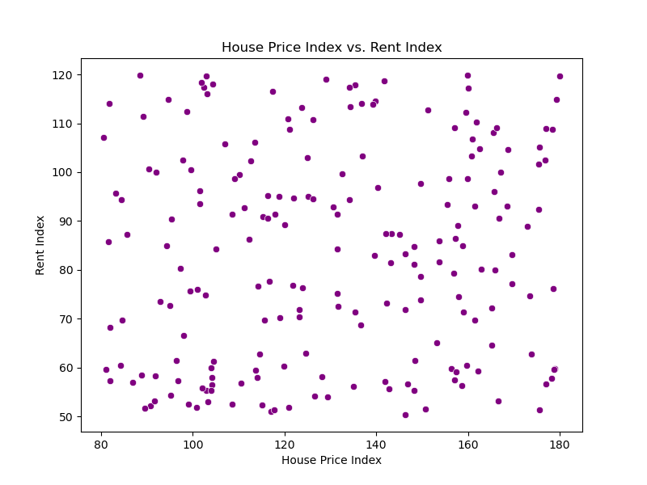
House Price Index vs Rent Index
Notes:
Rent Index measures the change in rent over time. Looking at the Scatter plot there does not seem to be a strong correlation between Rent Index and House Price Index. The data points on the plot look very spread out with no real pattern. Looking at the Heat map the Rent Index and House Price Index has a 0.098 correlation which is a weak correlation. Circling back to the Scatter Plot The Rent Index region with the most white would be in between 60 and 70. It did not really seem to matter what the House Price Index was the data points in this region seem fewer. There seems to be more of a population in between the 50 through 60 Rent Index especially near the 100 for the House Price Index. In general looking at this scatter plot feels like grasping at straws. There really does not seem to be much to work with for this chart.

Slide 8
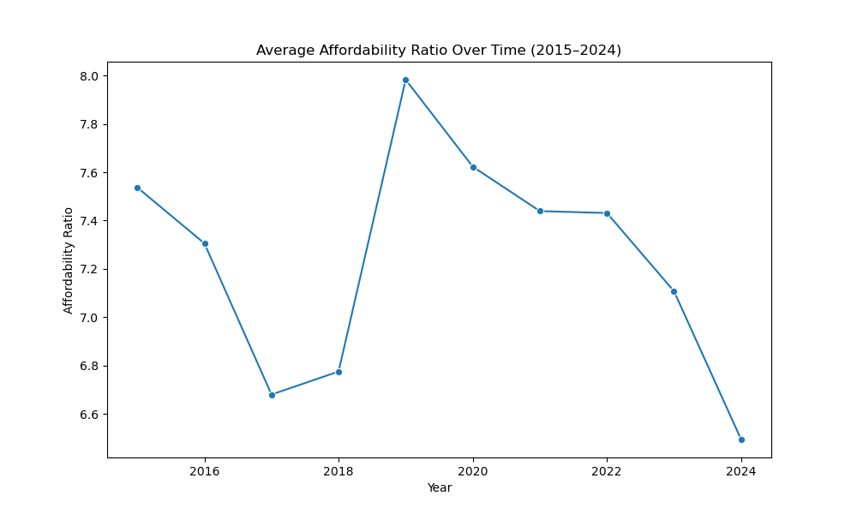
Affordability Ratio
The Affordability Ratio is a metric used to measure a household's ability to afford things relating to goods, services, and housing. A high Affordability Ratio meaning means that housing is less affordable. Whereas a low affordability ratio means it is easier to afford things. It is notable that the lowest the Affordability Ratio was, was in 2024 being at 6.5 for Affordability Ratio. It makes one wonder what was lowering prices globally during 2024. The year 2019 was the most expensive just slightly below 8. But after 2019 there is a steady decline of the Affordability Ratio until 2024. The year 2024 was a drop compared to 2023. The global event that comes to mind that may have impacted Affordability Ratio around 2019 and 2020 was the Covid-19 Pandemic. However using this dataset there is no way to investigate the connection only forming a hypothesis really. Another aspect to consider is the incline from 2018 to 2019, it goes from just under 6.8 to just under 8. To summarize the line plot 2015 to 2017 declines from under 7.6 to around 6.7. Then there is an incline 2017 to 2019, from around 6.7 to slightly under 8. Then there's a drop from 2019 to 2024, from under 8 to 6.5. This entire line plot implies that the pendulum swings both ways. Houses may be affordable for a couple of years then get expensive for some time then go back to being cheaper.
BRANDING
ENGAGEMENT
CONVERSIONS

Slide 9
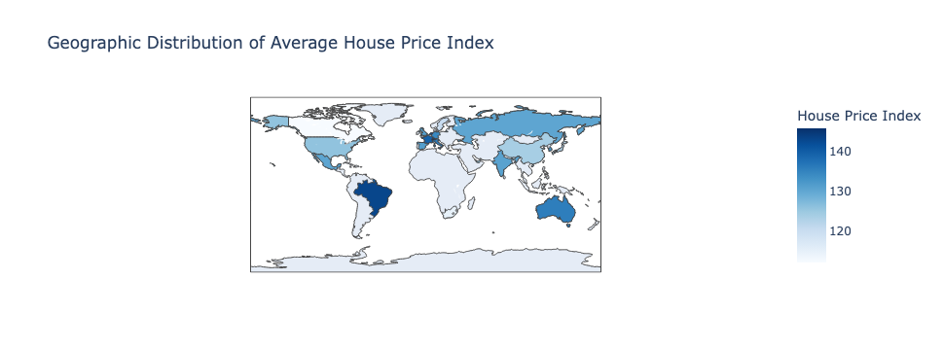
Geo Map
Looking at the Geo Map the Highest House Price Index belongs to Brazil, the Netherlands, and Switzerland. A high House Price Index indicates homes are more expensive compared to the median income of that country. Brazil, the Netherlands, and Switzerland is very expensive in regards to housing. A low House Price Index indicates homes are more inexpensive compared to the median income of that country. Canada and South Africa are the cheapest by this measure. One of the issues with using a Geo Map is that it is harder to see the color of some of the smaller countries. Looking at this map in order to see Europe clearly it needed to be zoomed in. This dataset only has 20 countries so the countries that are colored on the map are very few. But this allows one to better visually compare Countries. The cluster of darker countries seem to be in Europe indicating higher prices for buying homes.

Slide 10
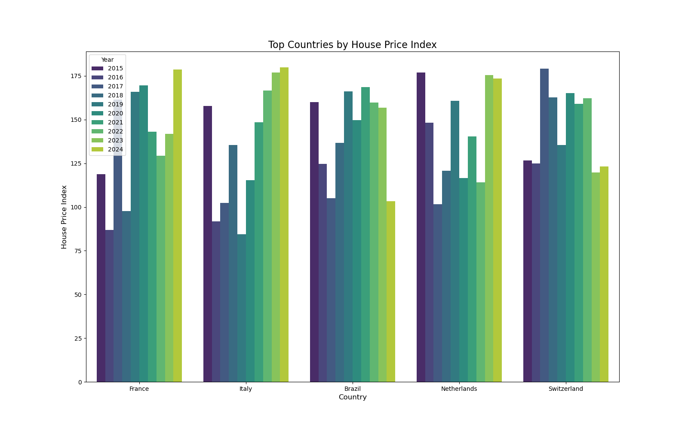
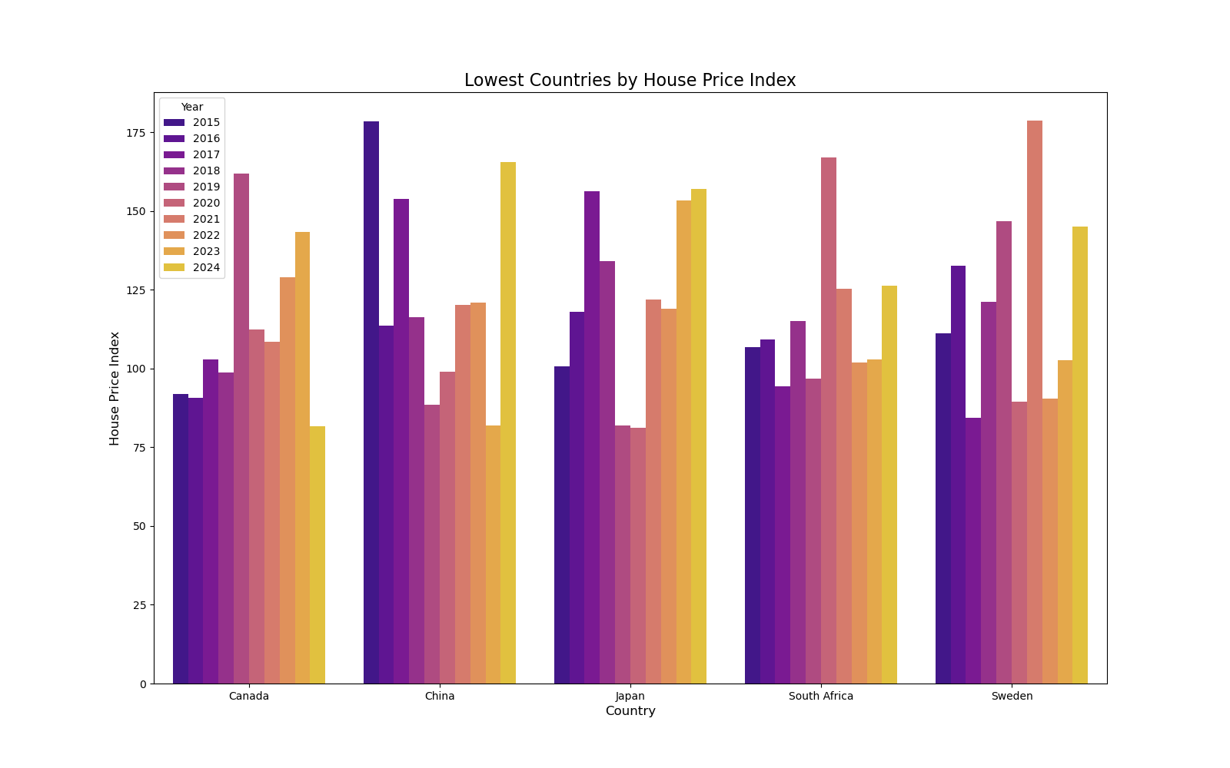
Highest vs. Lowest Price Index
The Top Countries by House Price Index are the most expensive. This graph was made to examine both the years and countries when it comes to House Price Index. For most of these countries it seems that 2024 was the more expensive year except for Brazil and Switzerland. It seems that in more recent years Switzerland has lowered their prices. France and Italy seems to have a more consistent incline of raising costs compared to the other countries. 2015 seems like a notable year for Italy, Brazil, and the Netherlands because they all seem to be higher for the countries because afterwards there is a drop.
For Bottom House Price Index the most part there is less frequent change with these countries as compared to the top House Price Index. It seems however that prices increased for most of these countries in 2024 except in Canada. That Japan and Sweden seemed to have a lower House Price Index around the 2020. This could potentially be explained by the Covid 19 pandemic. The lowest any of these countries reach is slightly above 75 and it is Japan.

Slide 11
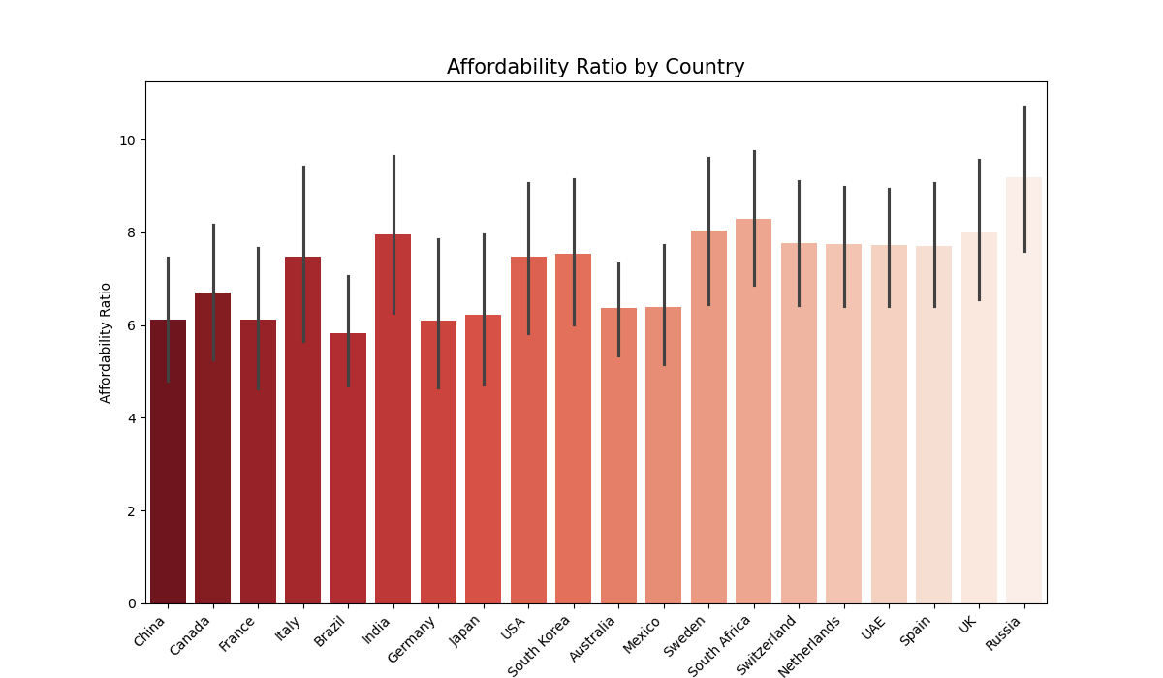
Affordability Ratio by Country
The Affordability Ratio is a metric used to measure a household's ability to afford things relating to goods, services, and housing. A high Affordability Ratio meaning means that housing is less affordable. Whereas a low affordability ratio means it is easier to afford things. It is interesting that Brazil is the lowest Affordability Ratio because on the Geo Map it indicated a high Price Index which means housing is more expensive. It implies that it is easy to purchase most things except a house. The highest Affordability Ratio is Russia which is interesting because that country did not seem to stand out in other charts. It makes one question why most things are harder to purchase. It looks like most countries Affordability Ratio is between to 8.

Slide 12
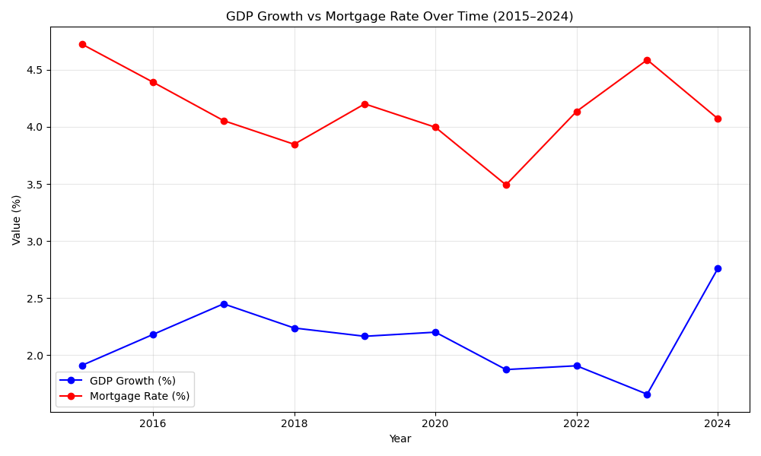
GDP Growth % vs Mortgage Rate %
The reason why this chart was created was because there is a correlation between GDP Growth % and Mortgage Rate % at 0.12. Looking at the line chart it is clear that the lines mirror each other to some extent. Or is an inverse. When the GDP Increases the Mortgage Rate decreases. When the GDP decreases it seems the Mortgage Rate increases. Some areas of the lines correlation are harder to see than others like in 2017 to 2018. That time frame seems to be when they both decrease. The lines do not intersect at any point. The Mortgage Rate is higher overall than the GDP Growth %.

Slide 13
Issues/ Limitations of the Data
Limited for International
No strong Correlations
Geo Map
The dataset is supposed to be for the Global Housing Market but there is only 20 countries. That is a very small amount of countries. There is around 195 recognized countries globally.
The data overall had very weak correlations. The highest positive correlation was 0.12 and the strongest for negative correlation was -0.18. Those are not the best to use when your looking at connections.
This is being nitpicky but when it came to the Geo Map it was hard to see some of the smaller countries in Europe. Zooming in also sometimes caused my laptop to buffer.

Slide 14
Conclusion
Prices
The main way these graphs examined housing prices was through House Price Index and Affordability Ratio
Time Data
Taking into account the prices by time through examining the graphs that prices seem to be lowering overall as of 2024
The Dataset
Focused on different housing market factors.
Data Cleaning
Was overall fine the only real tweaking or cleaning it need was making ”Year” a category.
Weak Correlation
The global housing market is influenced by very small loosely related factors.

Slide 15
THANKS
Does anyone have any questions?

