Slide 1

Group 4 – Civil Leaders
Project 2 Part 2 Presentation - Demographic Data

Slide 2

Dataset
Categories within the Dataset…
Demographic Data
  Population/Population growth
  Median age
  Sex ratio
Health Data
  Fertility
  Birth rate
  Death rate
Socioeconomic Data
  Youth unemployment
  Literacy rate
This dataset is a CIA culmination of demographic data from all recorded countries and territories as of 2025. It includes not only demographic data but also health information, literacy, and migration trends.

Slide 3
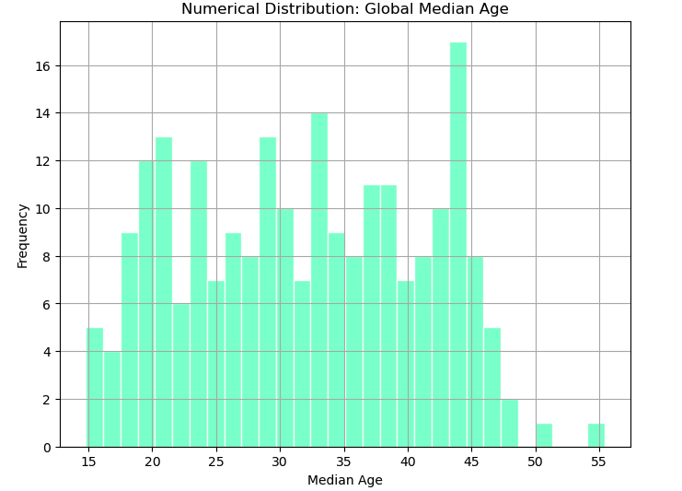

Slide 4
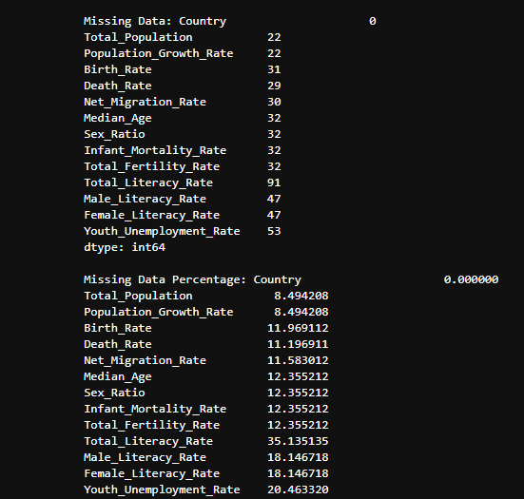
Wrangling Process
In the wrangling stage, we looked at the missing values in multiple variables to help us understand the dataset. Multiple columns had very noticeable gaps like Total Population and Population Growth Rate where there was about 8% missing. There were higher percents in the Total Literacy Rate and Youth unemployment Rate with about 35% & 20% missing respectively. We identified where the dataset was incomplete and took the gaps into account when analyzing the dataframe.

Slide 5
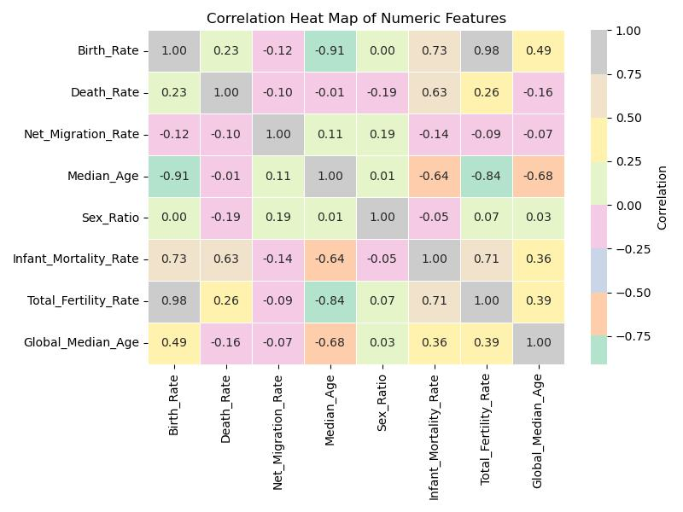

Slide 6
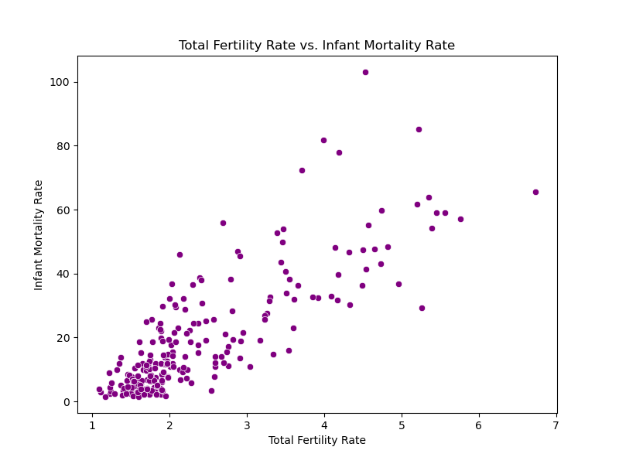
Key Insights
The Dataset is overall a great way to look at the world. Having access to the bigger picture allows the manager of the data to highlight or look at the connect between very similar or different variables. For example, there's the possibility of comparing the Total Fertility Rate to the Infant Mortality Rate. With this dataset the world is your oyster, you just need to know how to manipulate it.

Slide 7

Issues with the data…
Mixed Data Types
  Many of the numerical values in the dataset are recorded as percentages and not whole numbers leading to some confusion & difficulty with creating visualizations
Missing Values
  As the data is recorded from all countries/territories a lot of information is not recorded
Minor Details
  The world column skews the data when creating visualizations because it includes global totals, affecting the max, min, etc…

