Slide 1

Retrieval Augmented Generation (RAG)
The Artificial Intelligence Ecosystem

Slide 2

What is RAG?
Combines retrieval systems with advanced AI to enhance relevance and accuracy.
Bridges the gap between traditional search and intelligent generation.
Example: Enhanced search results in eCommerce, healthcare, and customer support.
Notes:
Introduce RAG as a transformative technology that integrates retrieval with AI. Mention its growing adoption across industries to improve user experiences.

Slide 3

The Need for RAG
Limitations of traditional keword-matching search systems.
Increasing demand for context-aware and personalized results.
LLMs are “stuck” at a particular time, potentially resulting in hallucinations.
Notes:
Traditional search systems rely heavily on keyword matching and exact phrase recognition. This approach often fails to capture the intent or contextual nuances of user queries, leading to irrelevant or incomplete results. RAG addresses these challenges by incorporating semantic search capabilities that interpret the meaning behind a query.
LLMs are “stuck” at a particular time, but RAG can bring them into the present.
ChatGPT’s training data “cutoff point” was September 2021. If you ask ChatGPT about something that occurred last month, it will not only fail to answer your question factually; it will likely dream up a very convincing-sounding outright lie. We commonly refer to this behavior as “hallucination.”

Slide 4
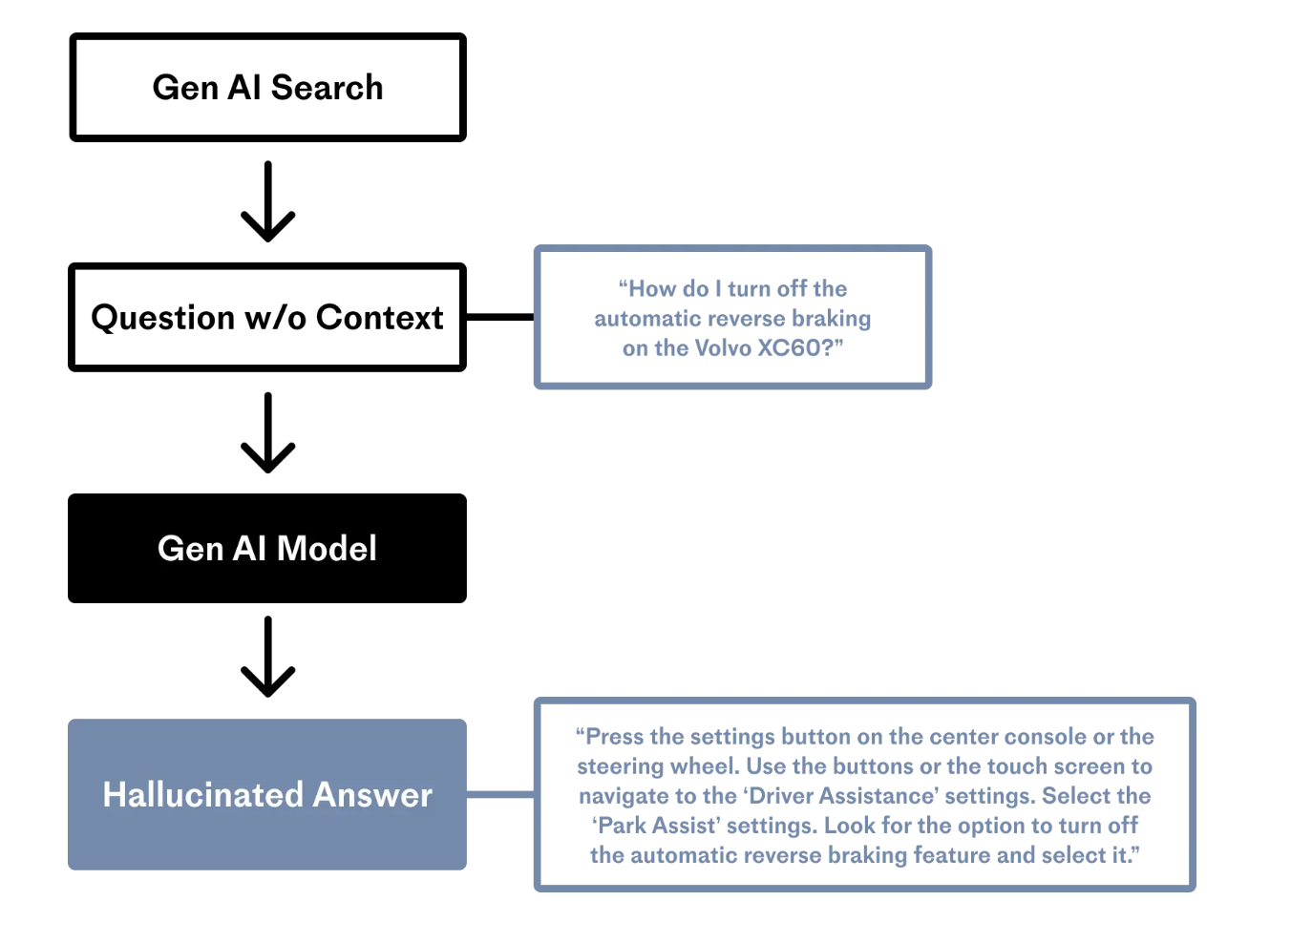
Drawback of Gen AI Without RAG
Credit: Pinecone.io

Slide 5
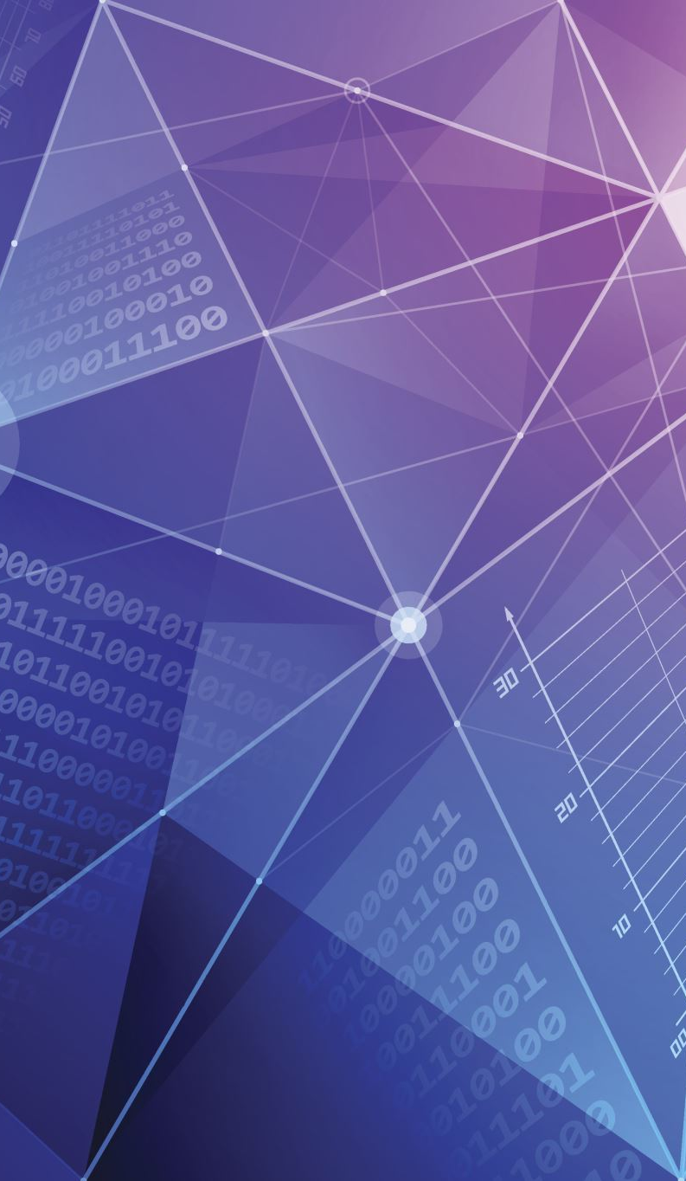
RAG Workflow
User Query: Input from the user.
Retrieval: Relevant documents retrieved using dense embeddings.
Augmentation: Retrieved data integrated with the query.
Generation: Final response produced using a generative model.
Notes:
Dense embeddings are vector representations of text that capture semantic meaning. Unlike traditional keyword-based methods, dense embeddings allow for more nuanced matching by placing semantically similar items closer in vector space. In the RAG workflow, the retrieval model uses these embeddings to fetch the most relevant documents. These retrieved documents are then augmented with the user query to provide additional context for the generative model. This interaction ensures the final output is both contextually rich and directly relevant to the query.

Slide 6
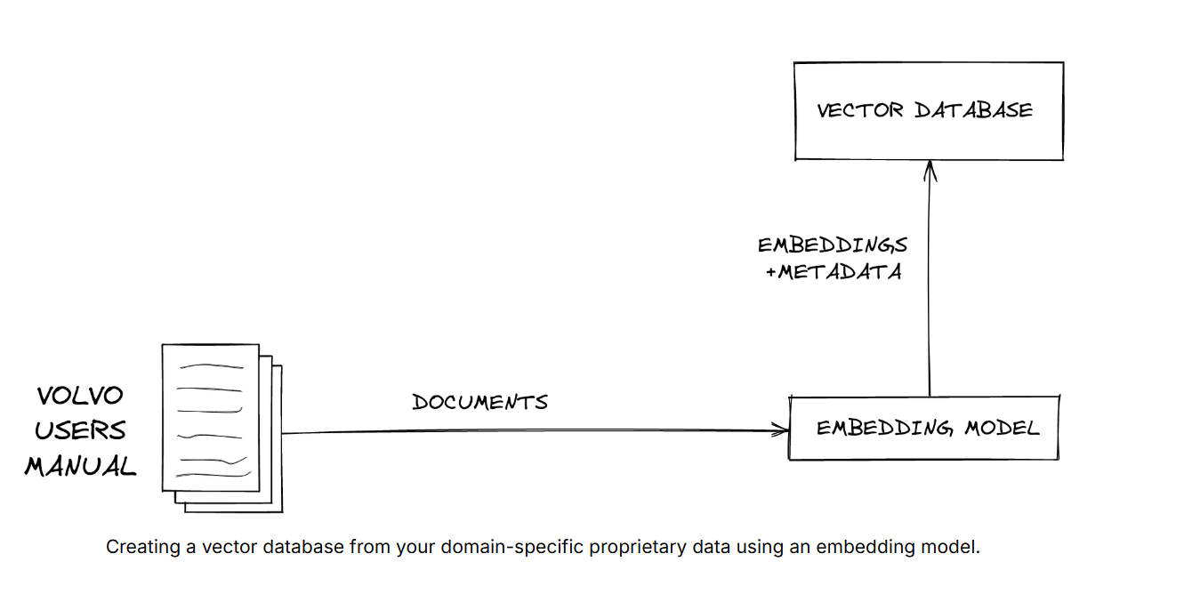
Creating a Vector Database
Credit: Pinecone.io
Notes:
Vector databases allow you to query data using natural language, which is ideal for chat interfaces.
This diagram shows how you make a vector database from your domain-specific, proprietary data. To create your vector database, you convert your data into vectors by running it through an embedding model.
An embedding model is a type of LLM that converts data into vectors: arrays, or groups, of numbers. In the above example, we’re converting user manuals containing the ground truth for operating the latest Volvo vehicle, but your data could be text, images, video, or audio.
The most important thing to understand is that a vector represents the meaning of the input text, the same way another human would understand the essence if you spoke the text aloud. We convert our data to vectors so that computers can search for semantically similar items based on the numerical representation of the stored data.
Next, you put the vectors into a vector database, like Pinecone. Pinecone’s vector database can search billions of items for similar matches in under a second.
Remember that you can create vectors, ingest the vectors into the database, and update the index in real-time, solving the recency problem for the LLMs in your GenAI applications.
For example, you can write code that automatically creates vectors for your latest product offering and then upserts them in your index each time you launch a new product. Your company’s support chatbot application can then use RAG to retrieve up-to-date information about product availability and data about the current customer it’s chatting with.

Slide 7
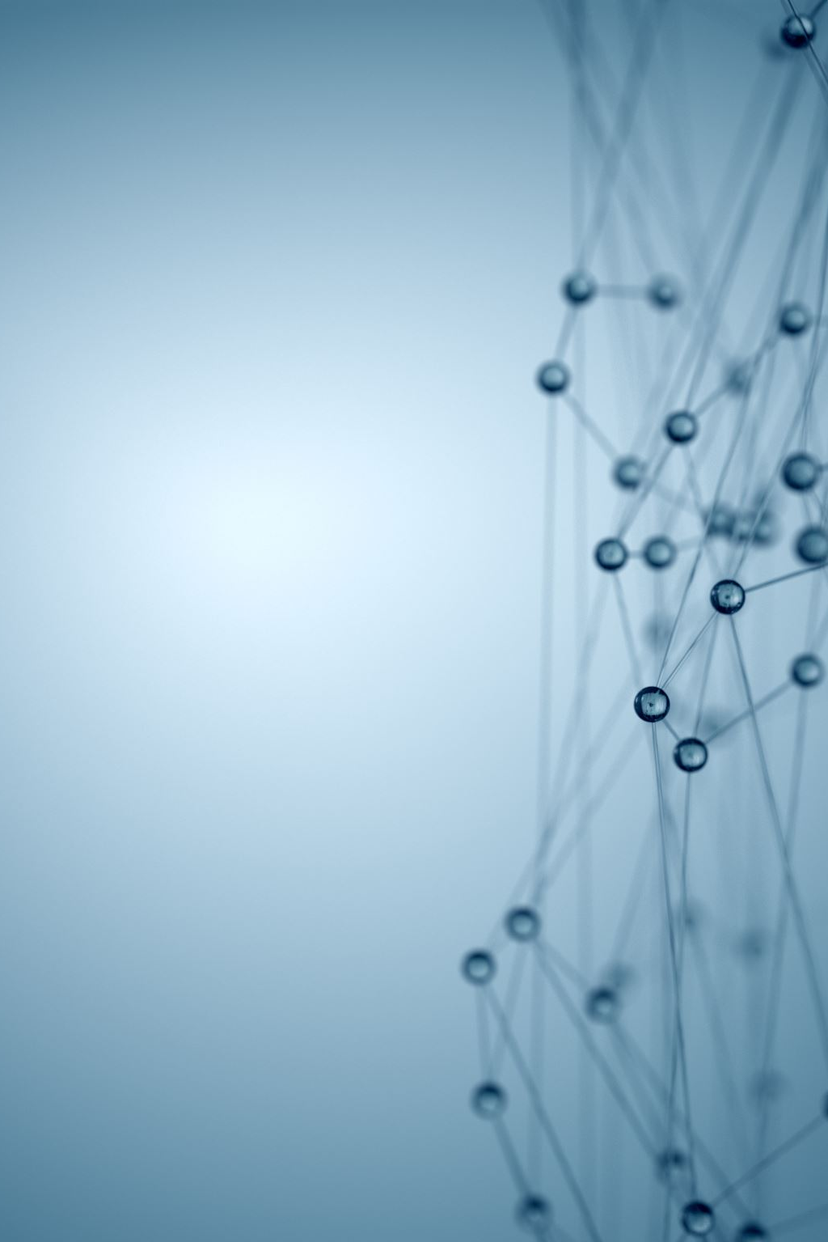
Core Technologies
Retrieval Models: BM25, dense embeddings, vector databases (e.g., FAISS, Pinecone).
Generative Models: Transformer-based architectures (e.g., GPT).
Knowledge Integration: Use of knowledge graphs to enhance context.
Notes:
Speaker Notes: Retrieval models form the backbone of the RAG system.
BM25: A traditional algorithm that ranks documents based on term frequency and inverse document frequency, effective for keyword matching but limited in understanding semantics.
Dense Embeddings: These are learned representations of text in a high-dimensional vector space, enabling semantic search by identifying documents with similar meanings, not just similar words.
Vector Databases: These tools store dense embeddings and allow for efficient searching. Think of them like specialized libraries: instead of looking up a book by its exact title, you find books based on similar themes or concepts. Vector databases ensure the retrieval process is fast and relevant.
Knowledge graphs further enhance context by representing relationships between entities in a structured format. For example, a graph could link "apple" to "fruit" and "tech company" as distinct entities with unique attributes. This structured knowledge allows RAG systems to generate responses that are not only relevant but also enriched with contextual details.

Slide 8
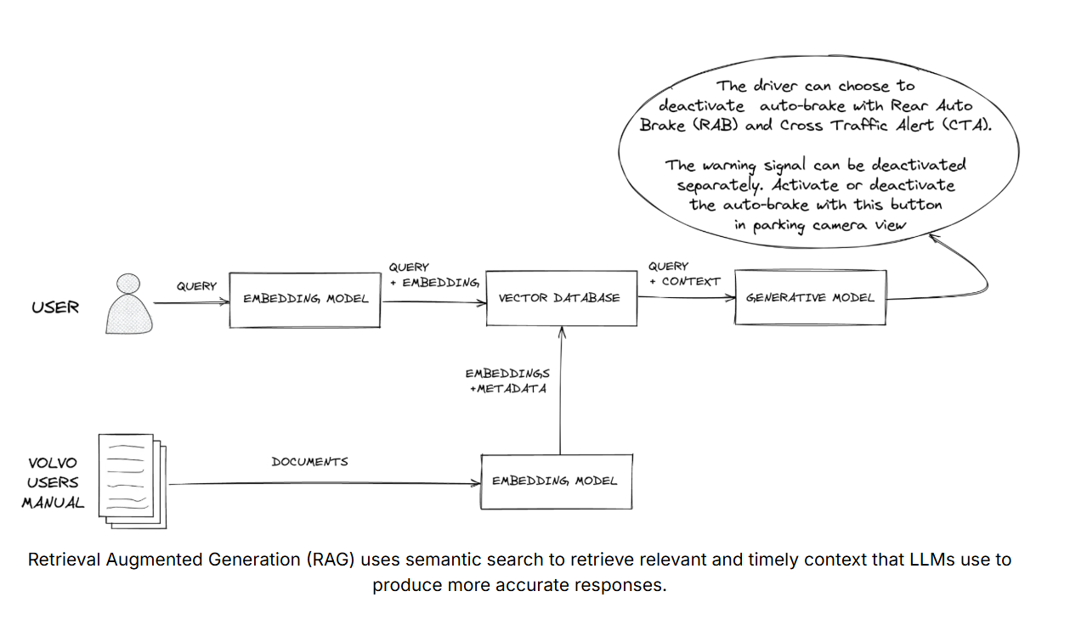
Using RAG with Sematic Search
Credit: Pinecone.io
Notes:
You originally converted your proprietary data into embeddings. When the user issues a query or question, you translate their natural language search terms into embeddings.
You send these embeddings to the vector database. The database performs a “nearest neighbor” search, finding the vectors that most closely resemble the user’s intent. When the vector database returns the relevant results, your application provides them to the LLM via its context window, prompting it to perform its generative task.

Slide 9
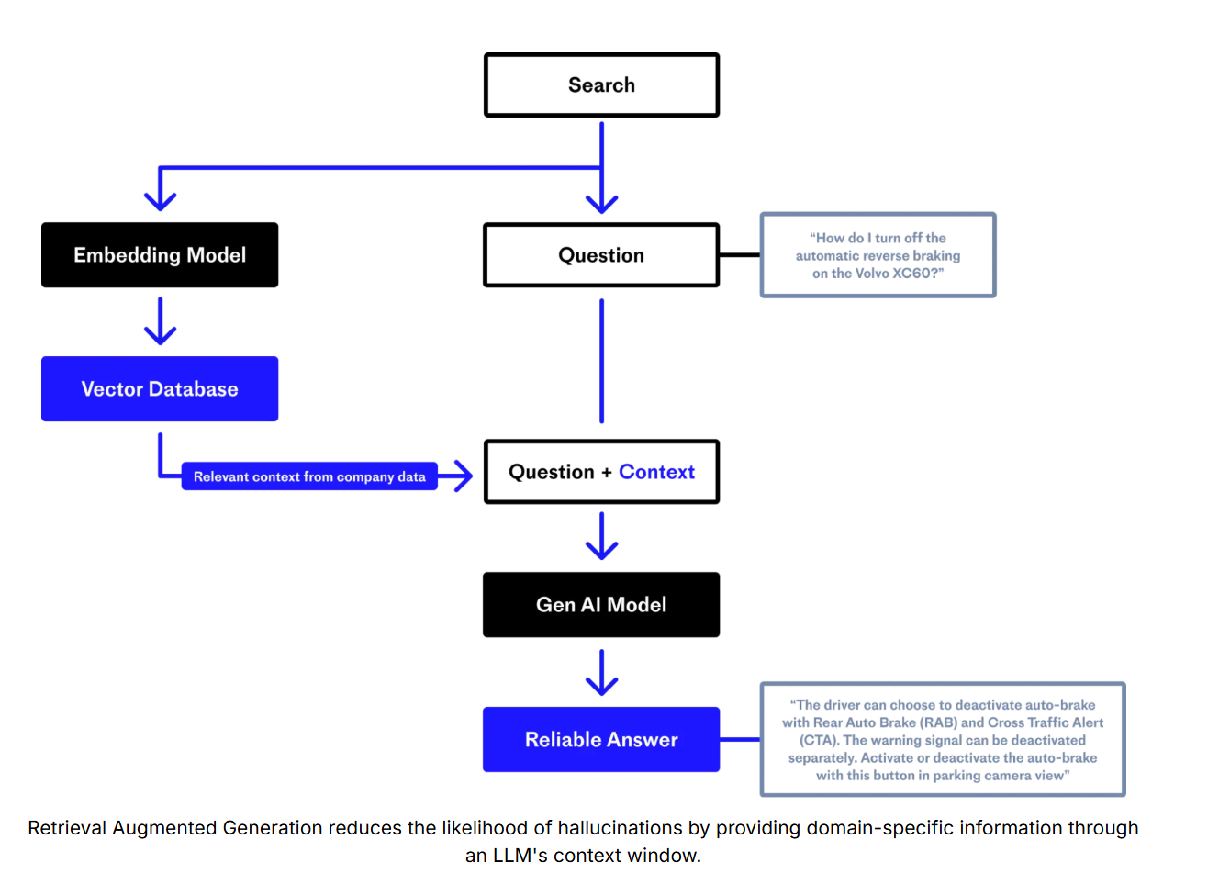
Returning a Better Answer
Credit: Pinecone.io
Notes:
Since the LLM now has access to the most pertinent and grounding facts from your vector database, your rag application can provide an accurate answer for your user. RAG reduces the likelihood of hallucination.
Vector databases can support even more advanced search functionality
Semantic search is powerful, but it’s possible to go even further. For example, Pinecone’s vector database supports hybrid search functionality, a retrieval system that considers the query's semantics and keywords.

Slide 10

Real-World Applications
Search Engines: Semantic search for accurate results.
Virtual Assistants: Siri and Alexa improving context-aware responses.
Healthcare: Medical diagnosis tools like IBM Watson.
eCommerce: Personalized shopping experiences on Amazon.
Notes:
Provide real-world examples of how RAG is enhancing various industries, improving efficiency, and driving innovation.

Slide 11

Key Advantages
Improved accuracy through contextual understanding.
Enhanced user experience with personalized responses.
Better decision-making from relevant information.
Mitigating hallucinations by grounding responses in retrieved data.
More cost-effective than “reinventing the wheel”.
Notes:
RAG significantly improves accuracy and user satisfaction. One of its key strengths is mitigating hallucinations—a common issue in generative models without retrieval. By grounding outputs in retrieved documents, RAG ensures responses are more factual and contextually appropriate, reducing the likelihood of the model generating misleading or nonsensical information.

Slide 12
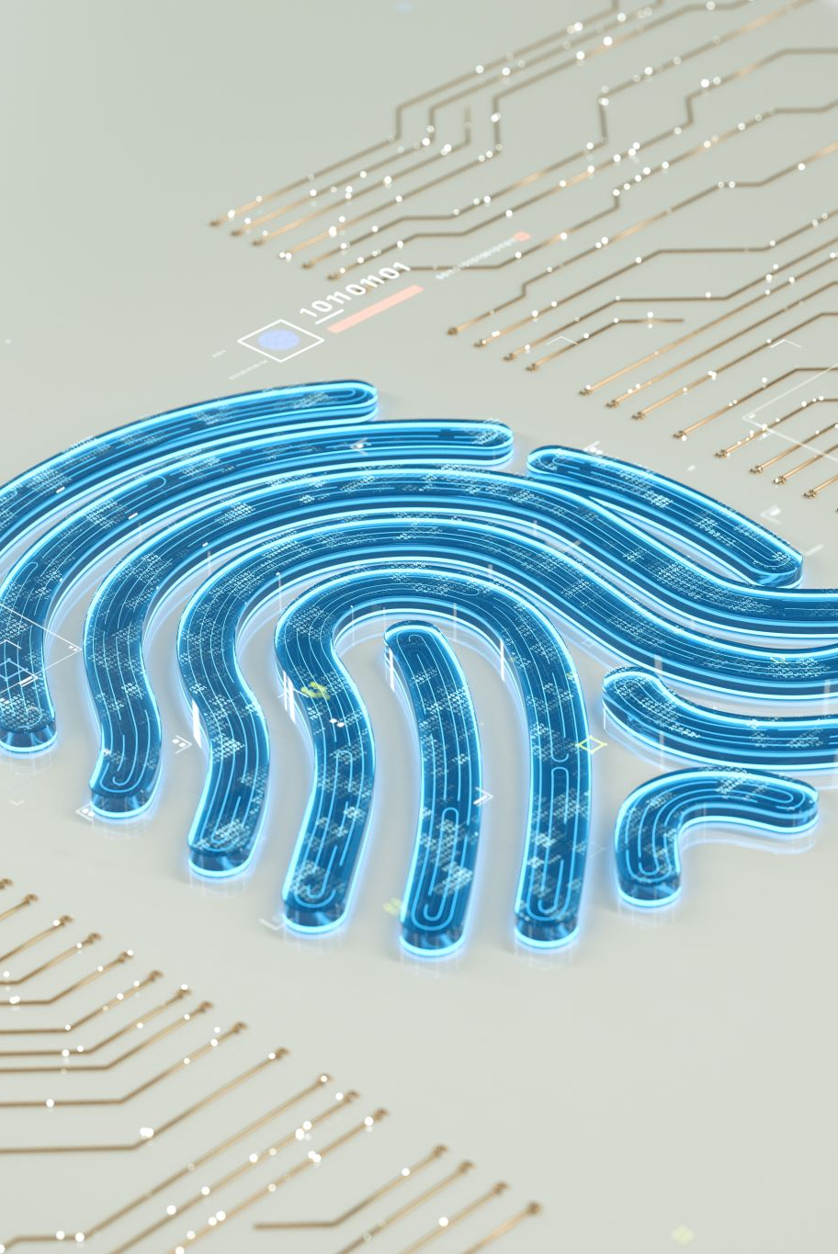
Addressing Challenges
Data privacy and security.
Bias in AI models.
Scalability with large datasets.
Managing retrieval errors affecting generation.
Notes:
Managing retrieval errors is a critical challenge in RAG systems. If the retrieval model returns irrelevant or low-quality documents, the generative model’s output can be inaccurate or misleading. For instance, in a healthcare application, incorrect retrieval could lead to flawed medical advice. Addressing this involves fine-tuning retrieval algorithms, incorporating feedback loops, and using human-in-the-loop systems to validate critical outputs.

Slide 13

What’s Next?
Multimodal Retrieval: Integrating text, image, and video data.
Explainable AI: Transparency in AI decision-making.
Real-Time Adaptation: Continuous learning from user interactions.
Notes:
Discuss how RAG is evolving with trends like multimodal retrieval and explainable AI, which will make it more versatile and trustworthy in complex applications.

