Slide 1

Identifying Data Collection Methods in a UX Case Study
Example: AR-Enhanced Training for Nursing Students

Slide 2

Objectives
Analyze UX case studies and identify qualitative and quantitative methods.
Finding key details in the case study.
Summarizing findings.
Identifying and categorizing data collection methods.
Results and reflection on effectiveness.

Slide 3

Where to find information in a UX Case Study?
A case study is a detailed account of a UX project, including research methods, findings, and recommendations.
Important sections:
Abstract: For a high-level summary.
Introduction or Background: For context and goals.
Results and Discussion: For findings and implications.

Slide 4

Summarizing a UX Case Study
Context: Look in the Introduction or Background.
Goal: Look in the Introduction or Methods section.
Findings: Look in the Results and Discussion sections.

Slide 5
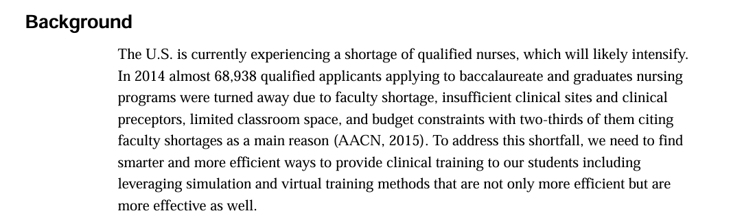
Context

Slide 6
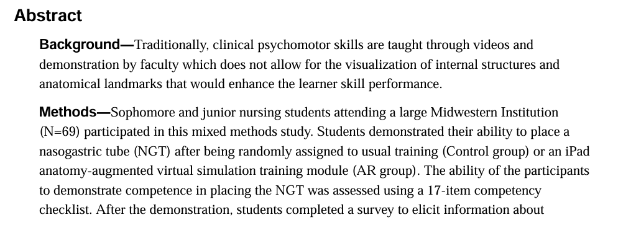
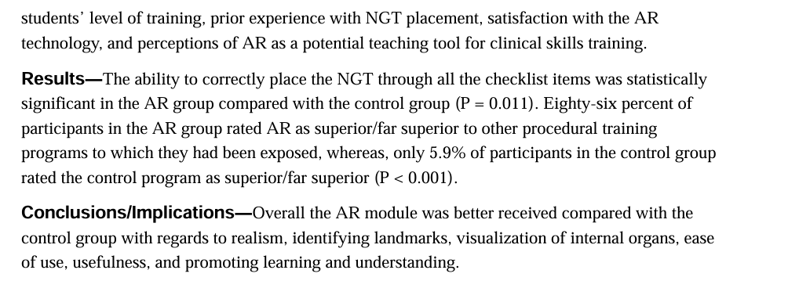
Goal and Findings

Slide 7

Identifying Data Collection Methods
Methods Section: Describes how data was collected and analyzed.
Quantitative: Structured, numerical data (e.g., competency scores).
Qualitative: Descriptive, exploratory data (e.g., survey comments).

Slide 8

Quantitative Methods
Surveys/Questionnaires: Structured questions with predefined answers to quantify user attitudes and behaviors.
Analytics Data: Data from web analytics tools to track user interactions and metrics.
A/B Testing: Comparing two versions of a design to measure performance differences.
Task Completion: Measuring the time taken or ability of an individual to complete specific tasks.
Click-Tracking: Tracking where and how often users click on elements.
Eye-Tracking: Tracking where users eyes focus on a computer screen.

Slide 9

Qualitative Methods
Interviews: In-depth discussions with users to explore their experiences and thoughts.
Focus Groups: Group discussions to gather diverse user perspectives.
Think-Aloud Protocols: Participants verbalize their thoughts while interacting with a product.
Contextual Inquiry: Observing users in their natural environment.
Card Sorting: Users organize content into categories, revealing their mental models.
Diary Studies: Users document their experiences over time.
Ethnography Studies: Talking with people and observing them perform their tasks in their own natural context.

Slide 10
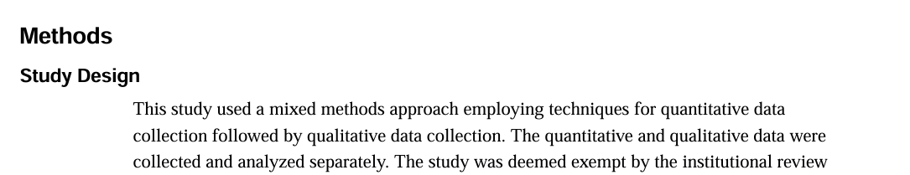
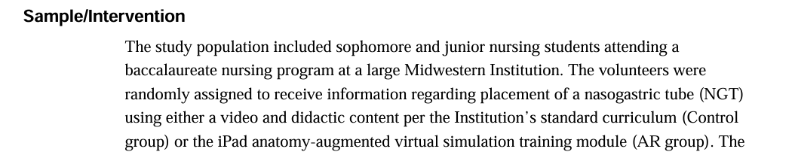

Data Collection Methods

Slide 11
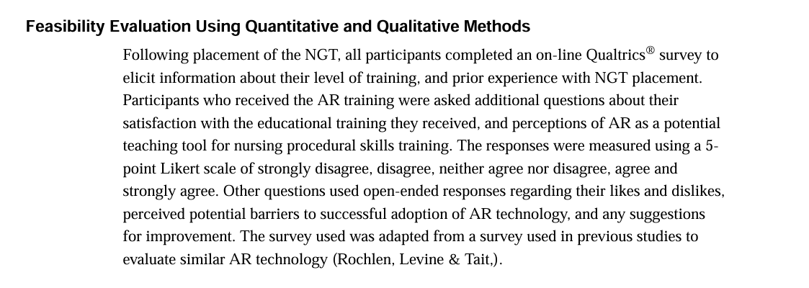
Data Collection Methods

Slide 12

Reflecting on Effectiveness
Results Section: For outcomes of each method.
Discussion Section: For author reflections on strengths and limitations.

Slide 13
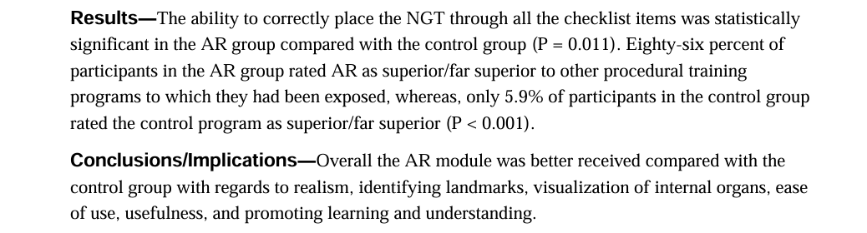
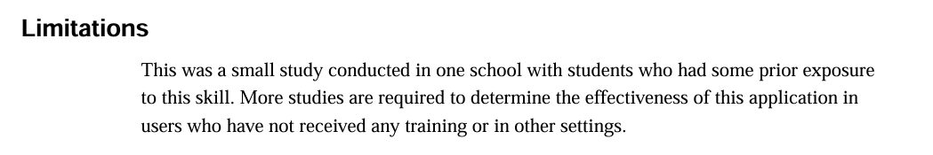
Results and Implications

Slide 14

Submission Checklist
Case Study Summary: Abstract, Introduction, and Results sections.
Data Collection Methods: Methods section.
Reflection: Discussion section for strengths and areas for improvement.
Make sure to identify where in the paper your answers came from!

