Slide 1

Customer Rating Classification
Xi Chen (chelsea)

Slide 2
Why this project?
Marketing is the lifeblood of an enterprise, and marketing data analysis is very indispensable. The marketing team of the company can find the laws and hidden information behind the data through the in-depth analysis of customers.
Notes:
As product designers, we need to understand the users’ purchasing behaviors and know their thoughts to make the iteration in the right direction to improve the user experiences while using the platform.

Slide 3
Which dataset?
The dataset that I used is “Fashion products on Amazon.com”. This is taken as a subset of a bigger dataset (more than 7 million fashion products) from Amazon.
Notes:
In this dataset, it contains product name,product price, product description, manufacturer, user feedback, and so on. I use amazon every week to buy almost everything since I came to the US. It is very convenient. I read the customers reviews and ratings before every purchase. I am curious about how does the recommendation system work.

Slide 4
What I did?
Step 1 : data cleaning.
Step 2 : missing values imputation.
Step 3 : TF-IDF text pre-processing.
Step 4 : model creating.
Step 5 : model evaluating.
Notes:
In this dataset, it contains product name,product price, product description, manufacturer, user feedback, and so on. From the information in the dataset, I could see the manufacturer’s name, the price of the product, the different customers’ comments on the same products, etc.

Slide 5
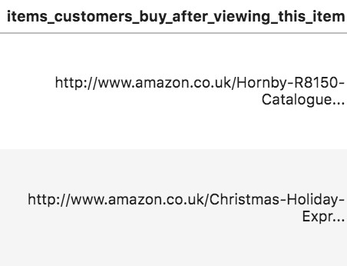
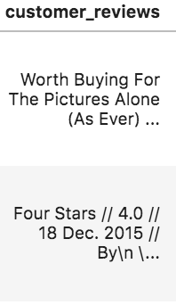
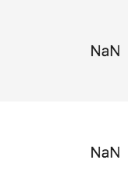
step 1 Clean the data
Drop off the useless data
Notes:
Drop the useless columns
Drop the ‘nan’ values in the ‘customer reviews’ column

Slide 6
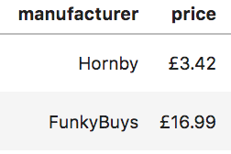
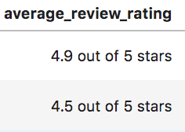
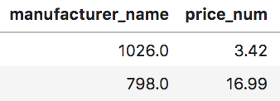
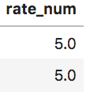
step 1 Clean the data
Change the data type
Round the number
Notes:
Drop the useless columns
Drop the ‘nan’ values in the ‘customer reviews’ column

Slide 7
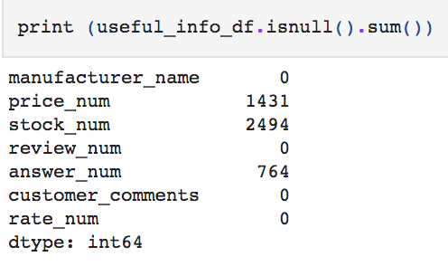
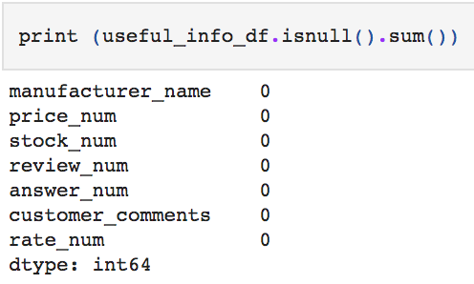
step 2 Impute missing values
Before
strategy='median'
After
Notes:
Use SimpleImputer(missing_values=np.nan, strategy='median', fill_value=None) to fill the NANs with the median number

Slide 8
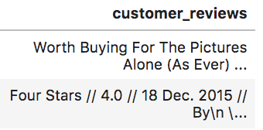
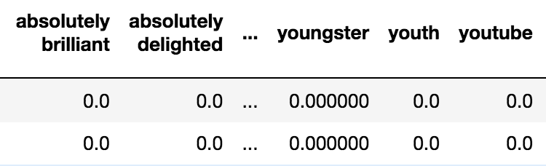
step 3 TF-IDF Text Pre-Processing
Before
After
Notes:
how to change the text content to features?

Slide 9
step 3 TF-IDF Text Pre-Processing
Select only the valid contents in the comments.
Change all the words to lower-case.
Get rid of the URLs and HTMLs.
Change the abbreviations.
Remove the stopwords.
Notes:
abbreviations : won’t → will not stopwords: the and a an

Slide 10
What is TF-IDF?
TF: Term Frequency
IDF: Inverse Document Frequency
Notes:
example:

Slide 11
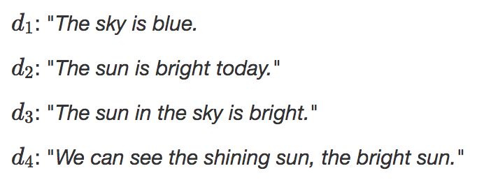
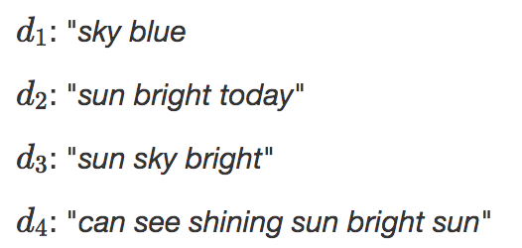
What is TF-IDF?
Example:
Notes:
remove stop words the is we..

Slide 12
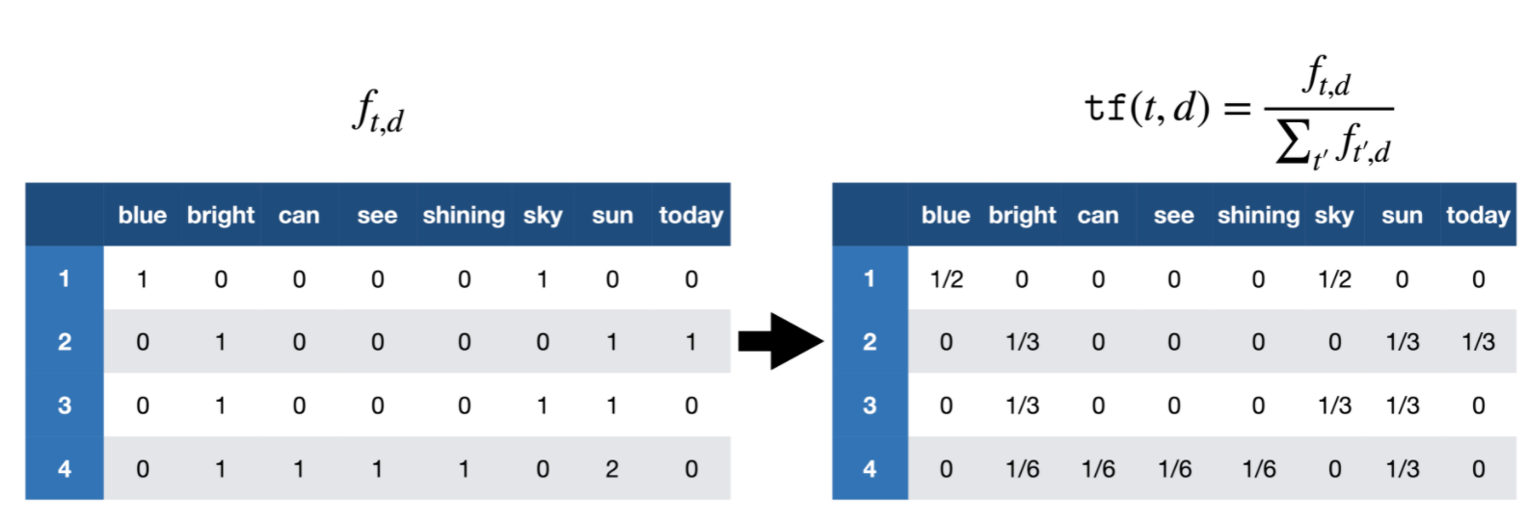
What is TF-IDF?
Notes:
remove stop words the is we..

Slide 13
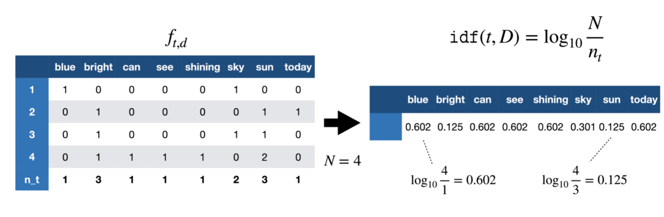
What is TF-IDF?
Notes:
remove stop words the is we..

Slide 14
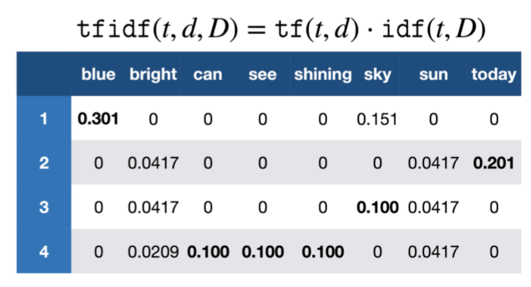
What is TF-IDF?
Notes:
The bigger the number is, the higher importance the word in the article

Slide 15
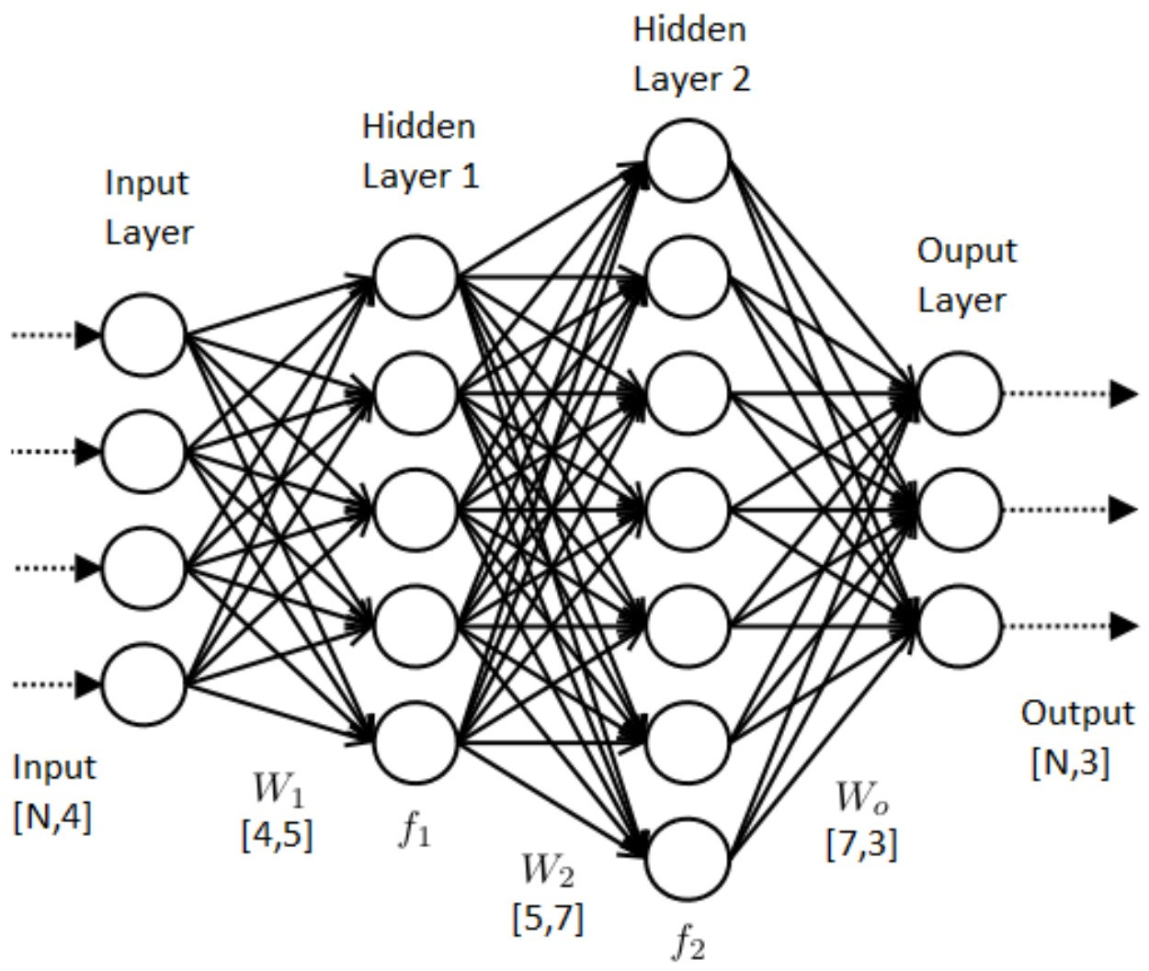
step 4 Create the model
Notes:
input:features number layers:nodes output:softmax -> compile : categorical crossentropy

Slide 16
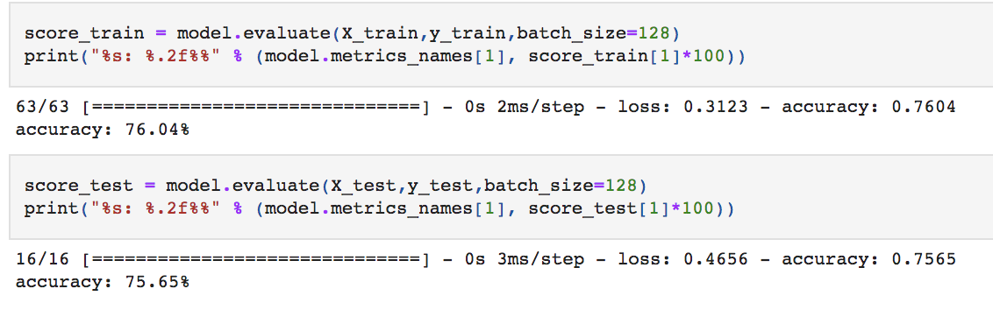
step 5 Test the model
Notes:
Get the accuracy of the model, which is not too bad.

Slide 17
TODO
Test the model with more data.
Add more layers and more nodes in each layer.
Encapsulate the program as a function.
Notes:
Test the model with more data to see if it can predict the correct result.
Add more layers and assign higher number of the nodes in each layer.
Encapsulate the program and provide API for the external calls.

Slide 18
Q & A
Thank you!
Notes:
Test the model with more data to see if it can predict the correct result.
Add more layers and assign higher number of the nodes in each layer.
Encapsulate the program and provide API for the external calls.

