Slide 1
Singularity-free Robotic Task Trajectory Generator based on Cubic Quaternion Splines
26th BE-CEM Students’ Coffee
Chelsea Davidson
BE-CEM-MRO

Slide 2
Content
Problem context – CERN Robotics Framework
Task Trajectory Generator design
  Cubic Polynomial algorithm
  Cubic Orientation Spline algorithm
Demonstration
Future work

Slide 3
Content
Problem context – CERN Robotics Framework
Task Trajectory Generator design
  Cubic Polynomial algorithm
  Cubic Orientation Spline algorithm
Demonstration
Future work

Slide 4
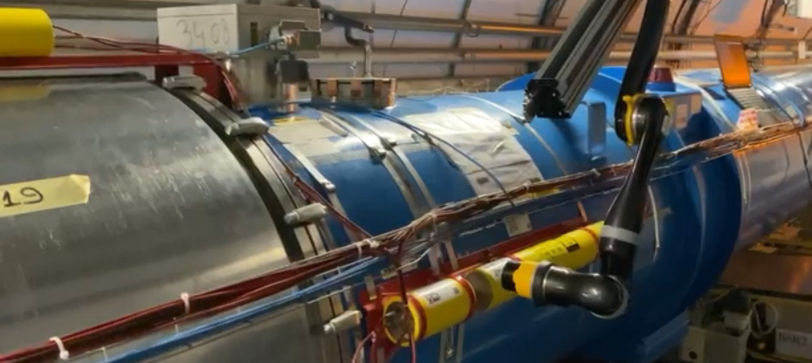
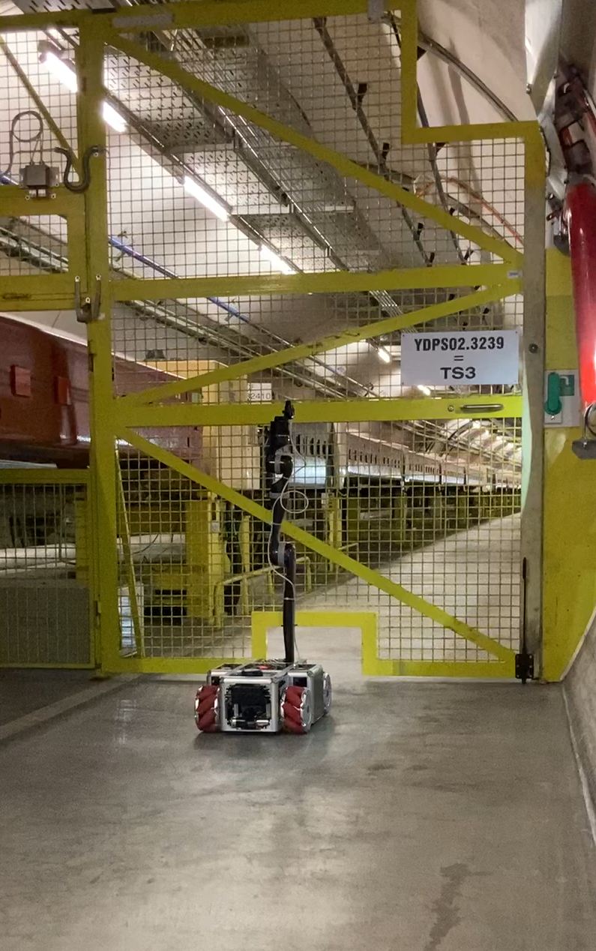
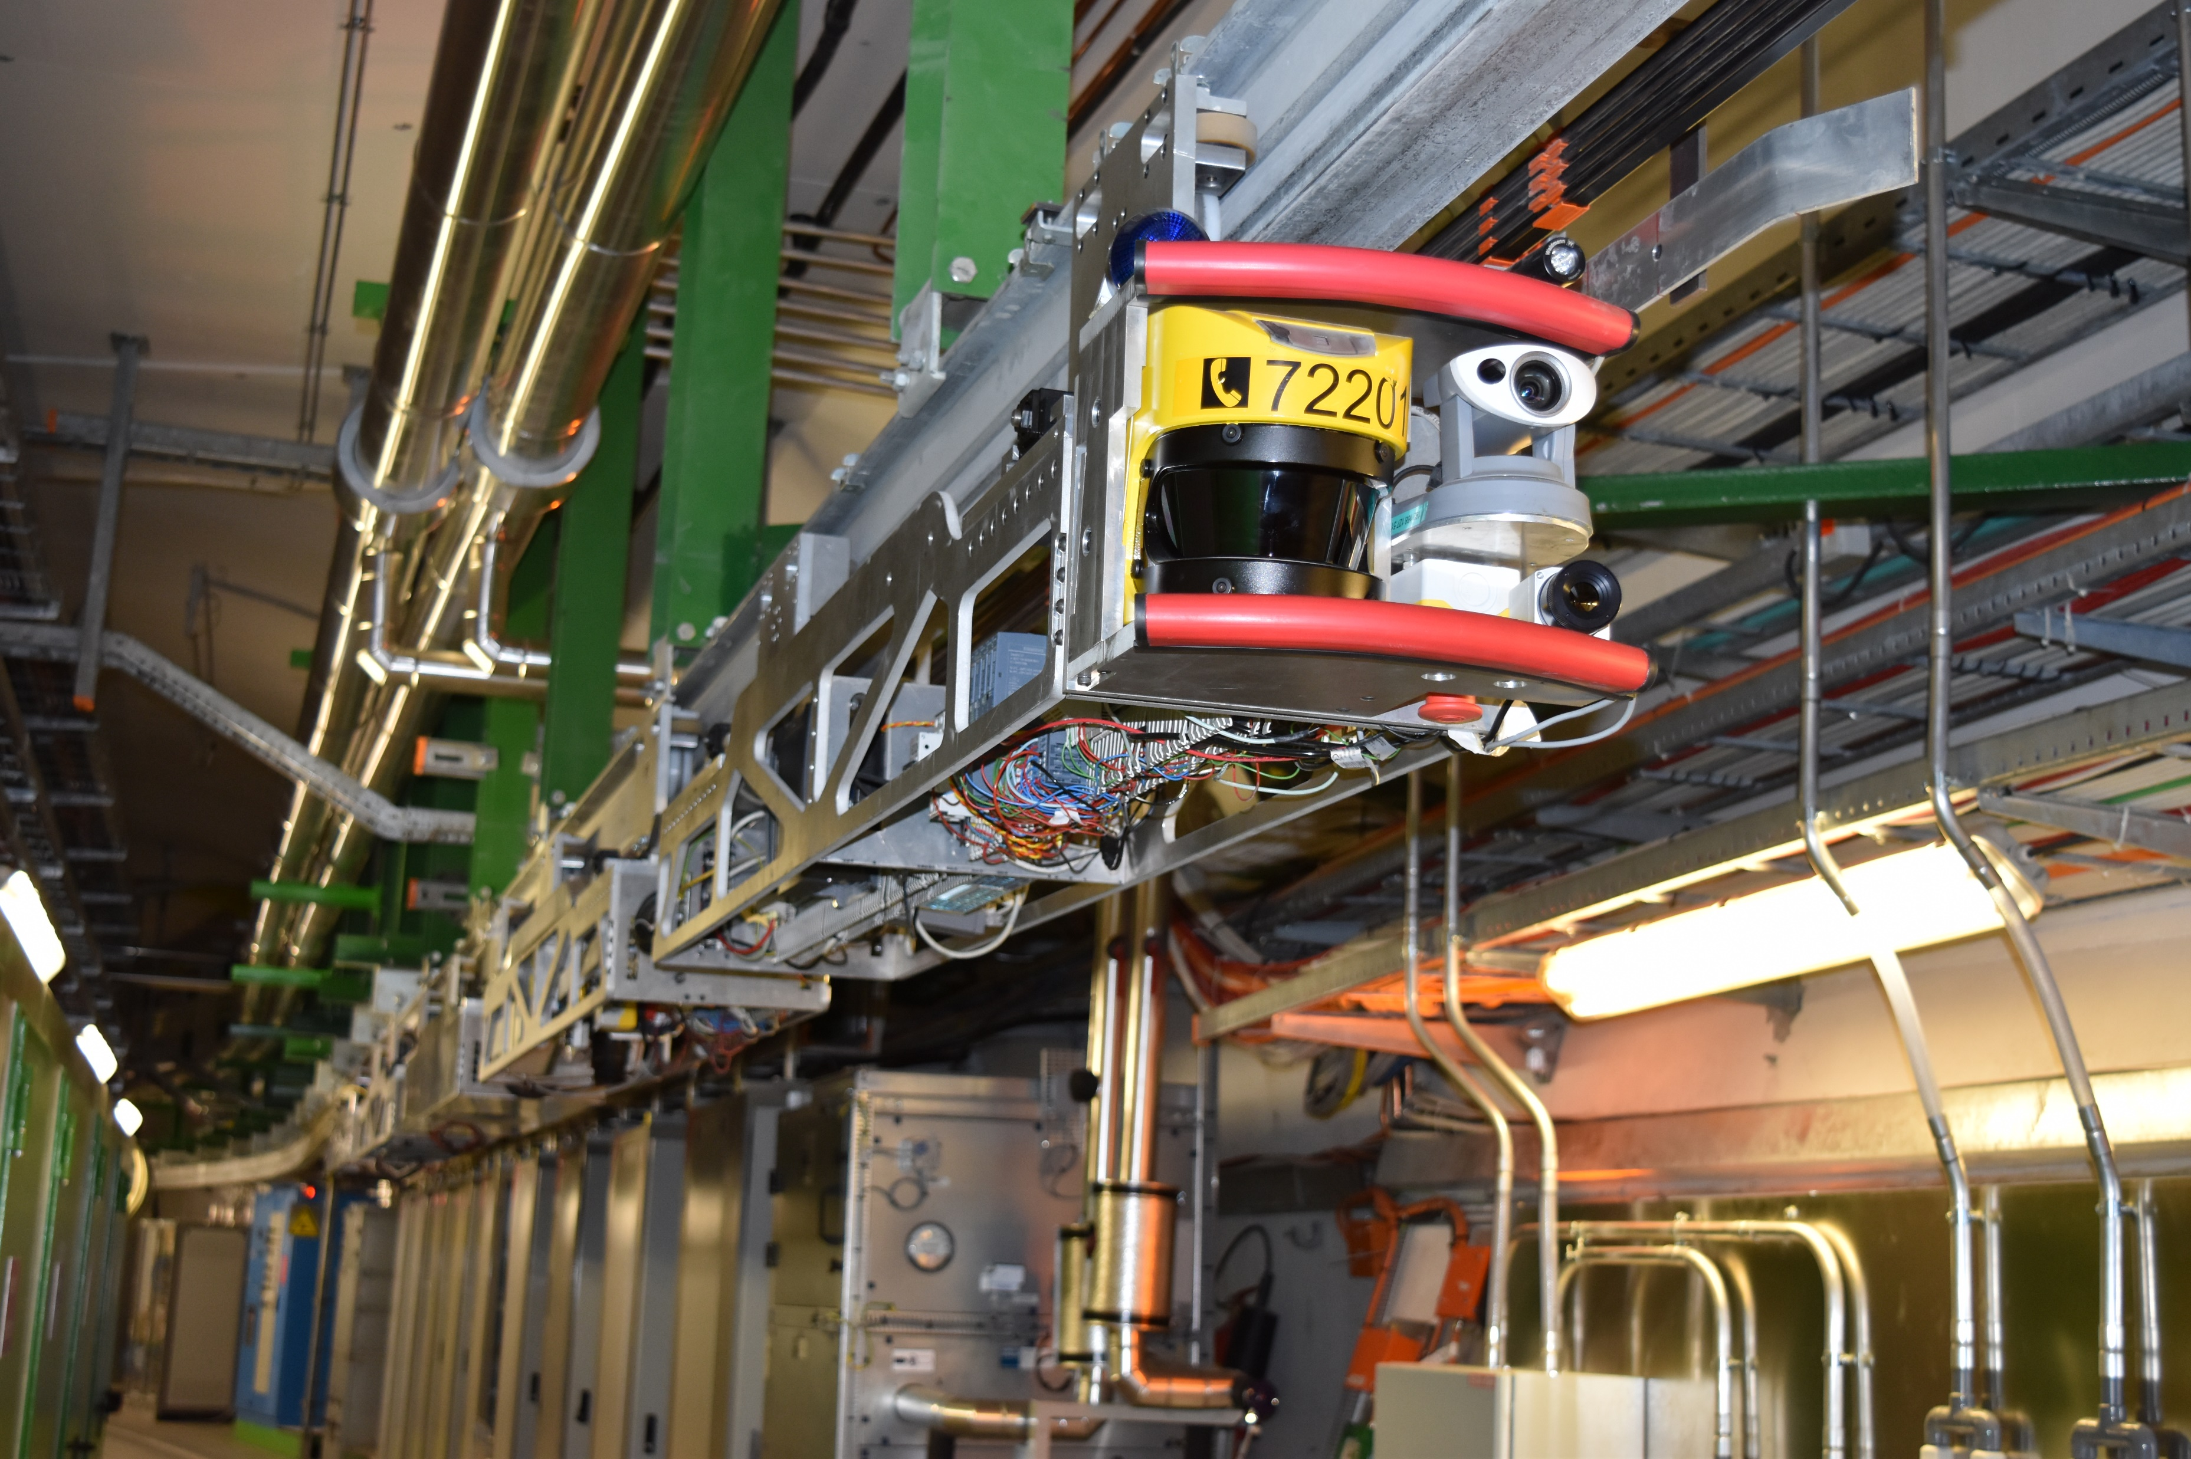
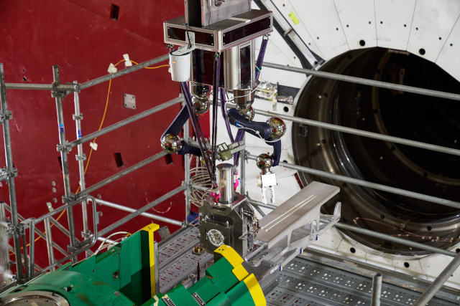
Problem Context – CERN Robotics Framework
Notes:
Now as many of you would already know, at CERN, robots play a crucial role in performing maintenance and inspection tasks in radiation-risk environments that are unsuited for human work.
To effectively control these robots, we are developing the CERN Robotics Framework (CRF).

Slide 5
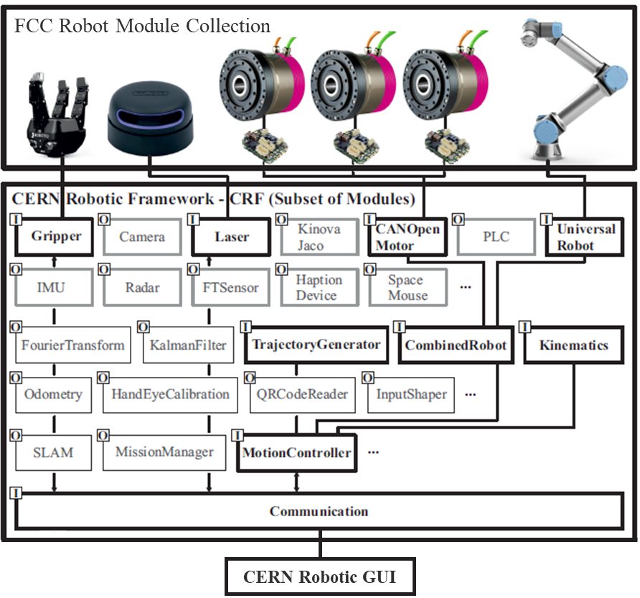
Problem Context – CERN Robotics Framework
Notes:
The CRF is made up of various software modules that achieve different subtasks related to perception, communication, actuation, and control.
You can combine these subtask modules to achieve a specific task.
So let’s start with an example robotics problem and look at how the CRF modules help us achieve the task.

Slide 6
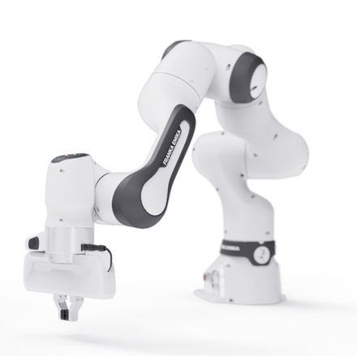


Problem Context – Motion Control
Notes:
Say you have an environment with some obstacles and a goal pose.

Slide 7
Problem Context – Motion Control
PathPlanner
Notes:
Using the path planner module in the CRF, you can get a set of points that the robot must pass through to avoid the obstacles and get to the goal.
Now in order for the robot to go through these points, we need to generate a continuous function of time that describes what the robot should be doing at each time instance. This is called the trajectory.
But there are two ways you can do this.

Slide 8

Problem Context – Motion Control
TaskTrajectoryGenerator
Notes:
The first way is to define these path points in the task space - so the points are defined in the physical space where the task is being conducted.
So in this example, the task space points are end-effector poses that are defined using the initial end-effector pose as the reference frame.
The trajectory is then a continuous function that passes through these task space points, thus making it a Task Trajectory.

Slide 9


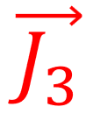
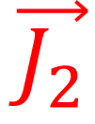
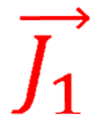
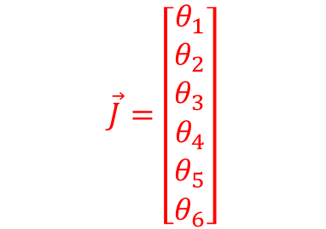






Problem Context – Motion Control
JointsTrajectoryGenerator
$$\vec{J}=\left[\begin{matrix}θ_{1} \\ \begin{aligned}θ_{2} \\ θ_{3} \\ θ_{4} \\ θ_{5}\end{aligned} \\ θ_{6}\end{matrix}\right]$$
$$θ_{3}$$
$$θ_{4}$$
$$θ_{2}$$
$$θ_{6}$$
$$θ_{5}$$
$$θ_{1}$$
Notes:
The second way is to define these points in the joint space.
So each point is a vector describing the angle of each of the robot’s joints.
In this case, since we have a 6 dof robot, each point is a 6-dimensional vector that describes the 6 joint angles.
The trajectory is then a continuous function that passes through these joint space points, thus making it a Joints Trajectory.

Slide 10
Problem Context – Motion Control
TaskTrajectoryGenerator
JointsTrajectoryGenerator
Control end-effector movements
Control joint movements
Notes:
Now deciding which method to use depends on the task.
Defining the trajectory in the task space is good for when you want to control the robot’s end-effector movements like if the robot was trying to draw a line or place a screw in a hole.
On the other hand, defining the trajectory in the joint space is useful when you want to control the movement of the robot’s joints which can help avoid self-collisions and over-extension, make movements more energy efficient, or directly handle joint angle constraints.
However, for tasks like drawing a line, you can’t guarantee the position of the end-effector will make sense when it is moving between path points if you’re using a joints trajectory generator.

Slide 11
Problem Context – Motion Control
Motion Control Loop
Trajectory point:
Joint angles, velocities, accelerations at t
JointsTrajectoryGenerator
IController
Joint path
Inverse Kinematics
IRobot
OR
Actual joint angles, velocities, accelerations at t
Joint angles,
velocities, accelerations at t
TaskTrajectoryGenerator
PID
Task path
Trajectory point:
Task pose, velocity, acceleration at t
Notes:
That’s why in the Motion Control Loop in the CRF, we have both a Joints Trajectory Generator and a Task Trajectory Generator which output trajectory points in the respective spaces.

Slide 12
Problem Context – Motion Control
Motion Control Loop
Trajectory point:
Joint angles, velocities, accelerations at t
JointsTrajectoryGenerator
IController
Joint path
Inverse Kinematics
IRobot
OR
Actual joint angles, velocities, accelerations at t
Joint angles,
velocities, accelerations at t
TaskTrajectoryGenerator
PID
Task path
Trajectory point:
Task pose, velocity, acceleration at t
Notes:
If we follow this process chain, these trajectory points then go into the Controller which outputs the joint angles, velocities, and accelerations that can actuate this trajectory smoothly.

Slide 13
Problem Context – Motion Control
Motion Control Loop
Trajectory point:
Joint angles, velocities, accelerations at t
JointsTrajectoryGenerator
IController
Joint path
Inverse Kinematics
IRobot
OR
Actual joint angles, velocities, accelerations at t
Joint angles,
velocities, accelerations at t
TaskTrajectoryGenerator
PID
Task path
Trajectory point:
Task pose, velocity, acceleration at t
Notes:
After the controller, these joint commands then get sent to the robot to actuate it.
During actuation, the actual joint angles, velocities, and accelerations are measured and

Slide 14
Problem Context – Motion Control
Motion Control Loop
Trajectory point:
Joint angles, velocities, accelerations at t
JointsTrajectoryGenerator
IController
Joint path
Inverse Kinematics
IRobot
OR
Actual joint angles, velocities, accelerations at t
Joint angles,
velocities, accelerations at t
TaskTrajectoryGenerator
PID
Task path
Trajectory point:
Task pose, velocity, acceleration at t
Notes:
sent back in a feedback loop to the controller.

Slide 15
Problem Context – Motion Control
Motion Control Loop
Trajectory point:
Joint angles, velocities, accelerations at t
JointsTrajectoryGenerator
IController
Joint path
Inverse Kinematics
IRobot
OR
Actual joint angles, velocities, accelerations at t
Joint angles,
velocities, accelerations at t
TaskTrajectoryGenerator
PID
Task path
Trajectory point:
Task pose, velocity, acceleration at t
Notes:
While a path may only be sent once, this motion control loop is happening online at every time step.

Slide 16
Problem Context – Motion Control
Motion Control Loop
Trajectory point:
Joint angles, velocities, accelerations at t
JointsTrajectoryGenerator
IController
Joint path
Inverse Kinematics
IRobot
OR
Actual joint angles, velocities, accelerations at t
Joint angles,
velocities, accelerations at t
TaskTrajectoryGenerator
PID
Task path
Trajectory point:
Task pose, velocity, acceleration at t
Notes:
We have already developed the Joints Trajectory Generator and the other greyed out modules so my project was to develop this Task Trajectory Generator
so take in a set of points in the task space and use them to generate a continuous function of time that satisfies the task velocity and acceleration limits.

Slide 17
Content
Problem context – CERN Robotics Framework
Task Trajectory Generator design
  Cubic Polynomial algorithm
  Cubic Orientation Spline algorithm
Demonstration
Future work
Notes:
So let’s now take a look at the design of this Task Trajectory Generator

Slide 18
Task Trajectory Generator Design
TaskTrajectoryGenerator
struct TaskTrajectory {
public:
std::shared_ptr<std::array<CubicPolynomial, 3>> linear;
std::shared_ptr<CubicOrientationSpline> angular;
};
Rotation
Translation
Notes:
To store a Task Trajectory object in the task trajectory generator class, we made this structure.
In this structure, a Task Trajectory is made up of 2 independent components, a linear component for the translation movement, and an angular component for the rotation movement.

Slide 19



Task Trajectory Generator Design
TaskTrajectoryGenerator
struct TaskTrajectory {
public:
std::shared_ptr<std::array<CubicPolynomial, 3>> linear;
std::shared_ptr<CubicOrientationSpline> angular;
};
$$x$$
$$z$$
$$y$$
Notes:
The translation trajectory is made up of 3 independent trajectories – one for each axis in Euclidean space.
In the Task Trajectory Generator module, these trajectories are created using Cubic Polynomial interpolation.

Slide 20
Content
Problem context – CERN Robotics Framework
Task Trajectory Generator design
  Cubic Polynomial algorithm
  Cubic Orientation Spline algorithm
Demonstration
Future work
Notes:
So let’s take a look at how this Cubic Polynomial Interpolation algorithm works

Slide 21
Task Trajectory Generator Design
TaskTrajectoryGenerator
struct TaskTrajectory {
public:
std::shared_ptr<std::array<CubicPolynomial, 3>> linear;
std::shared_ptr<CubicOrientationSpline> angular;
};
CubicPolynomial
$$x$$
$$z$$
$$y$$
Notes:
NEXT

Slide 22
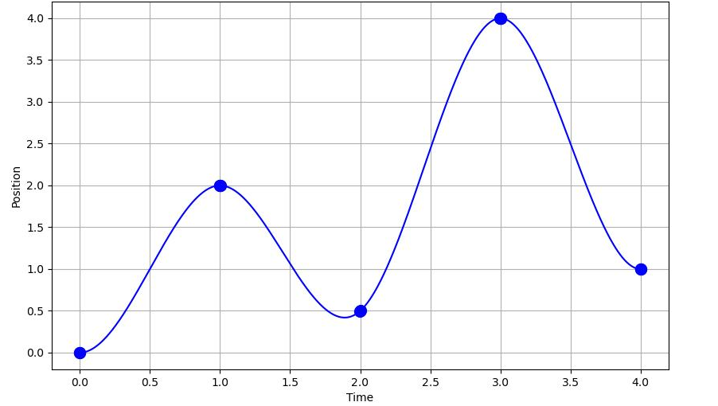



















Cubic Polynomial Algorithm
CubicPolynomial
$$P_{4}$$
$$p\left(t\right)=a_{1}+a_{2}t+a_{3}t^{2}+a_{4}t^{3}$$
$$P_{2}$$
$$P_{5}$$
$$v_{final}$$
$$P_{1}$$
$$v_{initial}$$
$$P_{3}$$
$$T_{1}$$
$$T_{2}$$
$$T_{4}$$
$$T_{5}$$
$$p_{1}(t)$$
$$p_{2}(t)$$
$$p_{3}(t)$$
$$p_{4}(t)$$
$$T_{1}≤t<T_{2}$$
$$T_{2}≤t<T_{3}$$
$$T_{1}≤t<T_{2}$$
$$T_{1}≤t<T_{2}$$
Notes:
To generate a cubic polynomial interpolation, you need a set of points to interpolate between, these are given as capital P.
You also need the time instances of these points, given as capital T.
a start velocity, v_initial and an end velocity, v_final.
The algorithm works by creating a set of cubic polynomials defined for the segments between the input points,
these are given as lowercase p in this diagram,
and then you need to force continuity at these intermediate input points or change-over points.

Slide 23

Cubic Polynomial Algorithm
CubicPolynomial
$$P_{4}$$
$$p\left(t\right)=a_{1}+a_{2}t+a_{3}t^{2}+a_{4}t^{3}$$
$${\dot{p}}_{i}\left(T_{i+1}\right)={\dot{p}}_{i+1}\left(T_{i+1}\right)$$
$$P_{2}$$
$$P_{5}$$
$$v_{final}$$
$$P_{1}$$
$$v_{initial}$$
$$P_{3}$$
$$T_{1}$$
$$T_{2}$$
$$T_{4}$$
$$T_{5}$$
$$p_{1}(t)$$
$$p_{2}(t)$$
$$p_{3}(t)$$
$$p_{4}(t)$$
$$T_{1}≤t<T_{2}$$
$$T_{2}≤t<T_{3}$$
$$T_{1}≤t<T_{2}$$
$$T_{1}≤t<T_{2}$$
Notes:
So this means you’re forcing the velocity going into the point to be the same as the velocity going out of the point to enforce continuity in velocity

Slide 24

Cubic Polynomial Algorithm
CubicPolynomial
$$P_{4}$$
$$p\left(t\right)=a_{1}+a_{2}t+a_{3}t^{2}+a_{4}t^{3}$$
$${\ddot{p}}_{i}\left(T_{i+1}\right)={\ddot{p}}_{i+1}\left(T_{i+1}\right)$$
$$P_{2}$$
$$P_{5}$$
$$v_{final}$$
$$P_{1}$$
$$v_{initial}$$
$$P_{3}$$
$$T_{1}$$
$$T_{2}$$
$$T_{4}$$
$$T_{5}$$
$$p_{1}(t)$$
$$p_{2}(t)$$
$$p_{3}(t)$$
$$p_{4}(t)$$
$$T_{1}≤t<T_{2}$$
$$T_{2}≤t<T_{3}$$
$$T_{1}≤t<T_{2}$$
$$T_{1}≤t<T_{2}$$
Notes:
And forcing the acceleration going into the point to be the same as the acceleration going out of the point to enforce continuity in acceleration

Slide 25

Cubic Polynomial Algorithm
CubicPolynomial
$$P_{4}$$
$$p\left(t\right)=a_{1}+a_{2}t+a_{3}t^{2}+a_{4}t^{3}$$
$$P_{2}$$
4(N-1) unknowns
$$P_{5}$$
$$v_{final}$$
$$P_{1}$$
$$v_{initial}$$
$$P_{3}$$
$$T_{1}$$
$$T_{2}$$
$$T_{4}$$
$$T_{5}$$
$$p_{1}(t)$$
$$p_{2}(t)$$
$$p_{3}(t)$$
$$p_{4}(t)$$
$$T_{1}≤t<T_{2}$$
$$T_{2}≤t<T_{3}$$
$$T_{1}≤t<T_{2}$$
$$T_{1}≤t<T_{2}$$
Notes:
Since we define functions between input points, for N input points, you only need to define N-1 equations.
Since there are 4 coefficients per equation, you have 4(N-1) unknowns.

Slide 26
Cubic Polynomial Algorithm
CubicPolynomial
$$P_{4}$$
$$p\left(t\right)=a_{1}+a_{2}t+a_{3}t^{2}+a_{4}t^{3}$$
$$P_{2}$$
4(N-1) unknowns
4(N-1) equations
$$P_{5}$$
$$v_{final}$$
$$P_{1}$$
$$v_{initial}$$
$$P_{3}$$
$$T_{1}$$
$$T_{2}$$
$$T_{4}$$
$$T_{5}$$
$$p_{1}(t)$$
$$p_{2}(t)$$
$$p_{3}(t)$$
$$p_{4}(t)$$
$$T_{1}≤t<T_{2}$$
$$T_{2}≤t<T_{3}$$
$$T_{1}≤t<T_{2}$$
$$T_{1}≤t<T_{2}$$
Notes:
If we define equations specifying the boundary conditions of each segment, the endpoint velocities of the trajectory, and the continuity constraints, we obtain 4(N-1) equations for 4(N-1) unknowns.
This makes the systems of equations solvable, allowing you to find the value of these coefficients for each segment, and thus allowing you to define the function for each segment.

Slide 27





Cubic Polynomial Algorithm
CubicPolynomial
$$P_{4}$$
$$p_{3}\left(t\right)=a_{1}+a_{2}t+a_{3}t^{2}+a_{4}t^{3}$$
CubicPolynomial.evaluate(Tp)
$$P_{2}$$
$$p_{3}\left(T_{p}\right)$$
$$P_{5}$$
$$v_{final}$$
$$P_{1}$$
$$v_{initial}$$
$$P_{3}$$
$$T_{1}$$
$$T_{2}$$
$$T_{p}$$
$$T_{4}$$
$$T_{5}$$
$$p_{1}(t)$$
$$p_{2}(t)$$
$$p_{3}(t)$$
$$p_{4}(t)$$
$$T_{1}≤t<T_{2}$$
$$T_{2}≤t<T_{3}$$
$$T_{1}≤t<T_{2}$$
$$T_{1}≤t<T_{2}$$
Notes:
so then if you want to know the value of the CubicPolynomial at a given time instance, you find which segment is defined for that evaluation time then evaluate the corresponding function which in this case is p_3.

Slide 28
Task Trajectory Generator Design
TaskTrajectoryGenerator
struct TaskTrajectory {
public:
std::shared_ptr<std::array<CubicPolynomial, 3>> linear;
std::shared_ptr<CubicOrientationSpline> angular;
};
CubicPolynomial
Rotation
Notes:
Creating the angular trajectory is much more difficult due to the non-linearity of Rotation Space, SO(3).
This means that standard interpolation methods used in Euclidean space such as the cubic polynomial interpolation we just looked at cannot be directly applied here.
Another complication in this design is the orientation representation.
So let’s explore that.
A common way to represent orientations is using Euler or Cardan angles.
This is where you rotate about 3 axes consecutively.

Slide 29
Task Trajectory Generator Design
TaskTrajectoryGenerator
struct TaskTrajectory {
public:
std::shared_ptr<std::array<CubicPolynomial, 3>> linear;
std::shared_ptr<CubicOrientationSpline> angular;
};
Notes:
Take CardanXYZ representation for example. Here you rotate about x then y then z

Slide 30
Task Trajectory Generator Design
TaskTrajectoryGenerator
struct TaskTrajectory {
public:
std::shared_ptr<std::array<CubicPolynomial, 3>> linear;
std::shared_ptr<CubicOrientationSpline> angular;
};
CardanXYZ
Notes:
Take CardanXYZ representation for example. Here you rotate about x then y then z

Slide 31
Task Trajectory Generator Design
TaskTrajectoryGenerator
struct TaskTrajectory {
public:
std::shared_ptr<std::array<CubicPolynomial, 3>> linear;
std::shared_ptr<CubicOrientationSpline> angular;
};
CardanXYZ
Notes:
Here you rotate about x then y then z

Slide 32
Task Trajectory Generator Design
TaskTrajectoryGenerator
struct TaskTrajectory {
public:
std::shared_ptr<std::array<CubicPolynomial, 3>> linear;
std::shared_ptr<CubicOrientationSpline> angular;
};
CardanXYZ
Notes:
Here you rotate about x then y then z

Slide 33
Task Trajectory Generator Design
TaskTrajectoryGenerator
struct TaskTrajectory {
public:
std::shared_ptr<std::array<CubicPolynomial, 3>> linear;
std::shared_ptr<CubicOrientationSpline> angular;
};
CardanXYZ
Notes:
Here you rotate about x then y then z

Slide 34
Task Trajectory Generator Design
TaskTrajectoryGenerator
struct TaskTrajectory {
public:
std::shared_ptr<std::array<CubicPolynomial, 3>> linear;
std::shared_ptr<CubicOrientationSpline> angular;
};
CardanXYZ
Notes:
Here you rotate about x then y then z

Slide 35
Task Trajectory Generator Design
TaskTrajectoryGenerator
struct TaskTrajectory {
public:
std::shared_ptr<std::array<CubicPolynomial, 3>> linear;
std::shared_ptr<CubicOrientationSpline> angular;
};
CardanXYZ
Notes:
Here you rotate about x then y then z

Slide 36
Task Trajectory Generator Design
TaskTrajectoryGenerator
struct TaskTrajectory {
public:
std::shared_ptr<std::array<CubicPolynomial, 3>> linear;
std::shared_ptr<CubicOrientationSpline> angular;
};
CardanXYZ
Notes:
Note the dependent rotations where the rotation about a parent axis affects the position of the next rotation axis.

Slide 37
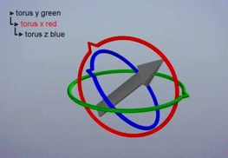
Task Trajectory Generator Design
TaskTrajectoryGenerator
struct TaskTrajectory {
public:
std::shared_ptr<std::array<CubicPolynomial, 3>> linear;
std::shared_ptr<CubicOrientationSpline> angular;
};
CardanYXZ
Gimbal lock
→ Representation singularity
Notes:
The issue with this sequential rotation structure is you can reach a state, where 2 rotation frames become aligned
This is shown here where you have CardanYXZ and rotate the x 90 degrees, causing the y and z axes to become aligned.
We refer to this as gimbal lock.
When gimbal lock occurs, you lose a degree of freedom in the rotation, so you have a representation singularity.

Slide 38
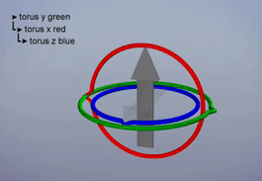
Task Trajectory Generator Design
TaskTrajectoryGenerator
struct TaskTrajectory {
public:
std::shared_ptr<std::array<CubicPolynomial, 3>> linear;
std::shared_ptr<CubicOrientationSpline> angular;
};
CardanYXZ
Gimbal lock
→ Unexpected movement
Notes:
Due to the loss of one rotational axis, trying to achieve a desired rotation after gimbal lock has occurred results in unexpected movements between rotations.
Thus, we choose to represent orientations and rotations as quaternions to avoid singularity issues and achieve smooth rotations.

Slide 39
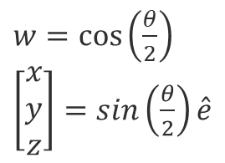


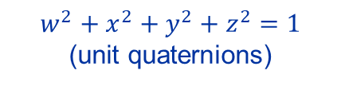

Task Trajectory Generator Design
TaskTrajectoryGenerator
struct TaskTrajectory {
public:
std::shared_ptr<std::array<CubicPolynomial, 3>> linear;
std::shared_ptr<CubicOrientationSpline> angular;
};
Quaternions
$$q=w+xi+yj+zk$$
$w=\cos\left(\frac{θ}{2}\right)$
$\left[\begin{matrix}x \\ y \\ z\end{matrix}\right]=sin\left(\frac{θ}{2}\right)\hat{e}$
$$\hat{e}$$
$$θ$$
$$w^{2}+x^{2}+y^{2}+z^{2}=1$$
(unit quaternions)
Notes:
A quaternion is a four-dimensional complex number, where in a unit quaternion, the w corresponds to the angle of rotation and the imaginary components correspond to a scaled axis about which we rotate.
This 4-parameter representation provides us with an added degree of flexibility and eliminates the issue of sequential axis alignment that leads to gimbal lock.
To represent orientations, we use unit quaternions which lie on a 3D unit sphere.
This allows any rotation trajectory to be smoothly represented as a continuous path on this hypersphere.
Although sequential axis rotation is no longer an issue with quaternions, their components are still dependent on each other as they must satisfy the unit quaternion constraint at all times in order to represent a valid rotation.
Since the quaternion space is non-linear, it is impossible to apply the linear trajectory approach of independently interpolating each component.
So instead we use an approach that extends the logic of Cubic Polynomial interpolation to work with quaternions.

Slide 40
Content
Problem context – CERN Robotics Framework
Task Trajectory Generator design
  Cubic Polynomial algorithm
  Cubic Orientation Spline algorithm
Demonstration
Future work
Notes:
This is what the Cubic Orientation Spline algorithm does so let’s now look at how it works.

Slide 41
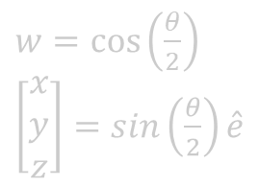


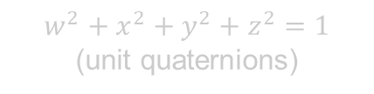

Task Trajectory Generator Design
TaskTrajectoryGenerator
struct TaskTrajectory {
public:
std::shared_ptr<std::array<CubicPolynomial, 3>> linear;
std::shared_ptr<CubicOrientationSpline> angular;
};
CubicOrientationSpline
$$q=w+xi+yj+zk$$
$w=\cos\left(\frac{θ}{2}\right)$
$\left[\begin{matrix}x \\ y \\ z\end{matrix}\right]=sin\left(\frac{θ}{2}\right)\hat{e}$
$$\hat{e}$$
$$θ$$
$$w^{2}+x^{2}+y^{2}+z^{2}=1$$
(unit quaternions)
Notes:
NEXT

Slide 42
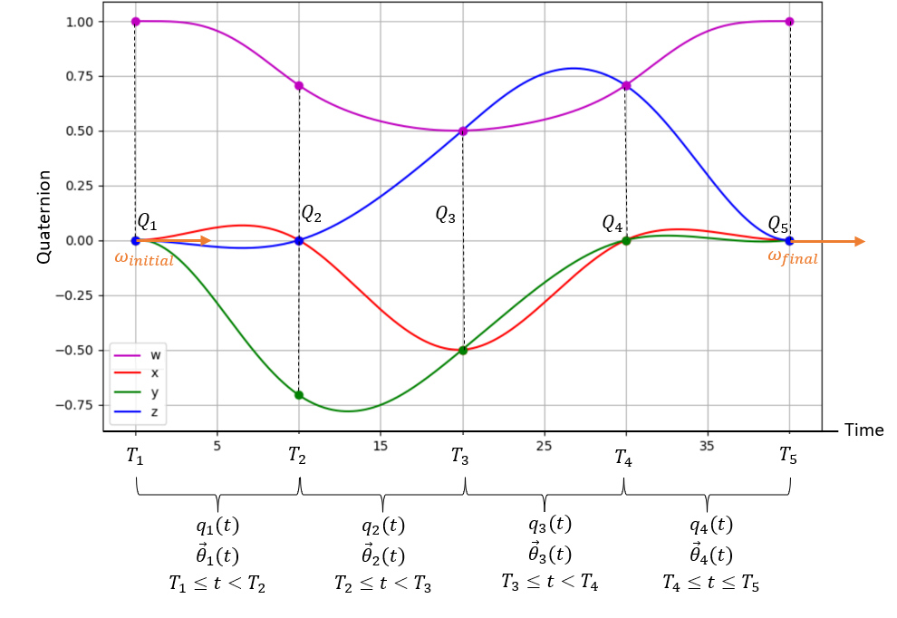




Cubic Orientation Spline Algorithm
CubicOrientationSpline
$${\vec{R}}_{1}\left(t\right)$$
$${\vec{R}}_{2}\left(t\right)$$
$${\vec{R}}_{3}\left(t\right)$$
$${\vec{R}}_{4}\left(t\right)$$
Notes:
Like in the Cubic Polynomial algorithm, to generate a cubic orientation spline, you still need a set of points to interpolate between, capital Q, the time instances of these points, capital T, a start velocity, omega_initial, and an end velocity, omega final.
You are still defining a function for each segment between input points and applying continuity constraints to ensure smooth spline interpolation.
The difference is that the points are now quaternions and the Cubic Polynomial is defined for the rotation vector rather than the quaternion function itself.

Slide 43




Cubic Orientation Spline Algorithm
CubicOrientationSpline
$$q\left(t\right)=q_{i}Δq(t)$$
$$q(t)$$
$$q_{i}$$
$$Δq(t)$$
Notes:
So let’s look at how this works.
The function defining the quaternions over time for a given segment is given as q which is equal to the initial orientation, qi, multiplied by the relative quaternion, delta q, which represents rotation from the start orientation to the orientation at this time.

Slide 44





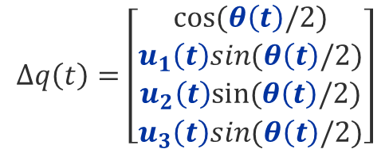
Cubic Orientation Spline Algorithm
CubicOrientationSpline
$$q\left(t\right)=q_{i}Δq(t)$$
$$Δq\left(t\right)=\left[\begin{matrix}cos⁡(θ\left(t\right)/2) \\ u_{1}\left(t\right)sin(θ\left(t\right)/2) \\ \begin{aligned}u_{2}\left(t\right)sin⁡(θ\left(t\right)/2) \\ u_{3}\left(t\right)sin(θ\left(t\right)/2)\end{aligned}\end{matrix}\right]$$
$\hat{u}\left(t\right)=$ $\frac{\vec{R}\left(t\right)}{\left|\vec{R}\left(t\right)\right|}$
$$q(t)$$
$$θ\left(t\right)=\left|\vec{R}\left(t\right)\right|$$
$$q_{i}$$
$$\hat{u}$$
$$θ$$
$$Δq(t)$$
Notes:
This relative quaternion is a function of a unit vector u and an angle theta which corresponds to the rotation axis and angle between the start orientation and the current orientation.
This vector and angle are both defined by the rotation vector, R which can be any vector-valued function of time.

Slide 45


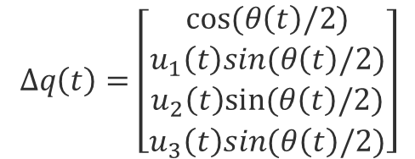
Cubic Orientation Spline Algorithm
CubicOrientationSpline
$$q\left(t\right)=q_{i}Δq(t)$$
$$Δq\left(t\right)=\left[\begin{matrix}cos⁡(θ\left(t\right)/2) \\ u_{1}\left(t\right)sin(θ\left(t\right)/2) \\ \begin{aligned}u_{2}\left(t\right)sin⁡(θ\left(t\right)/2) \\ u_{3}\left(t\right)sin(θ\left(t\right)/2)\end{aligned}\end{matrix}\right]$$
$\hat{u}\left(t\right)=$ $\frac{\vec{R}\left(t\right)}{\left|\vec{R}\left(t\right)\right|}$
$$q(t)$$
$$θ\left(t\right)=\left|\vec{R}\left(t\right)\right|$$
$$q_{i}$$
$$\hat{u}$$
$$θ$$
$$Δq(t)$$
Notes:
This relative quaternion is a function of a unit vector u and an angle theta which corresponds to the rotation axis and angle between the start orientation and the current orientation.
This vector and angle are both defined by the rotation vector, R which can be any vector-valued function of time.

Slide 46



Cubic Orientation Spline Algorithm
CubicOrientationSpline
$$q\left(t\right)=q_{i}Δq(t)$$
$$Δq\left(t\right)=\left[\begin{matrix}cos⁡(θ\left(t\right)/2) \\ u_{1}\left(t\right)sin(θ\left(t\right)/2) \\ \begin{aligned}u_{2}\left(t\right)sin⁡(θ\left(t\right)/2) \\ u_{3}\left(t\right)sin(θ\left(t\right)/2)\end{aligned}\end{matrix}\right]$$
$\hat{u}\left(t\right)=$ $\frac{\vec{R}\left(t\right)}{\left|\vec{R}\left(t\right)\right|}$
$$q(t)$$
$$θ\left(t\right)=\left|\vec{R}\left(t\right)\right|$$
$$q_{i}$$
$$\hat{u}$$
$$θ$$
$$Δq(t)$$
$$x=\frac{t−t_{i}}{t_{f}−t_{i}}$$
Notes:
Since we have chosen to do Cubic Interpolation, we define this rotation vector as a cubic polynomial function of x which is just the normalized time. This polynomial is written this way for convenient analysis.

Slide 47

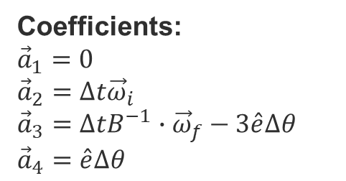



Cubic Orientation Spline Algorithm
CubicOrientationSpline
$$q_{f}$$
Coefficients:
${\vec{a}}_{1}=0$
${\vec{a}}_{2}=Δt{\vec{ω}}_{i}$
${\vec{a}}_{3}=ΔtB^{−1}∙{\vec{ω}}_{f}−3\hat{e}Δθ$
${\vec{a}}_{4}=\hat{e}Δθ$
$$q_{i}$$
$$\hat{e}$$
$$Δθ$$
$$Δq\left(t_{f}\right)=q_{i}^{−1}q_{f}$$
Notes:
By imposing the boundary conditions on this equation, you can obtain the value of these coefficients as functions of

Slide 48
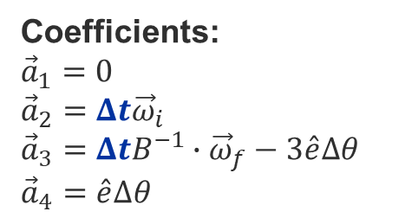
Cubic Orientation Spline Algorithm
CubicOrientationSpline
$$q_{f}$$
Coefficients:
${\vec{a}}_{1}=0$
${\vec{a}}_{2}=Δt{\vec{ω}}_{i}$
${\vec{a}}_{3}=ΔtB^{−1}∙{\vec{ω}}_{f}−3\hat{e}Δθ$
${\vec{a}}_{4}=\hat{e}Δθ$
$$q_{i}$$
$$\hat{e}$$
$$Δθ$$
$$Δq\left(t_{f}\right)=q_{i}^{−1}q_{f}$$
Notes:
the change in time

Slide 49

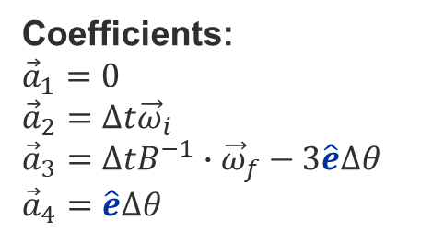
Cubic Orientation Spline Algorithm
CubicOrientationSpline
$$q_{f}$$
Coefficients:
${\vec{a}}_{1}=0$
${\vec{a}}_{2}=Δt{\vec{ω}}_{i}$
${\vec{a}}_{3}=ΔtB^{−1}∙{\vec{ω}}_{f}−3\hat{e}Δθ$
${\vec{a}}_{4}=\hat{e}Δθ$
$$q_{i}$$
$$\hat{e}$$
$$Δθ$$
$$Δq\left(t_{f}\right)=q_{i}^{−1}q_{f}$$
Notes:
the rotation axis between the initial and final orientation.

Slide 50

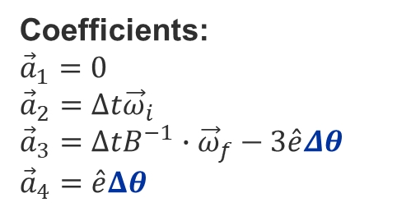
Cubic Orientation Spline Algorithm
CubicOrientationSpline
$$q_{f}$$
Coefficients:
${\vec{a}}_{1}=0$
${\vec{a}}_{2}=Δt{\vec{ω}}_{i}$
${\vec{a}}_{3}=ΔtB^{−1}∙{\vec{ω}}_{f}−3\hat{e}Δθ$
${\vec{a}}_{4}=\hat{e}Δθ$
$$q_{i}$$
$$\hat{e}$$
$$Δθ$$
$$Δq\left(t_{f}\right)=q_{i}^{−1}q_{f}$$
Notes:
the rotation angle between the initial and final orientation.

Slide 51
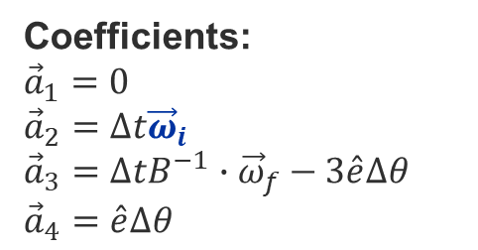
Cubic Orientation Spline Algorithm
CubicOrientationSpline
$$q_{f}$$
Coefficients:
${\vec{a}}_{1}=0$
${\vec{a}}_{2}=Δt{\vec{ω}}_{i}$
${\vec{a}}_{3}=ΔtB^{−1}∙{\vec{ω}}_{f}−3\hat{e}Δθ$
${\vec{a}}_{4}=\hat{e}Δθ$
$$q_{i}$$
$$\hat{e}$$
$$Δθ$$
$$Δq\left(t_{f}\right)=q_{i}^{−1}q_{f}$$
Notes:
The initial angular rate

Slide 52
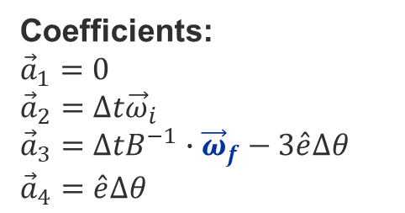
Cubic Orientation Spline Algorithm
CubicOrientationSpline
$$q_{f}$$
Coefficients:
${\vec{a}}_{1}=0$
${\vec{a}}_{2}=Δt{\vec{ω}}_{i}$
${\vec{a}}_{3}=ΔtB^{−1}∙{\vec{ω}}_{f}−3\hat{e}Δθ$
${\vec{a}}_{4}=\hat{e}Δθ$
$$q_{i}$$
$$\hat{e}$$
$$Δθ$$
$$Δq\left(t_{f}\right)=q_{i}^{−1}q_{f}$$
Notes:
And the final angular rate

Slide 53

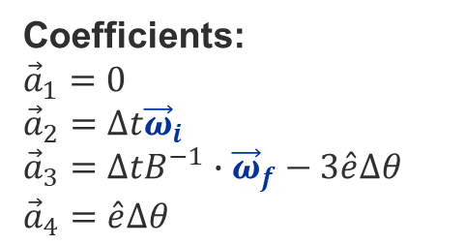





Cubic Orientation Spline Algorithm
CubicOrientationSpline
Iterative algorithm
$${\dot{q}}_{i}\left(T_{i+1}\right)={\dot{q}}_{i+1}\left(T_{i+1}\right)$$
$${\ddot{q}}_{i}\left(T_{i+1}\right)={\ddot{q}}_{i+1}\left(T_{i+1}\right)$$
Coefficients:
${\vec{a}}_{1}=0$
${\vec{a}}_{2}=Δt{\vec{ω}}_{i}$
${\vec{a}}_{3}=ΔtB^{−1}∙{\vec{ω}}_{f}−3\hat{e}Δθ$
${\vec{a}}_{4}=\hat{e}Δθ$
$${\vec{R}}_{1}\left(t\right)$$
$${\vec{R}}_{2}\left(t\right)$$
$${\vec{R}}_{3}\left(t\right)$$
$${\vec{R}}_{4}\left(t\right)$$
Notes:
Now all of these variables are known except for the initial and final angular rate for each segment since the angular rate at the intermediate input points are not directly given.
So, like in the Cubic Polynomial algorithm, these intermediate angular rates can be found by imposing the continuity constraints on the velocity and acceleration at these intermediate input points.
However, due to the non-linearity of the relationships, these velocities must be found using an iterative algorithm.

Slide 54
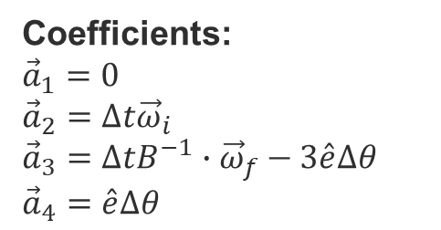
Cubic Orientation Spline Algorithm
CubicOrientationSpline
Iterative algorithm
$${\dot{q}}_{i}\left(T_{i+1}\right)={\dot{q}}_{i+1}\left(T_{i+1}\right)$$
$$\vec{R}\left(t\right)={\vec{a}}_{1}{\left(x−1\right)}^{3}+{\vec{a}}_{2}x{\left(x−1\right)}^{2}+{\vec{a}}_{3}x^{2}\left(x−1\right)+{\vec{a}}_{4}x^{3}$$
$${\ddot{q}}_{i}\left(T_{i+1}\right)={\ddot{q}}_{i+1}\left(T_{i+1}\right)$$
Coefficients:
${\vec{a}}_{1}=0$
${\vec{a}}_{2}=Δt{\vec{ω}}_{i}$
${\vec{a}}_{3}=ΔtB^{−1}∙{\vec{ω}}_{f}−3\hat{e}Δθ$
${\vec{a}}_{4}=\hat{e}Δθ$
$${\vec{R}}_{1}\left(t\right)$$
$${\vec{R}}_{2}\left(t\right)$$
$${\vec{R}}_{3}\left(t\right)$$
$${\vec{R}}_{4}\left(t\right)$$
Notes:
Since we know the initial and final velocity of the trajectory,
once all the intermediate velocities have been found,
the coefficients can be calculated and the rotation vector equation can be defined for each segment.

Slide 55
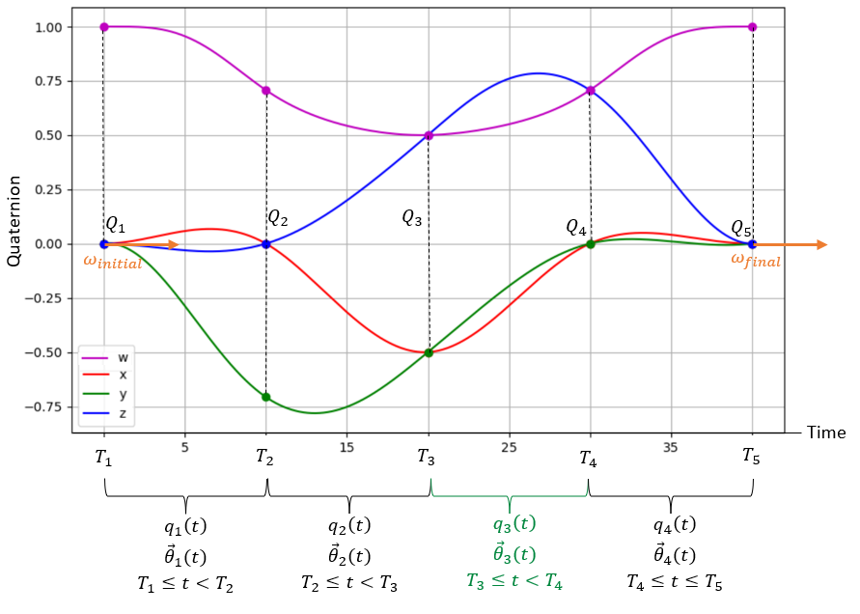




Cubic Orientation Spline Algorithm
CubicOrientationSpline
CubicOrientationSpline.evaluate(Tp)
$$\vec{R}\left(t\right)={\vec{a}}_{1}{\left(x−1\right)}^{3}+{\vec{a}}_{2}x{\left(x−1\right)}^{2}+{\vec{a}}_{3}x^{2}\left(x−1\right)+{\vec{a}}_{4}x^{3}$$
$$q_{3}\left(T_{p}\right)$$
$$q_{3}\left(t\right)=Q_{3}Δq(t)$$
$$T_{p}$$
$${\vec{R}}_{1}\left(t\right)$$
$${\vec{R}}_{2}\left(t\right)$$
$${\vec{R}}_{3}\left(t\right)$$
$${\vec{R}}_{4}\left(t\right)$$
Notes:
Then, like the Cubic Polynomial algorithm, when you want to find the value of the CubicOrientationSpline at a specific time,
you find which segment is defined for that evaluation time then evaluate the corresponding function and use it to find the orientation at that point.

Slide 56



Task Trajectory Generator Design
TaskTrajectoryGenerator
struct TaskTrajectory {
public:
std::shared_ptr<std::array<CubicPolynomial, 3>> linear;
std::shared_ptr<CubicOrientationSpline> angular;
};
CubicPolynomial
CubicOrientationSpline
Rotation
$$x$$
$$z$$
Translation
$$y$$
Notes:
So now that we know how to define the 3 CubicPolynomial translation trajectories and the CubicOrientationSpline rotation trajectory, let’s look at how these modules fit within the task Trajectory Generator.

Slide 57





Task Trajectory Generator Design
TaskTrajectoryGenerator
TaskTrajectory
CubicPolynomial
Position path
$x$
Position at t
Task path
$$v_{i}, v_{f}=0$$
$y$
Linear velocity at t
Time instances
$z$
Linear acceleration at t
Trajectory point:
Task pose, velocity, acceleration
CubicOrientationSpline
Angular acceleration at t
$$ω_{i}, ω_{f}=\vec{0}$$
Angular velocity at t
Orientation at t
Orientation path
Notes:
So we take our input task path and split it into a position path that goes into the respective Cubic Polynomial modules and an orientation path that goes into the Cubic Orientation Spline module.
If this is the first path we are adding to our trajectory, we also set the initial and final velocities to be 0 so that the robot starts and ends stationary.
We need to make sure that the time instances of the input points in each component module are the same so that the resultant trajectory hits each pose at the same time.
You wouldn’t want the robot to reach the correct orientation before it reaches the correct position.
To do this, we determine how long each component movement would take if the task velocity and acceleration limits were satisfied.
We then take the longest of these times and use this as the time instance for that pose in all component trajectories.
THEN, once we’ve made all our interpolation objects, we just have to evaluate the first, second, and third derivatives of each of the component objects to get the output trajectory point.
DRAFT:
So now that we have our 3 linear translation trajectories made from Cubic Polynomials and our angular rotation trajectory made from the CubicOreintationSpline, we have a Task Trajectory object.
However, it is important that these all these components hit each desired point at the same time so that the resultant trajectory hits each pose at the same time.
To do this, we use the maximum task velocity and task acceleration and for each movement, we determine how long the component movement would take if these limits were satisfied. We then take the longest time and use this as the time instance for that pose in all of these component trajectories.

Slide 58




Task Trajectory Generator Design
TaskTrajectoryGenerator
Task path
Time at end, $t_{e}$
TaskTrajectory
TaskTrajectory
TaskTrajectory
Trajectory point:
Task pose, velocity, acceleration
Poses at end
$$t_{start}=0$$
$$t_{start}$$
$$t_{start}=t_{e}$$
Velocity at end
Notes:
This process gets slightly more complicated if we want to add more points to the task path while the trajectory is being evaluated and running.
To achieve this, we define Task Trajectory objects for certain time ranges.
So, if you have already defined a trajectory, when you want to add more points, you just make a new Task Trajectory object and use the last points of the previous trajectory to start the new trajectory smoothly.
In this way, you set the start velocity to be the velocity of the end point of the previous trajectory.
Then, to find the trajectory point at a specific time, you find which Task Trajectory structure is defined for that evaluation time and evaluate the corresponding linear and angular components.

Slide 59
Content
Problem context – CERN Robotics Framework
Task Trajectory Generator design
  Cubic Polynomial algorithm
  Cubic Orientation Spline algorithm
Demonstration
Future work
Notes:
Now let’s take a look at how this module behaves on the physical robots.

Slide 60
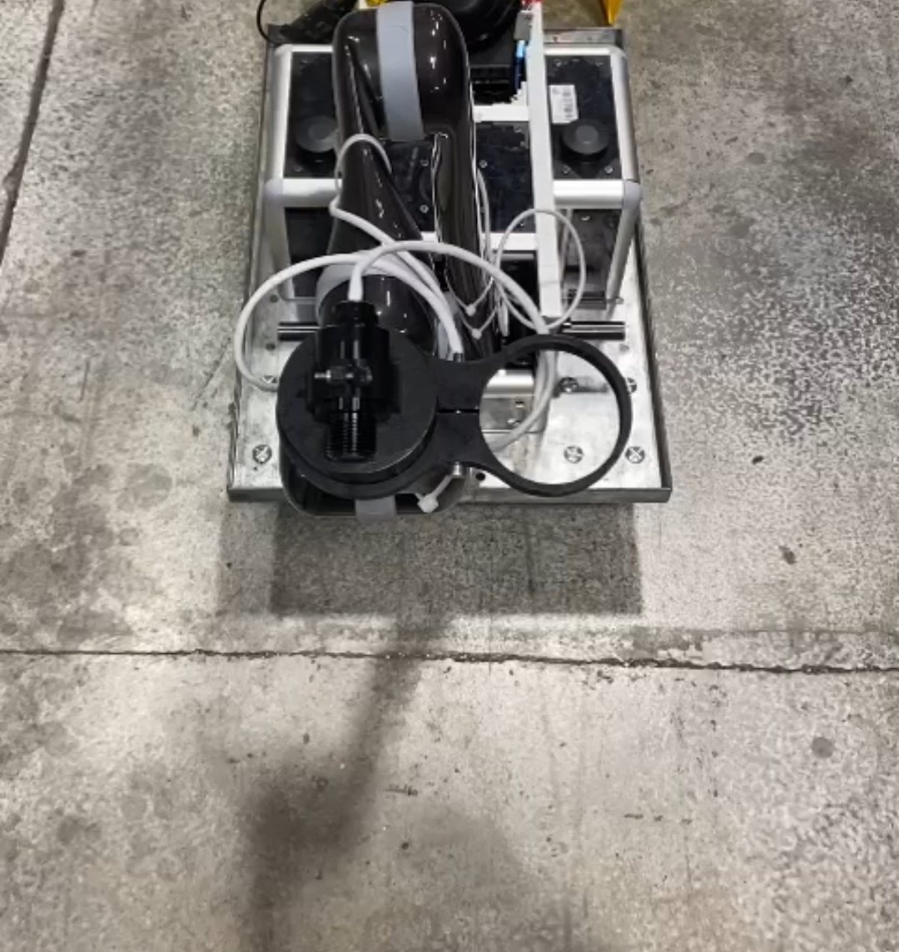
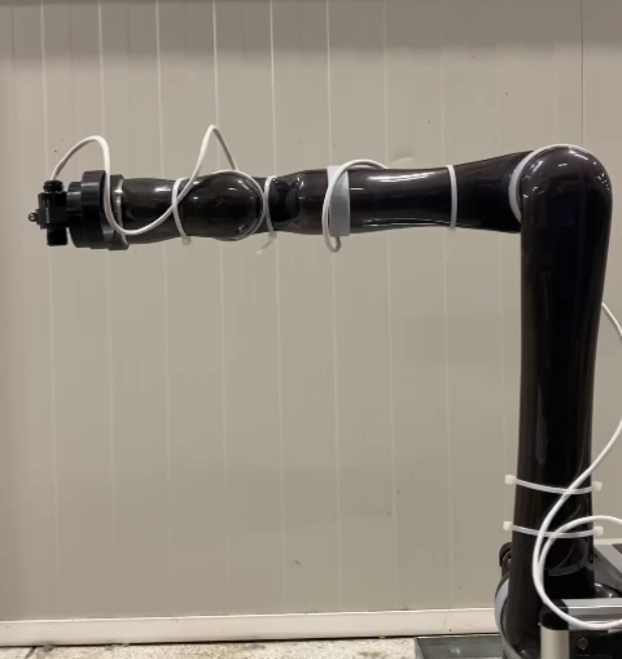
Demonstration – Translation and Rotation
Translation - Square
Rotation - Roll
Notes:
So when we test it on the SPS robot, we can see that it can do translation and rotation separately.
On the left we have inputted the corners of a square and we can see that it passes through these points with some velocity, making a curved trajectory at these edges.
And on the right, we are just doing a negative roll rotation so we can see that the last joint stays in the same position but it’s orientation is changing.

Slide 61
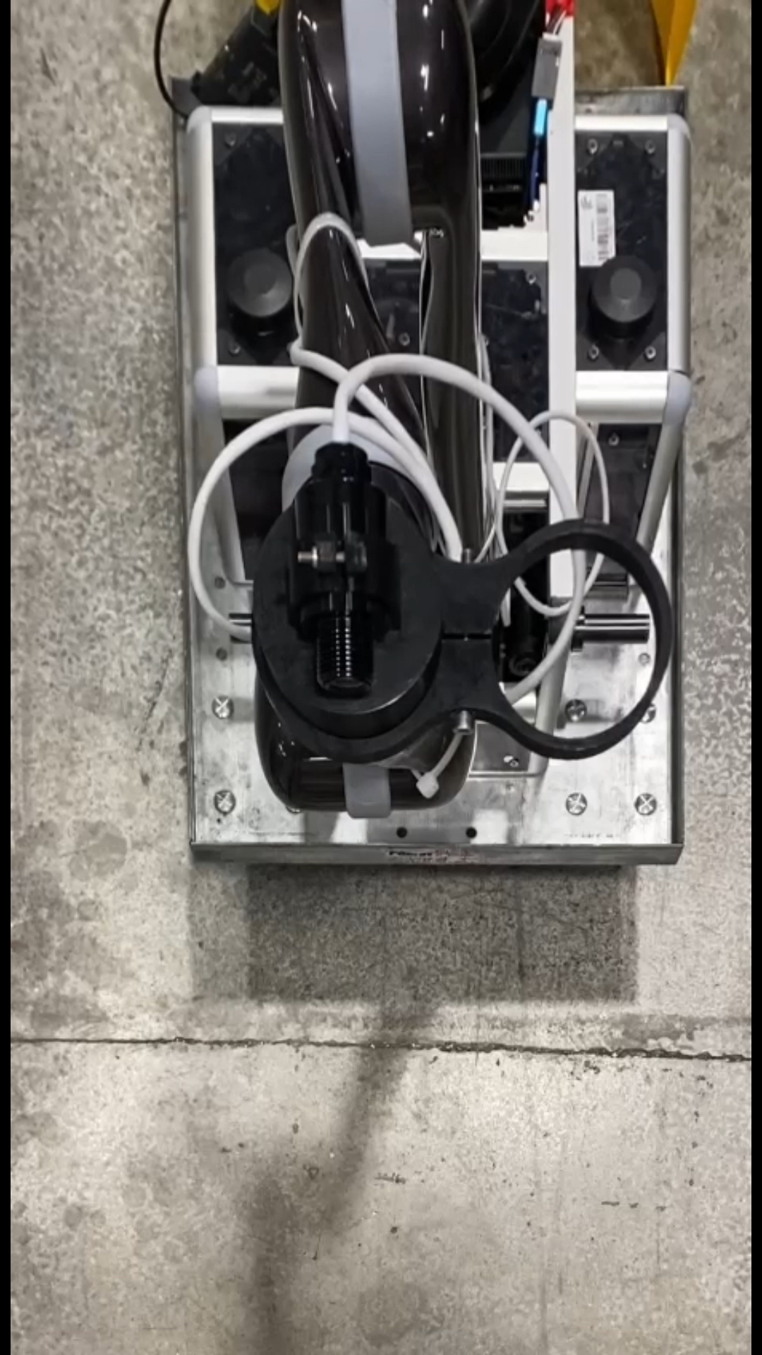
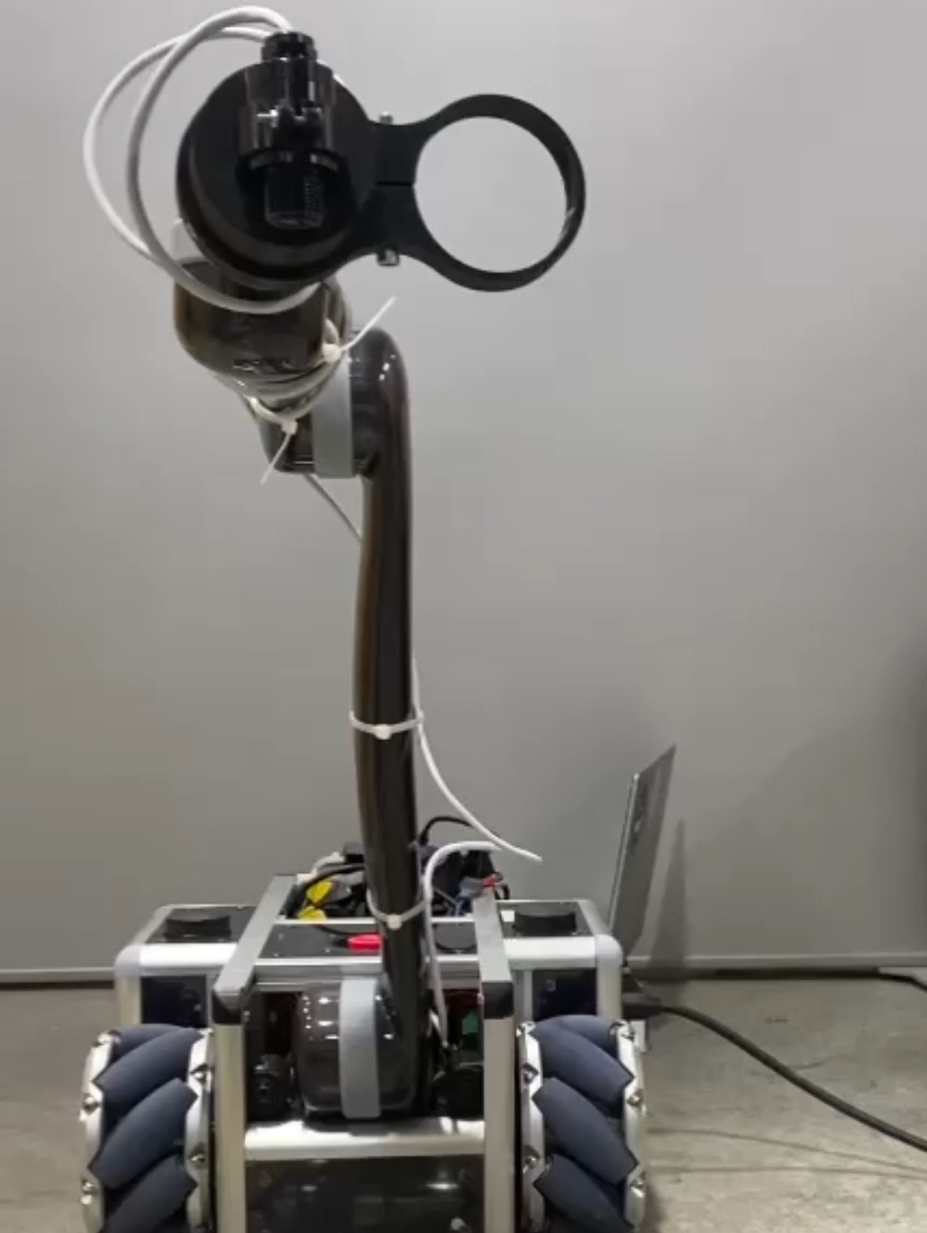

Demonstration – Combined Movement
Square translation with rotation
Point to point
Notes:
We can also see that we can combine translation and rotation movement.
So on the left, we have the same square path as before, but we have just added a roll rotation to two of the points.
And on the right, we are just getting the robot to move from an initial pose to a pose that is different in every component .

Slide 62
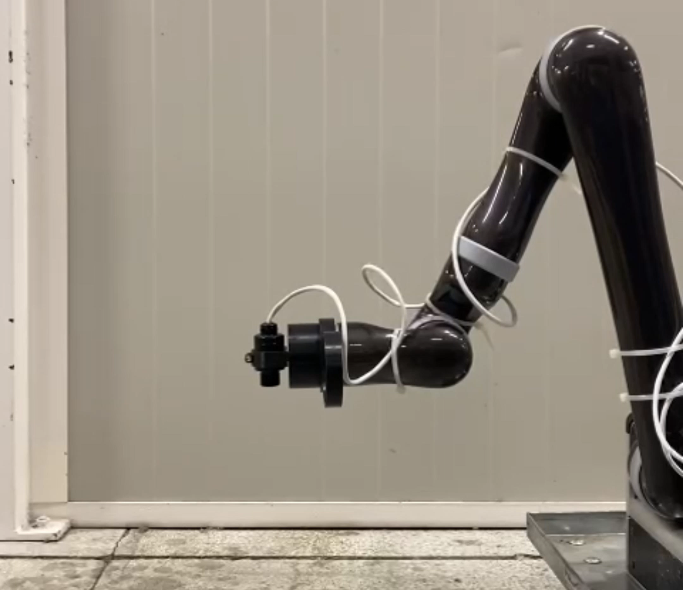

Demonstration – Combined Complex Movement
Screw
Notes:
We can see this clear combination of translation and rotation in this screw example where the robot’s end effector is travelling along the z axis while rotating about this axis.
So as we can see from these demonstrations, the algorithm worked as expected on the hardware and was able to achieve smooth translation and rotation movements in the task space.
While the algorithm performed well in these experiments, there is still room for improvement.

Slide 63
Content
Problem context – CERN Robotics Framework
Task Trajectory Generator design
  Cubic Polynomial algorithm
  Cubic Orientation Spline algorithm
Demonstration
Future work
Notes:
This brings me to my recommendations for future work.

Slide 64

Future Work – Quintic Polynomial
1. Change Cubic Polynomial to Quintic Polynomial
TaskTrajectoryGenerator
Task path
Time at end, $t_{e}$
TaskTrajectory
TaskTrajectory
Poses at end
TaskTrajectory
$$t_{start}=0$$
$$t_{start}$$
Velocity at end
$$t_{start}=t_{e}$$
Notes:
My first recommendation would be to explore the possibility of changing the interpolation functions to be Quintic instead of Cubic so that you can ensure the acceleration profile is continuous for the final task trajectory.
If we recall how we add new path points to an existing trajectory, we define trajectories over certain time ranges so that we can make a new trajectory for the new points and smoothly combine it with the existing trajectory.
However, since we are using Cubic Polynomial interpolation, we can only set the endpoint poses, and velocities, but not the accelerations.
This means that the position, orientation, and velocity profiles are smooth at the points where the trajectories change over, but the acceleration profile has sudden jumps that cannot be physically actuated.

Slide 65
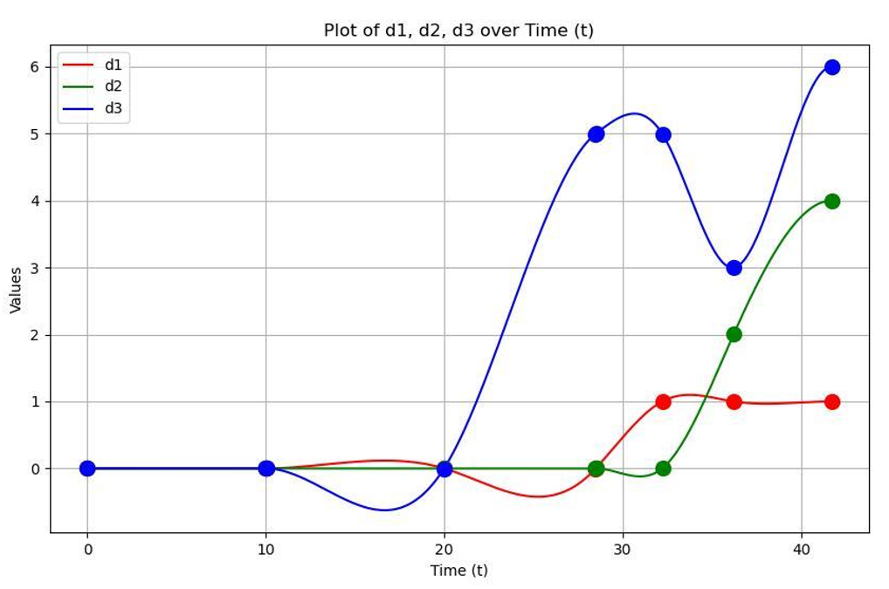
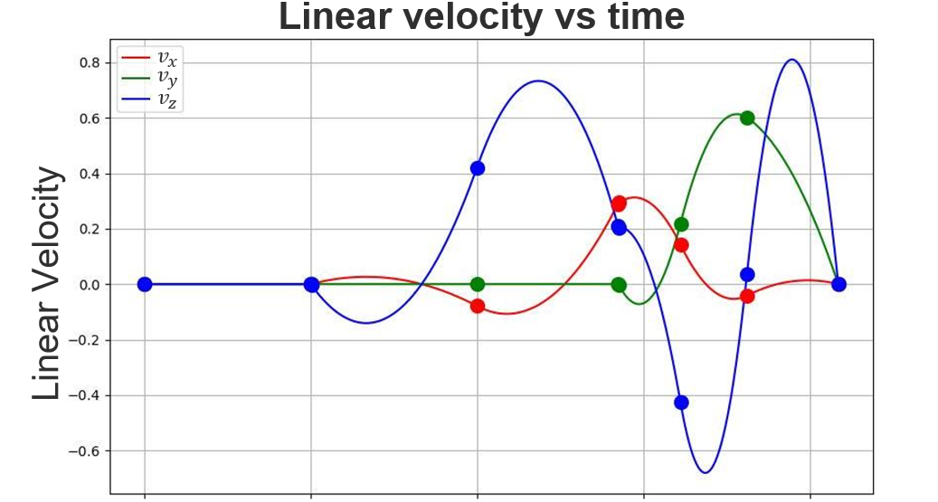
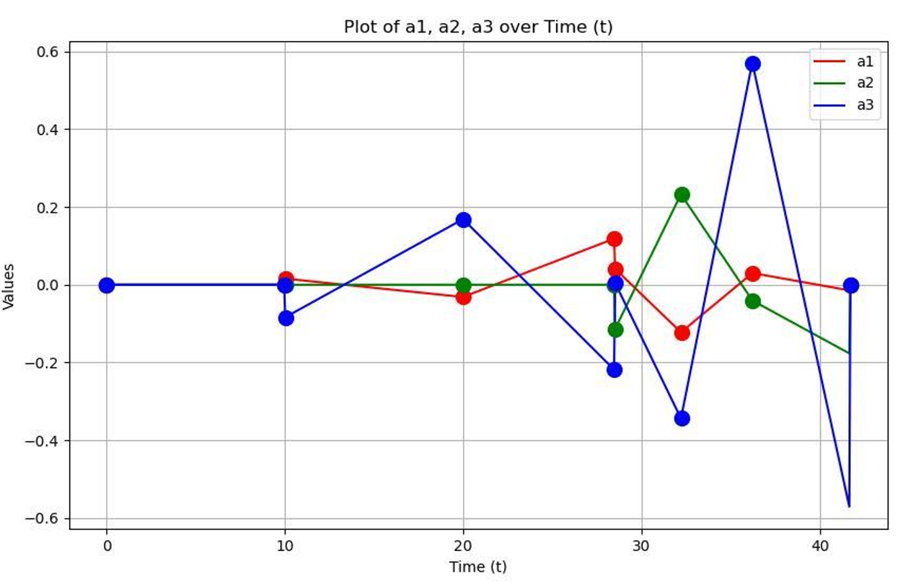
Future Work – Quintic Polynomial
Position vs time
$x$
$y$
$z$
1. Change Cubic Polynomial to Quintic Polynomial
Position
TaskTrajectoryGenerator
Task path
Time at end, $t_{e}$
TaskTrajectory
TaskTrajectory
Poses at end
TaskTrajectory
$$t_{start}=0$$
$$t_{start}$$
Velocity at end
$$t_{start}=t_{e}$$
Linear acceleration vs time
$a_{x}$
$a_{y}$
$a_{z}$
Linear acceleration
Time (s)
Notes:
This can be seen in this linear example on the right here where the dots represent the instances of the input points.
As you can see, the position and linear velocity profiles are continuous but at time 10s and 28s where the trajectories change over, there are jumps in the acceleration.
If we increased the order of the interpolation function to quintic, we would have the ability to set the endpoint accelerations and could therefore make the acceleration profile continuous.

Slide 66
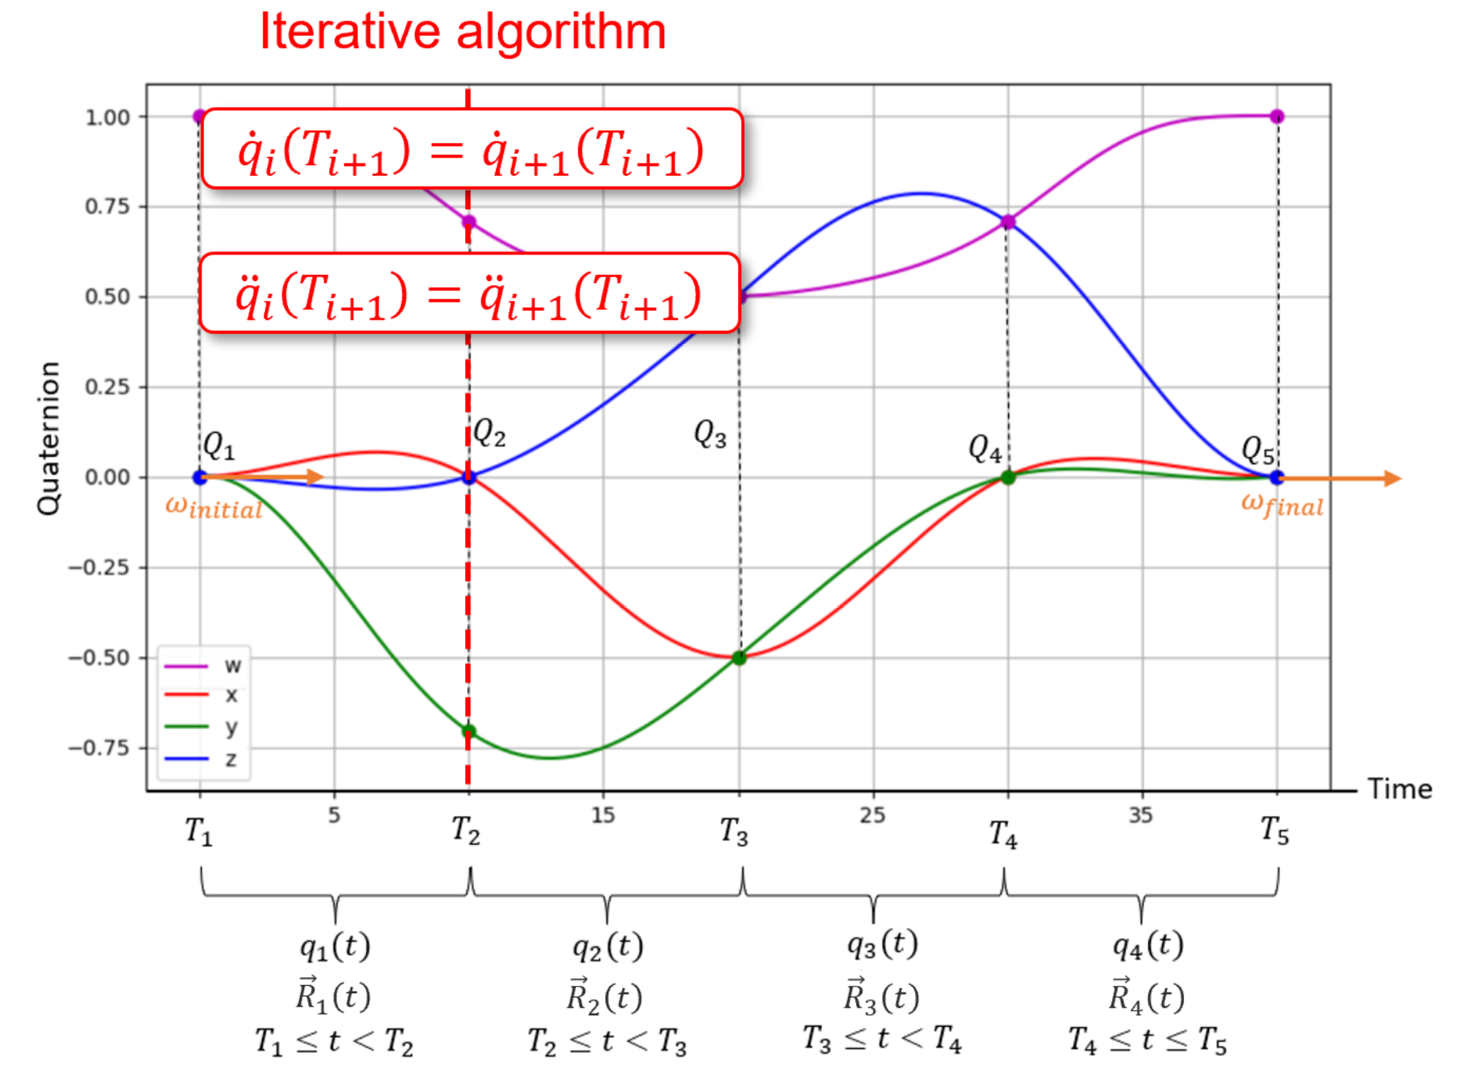
Future Work – Analytical Convergence Check
2. Check for convergence issues analytically
Notes:
The next recommendation would be to check for convergence issues analytically.
Recall the iterative algorithm that finds the intermediate angular velocities in the Cubic Orientation Spline by enforcing the continuity constraints.
This iterative algorithm can fail to converge if the input conditions are unreasonable.

Slide 67
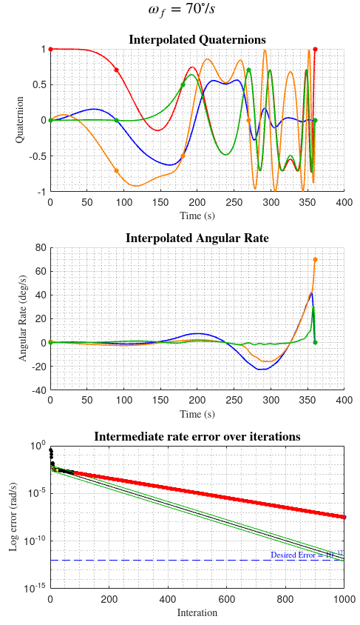
Future Work – Analytical Convergence Check
2. Check for convergence issues analytically
Time instances too close together
Time instances too far apart for a given endpoint velocity
Notes:
If the time instances are too close together, no solution may be found.
If they are too far apart, the algorithm can induce oscillations to try and maintain the energy required to achieve the endpoint velocities.
This can be seen here where the final velocity is set to 70 degrees/s, causing oscillations to be induced towards the end of the trajectory.
In severe cases, these oscillations can become unstable, causing the velocity and acceleration values to surge.
Currently, we have put a check on the number of iterations and forced it to below a reasonable value so if it hasn’t converged before this, we inform the user that the inputs are invalid.
While this ensures the output response is reasonable, it is a heuristic approach and requires a full run of the iterative algorithm before failing.
A better approach would be to determine the exact relationship that leads to these convergence issues so that the inputs can be checked at the initialization of the Cubic Orientation Spline object.

Slide 68
Notes:
This brings me to the end of my presentation. Thank you for listening, are there any questions?

Slide 69
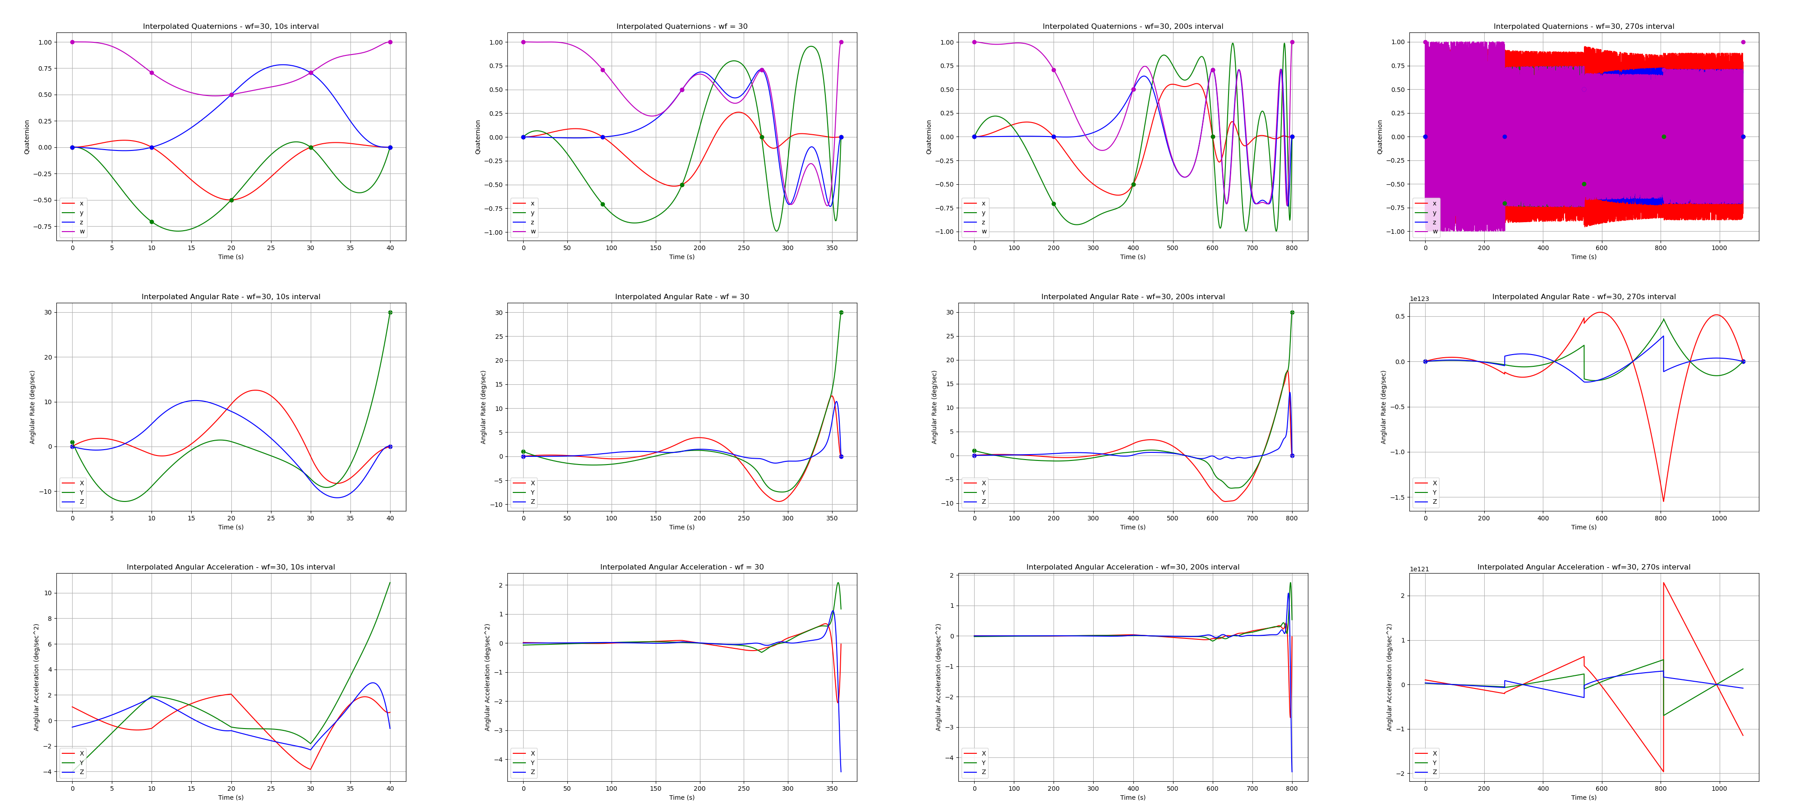
Future Work – Analytical convergence check
Tested example with $ω_{f}=30°$ and varied the time
  If the time interval is decreased, the oscillations stabilize whereas if the time interval is increased, the oscillations become unstable and the velocity and acceleration values surge.

Slide 70
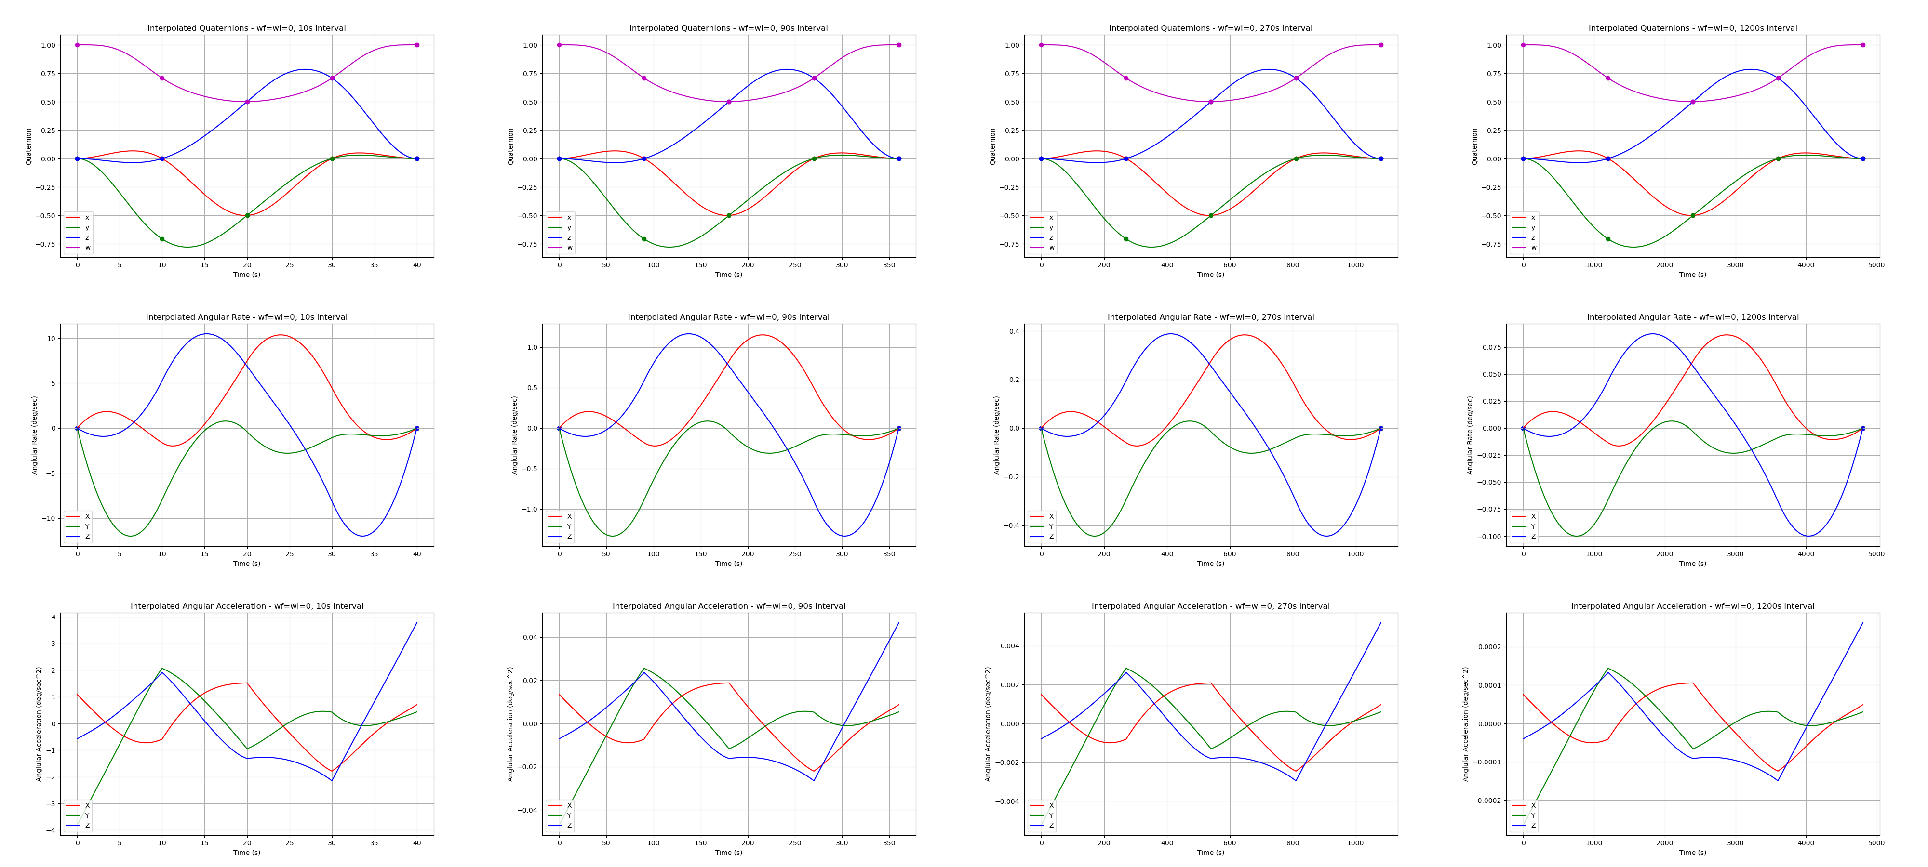
Future Work – Analytical convergence check
Increasing the time had no effect on the shape of the interpolated quaternions, angular velocities, or angular accelerations.
Increasing the time did change the max velocity and max acceleration (inextricably linked)

Slide 71
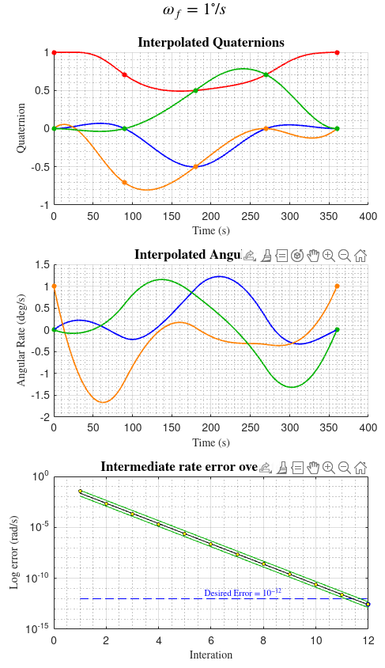
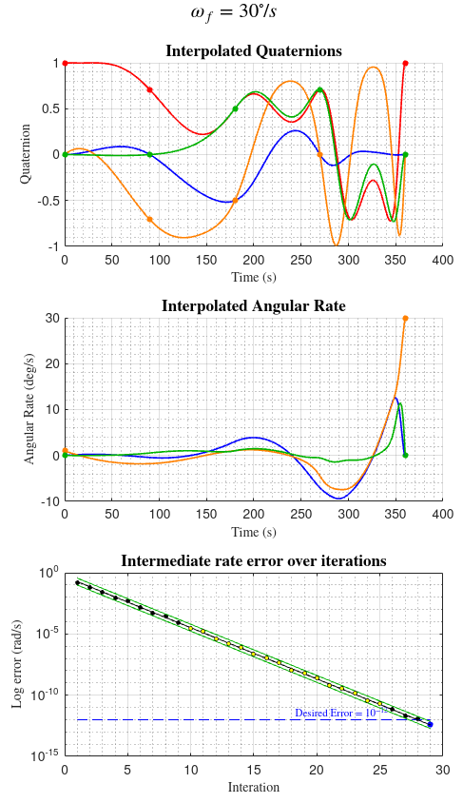
Future Work – Analytical convergence check
Tested increasing the final angular rate while keeping time instances at 90s intervals
Saw that the less the convergence followed a logarithmic shape, the more oscillations were induced
Notes:
Noticed a phenomena that if the error rate at each iteration was reducing logarithmically, it tended to be stable.
Couldn’t figure out how to quantify this relationship.

Slide 72
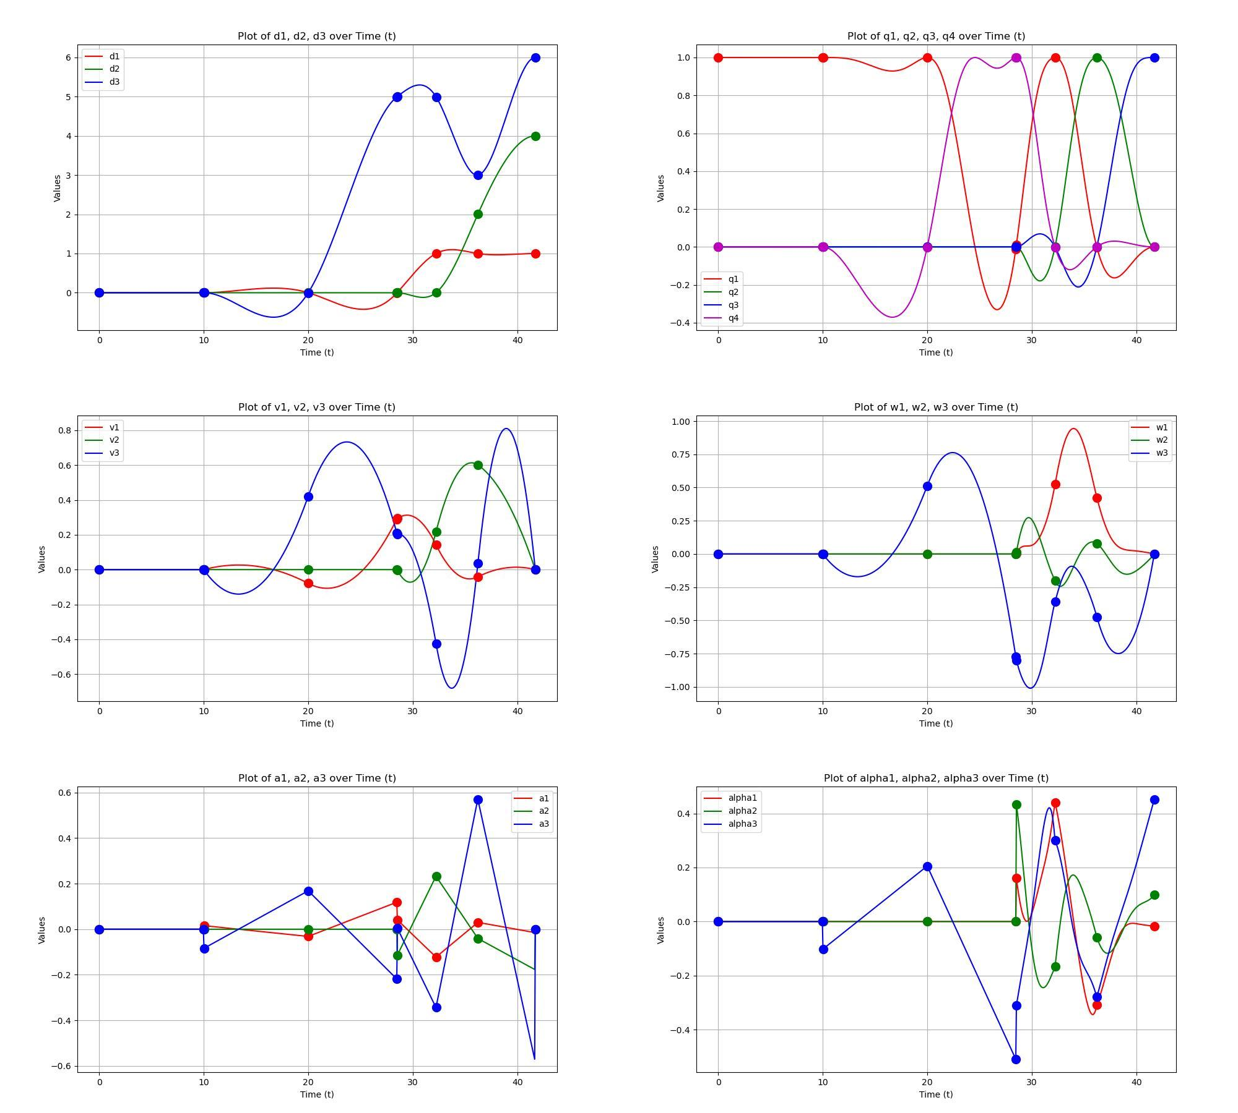
Task Trajectory Generator Design – Combined Trajectories

