Slide 1

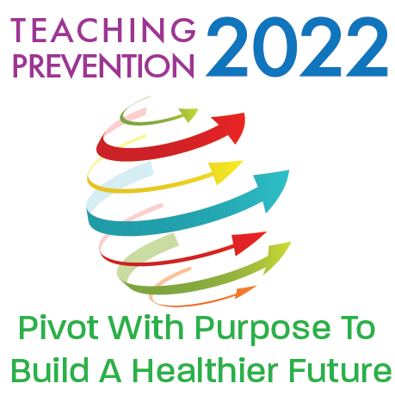


The Bridge to Resilience: Program Development
Researchers:
Chelsea Lacagnina, MPH-S¹; Rebecca Mortensen, PA-S¹; Joy Thomas, DrPH, MPH¹;
Erin Lepp, MMSc, PA-C¹; Stephanie May, PhD²; Bernita Reese, MS²
¹Mercer University College of Health Professions
²The Bridge at Austin Community Center
Notes:
Amy

Slide 2
Disclosure
"The presenters have no relevant financial relationships with any commercial interests to disclose."

Slide 3
The Bridge to Resilience: Program Development
MISSION
BACKGROUND
The Bridge to Resilience researchers will produce a public health program based around resilience skills in children ages 11 and 12 to improve the population’s mental health.
Anxiety and depression in children are on the rise during COVID-19.
Resilience has been shown to be both a protective factor and a positive predictor of outcomes for individuals with anxiety and depression.
ABSTRACT
For this project, resilience is defined as how well children bounce back in response to stress, anxiety, threats, or other adversities and vulnerabilities that they may face.
Notes:
Chelsea - Mission and Abstract
I wanted to do mental health
People said that this was a good age group because….
Rebecca - Background

Slide 4
Methodology
Table 1. Needs Assessment and Content Creation
Process | Themes |  |  | Improvements
Research | Isolation and the need for socialization Social Emotional Learning Self-Awareness Mindset Tools/techniques that have previously been effective for reducing anxiety/stress in kids |  |  | Added in activities/discussions: mindful meditation social games growth mindset conversations
Key Informant Interviews | Safety Expressing oneself Communication | Home support Structure |  | These findings align with the research and material that the researchers had in place
Focus Groups with Kids | Socialization Home support COVID-19 safety Appropriate behaviors | Coping skills Anxiety Anger Grief |  | Added a COVID safety game
Notes:
Rebecca
Research - Resilience Scale (RS10)

Slide 5
Methodology
Table 1. Needs Assessment and Content Creation
 | Topics |  |  | Key Activities
Content Creation | Peer Relations and Trying New Things Thinking Through Thoughts and Pushing Forward Anger Management Awareness, Understanding My Feelings Calming Coping Mechanisms/Stress and Anxiety |  |  | Growth Mindset Coping tools Name It, Aim It, Tame It, Solve It My Ways to Calm
 | Feedback |  |  | Improvements
Evaluation Focus Group | “...as lesson plans go, I thought they were excellent.” -Dr. May “...it does break down pretty good when you talk about you know the fixed mindset"-Ms. Reese Behavior redirection and mindfulness is in recreation centers now. -Ms. Kiesha |  |  | Added social emotional learning competencies to session plans
Notes:
Chelsea

Slide 6


Community Partners
Hamilton Recreation Center
through
Notes:
Rebecca
The Bridge at Austin Community Center
Recreation Center attached to a Church
May used to be a teacher and still supports youth
Results Kids Club, Inc.
Center for Youth
Hamilton Recreation Center
Summer Programs and After School programs for youth
Where we planned on implementing
©Smarty Pants Chefs!™
Nutrition Program for youth

Slide 7



Discussion
The major limitation of this project is the difficulty in implementing the program due to COVID-19 restrictions.
Future implications of the implementation:
Notes:
Chelsea
Future implications:
building a social group for participants, increasing confidence and self-efficacy for those involved in the program, and learning skills that will improve the overall emotional health of participants and their communities.
Rebecca
Future plans - curriculum script….

