Slide 1

QBUS3350: Project Planning and Management
Project Scheduling
Taught by
Dr. Erick Li
Discipline of Business Analytics

Slide 2
Project Scheduling
The forward and backward passes that we have studied implicitly assume that resources will be available in the required amounts when needed.
The critical path is merely a lower bound of the actual completion time.
With resource constraints, the actual completion time could prolong.
Notes:
With more constrains in the resources , the optimal objective (min project completion time) will do worse.

Slide 3
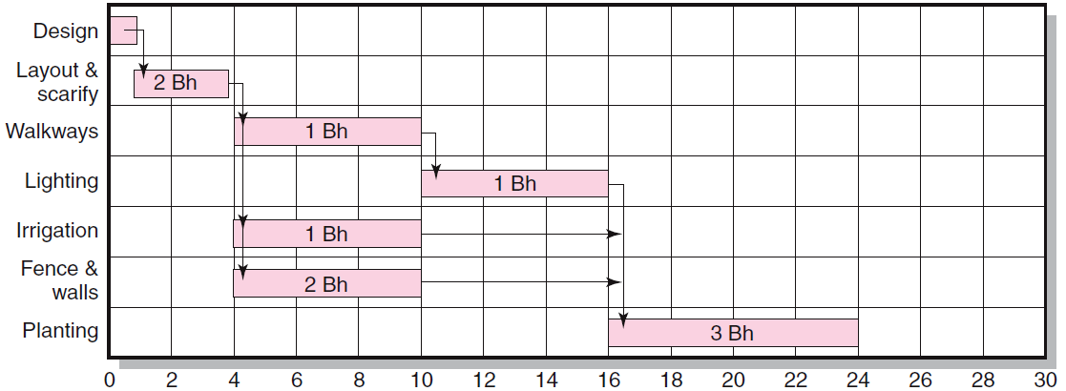
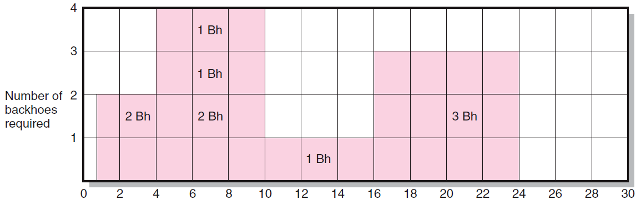
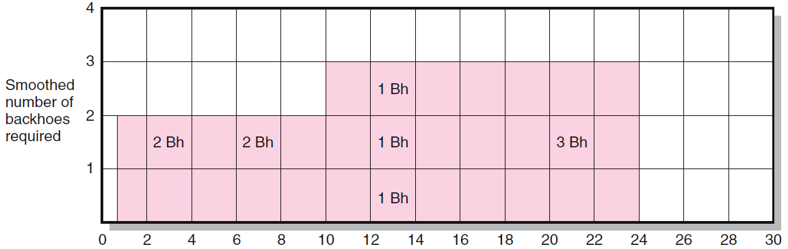
The top Gantt chart assumes that unlimited resources (i.e., backhoes) are available.
The middle chart shows the amount of resources is required over time.
Because there are only 3 backhoes available, we need to smooth the schedule, usually, by postponing the non-critical task. But in some rare circumstances, we may have to postpone critical tasks.
The bottom chart shows the amount of required resources after postponing “Irrigation”.
Notes:
The original charts are JPEG format that cannot be edited. Refer to EXCEL for the correct Gantt charts.

Slide 4
Project Scheduling
Chapter 12 of Pinto (2016) describes a widely accepted heuristic procedure to level the resource requirement. When the required resources exceed the available resources, the heuristic procedure that is based on a priority rule retains activities that have:
apply 1 by 1:
1. Minimum slack： include 0 slack, critical activity starts first
2. Smallest duration: activity with shortest duration starts first
3. Lowest activity identification number.
Assumption: Splitting is not allowed. In other words, once an activity starts, we must finish it. We cannot stop working on it and resuming the work later on to avoid over-consumption of resources.
Notes:
Answer pattern: On day 5, we face a shortage of resources (when using the unconstrained solution, we need 4 units of backhoes during days 5 to 10).
We apply the heuristic. 3 tasks can be started on Day 5 and they are Walkways, Irrigation and Fence.
Walkway’s has zero slack. We must start in on Day 5. After loading “ walkway”, we have only 2 units of backhoes left. We can load either irrigation or Fence all have the same slack of 6 and the sample duration of 6. Thus we use the 3rd tie-break that is to load E or Irrigation.
The delay of activity irrigation is equivalent to adding an FS lag of 6 between B and E.

Slide 5
Project Scheduling
Example of the Priority Rule:
Activities | Duration | Predecessor | Resources
A | 3 | - | 2T
B | 1 | - | 1T
C | 2 | - | 1T
D | 2 | A, B, C | 2T
We have only 3T available.

Slide 6
Project Scheduling
Resource Requirement (Initial)
Activities | Day 1 | Day 2 | Day 3 | Day 4 | Day 5
A | 2T | 2T | 2T
B | 1T
C | 1T | 1T
D |  |  |  | 2T | 2T
Total Requirement | 4T | 3T | 2T | 2T | 2T
A, B, C, and D have slacks of 0, 2, 1, and 0, respectively.

Slide 7
Project Scheduling
Resource Requirement (Detailed Process)
Activities | Day 1 | Day 2 | Day 3 | Day 4 | Day 5
A | 2T | 2T | 2T
B
C | 1T | 1T
D
Total Requirement
For day 1, activities A, B, and C are eligible to be scheduled. Because A has the smallest slack (0 slack actually), we first load A into the schedule. This would use up 2T in Day 1-3. We have 1T left. Then B and C are eligible. We continue to apply the smallest slack rule. C is preferred to B because of shorter slack. We load C. After that, all resources are used up. We are done for days 1 and 2.

Slide 8
Project Scheduling
Resource Requirement (Detailed Process)
Activities | Day 1 | Day 2 | Day 3 | Day 4 | Day 5
A | 2T | 2T | 2T
B |  |  | 1T
C | 1T | 1T
D
Total Requirement
For day 3, A is already loaded and we cannot unload it under the assumption of no splitting. B is the only activity eligible and we have 1 unit of resource available. We load B to day 3.

Slide 9
Project Scheduling
Resource Requirement (Final)
Activities | Day 1 | Day 2 | Day 3 | Day 4 | Day 5
A | 2T | 2T | 2T
B |  |  | 1T
C | 1T | 1T
D |  |  |  | 2T | 2T
Total Requirement
Repeating the same procedure, we obtain the new schedule that still completes the project in 5 days with 3T available.
However, all of the activities now have zero slacks. All of them become critical and B now follows C (i.e., B and C not concurrent any more).
Notes:
This example shows that the resource constraint does not cause any delay.

Slide 10
Project Scheduling
The updated planning network.
Sometimes, we may alter the “dependency” between tasks to reflect the changes.
More activities could become “critical” due to the resource constraint.

Slide 11
Project Scheduling
New Example of the Priority Rule:
Activities | Duration | Predecessor | Resources
A | 3 | - | 2T
B | 1 | - | 1T
C | 2 | - | 2T
D | 2 | A, B, C | 2T
We have only 3T available.

Slide 12
Project Scheduling
New Example of Resource Requirement (Final)
Activities | Day 1 | Day 2 | Day 3 | Day 4 | Day 5 | Day 6 | Day 7
A | 2T | 2T | 2T
B |  |  | 1T
C |  |  |  | 2T | 2T
D |  |  |  |  |  | 2T | 2T
Total Requirement
Notes:
This example shows that the resource constraint causes a delay!

Slide 13
Project Scheduling (Optional)
Optimal scheduling is often difficult because of its computational complexity is NP-hard (non-deterministic polynomial-time hard).
NP-hard: Class of problems which are at least as hard as the hardest problems in NP. Problems that are NP-hard do not have to be elements of NP; indeed, they may not even be decidable.
NP-complete: Class of problems which contains the hardest problems in NP. Each NP-complete problem has to be in NP.
In plain language, NP-complete is difficult with computational complexity that grows exponentially with the size of the problem; the difficulty of NP-hard problem is >= that of the hardest NP-complete problem.
So people focus on heuristics that are easy to compute but produce nearly optimal solutions.

Slide 14
Project Scheduling
Usually, the “Leveling” process is done by the embedded optimization tool of the software (e.g., Microsoft Project is available in the largest lab of H69).
Hereafter, we apply the Linear Programming (LP) approach.

Slide 15
Project Scheduling
With resource constraints, the optimal schedule may
Increase criticality of events
Increases scheduling complexity
May make the traditional critical path no longer meaningful
Can break sequence of events
May cause parallel activities to become sequential and critical activities with slack to become noncritical.

Slide 16
Project Scheduling
Terminologies related to “Levelling” in Microsoft Project
Splitting activities.
It means that an activity is started, then stopped for a period of time, and resumed and may stop again, resume until finished.
Splitting activities are related to laddering techniques but are usually not allowed in “Levelling” because of the concern about inconsistent quality.
When splitting is not allowed, any activity must be worked on continuously once it is started.
Partial assignment
A fraction of the resource is assigned to a task. Most of the resources in real life are of integer nature. So when partial assignment is not allowed, the quantity of the resource assigned to each task is an integer.

Slide 17
Project Scheduling
Terminologies related to “Levelling” in Microsoft Project
Baseline: Only after the resources are assigned and levelling is performed, the project network becomes a baseline.
Without the resource constraints, the forward and backward passes that we learn before only provide a lower bound on the true project duration.
In other words, the duration of the baseline schedule >= that produced by the forward and backward passes.
In addition, PERT that we have learned does not consider resource constraints.
With uncertain activity time and resource constraints, we have to use simulation to perform the analysis. Closed-form analysis is intractable except for very simple network.

Slide 18
Project Scheduling
Time-constrained scheduling (the objective is to minimize costs subject to time constraints)
The project manager must increase the resources; otherwise, the time cannot be reduced if the resource is limited.
We studied how to reduce time by “crashing” some of the activities earlier this semester.
Notes:
What we learned this morning is the resource-constrained scheduling. (The objective is to minimize time subject to resource constraints).

Slide 19
Project Scheduling
We can use linear programming (LP) to schedule the project tasks.
Let node 0 be the starting node and node n be the end node.
Importance of creating artificial start and end nodes
Decision variables include x_{i} (i=0,1,2,…,n), which represents the time when the event of node i is completed.
Objective is minimize x_{n} (which is the completion time of the final event).
Note the subscript n depends on the actual network structure. Do not just write x_{n} in the exam.

Slide 20
Project Scheduling
The constraints must reflect all of the network characteristics such as interconnectivity and time of each event for the nodes.
Generically, the constraints of the network can be written as
xj-xi ≥ d(i,j), for every (i,j) available.
By “available,” it means there exists an arc between node i and node j. So the network characteristics determine how many constraints may exist and the RHS of each constraint.
All x_{i} must be non-negative. In the optimal solution, x₀=0.

Slide 21
Project Scheduling
Example of LP model
Event ID | Duration | Predecessors
A | 2 | None
B | 5 | None
C | 5 | A
D | 3 | B
E | 9 | C,D
F | 2 | C,D
G | 6 | F
H | 7 | E
I | 2 | G,H
We must convert the information using the activity-on-the-arc approach!

Slide 22
Project Scheduling
After conversion, we obtain a new network with 8 nodes.
Example of LP model
Arc | Event ID | Length of Arc
0-1 | A | 2
0-2 | B | 5
1-3 | C | 5
2-3 | D | 3
3-4 | E | 9
3-5 | F | 2
5-6 | G | 6
4-6 | H | 7
6-7 | I | 2
1
4
0
3
7
2
5
6
The objective is to minimize x₇.

Slide 23
Project Scheduling
Example of LP model
We solve this model by using EXCEL solver.
All of the constraints depend on the structure of the AoA network.
Arc | Event ID | Length of Arc | Constraints
0-1 | A | 2 | x₁-x₀≥2
0-2 | B | 5 | x₂-x₀≥5
1-3 | C | 5 | x₃-x₁≥5
2-3 | D | 3 | x₃-x₂≥3
3-4 | E | 9 | x₄-x₃≥9
3-5 | F | 2 | x₅-x₃≥2
5-6 | G | 6 | x₆-x₅≥6
4-6 | H | 7 | x₆-x₄≥7
6-7 | I | 2 | x₇-x₆≥2

Slide 24
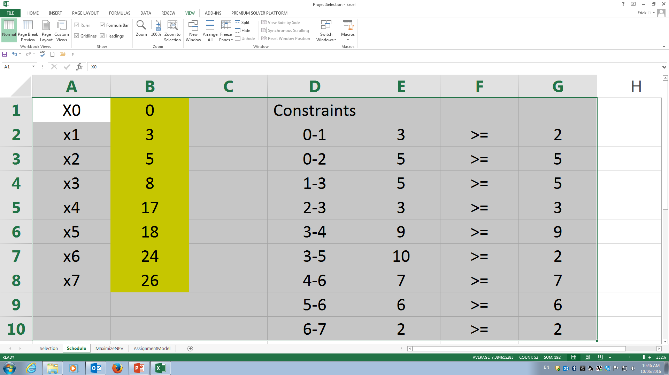
Project Scheduling
EXCEL Implementation
How can we determine the critical path?
Use the binding constraints.
In this particular example, the binding constraints include 0-2, 1-3, 2-3, 3-4, 4-6, 5-6, 6-7. The project duration is 26 and the critical path is B-D-E-H-I. (We must translate the binding constraints to the events.)
Note that arcs 1-3 and 5-6 are not on the critical path B-D-E-H-I.
Notes:
Use “shadow prices” of the Sensitivity output to determine the critical activities.

Slide 25
Project Scheduling
What happens if there exists FS lag?
We need to modify the relevant constraint to xj-xi ≥ d(i,j) + Lag.
Example:
Min x₄,
Subject to
x1-x0≥1 (Related to activity A)
x2-x0≥3 (Related to activity B)
x3-x1≥2 (Related to activity C)
x3-x2≥2+1 (Related to activity D)
x4-x3≥3 (Related to activity E)
All x_{i} are non-negative.
Activities | Predecessor | Duration
A | - | 1
B | - | 3
C | A | 2
D | B | 2
E | C, D+FS1 | 3

Slide 26
Project Scheduling
Self Exercise: Draw AON and AOA using the data shown in the previous slide.

Slide 27
Project Scheduling
Project managers may consider other issues when scheduling multiple projects.
Personality
Case in points:
Eric Schmidt, after a successful career at Sun Microsystems, took over Novell. He uses geek to describe his group of technologists who rule the cyber world. Schmidt has some interesting ideas about assigning geeks to projects. For example, let geeks control each other in small group. Why? Geeks care about how other perceive them. A team with geeks can produce positive peer pressure. However, too many geeks spoil the soup. So breaking up large projects into smaller and more manageable projects so that small teams of geeks can be assigned to them.
Notes:
Personality can create super-additive (1+1>2) or sub-additive (1+1<2).

Slide 28
Project Scheduling
Project managers may consider other issues when scheduling multiple projects.
Inexperienced and experienced staffs
Case in points:
The Department of Agriculture (DoA) in USA uses a project management software that requires each project manager to enter the required skill for each task. The algorithm then matches the staffs with the required skill to the task based on experience levels (an extended assignment model). The algorithm allows inexperienced staffs to work with experienced staffs such that the overall experiences of all the staffs can grow. The algorithm also considers the priority of each task such that experienced staffs work on highly prioritized task.
Notes:
Matching algorithm.

Slide 29
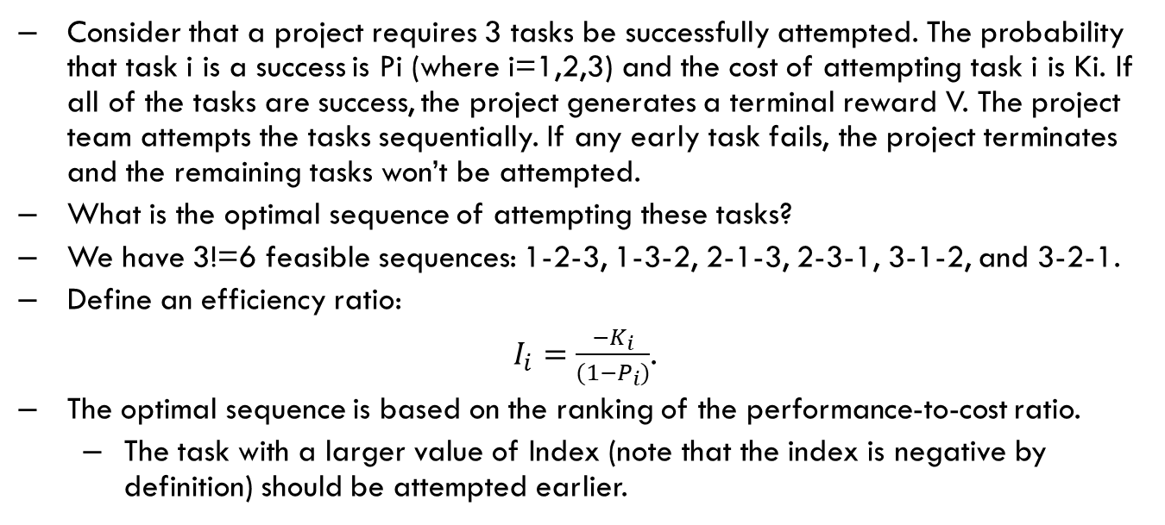
Risky Project Scheduling
Consider that a project requires 3 tasks be successfully attempted. The probability that task i is a success is Pi (where i=1,2,3) and the cost of attempting task i is Ki. If all of the tasks are success, the project generates a terminal reward V. The project team attempts the tasks sequentially. If any early task fails, the project terminates and the remaining tasks won’t be attempted.
What is the optimal sequence of attempting these tasks?
We have 3!=6 feasible sequences: 1-2-3, 1-3-2, 2-1-3, 2-3-1, 3-1-2, and 3-2-1.
Define an efficiency ratio:
$I_{i}=\frac{{−K}_{i}}{{(1−P}_{i})}$.
The optimal sequence is based on the ranking of the performance-to-cost ratio.
The task with a larger value of Index (note that the index is negative by definition) should be attempted earlier.

Slide 30
Summary
Create resources requirement based on Gantt chart (Microsoft Project Software and the “Level” function).
Apply the heuristic procedure to schedule tasks only if there are not enough resources.
Create AoA network based on AoN and formulate LP models.

Slide 31
Questions?

