Slide 1
Seattle Car Accident Report

Slide 2
Background
Road traffic injuries are a major but neglected public health challenge that requires concerted efforts for effective and sustainable prevention. Of all the systems with which people have to deal every day, road traffic systems are the most complex and the most dangerous. Worldwide, an estimated 1.2 million people are killed in road crashes each year and as many as 50 million are injured. Projections indicate that these figures will increase by about 65% over the next 20 years unless there is new commitment to prevention.

Slide 3

Problem
Data that describes each car accident can also be used to determine the severity of each accident. This project aims to predict how severe a car accident could be based on address type, collision type, weather, road condition and time. Knowing the severity of any such accident beforehand will lead to prevention and prompt action.

Slide 4
Interest
Insurance companies would like to know what features influence the severity of car accidents and adjust their insurance premium. Government would plan new road layouts to decrease car accidents during city construction.

Slide 5
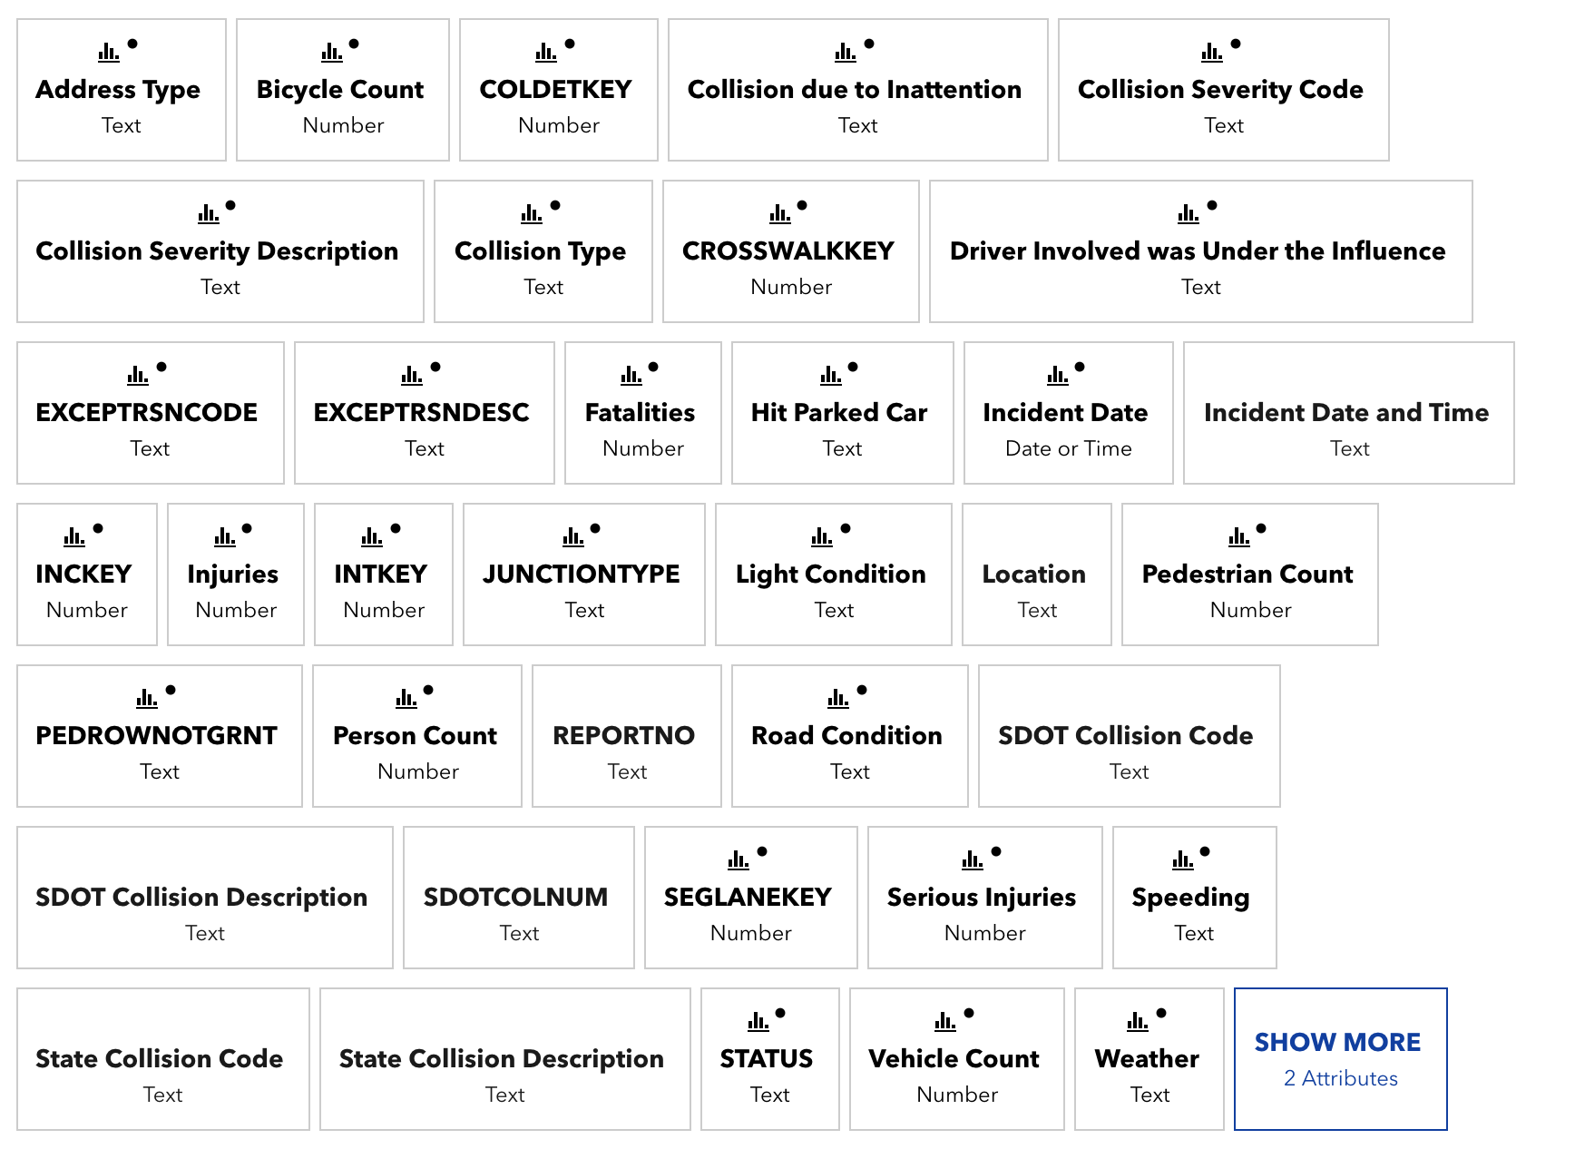
Data Source
Seattle GeoData

Slide 6
Data Pre-Processing
 | SEVERITYCODE | ADDRTYPE | COLLISIONTYPE | INCDTTM | WEATHER | ROADCOND
0 | 2 | Intersection | Angles | 3/27/2013 2:54:00 PM | Overcast | Wet
1 | 1 | Block | Sideswipe | 12/20/2006 6:55:00 PM | Raining | Wet
2 | 1 | Block | Parked Car | 11/18/2004 10:20:00 AM | Overcast | Dry
3 | 1 | Block | Other | 3/29/2013 9:26:00 AM | Clear | Dry
4 | 2 | Intersection | Angles | 1/28/2004 8:04:00 AM | Raining | Wet

Slide 7

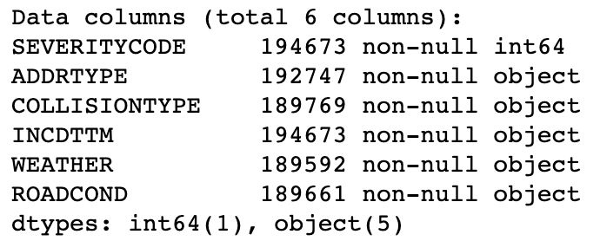



Data Pre-Processing

Slide 8
Data Pre-Processing
Input Feature | Data Type | Description
ADDRTYPE | Text | Collision address type: Alley Block Intersection
COLLISIONTYPE | Text | Collision type
INCDTTM | Text | The data and time of the incident.
WEATHER | Text | A description of the weather conditions during the time of the collision.
ROADCOND | Text | The condition of the road during the collision.

Slide 9
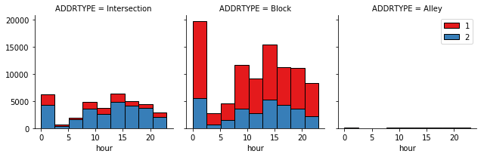
Data Pre-Processing

Slide 10
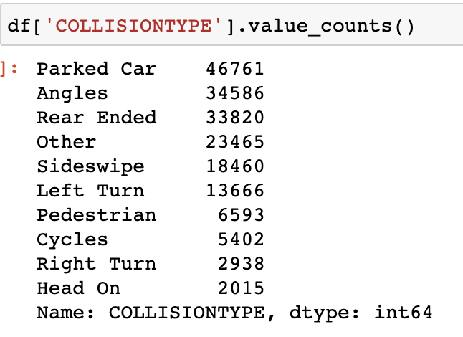
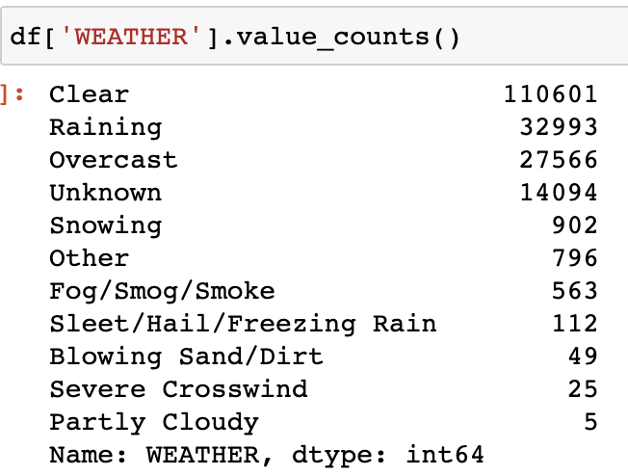
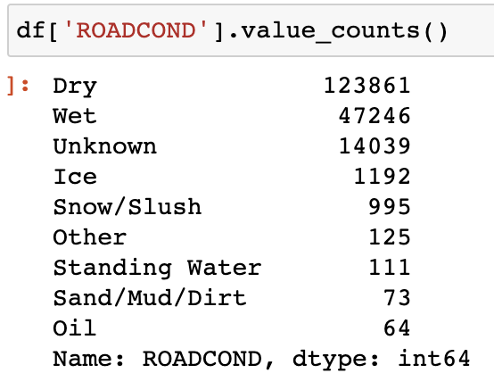
Data Pre-Processing

Slide 11
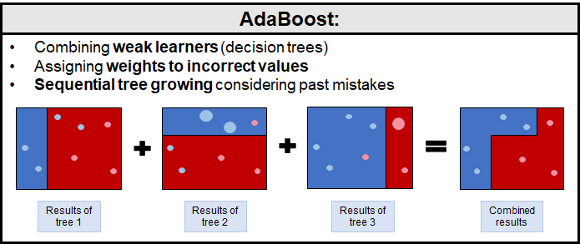
AdaBoost

Slide 12
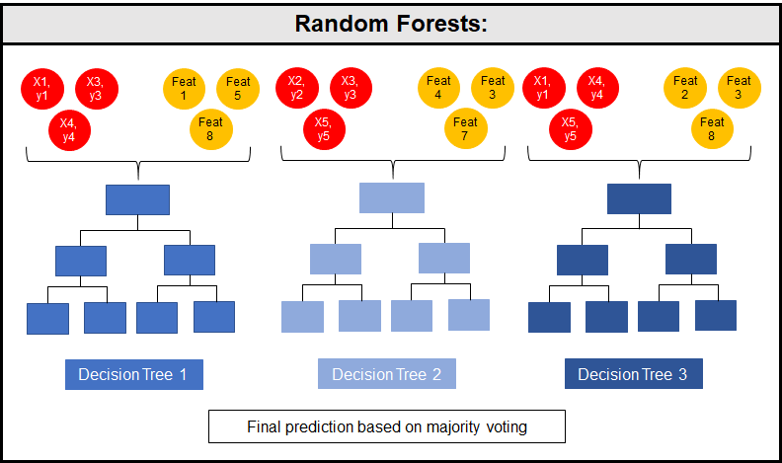
Random Forest

Slide 13
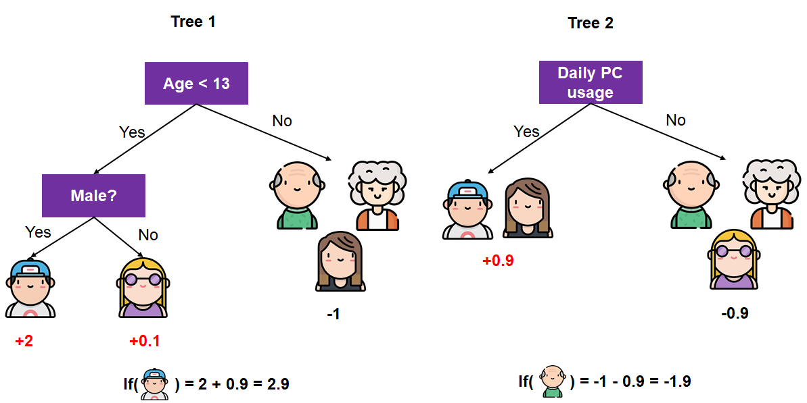
XGBoost

Slide 14
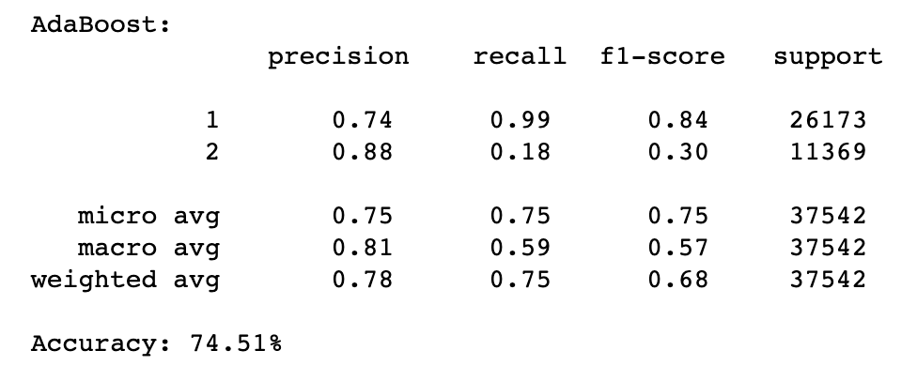
Results

Slide 15
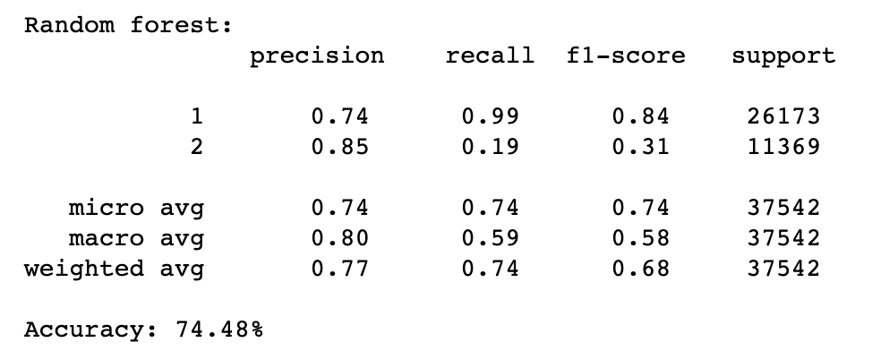
Results

Slide 16
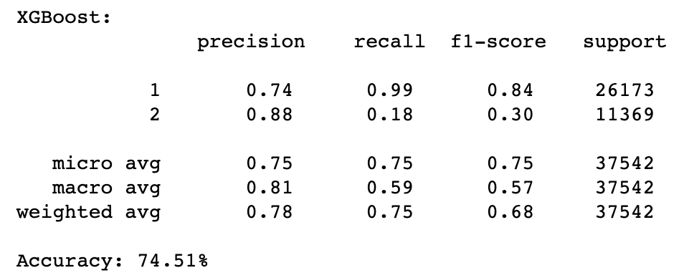
Results

Slide 17
Discussion & Conclusion
Built useful models to analyze the relationship between car accident severity and description data.
Accuracy of the models could be improved.
Ideas:
Hyperparameters
Input features

