Slide 1
Modules
Part 2

Slide 2
Modules - Recap
Remember from previous lessons, modules are simple ways of organising code to provide a function
They can be imported using the following syntax:
import <module name>
For example:
import sys
This will import the sys (system) module into your program scope
Currently we have only seen how to import modules provided with your installation of python or your own modules
How do you install modules developed via 3rd parties.

Slide 3
Method 1 – Manually Downloaded modules
Often a module that you download from the web will contain a “setup.py” file.
To install a module using this file you simply need to run:
python setup.py
i.e. just run this setup.py file with your python executable.

Slide 4
Method 2 – PyPI
PyPi is the “python package index” - https://pypi.python.org/pypi
It is the “official” store of modules available for use.
There are tools available to aid your installation from this index
The two main tools that you will see in use on the web are:
easy_install
pip
easy_install was the original installer however it only handle a subset of the files that pip handles.
Therefore, as recommended in the official python docs use pip over easy_install (if the documentation on the web suggest using easy_install I suggest that you try pip first – if that doesn’t work then use easy_install)
For windows Pip is in the Scripts folder of your python installation (if using version older that 3.4 or 2.6 you will need to manually install)

Slide 5
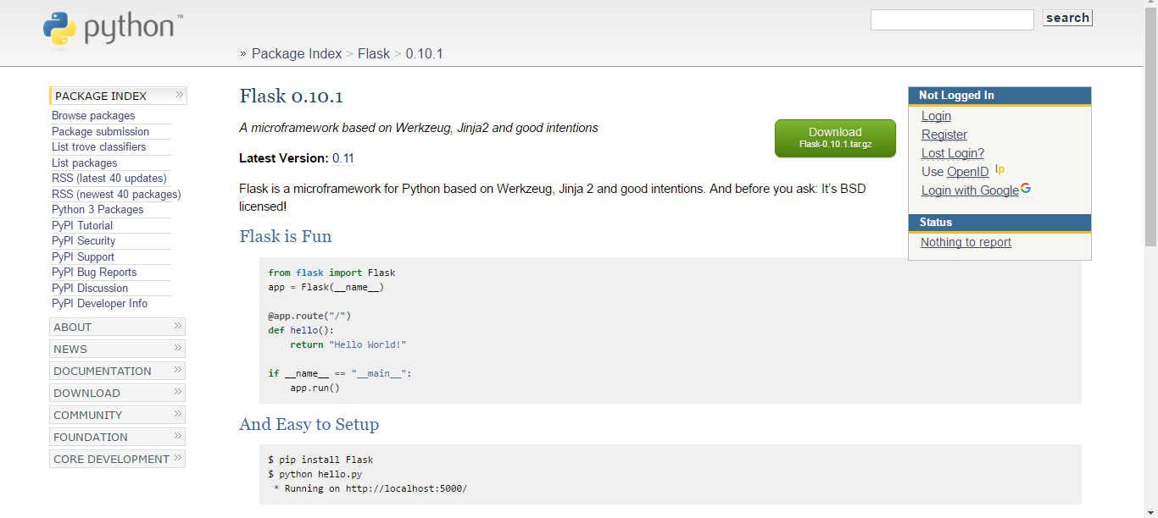
Method 2 - PyPI
Each module will have its own page in PyPI, for example flask:

Slide 6
Method 2 - PyPI
Most pages have the instructions on them how to install but normally the command is:
pip install modulename
It is also possible to specify a particular version (it depends on that version being available in the PyPI)
This can be done using the following command:
pip install modulename==version

Slide 7
Activity
Install the flask module and run the example code (hello.py) below:
You will need to specify the index using the -i and also that the host is trusted using the --trusted-host option.
The command in total is:
pip install -i http://192.168.1.50/pypi/simple --trusted-host 192.168.1.50 flask
hello.py:
import Flask
app = Flask.Flask(__name__)
@app.route("/")
def hello():
return "Hello World!"
if __name__ == "__main__":
app.run()
Run hello.py and navigate to address shown (should be something like http://127.0.0.1:5000)
This module is designed as a lightweight webserver

