Slide 1
GIT

Slide 2
Why Git
Git is a version control system
It allows multiple people to work on the same code base at the same time
It can also be used to get code from the interweb.
A lot of tutorial will include a git repository for the example
Some even give you a base for the tutorial and the completed example
However, can also be useful if you are working on your own.
Gives you a way to “save” your code and revert back to known working code

Slide 3
Git Installer
Installers for Mac and Windows available on local server
Windows:
http://192.168.0.50/downloads/git_installer/win/Git-2.8.1-64-bit.exe
Mac:
http://192.168.0.50/downloads/git_installer/mac/git-2.8.1-intel-universal-mavericks.dmg
(Suggest that you browse to http://192.168.0.50/downloads/git_installer/ and navigate from there)

Slide 4
Configure Git
Before we do anything in git lets configure it.
These commands are run from the terminal
For windows use – git bash
For mac – use terminal
We need to tell git who we are
Email
git config --global user.email “<enter email>”
Name
git config --global user.name “<enter name>”
Git will then use these when commiting

Slide 5
Git - Cloning
To “download” a codebase we “clone” it using the git clone command
For example:
git clone <repository link> <repository dir>
This will clone the repository at <repository_link> into a directory called <repository dir>
The directory is optional – if omitted the directory will be the same name as the repository
So where do we get repository links from

Slide 6
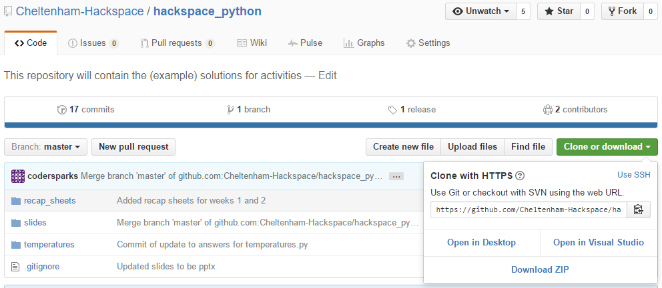
Git – Cloning – github example

Slide 7
Git – Cloning - exercise
Time to have a go (assuming the server is working)
Run the following command:
git clone http://192.168.0.50/git/git_demo.git
You should find a single file in the git_demo folder
Note: .git may be stripped from the repository name

Slide 8
Git – Commiting and staging
To record the state of the code we say that we commit it to the repository.
A commit is like a snapshot of the code. i.e. it is a record of the code at a particular point of time.
To build a commit we have to add it to git’s staging area using the following command:
git add <filename>
This can then be run repeatedly to add files to the staging area.
Once you have added all the files you want to commit you can do so by running the following command:
git commit
Git will open a text editor to allow you to enter a commit message
Normally this would be a summary of the changes you have made.

Slide 9
Git - Status
The git status allows you to check on the current status of your repository.
It will show you files in the following sections
Changes to be committed:
These files have been added to the staging area and will be committed if the git commit command is run
Changes not staged for commit:
These files have changed since the last commit – before committing you will need to run git add <file> for each file
Untracked files:
These files have never been committed – i.e. they are new and must be added using git add <file> before committing
Files not mentioned are committed (or ignored)

Slide 10
Git Add, Commit and Status exercise
Create the following files within your git folder
testfile1
testfile2
testfile3
Run the following commands in order
git add testfile1
git commit (and enter a comment)
git add testfile2
git status
You should not see examples of the status messages

Slide 11
Git - Branching
Branching allows you to work on different ideas at the same time.
It can be useful if you need to make a significant change that you are not sure if it will work
To create a branch run the command
git branch <branch_name>
<branch_name> is the name of the branch
You can then checkout that branch to work on.

Slide 12
Git branching - exercise
Clone the repository again (to another folder such as git_demo_branching)
git clone http://192.168.0.50/git/git_demo.git git_demo_branching
Once this has happened run the following command:
git branch demo_branch
git checkout demo_branch
git status (note it tells you the branch you are on)
Edit the hello_world.py script to say “Hello world from branch”
git add hello_world.py
git commit
Run the python program

Slide 13
Git branching - exercise
Now run the following command
git checkout master
Run the hello_world.py
git checkout demo_branch
If you named it differently use that name
Run the hello_world.py

Slide 14
Git branching
So branching lets you keep two (or more) different version of the same code.
Ok, so what happens when we are finished with a branch and want to update the original file so that we only have one again

Slide 15
Git merging
To do this we use the git merge command
This is run from the destination branch (i.e. the branch you want to merge to).
You need to specify the merge source in the command
i.e. the following commands would be used:
git checkout <destination branch>
git merge <source branch>

Slide 16
Git merge example
Run the following commands from you git_demo_branching folder
git checkout master
master is the default branch and our destination
git merge demo_branch
demo_branch is the source branch where the changes we want to merge exist
Run the program – you should now see that the changes are on our main branch
You can now delete the branch we were working on by running the following command
git branch –d demo_branch

Slide 17
Git log
Git log allows you to see the history of the commits that have been made for a project.
It can be execited by running the following command:
git log
Output will be something similar to:
commit b3691eaaa79597a992e721ab5cb0dfdb9cef28d3
Author: codersparks <codersparks@gmail.com>
Date: Sun May 22 21:53:35 2016 +0100
Added hello world from branch
commit b9fe45c1711afb18325046a94404e92202e9150f
Author: cheltenham-hackspace <another@example.com>
Date: Sun May 22 21:32:24 2016 +0100
Initial commit

Slide 18
Demo of merge conflict
Demo of merge conflict

