Slide 1
Hackspace Python
This is the slidepack for the Monday night introduction to Python at Cheltenham Hackspace
These slides will be updated as we progress through the course
Uses Pycharm Edu as tool for learning
Week one slides can be found here:
https://prezi.com/mqkqvsic6dtp/cheltenham-hackspace/
Week two was completed using only PyCharm Edu so there are no slides

Slide 2
Boolean Operators
Allows control of flow of program by comparison of variables
Already introduced:
Equals (==)
Not equals (!=)¹
Greater than/Greater than or equal (>/>=)
Less than/Less than or equal (</<=)
¹In python 2 you may see “<>” as the operator for not equals
Notes:
In all but the most simple programs you will be required to control the flow of a program.
This is where boolean operators come into effect. They allow you to compare the values of variables and make decisions based on that

Slide 3
Boolean Operators
Always returns True or False
Can use not, and and or to combine operators
not – will invert the comparison, i.e. if comparison is True it will return False
and – will return True if all comparisons return True
or – will return True if any comparison returns True

Slide 4
Boolean Operators
 |  | Comparison A
 |  | True | False
Comparison B | True | True | False
 | False | False | False
 |  | Comparison A
 |  | True | False
Comparison B | True | True | True
 | False | True | False
Can be visualised as truth tables
And
or

Slide 5
Boolean Operators
True
 |  | Comparison A
 |  | True | False
Comparison B | True | True | False
 | False | False | False
True
True and True
Example
name = “John”
age = 17
What is the value of:
answer = name == “John” and age == 17

Slide 6
Boolean Operators
Exercise:
Complete task “Boolean Operators”

Slide 7
Boolean Operators - Order
Operators are not evaluated left to right
The order is:
not
and
or
We can use parenthesis () to change order (i.e. operators in parenthesis are evaluated first)

Slide 8
Boolean Operators - Order
Example
age = 23
name = “Fred”
fav_col = “red”
What will answer be:
answer = name == "Tom" or not fav_col == "red" and age == 24
And what will answer2 be:
answer2 = name == "Tom" or not (fav_col == "red" and age == 24)

Slide 9
Boolean Operators
Exercise
Complete task “Boolean opeerators order”

Slide 10
If operator
How do we use boolean operators to control flow.
Use the if command, example
name = “fred”
if name == “fred”:
print(“Hello Fred”)
print(“Hello again Fred”)
print(“Not in if statement”)
Indicates start of if block
Set variable “name”
to value “fred”
If
name
is “fred”
True
Print
“hello fred”
False
Print
“hello again
fred”
All commands with same indent
are included in if block
Print “not in
if statement”

Slide 11
If operator
Exercise
Complete task “if statement”

Slide 12
If, elif, else
We have seen how to use if to execute commands if a condition passes.
How do we then execute commands if they fail.
Use:
else – Always executed if the if condition fails
elif – executed if the first if condition fails and the new condition passes

Slide 13
If, elif, else
Set variable “x”
to value “Fred”
Set variable “x”
to value “Mark”
Set variable “x”
to value “Tim”
Example
x = “Fred”
if x == “Fred”:
print(“x is Frederick”)
elif x == “James”:
print(“x is Jimbo”)
elif x == “Dave”:
print(“x is a python master”)
else:
print(“who?”)
If
x
is “Fred”
True
True
True
True
True
x = “Dave”
x = “Fred”
x = “Tim”
output
“x is Frederick”
False
If
x
is “James”
True
output
“x is Jimbo”
output
“x is Jimbo”
False
If
x
is “Dave”
True
output
“x is a python master”
output
“who?”
Output: x is Frederick
end
Output: x is a python master
Output: who?
Notes:
Note view this slide as a slide show for best effect

Slide 14
If, elif, else
Exercise
Complete task “Else, elif part in if statement”

Slide 15
Range function
The range() command creates a list of numbers within a range (docs)
Can be used two ways
range(3)
Returns list of numbers from 0 (inclusive) to 3 (exclusive)
[0, 1, 2]
range(3,8,2)
Returns list of number starting at 3 (inclusive) to 8 (exclusive) using step of 2
[3, 5, 7]
Stop (exlusive)
Step (i.e. increment by) if not specified defaults to 1
Start (inclusive)

Slide 16
For Loops
For loops allow us to iterate over a set of values
The specified variable is set to each value in each loop.
Same as if statement, the commands to execute are indented after the for command
The format is:
for item in list:
print(item)
Variable that is asigned to
List of items to iterate over
All commands with same indent will be executed as part of for loop

Slide 17
For Loops
Example
for i in range(3, 8, 2):
print(i)
print(“end”)
Output:
3
5
7
end

Slide 18
For loops
Exercise
Complete task “For loop”

Slide 19
For loops and Strings
Strings are just a list of characters
Therefore it is possible to loop over the characters in a string
Example:
for c in “Test”:
print(c)
Output:
T
e
s
t

Slide 20
For Loops and Strings
Exercise
Complete task “For loop using strings”

Slide 21
While Loops
Allow looping until a condition is broken
Format:
while(condition):
command
command
command outside of loop
Indicates start of while block
Commands with same indentation are in while loop

Slide 22
While Loops
Example:
a_list = [“x”,”y”,”z”]
while(len(a_list) > 0):
print(“Length at start of loop: %s” % len(a_list))
e = a_list.pop()
print(e)
print(“end: Length: %s” % len(a_list))
Output:
Length at start of loop: 3
z
Length at start of loop: 2
y
Length at start of loop: 1
x
end: Length: 0

Slide 23
While Loops
Exercise
Complete task “While loop”

Slide 24
Loop forever
It is possible to loop for ever
Example:
while(True):
print(“help”)
Output
help
help
help
help
…

Slide 25
Break Keyword
Allows you to exit from a loop
Example:
counter = 0
while(True):
print(counter)
if counter > 3:
break
counter += 1
Ouput:
0
1
2
3
4

Slide 26
Break Keyword
Exercise
Complete task “Break Keyword”

Slide 27
Continue Keyword
Continue keyword allows you to skip the rest of the loop
Example:
for i in range(5):
if i == 3:
continue
print(i)
Output:
0
1
2
4
5

Slide 28
Continue Keyword
Exercise
Complete task “Continue Keyword”

Slide 29
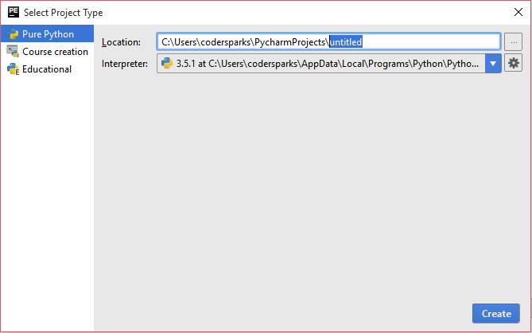
Activity
In pycharm edu, click File->New Project
Select Pure Python and replace “untitled” with “sandbox”
Click on create

Slide 30
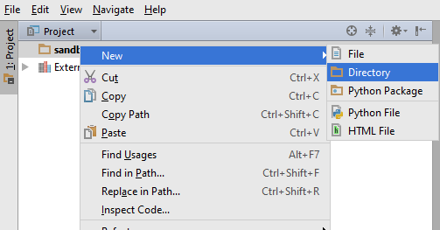
Activity
Right click on “Sandbox” and click
New → Directory
Enter “Temperatures” as name

Slide 31
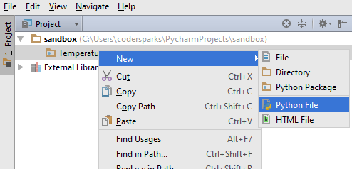
Activity
Right click on “Temperatures” and select
New → Python File
Enter “temperatures” as the file name

Slide 32
Activity
Copy the contents of the temperatures.py file to this new file.
The contents of this file contain a list of temperatures recorded in three different locations.
The format of each entry in the list is:
timestamp,chicken_temp,barn_temp,greenhouse_temp
Complete the activities listed at the end of the file (i.e. add code to the file to complete the activities)

Slide 33
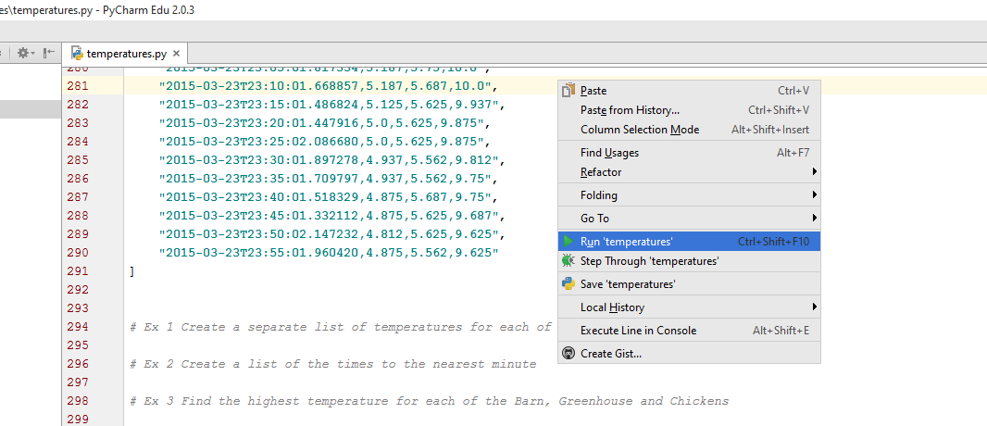
Activity
To run your python script:
Right-click anywhere within your file and select:
Run “temperatures”

