Slide 1
Network Analysis of COVID-19 Vaccine Misinformation on Social Media”
^{a, b} Chad A. Melton, ^{b} Olufunto A. Olusanya, ^{a, b} Arash Shaban-Nejad
ª Bredesen Center for Interdisciplinary Research and Graduate Education, University of Tennessee, Knoxville, TN, United States
^{b} University of Tennessee Health Science Center-Oak-Ridge National Laboratory (UTHSC-ORNL) Center for Biomedical Informatics, Department of Pediatrics, College of Medicine, Memphis, TN, United States

Slide 2
Introduction
The COVID-19 pandemic fueled the most rapid vaccine development and distribution in history.
The spread of misinformation plays a significant role in vaccine hesitancy, low vaccination rates →leading to morbidities and untimely deaths.
Network analysis of text data from social media can be used as an inexpensive and quick public health surveillance tool.
Inform public health officials to develop appropriate public health messaging, digital interventions, and public health policies.

Slide 3
Data and Methods
r/NoNewNormal 5,106 posts displayed by 3,770 unique authors within the Reddit community from November 23, 2020, to July 27, 2021.
Degree, Eigenvector, and Betweenness centrality.
Big Graphs = Hairballs (14289 nodes, 466918 edges)
Reduced by weight to ~160 nodes for clarity.

Slide 4
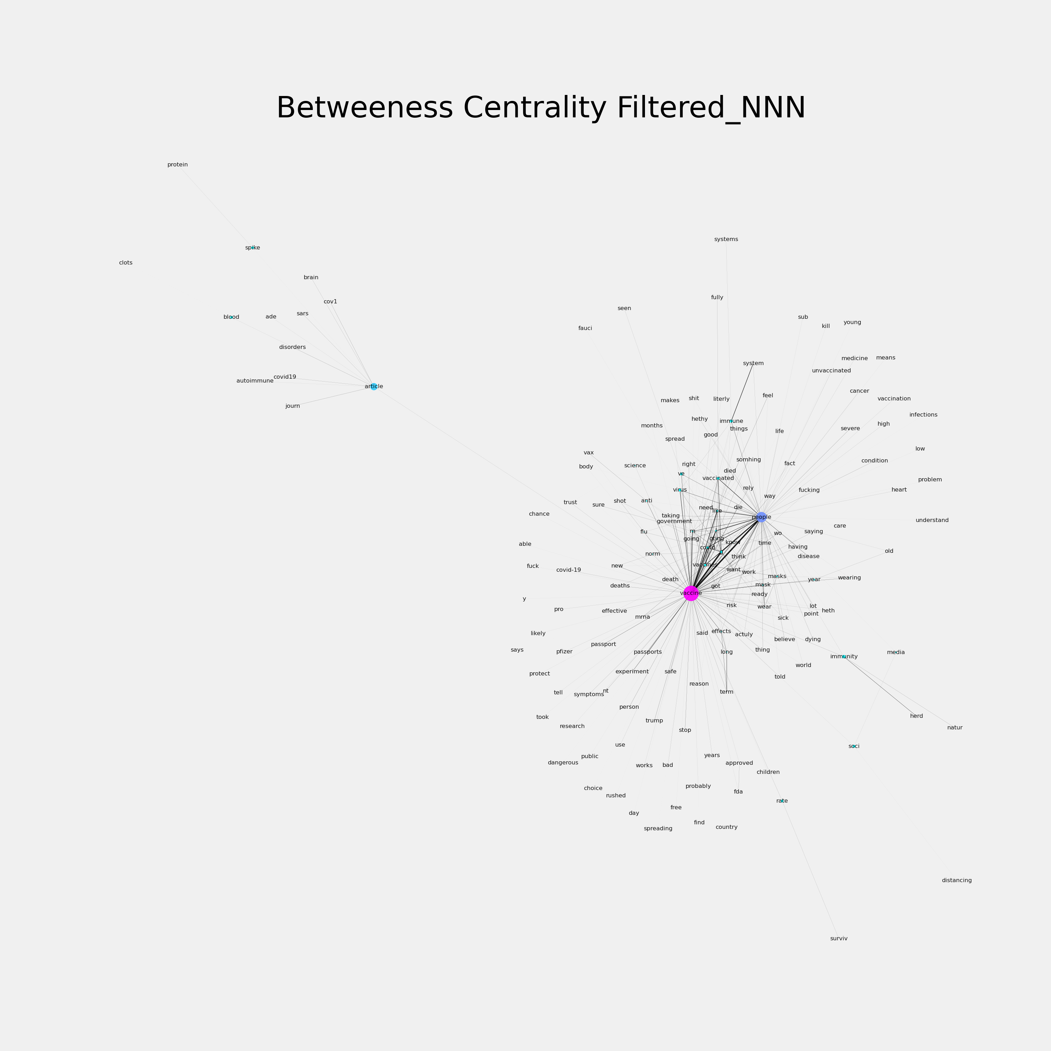
Results
Vaccine→people
→death
Vaccine → rushed

Slide 5
Data availability
r/NoNewNormal banned.
Many accounts of covid denial and brigading.
Data are not available from Reddit.
Please contact me if you’re interested in the raw data.
chadmeltone@gmail.com

Slide 6
Ongoing work…
Network evolution and diffusion in a collaboration with UTHSC, Korea University, and the Sanger Institute.
300k comments and posts from 12 Reddit communities ~ 5 million users.
Month to month analysis from Jan 1, 2020 to Nov 1, 2021.

Slide 7
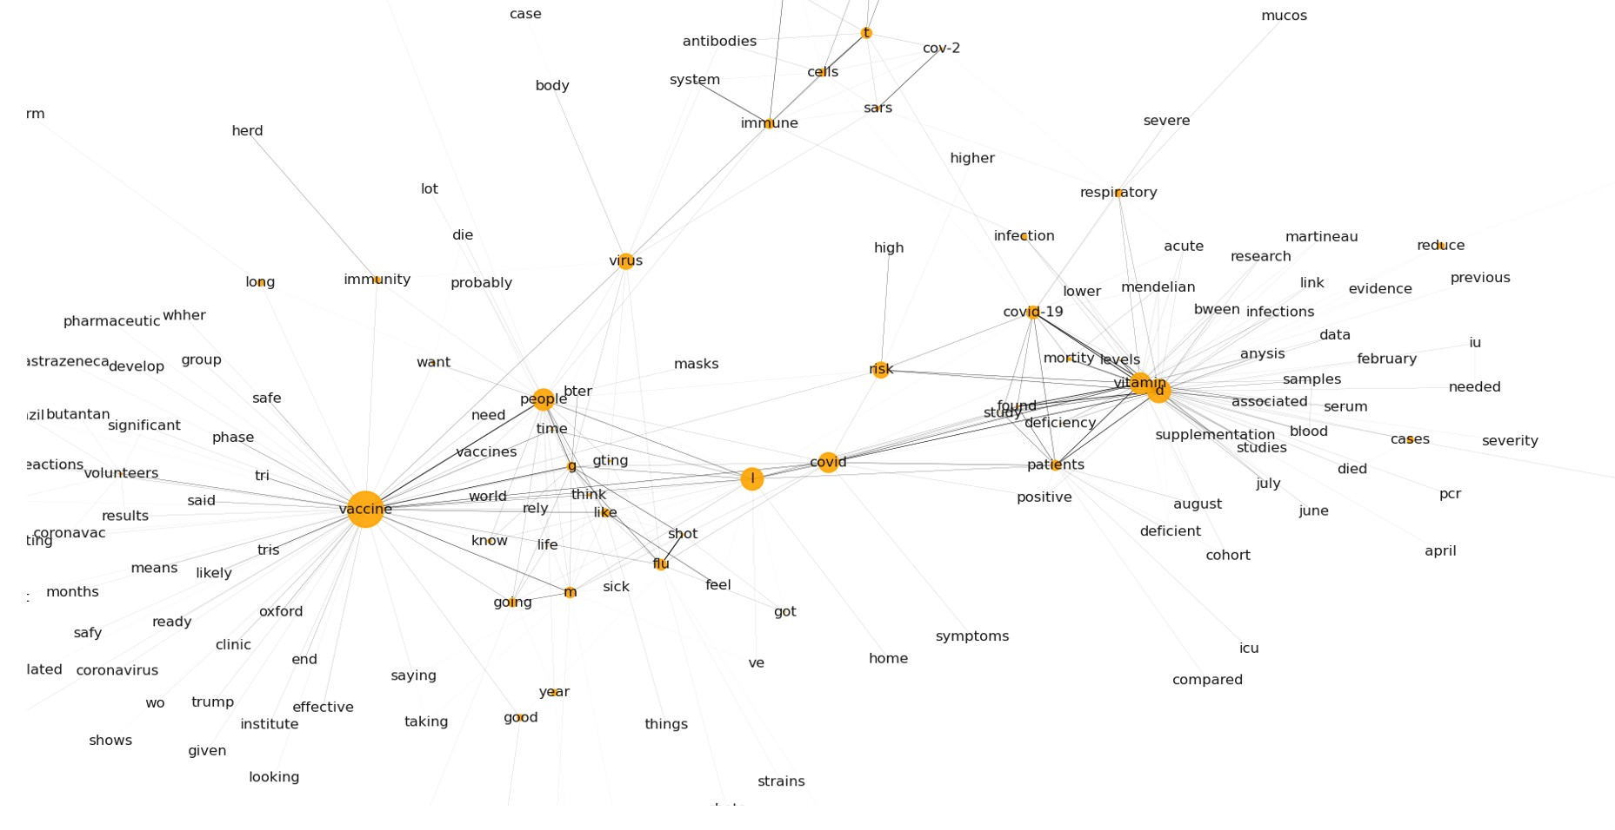
Betweenness Centrality September 2020

Slide 8
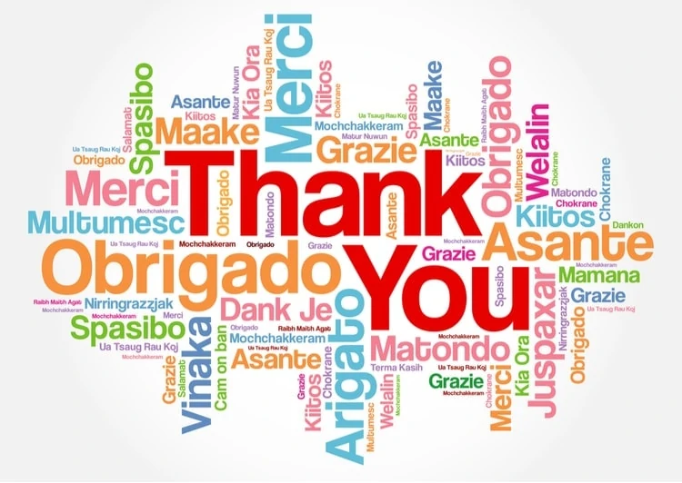
Questions?

Slide 9
Betweenness centrality measures the number of times a node lies on the shortest path between other nodes. (i.e., nodes bridge a network together. Ideal for communication networks).
Eigenvector centrality measures node influence based on quantity of connections to other nodes (ideal for social networks) .
Degree centrality is determined by number of links held by each node (how many connections… frequency of connections for nodes).

