Slide 1
Computational training
Session 7
Data analysis and visualisation in R
05/11/2025
Dr Irina Chelysheva, Senior Lecturer in Human Genomics
(acknowledgements: Dr Srinivasa Rao)

Slide 2
Today’s plan
Data exploration
  Intro to Tidyverse
  Dplyr verbs – mutate, select, filter, summarise, arrange
  Group and summarise data
  Reshape data
  Practical
    Covid data
    Wet-lab Covid-vaccine data

Slide 3
A typical workflow
col1
col2
col3
col1
col2
col3
col1
col3
new_col
col1
col3
col1
col3
1
2
3
1
2
3
1
2
1
1.9
1
1.9
1
1.9
1
2
1
2
3
2
2.1
2
2.1
2
2.1
1
2.1
1
2.1
21
3
2.4
3
2.4
3
2.4
2
2.4
2
2.4
24
Add new column
Select columns
df1
Sort
Filter
This can be achieved by using:
Base R – just the functions that come pre-installed in R
External packages – to make the analysis faster, more readable, more intuitive, etc.
  The data.table package – speed, conciseness
  The dplyr package (Tidyverse) – readability, beginner-friendly
  Other packages are available, but more help available online for the popular ones

Slide 4
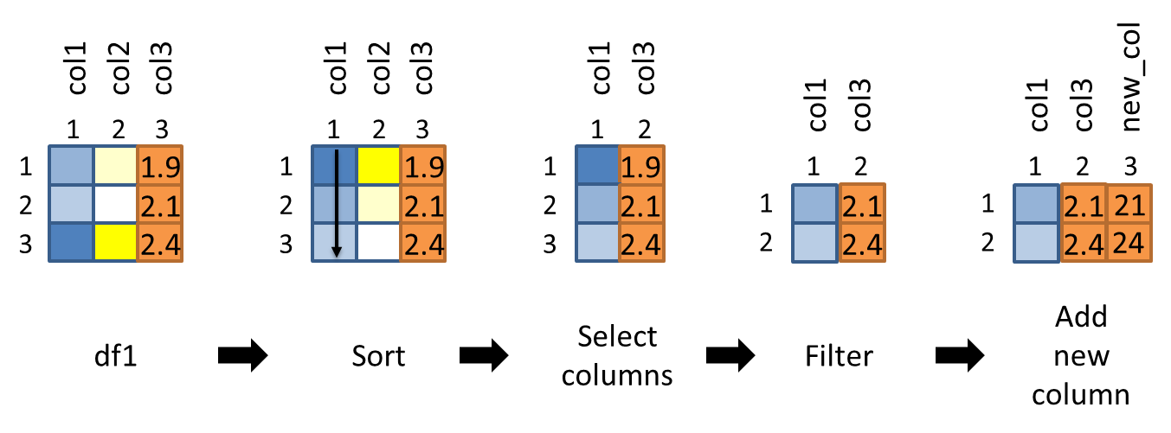
A typical workflow – base R
df1_sorted = df1[order(df1$col1), ]
df1_sel_vars = df1_sorted[, c(“col1”, “col3”)]
df1_filtered = df1_sel_vars[df1_sel_vars$col3 > 2.0, ]
df1_filtered$new_col = df1_filtered$col3 * 10
df1_sort_sel_filtered = df1[order(df1$col1), ][df1$col3 > 2.0, c(“col1”, “col3”)]
df1_sort_sel_filtered$new_col = df1_sort_sel_filtered$col3 * 10

Slide 5
A typical workflow – dplyr
df1 %>%
arrange(col1) %>%
select(col1, col3) %>%
filter(col3 > 2.0) %>%
mutate(new_col = col3 * 10) -> df_sort_sel_filtered
* Use spacing and indentation effectively to make your code readable

Slide 6
Dplyr is part of the ‘Tidyverse’
Tabular data structures - one observation per row, one variable per column
Simple functions that do one thing (filter, mutate, arrange, etc.)
Use the ‘pipe’ %>% to chain functions – imagine a flow of data from left to right
The Tidyverse package is a ‘meta-package’ consisting of
  dplyr – data manipulation
  ggplot2 – plotting (‘Grammar of Graphics’)
  tidyr – functions to create ‘tidy data’
  readr – reading and writing several file formats
  purrr – expanded set of loop functions
  tibble – tidy data.frames
  stringr – handling strings (joining, searching, splitting, etc.)
  forcats – handling categorical data (factors)

Slide 7
Arrange
OR
df1_sorted = arrange(df1, col1)
arrange(df1, col1) -> df1_sorted
OR
df1 %>%
arrange(col1) -> df1_sorted
df1_sorted = arrange(df1, col1, col2)
OR
df1 %>%
arrange(col1, col2) -> df1_sorted

Slide 8
Select columns
df1_selected = select(df1, col1, col3)
OR
df1 %>%
select(col1, col3) -> df1_selected
df1_selected = select(df1, -col2)
OR
df1 %>%
select(-col2) -> df1_selected

Slide 9
Filter
df1 %>%
filter(col3 > 2.0) -> df1_filtered
df1 %>%
filter(col2 < 100 & col3 > 2.0) -> df1_filtered
df1 %>%
filter(col2 < 100 | col3 > 2.0) -> df1_filtered

Slide 10
Mutate
df1 %>%
mutate(new_col = col3 * 2.0) -> df1_mutated
df1 %>%
mutate(new_col = col3 * 2.0) %>%
mutate(col4 = new_col/col3) -> df1_mutated
df1 %>%
mutate(new_col = col3 * 2.0, col4 = new_col/col3) -> df1_mutated

Slide 11
Base R vs Dplyr syntax
  Column names in quotations in base R, but not in Dplyr
df1[, “col1”] # base R syntax
select(df1, col1) # dplyr syntax
  Dplyr functions always have the data as the first argument
select(df1, col1)
arrange(df1, col1)
mutate(df1, col4 = col1 * 10)
  When the ‘pipe’ %>% is used, the first argument of any function is passed invisibly, so we drop it in the actual function call
df1 %>% arrange(df1, col1) %>% select(<output_from_previous_step>, col1, col3)

Slide 12

Let’s explore practically

Slide 13
Summarise
Reduces multiple values to a single value
One column:
summarise(df1, sum(col1)) or summarise(df1, mean(col2))
Several columns:
summarise(df1, sum(col1), mean(col2), sd(col3))
Assign column names:
df1 %>%
summarise(sum_col1 = sum(col1), mean_col2 = mean(col2), sd_col3 = sd(col3)) -> df1_sum
Note: summarise() can be used separately, but typically used on grouped data created by group_by() - see next slides.

Slide 14
Useful functions for summarisation
Center: mean(), median()
Spread: sd(), IQR()
Range: min(), max(), quantile()
Position: first(), last()
Count: n(), n_distinct()
Logical: any(), all()
...

Slide 15
Group by one or more variables
df1 %>% group_by(col2)
Grouping itself doesn’t change how the data looks!
It means that further operations will always be performed “by group”.
df1 %>%
group_by(col2) %>%
summarise(sum_col4 = sum(col4)) -> df1_grouped
df1 %>%
group_by(col2, col3) %>%
summarise(sum_col4 = sum(col4)) -> df1_grouped
df1 %>%
group_by(new_col2 = toupper(col2)) %>%
summarise(sum_col4 = sum(col4)) -> df1_grouped

Slide 16
Explore it yourself
across() – function that makes it easy to apply the same transformation to multiple columns
df1 %>%
group_by(col2, col3) %>%
summarise(across(c(col1, col4), mean)) -> df1_grouped

Slide 17

Real dataset
DOI: 10.1038/s41591-020-01194-5

Slide 18
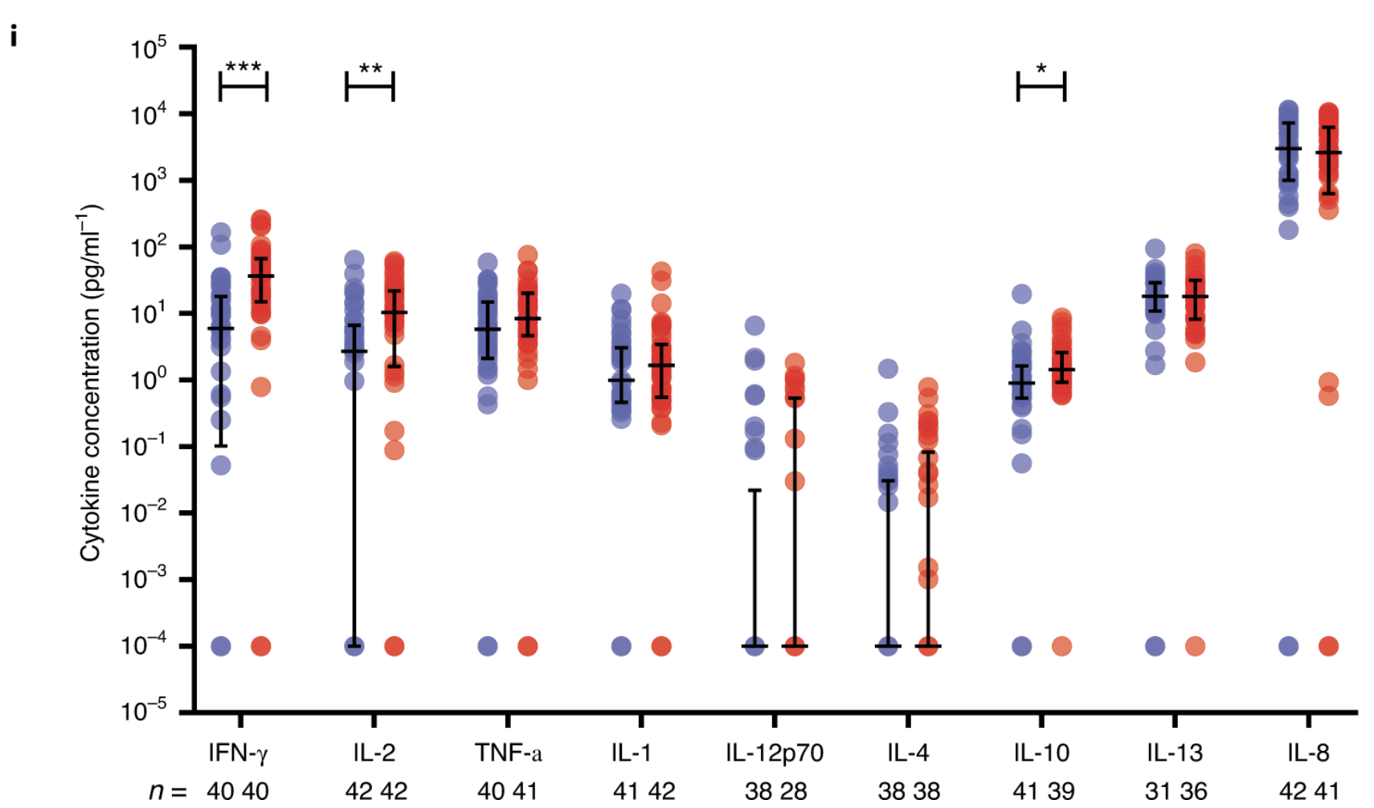
Data to explore - MSD
Fig.1
A multiplex cytokine analysis was performed on day 7 after vaccination using supernatants after antigen-specific stimulation of PBMCs from ChAdOx1 nCov-19 (red) and MenACWY (blue). Number of samples presented: MenACWY–ChAdOx1 nCov-19: IFN-γ (n = 40,40); IL-2 (n = 42,42); TNF-α (n = 40,41); IL-1β (n = 41,42); IL-12p70 (n = 38,28); IL-4 (n = 38,38); IL-10 (n = 41,39); IL-13 (n = 31,36); and IL-8 (n = 42,41). Individual data points are shown here as an aligned dot plot with lines showing the median with IQR. Significant differences were determined by two-tailed Mann–Whitney test with Bonferroni correction for multiple comparisons (***P < 0.001; **P < 0.01; *P < 0.05).

Slide 19
Let’s explore practically

Slide 20
Useful reference
R Programming for Data Science (Roger Peng) – Ch. 3, 4, 5, 9
Swirl – Interactive learning
R for Data Science (Hadley Wickham) – Using Dplyr verbs
The data.table package – Intro
A data.table and Dplyr tour – Side by side comparison of functions
Cheatsheets – quick reference for tasks like data wrangling, visualisation, and several packages

