Slide 1
Introduction to machine learning
in Python
Session 1 · Classification and regression
Irina Chelysheva
20 October 2026
Notes:
ML-only Day 1. Day 2 deep learning is taught separately.

Slide 2
Before we start
Python packages: numpy, pandas, scipy, scikit-learn, matplotlib, seaborn and joblib
Install: python -m pip install -r requirements_day1.txt
Use Spyder, Jupyter or your preferred editor.
Keep the scripts and CSV datasets in the same folder.
Course materials: github.com/Chelysheva/
ML_DL_Intro_Python_Oct2026
Notes:
Updated for 20 October 2026. Reference: https://scikit-learn.org/stable/

Slide 3
Introduction to machine learning
A model learns patterns from example data to predict an outcome for new observations.
Predictors (X) describe the observations.
The target (y) is the outcome we want to predict.
Our aim: useful predictions for unseen observations, with an honest estimate of error.
Today: classification and regression with scikit-learn.
Notes:
Updated for 20 October 2026. Reference: https://scikit-learn.org/stable/

Slide 4
Types of machine learning
Supervised learning
Labelled examples: predictors X and target y.
Classification predicts a category. Regression predicts a number.
Unsupervised learning
No target labels. Methods explore structure, such as clusters.
Semi-supervised learning
A mixture of labelled and unlabelled examples.
Notes:
Updated for 20 October 2026. Reference: https://scikit-learn.org/stable/

Slide 5
Supervised learning: classification
Question: which category does this observation belong to?
Example: benign or malignant breast sample.
A numerical class code still represents a category.
Today’s models
Logistic regression, K-nearest neighbours, decision tree, support vector machine and random forest.
Notes:
Updated for 20 October 2026. Reference: https://scikit-learn.org/stable/

Slide 6
Breast cancer classification dataset
Wisconsin Breast Cancer (Original)
699 observations, nine cell-characteristic predictors.
Predictors include clump thickness, cell size and shape, bare nuclei and mitoses. Sample ID is excluded from X.
Class in our CSV: 0 = benign, 1 = malignant.
16 observations have a missing bare-nuclei value.
645 distinct sample IDs: repeated IDs stay together in both the train/test split and cross-validation.
Notes:
Source: https://archive.ics.uci.edu/dataset/15/breast+cancer+wisconsin+original . CC BY 4.0, William Wolberg. Local CSV preserves the previous script’s mirror and its 0/1 class encoding. Original UCI encoding is 2/4. This is the Original dataset, not the 30-feature Diagnostic dataset.

Slide 7
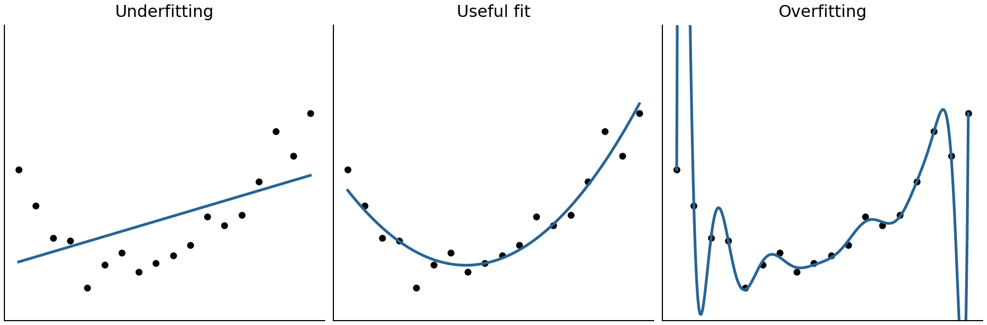
Overfitting and generalisation
An overly flexible model can fit training noise.
Its performance may worsen on unseen observations.
Cross-validation helps compare generalisation.
Regularisation and simpler models can reduce overfitting.
Notes:
Illustrative synthetic observations and polynomial fits, generated for this course. The test set remains untouched during model choice.

Slide 8
Training and test data
Training set: approximately 70%
Use this for fitting, feature selection and model comparison.
Test set: approximately 30%
Keep this aside until the final model has been selected.
Fit preprocessing on training data only.
Apply the fitted transformations to validation and test data.
For repeated patients or sample IDs, keep related observations in the same partition.
Notes:
Updated for 20 October 2026. Reference: https://scikit-learn.org/stable/

Slide 9
Cross-validation within the training set
Keep the test set separate. Rotate the validation fold across the training set.
Round 1
Validate
Train
Train
Train
Train
Test set
Untouched
until final
evaluation
Round 2
Train
Validate
Train
Train
Train
Round 3
Train
Train
Validate
Train
Train
Round 4
Train
Train
Train
Validate
Train
Round 5
Train
Train
Train
Train
Validate
Compare mean validation scores, choose a model, then refit on all training observations.
Notes:
In classification, use StratifiedGroupKFold because sample IDs repeat. In regression, use shuffled KFold. The same folds are reused across candidate models. Five-fold CV balances training time and useful validation in a short course. Source: https://scikit-learn.org/stable/modules/cross_validation.html

Slide 10
Preprocessing belongs inside the pipeline
1. Impute missing values using training-fold medians.
2. Standardise using training-fold means and SDs.
3. Optionally select features using training-fold labels.
4. Fit the estimator on the transformed training fold.
Apply these fitted transformations to the validation fold.
Repeat from scratch for the next fold.
Notes:
Pipeline([("imputer", SimpleImputer()), ("scaler", StandardScaler()), ("selection", SelectKBest()), ("model", estimator)]). The outer train/test split comes first. Save the complete pipeline so new data receive the same transformations. Source: https://scikit-learn.org/stable/common_pitfalls.html

Slide 11
Feature selection
Select a subset of predictors to simplify a model or remove redundant information.
Filter methods: score individual features, for example with ANOVA F-tests or correlation.
Wrapper methods: evaluate feature subsets using a model, for example recursive feature elimination.
Embedded methods: select during model fitting, for example Lasso. Ridge shrinks coefficients but usually retains all features.
Notes:
Updated for 20 October 2026. Reference: https://scikit-learn.org/stable/

Slide 12
Choosing a feature selection method
Filters are fast, but may miss useful combinations of features.
Wrappers can be expensive and can overfit the validation process. Their accuracy is not guaranteed.
Embedded methods depend on the fitted model.
There is no universal feature-count cutoff.
Compare using training cross-validation. Fit selection inside each fold. In the scripts, K_FEATURES="all" keeps every predictor.
Notes:
Updated for 20 October 2026. Reference: https://scikit-learn.org/stable/

Slide 13
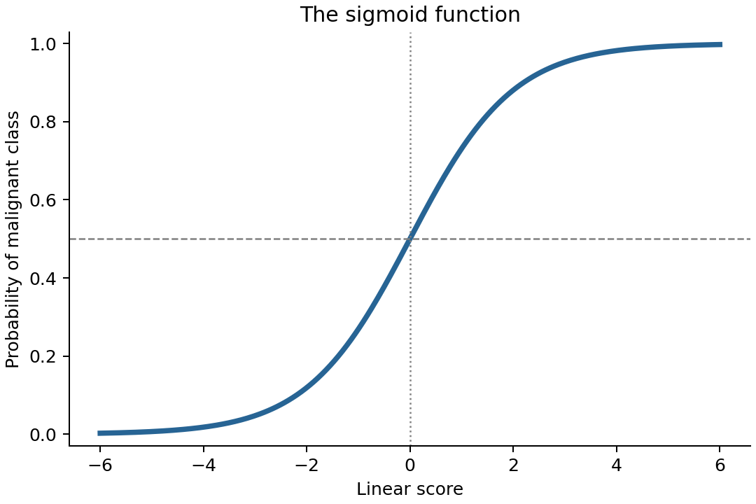
Logistic regression
Models the probability of a class.
A sigmoid maps a linear score to a probability between 0 and 1.
A threshold converts probability into a class prediction.
Notes:
Binary logistic regression. The relationship is linear in the log odds, not necessarily in the raw probability. Default prediction threshold is 0.5 for the binary case. Source: https://scikit-learn.org/stable/modules/linear_model.html#logistic-regression

Slide 14
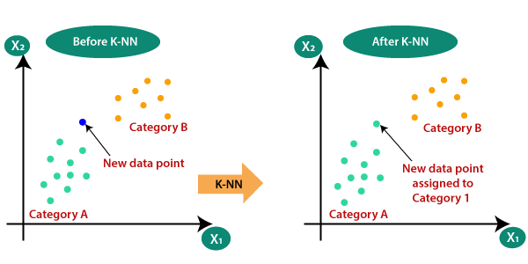
K-nearest neighbours
Find the k closest training observations.
Predict the most common class among those neighbours.
Feature scaling changes which observations are close.
Notes:
Source illustration retained from original deck: https://medium.com/swlh/k-nearest-neighbor-ca2593d7a3c4 . Method: https://scikit-learn.org/stable/modules/neighbors.html

Slide 15
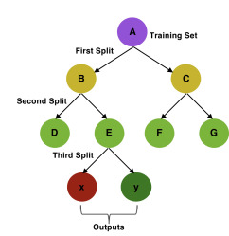
Decision tree
Split observations using a sequence of feature thresholds.
Each leaf predicts a class.
A deep tree can fit training noise. Tree depth controls complexity.
doi.org/10.1016/j.wnsx.2019.100012
Notes:
scikit-learn decision trees require categorical predictors to be encoded numerically. Source: https://scikit-learn.org/stable/modules/tree.html . Original illustration: https://doi.org/10.1016/j.wnsx.2019.100012

Slide 16
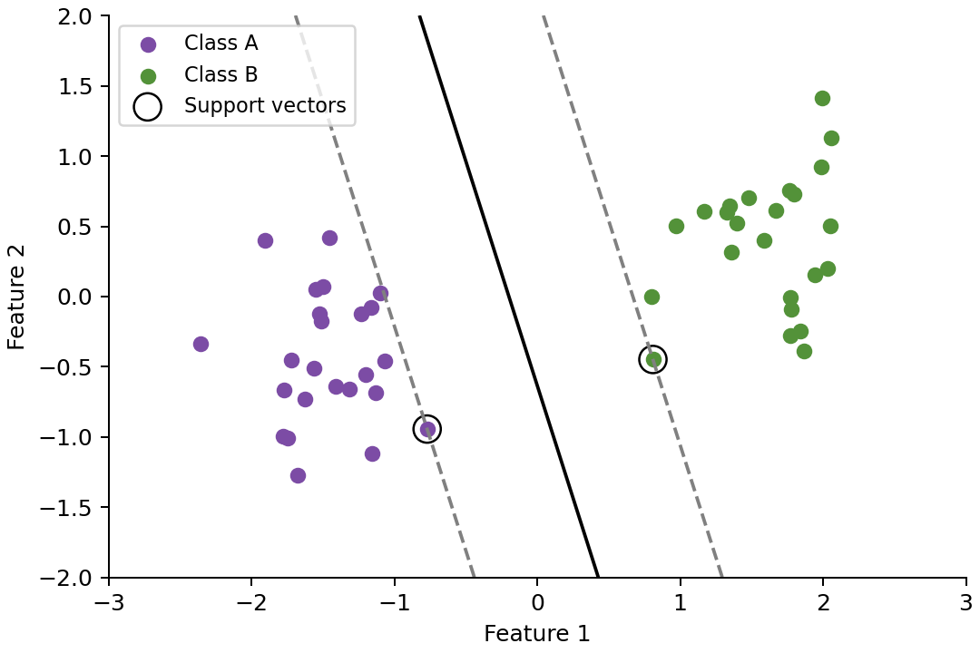
Support vector machine
A linear SVM separates classes with a large margin.
Kernels allow curved boundaries. Our script uses the RBF kernel.
C controls regularisation. RBF gamma controls how far each observation influences the boundary.
Notes:
The illustration shows a linear SVM with support vectors circled. The practical uses RBF SVC with scaled features. gamma is not a probability-estimation parameter. Source: https://scikit-learn.org/stable/modules/svm.html

Slide 17
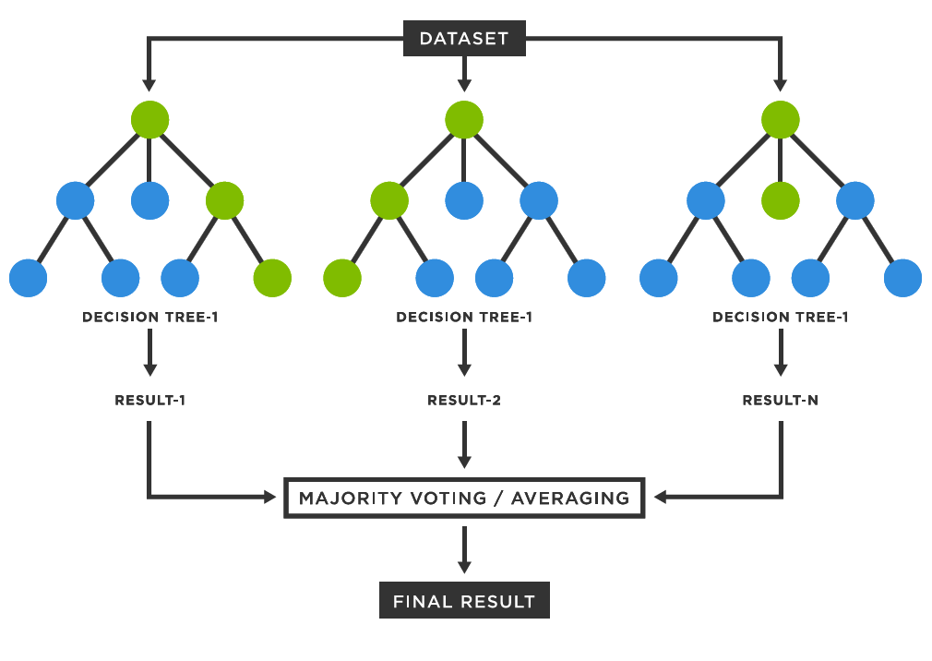
Random forest
Fit many trees using bootstrap samples and random feature subsets.
Combine tree probabilities for classification, or average predictions for regression.
Often more stable than one tree, but can still overfit.
Notes:
Illustration retained from original course deck. scikit-learn RandomForestClassifier averages tree class probabilities, rather than taking a hard majority vote. Source: https://scikit-learn.org/stable/modules/ensemble.html#forest

Slide 18
Evaluating classification
Accuracy: proportion of all observations classified correctly.
Sensitivity: proportion of malignant samples detected.
Specificity: proportion of benign samples correctly excluded.
ROC AUC: how well scores rank malignant above benign samples across classification thresholds.
Inspect the confusion matrix and class balance.
A high accuracy can hide missed malignant samples.
Notes:
Positive class is malignant (1). Sensitivity=TP/(TP+FN), specificity=TN/(TN+FP). Balanced accuracy is their mean for this binary task. Accuracy and sensitivity depend on the prediction threshold; ROC AUC evaluates ranking over thresholds. Source: https://scikit-learn.org/stable/modules/model_evaluation.html

Slide 19
Classification practical: workflow
1. Explore the data and split by sample ID.
2. Compare complete pipelines using five-fold CV.
Include a simple baseline that predicts the majority class.
3. Select the model with the highest mean CV ROC AUC, then refit it on all training observations.
4. Evaluate on the test set and save the whole pipeline.
Inspect errors and predictive feature importance.
Notes:
Updated for 20 October 2026. Reference: https://scikit-learn.org/stable/

Slide 20
Classification practical
Open ML_Python_day1_classification.py
Run the numbered sections and inspect the outputs.
Questions
Does every model beat the baseline?
Which errors are false negatives?
Notes:
Allow approximately 55–60 minutes. Optional feature-selection exercise can be done at home.

Slide 21
Supervised learning: regression
Question: how much, or how many?
The target is a numerical quantity.
Today: a disease-progression score at one year.
Compare linear regression and regularised linear models with KNN, a decision tree, SVR and random forest.
Notes:
Updated for 20 October 2026. Reference: https://scikit-learn.org/stable/

Slide 22
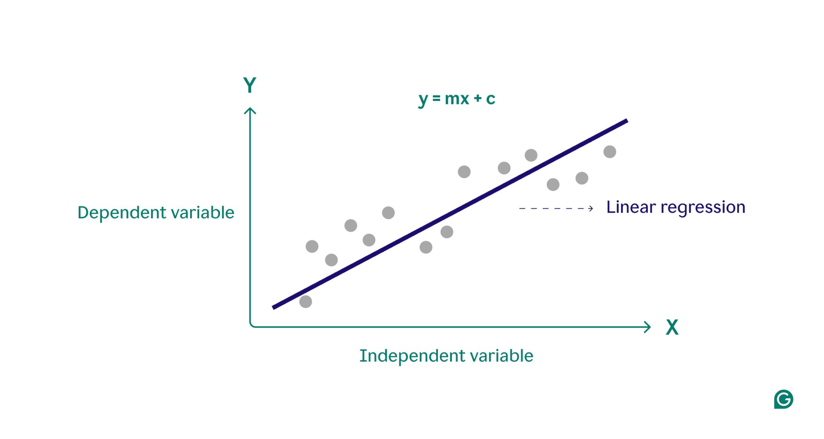
Linear regression
Predict a numerical outcome using a weighted sum of the input features.
Coefficients describe associations conditional on the other predictors.
A useful starting point and benchmark.
Notes:
Illustration retained from original deck. Predictive coefficients do not establish causality. Source: https://scikit-learn.org/stable/modules/linear_model.html#ordinary-least-squares

Slide 23
Regularised linear models
Ridge (L2)
Shrinks coefficients. Useful when predictors are correlated.
Lasso (L1)
Can set some coefficients to zero, producing a smaller model.
Elastic Net
Combines L1 and L2 penalties.
Scale predictors first. Alpha controls penalty strength.
Choose settings using training cross-validation.
Notes:
Updated for 20 October 2026. Reference: https://scikit-learn.org/stable/

Slide 24
Other regression models
KNN: average outcomes among nearby observations.
Decision tree: split the data into regions and predict a value in each leaf.
SVR: fit a function with a tolerance around the predictions. Kernels can model nonlinear patterns.
Random forest: average predictions from many trees.
Notes:
Updated for 20 October 2026. Reference: https://scikit-learn.org/stable/

Slide 25
Diabetes progression dataset
442 patients with diabetes, ten baseline predictors.
One observation per patient.
Predictors: age, sex, BMI, blood pressure and six serum measurements.
Target: quantitative disease-progression score one year after baseline. This is not HbA1c or a risk percentage.
Local CSV: diabetes_regression.csv
Exported from scikit-learn with scaled=False.
Notes:
Dataset documentation: https://scikit-learn.org/stable/datasets/toy_dataset.html#diabetes-dataset and https://scikit-learn.org/stable/modules/generated/sklearn.datasets.load_diabetes.html . Source: https://www4.stat.ncsu.edu/~boos/var.select/diabetes.html . Efron et al. (2004), Least Angle Regression. Historical benchmark for teaching, not clinical deployment.

Slide 26
Understanding the diabetes predictors
age, sex
Age and a coded sex variable
bmi, bp
Body mass index and average blood pressure
s1, s2
Total serum cholesterol and LDL
s3, s4
HDL and total-cholesterol / HDL ratio
s5, s6
Source triglyceride-related measure and blood sugar
Use the source definitions in DATASETS.md.
Do not infer clinical thresholds from this teaching dataset.
Notes:
Source: https://scikit-learn.org/stable/modules/generated/sklearn.datasets.load_diabetes.html . The documentation cautions that feature meanings, especially s5 (ltg), are not fully explicit in the original source. s5 is often described as log serum triglycerides. sex retains numeric source codes without inferring coding semantics. scaled=False returns source-scale predictors.

Slide 27
Evaluating regression
MAE: average absolute prediction error.
Easy to interpret in the target’s units.
RMSE: gives greater weight to large prediction errors.
Lower MAE and RMSE are better.
R²: 1 is perfect; values can be negative.
It is a score, not a percentage of correct predictions.
Compare with the training-mean baseline.
Inspect observed vs predicted values and residuals.
Notes:
RMSE=sqrt(mean((y-yhat)^2)). MAE=mean(abs(y-yhat)). R²=1-SSE/SST; zero corresponds to the constant mean of the evaluated targets. A deployable dummy model predicts the training mean, which may differ from the test mean, so its test R² need not equal zero. Source: https://scikit-learn.org/stable/modules/model_evaluation.html#regression-metrics

Slide 28
Regression practical: workflow
1. Split patients into training and test sets.
Explore training correlations without selecting on the test set.
2. Compare scaled pipelines with five-fold CV.
Include a baseline that predicts the training mean.
3. Select the model with the lowest mean CV RMSE.
Refit on all training patients.
4. Evaluate RMSE, MAE and R² on the test set.
Inspect predictions, residuals and feature importance.
Notes:
Updated for 20 October 2026. Reference: https://scikit-learn.org/stable/

Slide 29
Regression practical
Open ML_Python_day1_regression.py
Run the numbered sections and inspect the outputs.
Questions
Does the model beat the mean-prediction baseline?
Are predictions worse at the extremes?
Does the most complex model perform best?
Notes:
Allow approximately 40–45 minutes. Optional exercises: vary alpha or select five predictors using training CV.

Slide 30
What to take away
Define the prediction question, observation and target.
Keep related observations together and fit preprocessing inside training folds.
Compare with a baseline using training cross-validation.
Evaluate the selected pipeline on held-out data.
Feature importance describes predictive behaviour.
It does not establish a biological or clinical cause.
Notes:
Final discussion: how would the validation design change for repeated samples, multiple hospitals or future time points? Repeated tuning after viewing the test results makes those results exploratory.

Slide 31
Backup: feature selection and regularisation
Optional material for questions and further study.
The main practicals keep all features by default.
Try a smaller subset using training cross-validation.
Notes:
Updated for 20 October 2026. Reference: https://scikit-learn.org/stable/

Slide 32
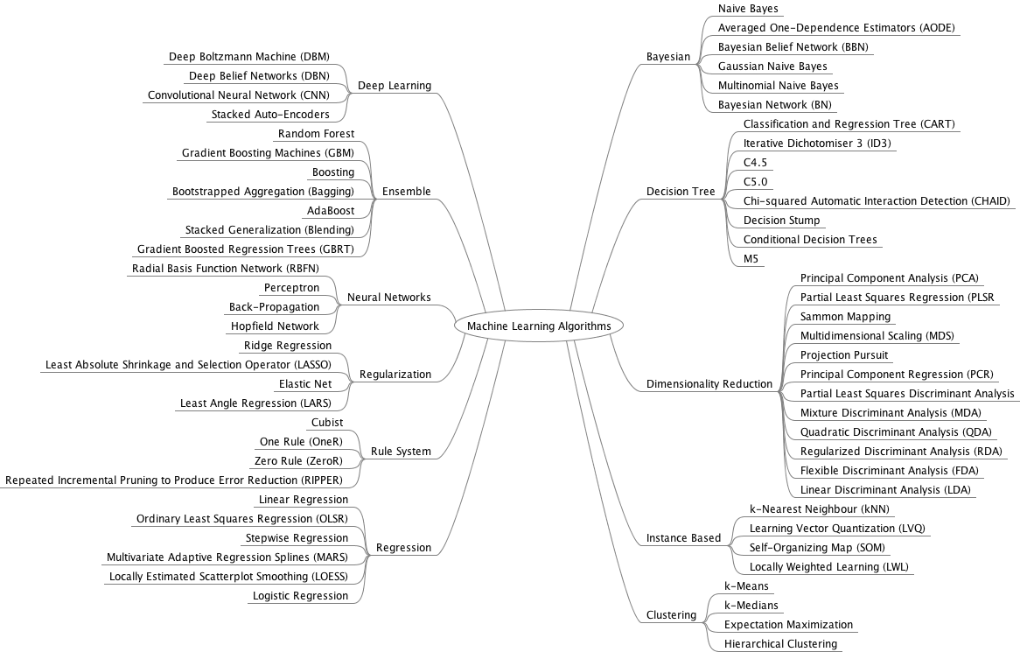
Overview of ML algorithms
Reference map: machinelearningmastery.com
Notes:
Optional reference only. Retained illustration from original deck: https://machinelearningmastery.com . Do not attempt to teach every algorithm here.

Slide 33
Classification and regression
Classification predicts a category.
Example: benign or malignant.
Regression predicts a numerical outcome.
Example: progression score at one year.
Both need suitable validation, a simple baseline and an independent assessment on held-out observations.
Notes:
Updated for 20 October 2026. Reference: https://scikit-learn.org/stable/

Slide 34
Filter methods
Score predictors without repeatedly fitting the final model.
Regression example: correlation or an F-test.
Classification example: ANOVA F-test.
Fast, but univariate scores can miss interactions or select several correlated predictors.
In the scripts: SelectKBest inside the pipeline.
Use k="all" first, then compare a smaller k using CV.
Notes:
Updated for 20 October 2026. Reference: https://scikit-learn.org/stable/

Slide 35
Wrapper methods
Evaluate feature subsets using a predictive model.
The search repeatedly fits models, making it more computationally expensive than a simple filter.
Performance depends on the model and validation design. More searching can overfit validation results.
Feature selection must be repeated within each training fold. It must not see the test set.
Notes:
Updated for 20 October 2026. Reference: https://scikit-learn.org/stable/

Slide 36
Examples of wrapper methods
Forward selection
Start with no predictors and add them according to a scoring criterion.
Backward selection
Start with all predictors and remove them according to a scoring criterion.
Recursive feature elimination (RFE)
Fit an estimator, remove the least important predictors and repeat until the chosen subset size is reached.
Notes:
Updated for 20 October 2026. Reference: https://scikit-learn.org/stable/

Slide 37
Embedded methods
Selection occurs as part of fitting a model.
Lasso and Elastic Net can produce zero coefficients.
The selected subset depends on penalty strength.
Ridge usually shrinks coefficients without making them exactly zero, so it is not normally a feature selector.
Tree importance can support a separate selection step.
An importance ranking alone does not remove predictors.
Notes:
Updated for 20 October 2026. Reference: https://scikit-learn.org/stable/

Slide 38
L1 and L2 regularisation
L1 penalty: sum of absolute coefficient values.
Can set some coefficients to zero.
L2 penalty: sum of squared coefficient values.
Shrinks coefficients and can stabilise correlated predictors.
Elastic Net combines the two penalties.
Penalty strength is a model setting. Standardise predictors and compare settings using training CV.
Notes:
Updated for 20 October 2026. Reference: https://scikit-learn.org/stable/

Slide 39
Further practice and reading
scikit-learn user guide
scikit-learn.org/stable/user_guide.html
Common pitfalls: preprocessing and data leakage
scikit-learn.org/stable/common_pitfalls.html
Hands-On Machine Learning with Scikit-Learn, Keras, and TensorFlow — Aurélien Géron
Dataset references and column definitions
See DATASETS.md in the course repository.
Notes:
Updated for 20 October 2026. Reference: https://scikit-learn.org/stable/

