Slide 1
Welcome to
Intro to R for Biologists We’ll start at 9:30am, please ask if you have any issues with installation of R and RStudio
Irina & Bea
Hilary 2025

Slide 2
Intro to R for Biologists Session 1 R basics
Irina & Bea
Hilary 2025

Slide 3
GitHub account (optional)
GitHub repository
https://github.com/Chelysheva/MSD_R_course_HT2025/tree/main
Screen sharing

Slide 4
Intro to R for biologists
Basic concepts
Your R environment
Getting help
Assignment to variables
Data types
Loading data
Subsetting data
Filtering
Logical operators

Slide 5
Why not Excel or GraphPad Prism?
Why not Python?
Why R?

Slide 6
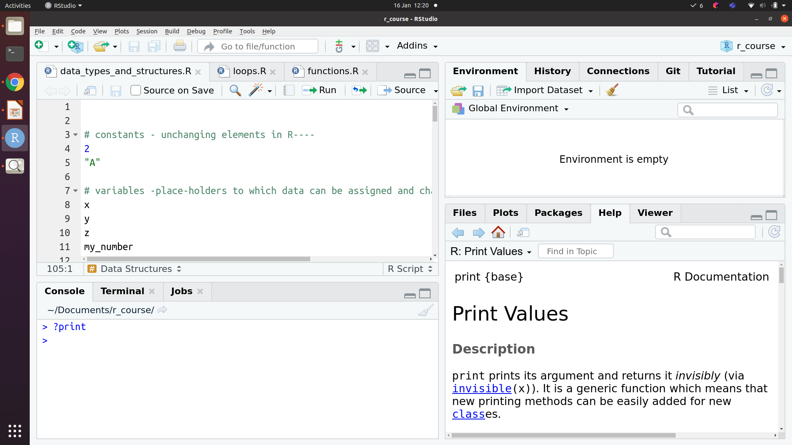




Your R (Rstudio) environment
Script
Environment / History
Help / Plots /
Files
Console
Script
Console
Help/Plots/Files
Environment/History

Slide 7
Constants vs. variables
Constants vs variables
Some constants are built-in
Pi, LETTERS
Variables are placeholders
(created by users)
x = 10, y = 20; x + y = 30

Slide 8
Assignment of data to variables
The ‘arrow’: x <- 2
Equals sign: x = 2

Slide 9
Data types in R
Character
“a”, “apple”
Numeric
1, 23, 3.14
Logical
TRUE, FALSE (also 1, 0 or T, F)
Factor
For categorical variables, when data is classified into groups
Quotations
‘’ “” – denote character or string data

Slide 10
Conversion (and coercion)
as.character()
Numeric, logical and factor types can be converted to character
as.numeric()
Logical, and character variables that are purely numbers can be converted to numeric
as.logical()
“FALSE” or 0 is converted to FALSE, “TRUE” or any non-zero number is converted to TRUE
as.factor()
Any other data type can be converted to a factor
Warnings
Silent effects
Warning message:
NAs introduced by coercion
> as.numeric(as.character(14))
[1] 14
> as.numeric(as.factor(14))
[1] 1

Slide 11
How to get help
? and ??
Google!
help()

Slide 12
Data Structures: atomic vector
atomic vector
All elements are of the same type
1
2
3
4
1
2
3
4
1
2
3
4
atomic vector
“a”
“a”
“c”
“f”
1
2
1
4
T
F
T
T
gene_names = c("TP53", "PTEN", "RB1", "MYC")
c - Combine Values into a Vector or List

Slide 13
Subsetting R objects: vector
[ ] – To get a subset of elements
[[ ]] or $ – To get a specific column of a data.frame
1
2
3
4
2
My_av
“a”
“a”
“c”
“f”
My_av[2]
“a”

Slide 14

Let’s explore practically

Slide 15

Reading data into R
Base functions:
read.table(file, header = FALSE, sep = "", quote = "\"'", dec = ".", numerals = c("allow.loss", "warn.loss", "no.loss"), row.names, col.names, as.is = !stringsAsFactors, na.strings = "NA", colClasses = NA, nrows = -1, skip = 0, …)
read.csv(file, header = TRUE, sep = ",", quote = "\"", dec = ".", fill = TRUE, comment.char = "", …)
read.delim(file, header = TRUE, sep = "\t", quote = "\"", dec = ".", fill = TRUE, comment.char = "", …)

Slide 16

Reading data into R
xls, xlsx files
install.packages("readxl") - install the package
library(readxl) - load the package
Other package: openxlsx
read_excel(path, sheet = NULL, range = NULL, col_names = TRUE, col_types = NULL, na = "", trim_ws = TRUE, ...)
read_xls(path, sheet = NULL, range = NULL, col_names = TRUE, col_types = NULL, na = "", trim_ws = TRUE, ...)
read_xlsx(path, sheet = NULL, range = NULL, col_names = TRUE, col_types = NULL, na = "", trim_ws = TRUE, ...)
https://www.rdocumentation.org
More examples (over 21 000 packages)

Slide 17
Managing working directory
The working directory is a file path on your computer that sets the default location of any files you read into R, or save out of R.
getwd() - returns the current working directory
setwd("path/to/your_new_wd") - changes the working directory
list.files() - displays the list of all the files in wd
Note: getwd() function has no arguments!

Slide 18
Data Structures: data.frame
data.frame
Data organised into rows and columns; elements of each column are of the same type, but different columns can be of different types
1
2
3
4
1
data.frame
2
3

Slide 19
Subsetting R objects: data.frame
Column names
Gene_name
Alt_name
Gene_count
Gene_id
Row
names
1
2
3
4
S1
1
My_df[3, ]
My_df
S2
2
My_df[“S3”, ]
S3
3
My_df[ , 3]
My_df[ , “Gene_count”]
My_df$Gene_count
My_df[[“Gene_count”]]

Slide 20
Adding rows or columns to a data.frame
df1
vec1
1
2
3
1
2
3
1
2
3
1
1
1
df1
2
2
2
3
3
3
4
cbind(df1,vec1)
vec1
rbind(df1,vec1)
1
2
3
4
1
2
3

Slide 21
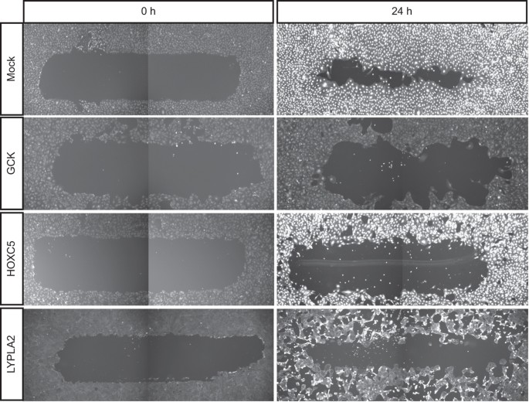

Migration and morphology data
Table 1: Migration data
col1: reagent_id
col2: gene_symbol
col3: migration
Table 2: Morphology data
col1: reagent_id
col2: gene_symbol
col3: elongatedness

Slide 22
Merging data.frames
gene_symbol
gene_symbol
reagent_id
elongatedness
migration
reagent_id
1
2
3
1
2
3
1
1
df1
2
2
df2
3
3
gene_symbol
reagent_id
elongatedness
migration
merge(df1, df2, by = c(“reagent_id”, “gene_symbol”))

Slide 23
Let’s explore practically

Slide 24

Write files from R
Base functions:
write.table(my_data, file = “my_data.txt”, append = FALSE, sep = " ", dec = ".", row.names = TRUE, col.names = TRUE)
Set separator to sep = “\t” to get tab separated txt file
write.csv(my_data, file = "my_data.csv") - comma-separated csv files

Slide 25
Data exploration and cleaning
Look at the data
head(), tail(), class(), str(), View()
Are the data types correct? If not, convert to appropriate type
as.numeric(), as.character(), as.logical()
Is there any missing data? NA or NaN are missing data
na.omit(), complete.cases()
Is there unnecessary data? Rows or columns you don’t need?
Subset the data
Filter the data
Visualise the data with graphs

Slide 26
Filtering a data.frame
Keep/remove data that satisfies one or more conditions
> # Puromycin is a built-in data.frame that is pre-loaded in R
> head(Puromycin)
conc rate state
1 0.02 76 treated
2 0.02 47 treated
3 0.06 97 treated
4 0.06 107 treated
5 0.11 123 treated
6 0.11 139 treated
> Puromycin$conc < 0.03
[1] TRUE TRUE FALSE FALSE FALSE FALSE FALSE FALSE FALSE FALSE FALSE
[12] FALSE TRUE TRUE FALSE FALSE FALSE FALSE FALSE FALSE FALSE FALSE
[23] FALSE
> Puromycin[Puromycin$conc< 0.03, ]
conc rate state
1 0.02 76 treated
2 0.02 47 treated
13 0.02 67 untreated
14 0.02 51 untreated
For more than one condition, we need to use logical operators
& (AND)
| (OR)

Slide 27
Comparisons
Comparison between two objects returns TRUE or FALSE or NA
== (Note the difference between this and = for assignment)
<
>
<=
>=
!= (Negation of anything in R is done with !)
%in%

Slide 28
Logical operators (Boolean operations)
TRUE & TRUE # evaluates to TRUE
TRUE & FALSE # evaluates to FALSE
FALSE & FALSE # evaluates to FALSE
TRUE | FALSE # evaluates to TRUE
!TRUE # evaluates to FALSE
> my_vec = c(1, 2, 3, 4, 5, 6)
> my_vec < 4 & my_vec > 2
FALSE FALSE TRUE FALSE FALSE FALSE
> my_vec[my_vec < 4 & my_vec > 2]
3

Slide 29
Let’s explore practically

