Slide 1

Data visualisation with ggplot2
Irina & Rao
10.06.2025

Slide 2
Today’s plan
Data Visualisation
Intro to ggplot2
Base R plotting vs ggplot2
ggplot2 syntax
Intro to factors
Reshaping data.frames
Plotting grouped data - Dot/box/bar plots
Calculating and adding statistics to the plots
Practicals
OWID Covid data
Covid vaccine data
GitHub repository: https://github.com/Chelysheva/data_vis_ggplot2_June2025

Slide 3
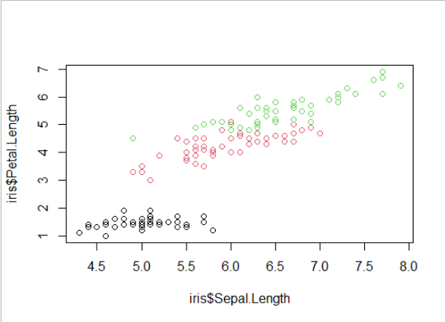
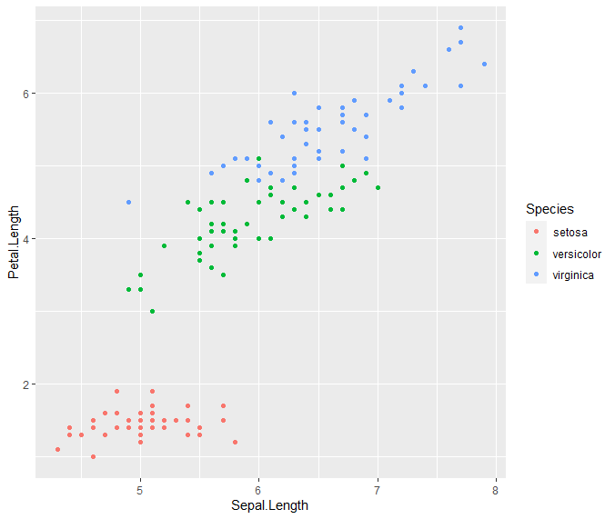
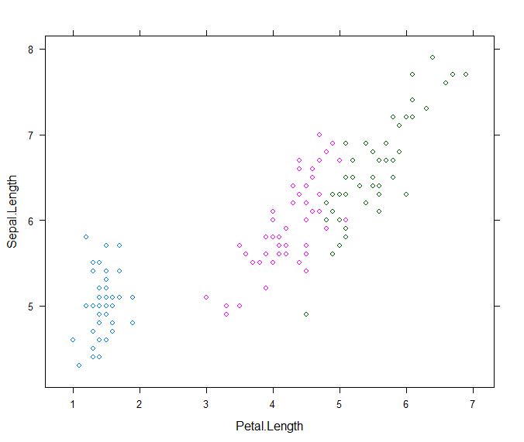
Visualising data in R
Base R plotting (e.g. plot() function)
plot(x = iris$Sepal.Length, y = iris$Petal.Length, col = iris$Species)
ggplot2 package
ggplot(iris, aes(x = Sepal.Length, y = Petal.Length, colour = Species)) + geom_point()
Lattice package
xyplot(Sepal.Length ~ Petal.Length, data = iris, groups = Species)
Grid package
Low level plotting (both ggplot2 and lattice built on grid graphics)

Slide 4
Graphics devices in R
The plotting window in Rstudio
Needs to be saved manually
Size of the figure can be adjusted manually
Can be copied to clipboard from RStudio
For quick exploratory visualisation
A file (svg, png, pdf, tiff, jpeg, bmp)
Saved to file from code
Size of the figure can be specified in the code
For creating reproducible figures
png(), pdf(), svg(), ggsave() are functions to save plots
Start or close graphical devices with dev.new() or dev.off() respectively
Tip: If your plot is not showing up on the window or file that you are expecting it to, you are probably drawing on the wrong device. dev.off() may solve this issue.

Slide 5
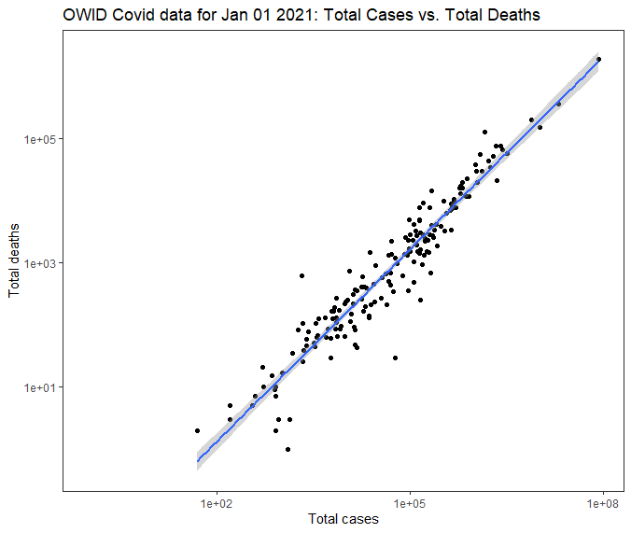

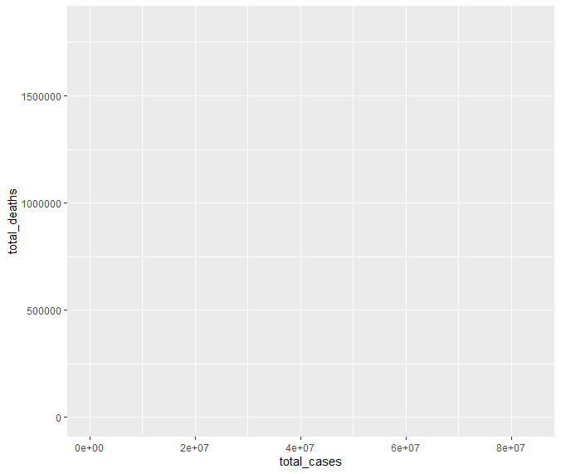
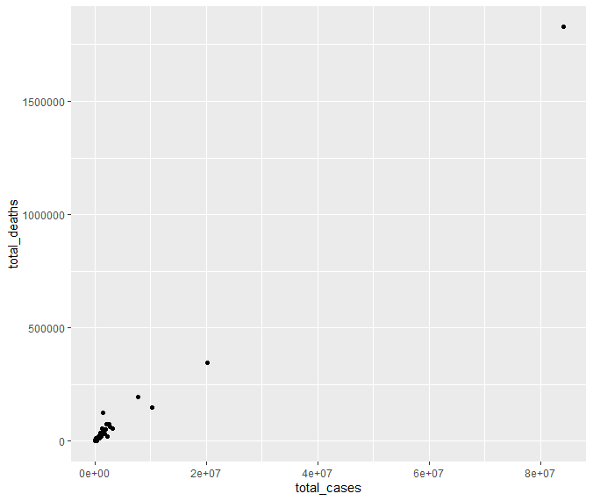
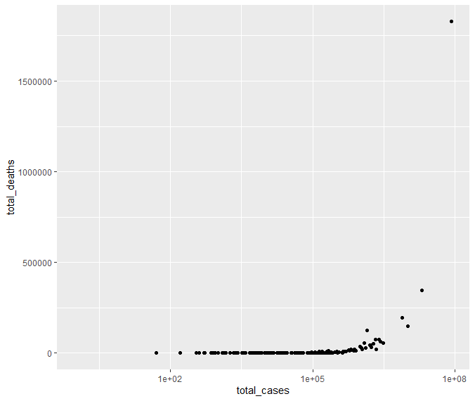
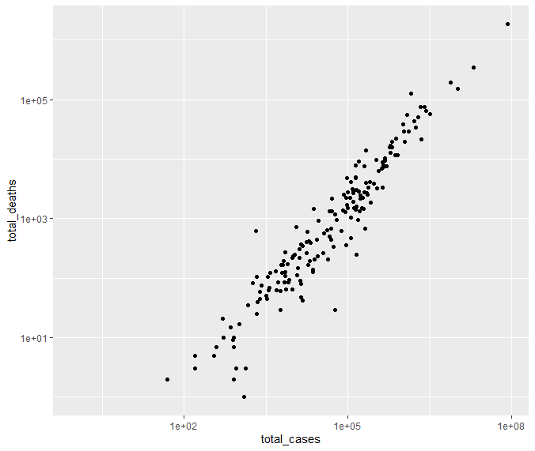
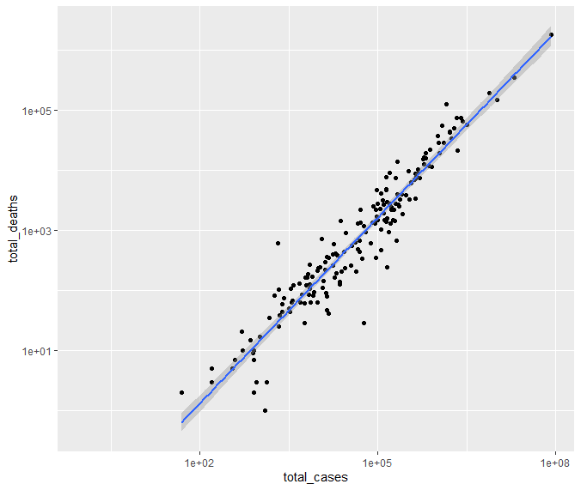
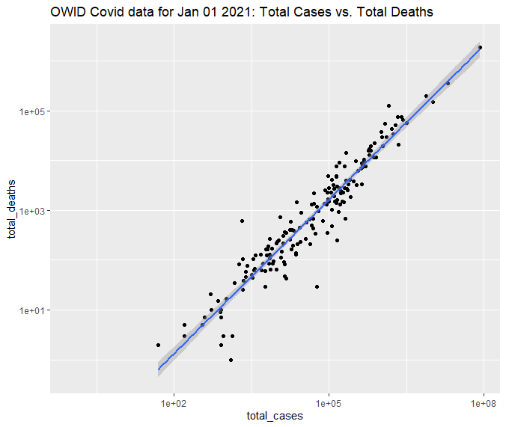


Building a graph step-by-step with ggplot2
ggplot(owid_covid_newyear, aes(x = total_cases, y = total_deaths)) +
geom_point() +
scale_x_log10() +
scale_y_log10() +
geom_smooth(method = "lm") +
ggtitle("OWID Covid data for Jan 01 2021: Total Cases vs. Total Deaths") +
xlab("Total cases") +
ylab("Total deaths") +
theme_bw() +
theme(panel.grid = element_blank())

Slide 6
ggplot2 syntax
Global mapping – applies to the entire plot
ggplot(data, mapping) +
geom_point(mapping, stat, position, colour, fill, shape, size, alpha) +
coord_cartesian() +
scale_colour_discrete() +
facet_wrap() +
theme_bw() +
ggtitle() +
labs()
Geom-specific
Where,
mapping = aes(x, y, colour, fill, shape, size, alpha)
Note: Colour, shape, alpha, etc. can be passed
to the mapping argument - changes attributes based on some variable in the dataset itself (e.g. colour = location, or shape = hdi_class)
directly as specific arguments in the geom function - changes the attributes to fixed values that are provided separately from the data (e.g. colour = “red” or size = 10)

Slide 7
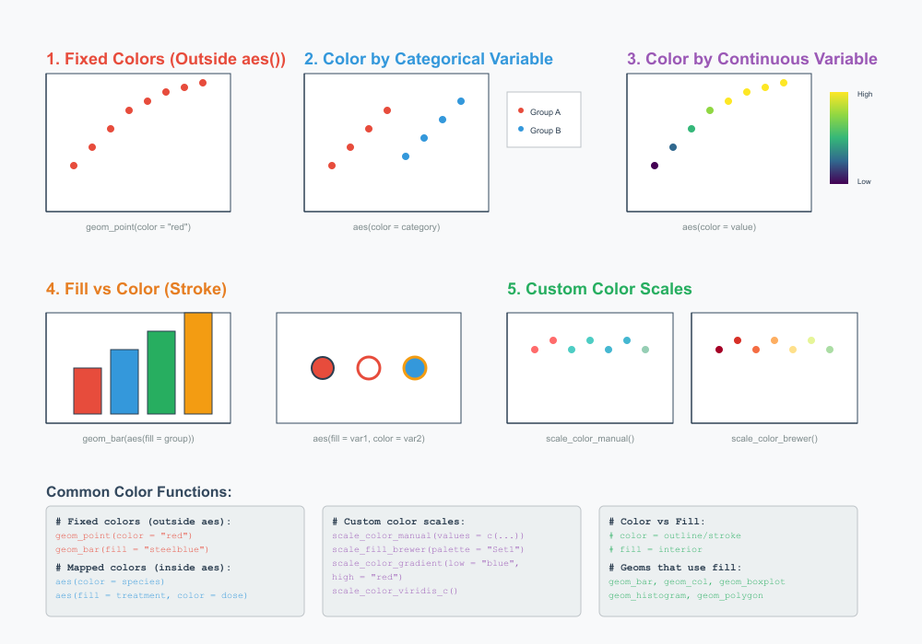
Colours in ggplot2

Slide 8

Let’s explore practically

Slide 9
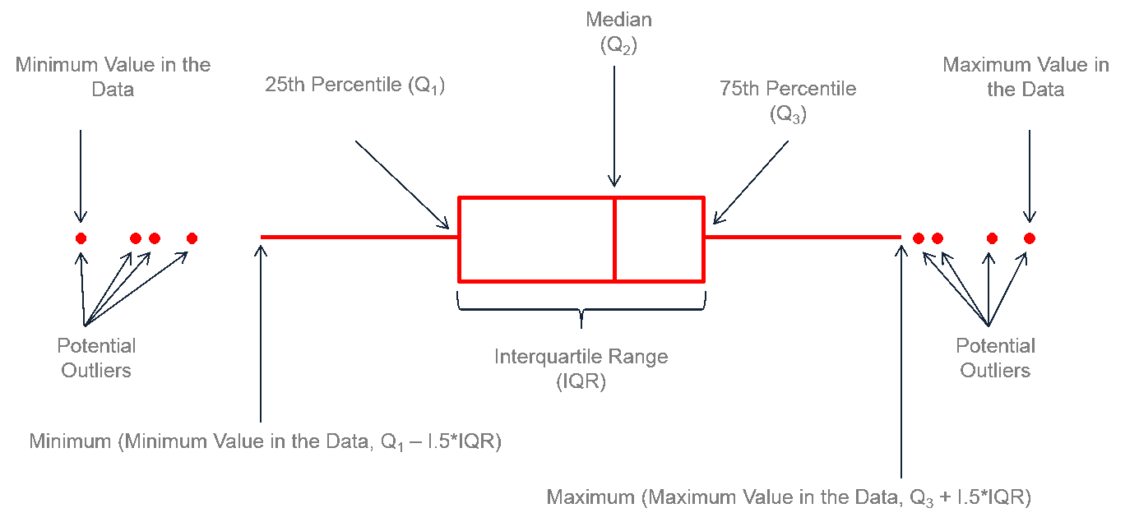
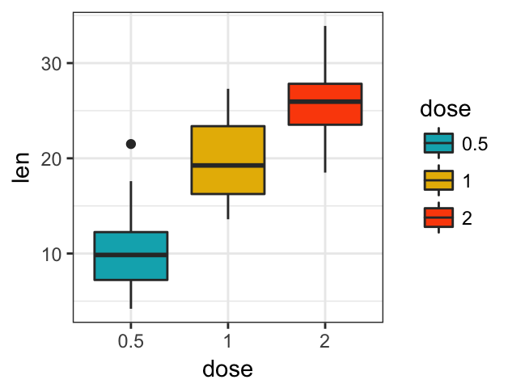
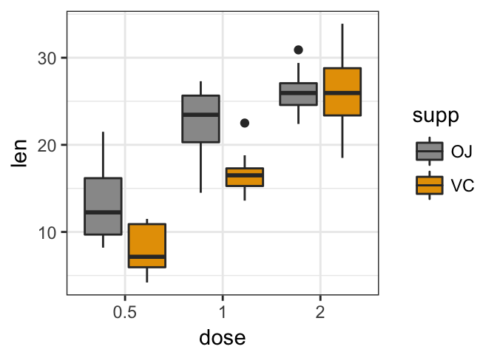
Plotting grouped data
Box-plots
geom_boxplot()

Slide 10
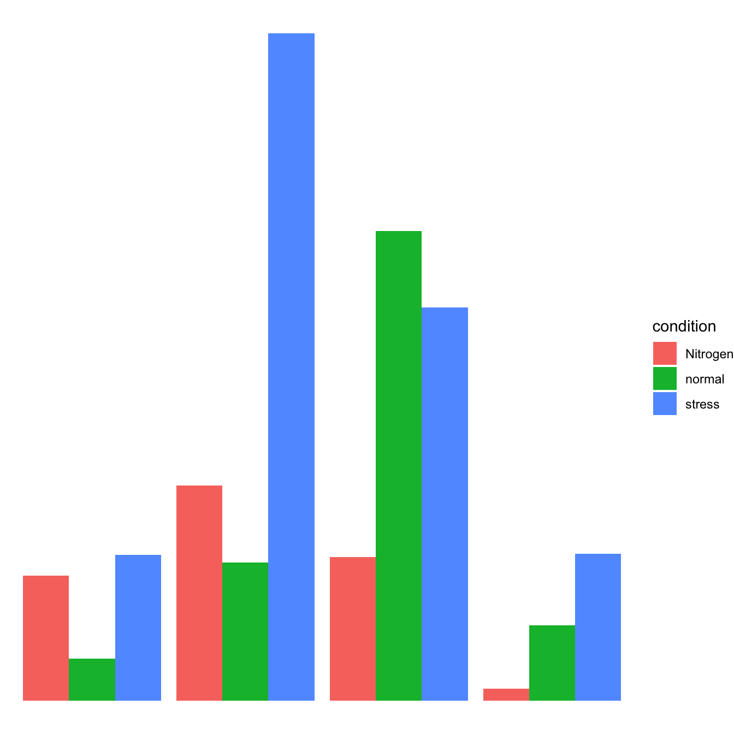
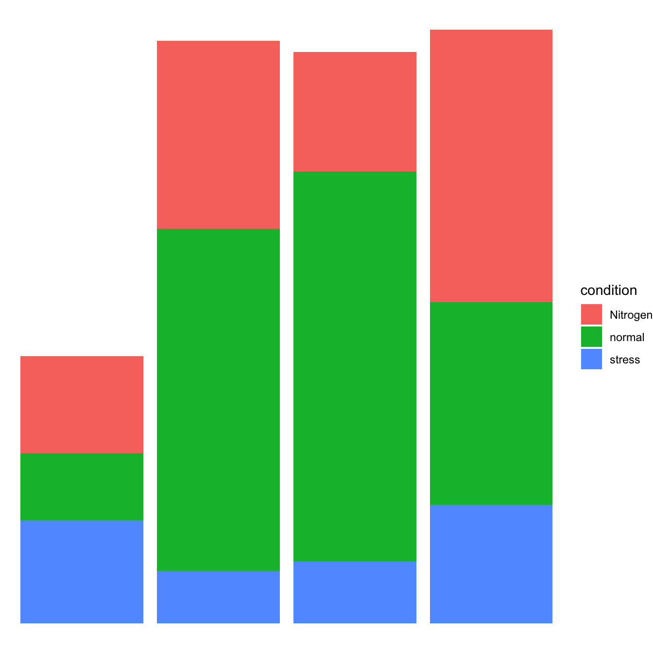
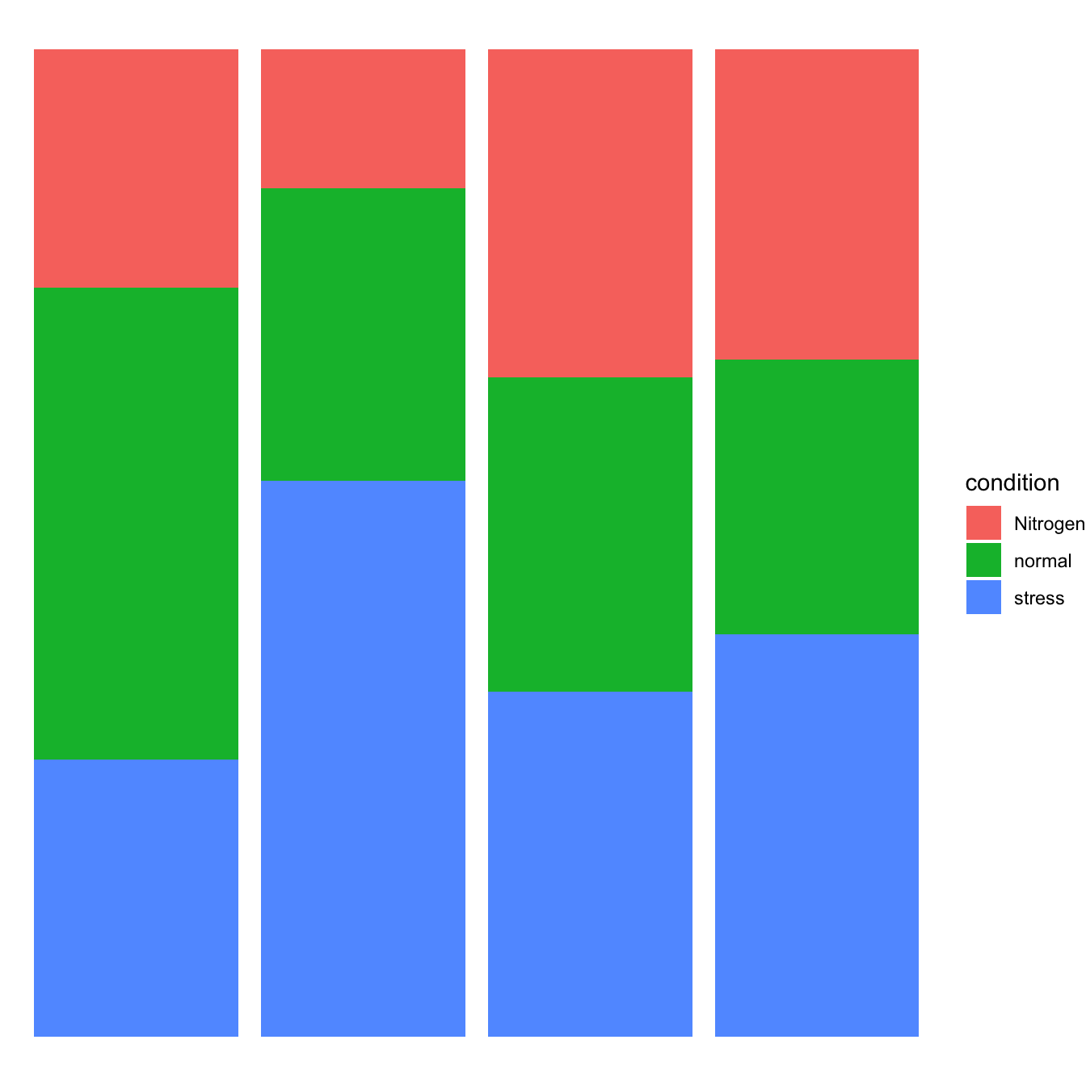
Plotting grouped data
Bar plots
geom_bar(position=...)
position="dodge"
position="stack"
position="fill"

Slide 11
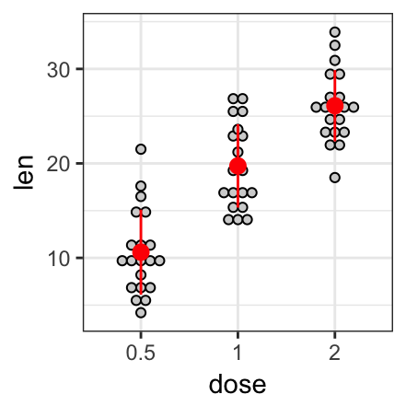
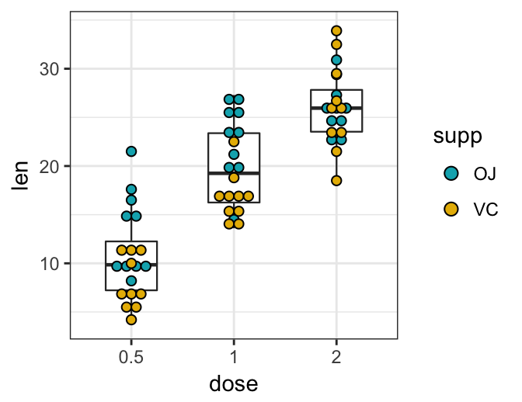
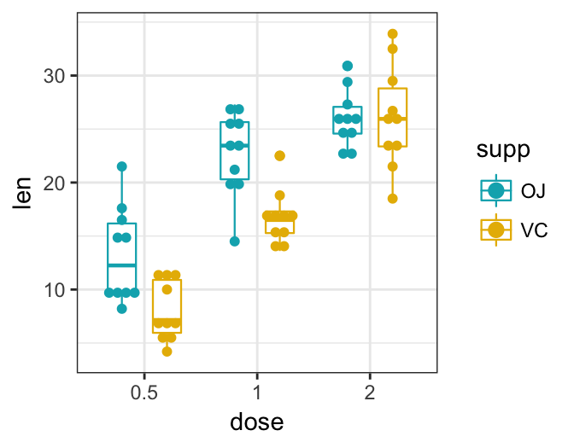
Plotting grouped data
Dot plots
geom_dotplot()
ggplot(…)+ geom_dotplot(…)
ggplot(…)+ geom_boxplot(…)+ geom_dotplot(…)
ggplot(…)+
geom_boxplot(position = "dodge")+
geom_dotplot(…)

Slide 12
Understanding factors
Factors are used to represent categorical data.
Factors don't have to be binary! You can have many categories.
When you import a table to R, your categorical columns are treated as characters ("Germany", "Belgium", "Germany", etc.) or numbers (1, 2): using safest option - stringsAsFactors = FALSE argument in read... functions.
You know where your categories are presented. Convert the relevant column into factor:
df1$col1 <- as.factor(df1$col1)
Factors have levels, you can check all the categories within the factor:
levels(df1$col1)
You need to have your categories as factors in order to analyse and to plot the data by group!

Slide 13
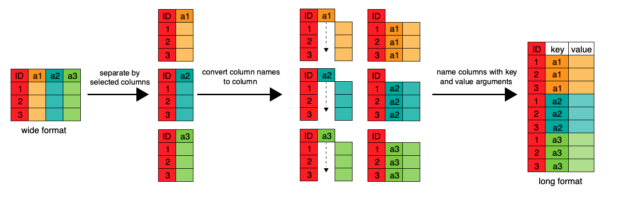
Wide vs. Long data format

Slide 14
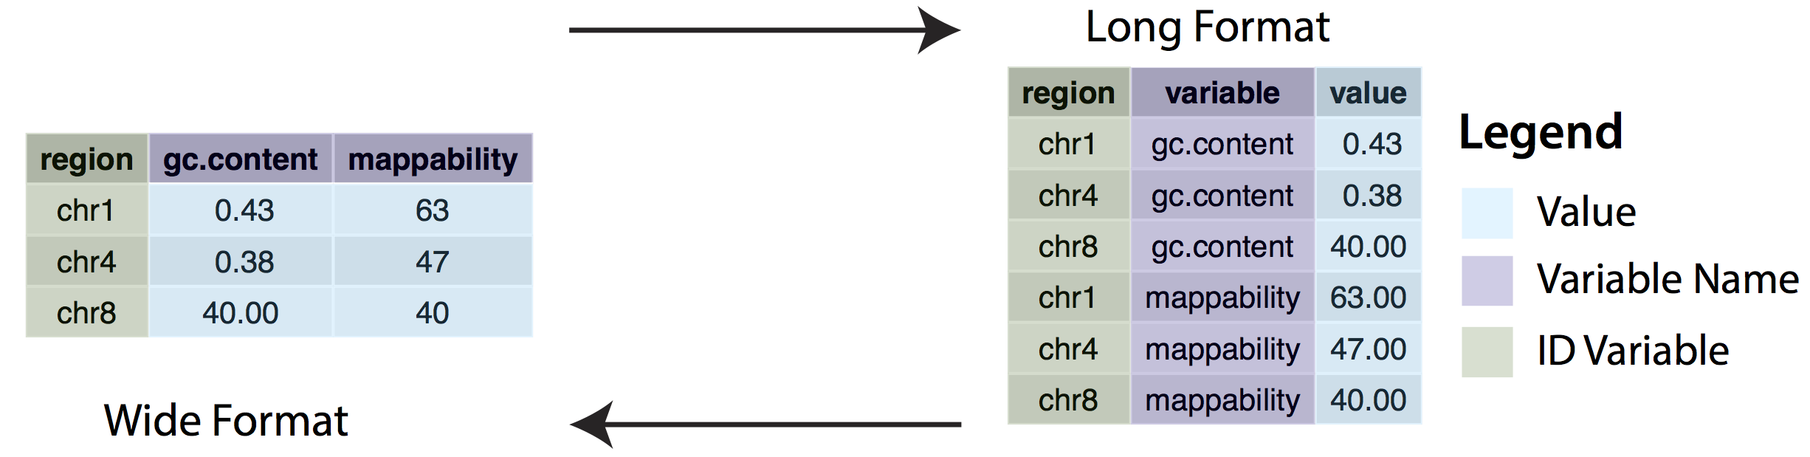
Reshaping data with tidyr
Wide-to-long format:
pivot_longer(data = chrData, cols = -region, names_to = "variable", values_to = "value")
Long-to-wide format:
pivot_wider(data = chrData, names_from = variable, values_from = value)
tidyr is a part of Tidyverse
To plot by groups we need our data to be in a long format!

Slide 15
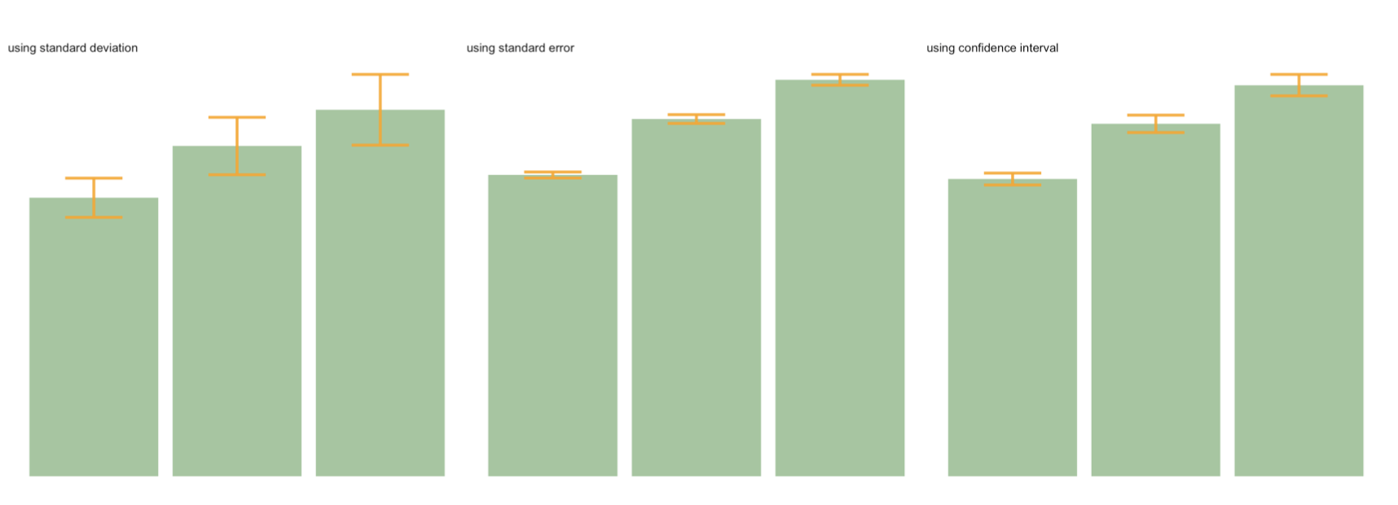
Error bars – geom_bar()
ggplot(data)
+ geom_bar( aes(x=group, y=mean), stat="identity", fill="forestgreen", alpha=0.5)
+ geom_errorbar( aes(x=group, ymin=mean-sd, ymax=mean+sd), width=0.4, colour="orange", alpha=0.9, size=1.5) + ggtitle("using standard deviation")

Slide 16
SD, SE, CI
Standard Deviation (SD) represents the amount of dispersion of the variable. Calculated as the root square of the variance:
sd <- sd(vec)
sd <- sqrt(var(vec))
Standard Error (SE) is the standard deviation of the vector sampling distribution. Calculated as the SD divided by the square root of the sample size.
se = sd(vec) / sqrt(length(vec))
Confidence Interval (CI).
This interval is defined so that there is a specified probability that a value lies within it. It is calculated as t * SE. Where t is the value of the Student's t-distribution for a specific alpha.
alpha=0.05
t=qt((1-alpha)/2 + .5, length(vec)-1) # tend to 1.96 if sample size is big enough
CI=t*se
Hint: easier way to add error bars without calculation! Explore stat_summary()

Slide 17
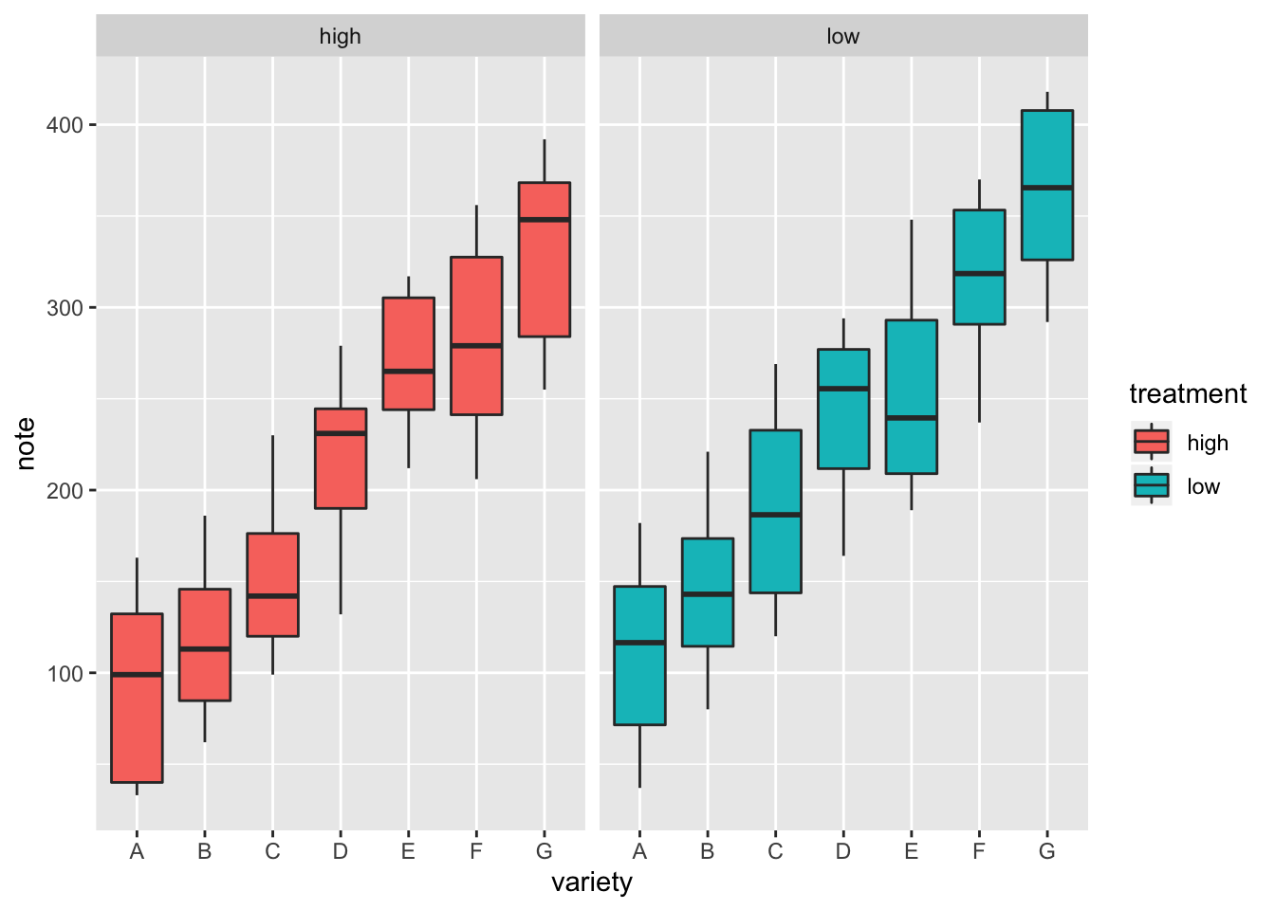
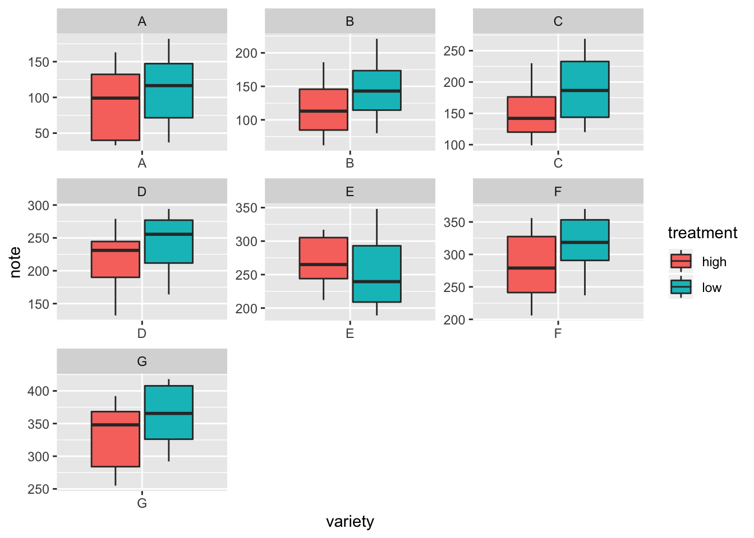
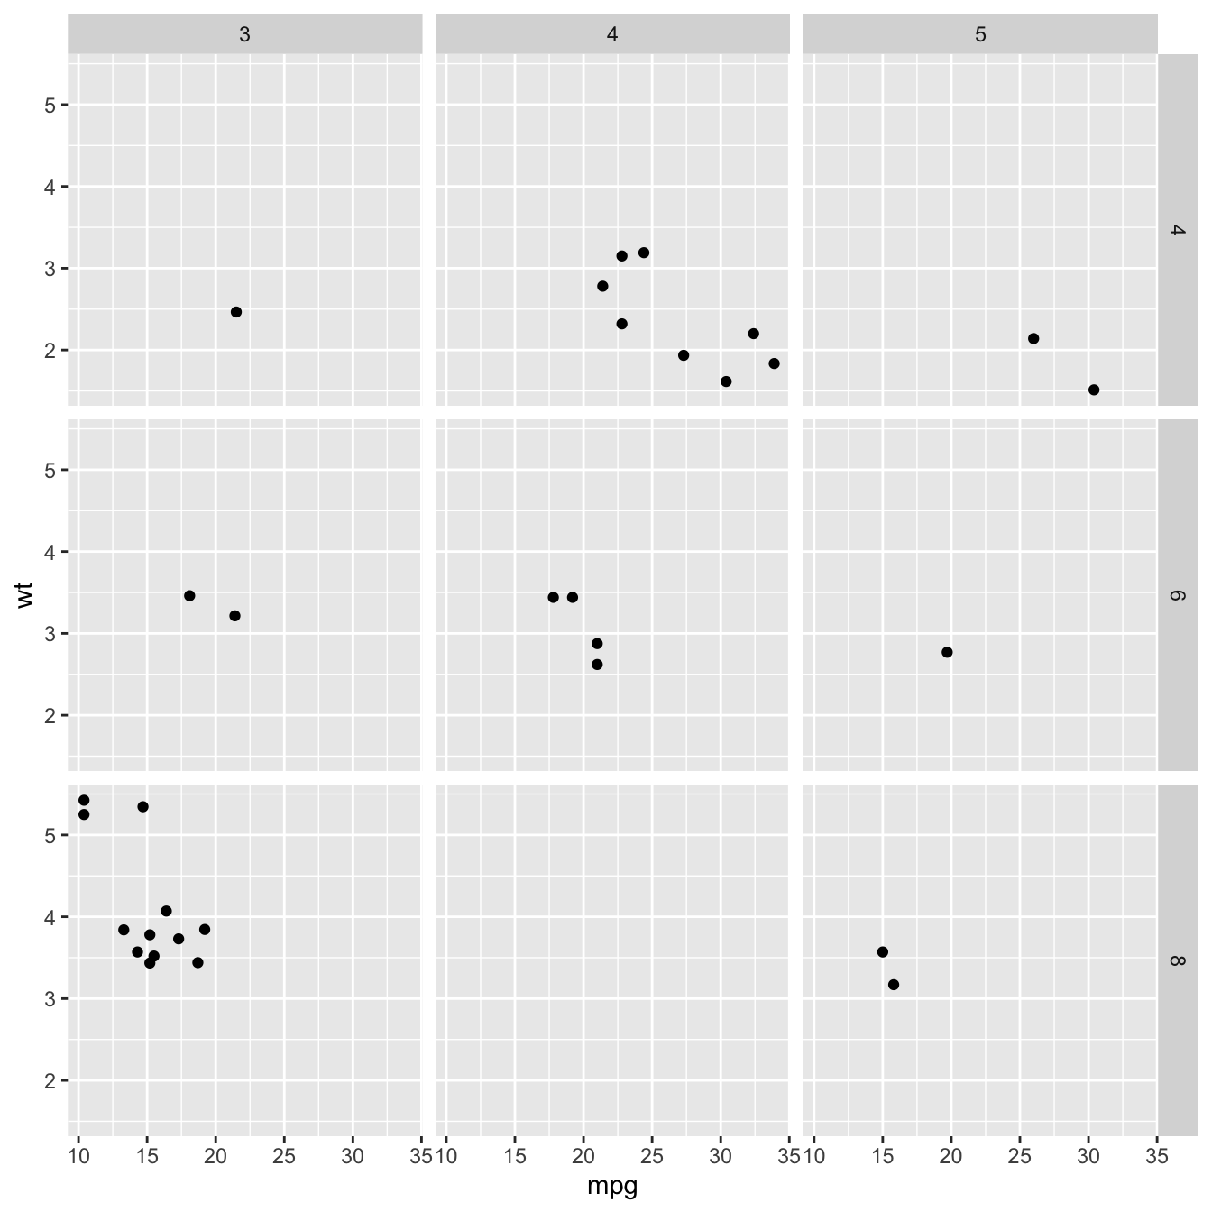
Faceting
facet_wrap(~var) builds a new chart for each level of a categorical variable
facet_grid(var1~var2) builds one chart for each combinations of 2 categorical variables

Slide 18
Basic statistics
Correlations – cor(), cor.test()
T-test (parametric):
Unpaired 2-group t-test
t.test(y~x) # where y is numeric and x is a binary factor
t.test(y1,y2) # where y1 and y2 are numeric
Paired 2-group t-test
t.test(y1,y2, paired=TRUE) # where y1 & y2 are numeric
Non-parametric tests:
Unpaired 2-group Mann-Whitney U Test
wilcox.test(y~A) # where y is numeric and A is A binary factor
wilcox.test(y,x) # where y and x are numeric
Paired 2-group Wilcoxon Signed Rank Test
wilcox.test(y1,y2, paired=TRUE) # where y1 and y2 are numeric
More than 2 groups - analysis of variance (ANOVA, parametric)
aov(), anova()

Slide 19
Adding statistics to the plots
library(ggpubr)
Perform the test
compare_means(formula, data, method = "wilcox.test", paired = FALSE, group.by = NULL, ref.group = NULL, ...)
*method = "t.test", "anova"
Or just add the significance levels to the plot
stat_compare_means(mapping = NULL, comparisons = NULL, hide.ns = FALSE, label = NULL, label.x = NULL, label.y = NULL, ...)
If adjusted p-values are required
stat_pvalue_manual(stat.test, label = "p.adj.signif”, hide.ns = TRUE, ...)

Slide 20
Let’s explore practically

Slide 21
Useful references
R Programming for Data Science (Roger Peng) – Ch. 3, 4, 5, 9
Swirl – Interactive learning
R for Data Science (Hadley Wickham) – Using Dplyr verbs
The data.table package – Intro
A data.table and Dplyr tour – Side by side comparison of functions
Cheatsheets – quick reference for tasks like data wrangling, visualisation, and several packages

Slide 22
Useful references
https://github.com/EmilHvitfeldt/r-color-palettes - a huge list of R palettes
https://colorbrewer2.org/ - RColorBrewer package based on this tool by Cynthia Brewer
https://jokergoo.github.io/ComplexHeatmap-reference/book/ - R package to produce Complex Heatmaps
https://carriebrown.github.io/r-novice-gapminder/challenges/ - R challenges
https://rosalind.info/problems/locations/ - biological programming and algorithmic challenges (mainly geared towards python, but can be solved using R as well)

