Slide 1

Bayesian Optimization
Rodrigo A. Vargas Hernández
Rodrigo A. Vargas Hernández
vargashr@mcmaster.ca
Notes:
I would like to thank the committee for inviting me and giving me the opportunity to talk about my research.

Slide 2
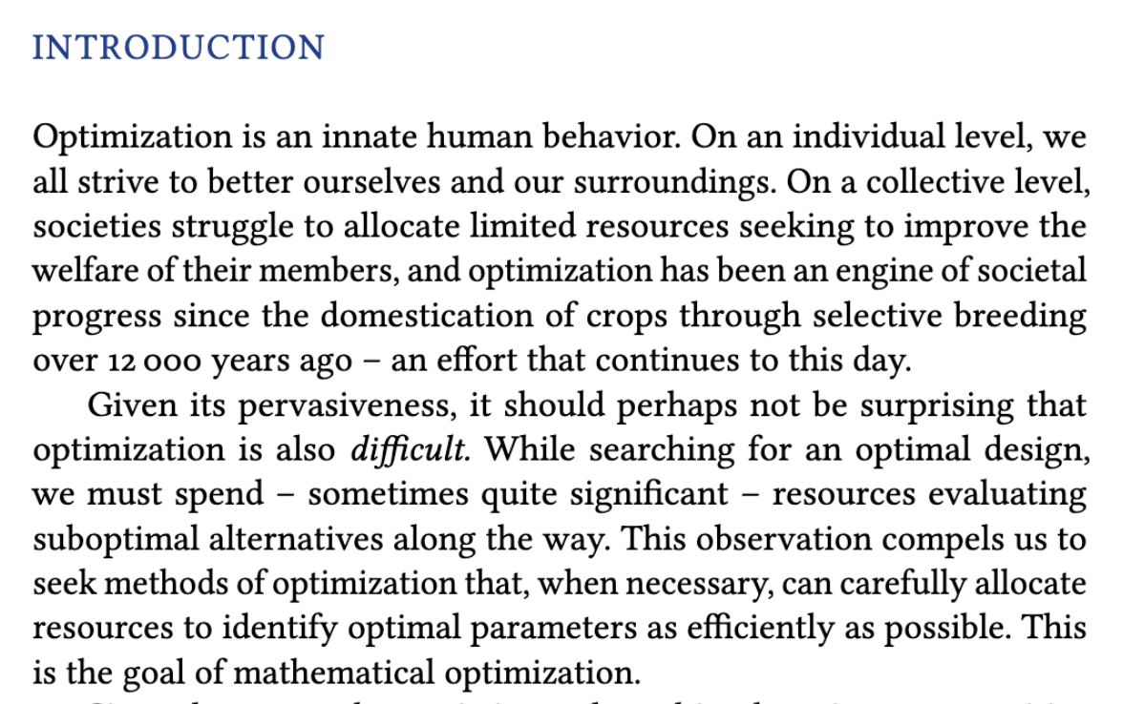
(book) R. Garnett, Bayesian Optimization (2021)

Slide 3


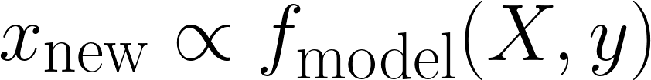
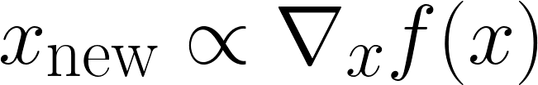

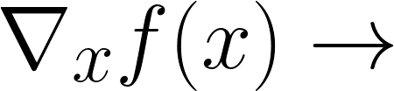


Optimization algorithms
Sampling:
Gradient:
Surrogate model to approximate $f(x)$
Gradients and higher order derivative of $f(x)$
Bayesian optimization
Differentiable programming
Notes:
There are two main frameworks for optimization,
Sampling
gradient
For sampling, one uses a a model that tries to mimic the landscape of the optimization process and through an iterative manner we search for the minimum
On the other hand, gradient methods used the gradient as the informational guidance to search for the minimum.
First, I will present some of my research where we used Bayes Opt to optimize physical models, and in the second part of my talk I will briefly introduce differentiable programming, a tool that could allow us the efficient computation of of gradients in in silico simulations.

Slide 4

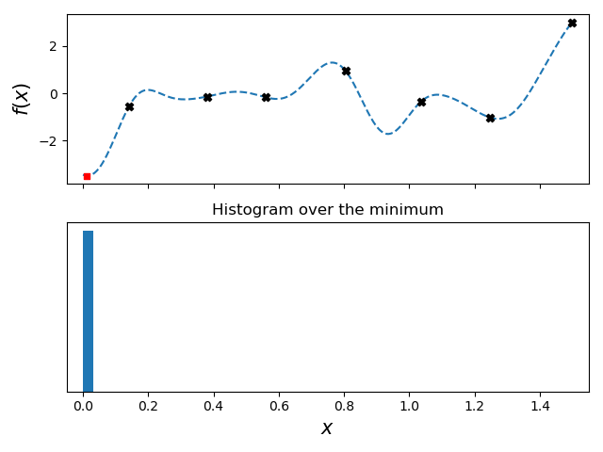
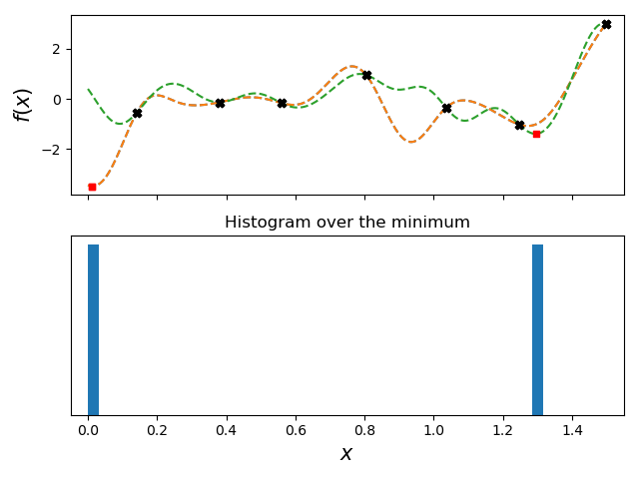
black-box function
data
models
model
possible minimum
Where is the minimum of ?
Notes:
Let’s assume we aimed to find the minimum of an oracle function, meaning we are only able to get one sample at the time. Obviously, we don’t aimed to waste samples by randomly sampling the space.
So one option is to construct a model based on some previously known points of the function problem.
This model will give us a possible minimum of the function, however, there is no certainty that that is the correct model so we could proposed a second one, leading to a second possible location of the minima.

Slide 5
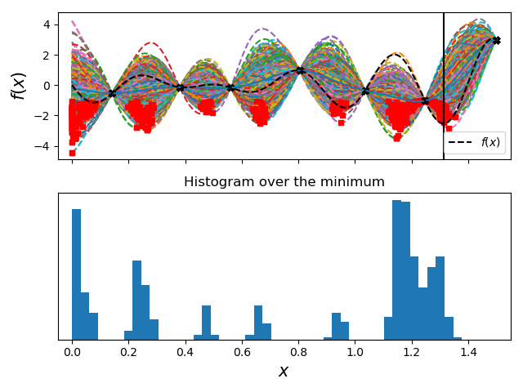
black-box function
possible minimum
Things to consider:
Fast training
Easy sampling
Low-data efficient
Notes:
Under the same premise, we could construct or ask multiple experts on the field for possible models and use this as an ensemble of models that could dictate what is the most problable minima.
Obviously, the idea of using multiple experts is not viable as that will require a great amount of time to gather all the models and could add some cost.
This procedure force us to have a model that is easy to train, easy to generate samples, and is low-data efficient.

Slide 6
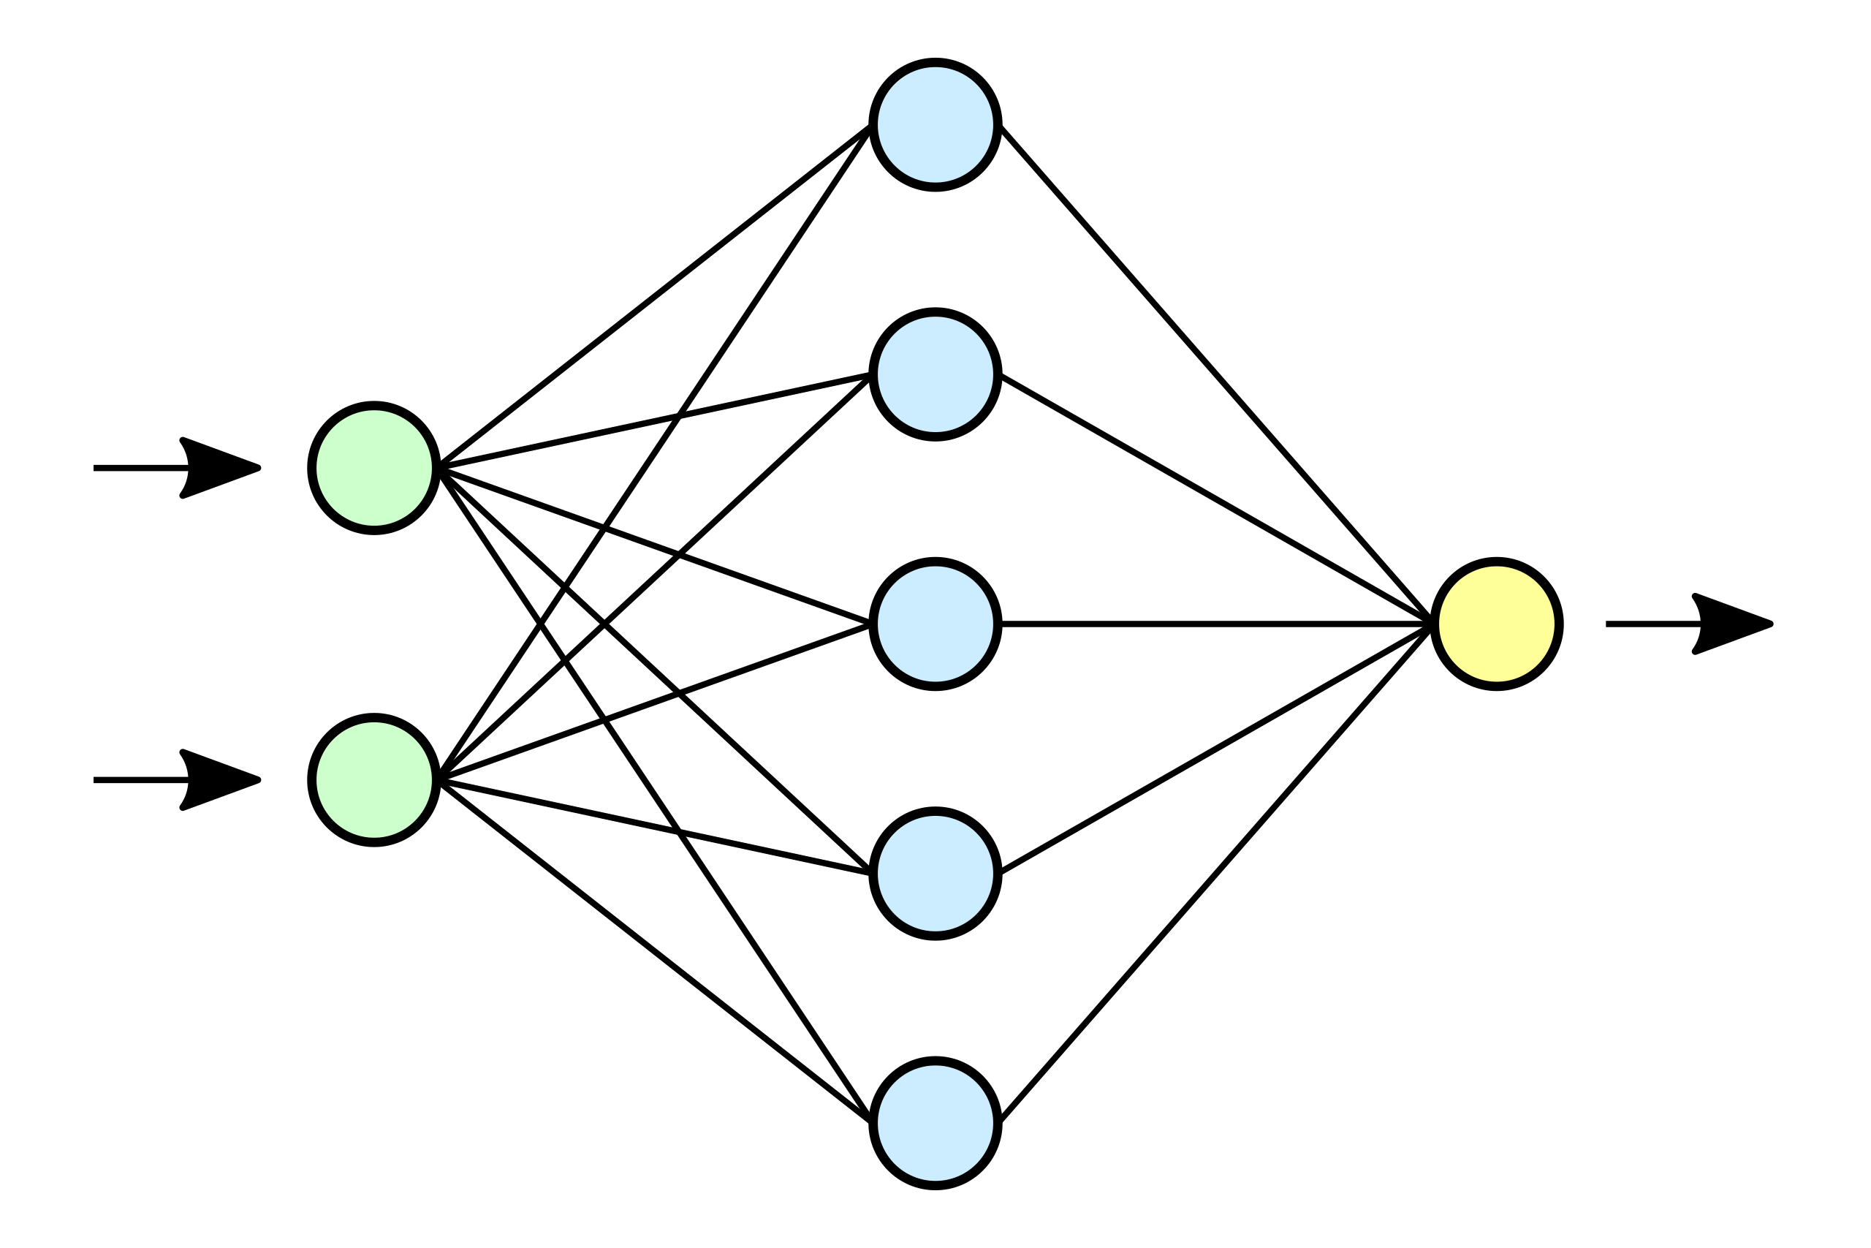






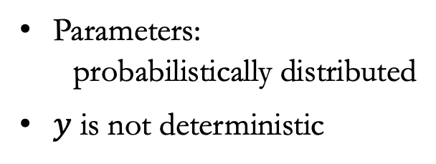

Probabilistic models
Posterior samples
Prior samples
$$x_{0}$$
$$x_{1}$$
$$y$$
Parameters:
probabilistically distributed
$y$ is not deterministic
$$p\left(θ | X,y\right)∝p\left(y | θ,X\right)p(θ)$$
R. M. Neal, Bayesian Learning for Neural Networks (2012)
Notes:
To generate samples we can not consider deterministic regression models, we most account for an ensemble of models which could be described probabilistically.
Here we can assume a NN where each weight and bias is described by a gaussian distribution.
We could sample an infinite different parameters generating an ensemble of NN. however, not all will be able to reproduce the initial information that we have about the problem function
The samples that we aimed to have should at reproduce the gathered data so we could properly construct the acq. function.
One could construct a posterior distribution using Monte Carlo routines, however this could be expensive.

Slide 7





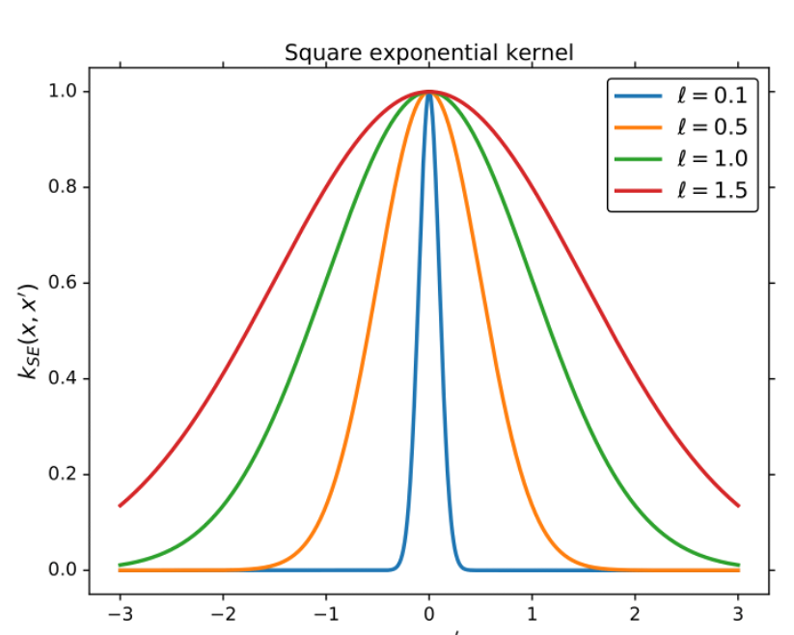

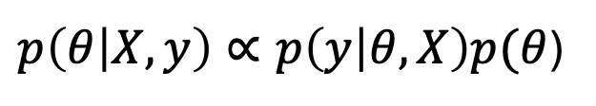
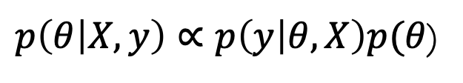



Law of large numbers:
Gaussian Processes
Hidden layer random numbers
Infinite 1 layer Neural Network
$$x_{0}$$
Mean
$$x_{1}$$
$$y$$
Variance
Kernel function
Similarity between points
$p\left(θ | X,y\right)∝p\left(y | θ,X\right)p(θ$)
R. M. Neal, Bayesian Learning for Neural Networks (2012)
Notes:
An alternative option is to try to construct a posterior distribution that is Gaussian.
To do so we could assume we have an infinite number of hidden neurons and since the parameters are gaussian we could use the law of large numbers.
To properly describe this posterior G distribution we need to know the mean and std of it.
Given that all NN params mean is 0 so does the mean of this prob NN
The variance is described by a correlation function between two samples, and all the properties of this family of models is described by the kernel function.
This family of models are known as Gaussian process models, meaning when you hear a GPs is simple an infinite single layer NN.

Slide 8
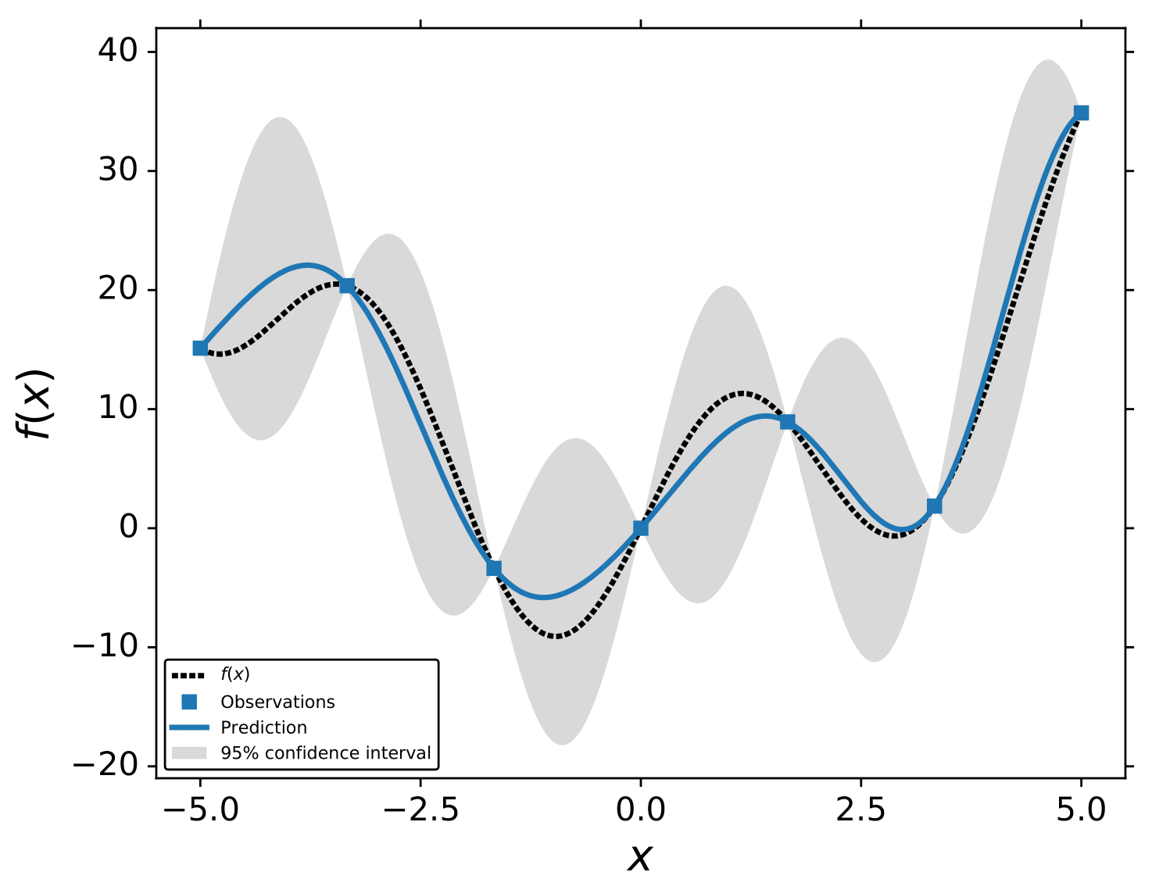
Gaussian Processes
No sampling
Kernel function
(book) C. E. Rasmussen, C. K. I. Williams,
Gaussian processes for machine learning (2005)
Notes:
The two key advantages of GPs are that the prediction of a point has a close form for both the mean and std, meaning that for Bayesian Optimization we do not require to generate samples and average them we can simple use the eqn for the std and mean.
As I said, the kernel function plays a key role in this type of models as it describes entirely the form of the function. For example if we have periodic data, we must use a kernel that will quantify similarity in a periodic space.
(revise epistemic and aleatoric uncertainty)

Slide 9
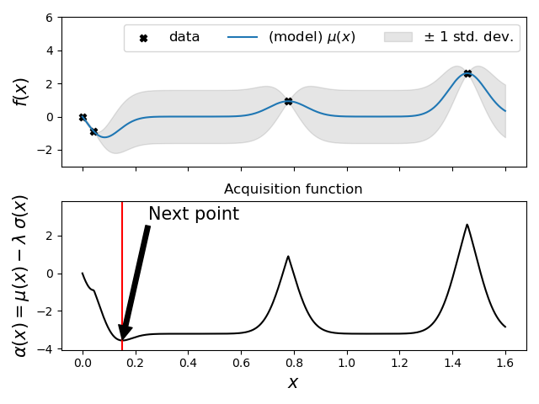
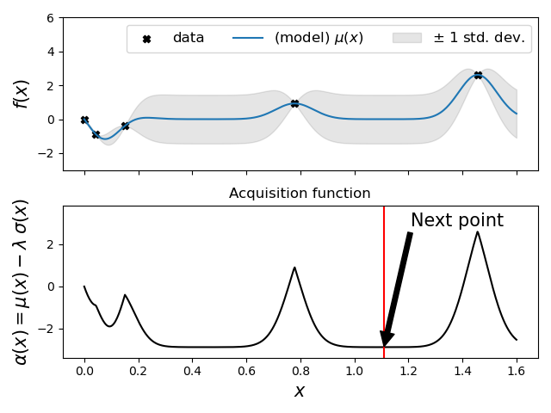
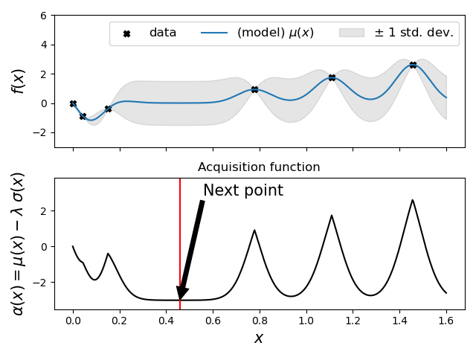
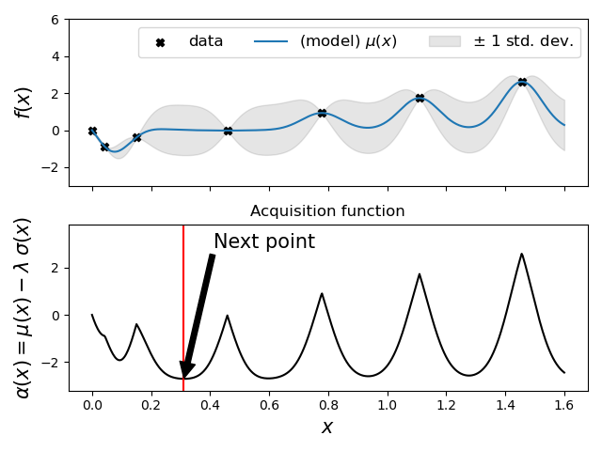
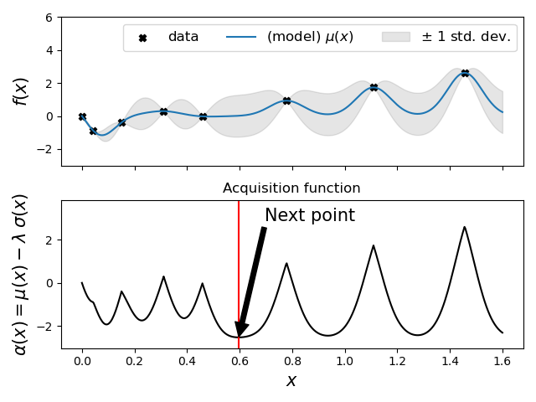
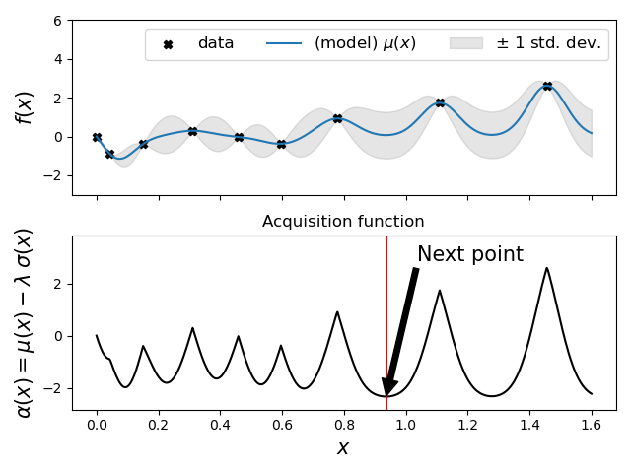
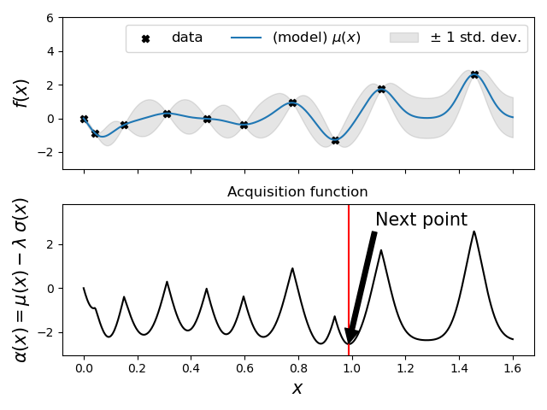
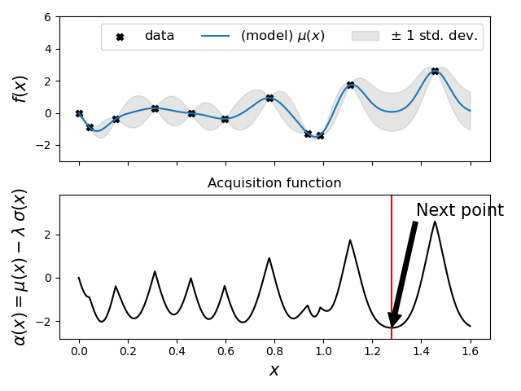
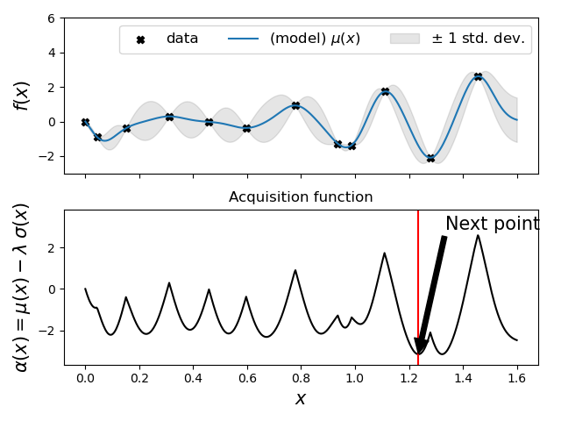
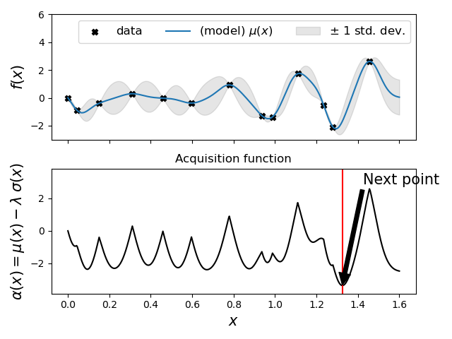
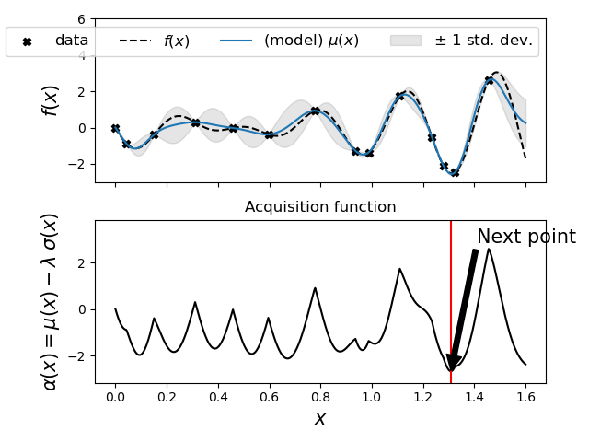
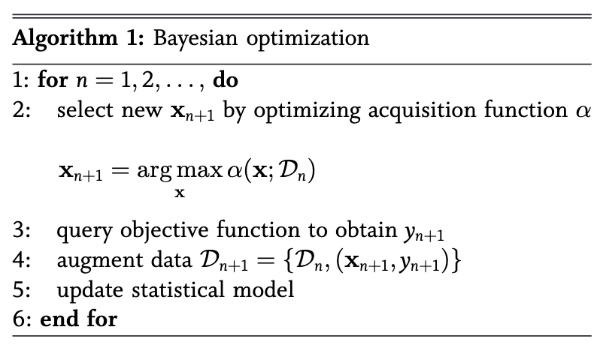
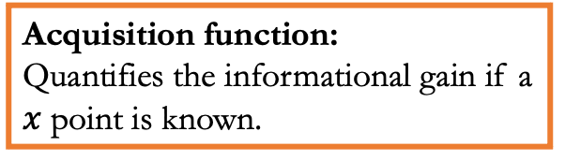
BAYESIAN OPTIMIZATION
arg min
Acquisition function:
Quantifies the informational gain if a $x$ point is known.
(book) R. Garnett, Bayesian Optimization (2021)
Notes:
This is the core idea of Bayesian Optimization, a sampling algorithm that generate one sample at the time following a policy dictated by the acquisition function.
by the acquisition function plays a central role as dictates which next point will give us the most information if it was known.
For this example we used the mean and standard deviation of the ensemble predictions to construct the acquisition function
And as we could see my following this policy we were able to find the minimum of the problem function with only a handful of iterations.
What type of ML algorithms could we use for this problem setup?

Slide 10
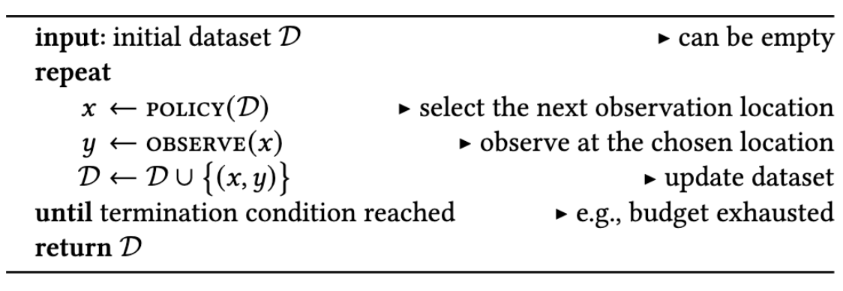
Bayesian optimization
Algorithm: Sequential optimization

