Slide 1


Basic Python Functions
First Tutorial for 3CP3 class

Slide 2
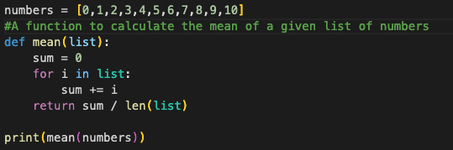
Python Indentation and basic syntax
A comment that is not executed
Python uses whitespace and indentation to construct the code structure
Whitespace to define the block of coding
More readable and uniform
Python is case sensitive, so it encourages precision and clarity while coding.

Slide 3



Basic operations
You can compute basic operations directly.
Type on your jupyter notebook (Google Colab)
Get the answer
But working with multiple variable is useful to assign each variable a name.
And then you can print the variable that you stored the operation.
You can print multiple variables, strings, arrays...

Slide 4



List and operations with lists
You can create lists and populate them with numbers and strings.
Lists are:
Ordered
Mutable
Denoted by square brackets
You can check the length of a list
You can add more variables to your list by using the append command

Slide 5
Given a list L = [1,2,3,4,5,6,7,8,9] . We can access a specific position of the list using slicing.
L[0] = [1]
L[2:] = [3,4,5,6,7,8,9]
L[:4] = [1,2,3,4]
L[-2:] = [8,9]
L[:-6] = [1,2,3]
The whole list: L[:]
Everything after (and including) index position i : L[i:]
Everything before index position i: L[:i]
Everything before the position j steps from the end: L[:-j]
Everything after (and including) the position j steps from the end: L[-j:]
Note
Index -2
Negative Index
Index -1
L = [1,2,3,4,5,6,7,8,9]
Positive Index
Index 0
Index 1

Slide 6


Functions
A function in Python works the same as a function in math: you define an input and an output.
Output
Functions in Python are defined by the def keyword.
And you put the list of outputs inside a parenthesis followed by :
This defines the function and to evaluate the function in each input you do,
Print the output
Call the function by its name
Put the input inside the parenthesis. This is the value that you want to evaluate.

Slide 7

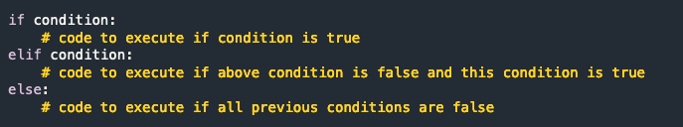
Conditional Statements
There are instances where we want to only execute a particular block of code if a certain condition is true.
For multiple conditions, the syntax is,
Comparison operations,
Equals x == y
Not Equal x != y
Less Than (strictly) x < y
Greater Than (strictly) x > y
Less Than or Equal to x <= y
Greater Than or Equal to x >= y

Slide 8

Loop
When programming, there are times when you need to repeatedly perform a specific operation/action while updating certain parameters. In these situations, we use loops,
Exercise
Test the convergence of the alternating series,
Converges to ln(2)

Slide 9
Quick Feedback on Quiz 1
Pay attention to the information on the website on how to send the files. You need to follow the template there otherwise your quiz will not be accepted.
You don’t need to write #return print() (This can lead to errors)
For the next assignments you can delete the #Write your code here.
Do not write the exercise asking for the input of an user:
Like:
The code must work on its own.

Slide 10


Last Class
I think it is still not super clear how does the definition of a function works using Python.
These definitions are only valid inside
the function box. After the colon.
What happens if I try to print the value of ‘a’ outside the function ?

Slide 11


A function can have many variables
What if we want to change the values of ‘a’ and ‘b’ ?
Written like this the values of the variables are immutable inside the function.

Slide 12
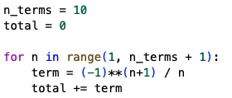
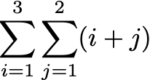
A function can have many variables
Can you write this in one line ?
Converges to ln(2)
How to code ?

Slide 13

Derivatives
You can evaluate derivatives and integrals symbolically using the SymPy library.
Call the library
Define x and y as symbols
Calculate the derivative of the logistic function by hand and using SymPy.
Write the derivative as
Logistic function

