Slide 1


Numerical Integration
Tutorial for 3CP3 class

Slide 2
Numerical integration is used to approximate the definite integral of a function when an analytical solution is difficult or impossible to obtain. Given a function ( f(x) ), we want to approximate the integral of ( f(x) ) over the total interval, ([a, b]). The fundamental idea is to:
Discretize the interval [a, b] into a grid of n+1 points
Approximate the area under f(x) in each subinterval using simple shapes
Sum these approximations to estimate the total integral
Key Concepts:
Interval: [a, b] - the range over which we integrate
Grid Points: x₀, x₁, ..., xₙ where x₀ = a and xₙ = b
Spacing: h = (b - a)/n (distance between grid points)
Subintervals: [xᵢ, xᵢ₊₁] for i = 0, 1, ..., n-1

Slide 3
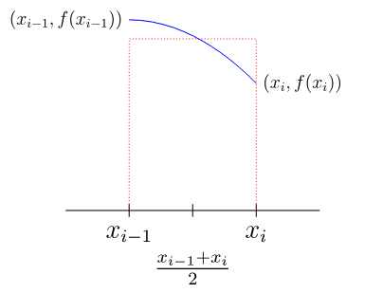
Midpoint Sum (Riemann Sum)
If we think of the integral as computing an area, we can add up the areas of some rectangles (Riemann sum):
For a single rectangle.

Slide 4
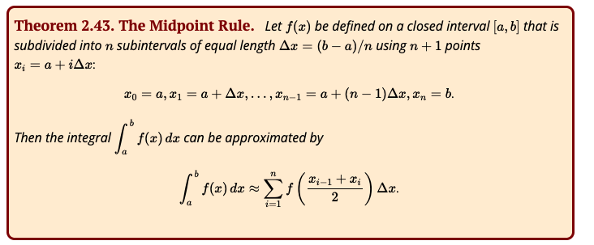
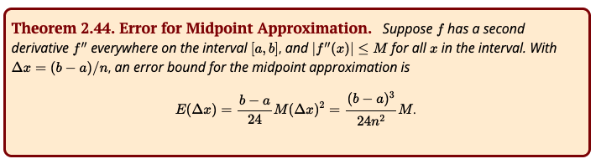

Slide 5
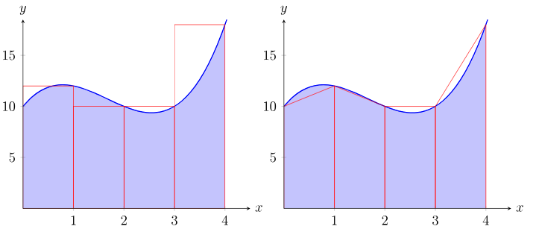
Trapezoid Rule
We approximate the area under a curve over a small interval as the area of a trapezoid.
Rectangles
Trapezoids

Slide 6
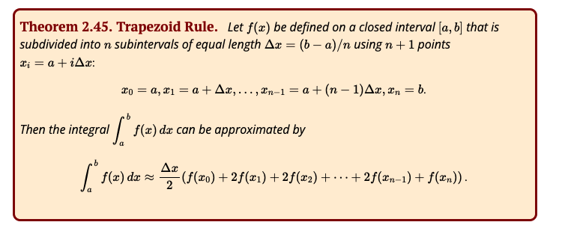
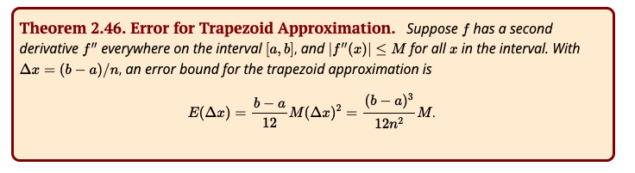

Slide 7
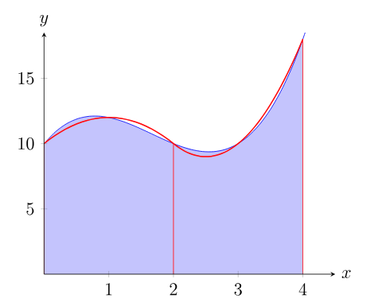
Simpson's Rule
If we can approximate a short piece of the curve with a parabola with equation y=ax^2+bx+c, we can easily compute the area under the parabola.

Slide 8
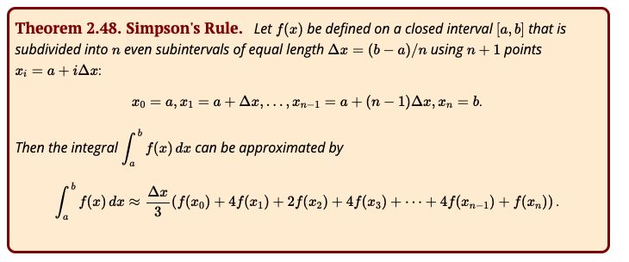
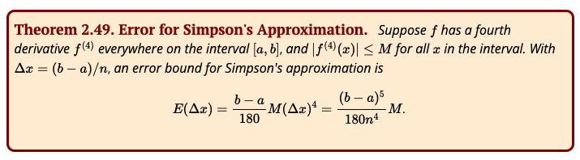

Slide 9

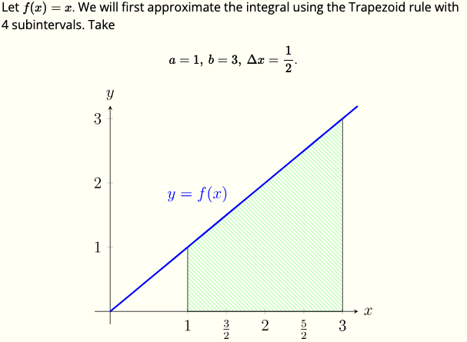
Approximate the following integral by computing the Trapezoid and Simpson approximations using 4 subintervals
Start using the trapezoid rule for 4 points

Slide 10
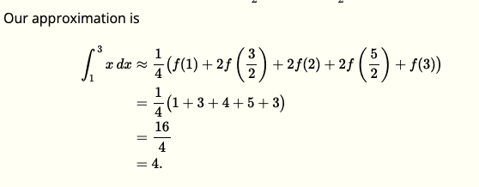

Slide 11
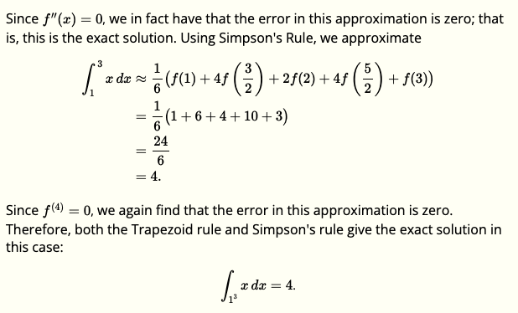
Simpson’s Rule

Slide 12
Exercise:

