Slide 1
Linear Algebra
Gauss Method

Slide 2
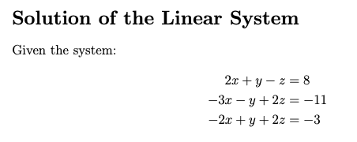

Write the augmented Matrix.

Slide 3
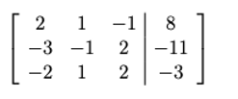

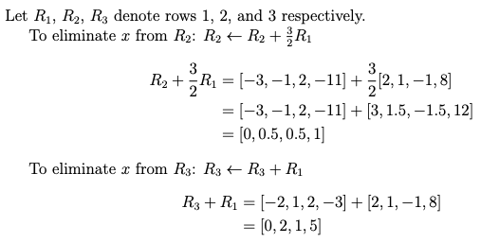


Slide 4




Slide 5

