Slide 1
Tips for Solving Question 1 from Assignment

Slide 2




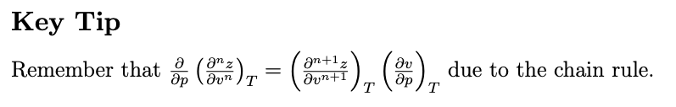
Given this relation
Consider f = z, then
Separate in two parts A +B for example and then take the derivative w.r.t p
Consider a function g(v,T)

Slide 3
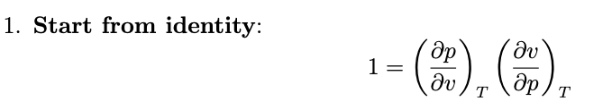
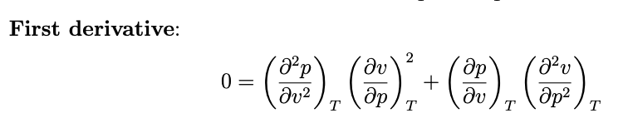

Equation (2)
Remember: p depends on v
Take another derivative, separate the terms in A and B. You should get something like:

Slide 4
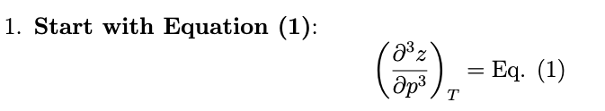
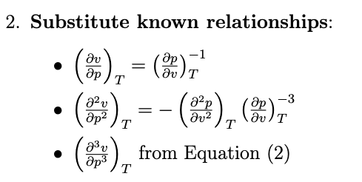
Equation (3)
Simplify and that is it.

Slide 5
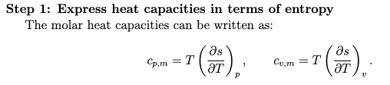
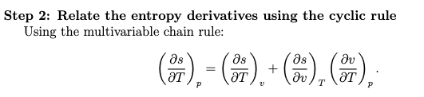


Question 2
Exact differential . The mixed part of derivatives must be equal.
Using PV = nRT you should get the result.

