Slide 1
Blocked Matrices
Pandora’s Box
For numerically stable refinements, it is not necessary to compute the full normal matrix at every intermediate stage of an analysis. Smaller sub-blocks of the full matrix may be adequate.
However, if there is instability, especially as a consequence of data shortage or pseudo symmetry, it is wisest to use the full matrix
Using the full matrix is almost always the safest procedure, though it may not be the most efficient.

Slide 2
Solvent of Crystallisation
One really important use for blocking the matrix is when the bulk of the structure is well behaved, but there is a small part (solvent, small ligand) which is proving difficult to model.
In this situation, the analyst usually proposes a model, performs some refinement, and then assesses the outcome.
It is not cost-effective to re-refine the whole of the well-behaved part during this experimental stage, though everything must be refine together to finish the analysis

Slide 3
Example Structure
Consider a structure composed of 95 atoms in the main molecule, and a 5-atom solvent or counter-ion.

Slide 4
Atom 2
If only 5 of the 100 atoms are in the solvent, then for the same structure, this means that only 1035 elements need computing instead of 405,450 elements.
solvent

Slide 5
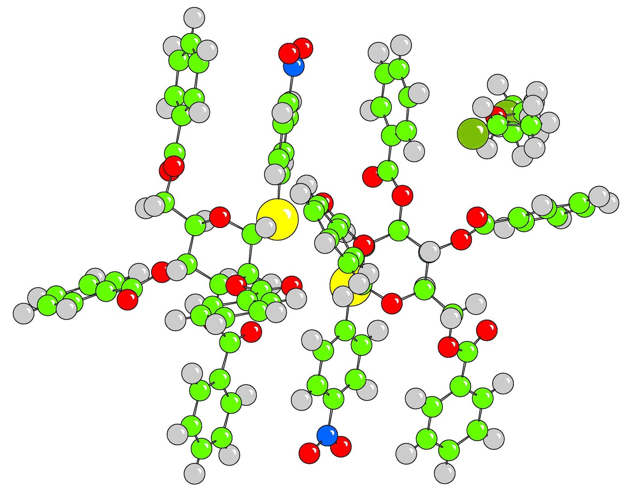
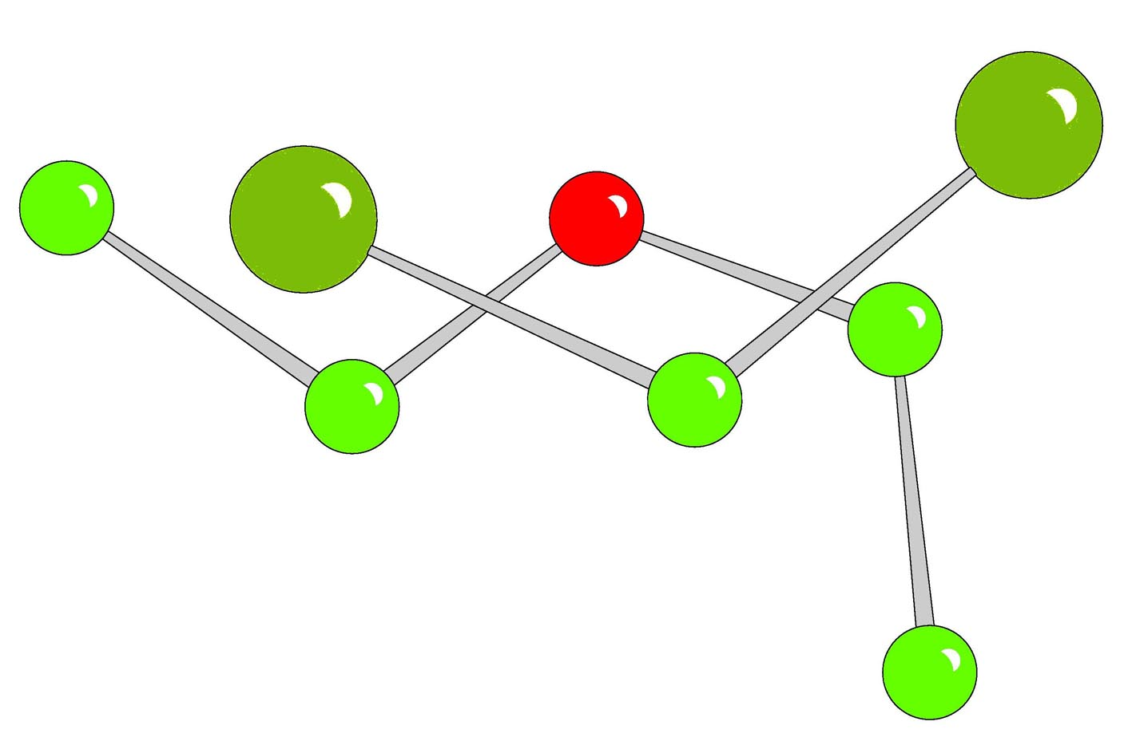
Solvent of Crystallisation
The structure contains 106 well-resolved atoms, plus 8 atoms in the solvent.
Refining the main part aniso plus solvent iso gives 986 parameters (486,098 LSQ elements)
Refining just the solvent while it is being sorted out gives 32 parameters (512 LSQ elements)
A cycle of refinement is 1000 times faster.

Slide 6
Blocked Matrices
For mesomolecular structures (100-1000) atoms, conventional full matrix least squares becomes increasingly inefficient, but conjugate gradient methods show no advantage.
Dividing up the normal matrix into sub matrices (either within a single cycle, or in successive cycles) is a cost-effective way of handling medium sized problems.

Slide 7
Matrix Schemes
For 100 anisotropic atoms in a single block, this means that (900x901)/2 = 405,000 matrix elements must be computed.
If there are 10 reflections per parameter, this gives 4 million sums-of-products.
Various schemes are available to reduce the size of the computation.

Slide 8
x y z U11 ..x y z U11 ...x y z U11
x
y
z
U11
x
y
z
For 100 anisotropic atoms in a single block, this means that (900x901)/2 = 405,000 matrix elements must be computed.

Slide 9
Large-Block Approximation
If the structure consists of non-bonded molecular fragments, and there is no pseudo-symmetry between them, then each fragment can be refined in a separate matrix block. For this example with two blocks, this gives 2x(450x451)/2 = 202,950 elements.

Slide 10
x y z U11 ..x y z U11 ...x y z U11
x
y
z
U11
x
y
z
Diagonal block containing terms for the 1st fragment
Off-diagonal terms – These link fragments 1 and 2
Diagonal block containing the terms for the 2nd fragment
For this example with two blocks, this gives 2x(450x451)/2 = 202,950 elements.

Slide 11
Refining Fragments in Alternate Cycles
This is similar to the large-block approximation.
If the full matrix refinement is unstable because of high correlations, this method will appear to fix it, but in fact only conceals the problem.

Slide 12
Atom-Block Diagonal
This is the most extreme scheme, and is used in SIR92 etc. It puts all the refinable parameters for each atom into an individual block.
For the same structure, this means that only
100(9x10)/2 = 4,500 elements need computing.
However, the rate of convergence is often poor, (or non-existent). Remember that structure factors and derivatives also have to be computed for each cycle.

Slide 13
Atom 1
Atom 2
Diagonal blocks contain refineable parameters for individual atoms
Atom on special position
For the same structure, this means that only
100(9x10)/2 = 4,500 elements need computing.

Slide 14
Some Useful Recipes
Some suggested blocking schemes are:
A block for x, y, z separately, plus one for Uiso and scale.
A block for x’s, and a block for U’s and scale
As in 2, but with adps divided into two, plus dummy and scale.
Parameters in directions related by a very oblique angle must be in the same block.

Slide 15
Conclusion
For an unknown material, the safest strategy is almost always to use a full matrix refinement.
Dividing a structure to avoid singularities is always dangerous, and may lead to the structure being ‘Marshed’.
However, for very large structures, full matrix is a wasteful strategy (since many off-diagonal elements will sum to zero), and may actually be slow to converge if rounding errors are allowed to accumulate.

