Slide 1




Foundation Models Workshop
Tutorial # 3 Latent Space Analysis

Slide 2
Learning Outcomes
What is a latent space?
How to access latent space representations of a foundation model?
How to perform dimensionality reduction on latent space representations?
How to understand the way latent representations change through the model?

Slide 3
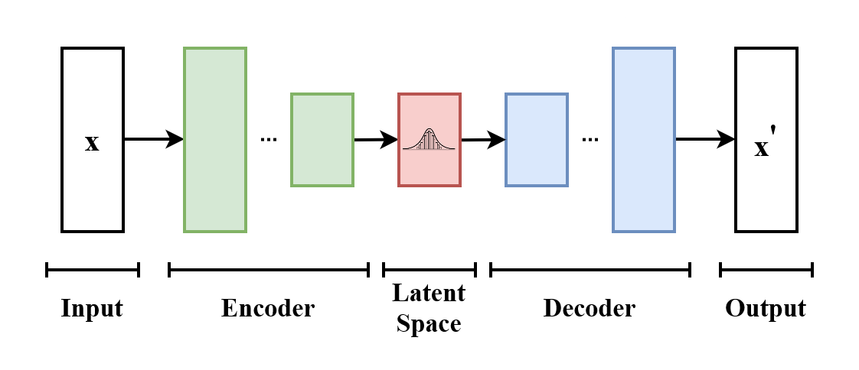
What is a latent space
“latent” == hidden information

Slide 4
How to access latent space
1. Download and prepare dataset
2. Select model with autotokenizer
3. Create encodings with autotokenizer
4. Pass encodings to the model for prediction
5. Obtain the last hidden state from the model; this is the feature vector

Slide 5
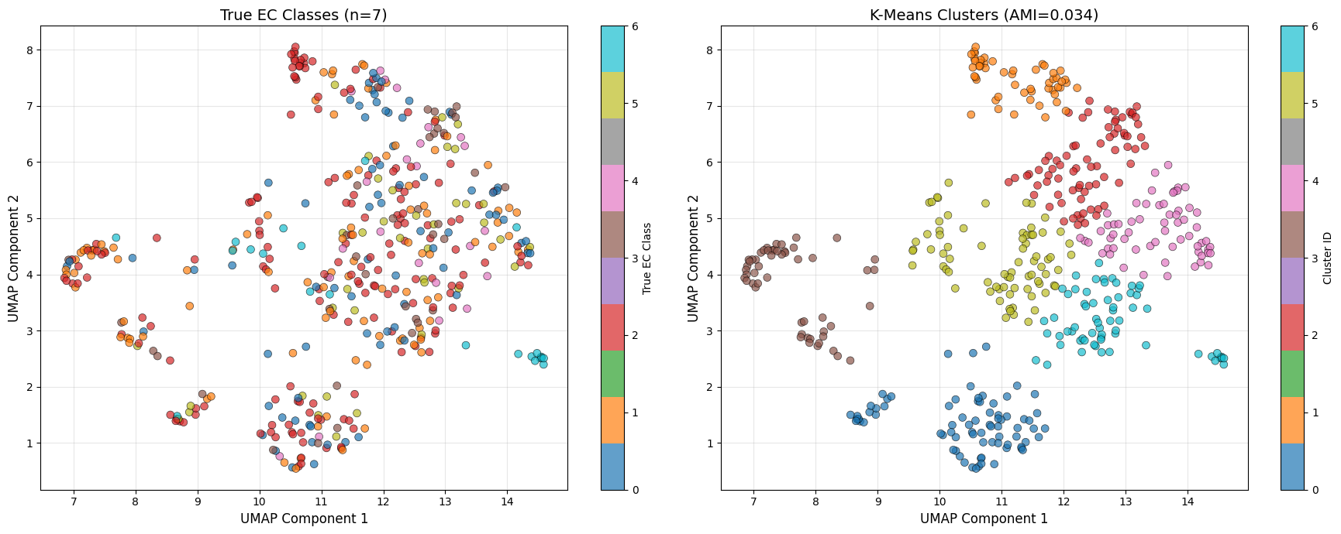
How to perform dimensionality reduction
Introduce UMAP algorithm

Slide 6
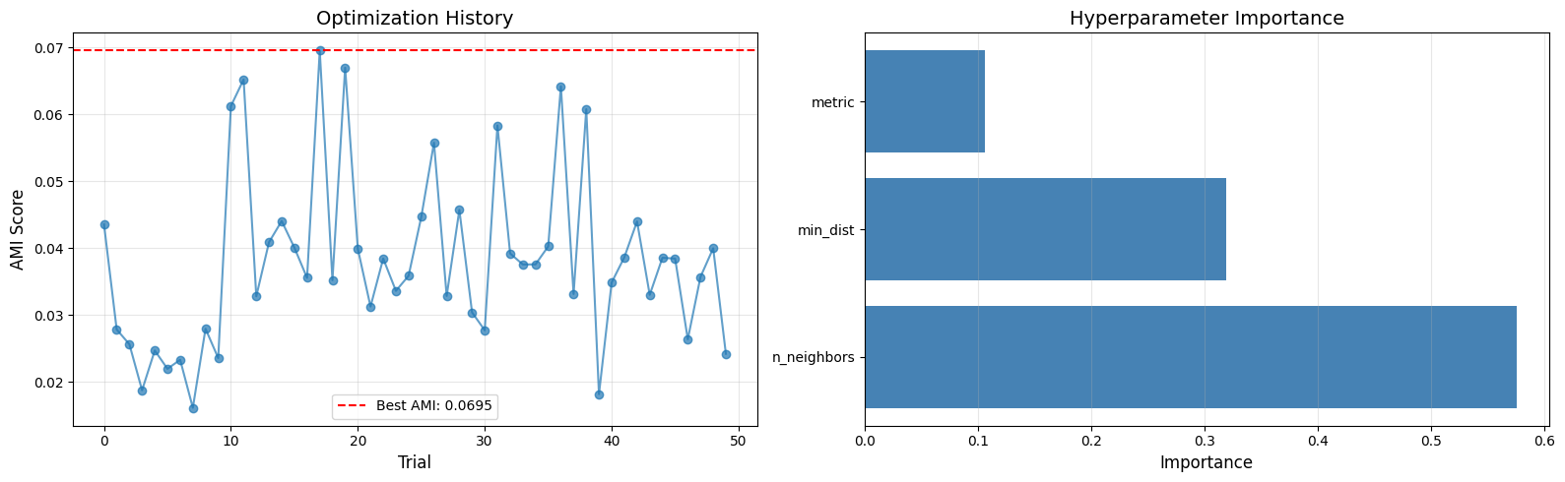
Optimize dimensionality reduction

Slide 7
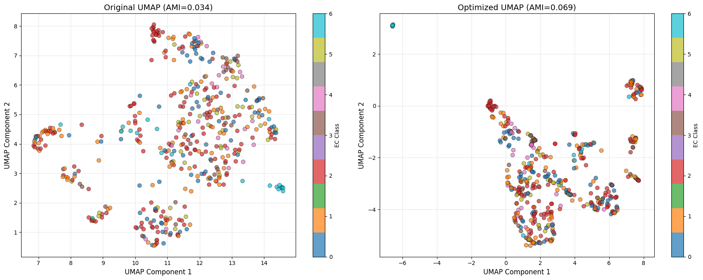
Optimize dimensionality reduction

Slide 8
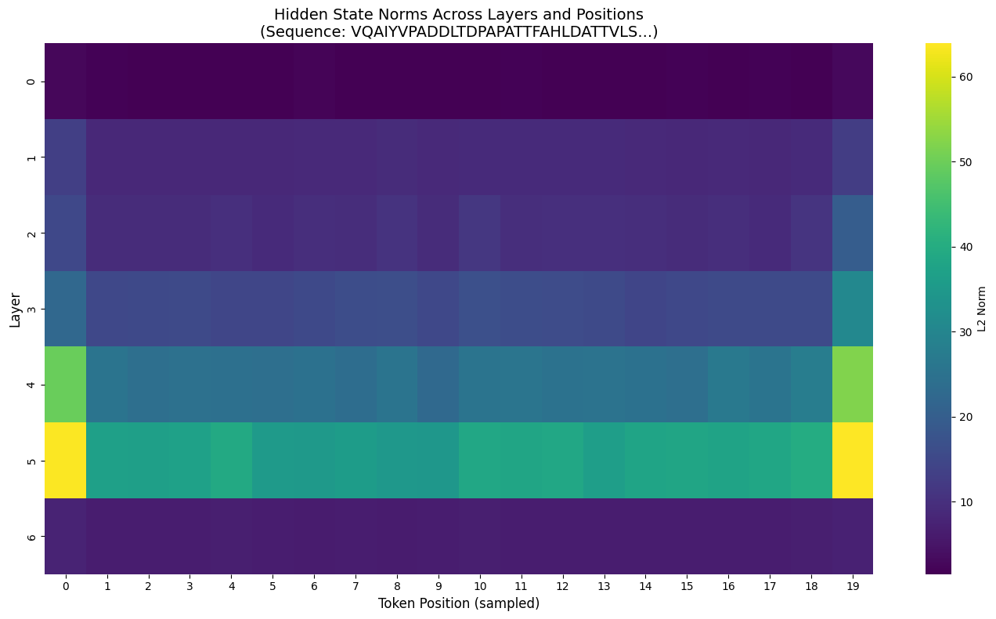
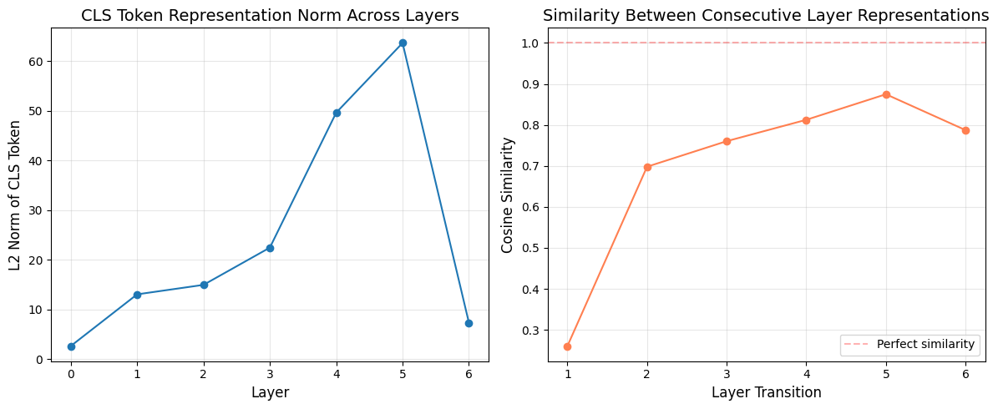
Latent Representation Through the Model

Slide 9
Things to try

Slide 10
How to use this template
Right click → rulers and guides → enable smart guides, guides and gridlines
Right click → add vertical guide and add horizontal guide (if you can’t see them already)
Do NOT move the positions of the header text boxes.
Font sizes: 36 for headings and 24 for main body text. Lato.
Colour scheme: 0795A2 , 155C7D, 00B3B5.
If 3 colours are insufficient and you need a fourth contrast colour use F26A43

Slide 11
Use text boxes, colours and bold font to highlight important information
Use Lato size 26 for headings and 18 for body text
Use text boxes, colours and bold font to highlight important information
Use text boxes, colours and bold font to highlight important information

