Slide 1
Comments
Homeworks assigned before lectures

Slide 2
Chapter 2
Examining Relationships

Slide 3
Example 2.1
Finding the most profitable price for a TV set

Slide 4
More Variable Types
Response Variable
Explanatory Variable

Slide 5
Example 2.2
Emily
Zachary
Inventory Level | Monthly Sales
Response Variable | Response Variable
Inventory Level | Monthly Sales
Explanatory Variable | Response Variable

Slide 6
More Variable Types
Explanatory variable ≡ independent variable
Response variable ≡ dependent variable

Slide 7
Exercise 2.1 (Try it)
The relationship between worker productivity and sleep
Cases
Label variable
Quantitative vs Categorical
Explanatory vs Response

Slide 8
Exercise 2.1 (Solution)
The relationship between worker productivity and sleep
Cases: Workers
Label variable: Worker’s name or ID
Quantitative vs Categorical: Can be both. E.g., hours slept or “a lot” vs “a little”
Explanatory vs Response: Probably sleep as explanatory and productivity as response. But can investigate work’s impact on sleep.

Slide 9
Scatterplots
Section 2.1

Slide 10
Exercise 2.3
Classify variables as categorical or quantitative
Is there a label variable?

Slide 11
Exercise 2.3
Classify variables as categorical or quantitative
Is there a label variable?

Slide 12
Exercise 2.3

Slide 13
Example 2.3
Scatterplot of state spending on education against population

Slide 14
Example 2.3

Slide 15
Interpreting Scatterplots
Form
Direction
Strength

Slide 16
Example 2.4
Describe the form, direction, and strength of scatterplot data using a trendline

Slide 17
Example 2.4

Slide 18
Interpreting Scatterplots
Form | Direction | Strength
Linear | Positive | Strong
Quadratic | Negative | Weak
Exponential
…
Direction is also known as association

Slide 19
Customizing the Trendline
The straight line from EG2.4 is modified by altering the smoothing parameter

Slide 20
Modifying Data Using the Log Transform
Used to make positive skewed data more Normal
Log_{e} vs log₁₀

Slide 21
Exercise 2.7

Slide 22
Example 2.5

Slide 23
Example 2.5

Slide 24
Adding Categorical Variables to Scatterplots

Slide 25
Example 1.28

Slide 26
Example 2.7

Slide 27
Example 2.7
Z, premium gasoline
X, regular gasoline
E, ethanol
D, diesel

Slide 28
Correlation
Section 2.2

Slide 29
Correlation
Correlation measures the strength of the relationship between variables

Slide 30
Correlation as a measure r
Xbar is the average of X
Ybar is the average of Y
S_{x} is the std. dev. of X
S_{y} is the std. dev. of Y

Slide 31
Exercise 2.23, 2.24

Slide 32
About Correlation
X and Y are interchangeable
X and Y must be quantitative
Unitless
Sign indicates direction
Between -1 and 1
Only for linear relationships
Susceptible to outliers

Slide 33
About Correlation

Slide 34
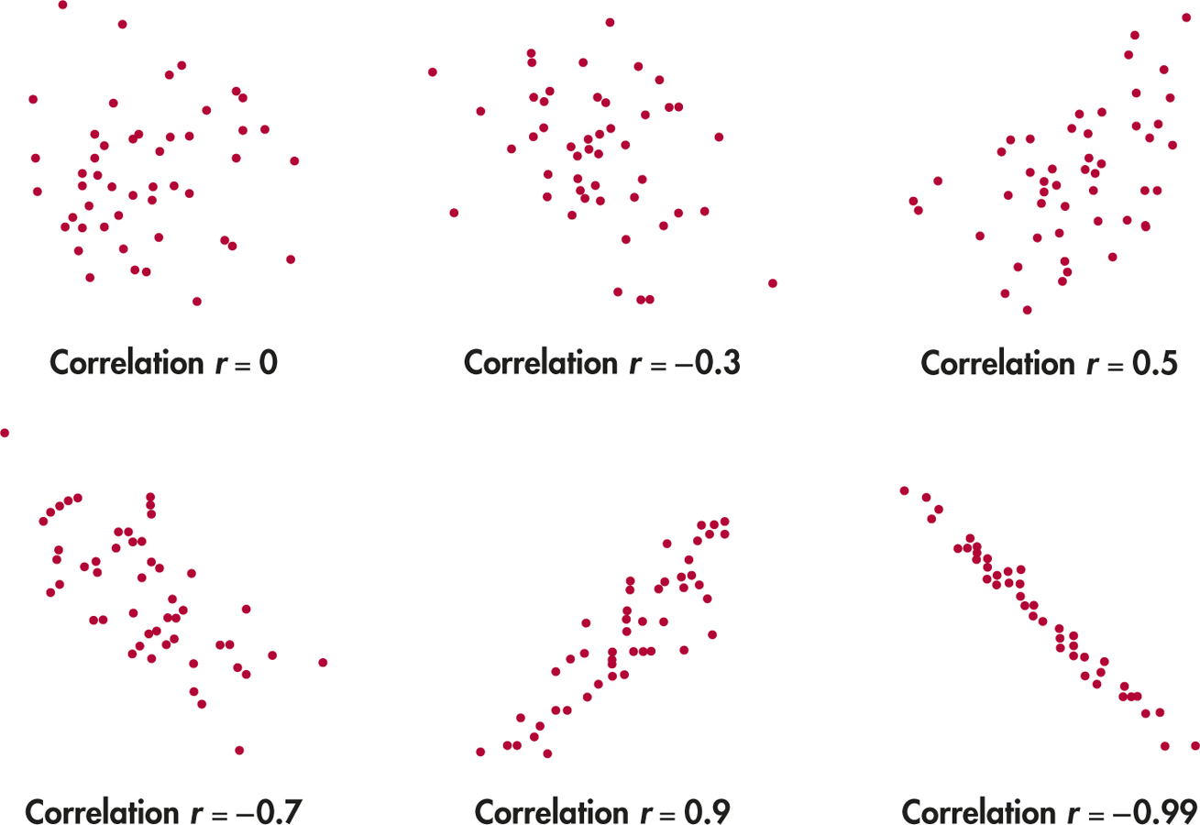
Figure 2.8

Slide 35
Least-Squares Regression
Section 2.3

Slide 36
The Regression Line
A straight line used to describe the effect of on variable on another

Slide 37
Example 2.9

Slide 38
Example 2.9
A scatterplot of GDP and Assets with a regression line.

Slide 39
Example 2.10
The least-squares regression line minimizes the overall distance of the points to the line.

Slide 40
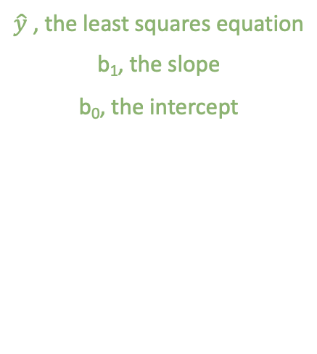
Least-Squares Regression Line Equation
$\hat{y}$ , the least squares equation
b₁, the slope
b₀, the intercept

Slide 41
Regression
Predicted vs observed responses

Slide 42
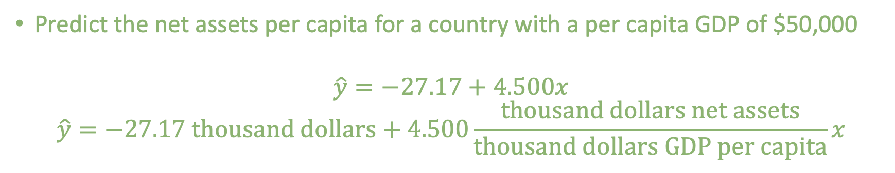
Example 2.12
Predict the net assets per capita for a country with a per capita GDP of $50,000
$$\hat{y}=−27.17+4.500x$$
$$\hat{y}=−27.17 thousand dollars+4.500\frac{thousand dollars net assets}{thousand dollars GDP per capita}x$$

Slide 43
Example 2.12

Slide 44

Exercise 2.46
$y=15+30x$
What is the slope?
What is the intercept?
Find the predicted values for x=10, x=20, and x=30
Plot the regression line for values of x between 0 and 50

Slide 45


Exercise 2.46
$y=15+30x$
What is the slope?
What is the intercept?
Find the predicted values for x=10, x=20, and x=30
Plot the regression line for values of x between 0 and 50
B1 = 30
B0 = 15
${\hat{y}}_{x=10}=315$, ${\hat{y}}_{x=20}=615$, ${\hat{y}}_{x=30}=915$
…

Slide 46

Exercise 2.46
$${\hat{y}}_{x=10}=315$$
${\hat{y}}_{x=20}=615$
${\hat{y}}_{x=30}=915$

Slide 47
Exercise 2.46
$${\hat{y}}_{x=10}=315$$
${\hat{y}}_{x=20}=615$
${\hat{y}}_{x=30}=915$

Slide 48
Exercise 2.47
See spreadsheet for steps and error calculation

Slide 49
Facts about least-squares regression
Correlation dictates how much of an impact X has on Y

Slide 50
Facts About Least-Squares Regression
Suppose b₁=1, s_{x}=1/2
Suppose r=1
To maintain equality, s_{y} must be 2
Fact 1: Correlation dictates how much of an impact X has on Y
Suppose r= 1/2
To maintain equality, s_{y} must be 1
Suppose r=0
To maintain equality, s_{y} can be any number

Slide 51
Facts about least-squares regression
Correlation dictates how much of an impact X has on Y
The least-squares regression line always goes through the means

Slide 52
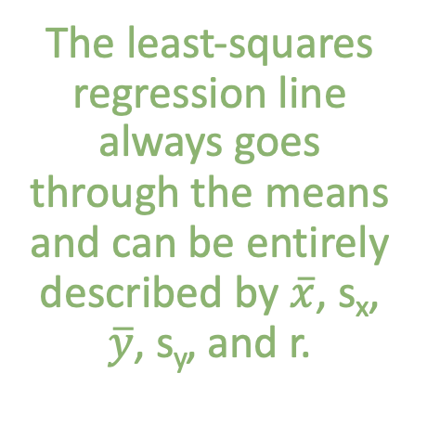
Facts About Least-Squares Regression
The least-squares regression line always goes through the means and can be entirely described by $\overline{x}$, s_{x}, $\overline{y}$, s_{y}, and r.

Slide 53
Facts about least-squares regression
Correlation dictates how much of an impact X has on Y
The least-squares regression line always goes through the means
Response and explanatory variables matter

Slide 54
Facts About Least-Squares Regression
The regression line depends on which variable is used as the explanatory variable.

Slide 55
Interpretation of r²
Two values, one real, one estimated.
Intuition for r²

Slide 56
Interpretation of r²

Slide 57
Example 2.15

Slide 58
Z-Table practice
University student monthly expenditure on Starbucks product is Normally distributed with mean $40 and standard deviation $6
A sample of FSU students has a mean of $53.02
What percent of university students spend more per month on Starbucks than the FSU sample?

Slide 59
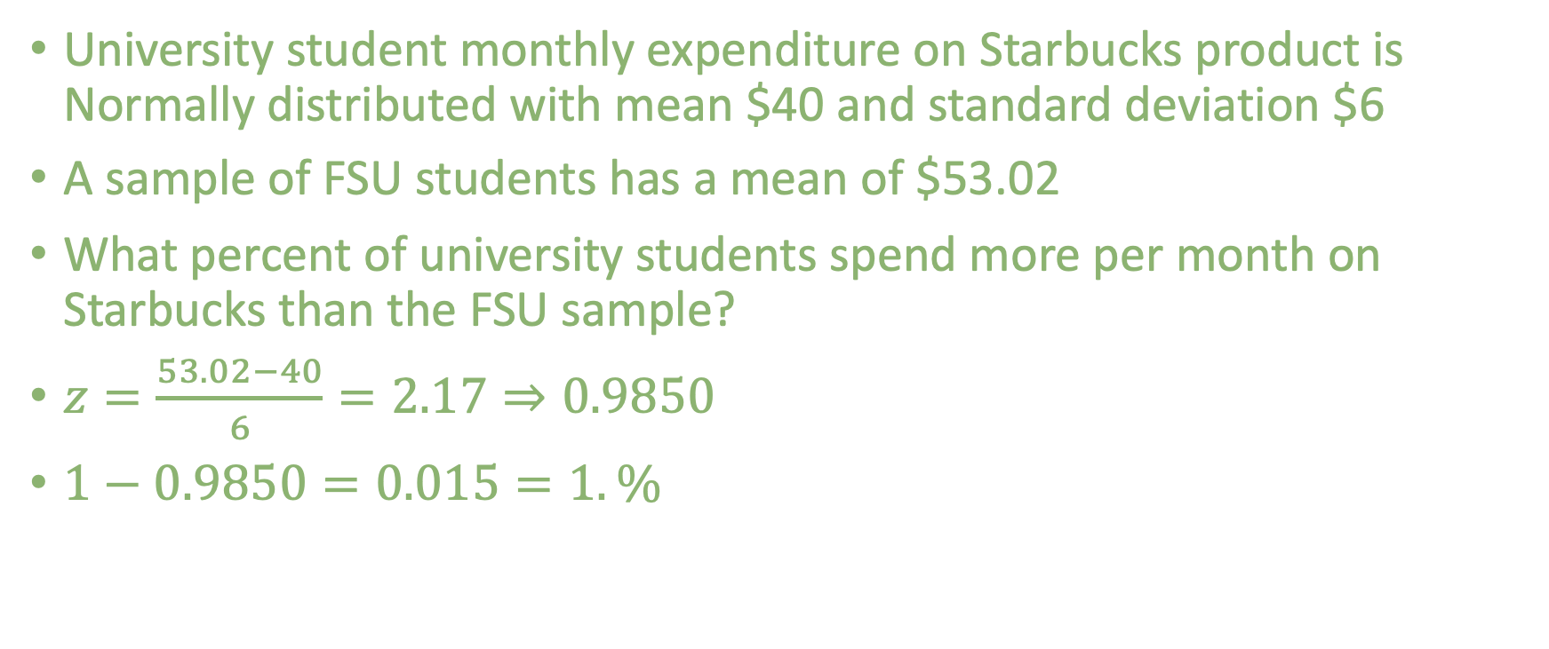
Z-Table practice
University student monthly expenditure on Starbucks product is Normally distributed with mean $40 and standard deviation $6
A sample of FSU students has a mean of $53.02
What percent of university students spend more per month on Starbucks than the FSU sample?
$z=\frac{53.02−40}{6}=2.17⇒0.9850$
$1−0.9850=0.015=1.\%$

Slide 60
Z-Table practice
Blah blah blah mean 50 and standard deviation 10
Blah blah blah 23
What percent below 23?
What percent above 23?
What percent between 23 and 50?

Slide 61
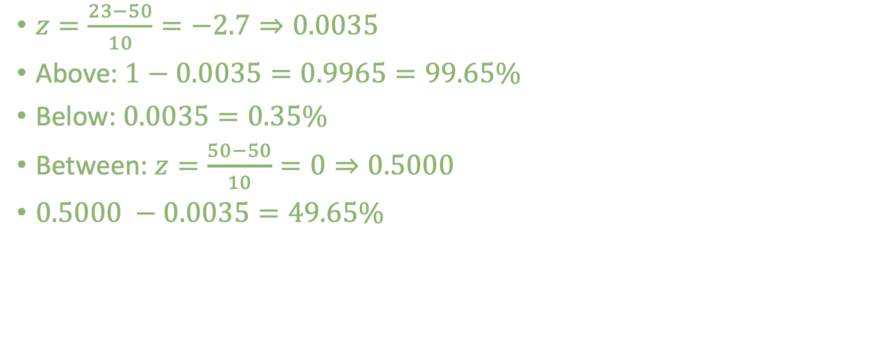
Z-Table practice
$z=\frac{23−50}{10}=−2.7⇒0.0035$
Above: $1−0.0035=0.9965=99.65\%$
Below: $0.0035=0.35\%$
Between: $z=\frac{50−50}{10}=0⇒0.5000$
$0.5000 −0.0035=49.65\%$

