Slide 1
methaNNol + (DME synthesis)
Johannes Geri

Slide 2
Where to find the relevant files for methaNNol?
Git repo: gibbsenergymininimizationmodel → Folder: PhaseStabilityTests
Files:
CubicEquationSolver.py → finds analytical roots for fugacity coefficients
EqConstant.py → might be used for comparison of equilibrium constants in methanol synthesis by GEM results and free Gibbs energies of formation in future
SRK.py → calculation of fugacity coefficients, two functions: one for VLE and one for single phase
PhaseStability.py → functions for evaluation of stability of GEM solution
Gmin.py → Gibbs Energy minimization model

Slide 3
Gibbs Energy Minimization Algorithm for VLE – Literature sources
Michelsen Part I - https://doi.org/10.1016/0378-3812(82)85001-2
Michelsen Part II - https://doi.org/10.1016/0378-3812(82)85002-4
C. Tsanas 2018 – Simulatenous Chemical and Phase Equilibrium Calculations with Non-Stoichiometric Method (Chapter 3.1.3 Stability analysis)
→ Here a brief explanatioin of the Tangent Plane Distance criterion is given
Michelsen 2007 – Thermodynamic Models: Fundamentals & Computational Aspects

Slide 4
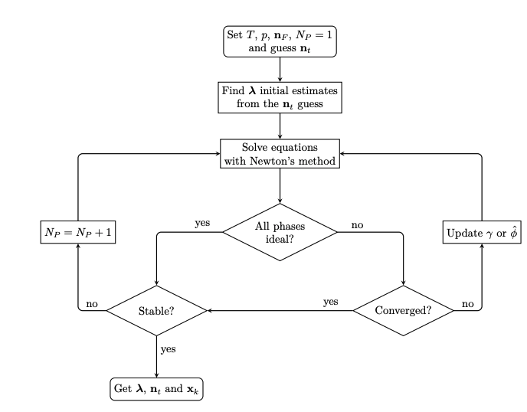
Procedure for calculating simultaneous phase and chemical equilibrium
Input for GEM solver (T, p, n₀, n_{eq,guess}), assume N_{P} = 1
1. Assume N_{P} = 1
2. Solve for equilbrium mole numbers with GEM model
3. Use Phase Stability Criterion (TPD function)
4. If solution unstable, set N_{P} = 2
5. Solve for new equilibrium solution with GEM model, now isofugacity criterion can be added during solving for G_{min}
[1] C. Tsanas, Simultaneous Chemical and Phase Equilibrium Calculations with Non-Stoichiometric Method, PhD thesis.

Slide 5
Phase stability criterion: Tangent plane distance function
Implementation in Python (all functions in PhaseStability.py)
function tpd: calculates the tangent plane distance between a trial composition and the found equilibrium solution under assumption of N_{p} = 1.
function min_tpd: minimizes the tpd function. If a composition of a trial phase is found which results in a negative value for tpd function, the found equilibrium solution is unstable
→ 2 phases are present in chemical equilibrium
For checking if another phase might be present, the function initial guesses is used which calculates the distribution coefficient according to Wilson equation
For initializing the VLE calculation ,the function init_2Ph_calc is used

Slide 6
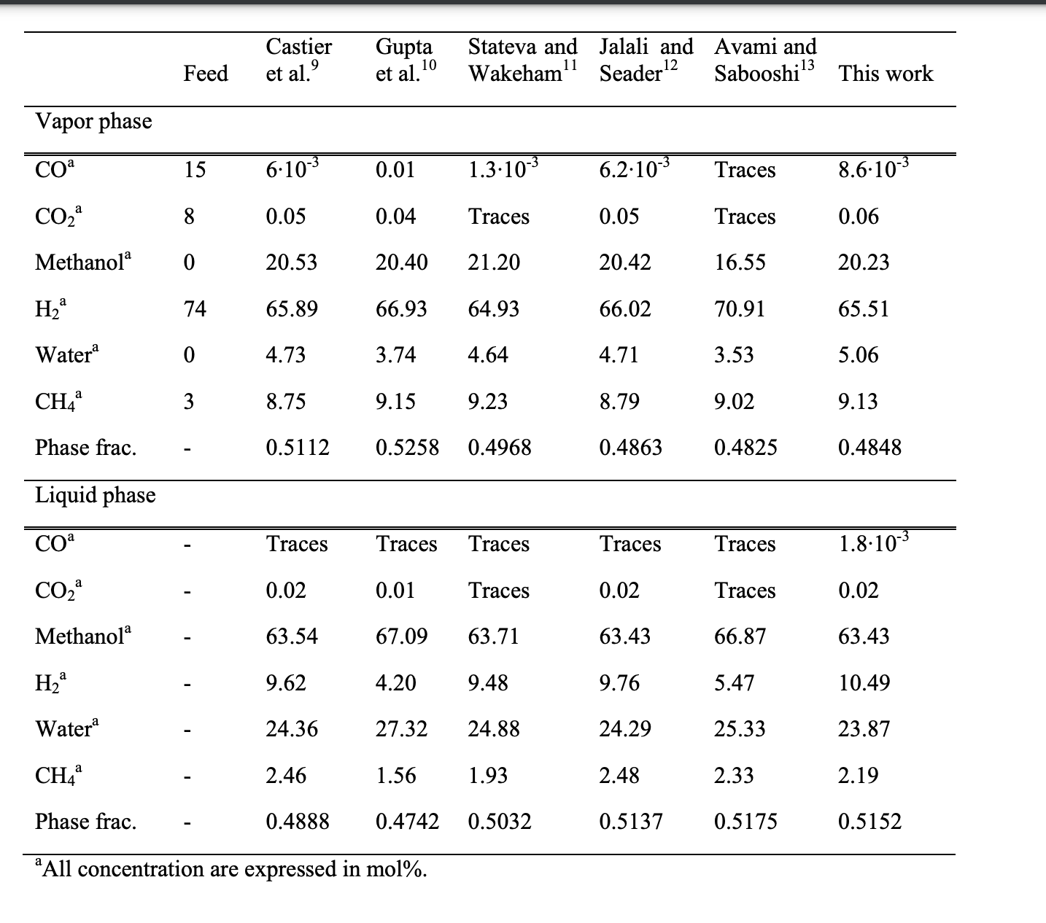
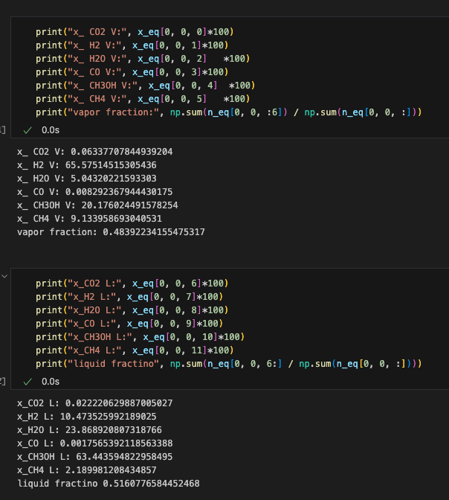
Comparison of GEM model with literature data
Stangeland 2018 - Thermodynamic Analysis of Chemical and Phase Equilibria in CO2 Hydrogenation to Methanol, Dimethyl Ether, and Higher Alcohols (https://doi.org/10.1021/acs.iecr.7b04866)
Van Bennekom 2012 - Modeling and Experimental Studies on Phase and Chemical Equilibria in High-Pressure Methanol Synthesis (https://doi.org/10.1021/ie3017362)
Van Bennekom 2012 – Table S.3 (SI); comparison for a given pressure, temperature and inlet composition

Slide 7
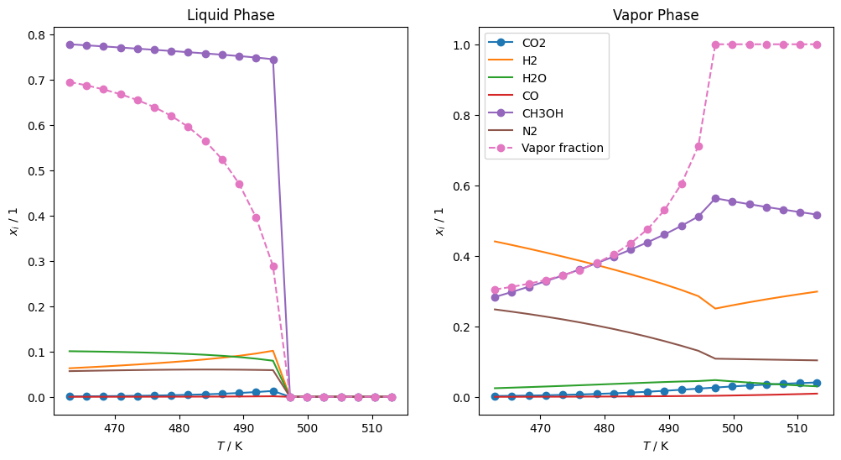
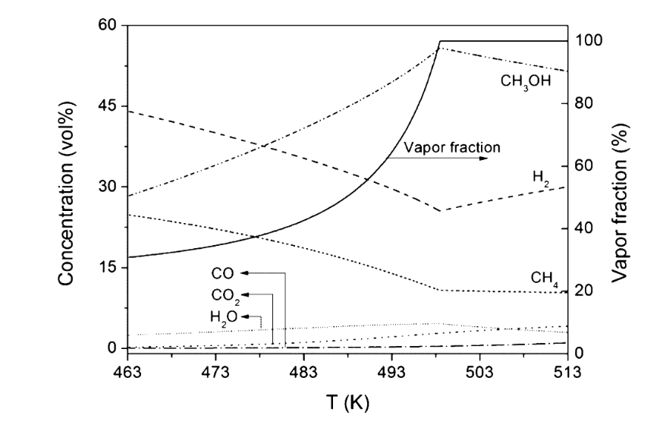
Further literature comparisons – Van Bennekom 2012 Figure 8

Slide 8
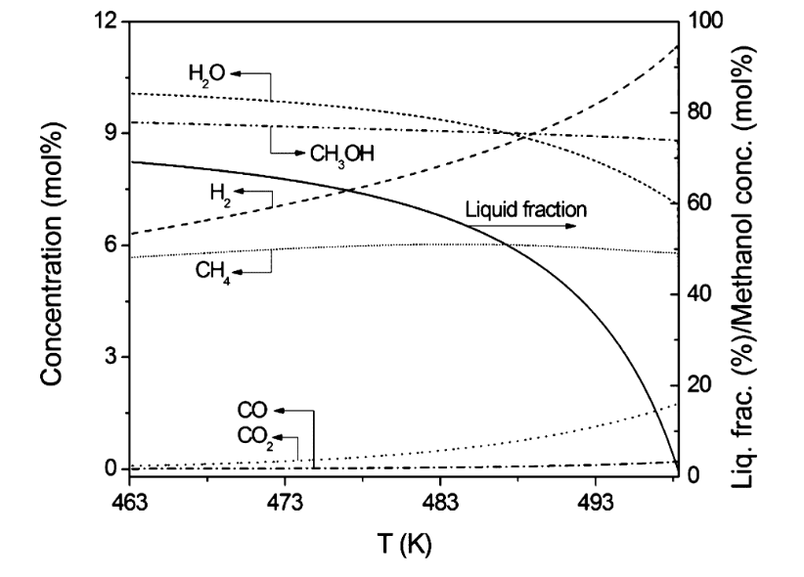
Further literature comparisons – Van Bennekom 2012 Figure 9

Slide 9
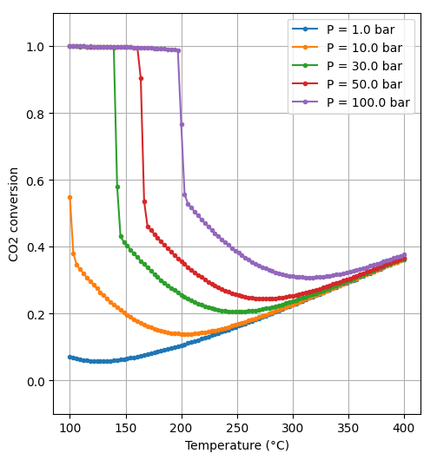
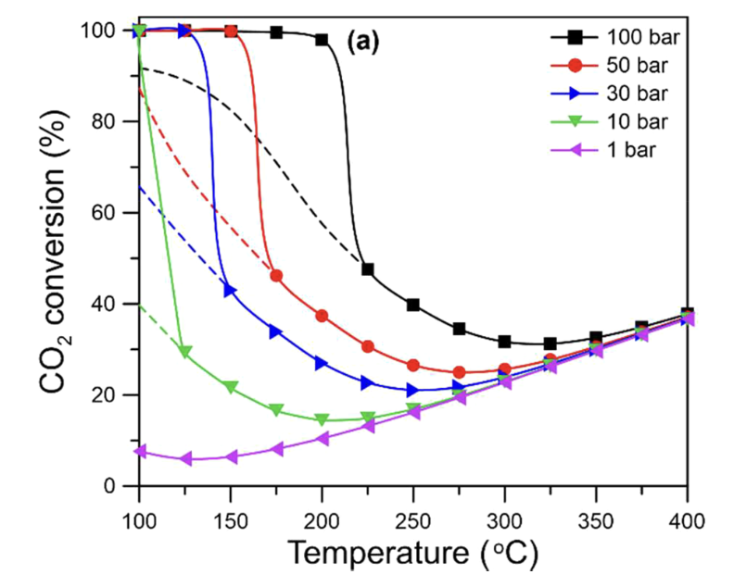
Further literature comparisons - Stangeland 2018 Figure 1 (a)

Slide 10
Current challenges/problems
Computational time: if more robust solvers like basinhopping are used, no jumps in plots in comparison to literature data were observed, see PowerPoint figures and git repo
BUT: way too time consuming, if f.e. 1e6 training data points should be generated (would take more than one week computational time on my laptop…..)
GEM with SLSQP (faster calculation):
Same problem as with methANNation: obviously wrong solution found even though solver converged → extra criterion needed to evaluate convergence
Problem: additional two phase region → what to do…?
For high temperatures however, K⁰ comparison would work very good
Nevertheless: problematic as one can never be 100% sure whether solution is correct or not
Another problem:
A criterion to determine confidently whether the single phase solution is vapor or liquid is still needed, for VLE it‘s not a problem as compressibility factors Z_{L} and Z_{v} can easily be compared

Slide 11
Acknowledgement
People: Names
Funding: Sources

