Slide 1
Machine Learning Approach for Predicting Residence Time Distribution Functions In A Plug Flow Reactor
Tuana Oyuncu

Slide 2

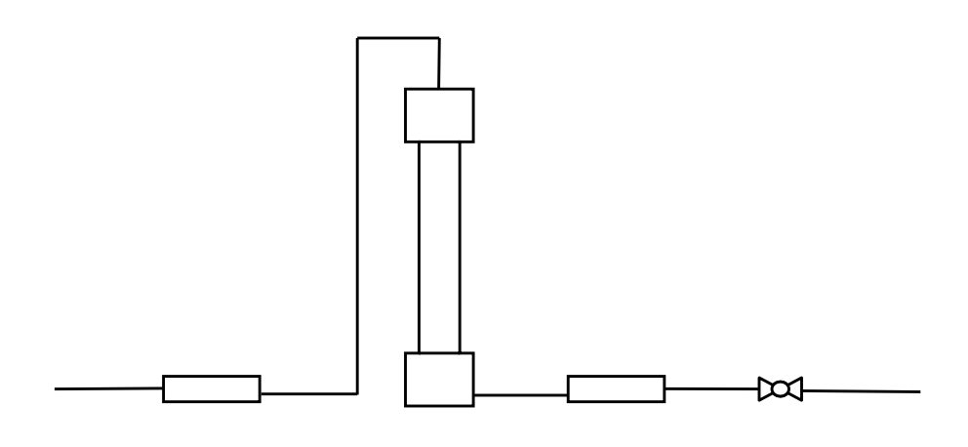

Experimental Set-up
RTD 3
3
RTD 4
(new MS)
4
2
1
RTD 2 (old MS)
RTD 1 (old MS)

Slide 3
RTD 3
3
RTD 4
4
2
1
RTD 2
RTD 1

Slide 4

Computer
MS Instrument
MS Capillary
Reactor
1
1st Pipe
2
3
2nd Pipe
4

Slide 5
C_{in}
C_{out}
E
C
t

Slide 6
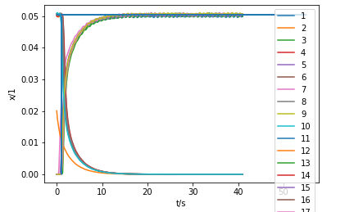
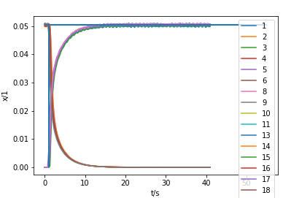
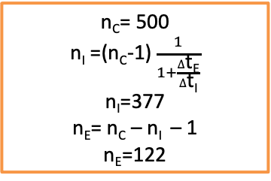

1. RTD
The RTD at the first point which represents the RTD of the MS capillary.
The data is from the old MS and the duration of the experiment is 41 sc.
$∆$t_{c}= 41 s
$∆$t_{E}= 10 s
$∆$t_{I}= $∆$t_{c}- $∆$t_{E}
$∆$t_{I}= 31 s
n_{C}= 500
n_{I} =(n_{C}-1) $\frac{1}{1+\frac{∆\text{t}\text{E}}{∆\text{t}\text{I}}}$
n_{I}=377
n_{E}= n_{C} – n_{I} – 1
n_{E}=122
&
Total flow rate : 100
Elimination of
data set : 7, 12

Slide 7
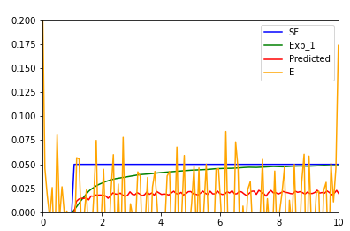
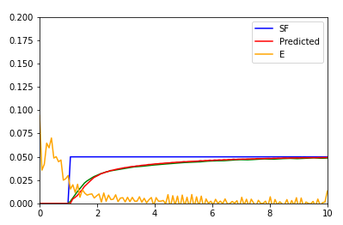
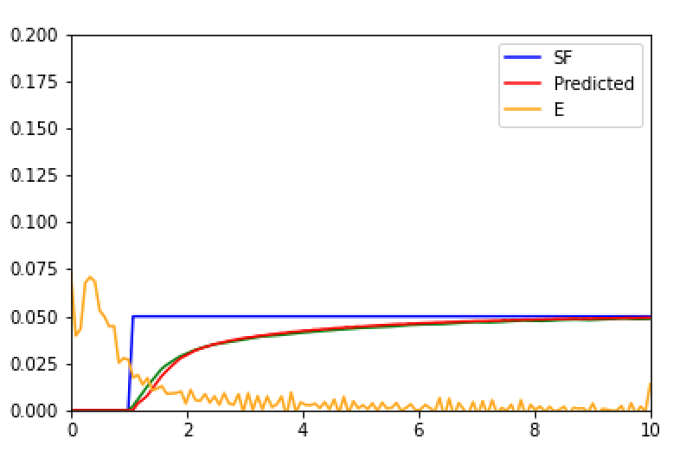
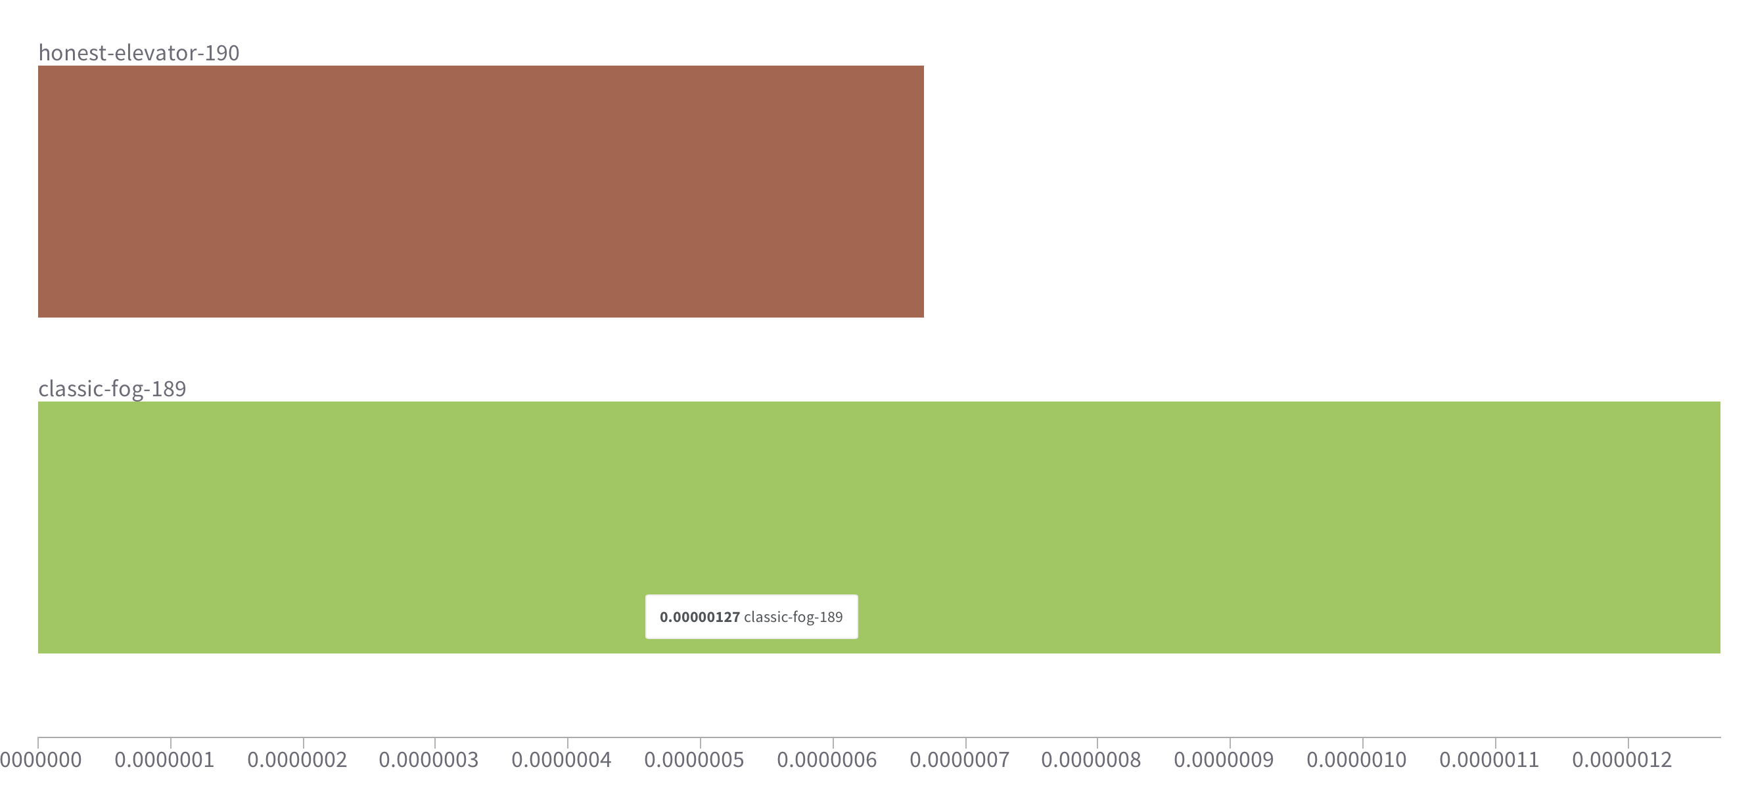
Question:
Better results with elimintaion

Slide 8
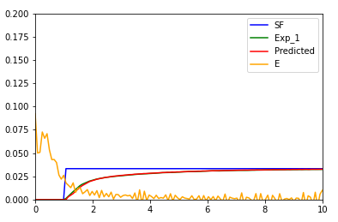
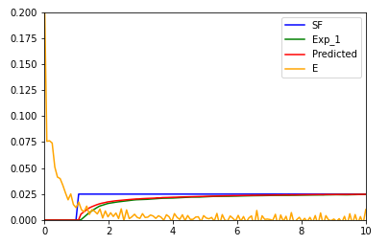
1. RTD
Total flow rate : 150
Total flow rate : 200

Slide 9
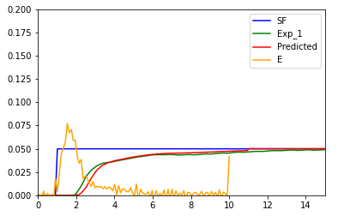
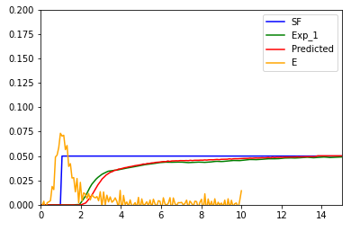
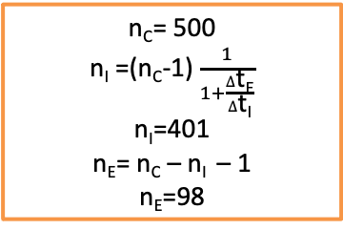

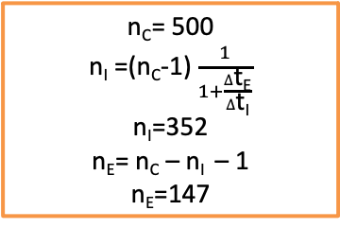

2. RTD
The RTD at the end of the first laminar behaviour tube. (Just right before the reactor)
$∆$t_{c}= 51 s
$∆$t_{E}= 10 s
$∆$t_{I}= $∆$t_{c}- $∆$t_{E}
$∆$t_{I}= 41 s
n_{C}= 500
n_{I} =(n_{C}-1) $\frac{1}{1+\frac{∆\text{t}\text{E}}{∆\text{t}\text{I}}}$
n_{I}=401
n_{E}= n_{C} – n_{I} – 1
n_{E}=98
&
OR
$∆$t_{c}= 51 s
$∆$t_{E}= 15 s
$∆$t_{I}= $∆$t_{c}- $∆$t_{E}
$∆$t_{I}= 36 s
n_{C}= 500
n_{I} =(n_{C}-1) $\frac{1}{1+\frac{∆\text{t}\text{E}}{∆\text{t}\text{I}}}$
n_{I}=352
n_{E}= n_{C} – n_{I} – 1
n_{E}=147
&

Slide 10
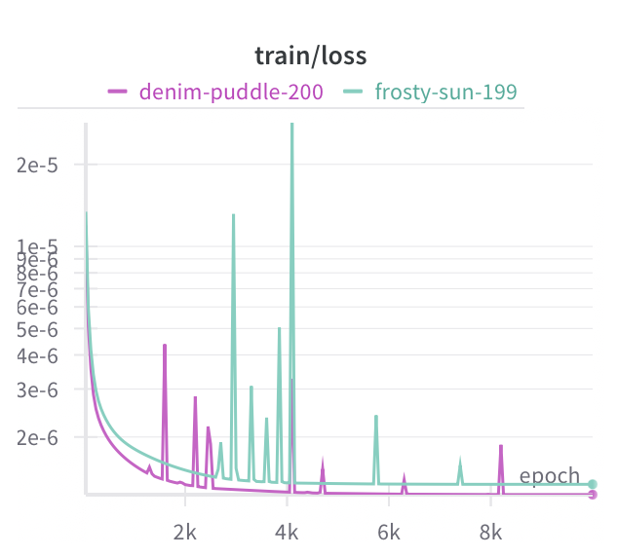
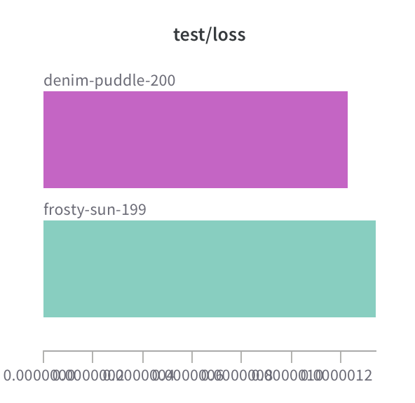
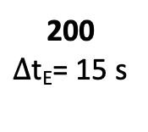
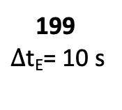
2. RTD
199
$∆$t_{E}= 10 s
200
$∆$t_{E}= 15 s

Slide 11
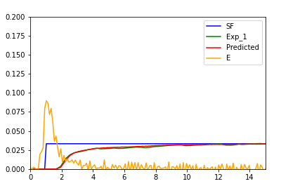
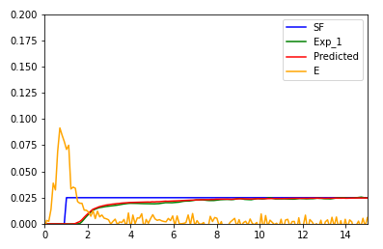
2. RTD
Total flow rate : 150
Total flow rate : 200

Slide 12
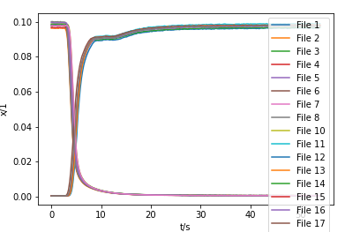
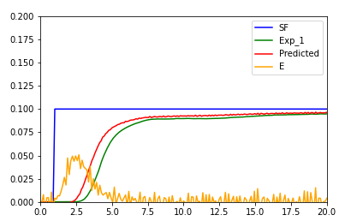
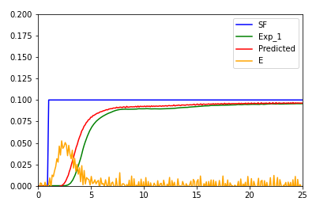
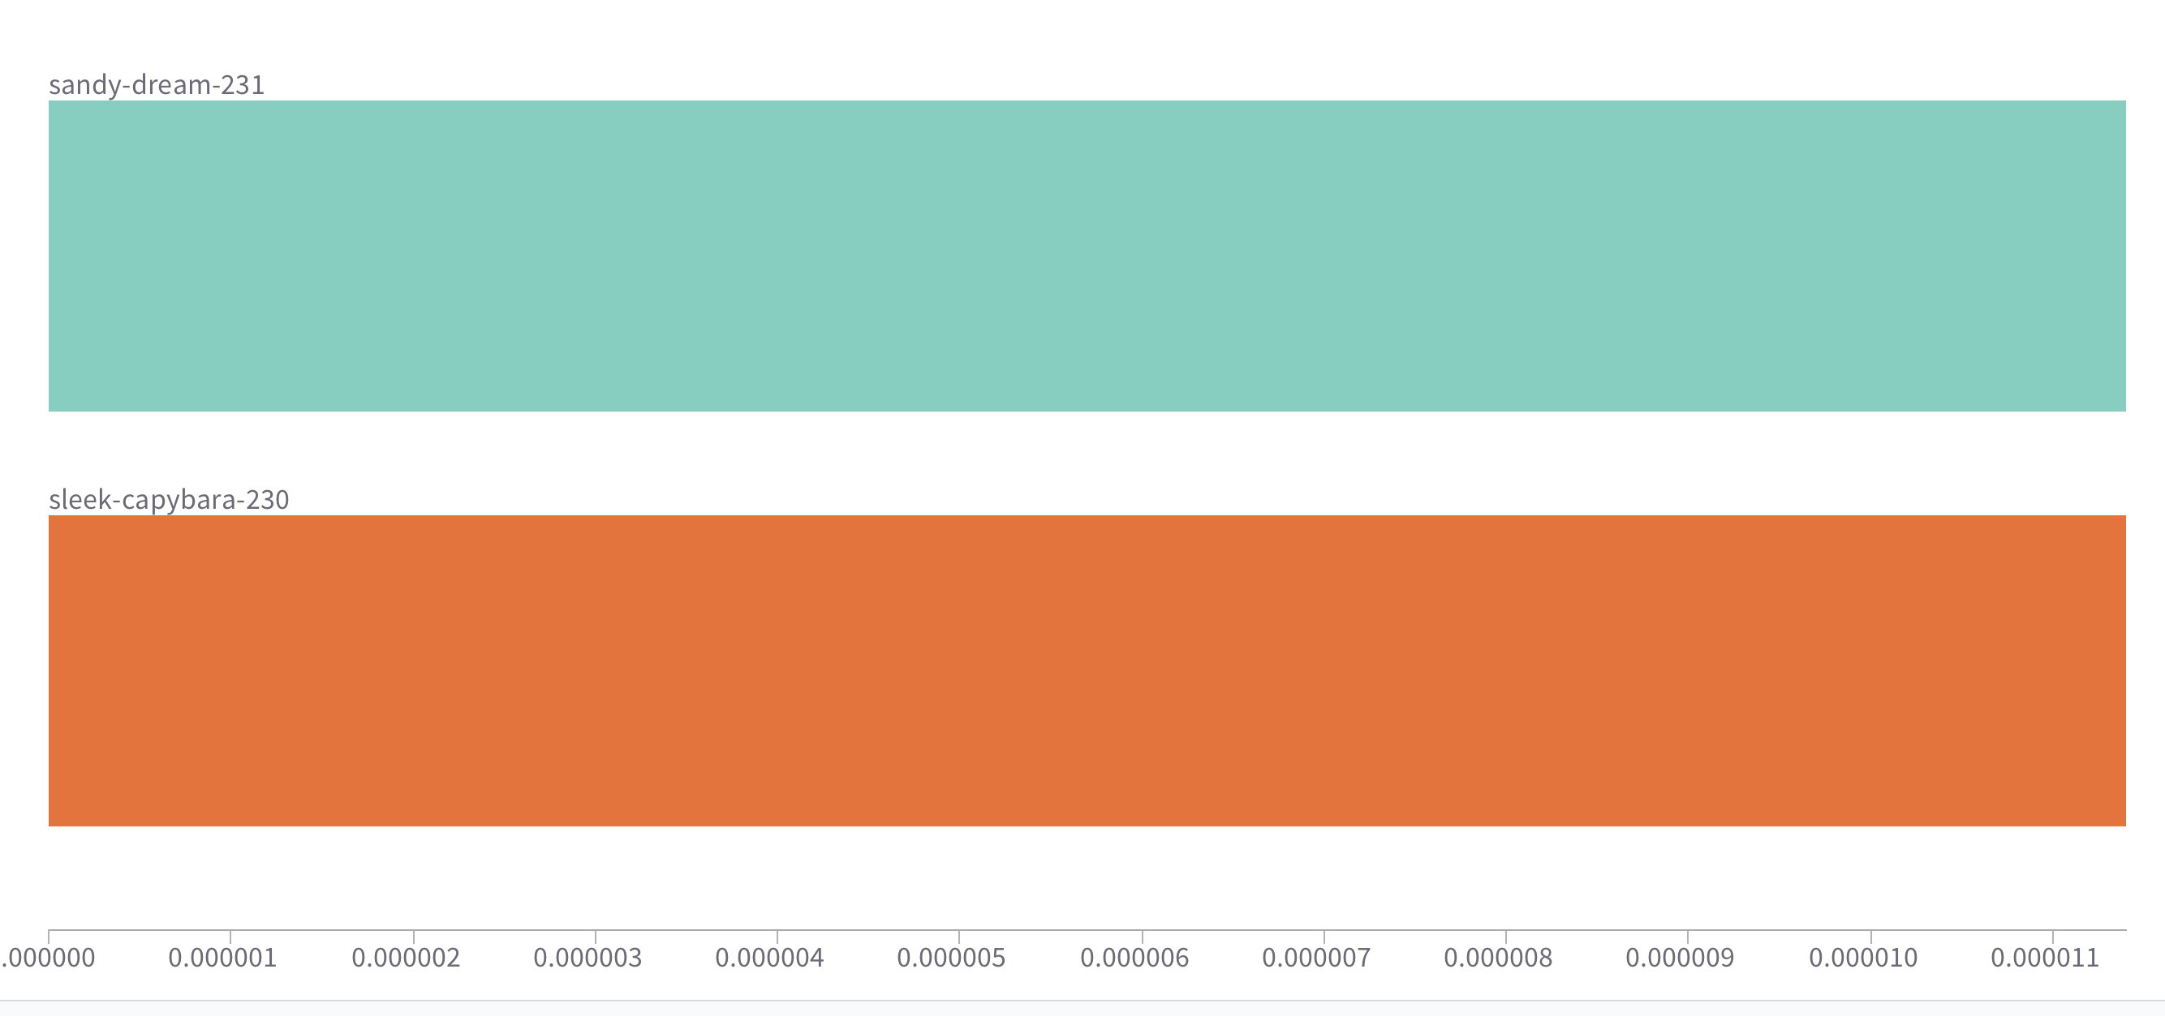
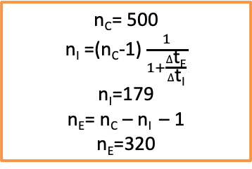

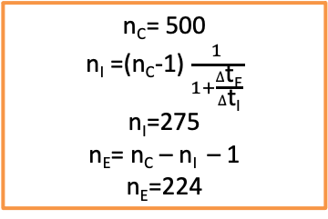

4. RTD
It represents the whole set-up which includes :
MS Capillary
1st tube
Reactor
2nd tube
$∆$t_{c}= 56 s
$∆$t_{E}= 20 s
$∆$t_{I}= $∆$t_{c}- $∆$t_{E}
$∆$t_{I}= 36 s
n_{C}= 500
n_{I} =(n_{C}-1) $\frac{1}{1+\frac{∆\text{t}\text{E}}{∆\text{t}\text{I}}}$
n_{I}=179
n_{E}= n_{C} – n_{I} – 1
n_{E}=320
$∆$t_{c}= 56 s
$∆$t_{E}= 25 s
$∆$t_{I}= $∆$t_{c}- $∆$t_{E}
$∆$t_{I}= 31 s
n_{C}= 500
n_{I} =(n_{C}-1) $\frac{1}{1+\frac{∆\text{t}\text{E}}{∆\text{t}\text{I}}}$
n_{I}=275
n_{E}= n_{C} – n_{I} – 1
n_{E}=224
OR
Total flow rate : 100

Slide 13
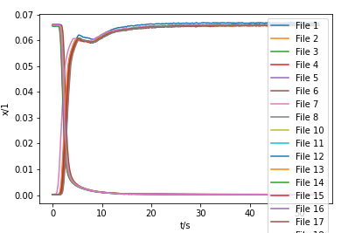
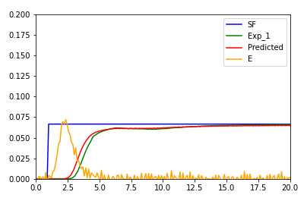
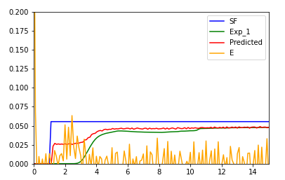
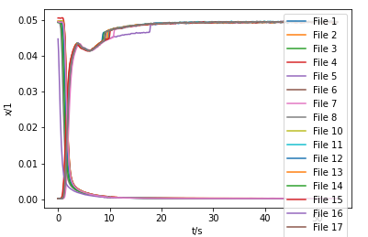
4. RTD

Slide 14
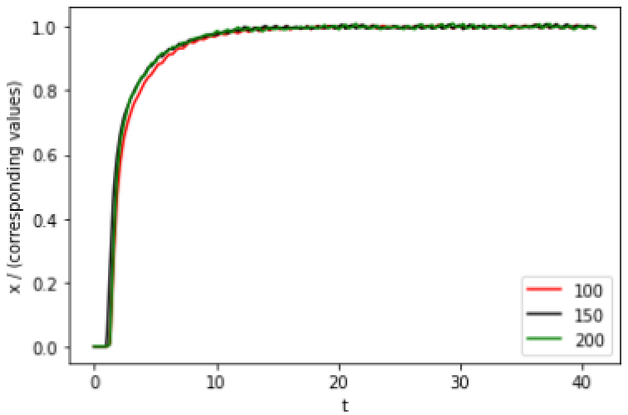
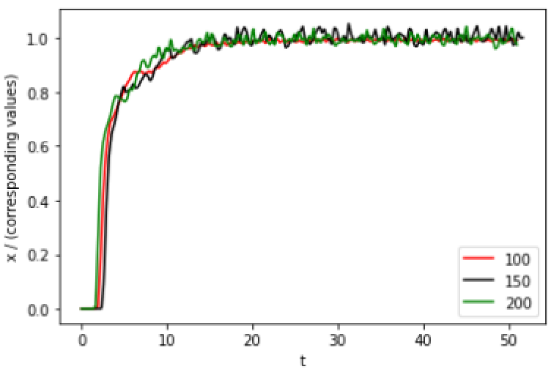
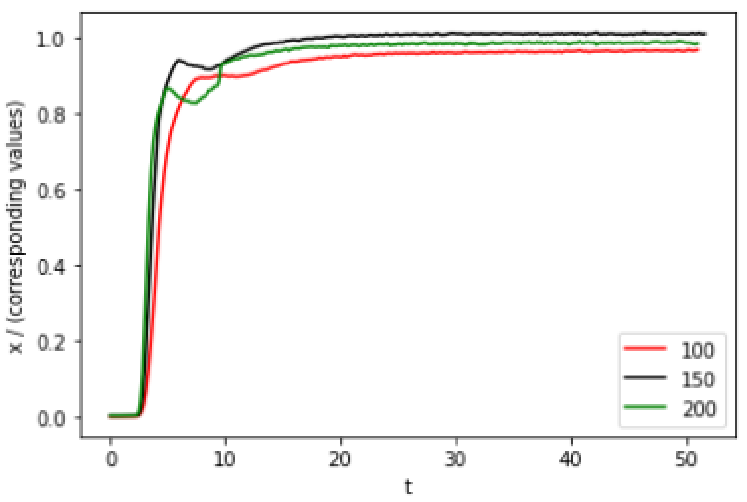
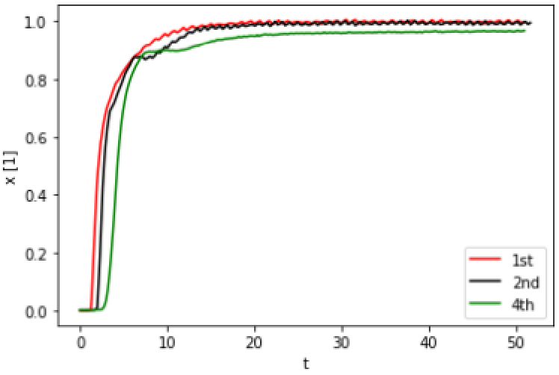
Normalized RTD
- 1st :
- 2nd :
- 4th :

Slide 15
Parameter Variation

Slide 16
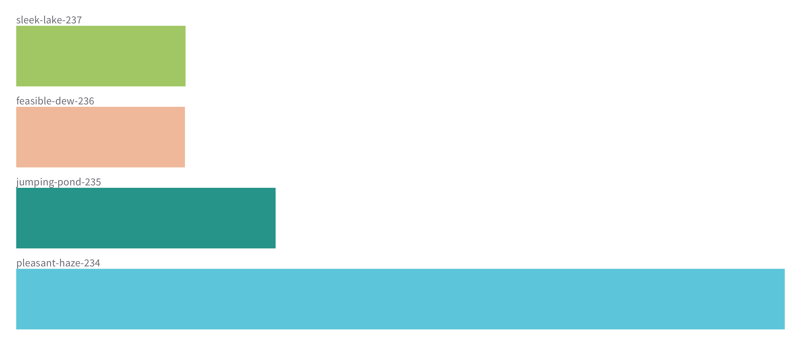
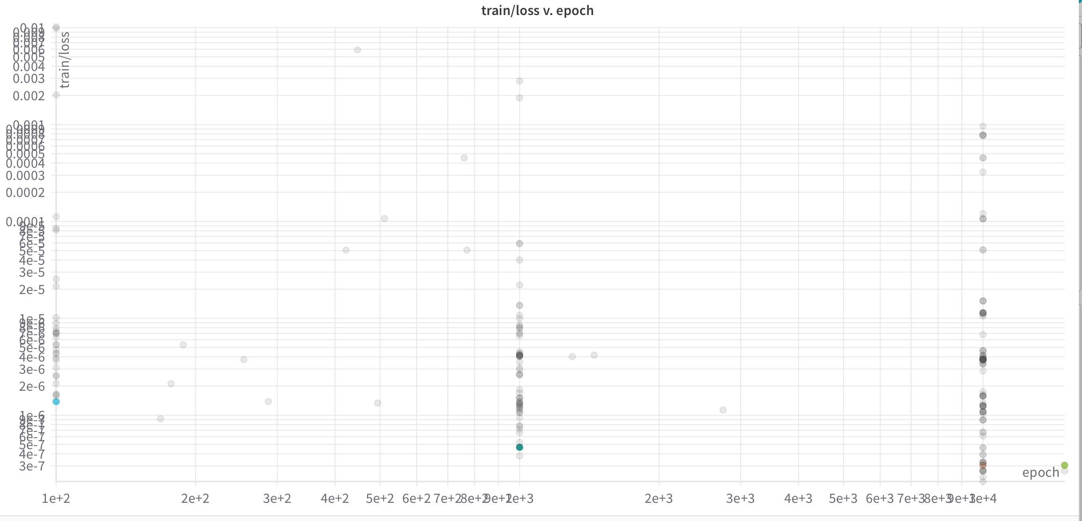
Epoch
S_233 = 10---0.000003730136995727662
S_234 = 100 --0.0000013833750927005894
S_235 = 1000 --4.6712145262972626e-7
S_236 = 10000 (epoch) 0.000003771
S_237 = 15000 (epoch) 3.042388527774165e-7

Slide 17
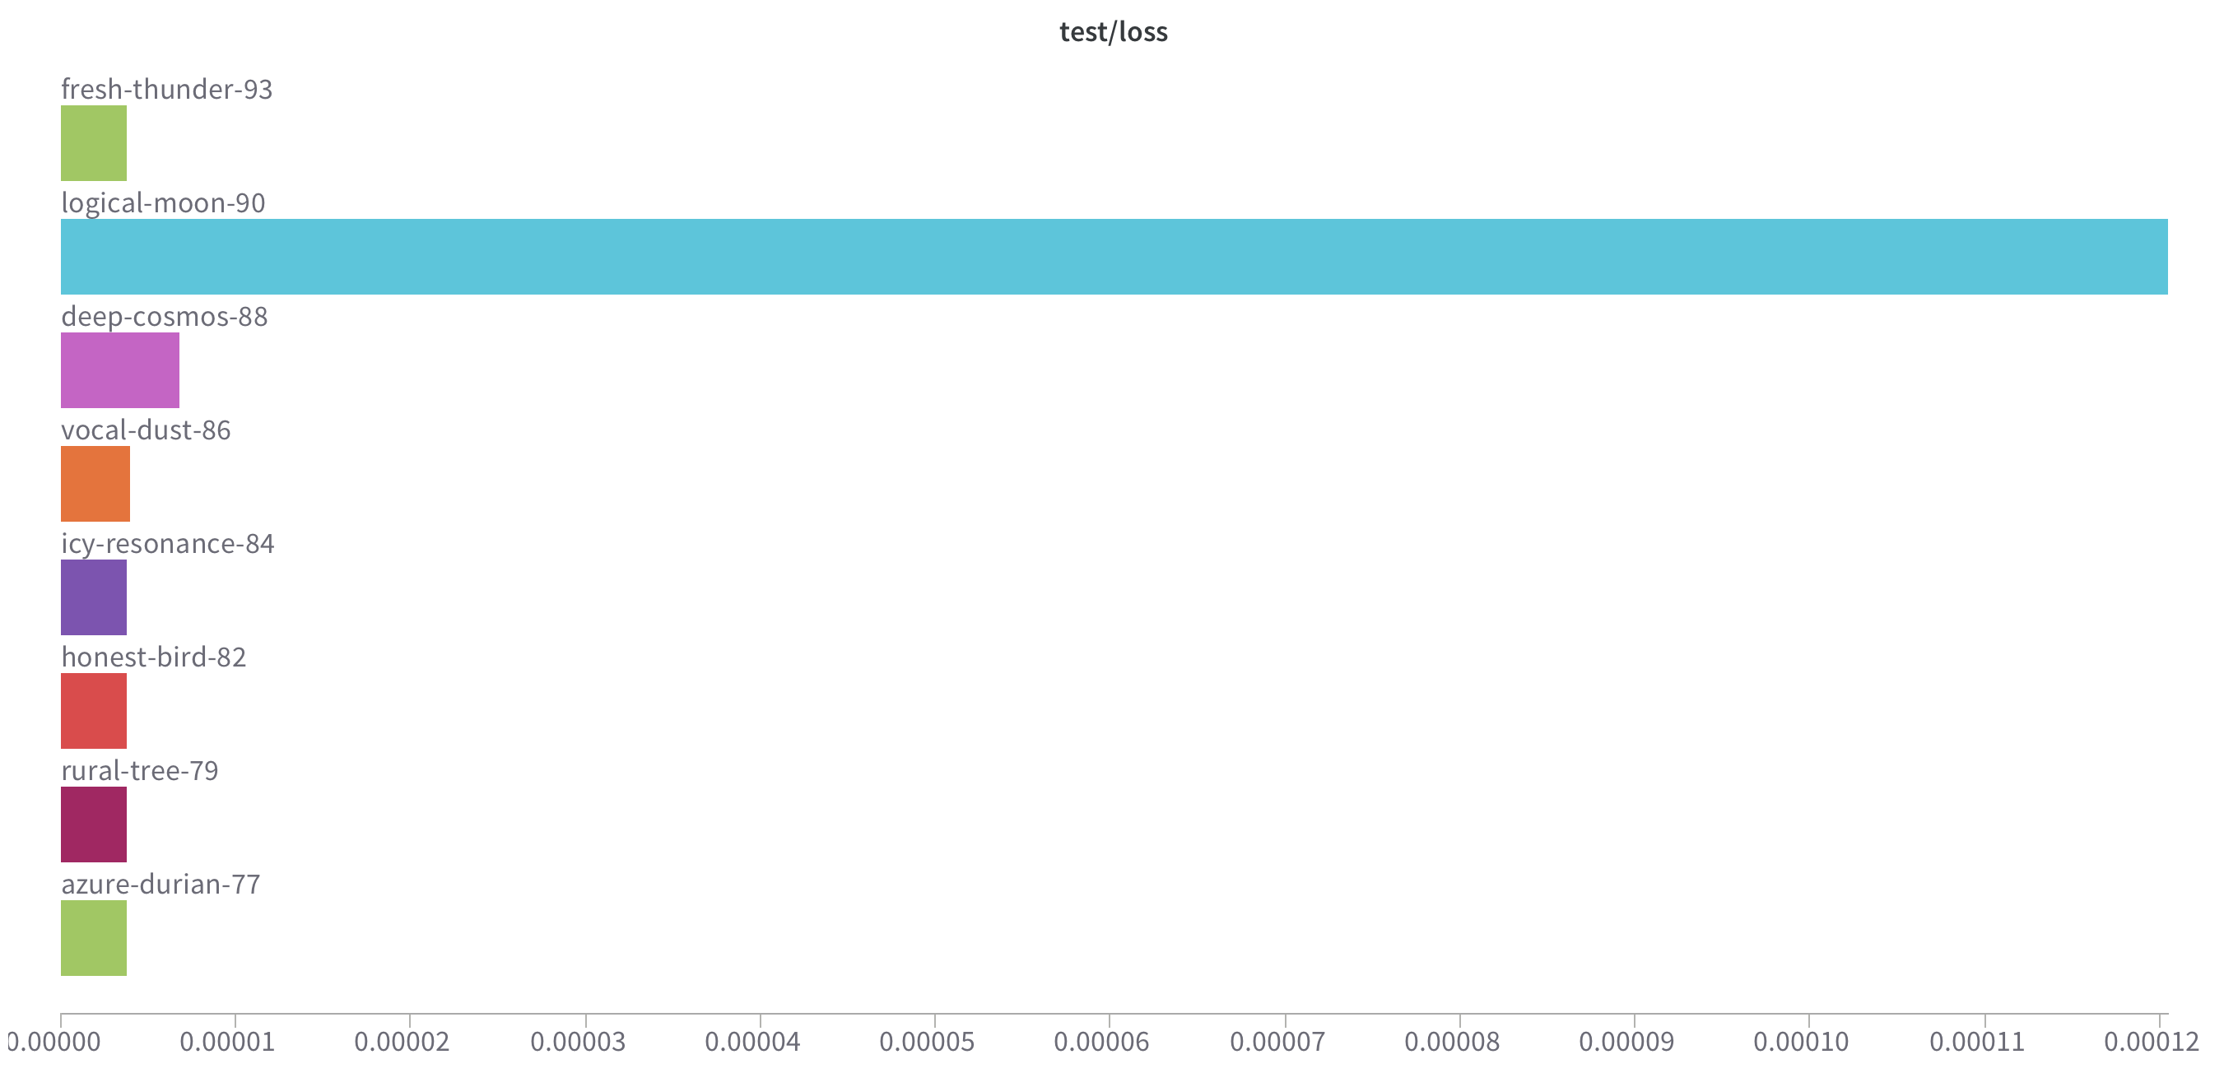
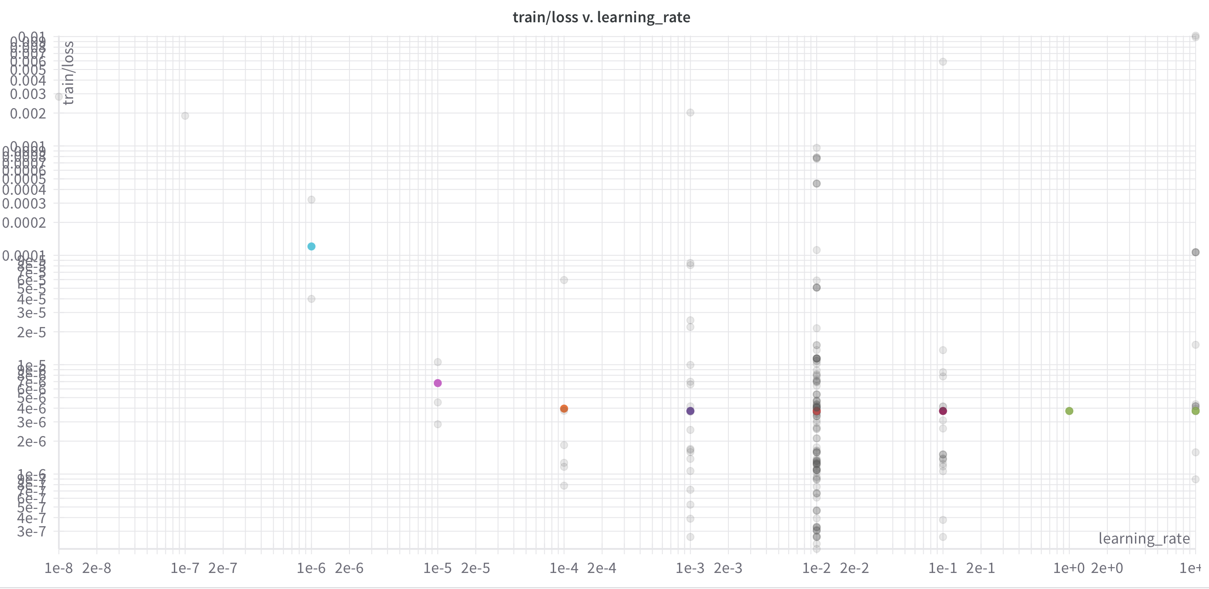
Learning Rate
S_93 = 10 (LR)- 0.000003781437499128515
S_77 = 1 (LR)- 0.00000377167566512071
S_79= 0.1 (LR)- 0.0000037723552850366104
S_82 = 0.01 (LR)- 0.0000037716872611781582
S_84 = 0.001 (LR)- 0.0000037750476167275338
S_86 = 0.0001 (LR)- 0.000003964139068557415
S_88 = 0.00001 (LR)- 0.000006785072400816716
S_90 = 0.000001 (LR)- 0.00012050408258801326

Slide 18
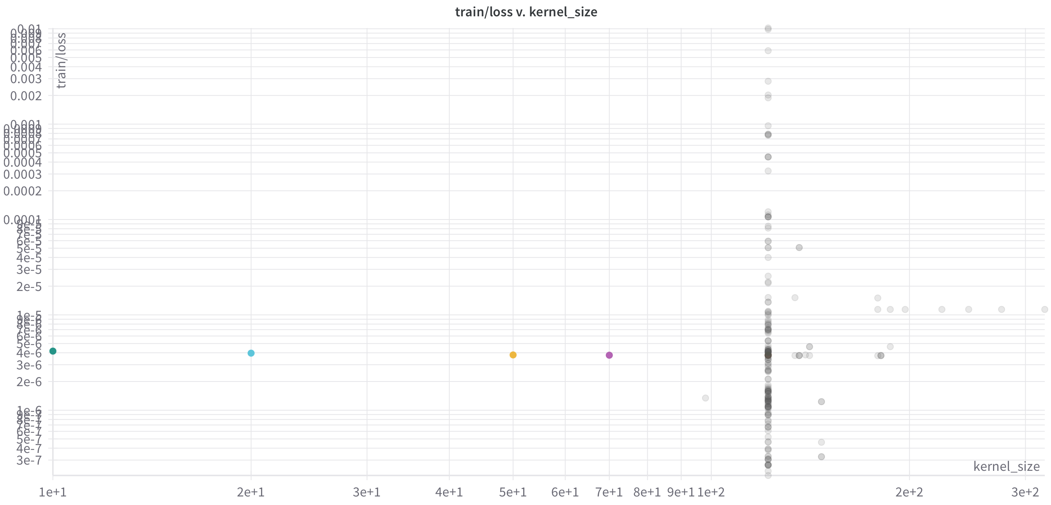
Kernel size
S_102= 122 (KS)- 0.000003781106670430745
S_104= 70 (KS)-
S_105= 50 (KS)
S_106= 20 (KS)
S_107= 10 (KS)

Slide 19
- 1st :
- 2nd :

Slide 20
- 3rd :

Slide 21
Thank you !

Slide 22
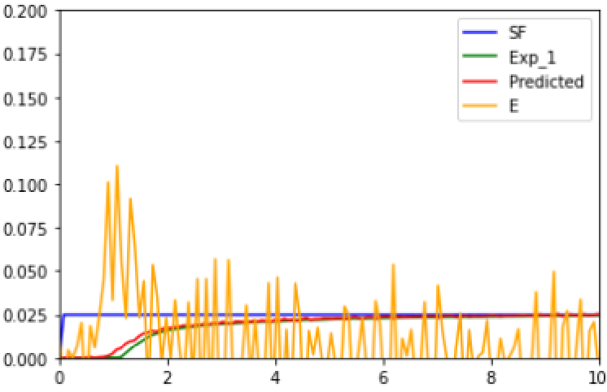
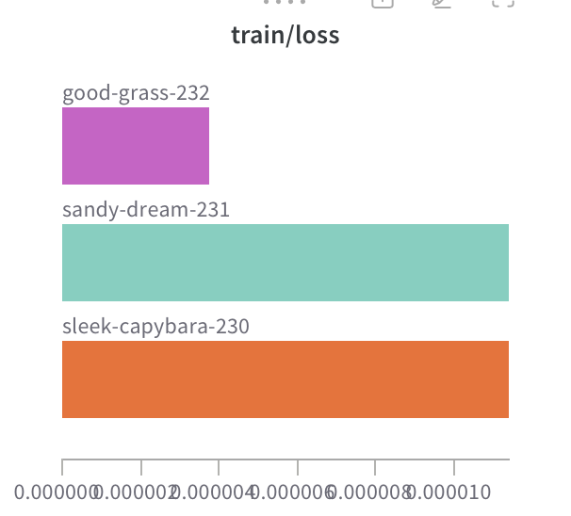
Appendix

Slide 23
Pulse Injection
Pulse Response
C(t) Curve
C
C
0
t
Step Injection
Step Response
C
C
0
t

Slide 24
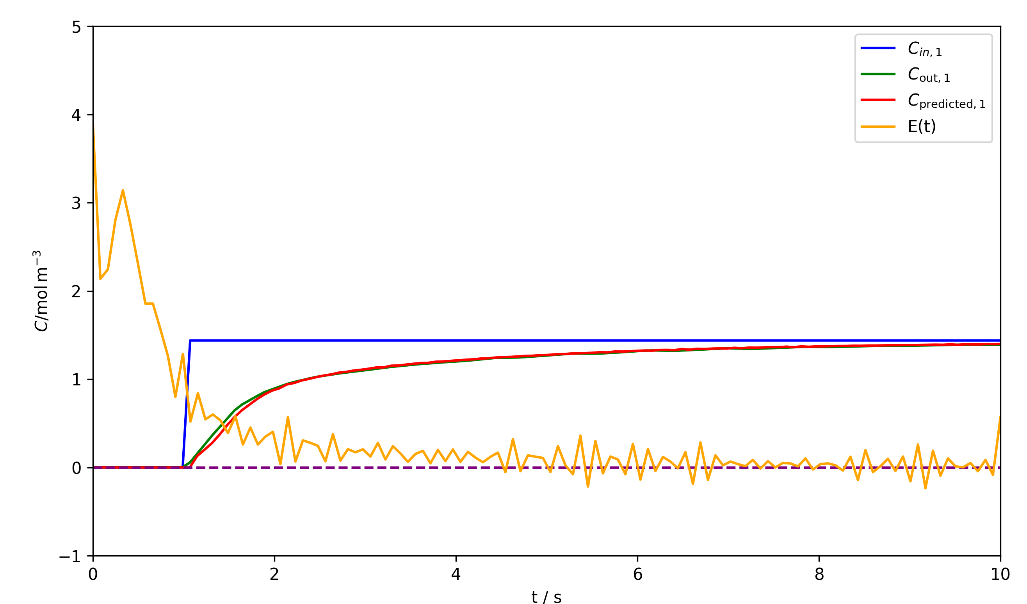
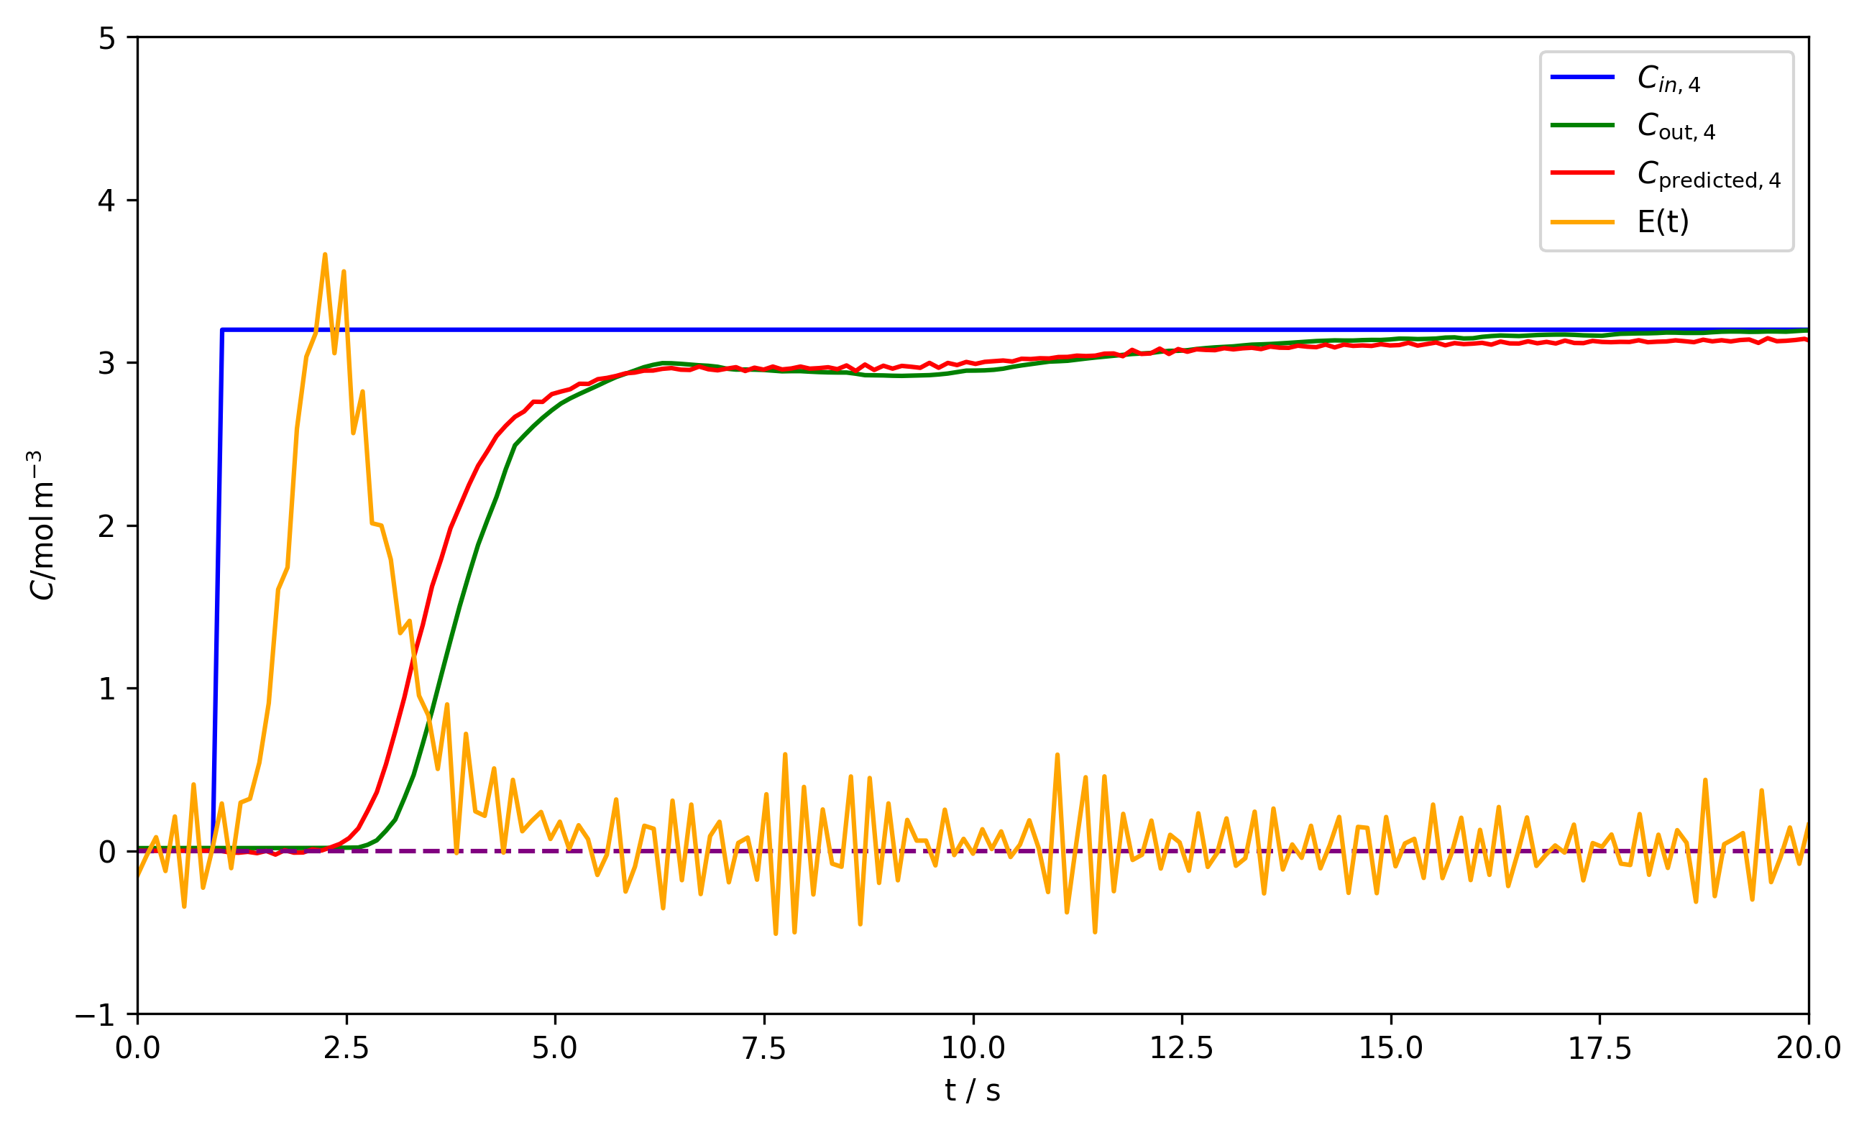
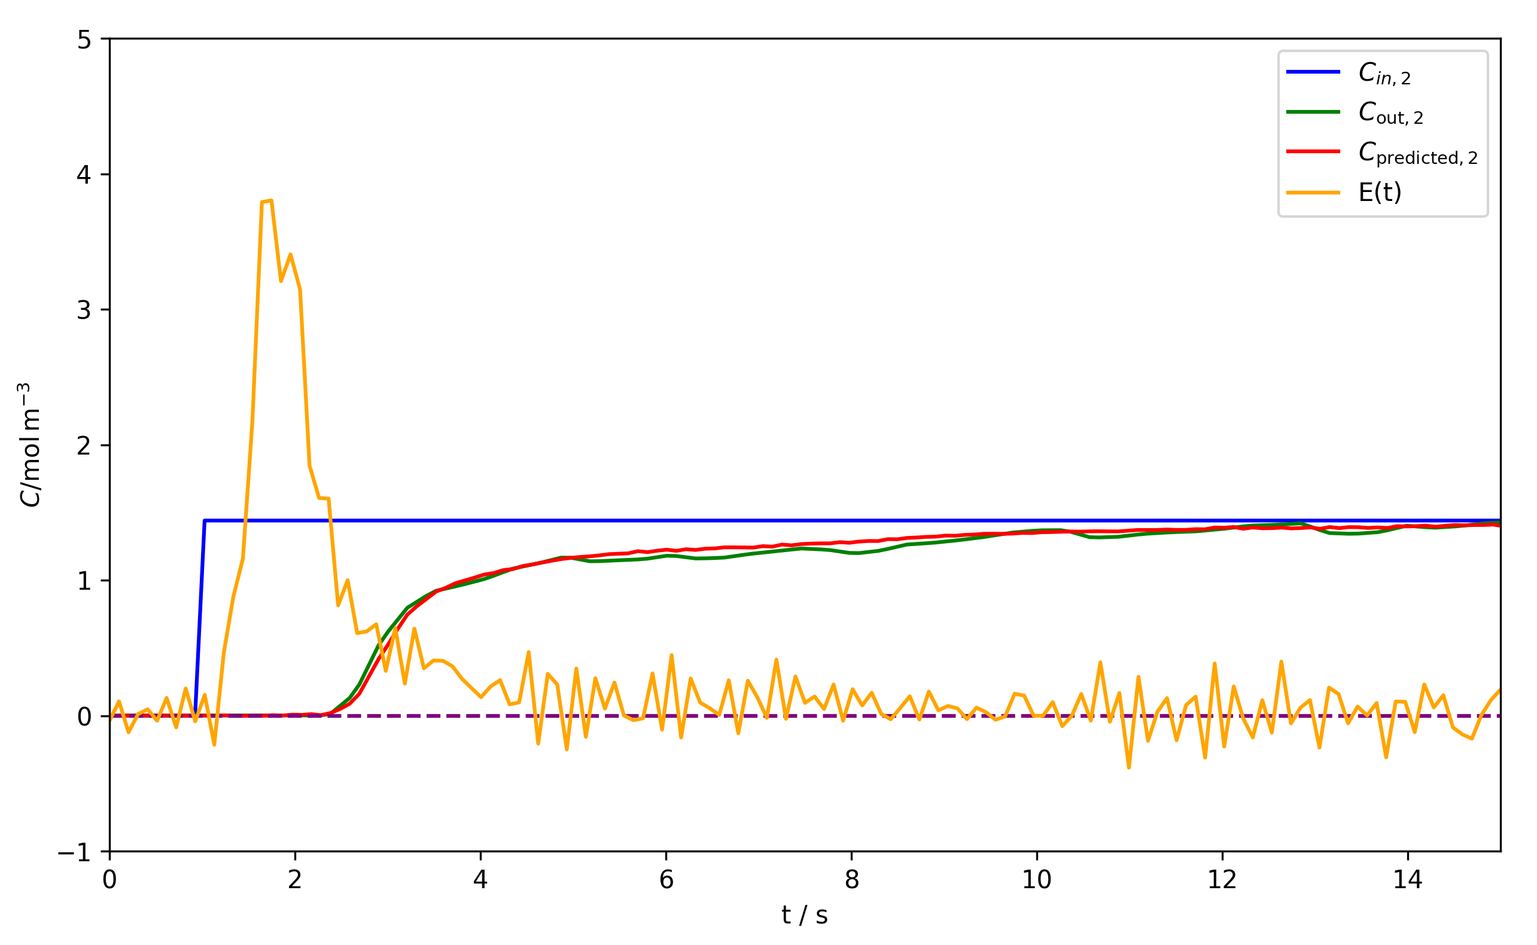
Diff cap
(a)
(c)
(b)

Slide 25
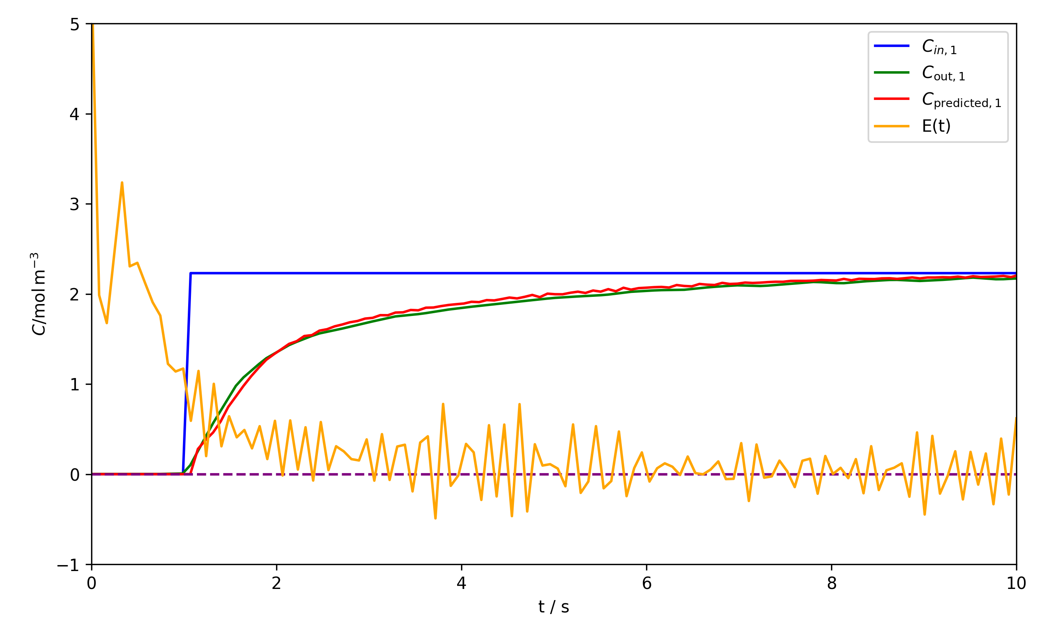




MS
(a) 100 mL min⁻¹
(b) 150 mL min⁻¹
(c) 200 mL min⁻¹

Slide 26


Slide 27


2nd
(a)
(b)
(c)

Slide 28

(a)
(b)

Slide 29
n - 1
V_{n} , y_{n}
L_{n-1} , x_{n-1}
n
V_{n+1} , y_{n+1}
L_{n} , x_{n}
n + 1

Slide 30
q = 1
q > 1
0 < q < 0
q = 0
Mole fraction in vapor, y
Enriching
operating line
Stripping
operating line
x_{B}
x_{F}
x_{D}
Mole fraction in liquid, x

