Slide 1

ព្រះរាជាណាចក្រកម្ពុជា
ជាតិ សាសនា ព្រះមហាក្សត្រ
Khmer Text Summarizer
Using Java, Flutter and AI
ដឹកនាំដោយ៖ សាស្រ្តាចារ្យ សុខ ពង្សសមេត្រី
បទបង្ហាញដោយ៖ និសិត្ស សុខ វ៉ាន់ដេត និសិត្ស ចែម ស៊ីដេត និសិត្ស រ៉ា បូរី និសិត្ស សាត សិលា និសិត្ស សាមឿន កិត្យា
ឆ្នាំសិក្សា៖ ២០២៥-២០២៦

Slide 2
Content
Introduction
Processing Flow
Pros and Cons
Responsibility
DEMO

Slide 3
I. Introduction

Slide 4
1. Why Khmer Text Summarize?
A Khmer Text Summarizer is a system (AI model or algorithm) that automatically reads long Khmer-language text — such as articles, reports, or documents — and generates a short, meaningful summary that keeps the main ideas.
It can be built using machine learning, NLP (Natural Language Processing), or hybrid techniques (rule-based + neural).

Slide 5
2. Why it’s importance?
1. Information Overload in Khmer
People face thousands of Khmer news articles, social media posts, and reports daily.
Summarization helps save time by extracting only the important points.
Example: turning a 2-page Khmer news article into a 2–3 sentence summary.

Slide 6
2. Why it’s importance?
2. Educational Use
Students and teachers can use it to quickly understand lessons, research papers, or stories in Khmer.
Helps summarize long PDFs or book chapters into short notes.
Promotes digital literacy in Khmer, not just English.

Slide 7
2. Future plan
Practical Applications
News apps: show “summary view” of articles.
Government/NGO reports: generate summaries for quick public reading.
Social media analysis: summarize long Facebook posts or comments.
Voice assistants: read short summaries in Khmer for accessibility.

Slide 8
II. Processing Flow

Slide 9
1. Processing flow
Mobile App
Java
Gemini AI
(Flash 2.5)
Step | Component | Action / Process | Input | Output / Response | Purpose
1 | Mobile App (Flutter) | User inputs or scans Khmer text (from image or typed input). | Khmer text or image | JSON request sent to Java API | Collects and sends text data for processing
2 | Java Backend (Spring Boot) | Receives text from mobile, validates and prepares request to Gemini. | JSON text from mobile | API request to Gemini (Flash 2.5) | Acts as middleware between app and AI model
3 | Gemini (Flash 2.5 API) | Performs Khmer text summarization using AI language model. | Request payload with text | Summary result in JSON format | Provides summarized text output
4 | Java Backend | Receives summarized result, formats and returns to mobile. | Summary from Gemini | JSON response | Ensures proper data structure for frontend
5 | Mobile App | Displays summarized text to the user. | JSON summary | Summarized text shown in UI | Delivers final summarized content to user

Slide 10
2. Integration Flow
Component | Role | Integration Details
1. Flutter App (Frontend) | User Interface | Users input Khmer text manually or capture it from an image using OCR (e.g., google_mlkit_text_recognition). The app sends this text via HTTP POST request to your Java backend API.
2. Java Backend (API Server) | Bridge between App and AI | The Java backend receives text input at /api/summarize. It formats the text request and sends it to Gemini Flash 2.5 API using an API key. It also handles request validation and error responses.
3. Gemini Flash 2.5 API (AI Engine) | Summarization Model | Gemini processes the Khmer text and returns a short, meaningful summary. The model is capable of handling Khmer language structure and semantics.
4. Java → Flutter Response | Return Result | The Java backend receives Gemini’s summarized result, converts it into a JSON response, and sends it back to the Flutter app.
5. Flutter Display Layer | User Output | The app displays the summarized Khmer text in a readable format with options like copy, save, or share.

Slide 11
3. AI Prompt
String prompt = "ភារកិច្ច: សូមបង្កើតសង្ខេបអត្ថបទខាងក្រោមជាភាសាខ្មែរ។\n" +
"លក្ខខណ្ឌ:\n" +
"1. សង្ខេបអត្ថបទក្នុងរយៈ 3-5 ឃ្លា ឬចំណុចសំខាន់ៗ (bullet points) បើអាច.\n" +
"2. រក្សាអត្ថន័យសំខាន់ៗ និងឈ្មោះ, ថ្ងៃខែ, និងលេខសំខាន់ៗទាំងអស់.\n" +
"3. ប្រើភាសាផ្លូវការនិងរលូន (formal & fluent).\n" +
"4. កុំបន្ថែមព័ត៌មានថ្មីៗ ដែលមិនមាននៅក្នុងអត្ថបទដើម.\n" +
"----------\n" +
"អត្ថបទដើម:\n" +
chunk;

Slide 12
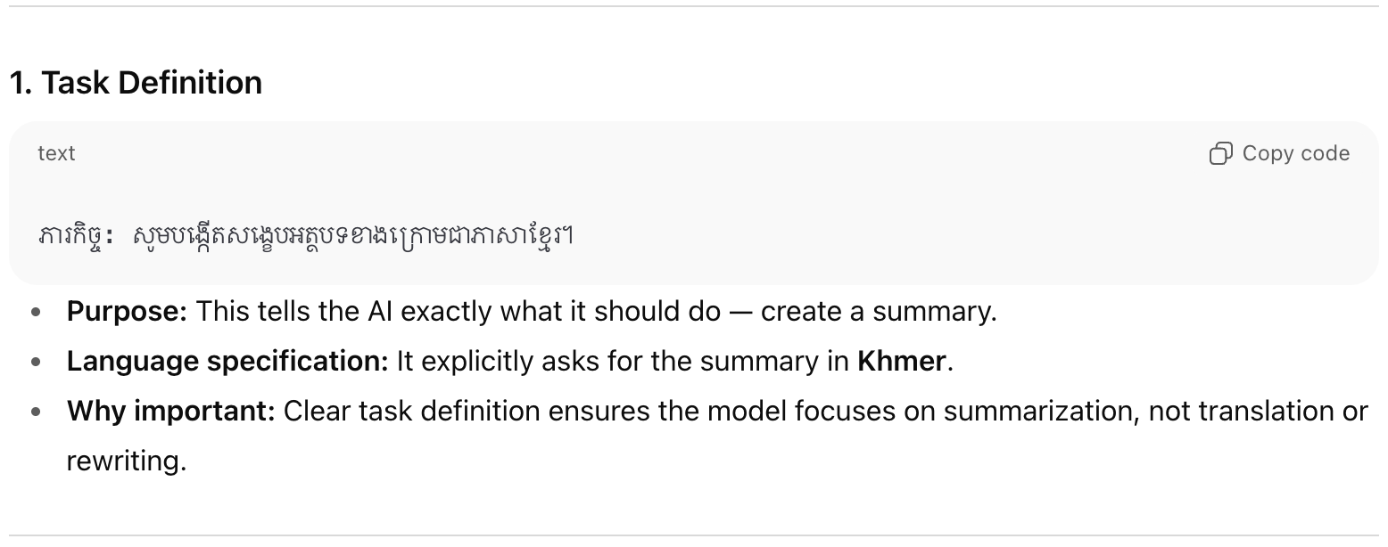
3. AI Prompt (cont.)

Slide 13
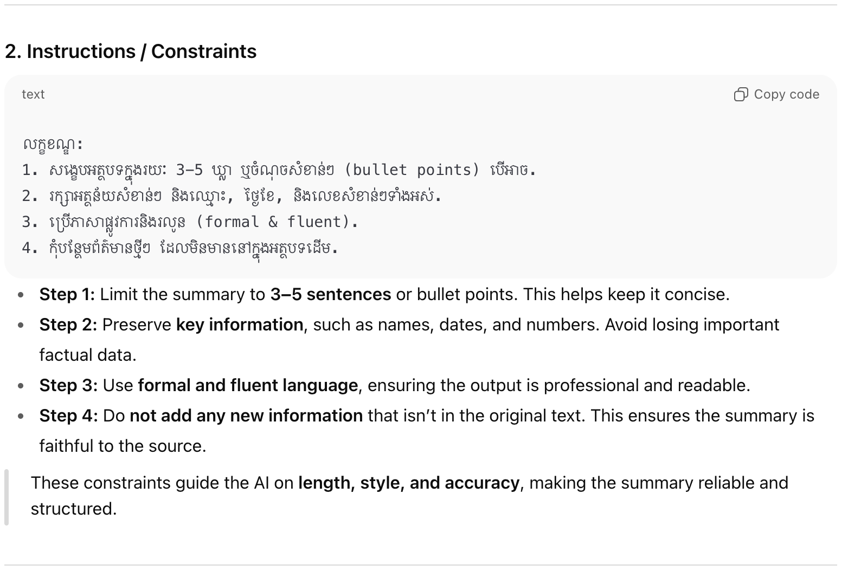
3. AI Prompt (cont.)

Slide 14
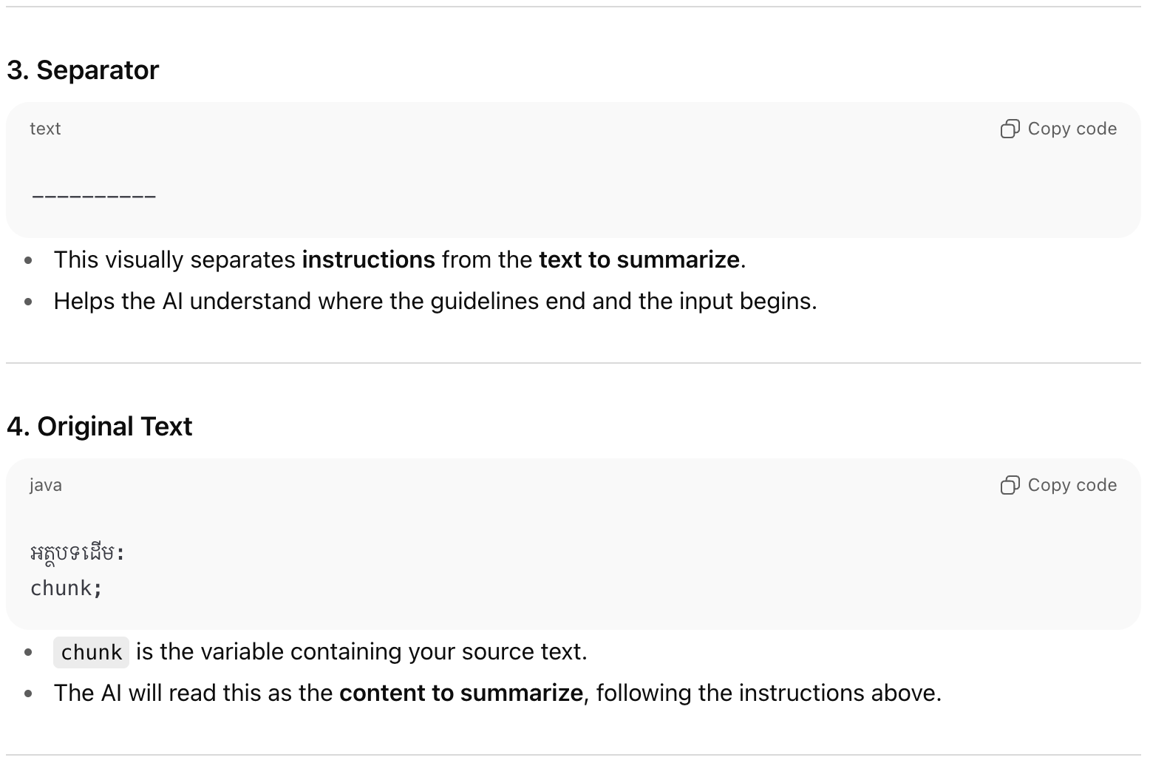
3. AI Prompt (cont.)

Slide 15
II. Pros and Cons

Slide 16
Pros and Cons
Aspect | Pros (Advantages) | Cons (Limitations)
Architecture (Mobile → Java → Gemini) | • Clear separation of frontend, backend, and AI logic | • More components = higher latency
 | • Easier maintenance and scaling | • Network dependency between layers
 | • Java backend can handle validation, security, and caching
Mobile (Flutter) | • Cross-platform (Android/iOS) | • Needs stable API connection
 | • Easy to design modern UI/UX | • Limited local AI processing power
 | • Can integrate camera or OCR for text scanning
Java Backend | • Strong type-safety and structure | • Adds complexity
 | • Supports authentication (JWT, Spring Security) | • Requires hosting/server maintenance
 | • Can integrate with databases for saving summaries or history
Gemini (Flash 2.5) | • High-quality Khmer text summarization | • Dependent on internet/API quota
 | • Fast and context-aware | • May cost usage fees
 | • Can handle both short and long text | • Limited offline capability
Overall System | • Modular and extensible design | • Data privacy concerns (sending text to external API)
 | • Good user experience (mobile friendly) | • Latency if network is slow
 | • Can easily switch or upgrade AI models later | • Complex error handling across 3 layers

Slide 17
III. Responsibility

Slide 18
Responsibility
No. | Student Name | Role | Main Responsibilities
1 | SOK Vandet | Project Manager & Developer | - Lead the project planning and timeline management.
 |  |  | - Develop the Flutter frontend and Java backend API.
 |  |  | - Integrate Gemini API for Khmer text summarization.
 |  |  | - Conduct testing and deployment.
2 | CHEM Sydeth | Project Coordinator | - Coordinate communication among team members.
 |  |  | - Prepare project documentation and reports.
 |  |  | - Monitor progress and ensure task alignment.
 |  |  | - Support presentation organization.
3 | RA Borey | Project Researcher | - Research on Khmer text summarization techniques.
 |  |  | - Collect datasets and analyze model accuracy.
 |  |  | - Provide technical insights and suggestions.
4 | SAT Seyla | UX/UI Designer | - Design user interface and experience flow (UX/UI).
 |  |  | - Create mockups, wireframes, and interactive prototypes.
 |  |  | - Ensure visual consistency and usability.
5 | SAMOEUN Ketya | Project Researcher | - Research AI/NLP methods for Khmer language.
 |  |  | - Analyze summarization performance.
 |  |  | - Collaborate with developers for testing and evaluation.

Slide 19
DEMO

Slide 20
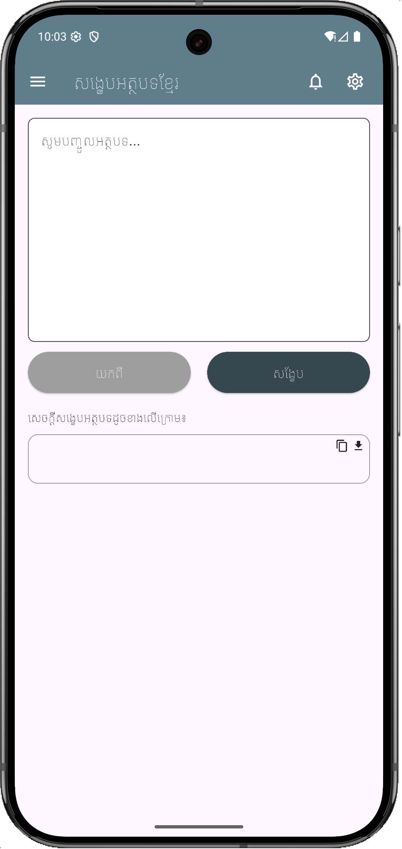
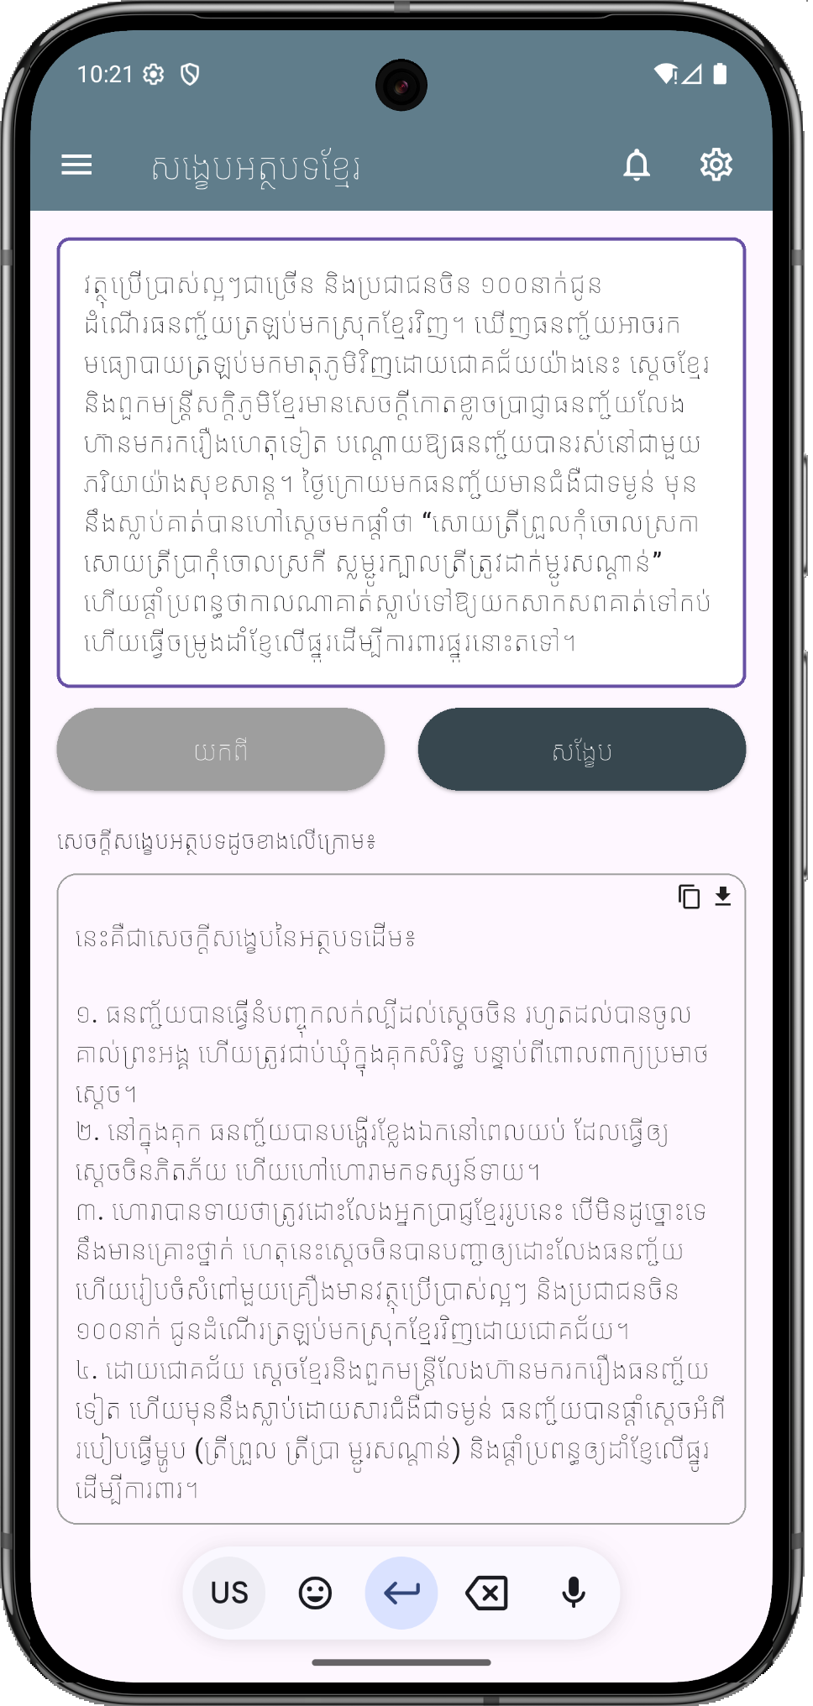
Flutter UI

Slide 21


